Slide 1
杜甫 – Du Fu
Wantong Du

Slide 2
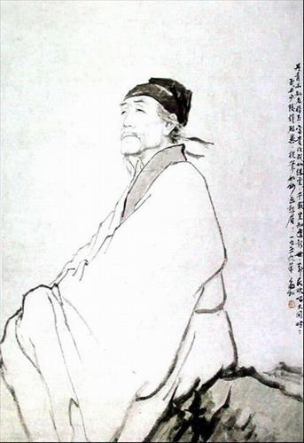

Slide 3
生平 – My Life
Born in Henan province
February 12, 712
Tang Dynasty
& 李白 – greatest

Slide 4
早年 – Early Years
Age <1: mother’s death
Age 7: 1st poem
Standard education: Confucian classics of philosophy
Age 19-23: travel
Age 24: 进士考试 (highest of imperial exam) – failed
Notes:
Raised by aunt, 1 older brother died young, 4 step siblings
Loved learning, wrote 1st poem at age 7, memorized Confucian classics of philosophy
Travels – 江苏, 安徽, 浙江; met 李白 in 洛阳
进士考试 – to select administrative officials

Slide 5
中年 – Mid-Life
Age 30: marriage
Age 32: met Li Bai
Age 35: 进士考试 2nd time – failed again; petition to emperor
Age 43: position in military
Notes:
Went to the capital, 进士考试 – prime minister failed everyone

Slide 6
去世 – Death
Xiang Jiang
Sickness
8 graves
Notes:
湘江

Slide 7
Poems
1400 poems – 4 periods
Before age 35: travels
Ages 35-44: life, politics
Ages 45-48: An Lushan Rebellion
Ages 48-59: famine, An Lushan Rebellion impact on society
Notes:
Horse – ambitious, loyal, reliable; racing symbolizes life and its possibilities
批评时政、讽刺权贵
自京赴奉先县咏怀五百字 – 经历十年长安困苦生活后对朝廷政治、社会现实的认识达到了新的高度
把家安置在一邊，独自去投肃宗，中途为安史叛军俘获，押到长安。
Famine, 弃官，携家随人民逃难，经秦州、同谷等地，到了成都，在严武的帮助下，过了一段比较安定的生活。 More than 70% written during this period, about the history during a 20-year period before and after the rebellion

Slide 8
Style
Confucian
Mood: depressing
Language: dense, compressed
Loyalty to the nation and the people
“People’s language” (人民的语言)
Notes:
Philosophical views similar to that of Confucius
Poetry that portrays duties, consciousness, suffering; lives of soldiers and civilians
Domestic life, calligraphy, paintings, animals, and other poems

Slide 9
Influence
Not known while alive
794: 1st time circulating and admired in the capital
9th century: beginning
11th century (Northern Song era): peak
“詩圣” (Shīshèng)
“詩史” (Shīshǐ)
Notes:
元稹 = Yuán Zhěn
Personal details intersected with large political events -> “poet-historian”
Family to safety, then returned to the capital

Slide 10
画鹰
The Painted Hawk
素练风霜起 苍鹰画作殊
竦身思狡兔 侧目似愁胡
绦镟光堪摘 轩楹势可呼
何当击凡鸟 毛血洒平芜
Wind and frost swirl up from the white silk surface,
so superb, this painting of the gray hawk!
Shoulders hunched, he schemes to outwit the wily rabbit;
peers to one side like a vexed barbarian.
Foot cord and ring, a gleam bright enough to grasp;
by pillar and eaves, poised to come if you should call.
When will he swoop down on those lesser birds,
feathers and blood splattered over the barren plain?
Burton Watson

Slide 11
春夜喜雨
Enjoying Rain on a Spring Night
好雨知时节 当春乃发生
随风潜入夜 润物细无声
野径云俱黑 江船火独明
晓看红湿处 花重锦官城
A good rain knows its season
It brings things to life right in spring
It enters the night, unseen with the breeze
It moistens things gently and without sound.
Over paths through moors are clouds all black,
A boat on the river, a single fire bright.
At daybreak look where the red is soaked,
the blossoms are heavy in Brocade City.
Stephen Owen

