Slide 1
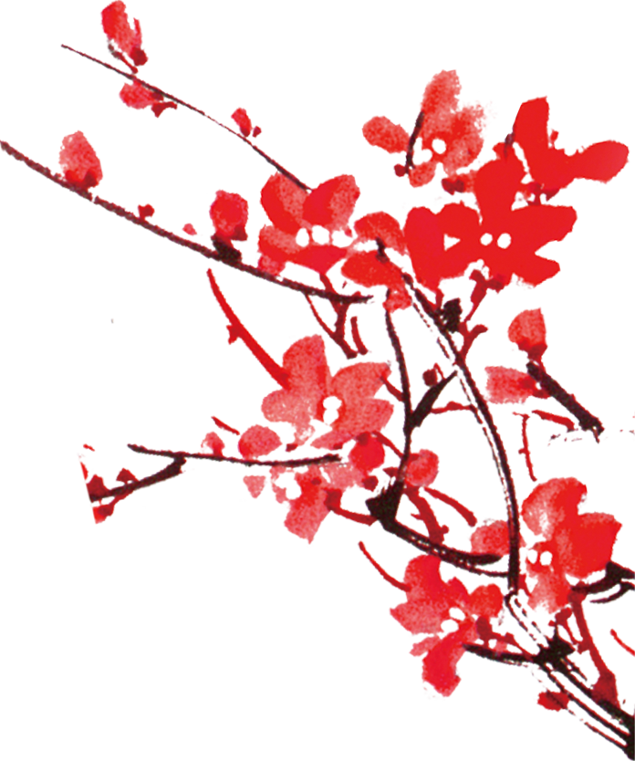

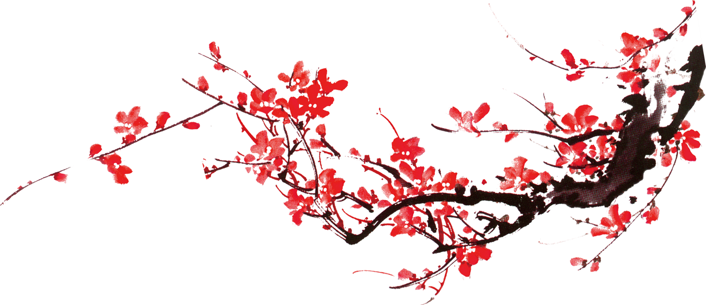
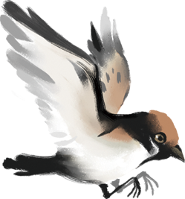

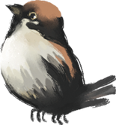

Chinese Terms of Endearment
Zeng Zhi
202070081609

Slide 2
Contents
Terms for Handsome and Talented Men
Terms Related to Hierarchy
Interesting Terms Showing Intimacy

Slide 3


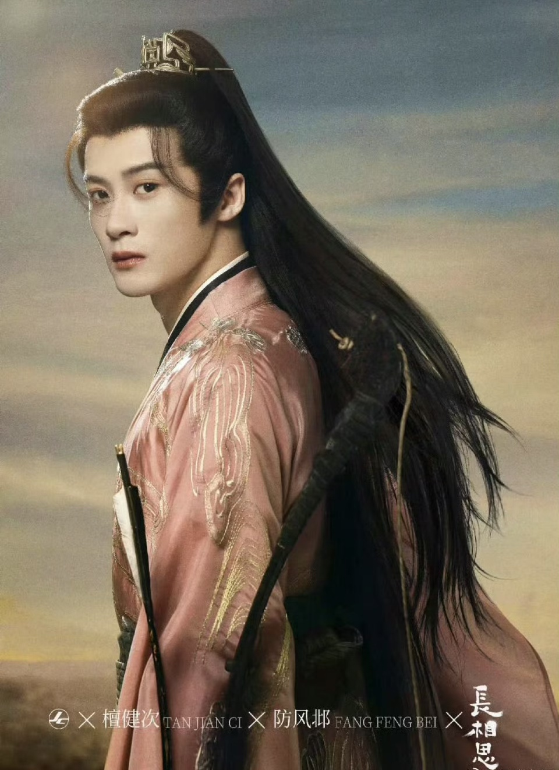
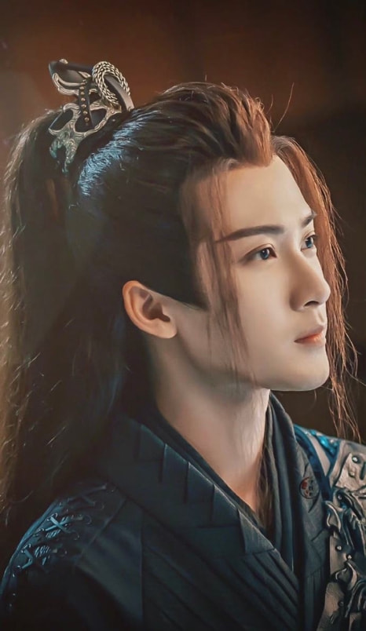
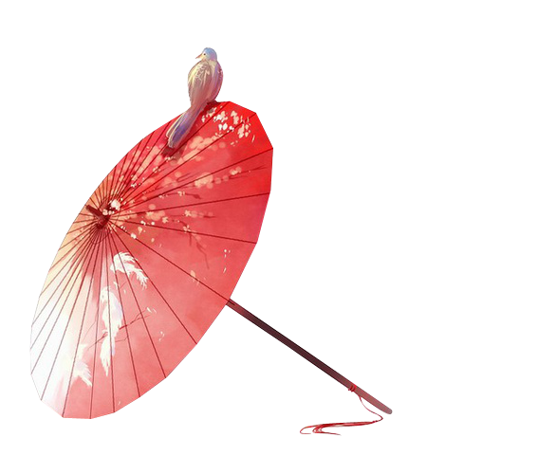

Slide 4
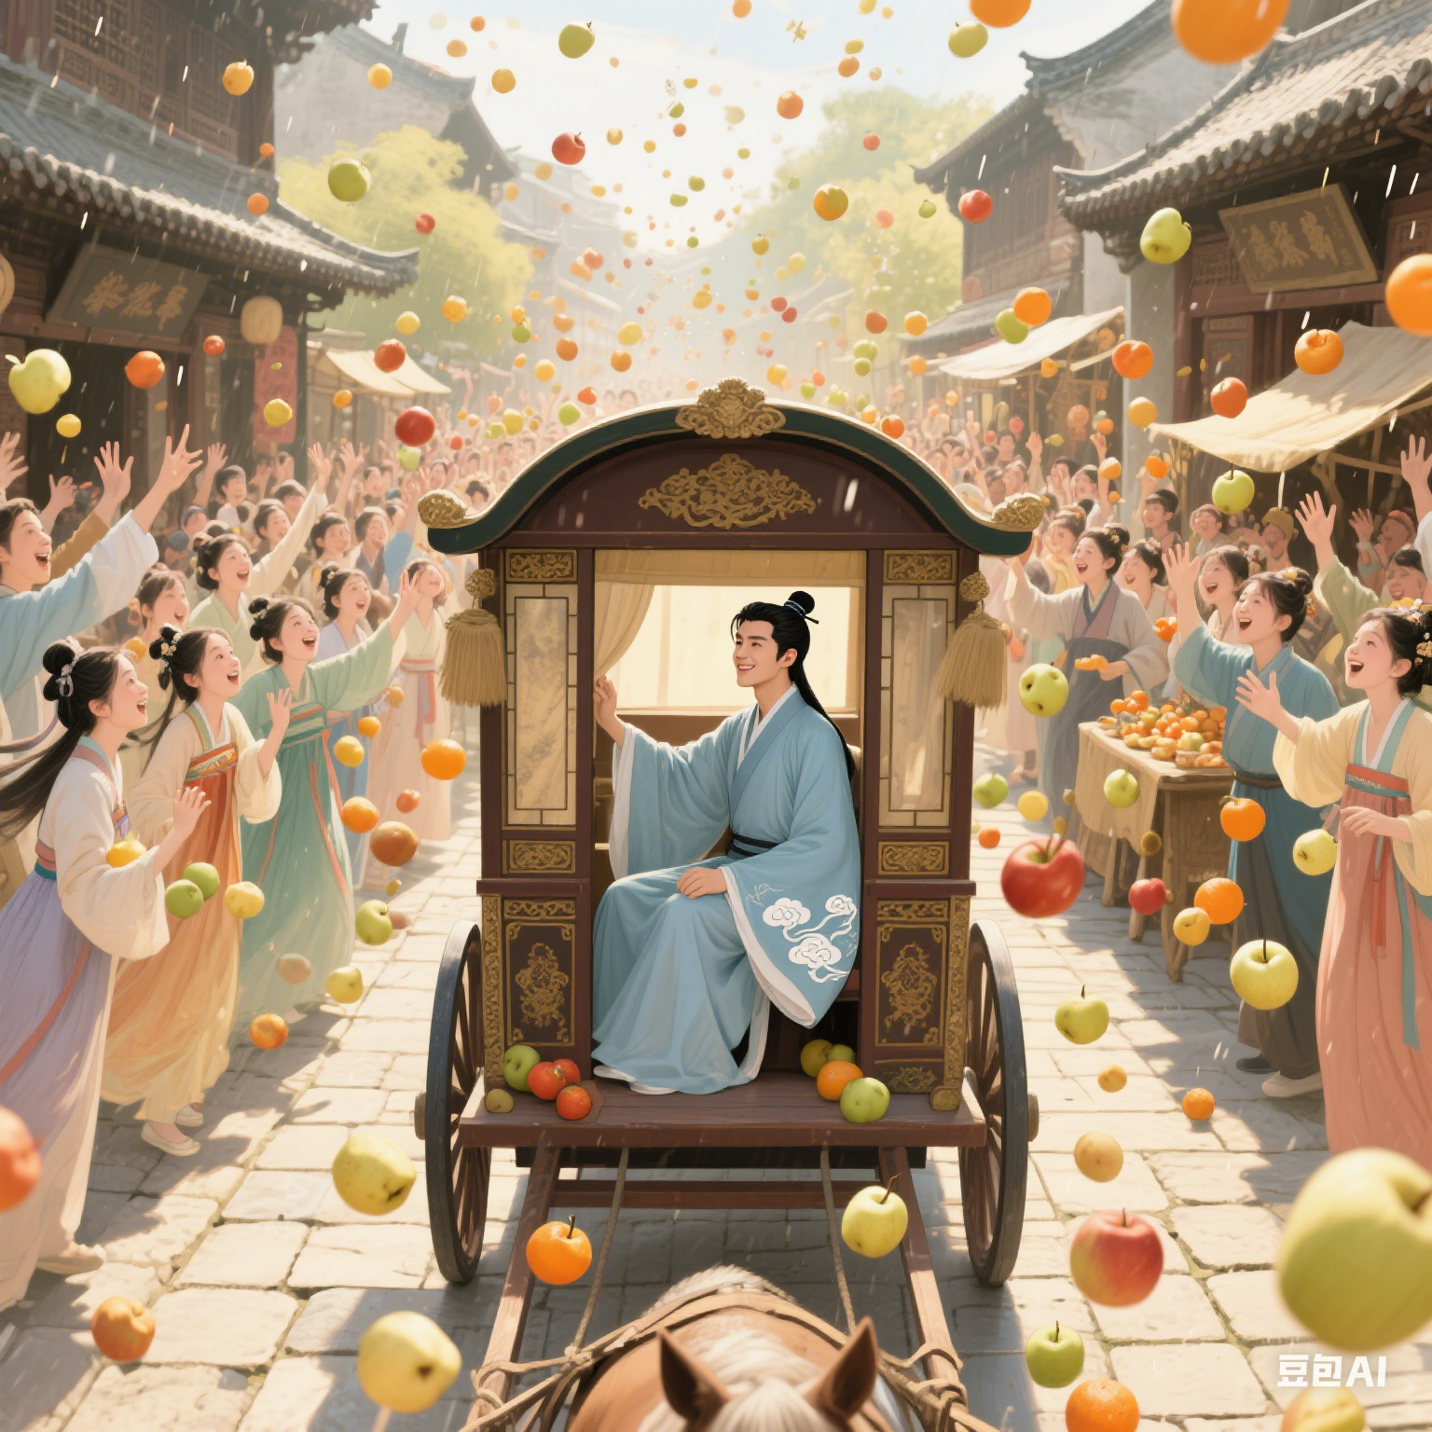
Tan Lang
檀郞
Pan An (潘安)
courtesy name: Tan Nu（檀奴）
Tan(檀) + Lang(郞) = Tan Lang
Xiao Lang (萧郞)
Zhou Lang (周郎)
√

Slide 5
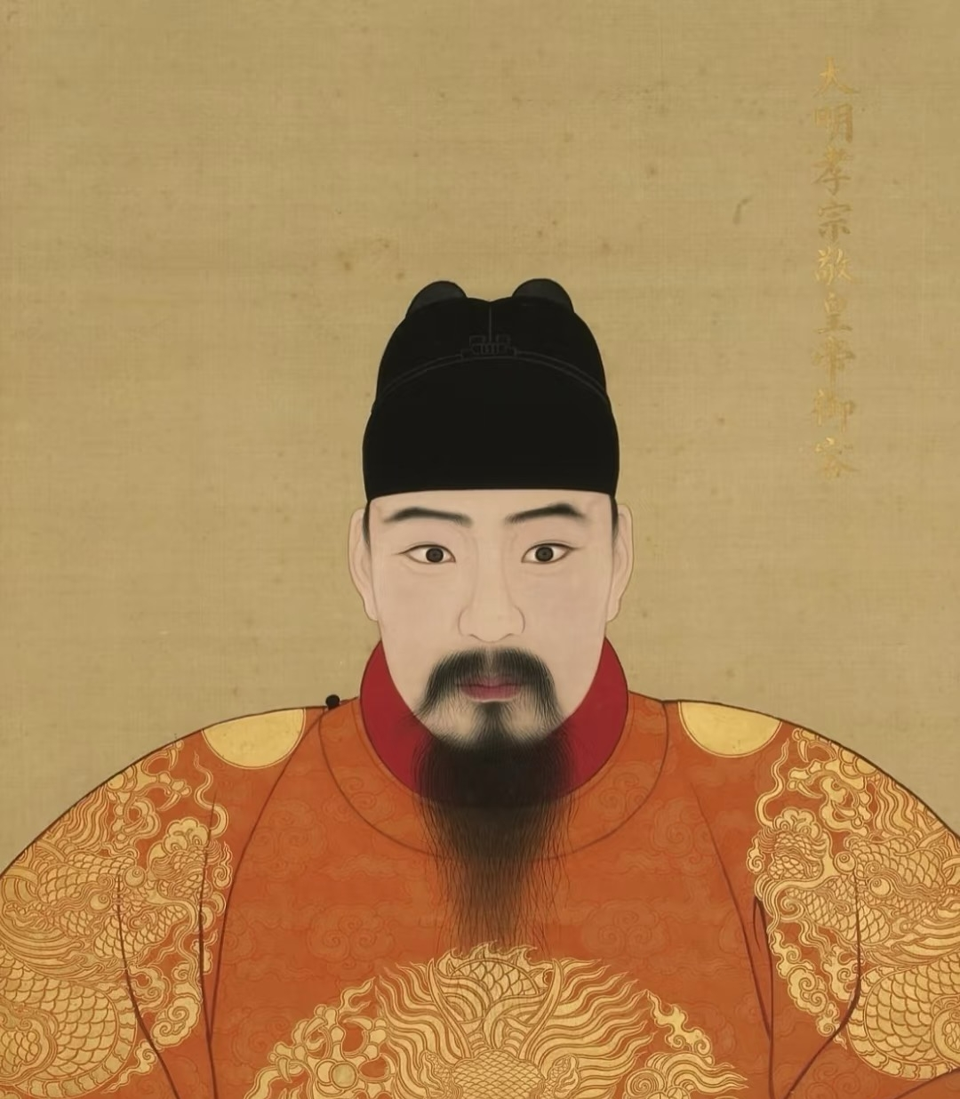
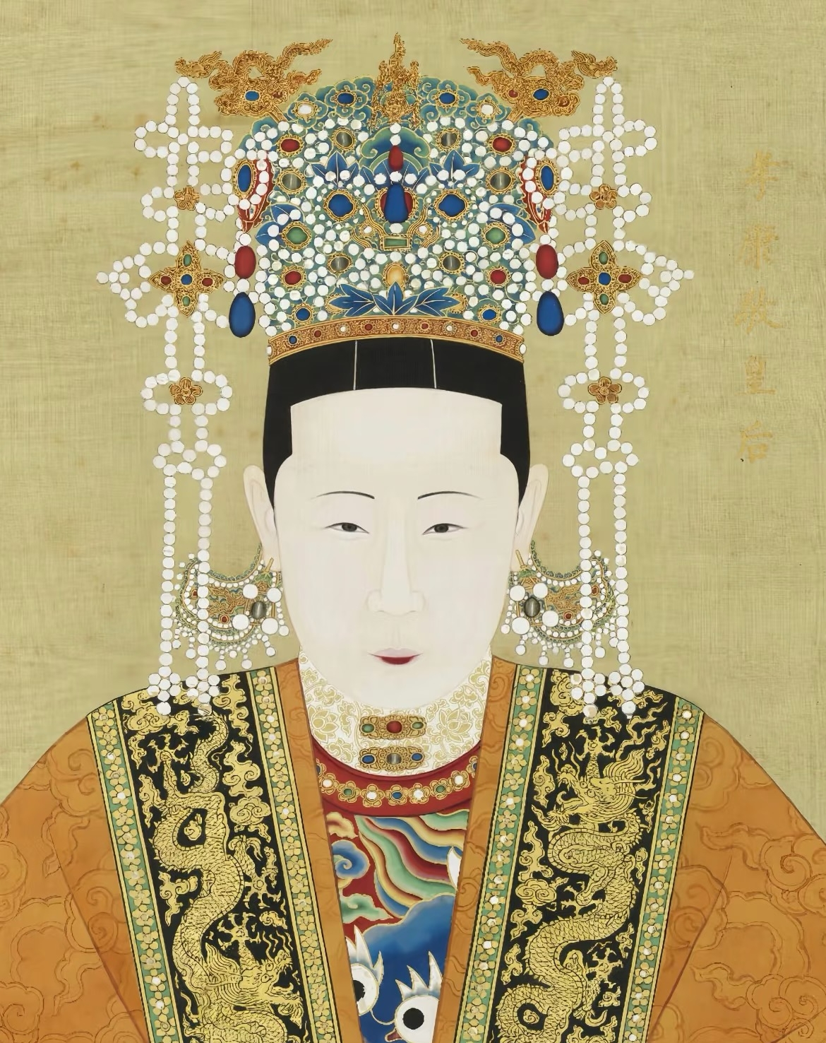
Terms Related to Hierarchy
Zi Tong
（梓童）
An Exclusive endearing term for emperors addressing empresses

Slide 6
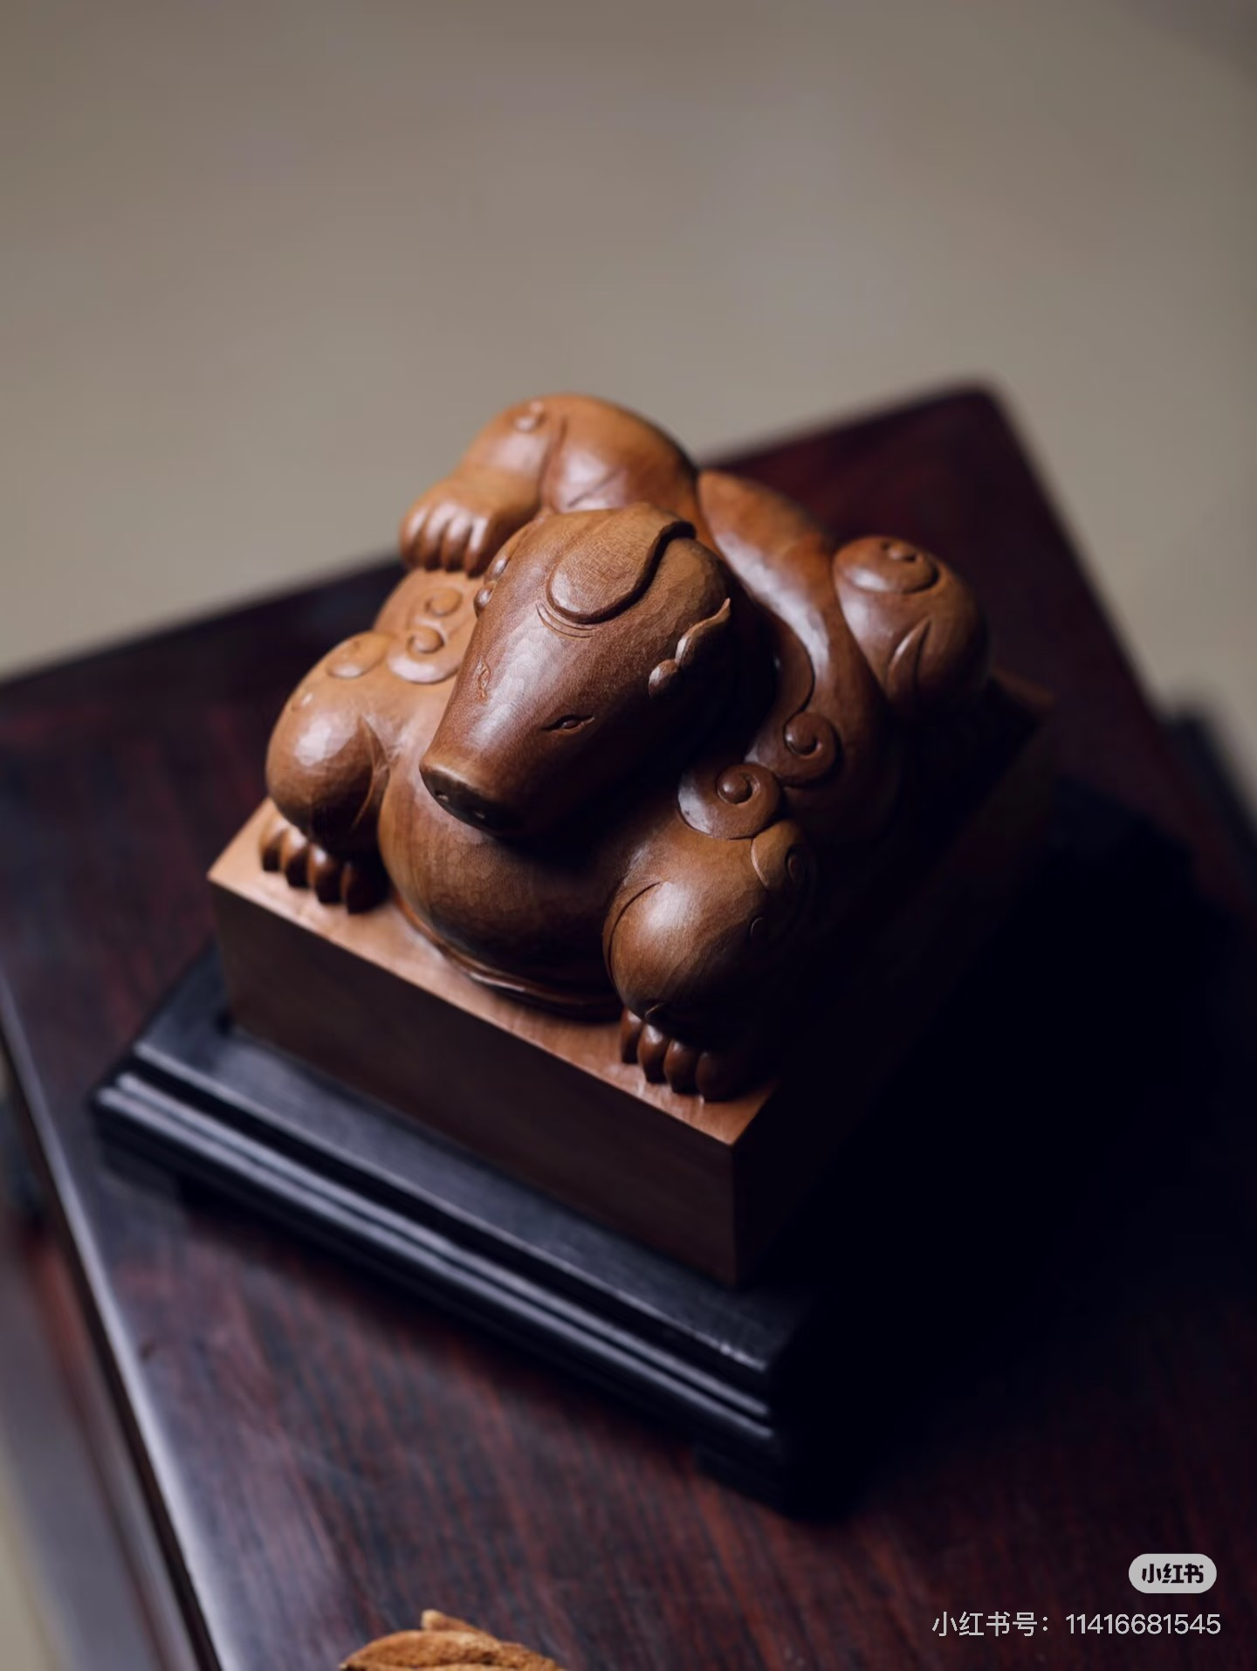
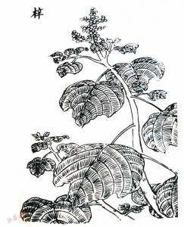
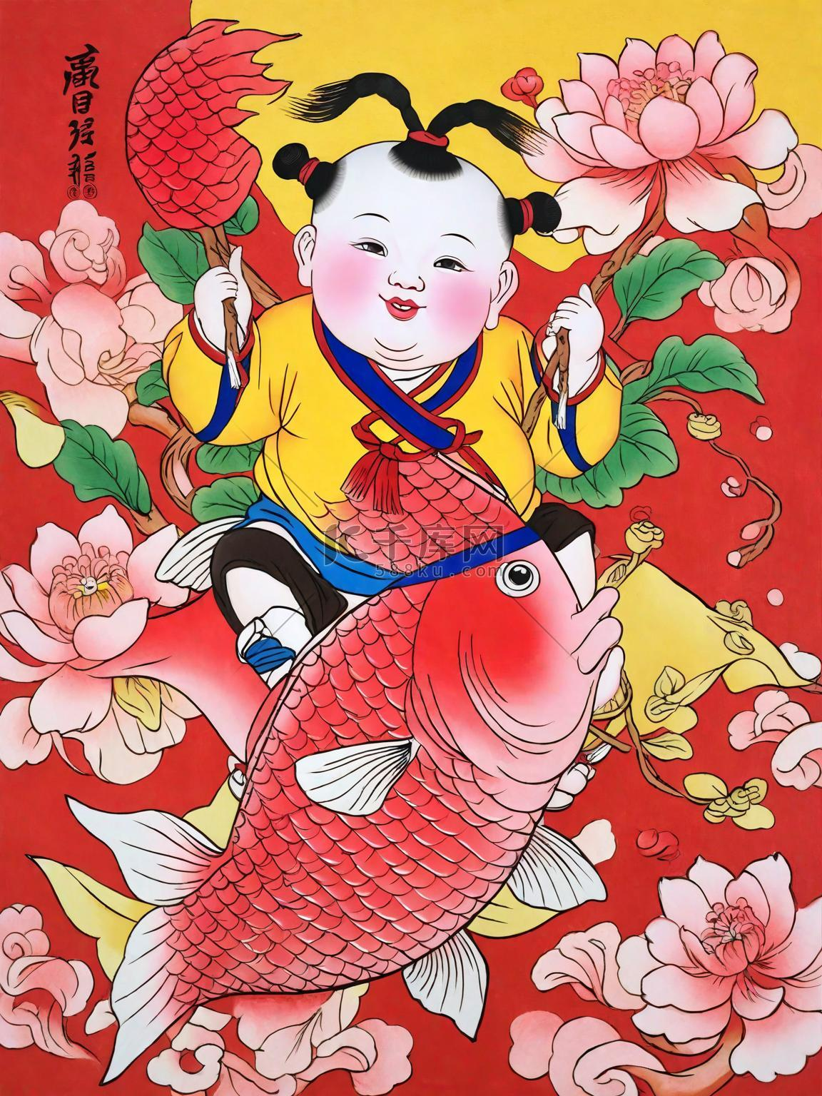
Terms Related to Hierarchy
royal seal made of catalpa ovata (zi)
梓（zi）
catalpa ovata
子（zi）
offspring

Slide 7
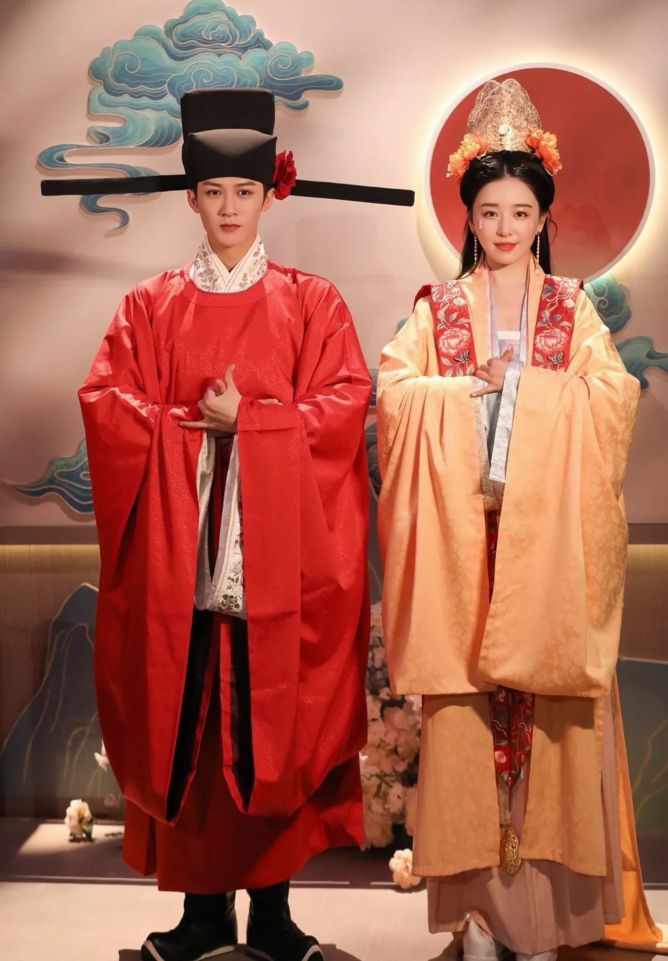
Terms Related to Hierarchy
细君（Xi Jun）: A Term for addressing wives of the feudal princes in ancient China
夫人（Fu Ren）: A Term for addressing wives of officials in Ming and Qing Dynasties

Slide 8

Interesting Terms Showing Intimacy
Qing
Qing
(卿卿)
亲卿爱卿，是以卿卿；
我不卿卿，谁当卿卿？
(I love you so I call you Qing. If I couldn’t call you Qing, who can?)

Slide 9
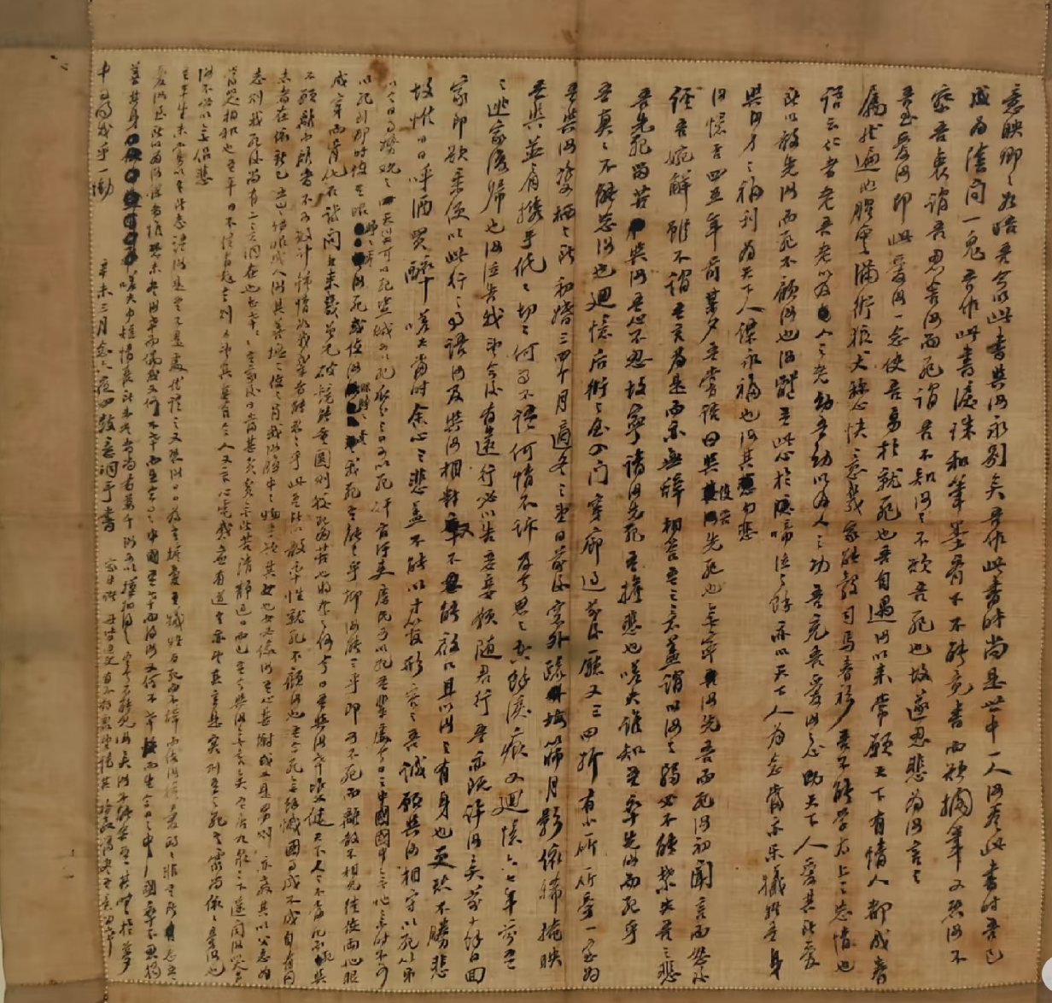
Interesting Terms Showing Intimacy
意映卿卿如晤
——林觉民《与妻书》
Yiying my dariling
-- A Letter of Farewell to My Wife

Slide 10
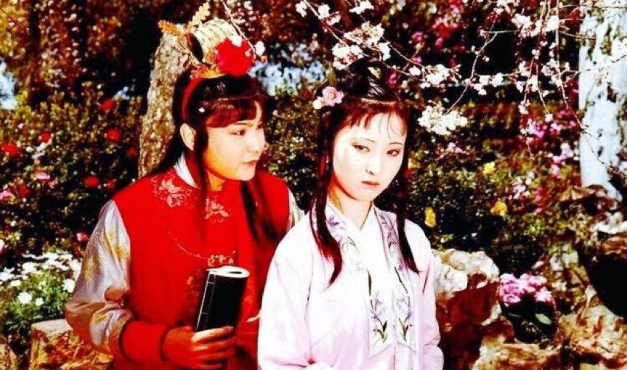
冤家
（Yuan Jia）
A term that paradoxically describes the
intricate and romantic feelings between lovers

Slide 11
Thank you for your listening!
中国板
Zeng Zhi
202070081609

