Slide 1
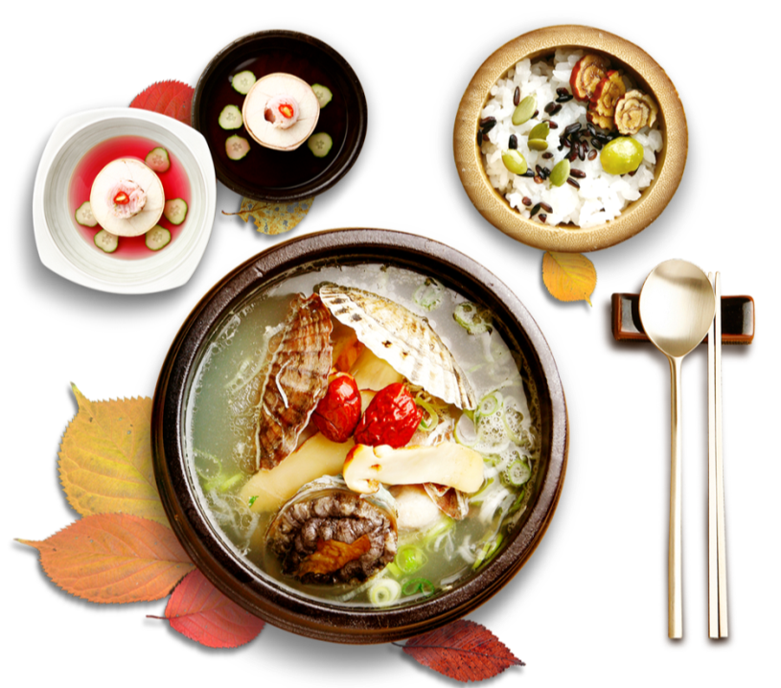
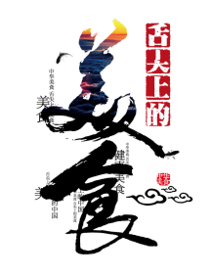
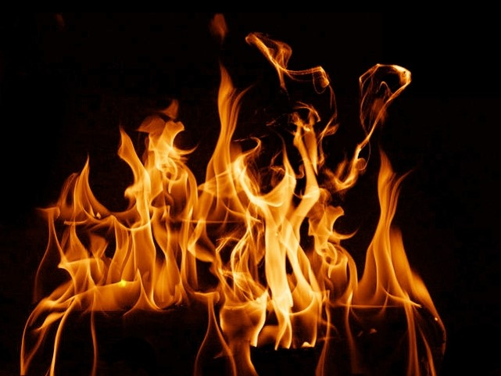
Eight Major Cuisines of China
汇报人：张敏杰

Slide 2
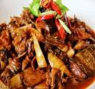
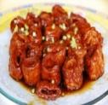
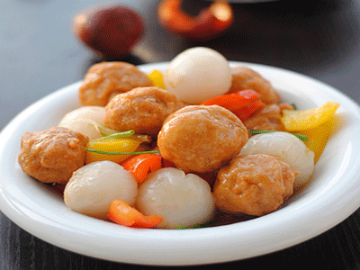
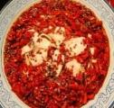
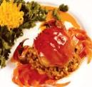
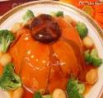
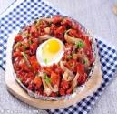
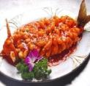
Introduction
Chinese food culture dates back to the Shang and Zhou dynasties.
Regional differences emerged during the Spring and Autumn and Warring States periods.
The “Four Major Cuisines” (Shandong, Sichuan, Cantonese, Jiangsu) formed in the early Qing Dynasty.
By the late Qing Dynasty, the “Eight Major Cuisines” were established, including:
Zhejiang, Fujian, Hunan, and Anhui cuisines.
八大
菜系

Slide 3
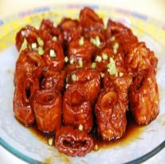





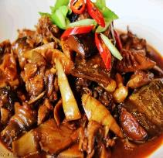
Contents
鲁
菜
川
菜
粤
菜
苏菜
浙
菜
闽菜
湘菜
徽菜

Slide 4
Why Eight Cuisines?
China’s vast territory and diverse ethnic groups contribute to varied food cultures.
Each region has its own unique ingredients, climate, and cooking styles.
The eight cuisines represent the most influential and distinct culinary traditions.

Slide 5
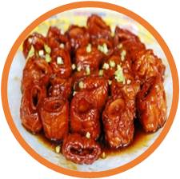
Shandong Cuisine

Slide 6
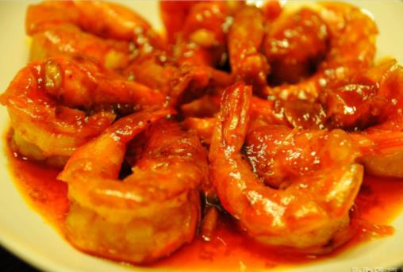
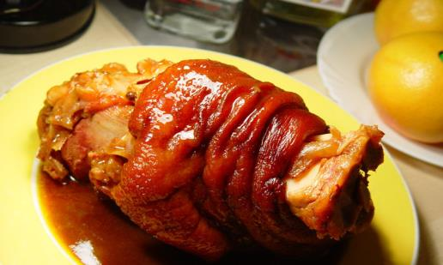
Shandong Cuisine
Features
aroma, freshness, crispness, tenderness; not greasy
Seasonings
shallot, garlic → pungent flavor
Sub-styles
Jinan: deep-frying,
grilling, stir-frying
Jiaodong:
seafood, light taste

Slide 7
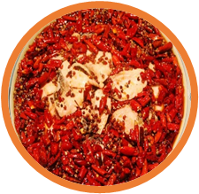
Sichuan Cuisine

Slide 8
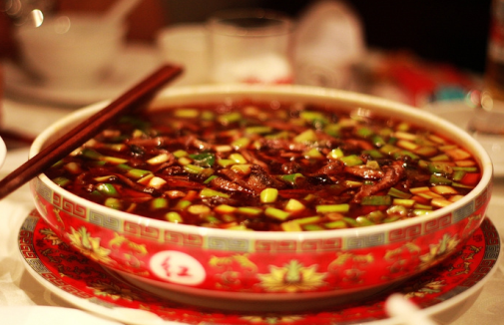
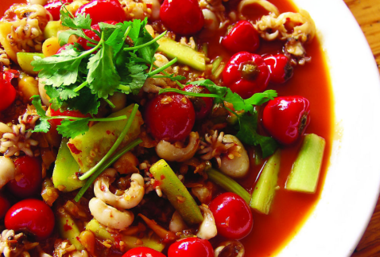
Sichuan Cuisine
Features
spicy, pungent, bold flavors;
knowing for its “numbing spice” (麻) from Sichuan peppercorns
Key Ingredients
chili, pepper, prickly ash, garlic, ginger, fermented soybean
Famous Dishes
Kung Pao Chicken, Mapo Tofu

Slide 9
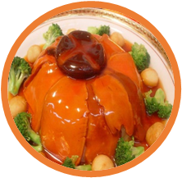
Guangdong Cuisine

Slide 10
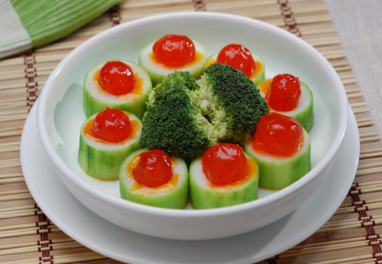
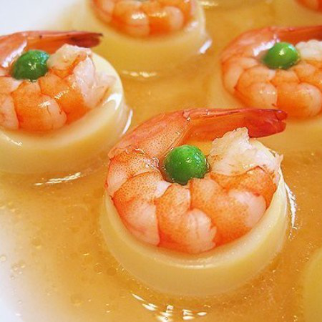
Guangdong Cuisine
Features
light, fresh, crisp; preserves natural flavors
Ingredients
wide variety, including exotic meats and vegetables
Philosophy
“Eat everything with four legs except tables.” – adventurous eating culture.

Slide 11
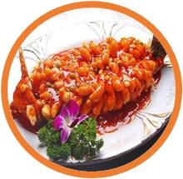
Jiangsu Cuisine

Slide 12
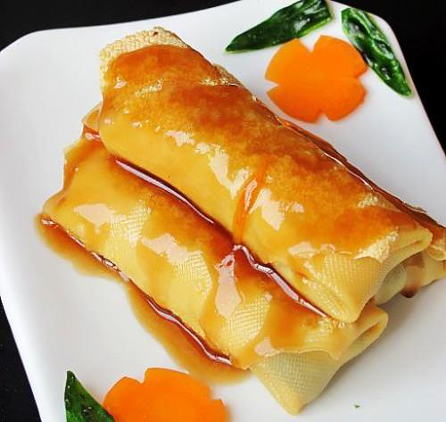
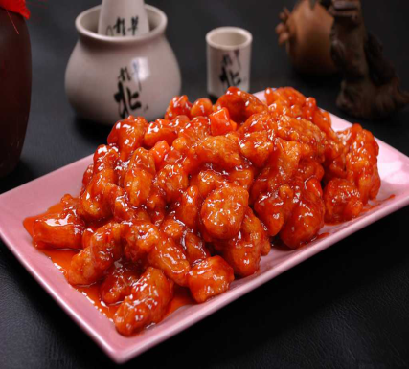
Jiangsu Cuisine
Features
fresh, tender, slightly sweet; delicate carving techniques
Ingredients
aquatic foods, careful selection
Example Dish
Sweet and Sour Mandarin Fish

Slide 13
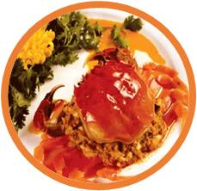
Zhejiang Cuisine

Slide 14
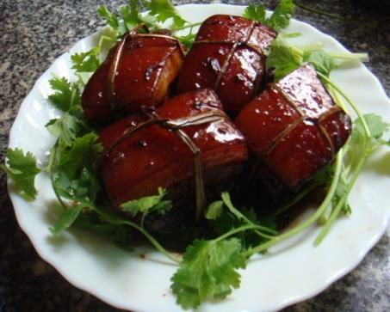
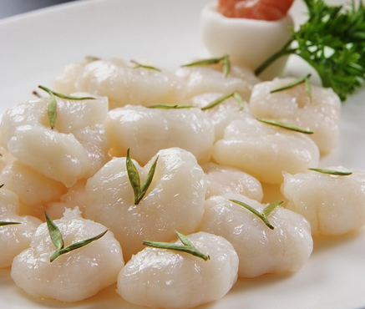
Zhejiang Cuisine
Features
fresh, tender, soft, smooth; not greasy
Sub-styles
Hangzhou, Ningbo, Shaoxing
Hangzhou Cuisine: Most famous-elegant and mild
Example Dish
Dongpo Pork

Slide 15
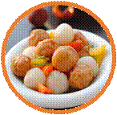
Fujian Cuisine

Slide 16
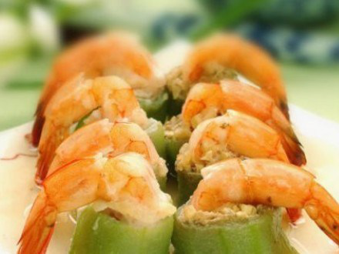
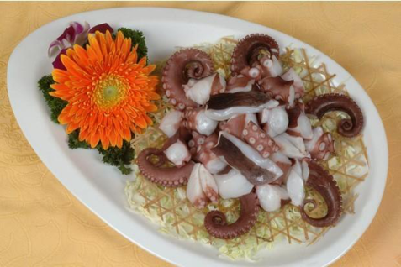
Fujian Cuisine
Features
seafood-based; sweet, sour, salty, savory
Specialty
“Pickled taste” from fermentation and brewing techniques
Example
Buddha Jumps Over the Wall

Slide 17
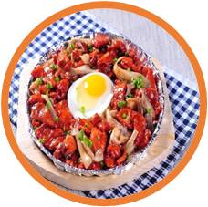
Hunan Cuisine

Slide 18
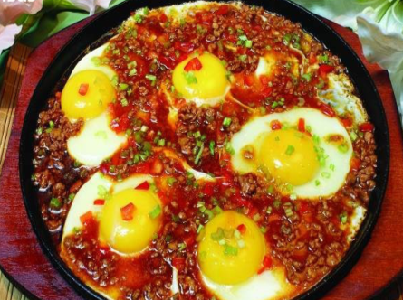
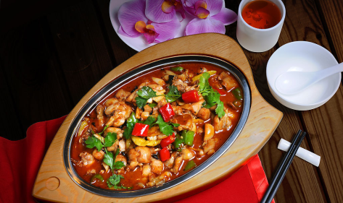
Hunan Cuisine
Features
thick, pungent, spicy; uses chili, pepper, shallot;
rich aroma, deep color, intense heat
Sub-regions
Xiangjiang, Dongting Lake, Xiangxi
Example Dish
Steamed Fish Head with Chopped Chili

Slide 19
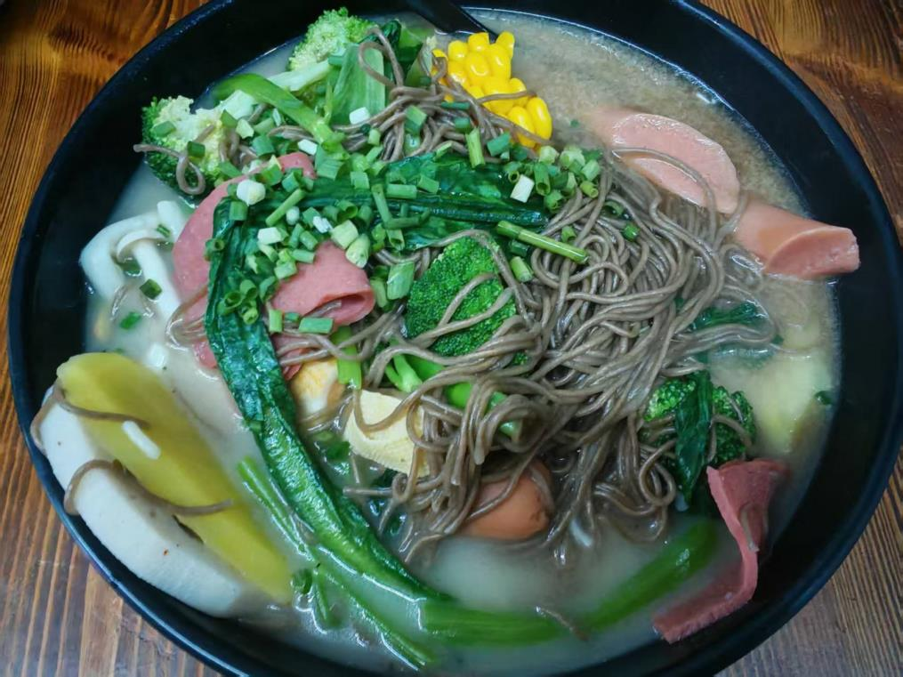
Hunan Cuisine
No Chili !

Slide 20
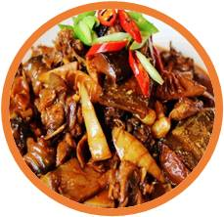
Anhui Cuisine

Slide 21
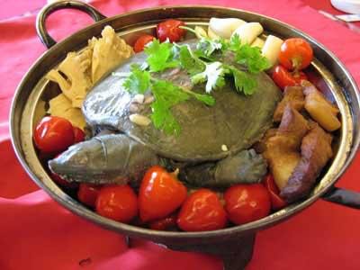
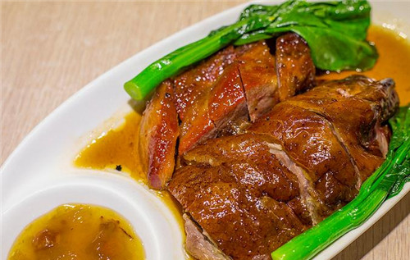
Anhui Cuisine
Features
emphasis on cooking temperature; uses ham and sugar
Ingredients
wild herbs, mushrooms, bamboo shoots
Example Dish
Braised Turtle with Ham

Slide 22

THANKS
汇报人：张敏杰
内容来源：教材、豆包、百度、日常生活
模板来源：小红书

