Slide 1
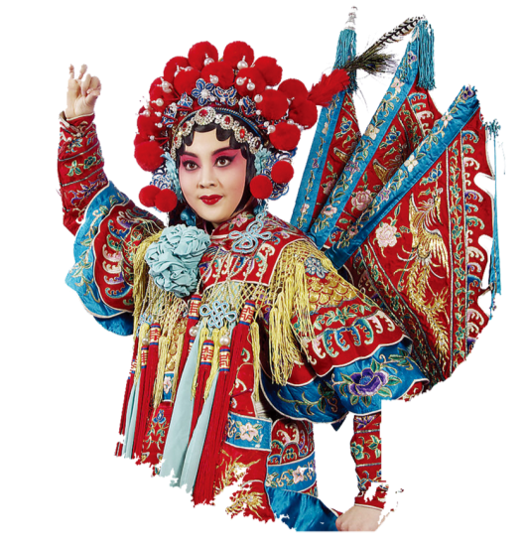
Peking Opera Actor--Mei Lanfang
Reporter: Zheng Dongqin

Slide 2
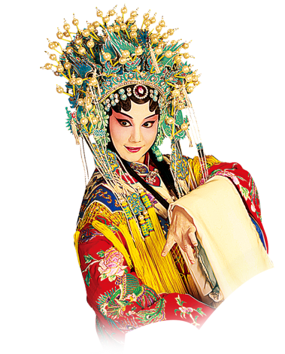
CONTENTS
1
Personal Profile
2
Masterpieces
3
Contributions

Slide 3
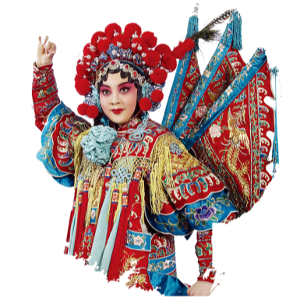
01
Personal Profile

Slide 4
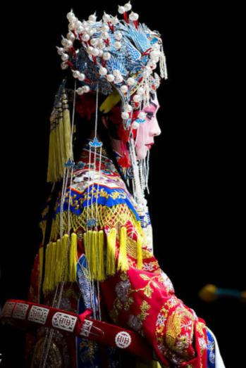
Personal Profile
Mei Lanfang (1894-1961), a great master of Peking Opera, was born into a family of Peking Opera performers in Peking. He started to learn the art of opera when he was a little boy. He made his debut at the age of 11 and became well-known before he reached 20. Mei Lanfang, Cheng Yanqiu, Shang Xiaoyun and Xun Huisheng are recognized as the Four Greatest Artists of Peking Opera.

Slide 5
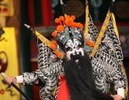
Personal Profile
Mei Lanfang not only inherited the fine traditions of Peking Opera, but improved it with his own creations. In his career of 50 years, he played more than 100 roles, which include the emperor’s concubines, daughters of noble families, women generals and goddesses. In the performances, he demonstrated skillfully the different characters and personalities of these women. He was the first to change the tradition that female characters paid attention only to the art of singing or acrobatic skills. Instead, he combined singing, dancing, expression and martial arts to develop comprehensive roles.

Slide 6
02
Masterpieces

Slide 7
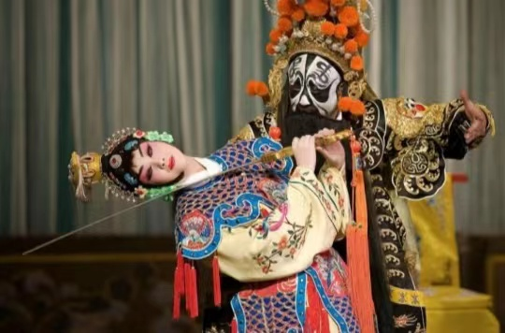
Masterpieces
Mei Lanfang designed various kinds of dances to help express the character of the role he played. In the opera Conqueror Xiangyu Parts with his Concubine《霸王别姬》, he used a sort of sword dance. Through the gentle but forceful movements of the sword, the audience saw the heroine’s bravery, gentleness and loveliness.

Slide 8
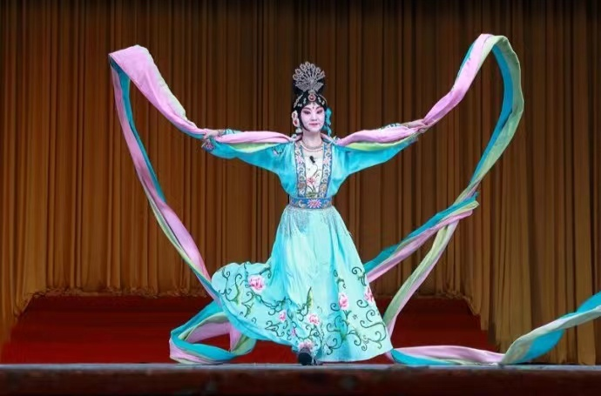
Masterpieces
In the opera The Fairy Scattering Flowers《天女散花》, he designed a silk-ribbon dance based on ancient Buddhist grotto frescoes. With two colorful ribbons tied to his body, he danced with the elegance of a fairy flying in the sky.

Slide 9
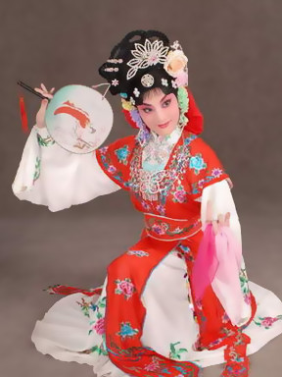
Masterpieces
The repertory of the Mei School includes Conqueror Xiangyu Parts with his Concubine《霸王别姬》、The Drunken Beauty《贵妃醉酒》、A Startling Dream of Wandering through the Garden《游园惊梦》、 Beauty Defies Tyranny《宇宙锋》、Mu Guiying Takes Command《穆桂英挂帅》、The Fisherman’s Revenge 《打渔杀家》and Phoenix Returns to its Nest《凤还巢》

Slide 10
03
Contributions

Slide 11
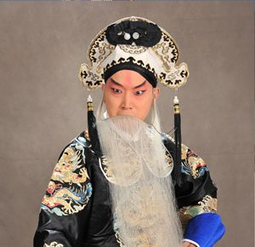
Contributions
Mei was the first to introduce Erhu into the Peking Opera orchestra. Today, Erhu has become one of the main orchestral instruments for Peking Opera. Under Mei’s direction, Western musical instruments were also used in the accompaniment for Peking Opera. His other stage innovations include changes in hair styles and colors of the costumes used in the opera.

Slide 12
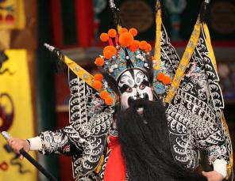
Contributions
Mei Lanfang was the first person to introduce Peking Opera to foreign countries. He visited Japan three times with his troupe. During his first visit in 1919, he was praised as “an outstanding performer of the Oriental art. ” In 1929, Mei and his troupe visited the United States. In spite of the Great Depression, all the tickets for the 2-week premiere were sold out in only 3 days. Mei’s performance was a great success.

Slide 13
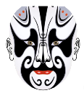
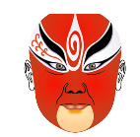
Contributions
During his stay in the U.S, he met with the famous motion-picture actor Charles Chaplin (查理·卓别林)and the American singer Paul Robeson(保罗·罗伯逊). Six years later, Mei introduced Peking Opera to the Soviet Union. There he had the chance to meet the super star Konstantin Stanislavski(斯坦尼斯拉夫斯基) as well as other artists. They all felt that they could learn from the superb acting forms of Peking Opera.
In a word, Mei Lanfang has made great contributions to the development of Peking Opera and the spread of the beauty of Chinese theatre all over the world. Although Mei Lanfang has passed away, his art is well-remembered, and his huge impact on Peking Opera remains.

Slide 14
谢谢观看

