Slide 1
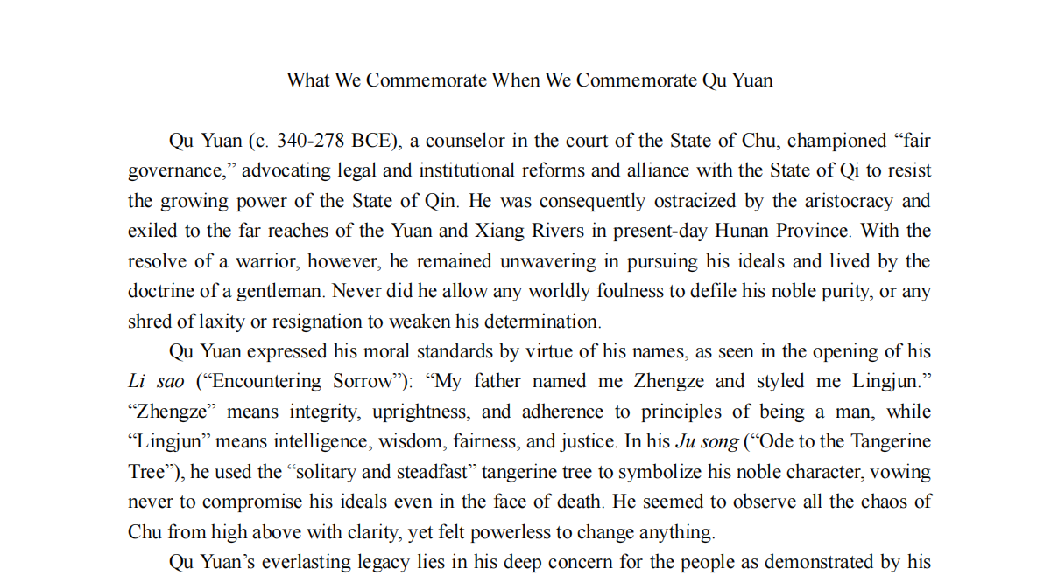

Slide 2
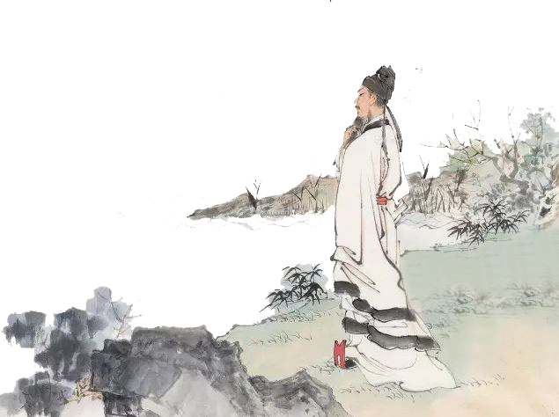

Qu
Yuan
汇报人：蒋才匀 英语口译

Slide 3
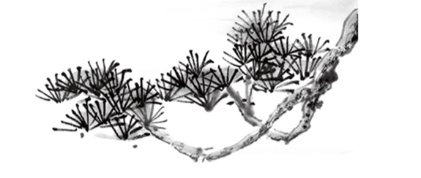
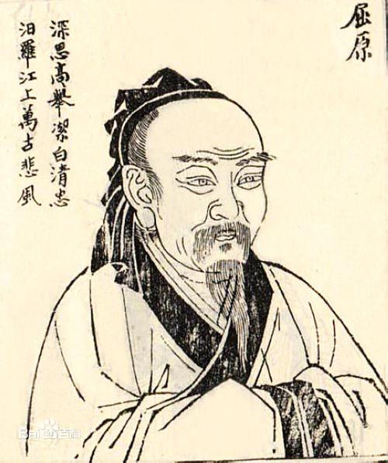
屈
原
Qu Yuan
ca. 340 B.C.E. - 278 B.C.E.
氏（Clan name）：屈（Qū）
名（Given name): 平（Píng）
字（Courtesy name ）：原（Yuán）
自名（Alias Given name）：正则（Zhengze）
号/别字（Pseudonym）：灵均（Lingjun）
？
姓（Ancestral name）：
芈（Mǐ）

Slide 4
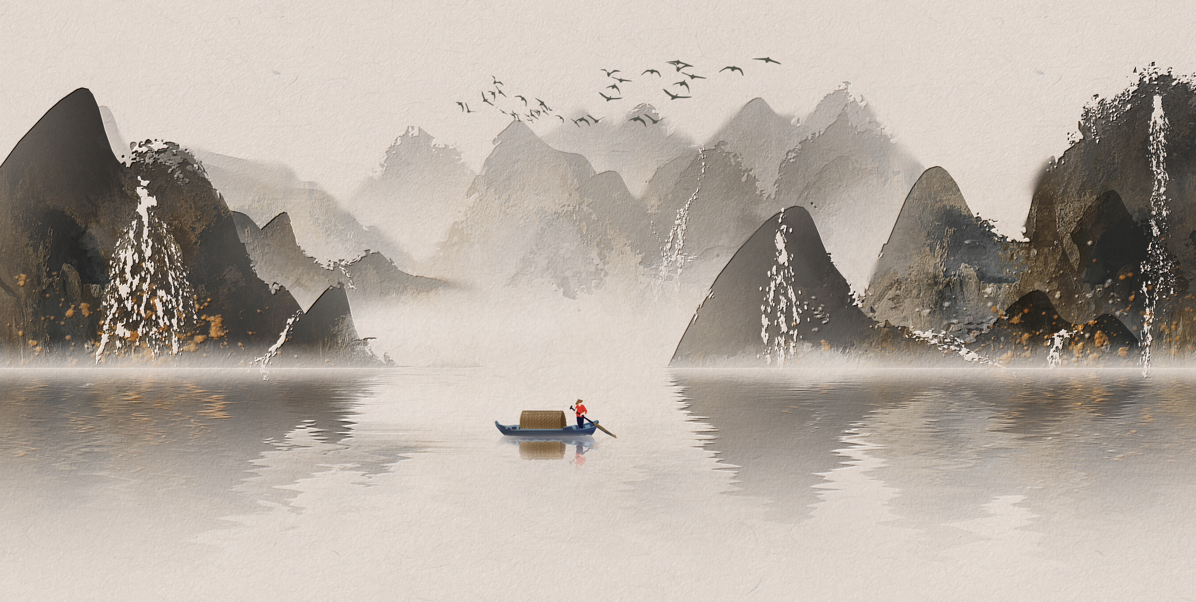

Qu Yuan's Life
Dragon Boat Festival commemorates
Literary achievements
Content

Slide 5


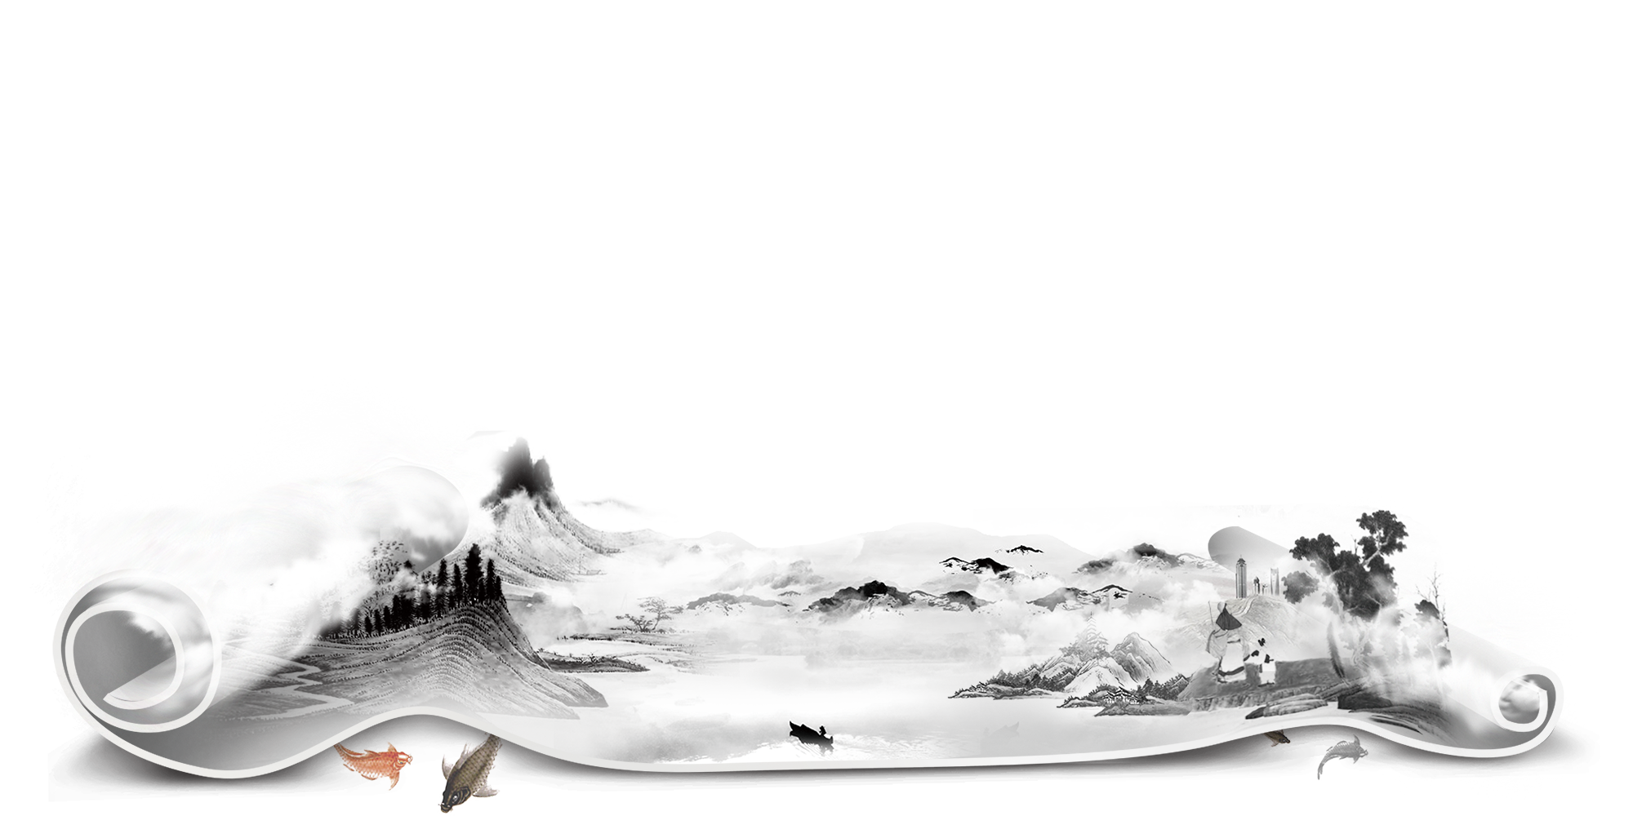
Chapter 1: Qu Yuan's Life

Slide 6
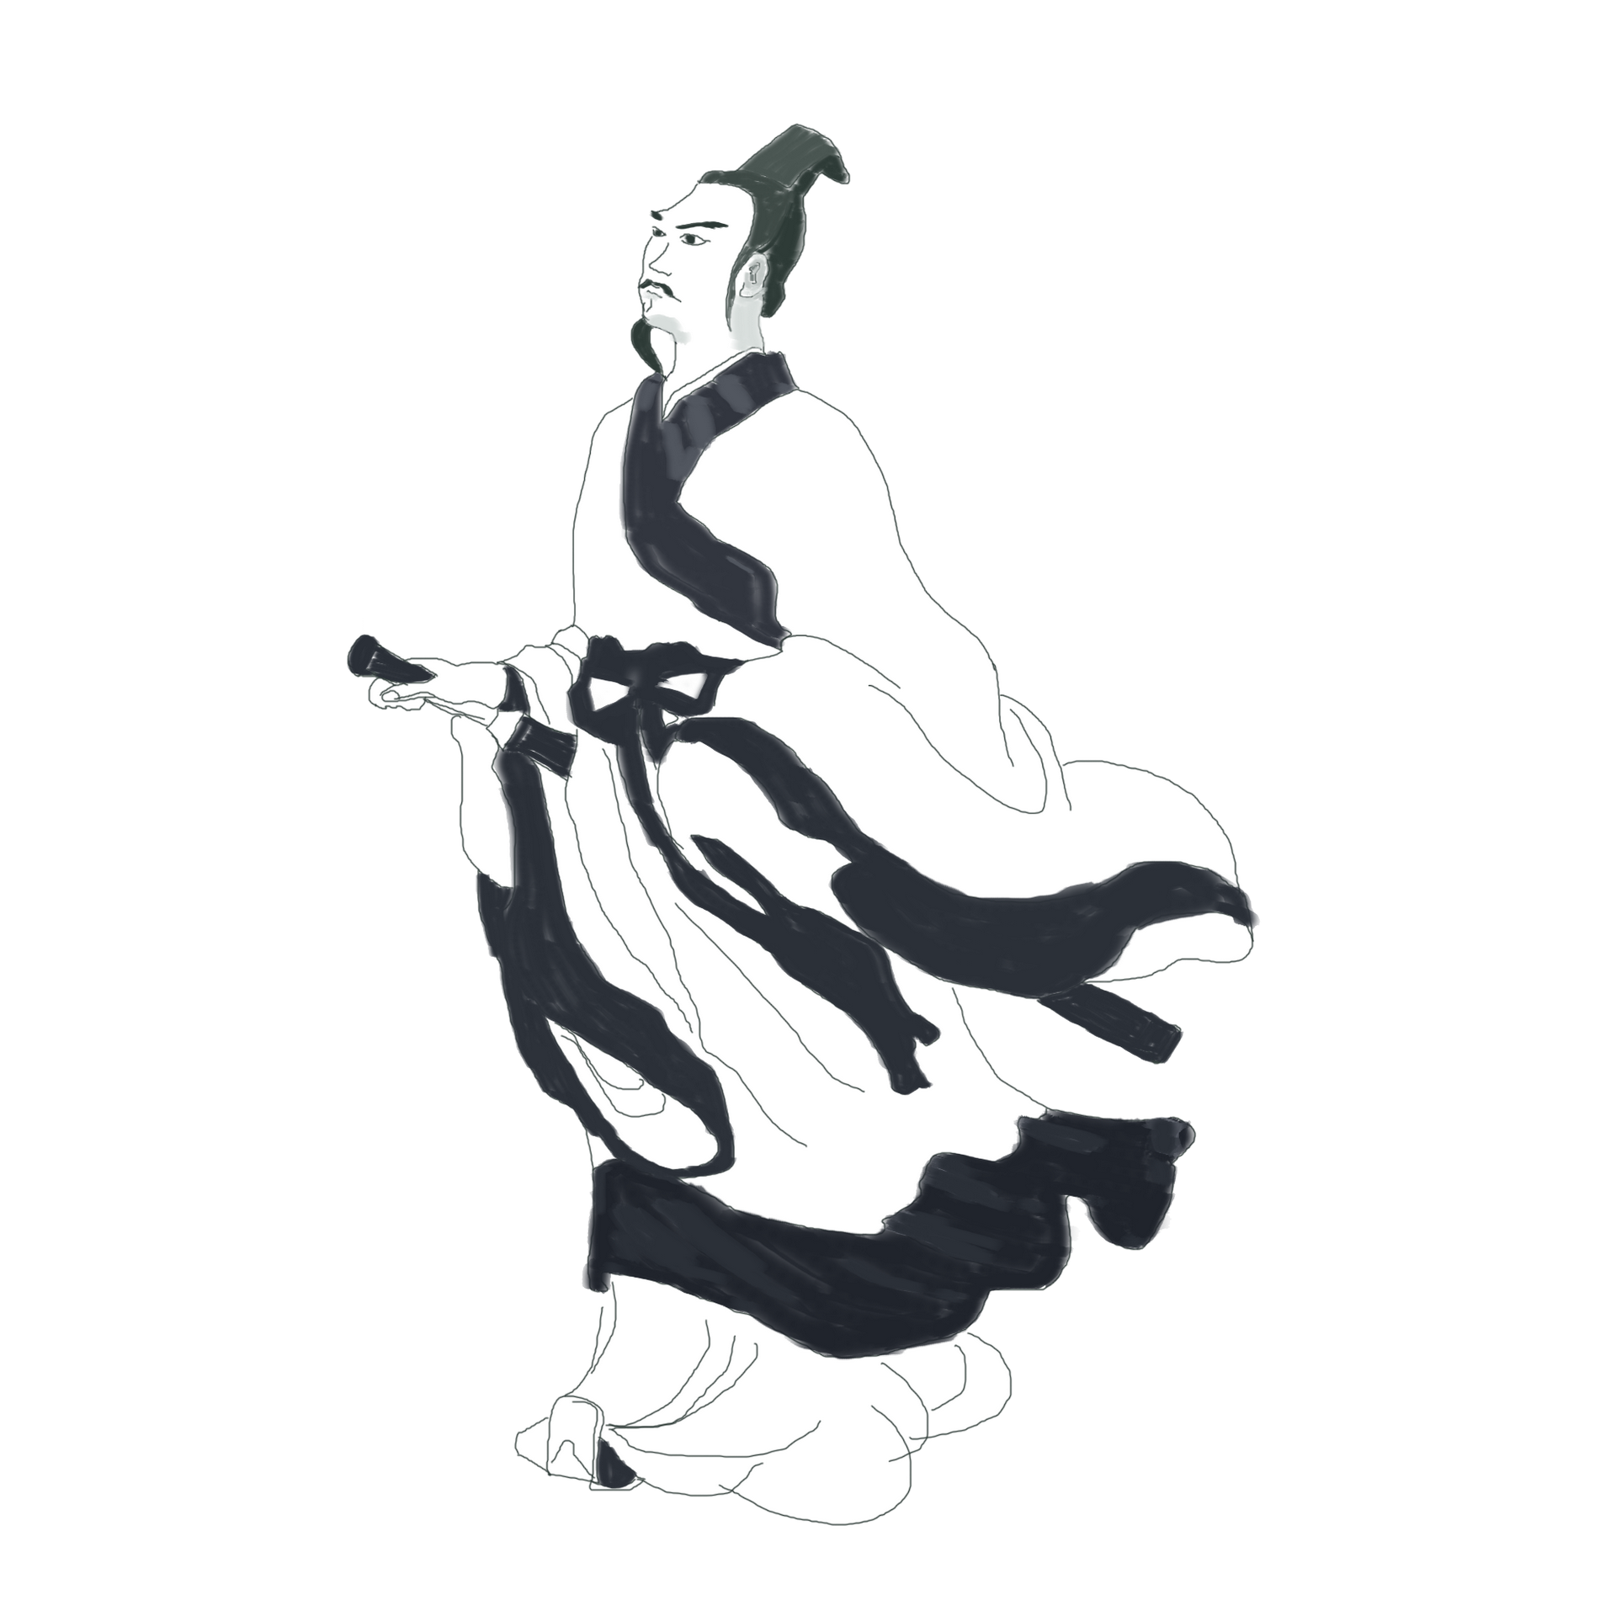

Birth and Experience
He was born to an aristocratic family which belonged to the same clan of the King of the State of Chu.
As a court minister, Qu Yuan attempted to persuade the king to promote the talented and to govern with laws and regulations in purpose of achieving "perfect ruling". He also wished that the State of Chu could, through political reforms, become a sovereign and affluent power, capable of reunifying the war-torn China.

Slide 7
The first exile
Qu Yuan had a straightforward personality, but he fell out of favor due to his refusal to heed the advice of Minister Shangguan when revising the laws, and instead refused to compromise with him. Additionally, Chu's King Huai and officials such as Zilan, Shangguan, and his favored concubine Zheng Xiu were bribed by the Qin emissary Zhang Yi. They not only prevented King Huai from accepting Qu Yuan's counsel but also led to King Huai distancing himself from Qu Yuan.
In 305 BC, Qu Yuan opposed King Huai of Chu's alliance with the Qin Kingdom through the Huangji Treaty. However, Chu still fully embraced Qin.
As a result, Qu Yuan was exiled by King Huai and began his life in banishment from the capital, Edu.
The second exile
As a result, under the intense persuasion of his young son Zilan and others, King Huai of Chu was lured into Qin, where he was imprisoned and died.
After King Xiang of Chu ascended the throne, Qu Yuan continued to face persecution and was exiled to the southern regions of the Yangtze River.

Slide 8
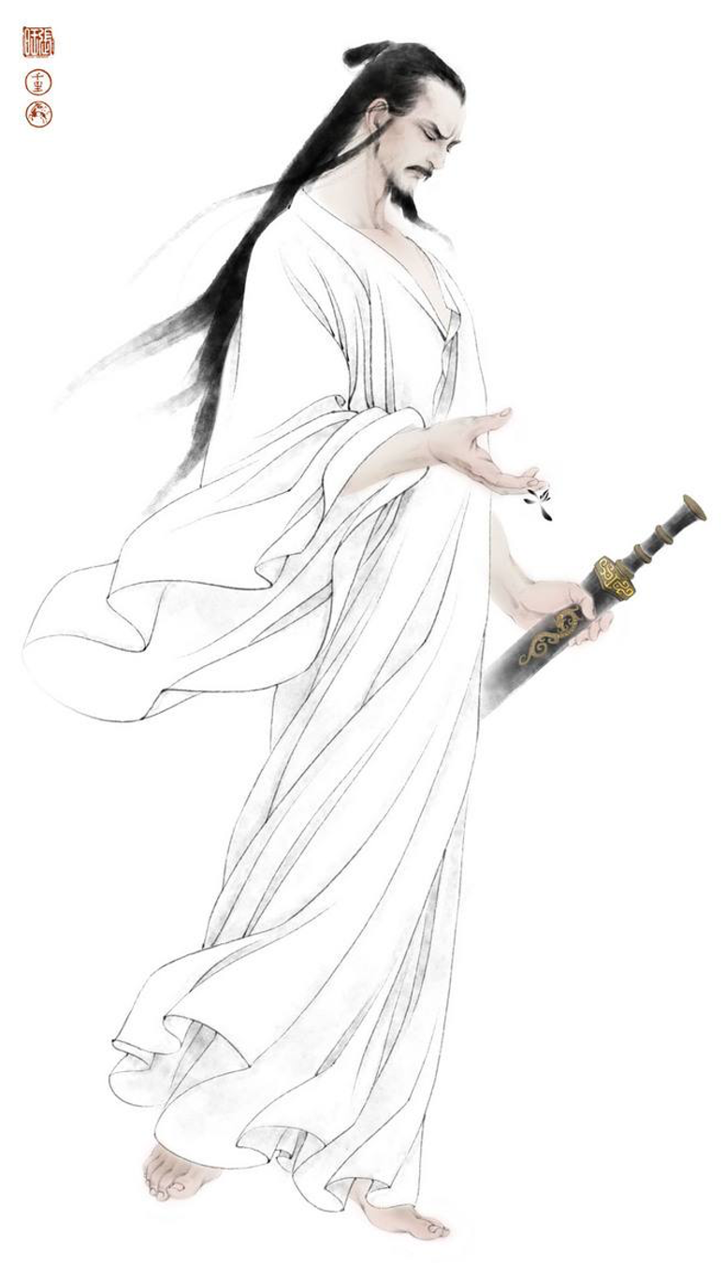
Suicide
In 278 BC, the Thai general Bai Qi led his troops southward and captured the capital of the Qin Kingdom. Qu Yuan's political ideals were shattered, and he became despairing about the future. Although he wished to serve his country, he felt powerless to change anything. In his frustration and to express his determination, he committed suicide by drowning in the Miluo River in May of the same year. Qu Yuan was around 62 years old at the time.

Slide 9
Chapter 2: Dragon Boat Festival commemorates

Slide 10


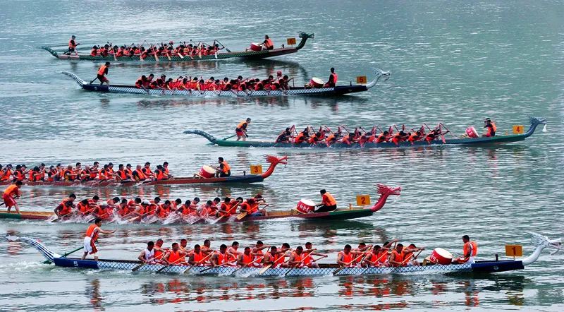
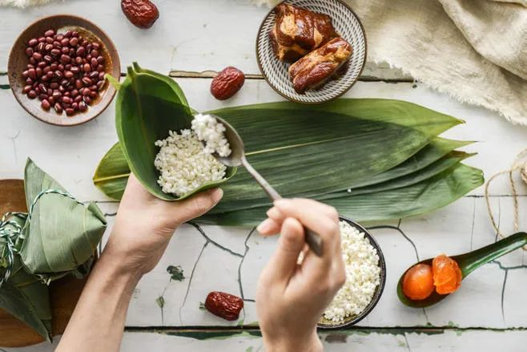
In memory of Qu Yuan
After he died in the river, people were very sad. They decided to throw food into the river to feed the fish, so the fish would not eat his body. People also tried to scare the fish away with the dragon-head boats.
Today, we eat zongzi and race dragon boats to remember this great man Qu Yuan.

Slide 11
Chapter 3: Literary achievements

Slide 12
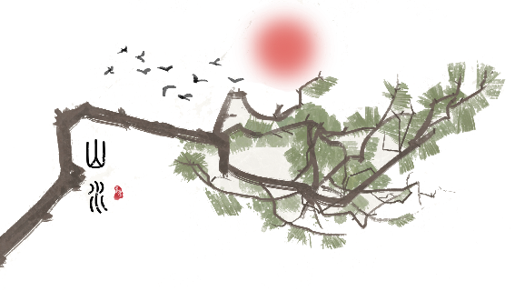
The Literary Works of Qu Yuan
Li Sao, his key poetic work, is the first existing long lyric poem in the history of Chineseliterature and a masterpiece of romanticism.
Other works of Qu Yuan include Jiu Ge (Eleven Odes), a collection of surrealistic lyric poems adapted from ritual songs of the State of Chu. His Jiu Zhang (Nine Elegies) faithfullyrecords his life in exile and expresses his intense political frustration and patriotic emotions. In Tian Wen (The Riddle), he bombards with 170 questions throughout the poem, presenting his extensive learning and inquisitive spirit.

Slide 13
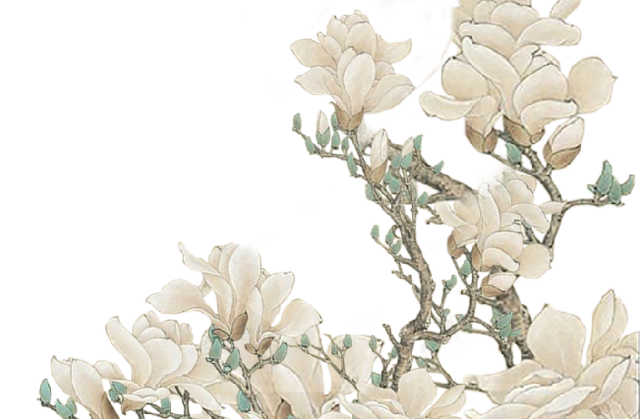


《Jiu Ge》
Jiuge is a title of Chuci. It was originally the name of an ancient song in Chinese mythology. Qu Yuan re created it. There are 11 chapters in Jiuge, most of which are about the sentimental relationship between gods, showing deep yearning or the sadness of the attempt; the other one is about mourning and praising the soldiers who died in the war for Chu.

Slide 14

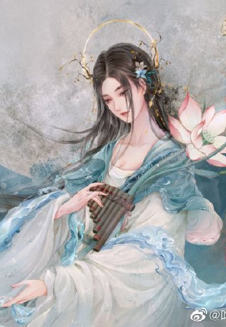
东皇太一
Dong Hunag Tai Yi
云中君
Yun Zhong Jun
湘夫人
Madam Xiang
The supreme god of the Chu region worshipped in the "Nine Songs" system. "Taiyi" literally means "the great one", which implies the supreme and original meaning of all things.
The spirit of the Xiang River, the largest river in the territory of the State of Chu
Cloud God

Slide 15
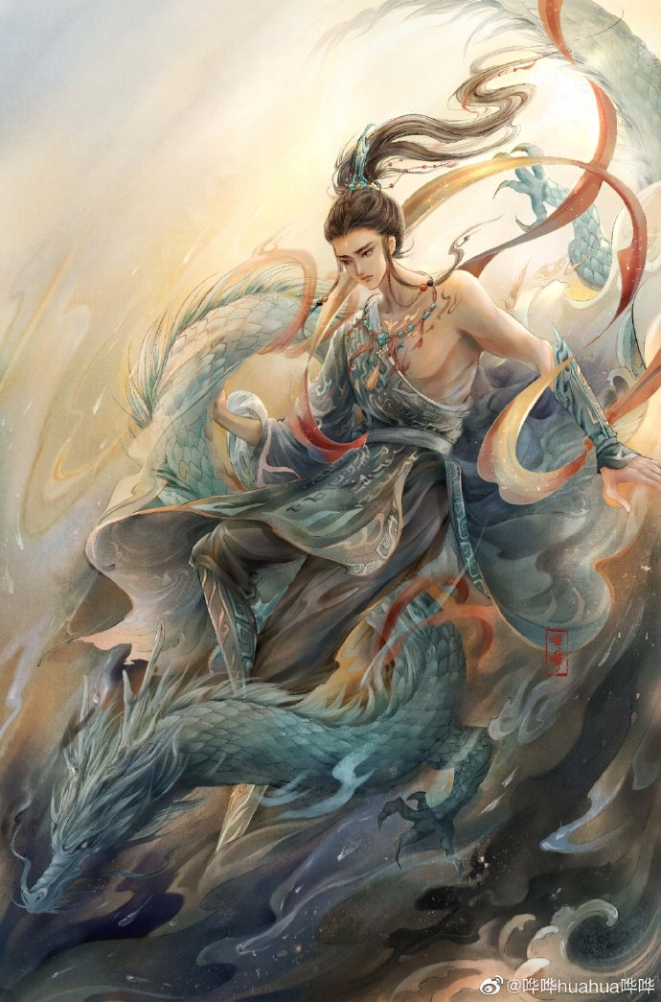
大司命
Da Si Ming
少司命
Shao Si Ming
东君
Dong Jun
dominate human life and death.
The goddess in ancient Han legend who presides over the fate of human offspring and children.
Sun God

Slide 16
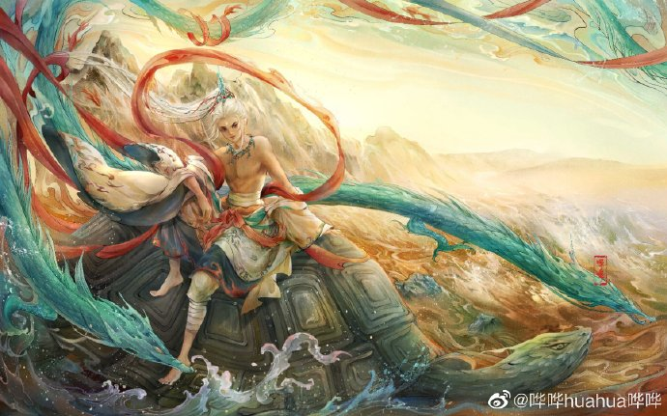
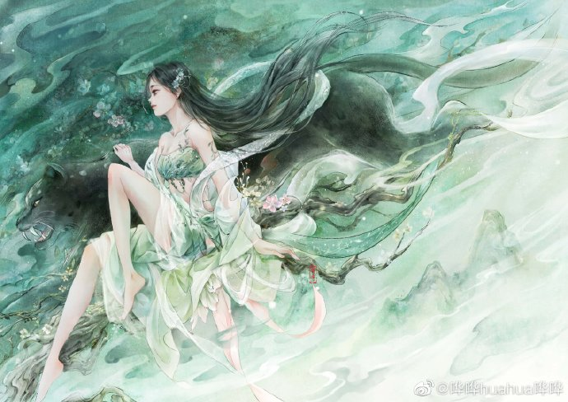
河伯
Hebo
山鬼
Mountain Ghost
The Water God of the Yellow River in Ancient Han Mythology.
The Goddess of the Mountain. Guo Moruo believed that the mountain ghost was the famous Wushan goddess.

Slide 17
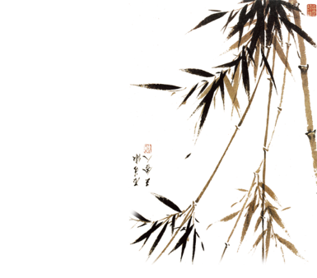
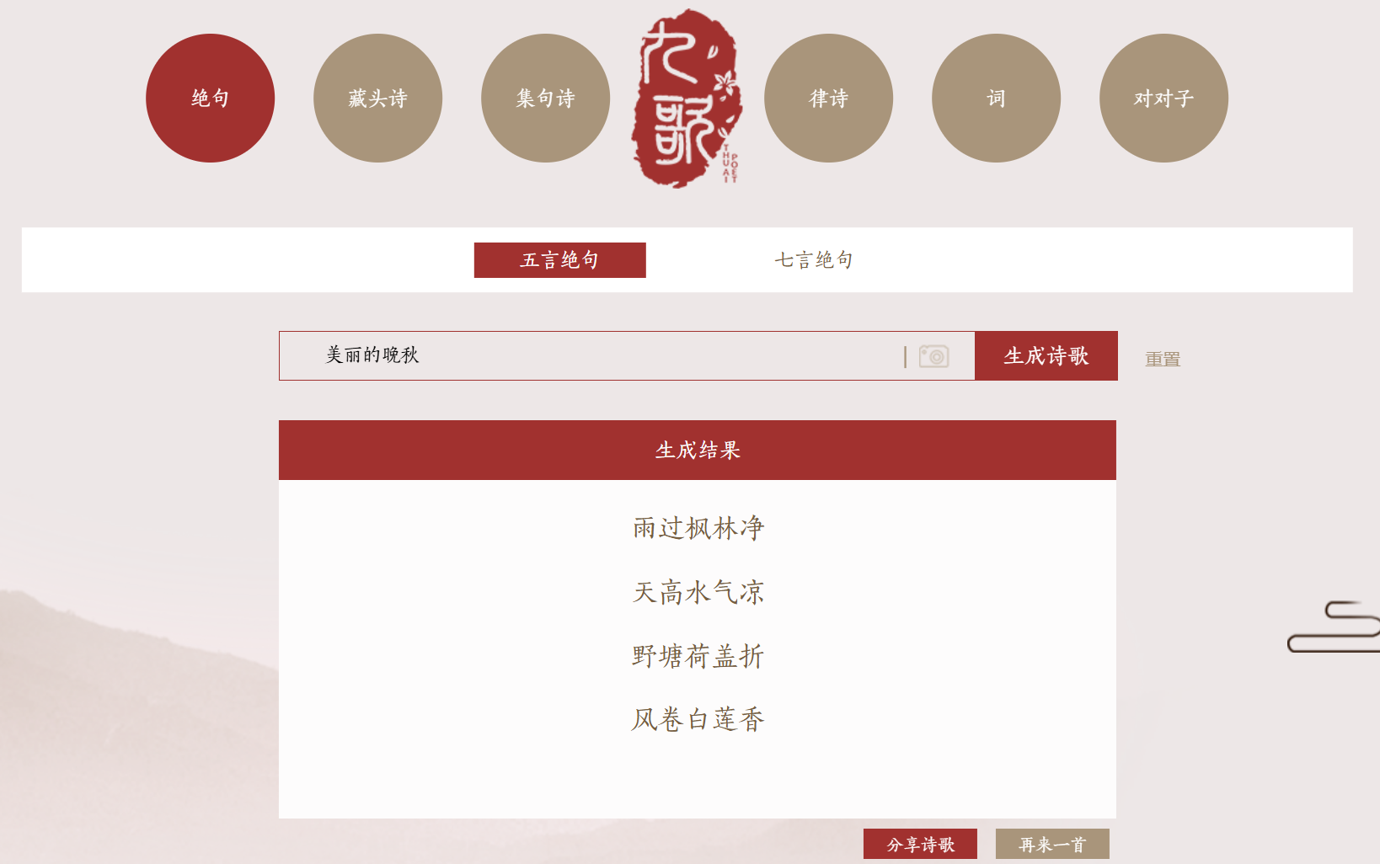
九歌——人工智能诗歌写作系统
https://jiuge.thunlp.org/jueju.html

Slide 18

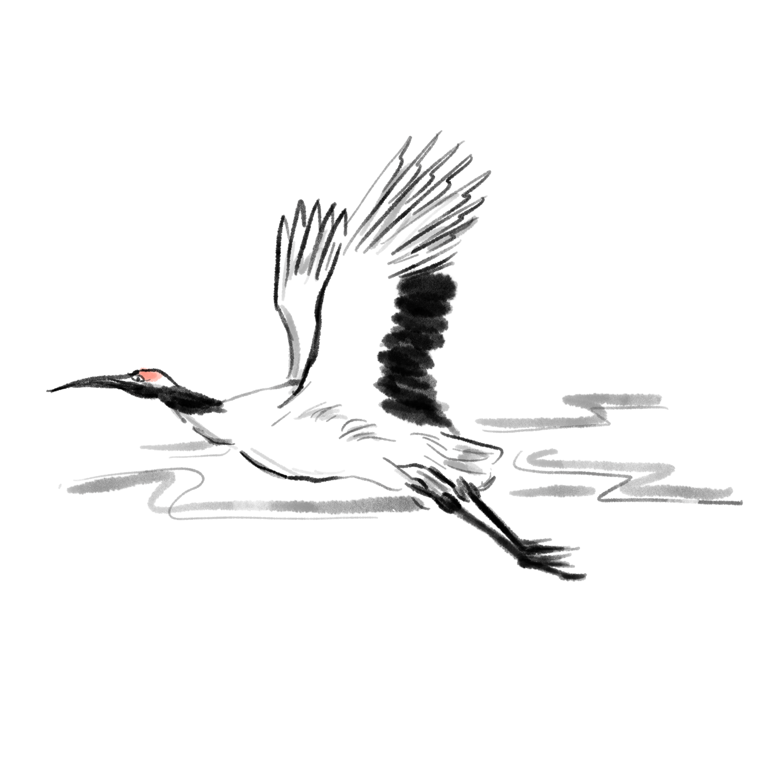
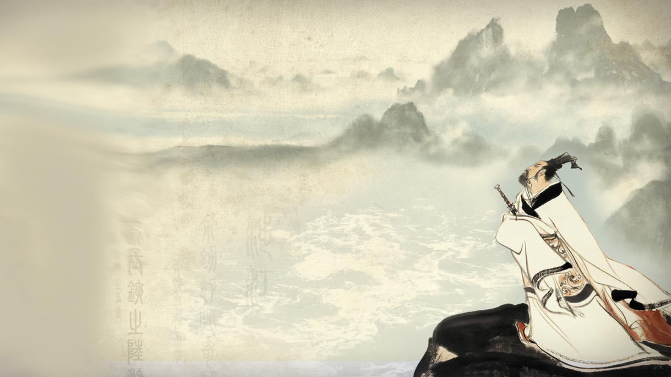

This is Qu Yuan, one of the greatest poets of ancient China
感谢您的聆听
THANKS

