Slide 1
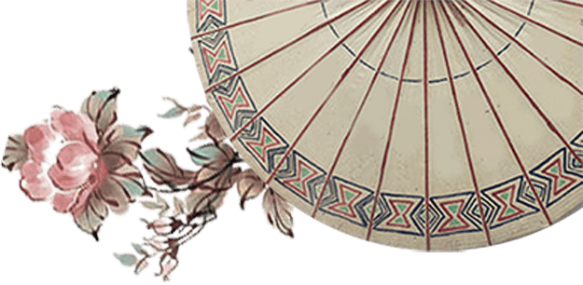

Will Chinese Classics
Have a Market in the West in the Future?
正方：Kuang Yuqi
反方：Cao Jiao

