Slide 1
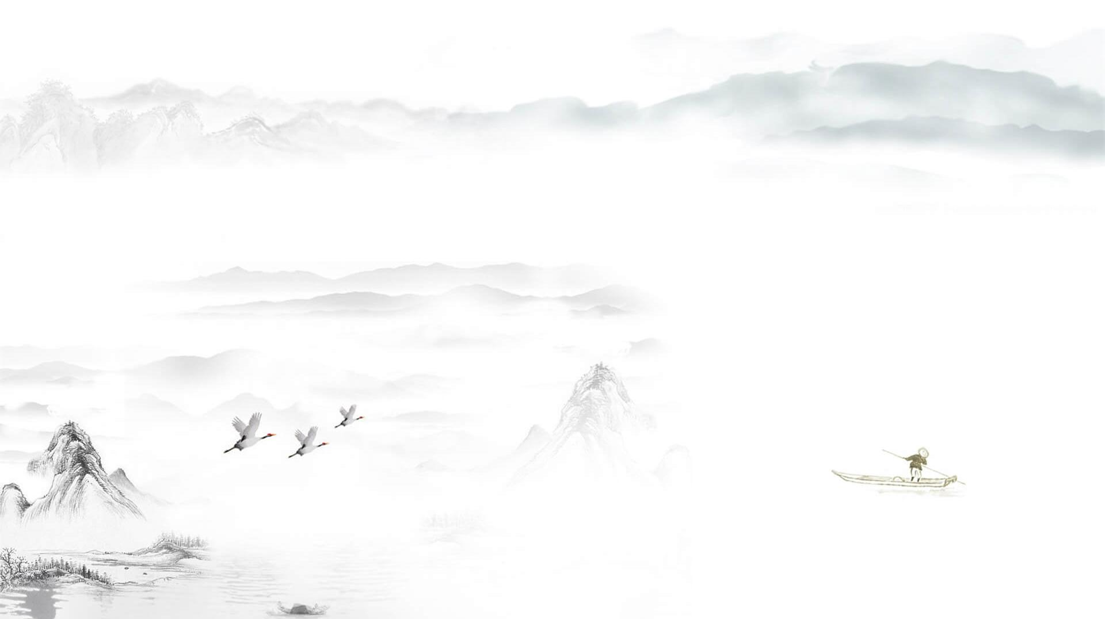



Bada shanren and
Qi baishi
中国风
Wu Zijia 吴子佳
Lei Kuangxi 雷旷溪

Slide 2

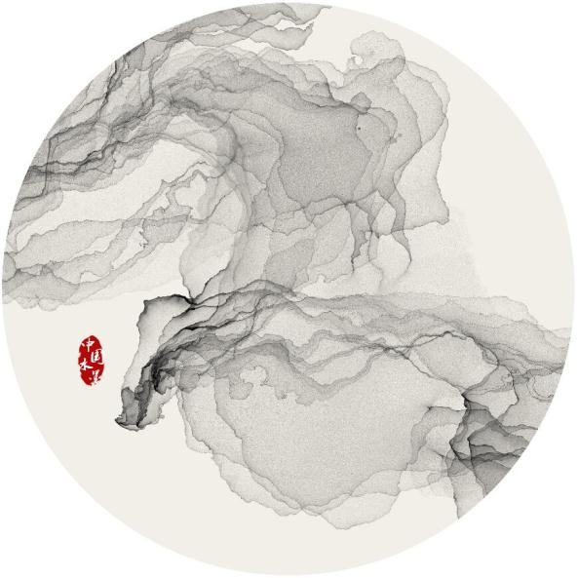

Introduction of Bada shanren
Introduction of Qi baishi
Content
Relationship between Bada shanren and Qi baishi
Difficulties in translation

Slide 3
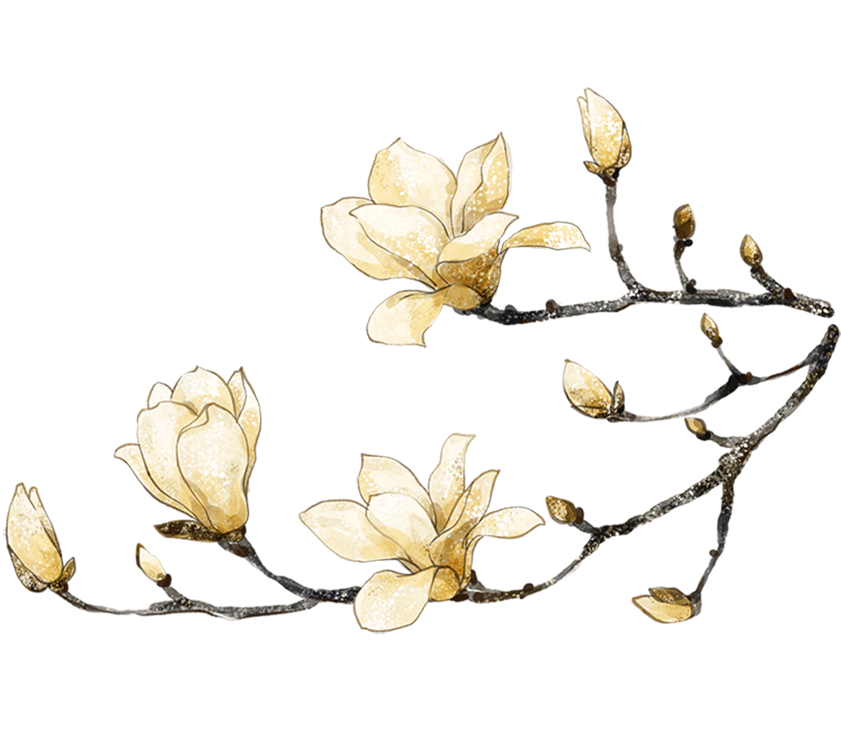

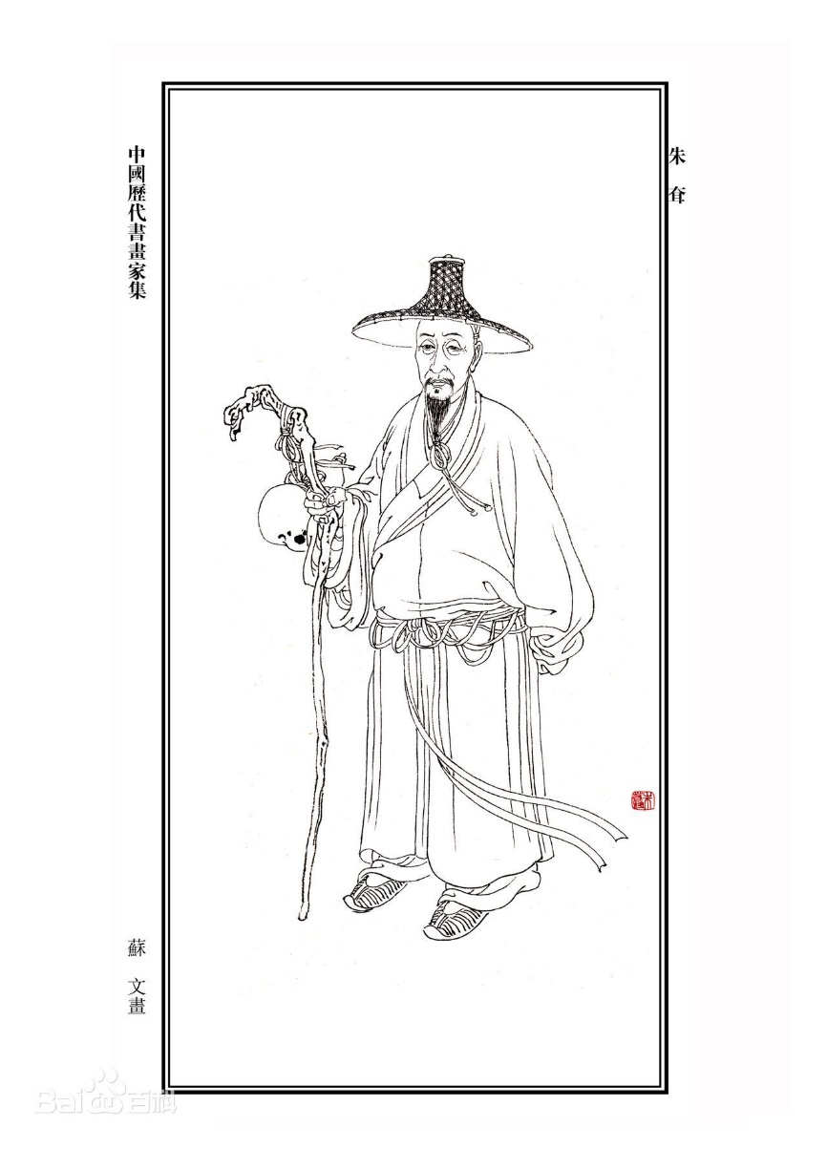
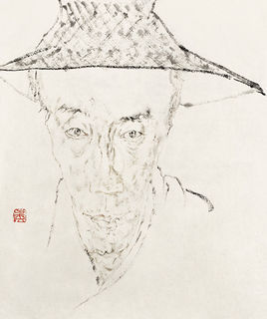
I
Introduction of Bada shanren
Zhu da 朱耷
Bada shanren 八大山人
A descendant of Zhu Yuanzhang (1328-1398), founder of the Ming Dynasty (1368-1644),
Nanchang, Jiangxi Province.

Slide 4
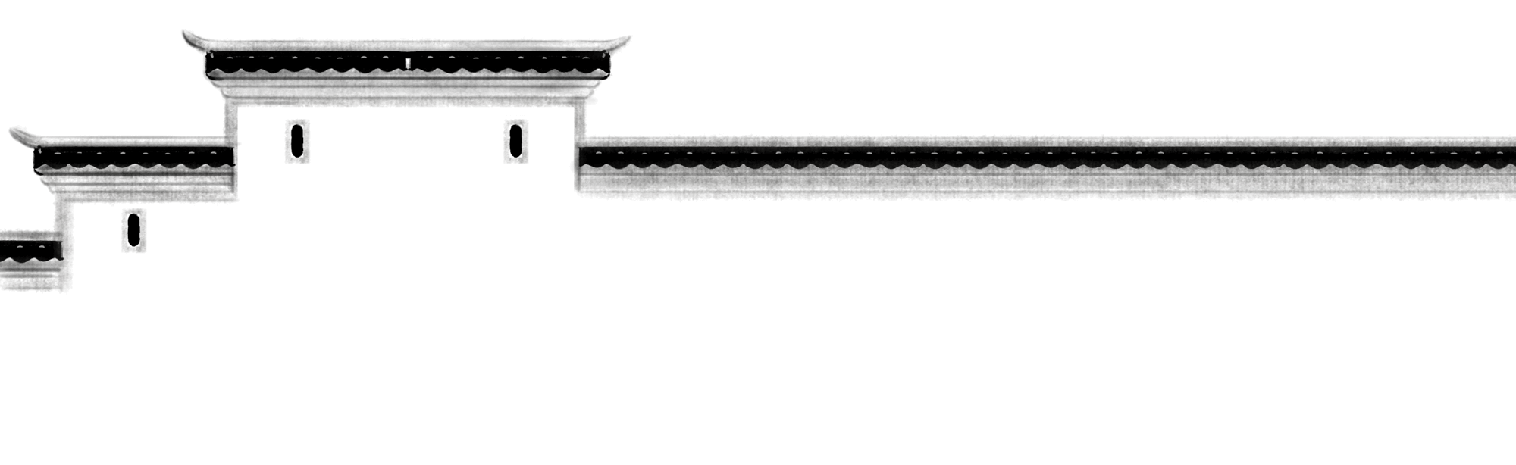
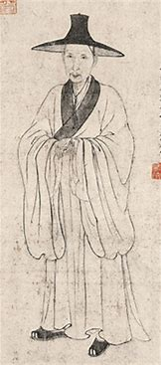
z
壹
Introduction of Bada shanren
Life span
19 years old
62 years old
Little boy
23 years old

Slide 5

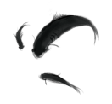
壹
Introduction of Bada shanren
朱
耷
八
牛niu
Badashanren
人
耳er
大
山

Slide 6
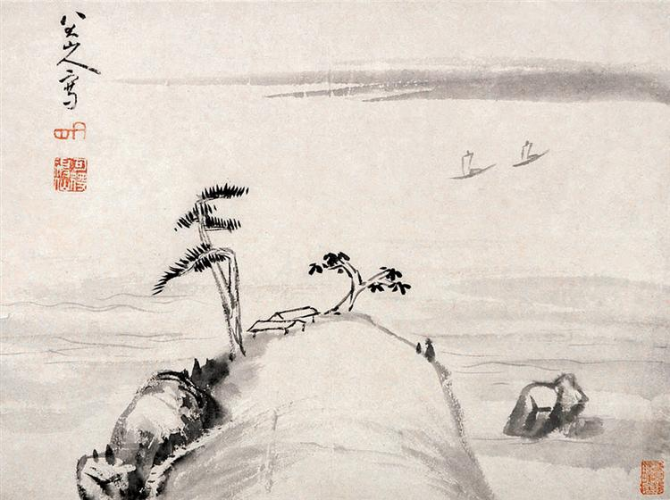
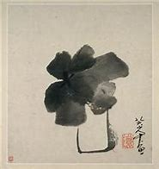
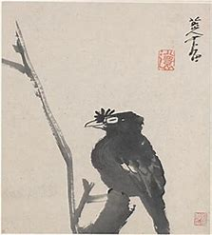
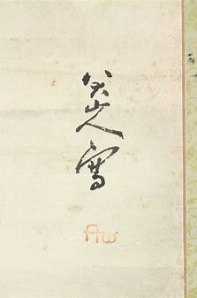
壹
Introduction of Bada shanren
Painting works
Nhbgbhb
simple composition
brief and precise brush strokes e
strange

Slide 7
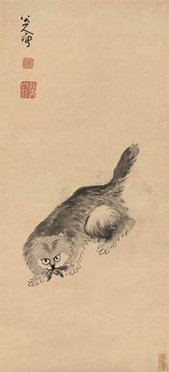
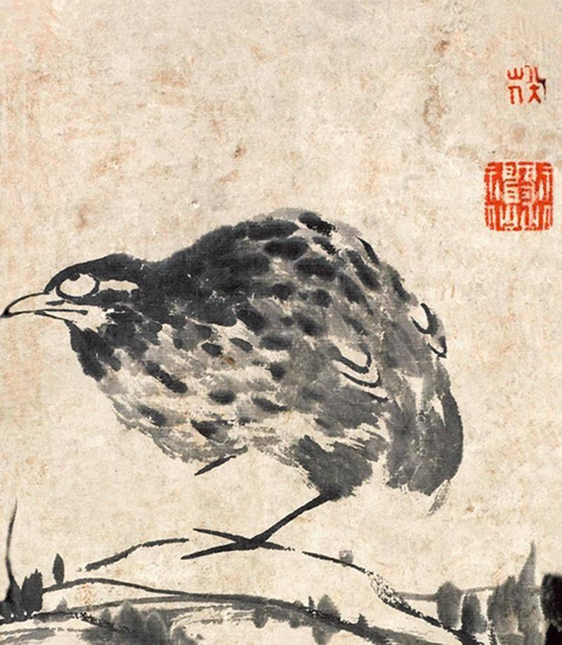
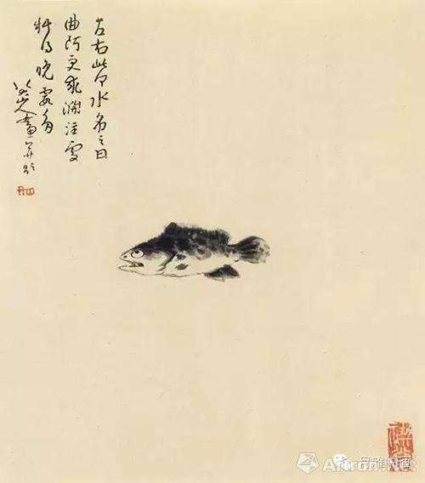
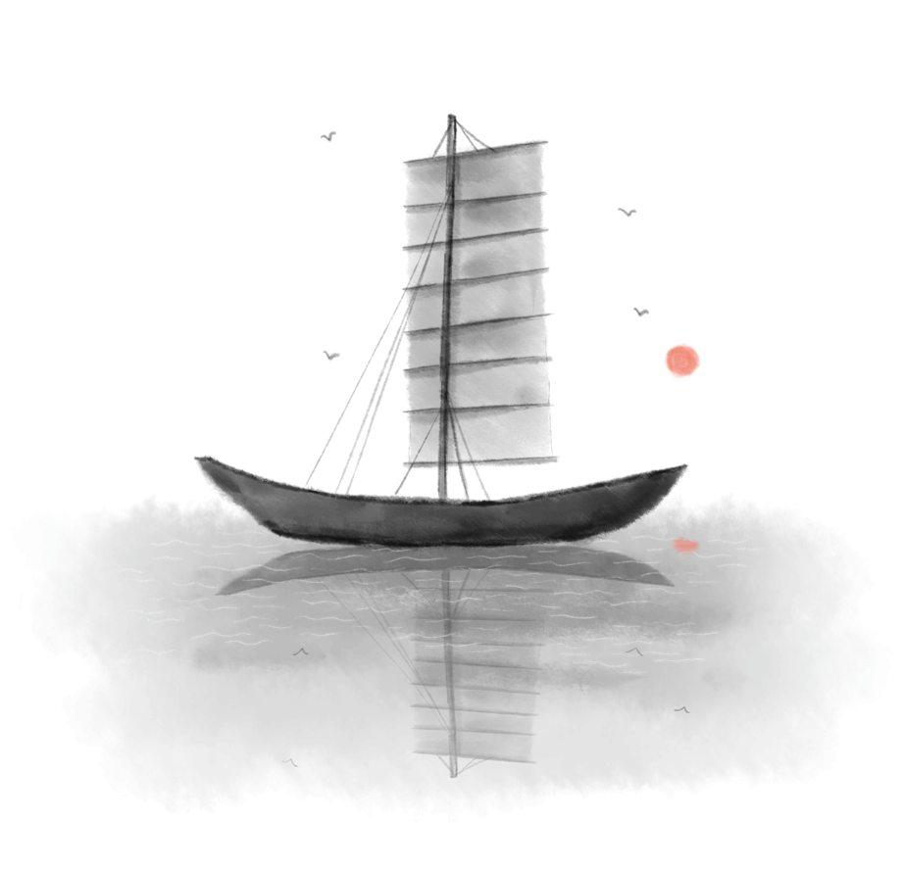
壹
Introduction of Bada shanren
Big eyes
Weird postures
Sadness and grudges

Slide 8


Introduction
of Qi baishi

Slide 9
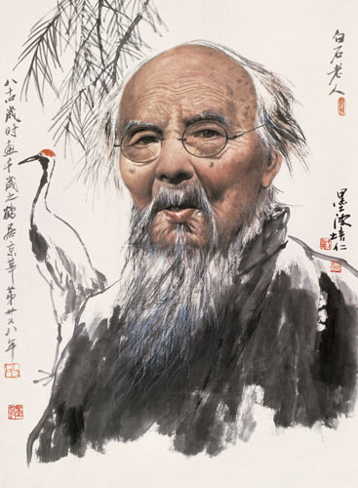
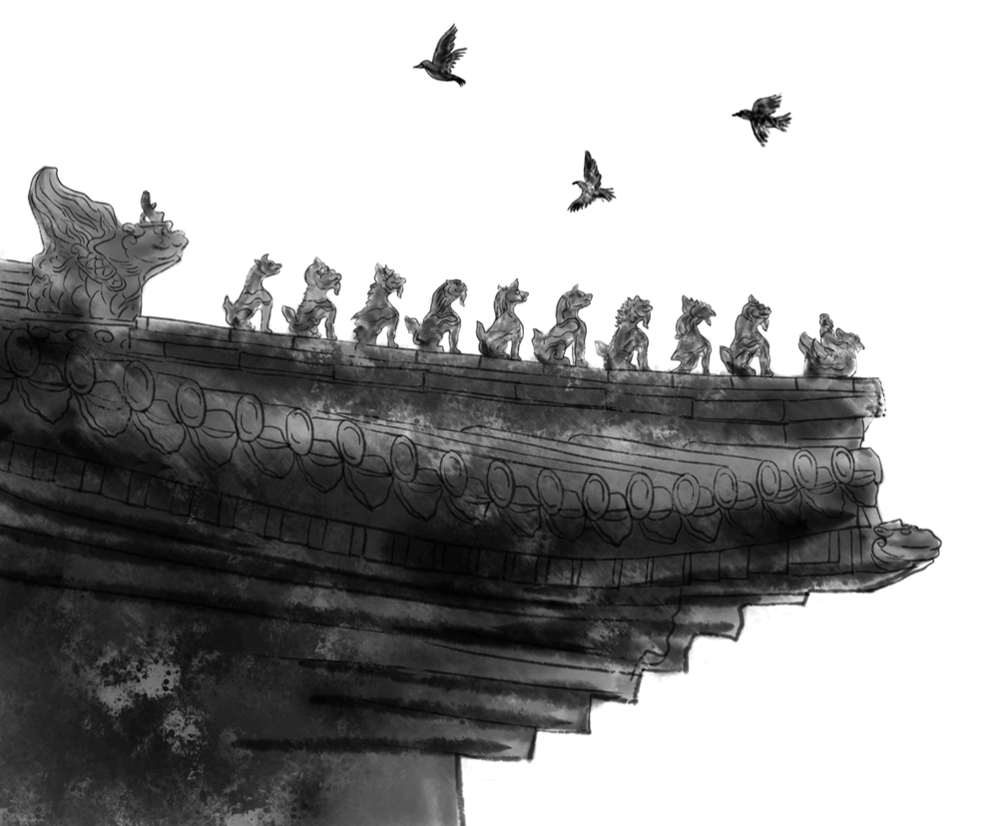

贰
Introduction of Qi baishi
Qi baishi
Born in Xiangtan, Hunan province
Chinese painter,calligrapher
Noted for the whimsical and playful style of his watercolor works

Slide 10


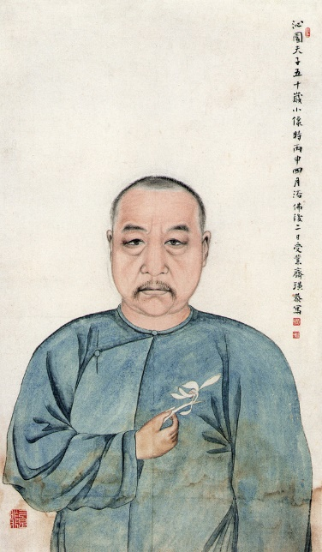
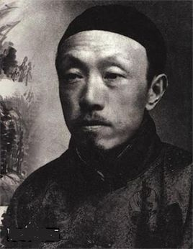
贰
Introduction of Qi baishi
Hu Qinyuan
(1847-1914)
Chen Shizeng
(1876-1923)
Distinctive style

Slide 11
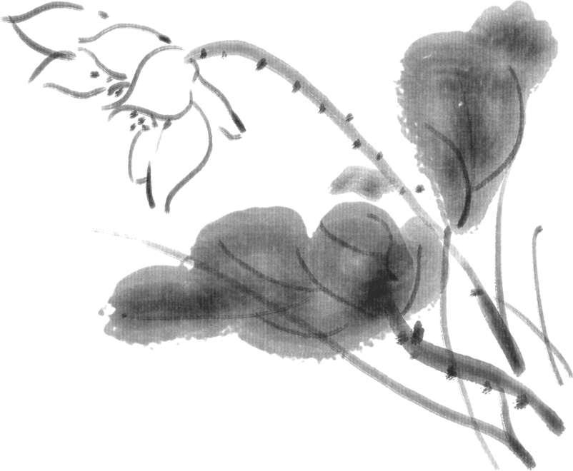
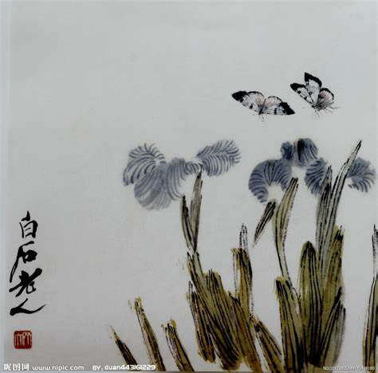
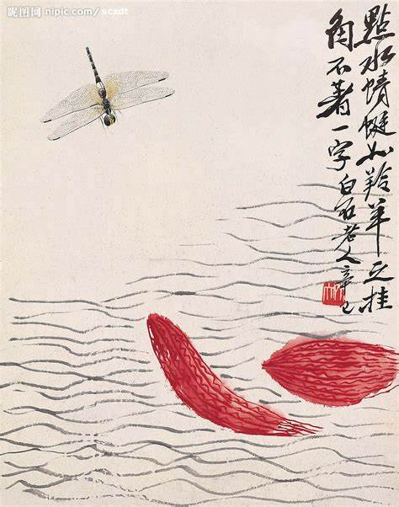
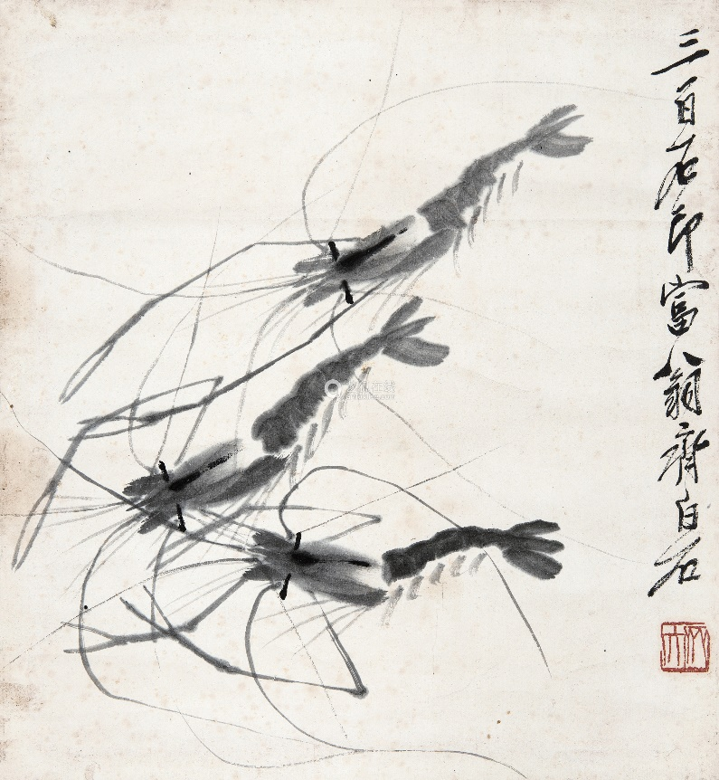
贰
Introduction of Qi baishi
diberse
输入标题
Diverse subjects
Realistic and vivid
Famous for prawns painting

Slide 12
Relationship between Bada shanren and Qi baishi

Slide 13

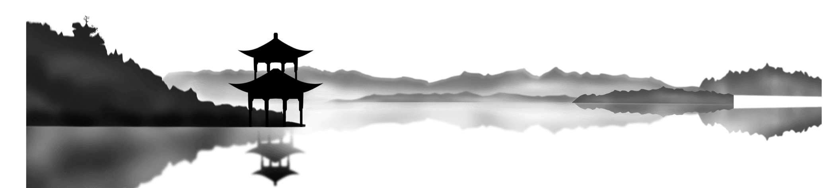
Bada shanren
Relationship between Bada shanren and Qi baishi
叁
Qi baishi
Learn from
influence
Both of them were man of noble character.

Slide 14
Difficulties
in translation

Slide 15
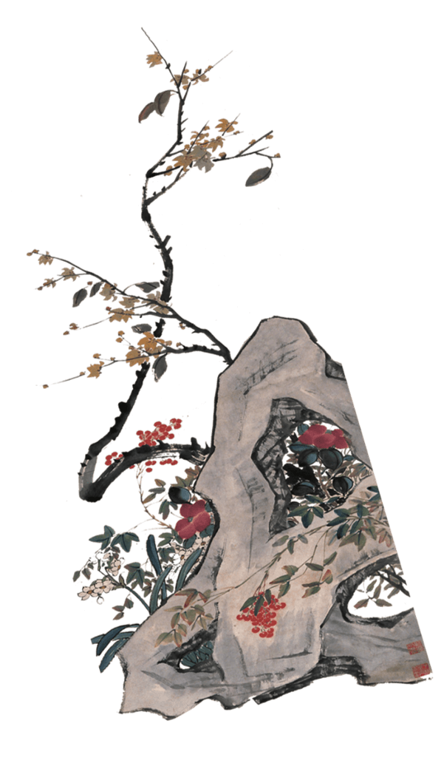

= eight great persons in the mountain？
肆
Difficulties in translation
八大山人 Badashanren
Badashanren is actually a name of one person,so while doing our translation,
we should give an explaination of his name ,otherwise people may
get confused.

Slide 16
Thank you
中国风
Wu Zijia 吴子佳
Lei Kuangxi 雷旷溪

