Slide 1
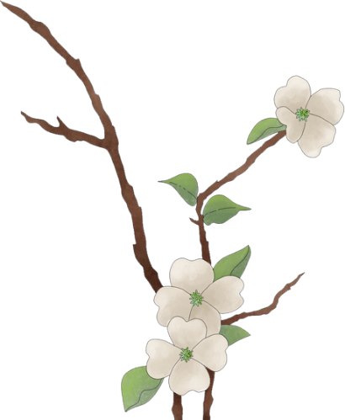


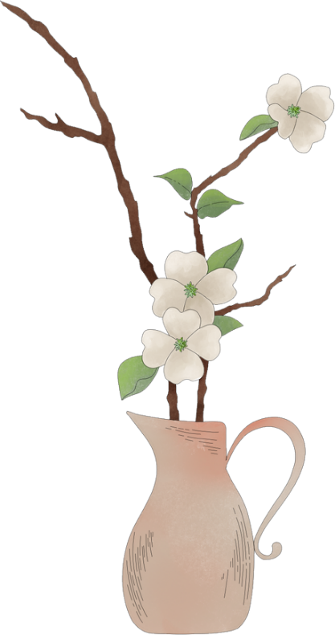

茶
百
戏
Cha Bai Xi
Tea Latte Art

Slide 2

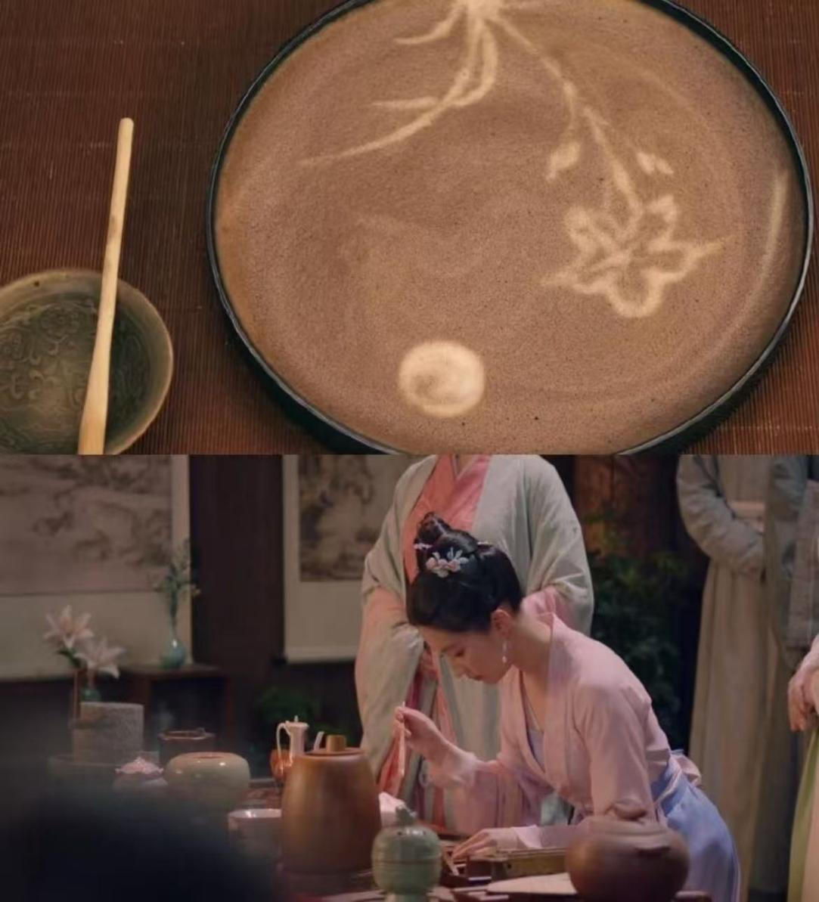
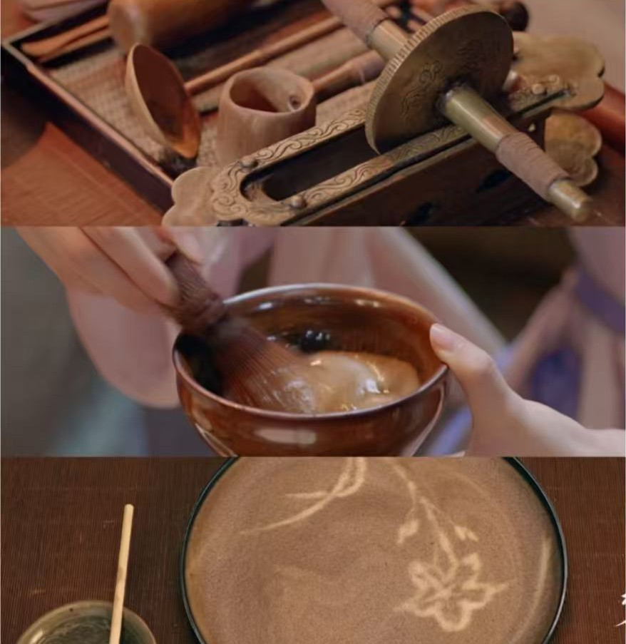
The TV series "Dreaming of Splendor"

Slide 3

CONTENT
01
02
Tea Opera introduction
Historical development
03
04
Acrobatic features
Inheritance and protection

Slide 4
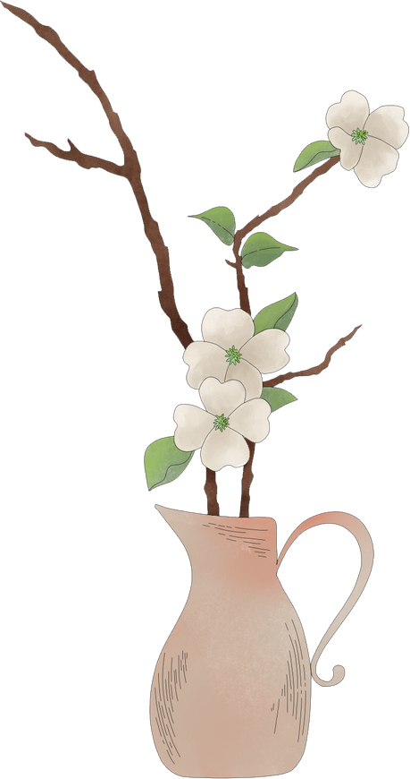
第
一
部
分
Cha Bai Xi introduction
01

Slide 5
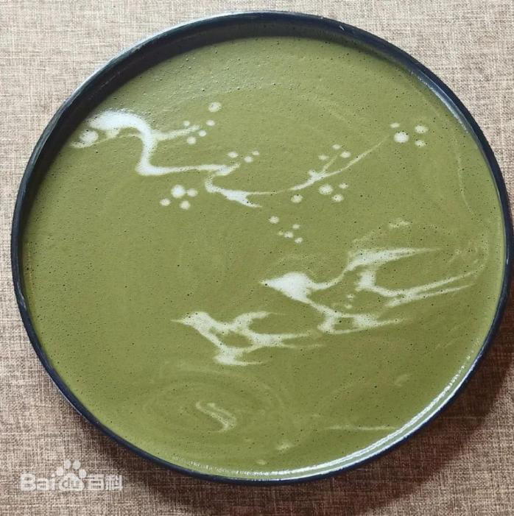
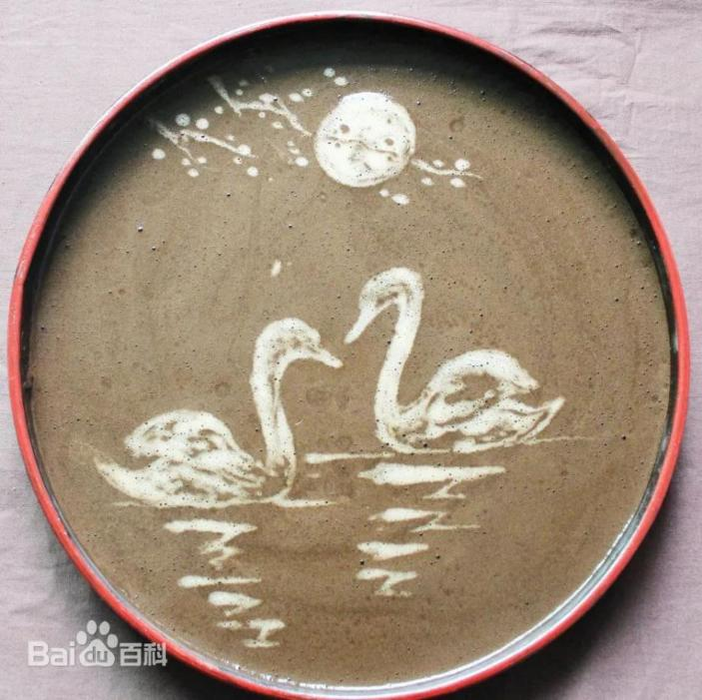
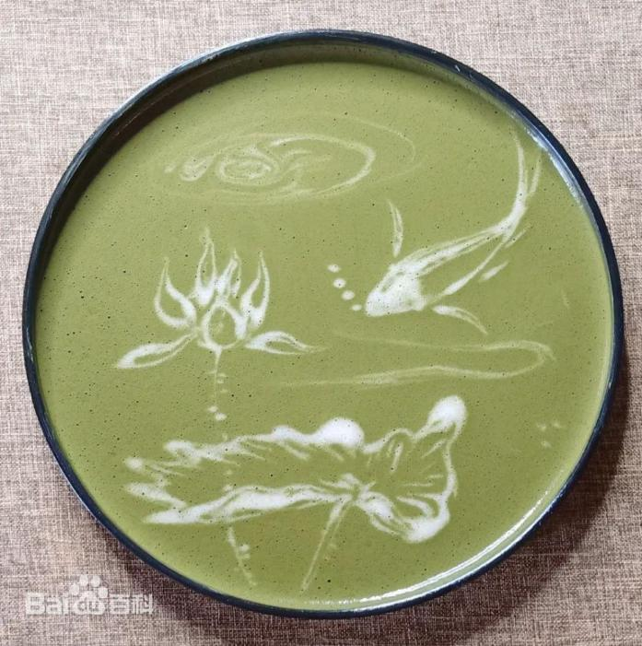

Cha Bai Xi, also known as tea, water danqing, soup opera, Cha Bai Xi, etc., is a kind of folk art that can make the veins of tea soup form an image, characterized by only tea and water without other raw materials can show words and images in the tea soup.

Slide 6
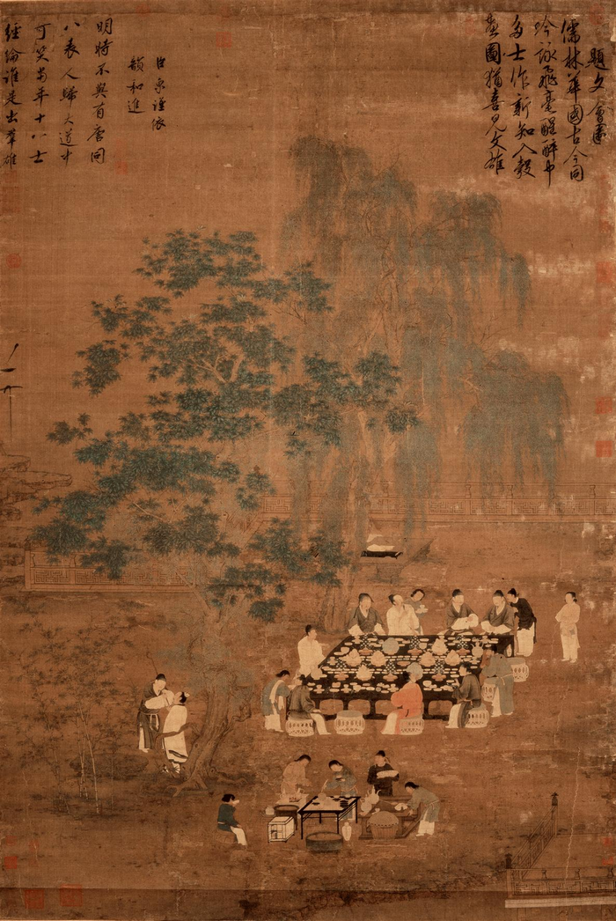
Cha Bai Xi was first seen in the Tang Dynasty, and it was more popular in the tea area of northern Fujian during the Song Dynasty. In the Song Dynasty, people juxtaposed Cha Bai Xi with piano, chess, and books, which was a kind of cultural activity that scholars loved and admired.

Slide 7
第
二
部
分
Historical development
02

Slide 8
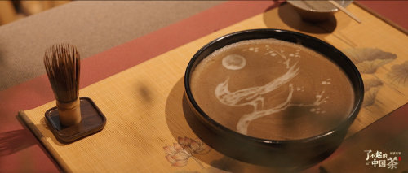
Tang Dynasty: It started to take shape.
Song Dynasty: Reached its peak! The royal family loved it, and famous poets like Su Shi and Lu You wrote about it, making it popular.
Yuan Dynasty: As the "dian cha" method was replaced by other tea-making ways, Cha Bai Xi became less common.
Ming and Qing Dynasties: It still existed in northern Fujian, but not as widely.

Slide 9
第
三
部
分
Acrobatic features
03

Slide 10

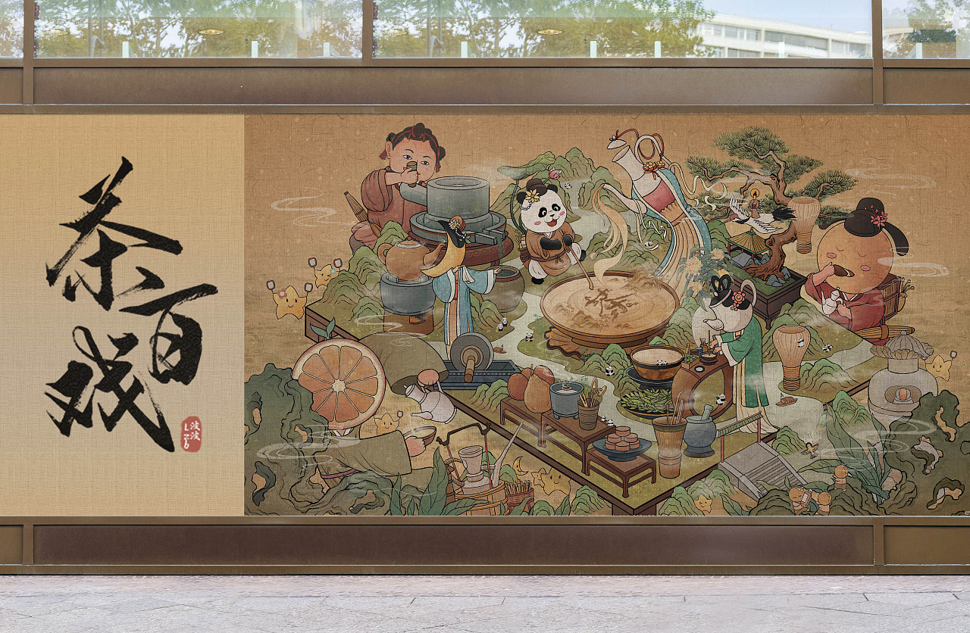
What makes Cha Bai Xi special?

Slide 11
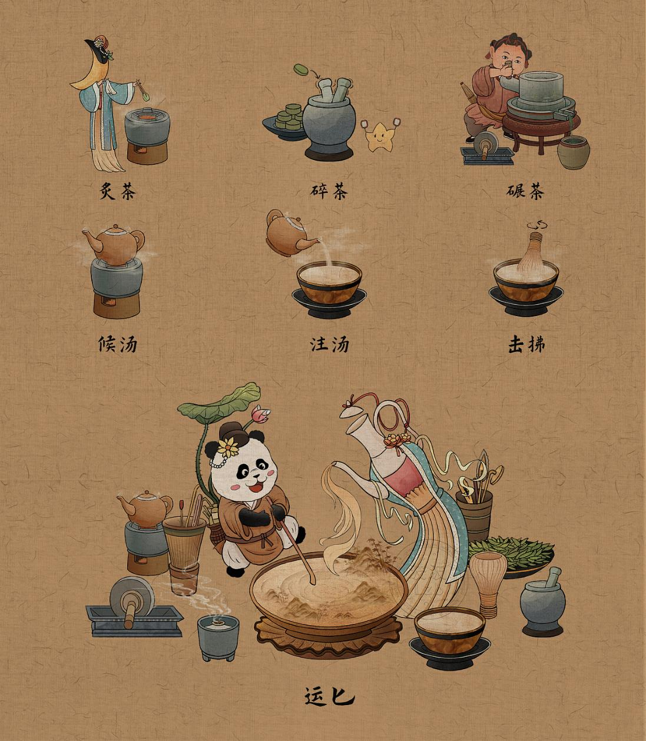

Slide 12
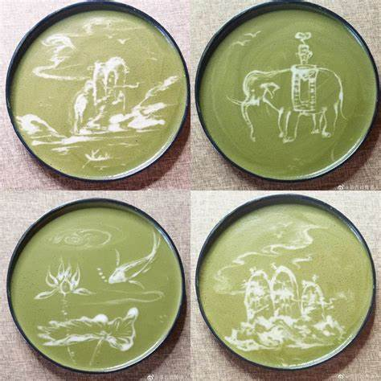
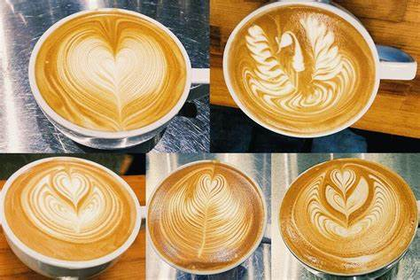
Cha Bai Xi VS coffee latte art
ancient Chinese
landscape paintingsand
symmetrical shapes

Slide 13
第
四
部
分
Inheritance and protection
04

Slide 14
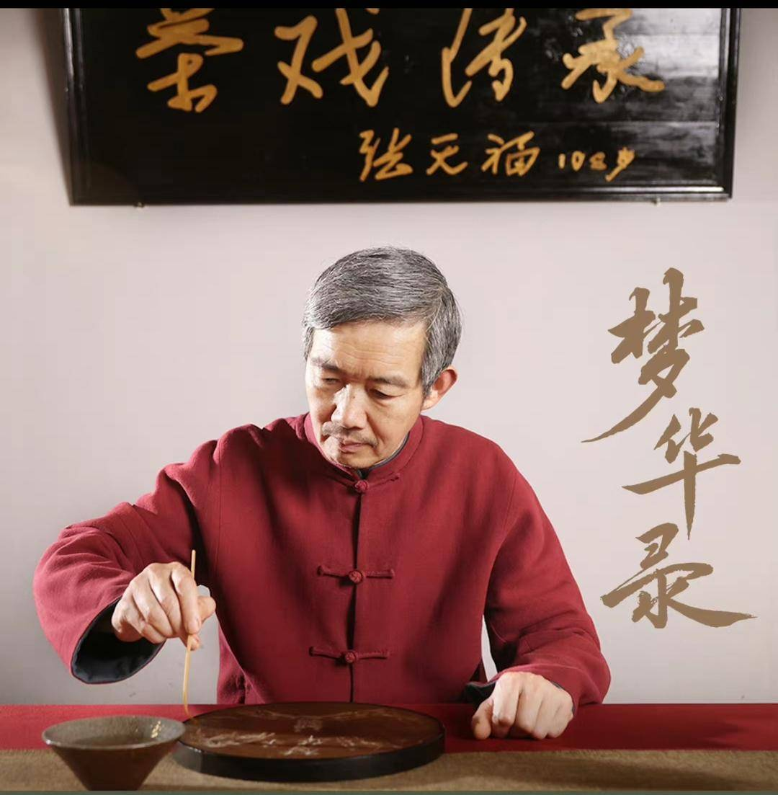
tea culture
a unique art form
a provincial intangible
cultural heritage in Fujian

Slide 15
thank you!

