Slide 1
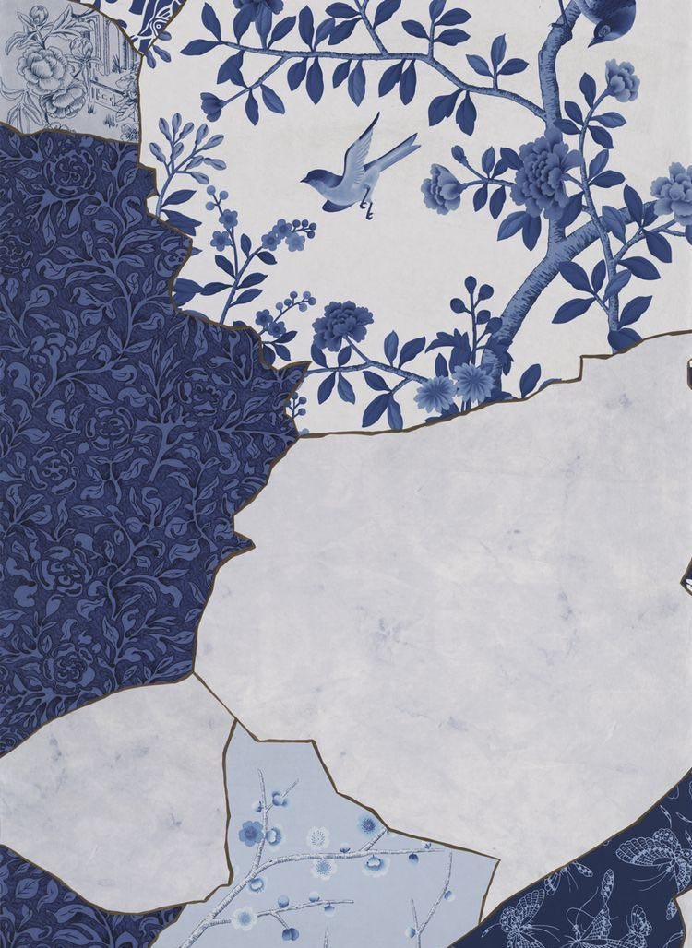
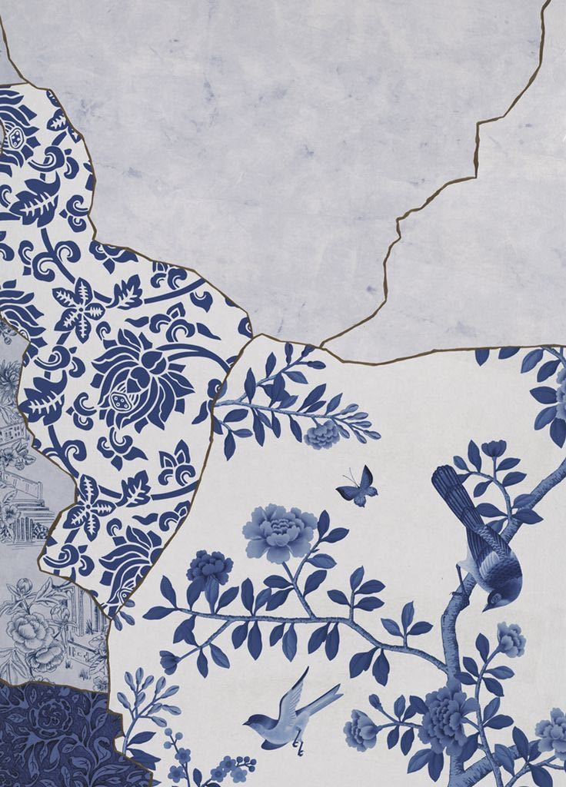

CHINESE PORCELAIN

Slide 2
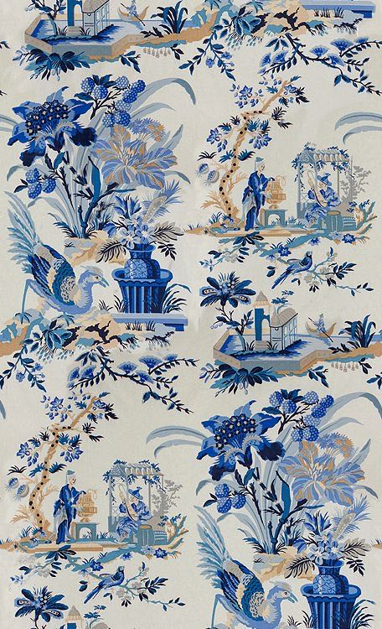
Welcome
And Enjoy
The invention of porcelain in China was a development that changed the face of art throughout the world. It took years for the process to be replicated anywhere else, but by then the ubiquity of Chinese porcelain was firmly stamped in the books of history.

Slide 3
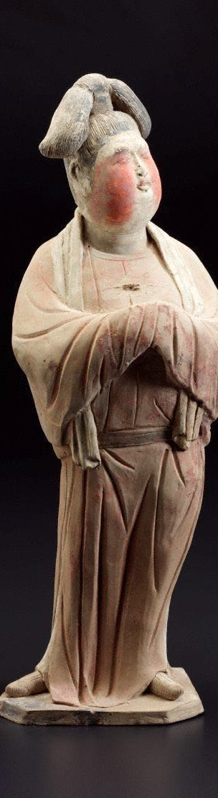
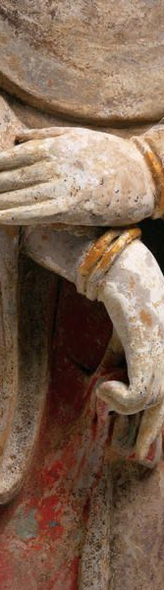
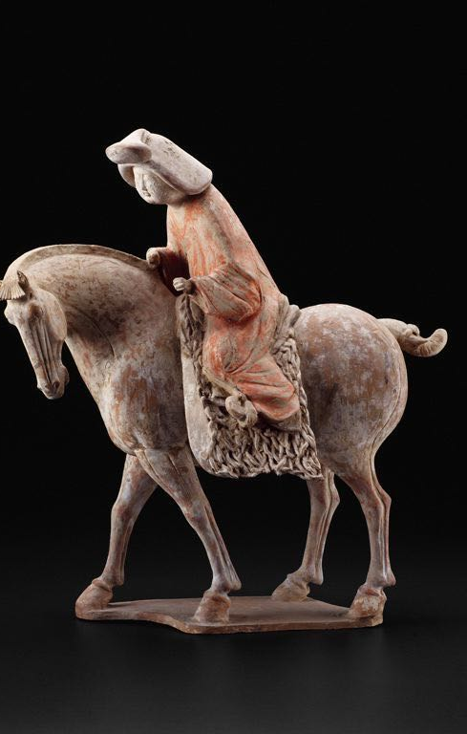
Tang dynasty (618-907) — Sancai, or three-colour ware
Sancai literally means three colours, but actually it’s a general term because you see examples of Sancai in which there are more than three colours. Usually these basic colours will be green, cream and amber — known as ‘egg and spinach’ in the West — but the glaze could also feature brown, blue and purple.

Slide 4
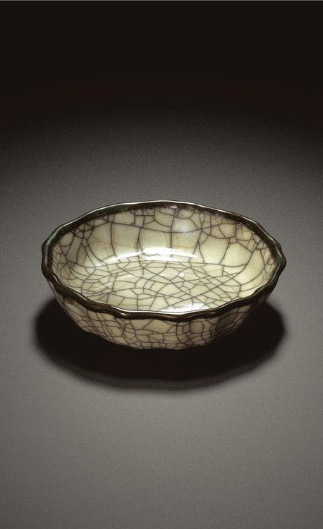

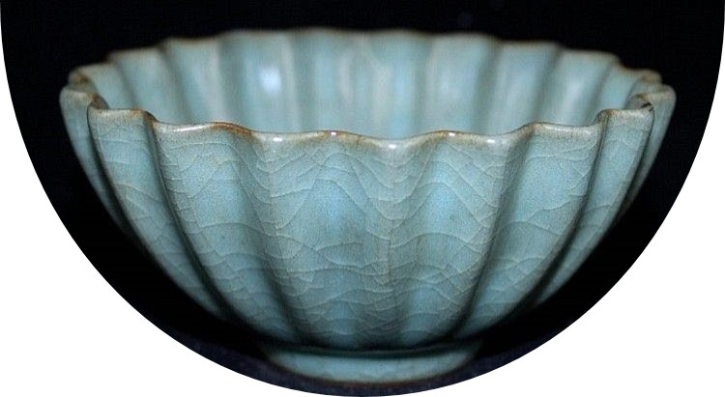


Song dynasty (960-1279)
The Song dynasty, in contrast to its predecessor, the Tang, is known for monochrome, very cool-toned glazes which resemble jade and silver, snow and ice.

Slide 5
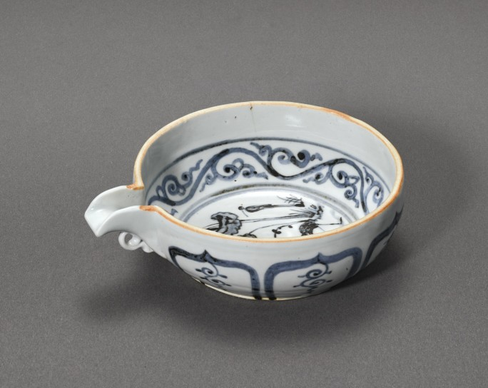
Did
You
know?
Yuan dynasty (1279–1368)
The large blue-and-white porcelains of the Yuan dynasty are amongst the most impressive and characteristic product of that period. Porcelains of this type, with their bold potting and elaborate cobalt-blue decorations, were exported all over Asia and highly sought after for their durability and suitability for Middle Eastern banquets.
One of the first Song Dynasty emperors named Zhenzong selected Jingdezhen in Jiangxi Province to be an imperial porcelain production center in the year 1004. It remained the main imperial production center for about 900 years until the end of the Qing era.

Slide 6
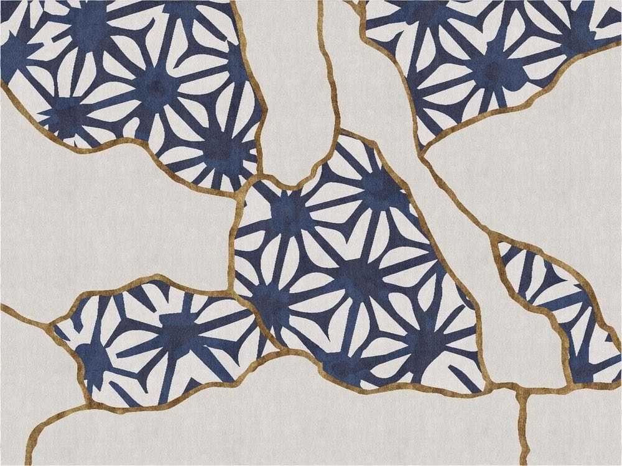
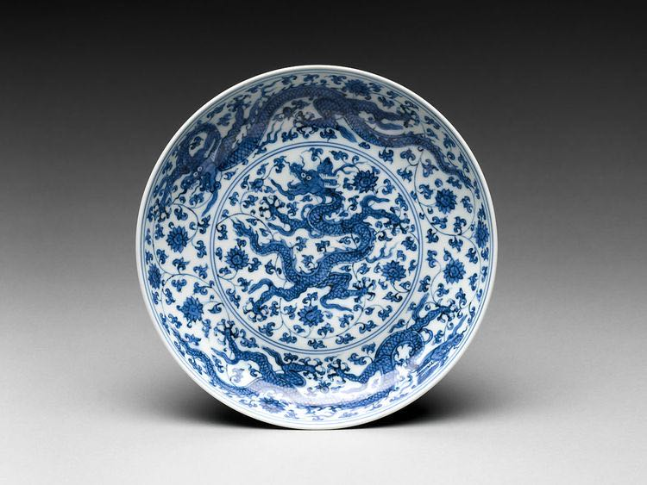
Ming dynasty (1368–1644)
No other period in China’s history is so closely associated with ceramic production than the Ming dynasty. Its porcelains have attained such recognition that the word “Ming” has almost become a generic term for any piece of Chinese ceramic created before the 20th century.

Slide 7
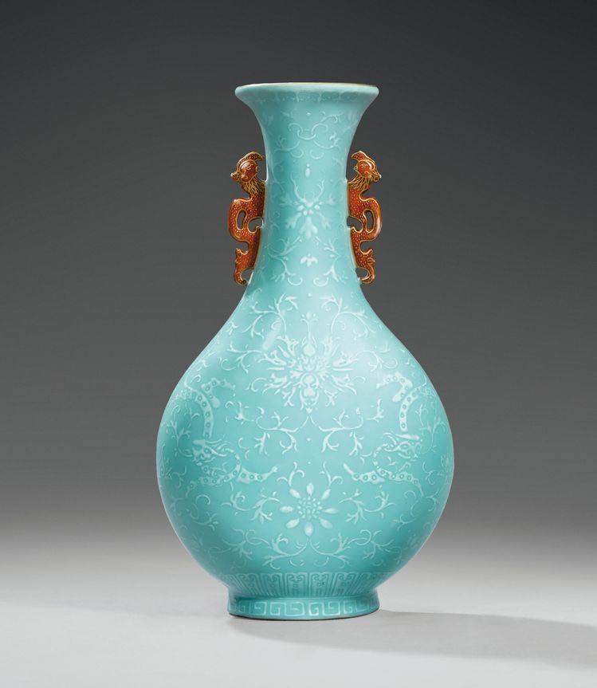
Qing dynasty (1644–1911)
Qing imperial porcelain workshops found inspiration from revered art objects throughout the history of China, including Ming ceramics, and combined it with ground-breaking developments in porcelain production to produce a vast quantity of high quality wares that were both innovative and classical.

Slide 8
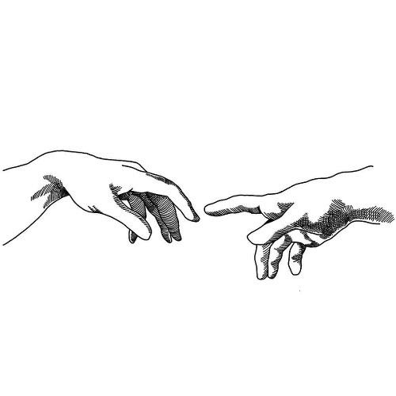
DIFFICULTIES
DURING
TRANSLATION
CULTURAL FACTORS - The impact of culture is very important and translators should have a certain knowledge of the culture they are translating with to encode, react and transmit the message correctly.
60%
MISSING WORDS - Not everything translates. For anyone looking to have documentation translated into a target language, that can be a scary prospect, but it's the straight up truth. While the majority of languages will have words and phrases for most things, there are always certain words and phrases that are just either totally different or missing entirely from target languages.
20%
MULTIPLE MEANINGS OF A SINGLE WORD - In various languages, there are words that have different meanings in the way the sentence is used but are spelled and pronounced alike. Some words also have different meanings and spelling but have similar pronunciation.
20%

Slide 9
THANK
YOU

