Slide 1
Money culture: The tradition of Red Envelope and Lucky Money
-- 赵喜珍

Slide 2
contents
The Introduction and The Legend
The Meaning of the Chinese New Year Red Envelopes and Lucky Money
Tips for Giving and Receiving a Red Envelope
Other Occasions for Red Envelopes

Slide 3
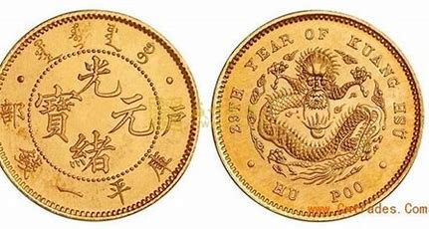
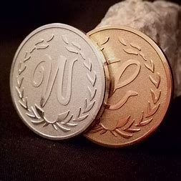
The Introduction
●red envelope：also called Red Packets, Lucky Money, or
Hóngbāo ( 红 包 ) in Chinese;
it appears in many occasions;
the Lunar New Year Festival;
wish good luck and share blessings
●The Lucky Money:began in the Han Dynasty;
small collectibles in the form of coins;
"worldwide peace" ( 天 下 太 平),
“longevity and fortune” ( 千秋万岁 );
dragons and phoenixes were common.

Slide 4
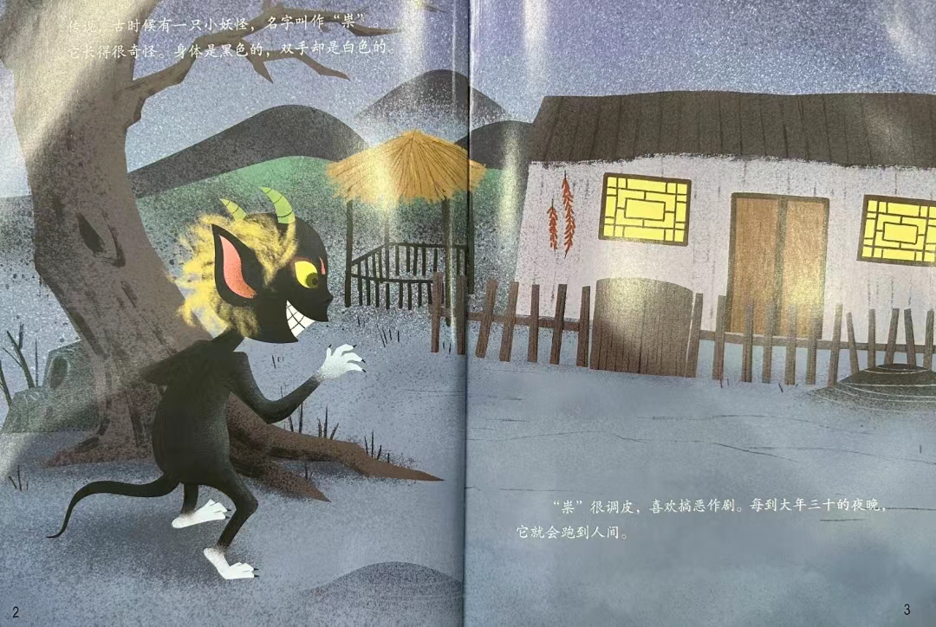
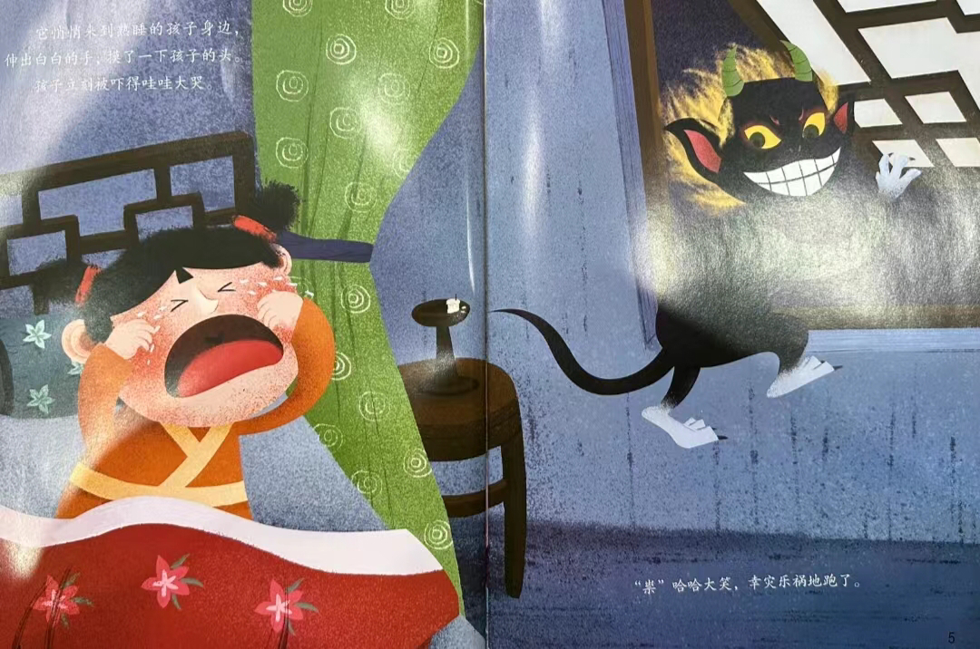
The legend

Slide 5
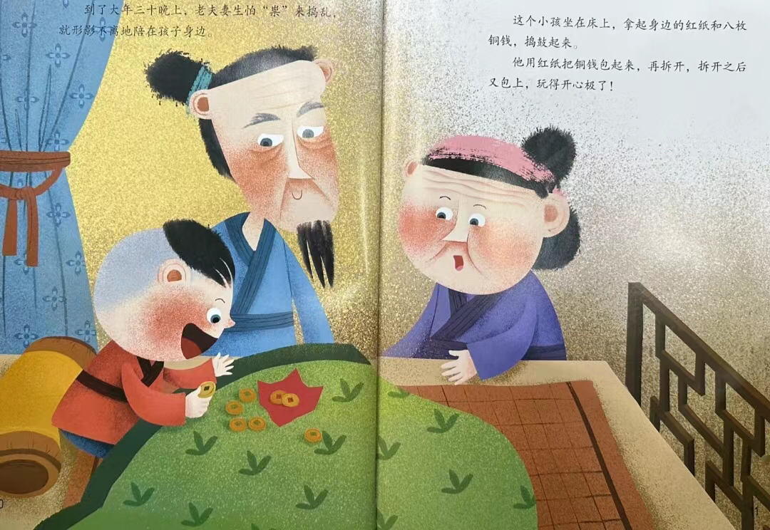
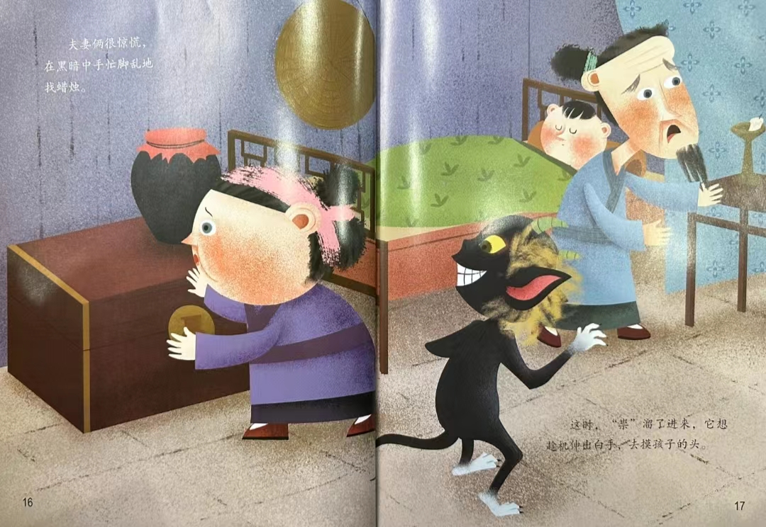
The legend

Slide 6
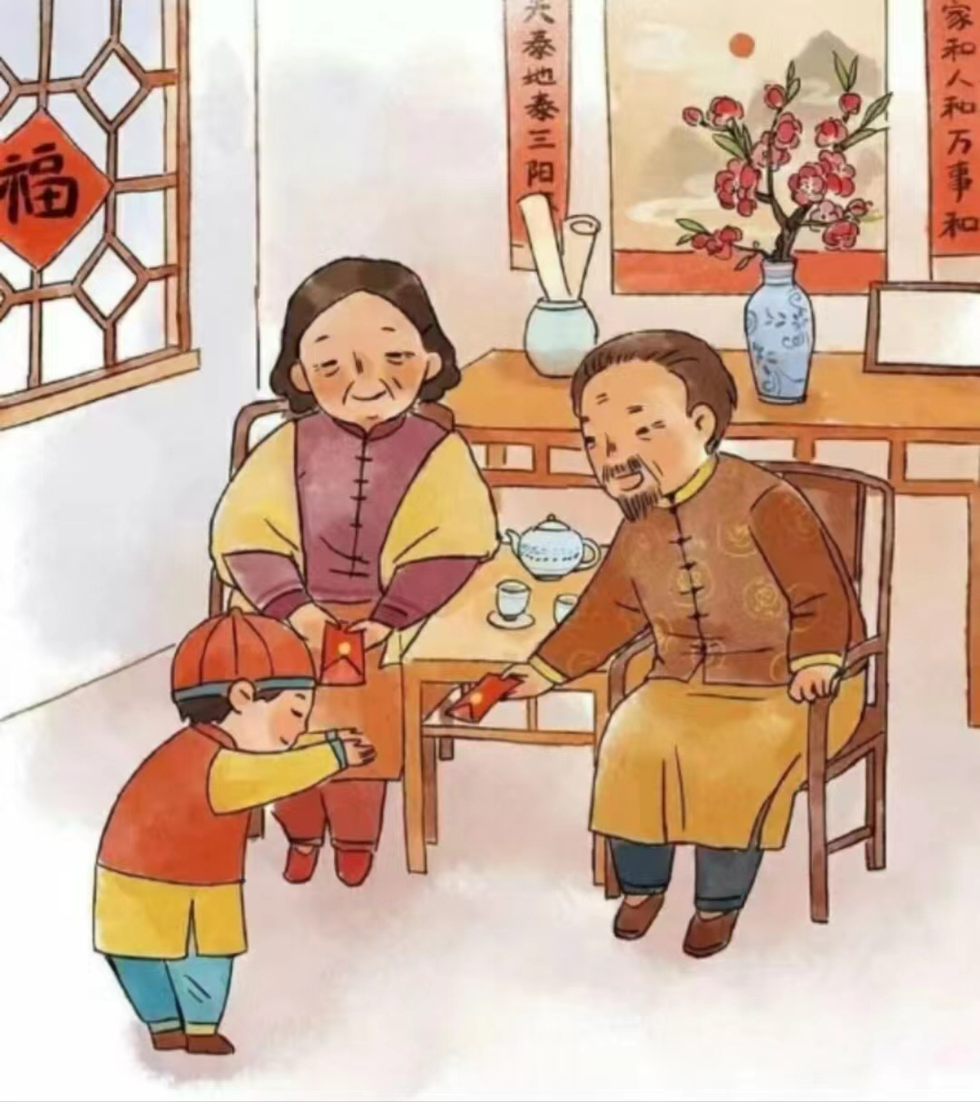
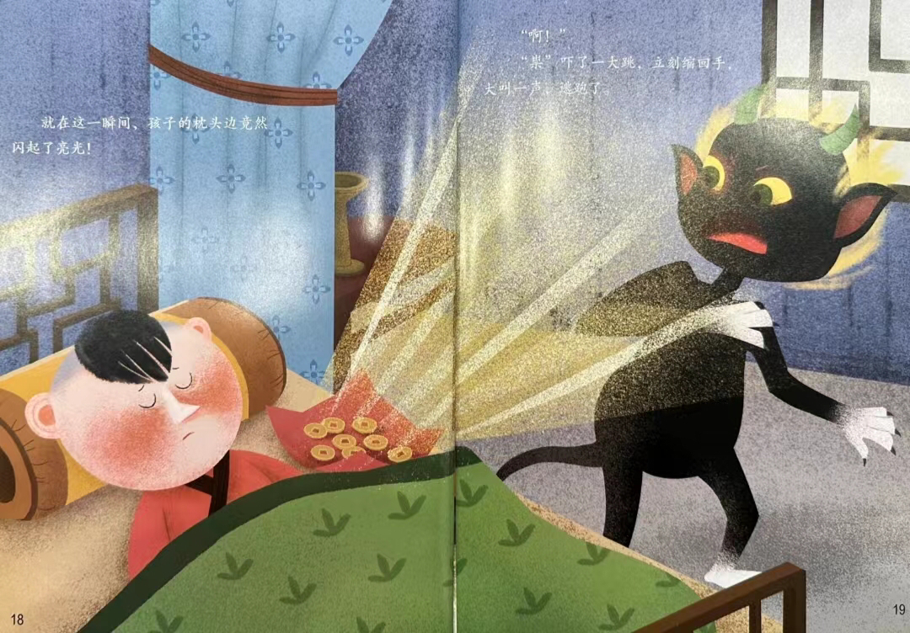
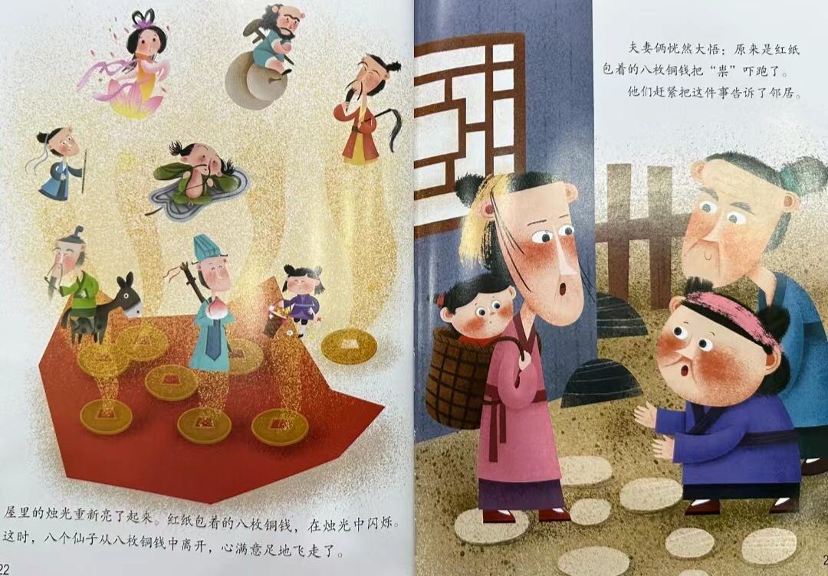
The legend

Slide 7
The Meaning of the Chinese New Year Red Envelopes
and Lucky Money
good luck, happiness, and health.
suppressing Sui money

Slide 8
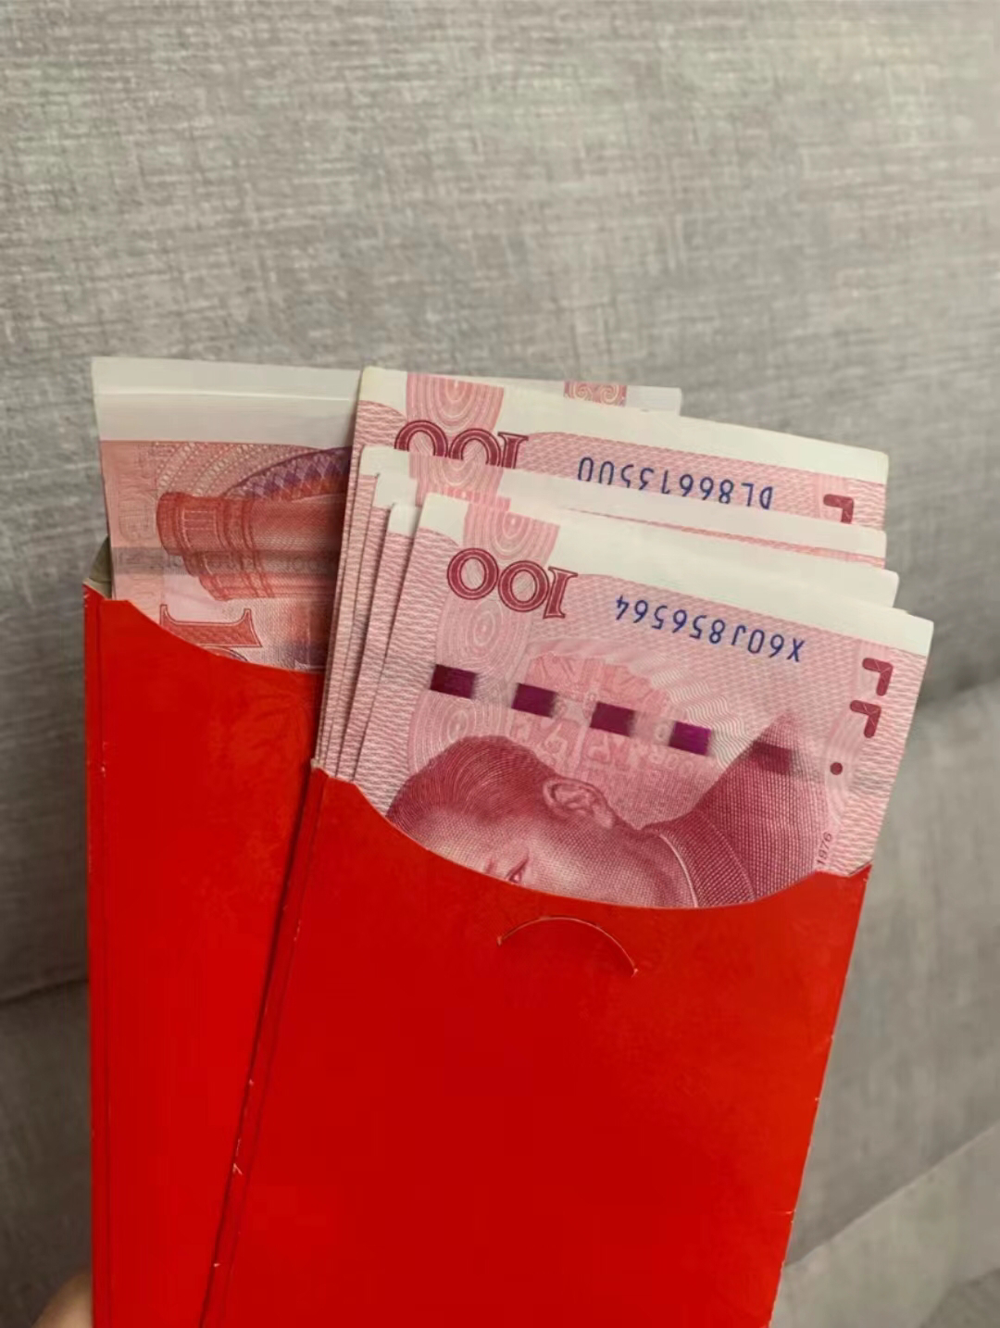
Tips for Giving and Receiving a Red Envelope
and Lucky Money
giving
Put crisp, new bills inside a Chinese New Year red envelope. Giving dirty or wrinkled bills is in bad taste.
Avoid putting coins in the envelopes.
Avoid giving amounts such as 40 yuan or 400 yuan.
·even numbers are better than odd.
·nine (Chinese: 九) is homophonous to the
word long (久)

Slide 9
Tips for Giving and Receiving a Red Envelope
and Lucky Money
receiving
Receive with both hands.
Express thanks and greet the giver with a pleasing, auspicious phrase, such as 恭喜发财 (gōng xǐ fā cái, meaning ‘happiness and prosperity’).
Never open your red envelope in front of the person who just gave it to you.

Slide 10
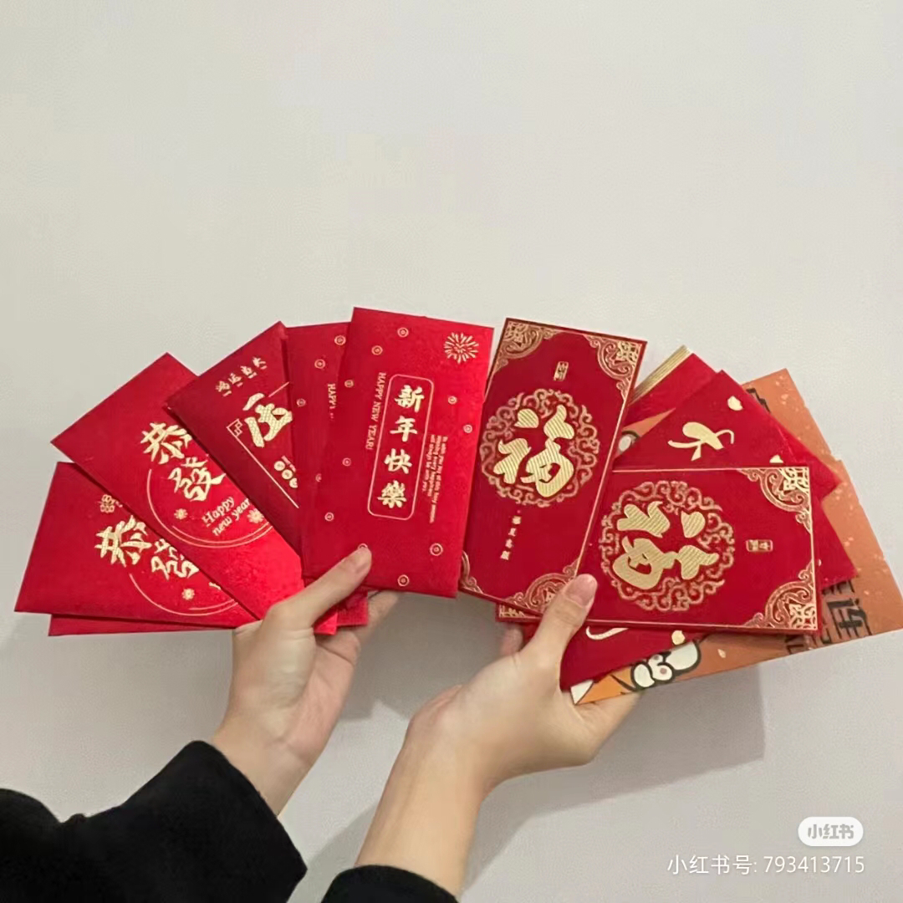
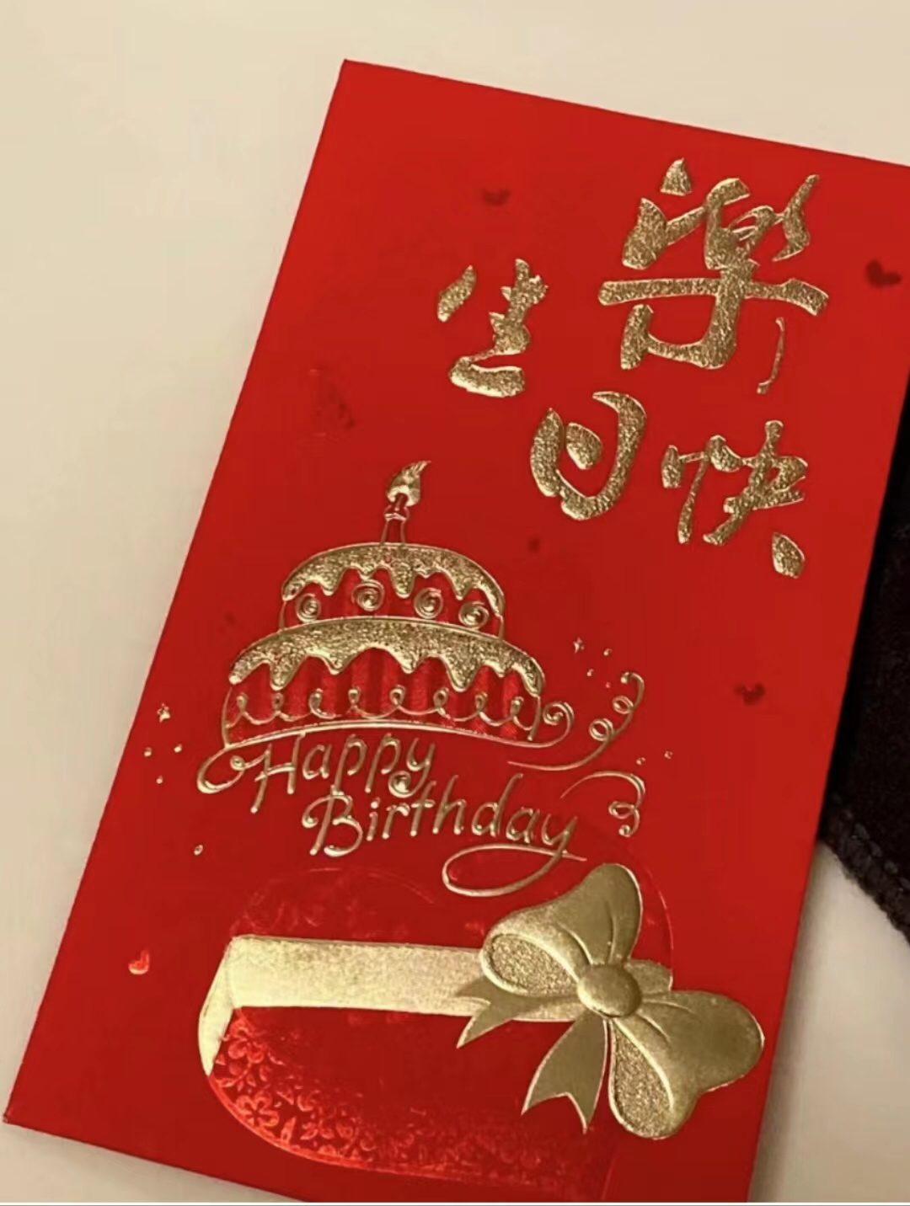
Other Occasions for Red Envelopes
For Chinese New Year, use red envelopes featuring Chinese characters such as福 (fú, meaning 'good luck and blessings'), 恭喜发财 (gōng xǐ fā cái, meaning 'happiness and prosperity'), and 新年快乐 (Xīn Nián kuàilè, meaning 'happy New Year‘).
For birthday parties, use red envelopes featuring Chinese characters such as 寿 (shòu, meaning ‘longevity’) and 生日快乐 (shēng rì kuài lè, meaning 'happy birthday').

Slide 11
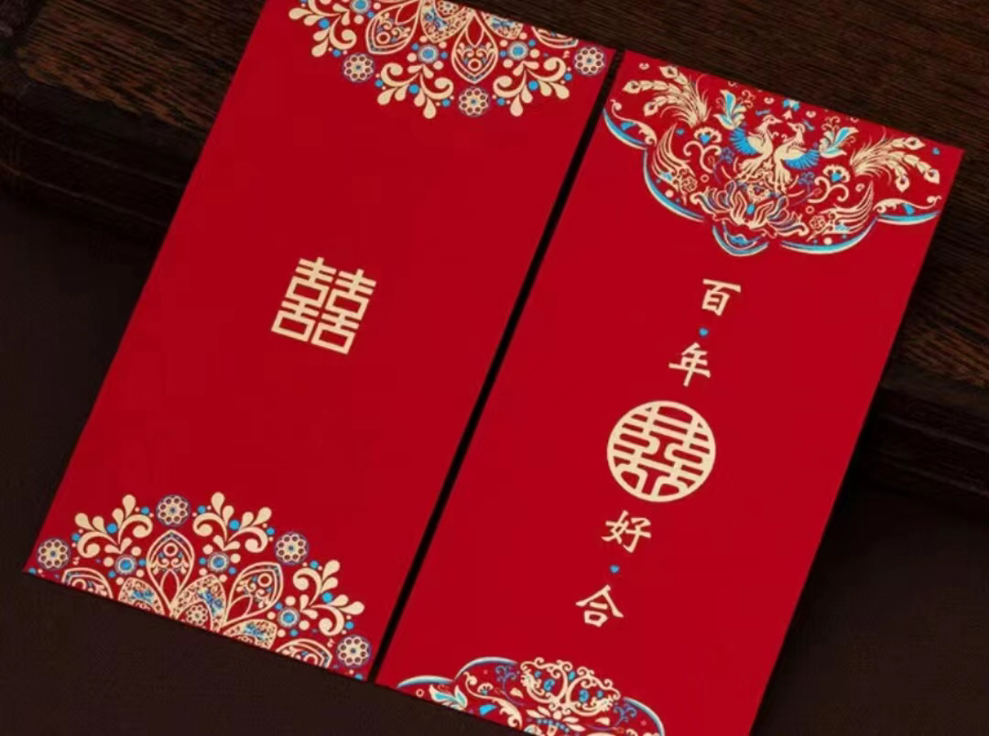
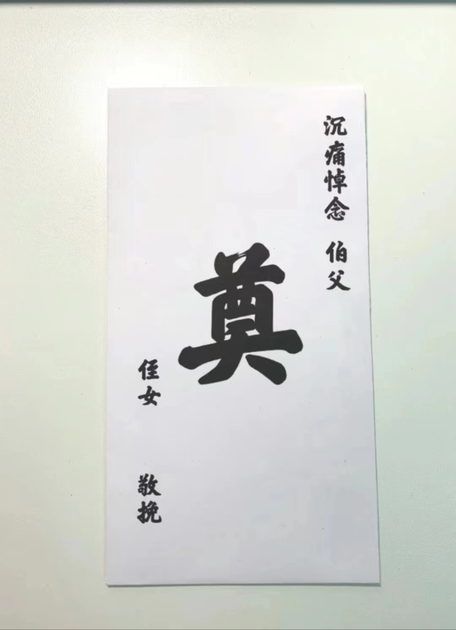
Other Occasions for Red Envelopes
For weddings, use red envelopes featuring Chinese characters such as囍 ("doublexǐ", meaning 'double happiness') and 百年好合 (bǎi nián hǎo hé, meaning [may you] 'live together happily for a hundred years, i.e. a longtime').
For funerals, white envelopes are often used and the character is usually 奠(diàn, meaning 'make offerings to the spirits of the dead').

Slide 12
Thanks for listening

