Slide 1



Attractiveness of Chinese Classics
as part of softpower

Slide 2

01: What is softpower
02: Attractiveness of Chinese Classics
03: The dilemma of Chinese classics at present
04：How to disseminate Chinese classics to the world
Content

Slide 3

What is softpower
Soft power is relative to hard power such as GDP and urban infrastructure, and refers to a country's culture, values, social system and other factors that affect its own development potential and appeal. Joseph Nye, a Harvard professor, coined the concept of "soft power"
"Soft power" mainly includes the following aspects:
First, the attraction and appeal of culture.
The second is the appeal of ideology and political values.
Third, the morality and legitimacy of China's foreign policy.
Fourth, affinity in handling state-to-state relations.
Fifth, the attractiveness of development paths and institutional models.
Sixth, the ability to guide, formulate and control international norms, standards and mechanisms.
Seventh, the degree of appreciation and recognition of a country's international image by international public opinion.

Slide 4

Attractiveness of Chinese Classics
China is a country of poetry, from "The Book of Songs", "Songs of Chu" to Tao Yuanming, Li Bai, Du Fu, up to the Song, Yuan, Ming and Qing dynasties, there are many elegant, delicate, beautiful masterpieces.
At the same time, China is also a country of prose, as early as in the pre-Qin period, there appeared as Zhuangzi's boundless, unrestrained, as unrestrained as the magnificent works, and as Mencius's, as the Yangtze River rolling, vigorous and powerful grand prose.
Later, there were masterpieces like Sima Qian's "Records of the Grand Historian" and meaningful sketches like Liu Yiqing's "New Sayings of the World".
Since then, although there have been changes in the dynasty, the rise and fall of the state, but "jiangshan generation has talented people", ancient readers can be said to be immersed in these poems from childhood, day and night, imperceptible, the essence of these famous pieces, almost become a part of their respective feelings.
The reason why China can become a country of rites and ceremonies with a great diversity of people and a world renowned ancient civilization is closely related to these long standing and colorful poetic traditions.

Slide 5
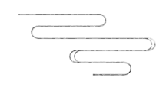



The dilemma of Chinese classics at present
The ability to inherit and carry forward innovation is relatively weak,and the level of activation and utilization needs to be improved
The modern discourse expression of contemporary culture makes the inheritance and development of classical discourse of traditional culture encounter difficulties
The disconnection
with contemporary
Chinese culture
is quite serious
The ways and means
of inheritance
and promotion
are relatively single
Ⅱ
Ⅲ
Ⅰ
Ⅳ

Slide 6
How to disseminate Chinese classics to the world

Slide 7
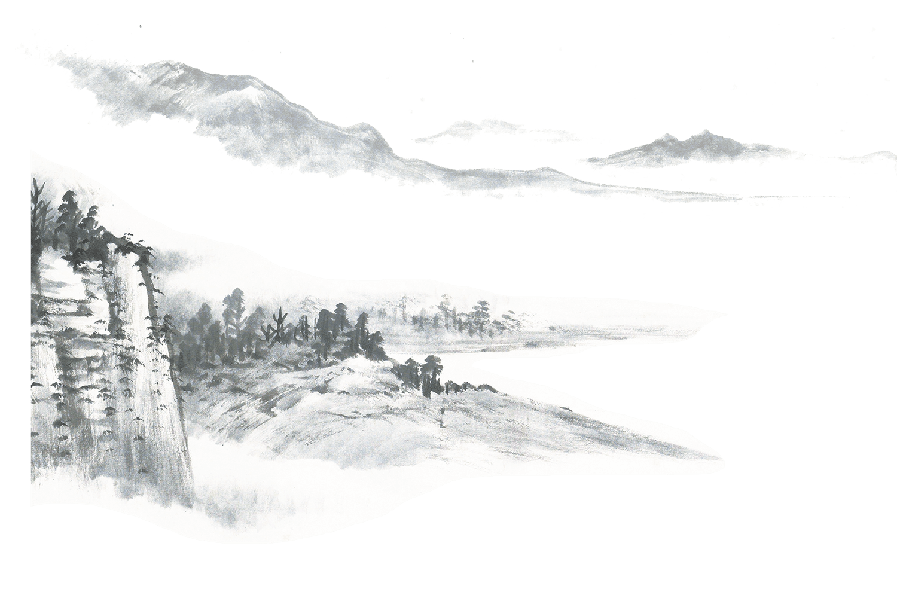
Ⅰ. To meet the needs of cultural communication, to create a new mode of cooperation.
Translation of classics work in our country is still in the condition of lack of systemic goals, in order to effectively plan and implement translation work, we can organize large translation from the national level and research projects, integrated national functional departments, publication editing and translation studies departments tripartite strength, to carry out large-scale translation publishing activities.
We should attach particular importance to sino-foreign cooperation. China may set up special funds to finance scholars undertaking foreign translation projects to pursue advanced studies in Western Sinology institutions. At the same time, attract foreign scholars to participate in the translation of Chinese works, so that domestic writers and scholars try to cooperate with foreign translators.

Slide 8
Ⅱ. Broaden the field of translation and coordinate the works to be translated.
Translators need to re-understand Chinese culture and its position in the world cultural pattern, and reflect comprehensively and deeply from the height of cultural strategy with a modern academic perspective
First, in terms of ethnic distribution, translators pay insufficient attention to the cultural classics of ethnic minorities.
Secondly, in terms of chronological distribution, the translator pays more attention to the pre-Qin classics and pays less attention to the post-Qin classics.
Thirdly, in terms of translation categories, translators pay uneven attention to translation categories. Literary classics are the focus of their research, followed by ideological classics, while other types of classic books are less concerned.

Slide 9
Ⅲ. the translation scheme should be adjusted for the foreign public.
In order to meet the different needs of foreign readers to understand Chinese culture, we should adopt different translation schemes and launch different versions according to different levels of target audiences.
For example, for young children, some easy to understand, interesting and illustrated translation can be published, or make some audio books and audio and video products. For the general public, we should launch some readable and popular versions.

Slide 10
Ⅳ.Go deep into overseas markets and promote Chinese cultural classics
Chinese cultural classics cannot go abroad, largely because China does not understand the publishing trend of the international market.
Therefore, we should make clear the foreign publishing and distribution system, organize expert teams to investigate overseas markets and overseas readers, and study the history of translation and overseas dissemination of classic books.
We should select topics according to different needs of readers, and adjust book format and binding according to the reading habits of readers in different countries.

Slide 11

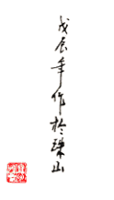

Conclusion
With the enhancement of China's comprehensive national strength, under the request of enhancing national cultural soft power, it is a great undertaking that Chinese cultural classics should go abroad. It needs strong support and guidance from the Party and the government, as well as cooperation from the translation, academic and publishing circles to jointly build a project of Translating Chinese cultural classics into English, so as to spread Chinese culture to every corner of the world and contribute to the progress of human civilization.

Slide 12
Thank you for your time!

