Slide 1
中國語言文化
Session 10, Thursday Nov 14, 2024, Zhishan Bldg. 至善楼105, room 105
Martin Woesler

Slide 2
TOPICS
Field research: Daily entries => You can see your oral contribution grade on the wiki website and also your
加分

Slide 3
TOPICS
189. Vintage Clothing p.1697 (Hu Shanshan/Maddy)
191. Flowers p. 1712（Chen Weiping/Jackie)
193. Buytogether（PDD) p. 1729（Wang Yujiao/Wendy)
194. Tujia: Marriage, Burial Customs p.1748 Jiao Mengting/Sherry
195. Breakfast Culture of Guangdong p. 1753（Wu Ziyi/Andrew)
196. Become a Farmer p. 1765（Sha Lijia/Reika)
197. Chinese Rural Dogs p. 1773 (Zhao Jing/winnie)

Slide 4

189. Vintage Clothing p.1697 (Hu Shanshan/Maddy)

Slide 5
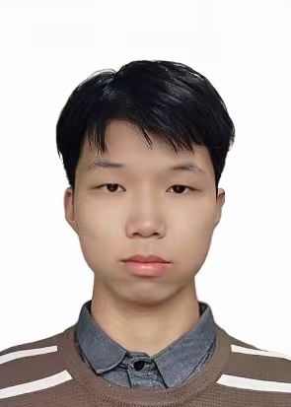
191. Flowers p. 1712（Chen Weiping/Jackie)

Slide 6
193. Buytogether（PDD) p. 1729（Wang Yujiao/Wendy)

Slide 7
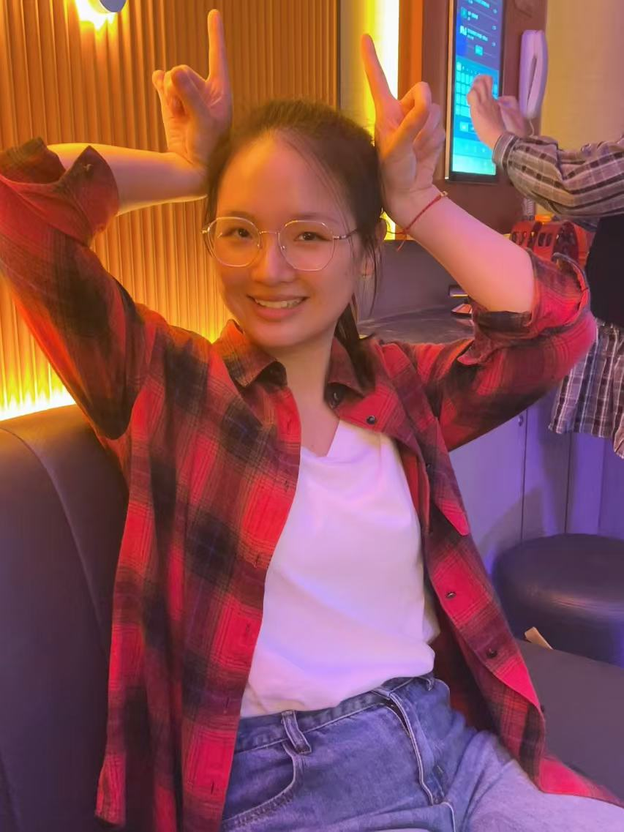
194. Tujia: Marriage, Burial Customs p.1748 Jiao Mengting/Sherry

Slide 8
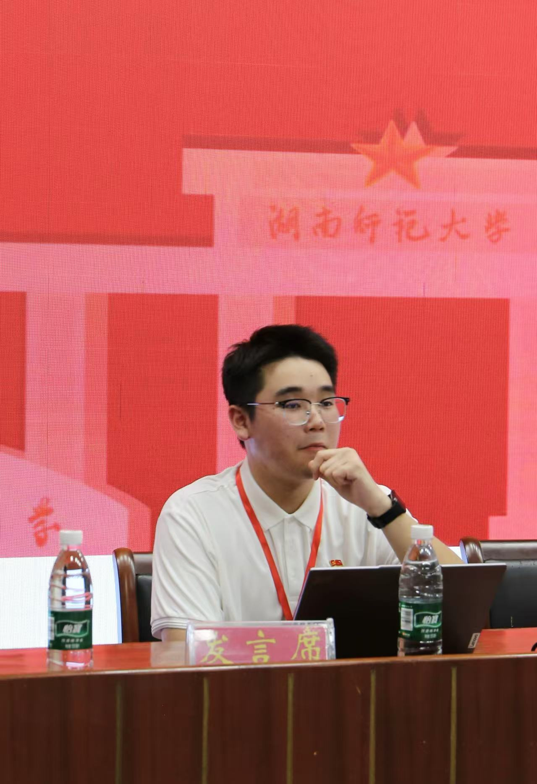
195. Breakfast Culture of Guangdong p. 1753（Wu Ziyi/Andrew)

Slide 9
196. Become a Farmer p. 1765（Sha Lijia/Reika)

Slide 10
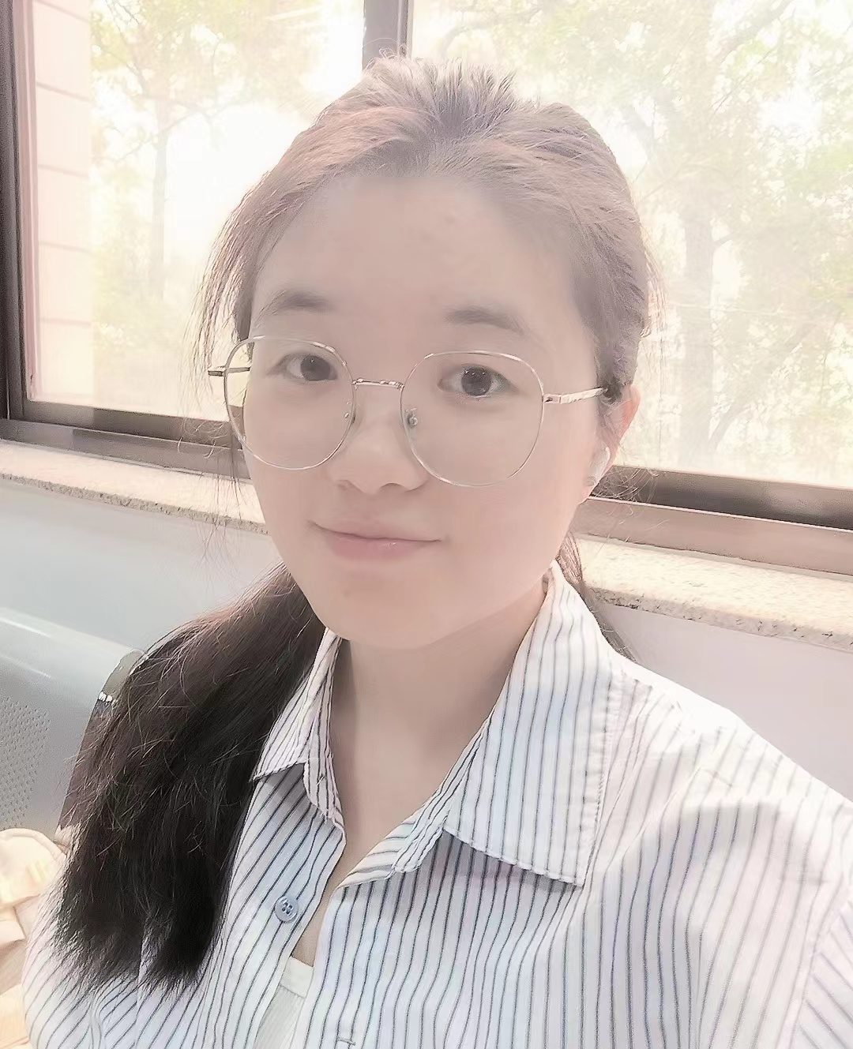
197. Chinese Rural Dogs p. 1773 (Zhao Jing/Winnie)

Slide 11
Prepare for next time
Homework:
1. Please read the six texts for next time in the textbook.
2. Please add your final exam paper topic and your name in the respective section above.
3. Take the surveys (EU: https://wn8ae3qwafbc11zv.mikecrm.com/9gdWrQT
, 2024: https://wn8ae3qwafbc11zv.mikecrm.com/CTrdOjm).

Slide 12
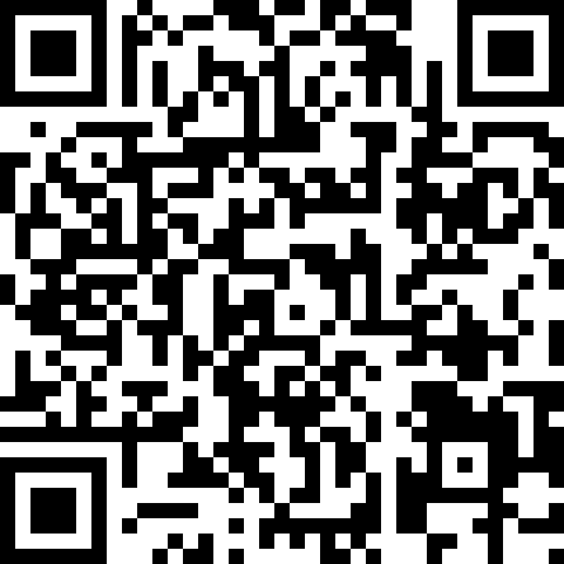
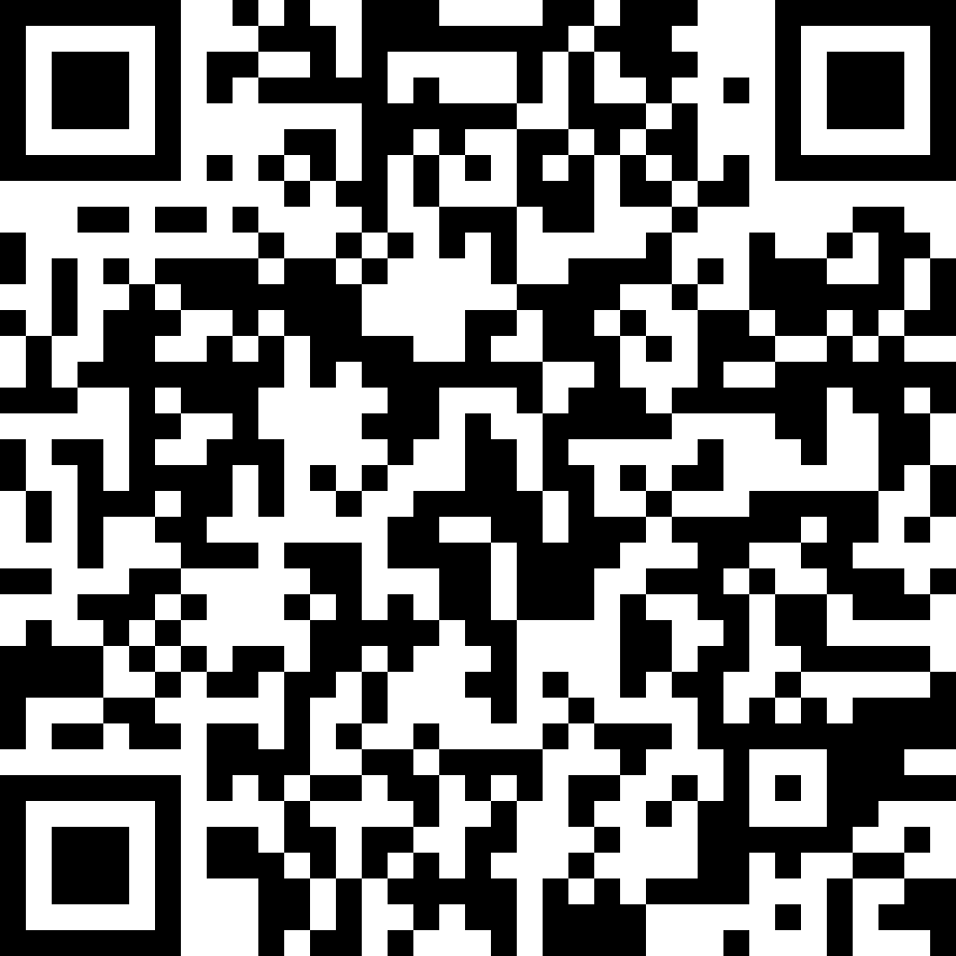
Questionnaires
EU
https://wn8ae3qwafbc11zv.mikecrm.com/9gdWrQT
2024 https://wn8ae3qwafbc11zv.mikecrm.com/CTrdOjm

