Slide 1
“GUO ZAO”
Major Life Events in WuHan city
Rebecca

Slide 2
Table of contents
01
02
What is "Guo Zao"?
How Did This Culture Emerge?
03
04
Wuhan Guozao vs.
Guangzhou Dim Sum
What they eat for Guo Zao?
05
What makes Guo zao unique?

Slide 3
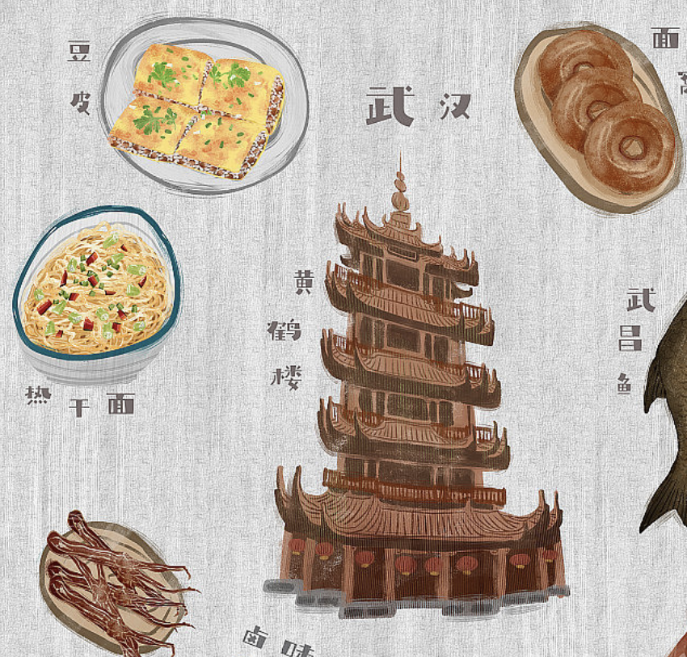
01
What is
"Guo Zao?"

Slide 4
What is "Guo Zao?"
《漢口竹枝詞》
三天過早異平常，
一頓狼吞飯可忘。
切麵豆絲乾線粉，
魚滲元子滾雞湯。

Slide 5
What is "Guo Zao?"
过节 过生日 过年
"过" conveys a sense of ceremony, indicating that breakfast is a significant part of daily life for Wuhan residents.
"早" highlights the importance of the morning meal, making it clear that breakfast holds cultural value.

Slide 6
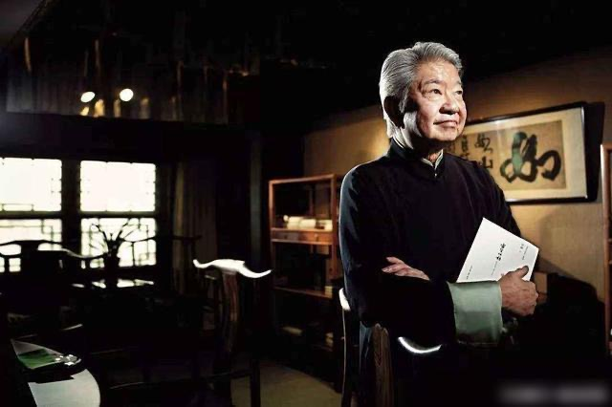
蔡澜
「處處的早餐文化，因生活優裕而消失之中，武漢的街頭巷尾還在賣，我將之冠上早餐之都。」

Slide 7
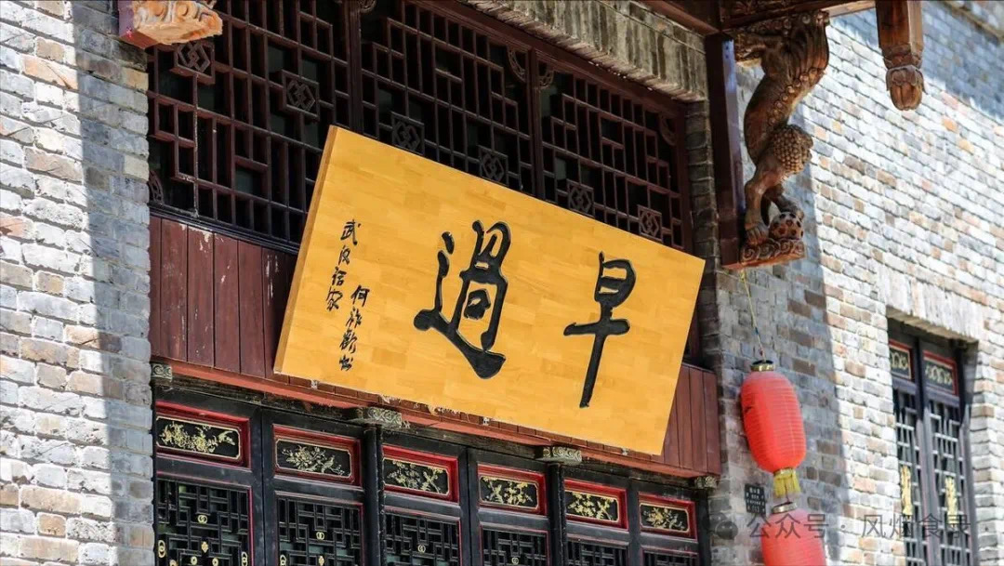
How Did This Culture Emerge?

Slide 8
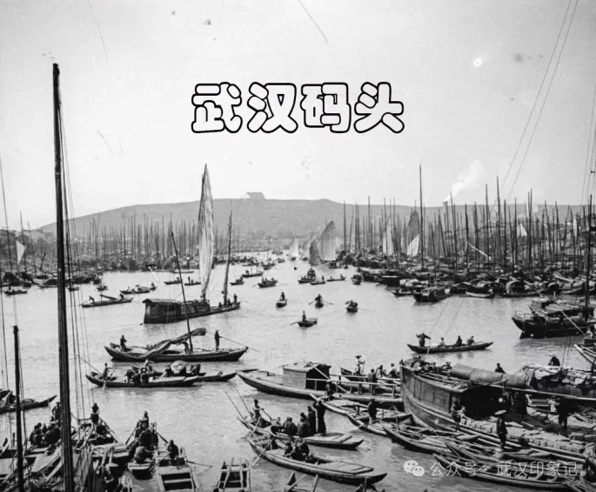
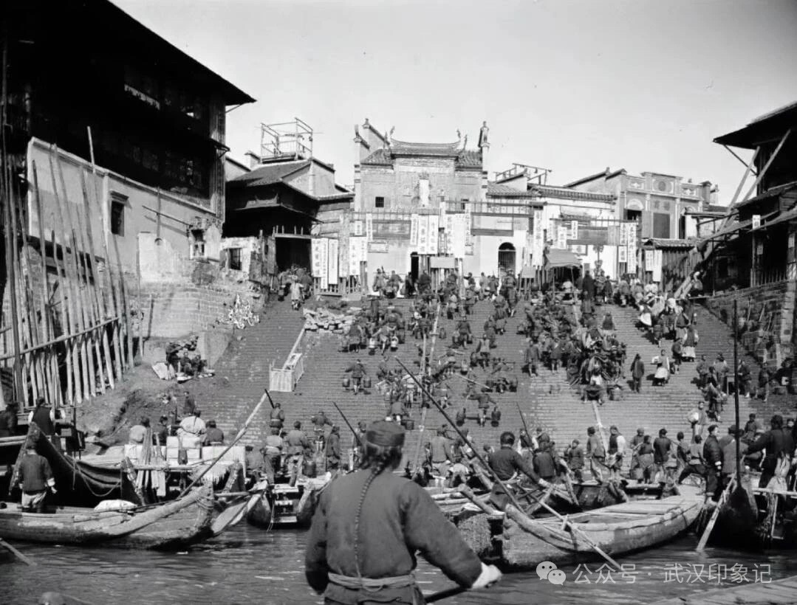
The Role of the Docks

Slide 9
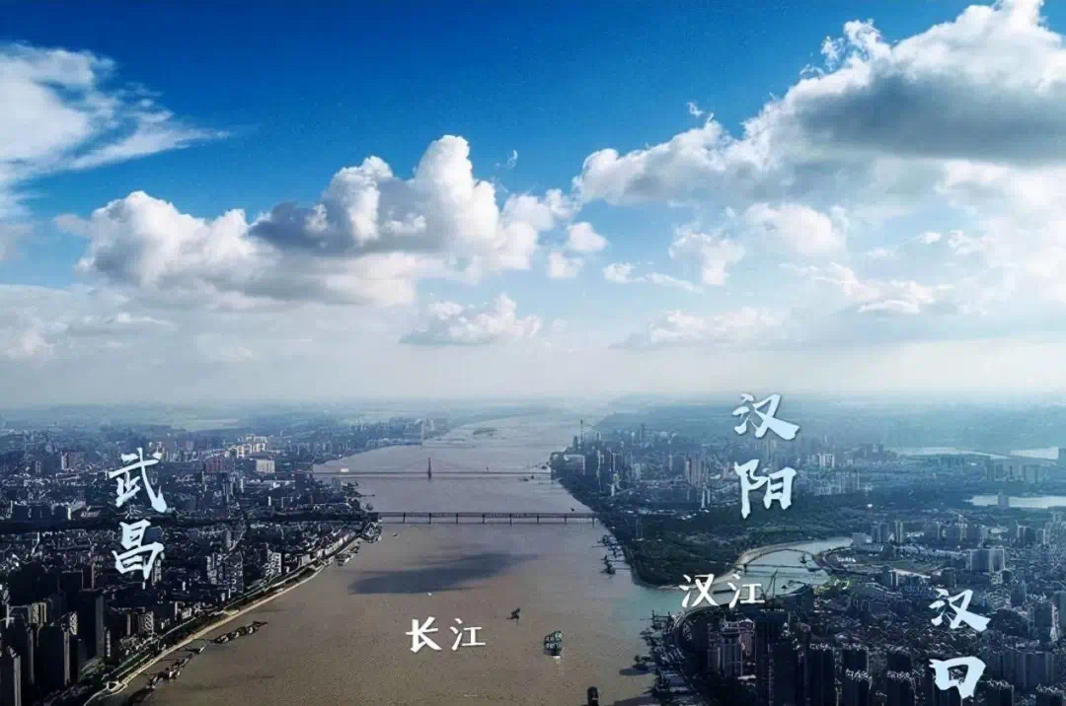
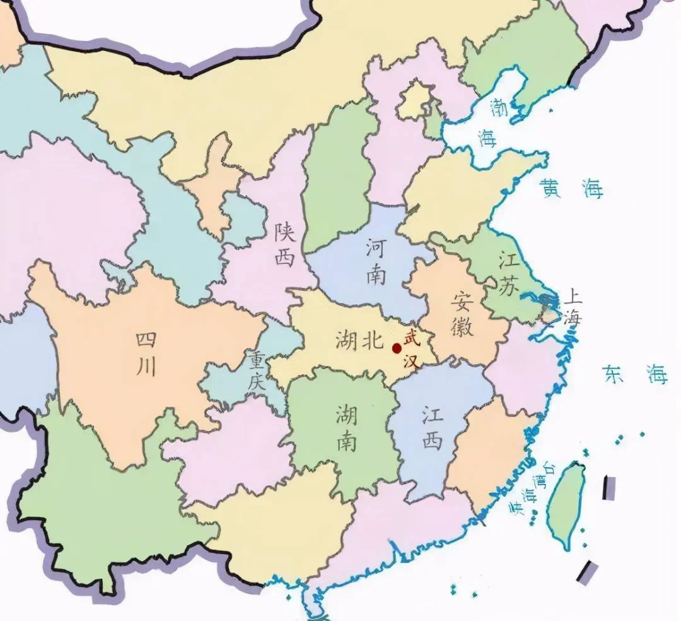
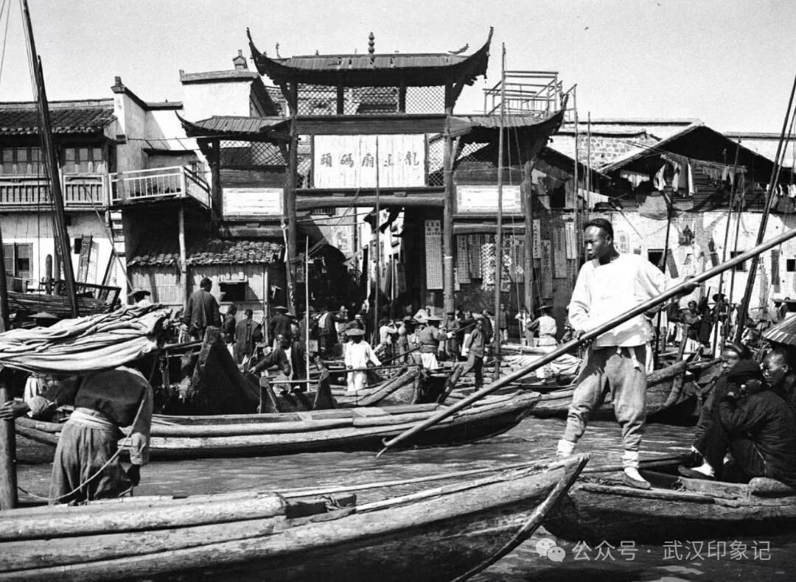
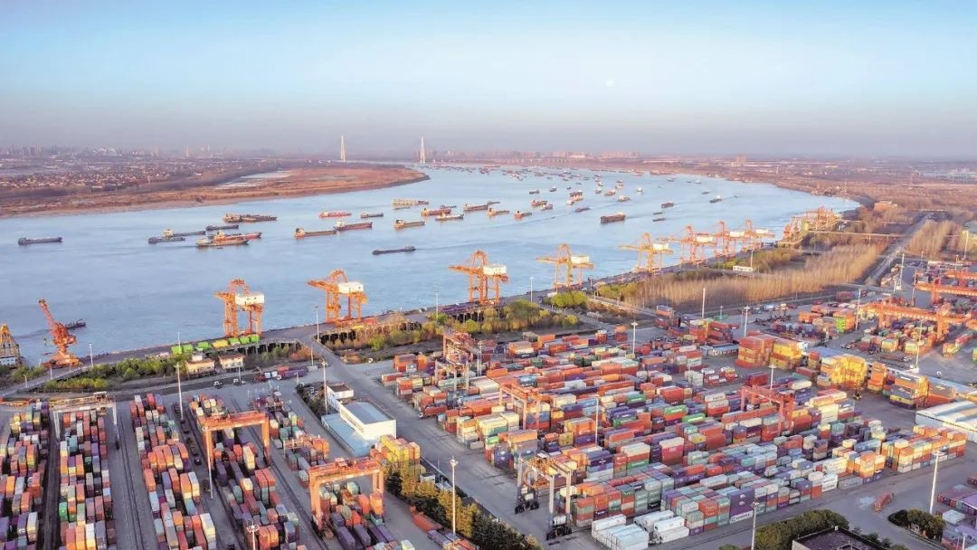
This is a timeline
01
02
03
04
The period of Yangtze River port cities
(from the Eastern Han to the Ming Dynasty).
The period of international comprehensive transportation hubs (1949 to the present).
The period of international commercial ports (1861–1949)
The period of the Nine Provinces Thoroughfare (mid-Ming to late Qing).

Slide 10
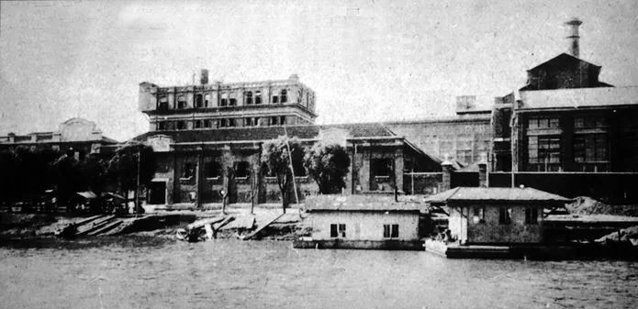
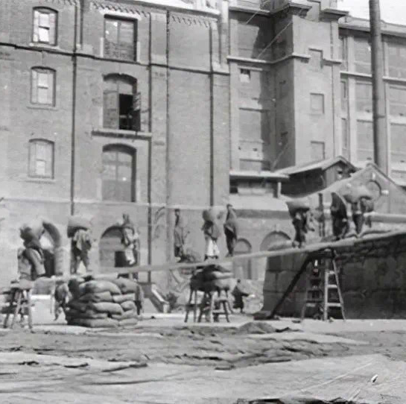
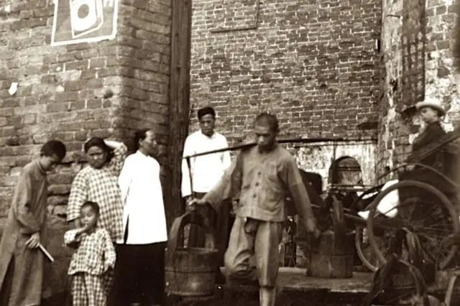
The Role of the Docks
low proportion of women
the development of machine flour milling.
Dock work demands high punctuality

Slide 11
Guo Zao?
What they eat for

Slide 12
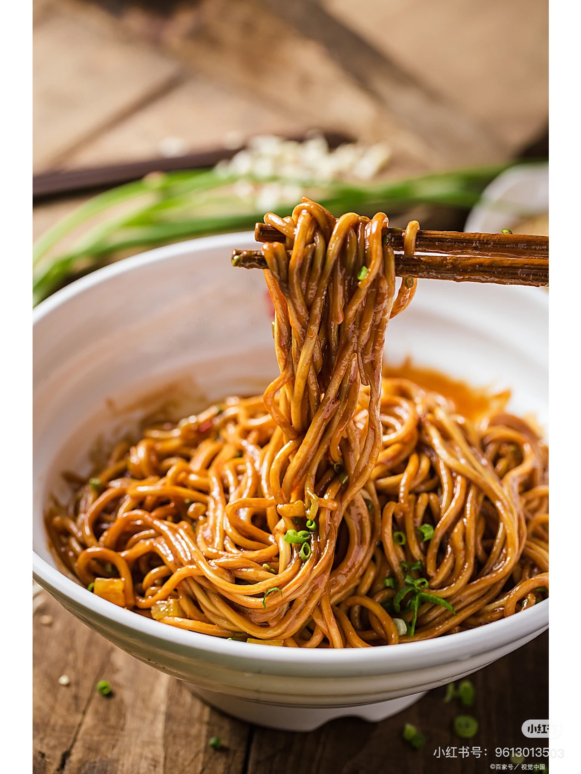
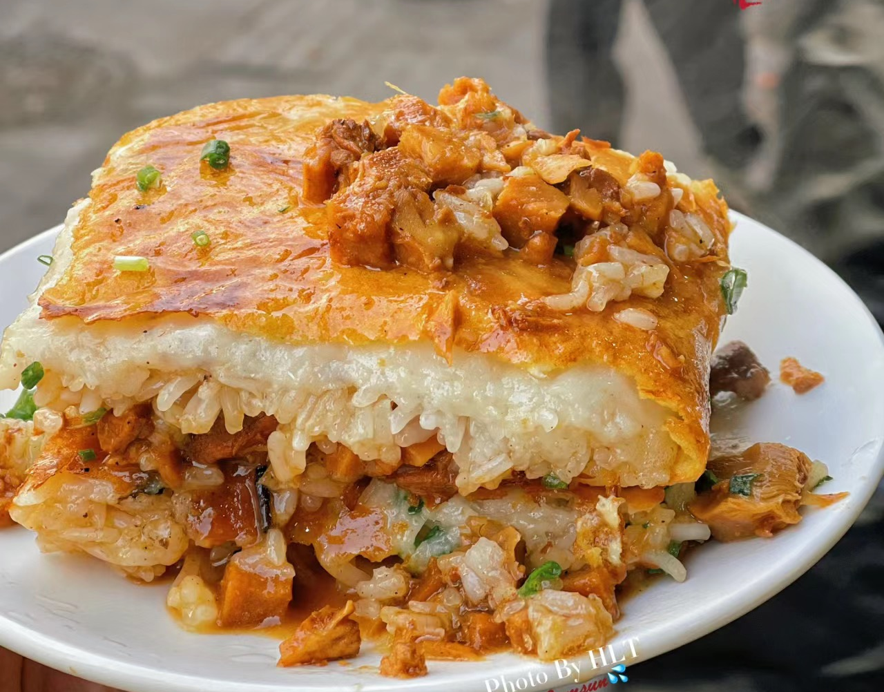
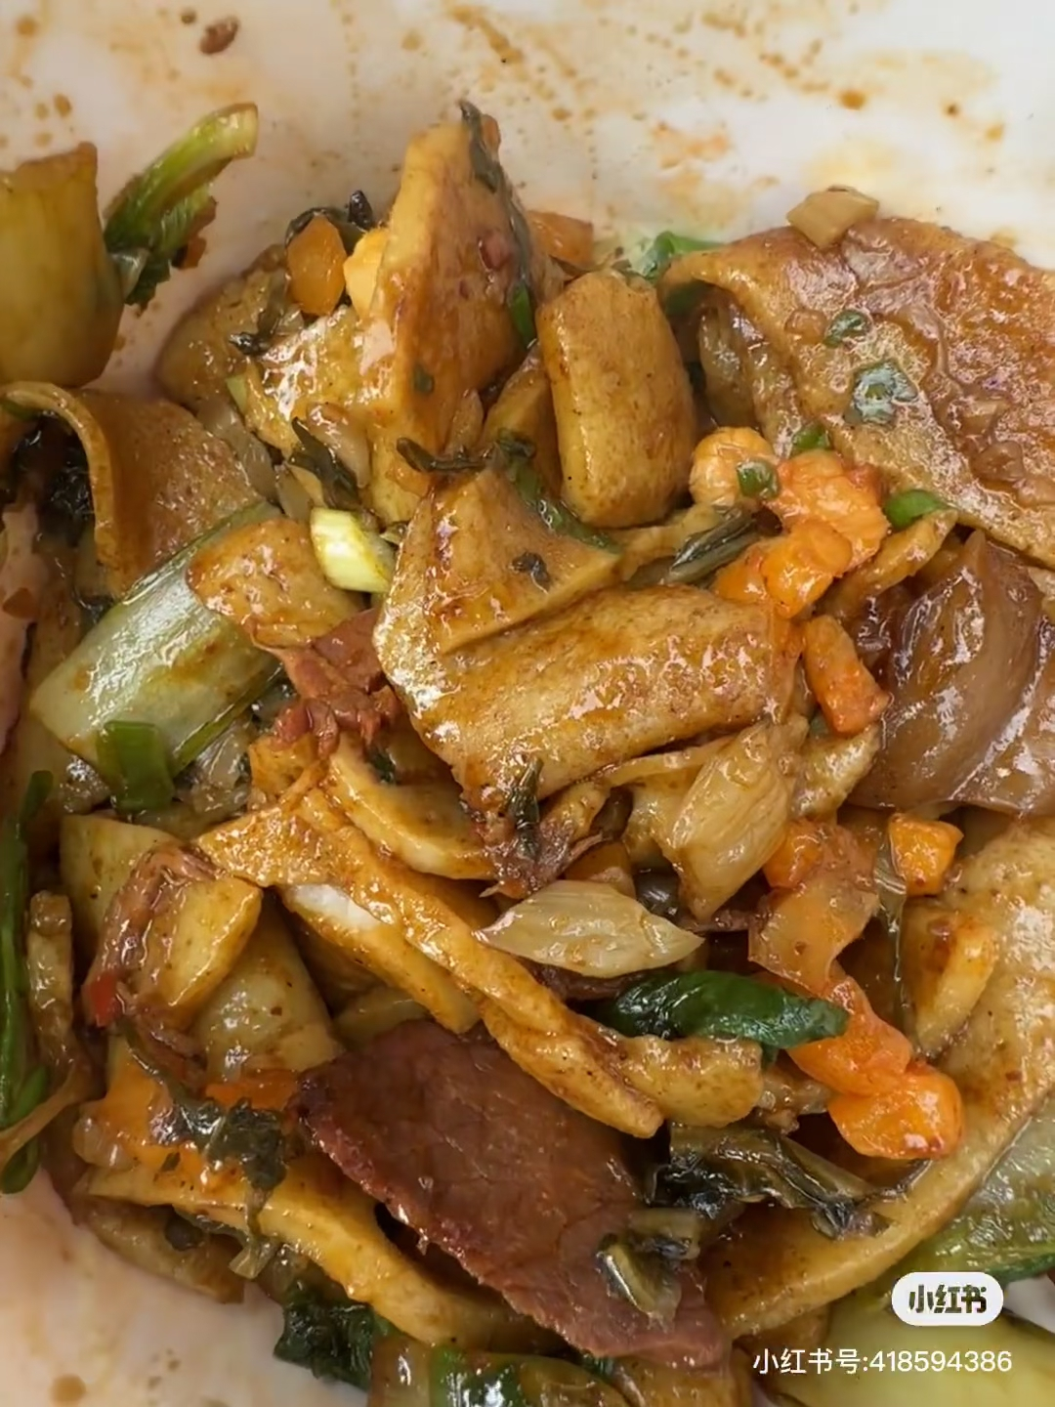
What they eat for Guo Zao?
01
Hot Dry Noodles
02
Bean Curd Skin
03
Bean Thread Noodles

Slide 13
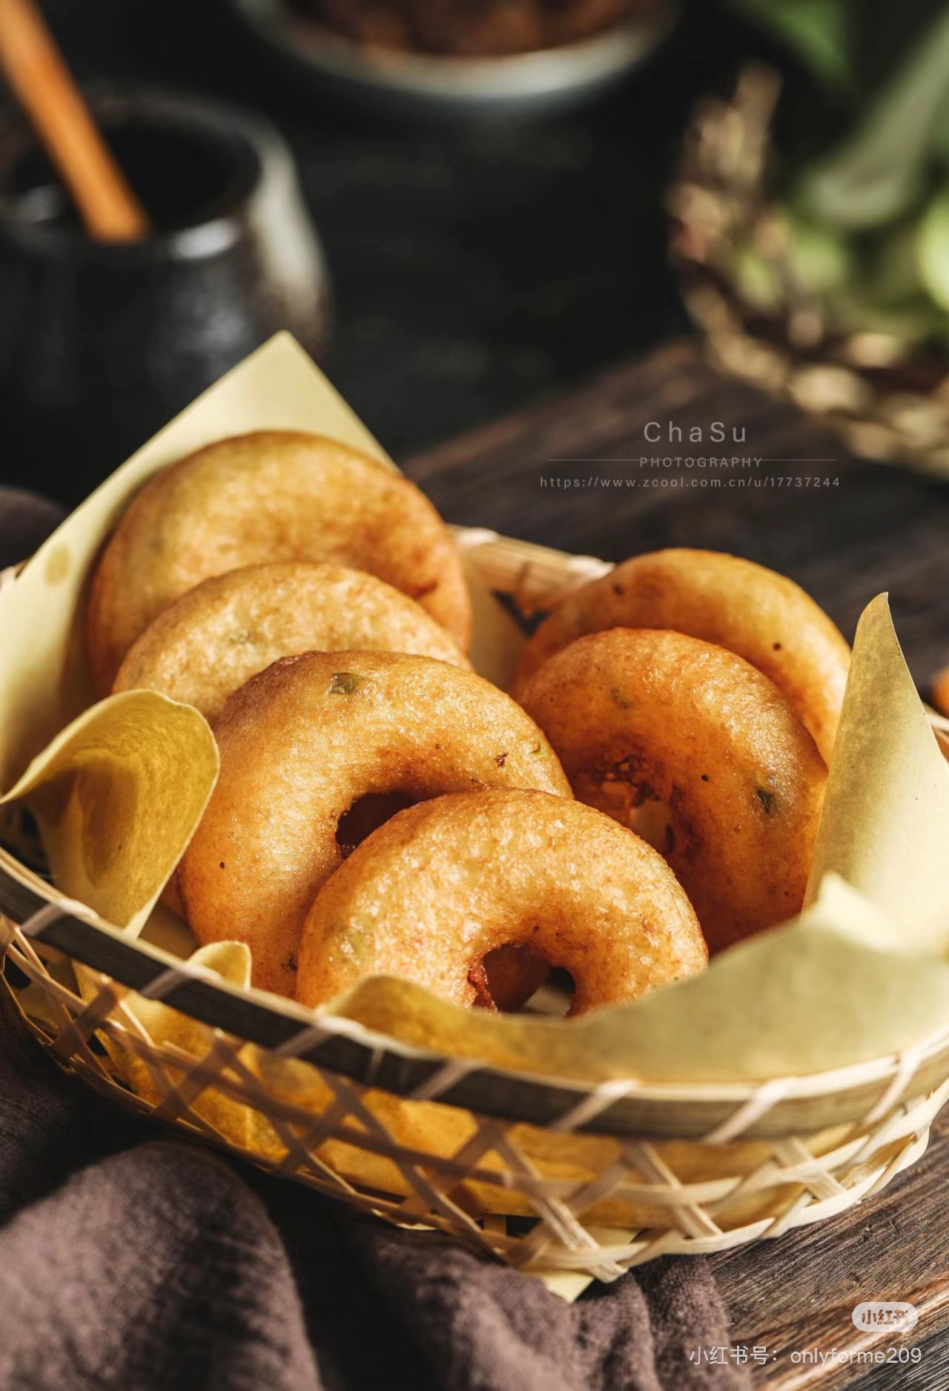
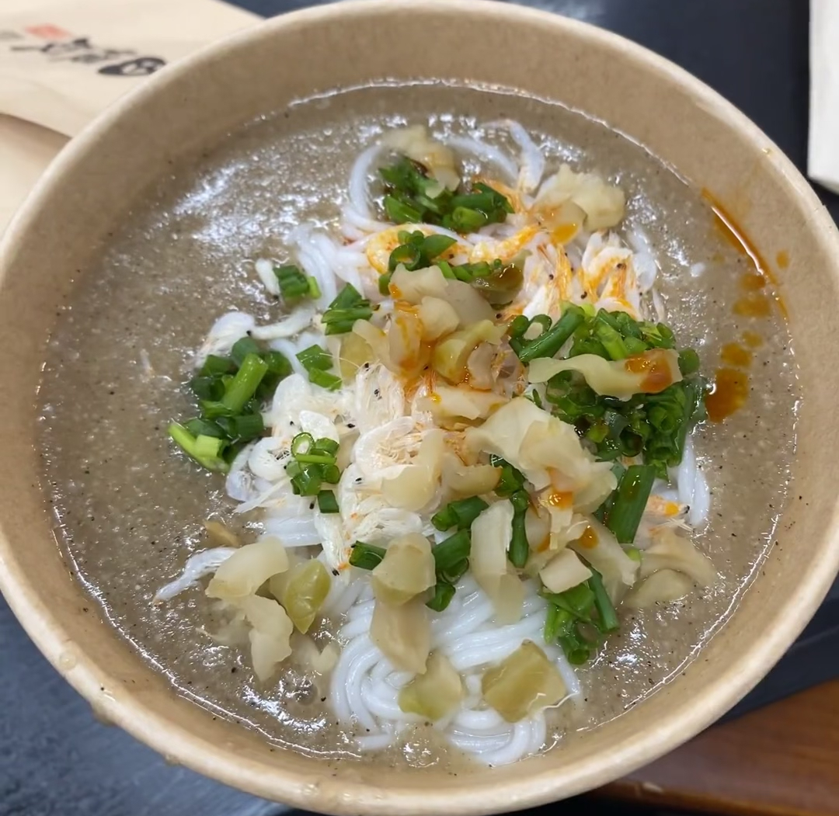
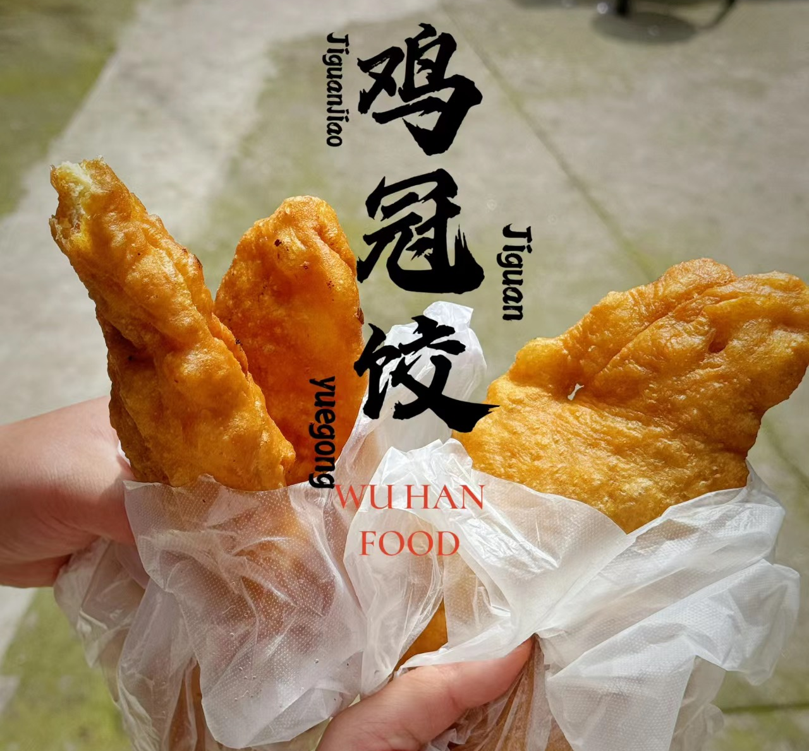
What they eat for Guo Zao?
Fried Dough Fritters
04
Fish Paste Noodles
05
Chicken Crown Dumplings
06

Slide 14
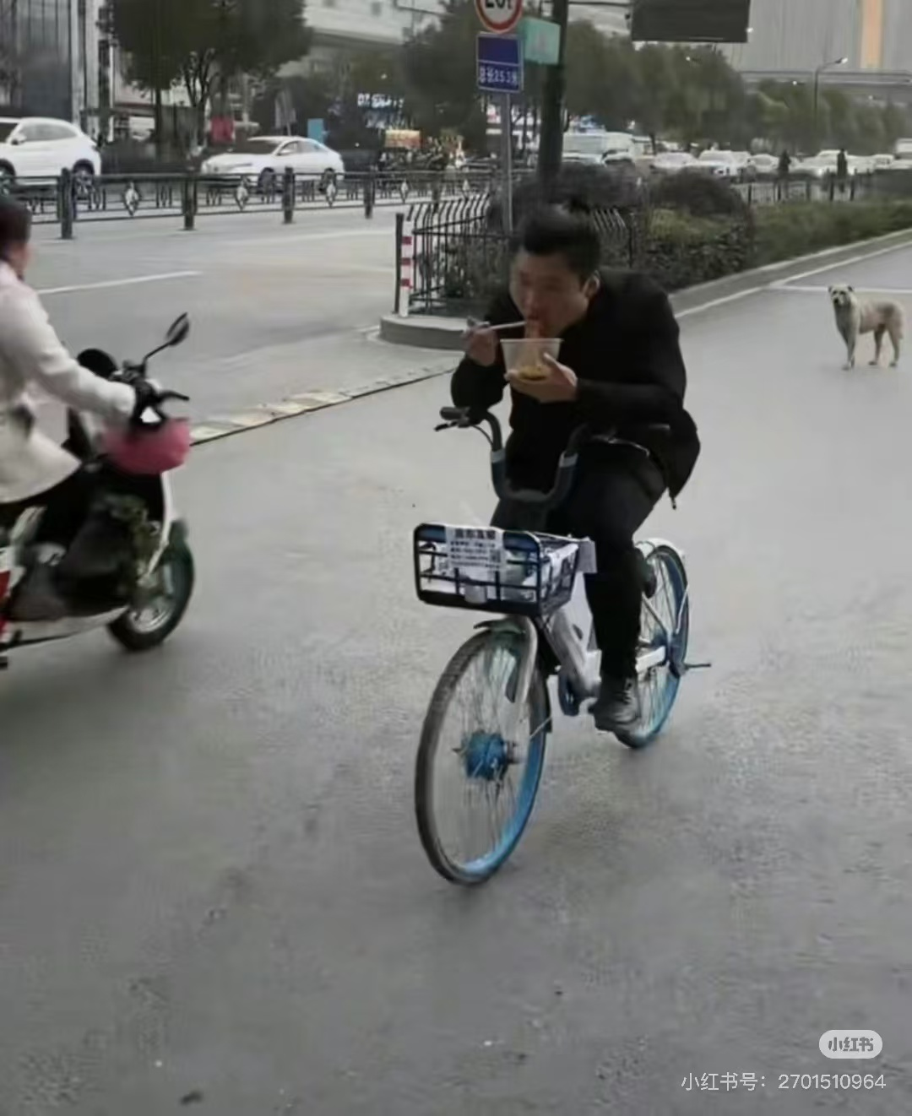
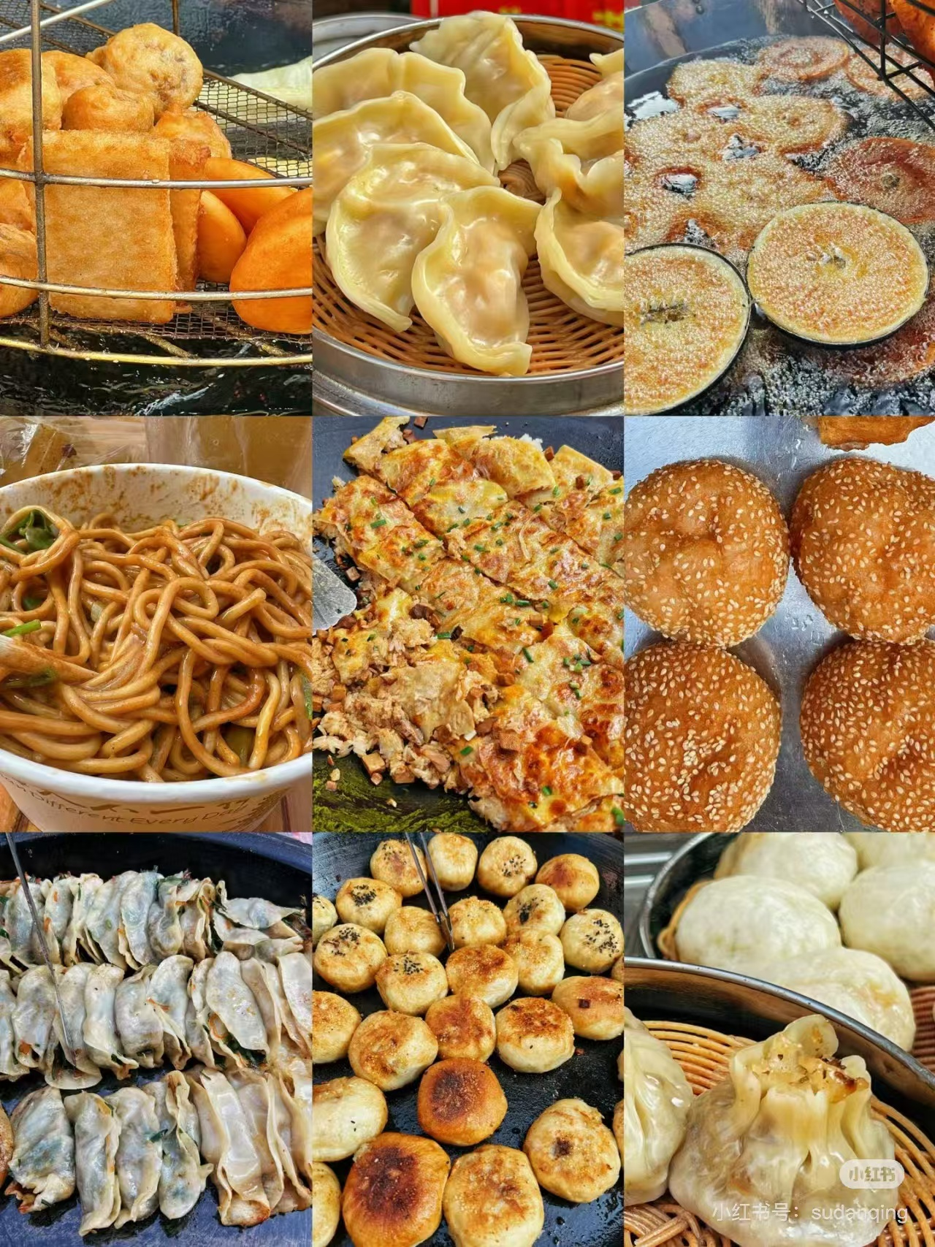
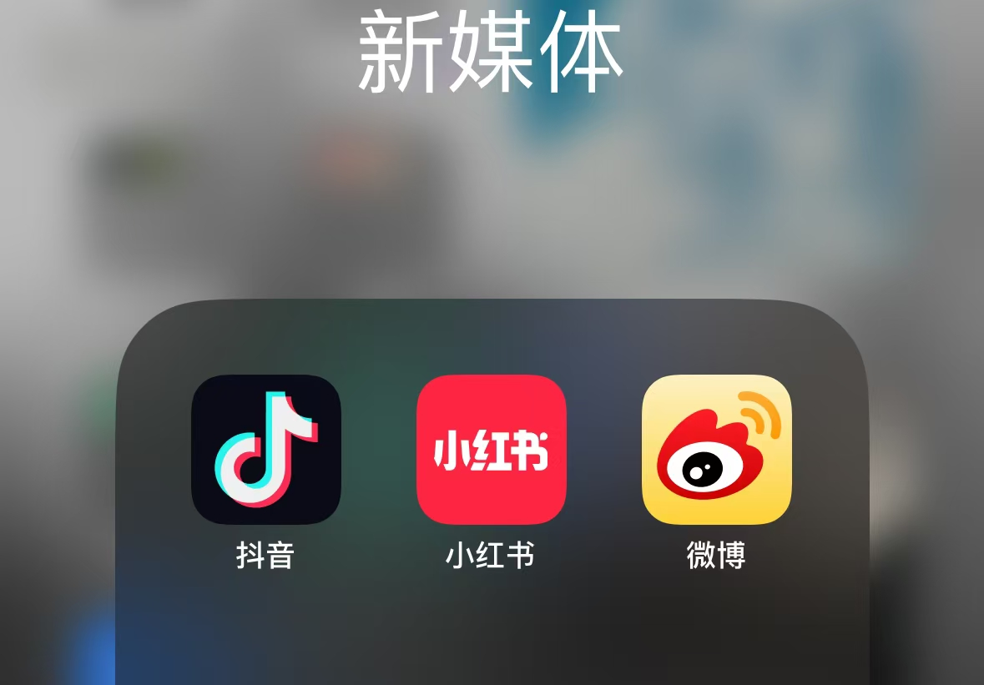
“Movement”
"mix"
“New Media”
What makes Guo zao unique?

