Slide 1
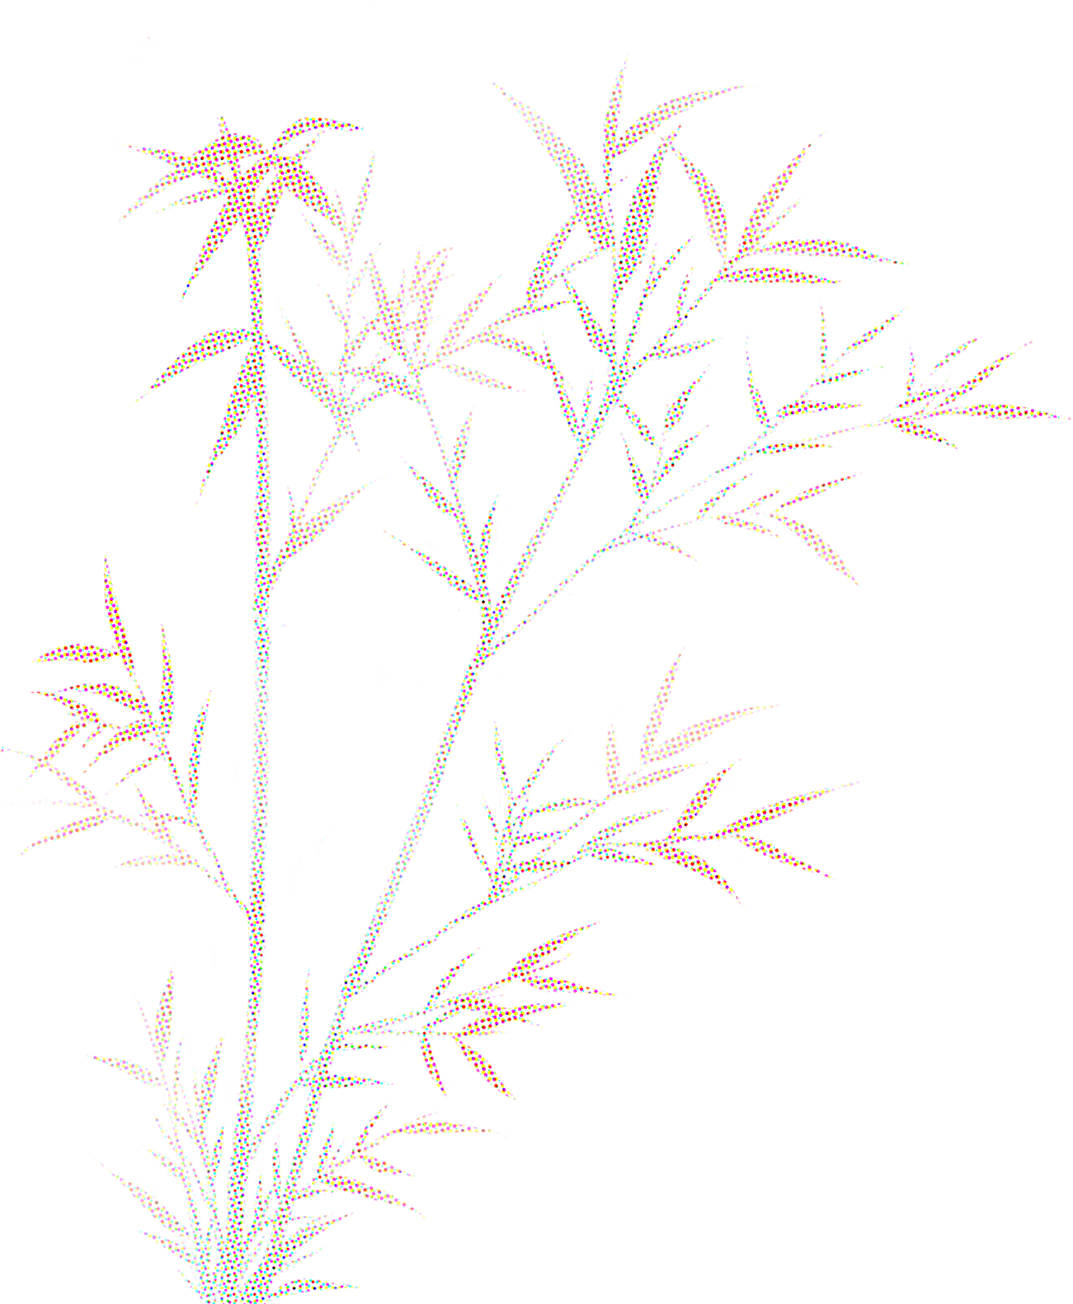


Chinese style
sun protection
presenter｜廖如婷 朝鲜语笔译
2025.12.18

Slide 2
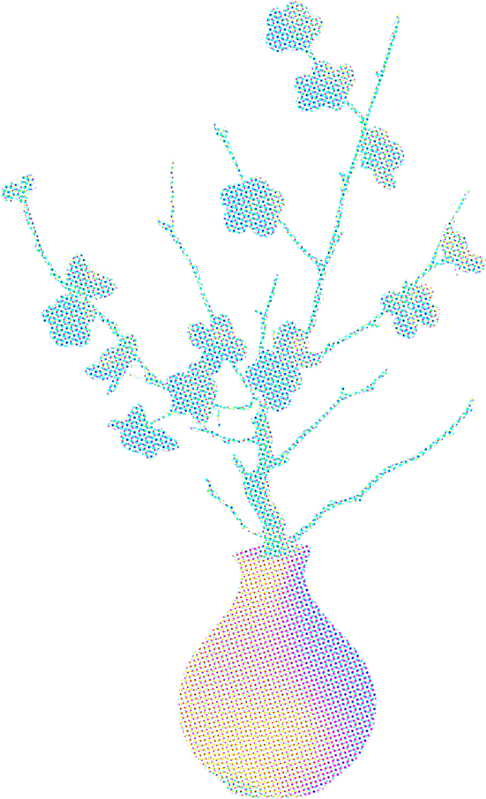

Contents
01
Defintion
02
Traditional VS Modern
03
Chinese style VS Western style
04
Conclusion

Slide 3
01
What is the Chinese style-sun protection？

Slide 4
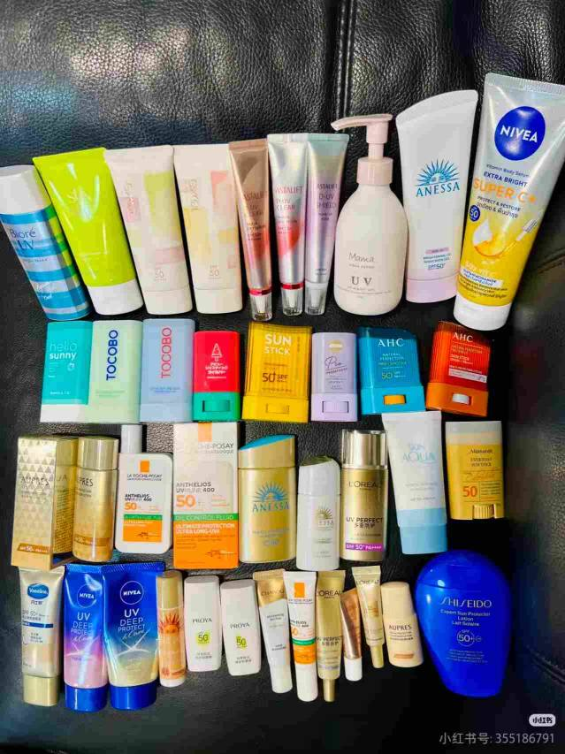
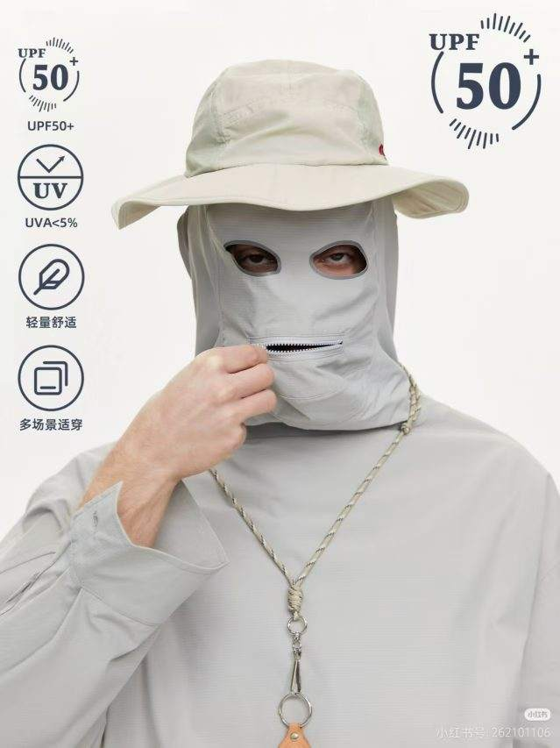
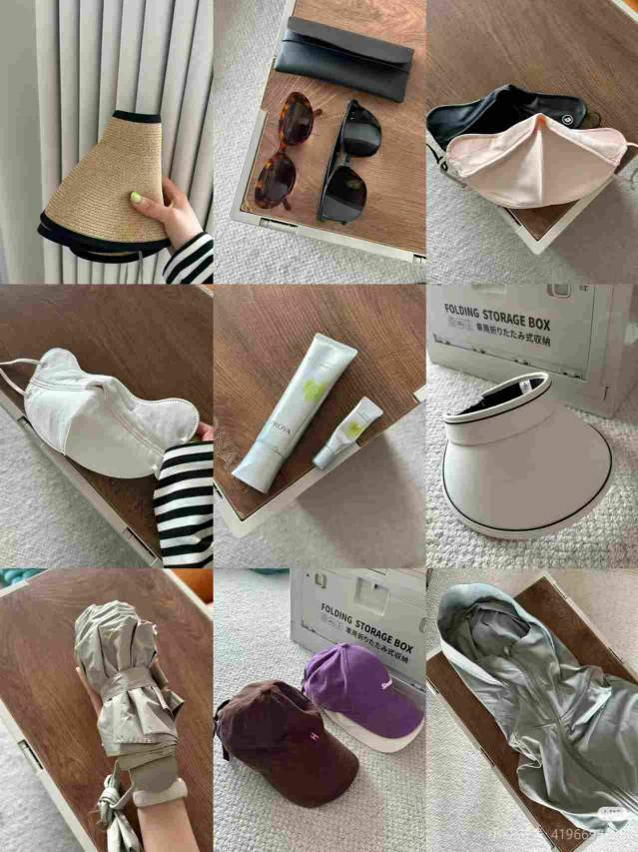
It is not simply “blocking sunlight.” Instead, it’s a holistic concept focused on nourishment, integrating traditional Chinese medicine, culture, and life wisdom. It doesn’t only rely on external barriers against UV rays but also emphasizes internal regulation to improve the skin’s tolerance to sunlight. The goal is to achieve both skincare and health preservation.

Slide 5
02
Traditional sun protection
VS
Modern sun protection

Slide 6
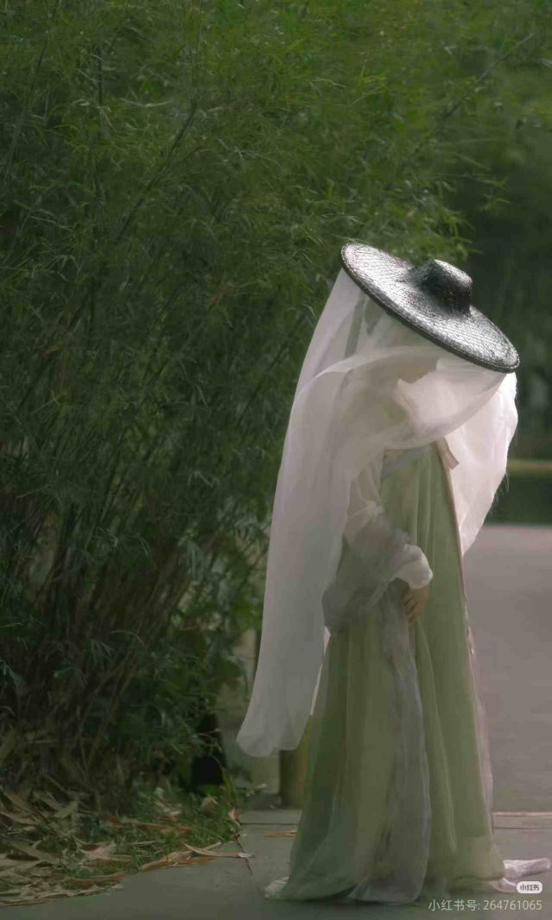
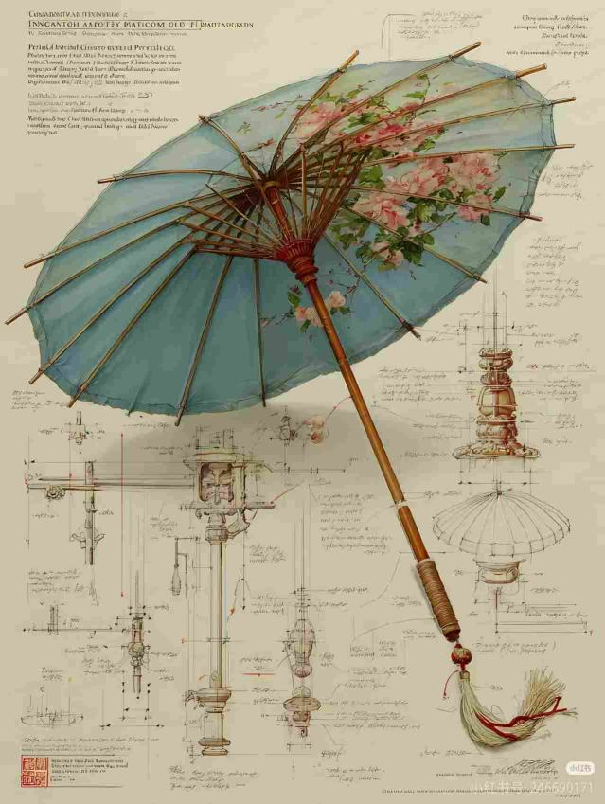

Traditional sun protection
  physical method
In summer, ancient people would wear lightweight gauze clothes, which were both breathable and sun-protective. Women in the Tang Dynasty often wore "curtain hats" - a type of hat with wide brims and a thin veil hanging from it, which not only shielded from the sun but also covered their faces. During the Ming and Qing dynasties, women often wore "face veils" or "mittens" when going out
The most common way for ancient people to protect themselves from the sun was "shading". During the Han and Tang dynasties, noblewomen would use oil-paper umbrellas or silk umbrellas to block the sun. The popular "qingluo umbrella" in the Song Dynasty served both to shelter from the rain and the sun.

Slide 7
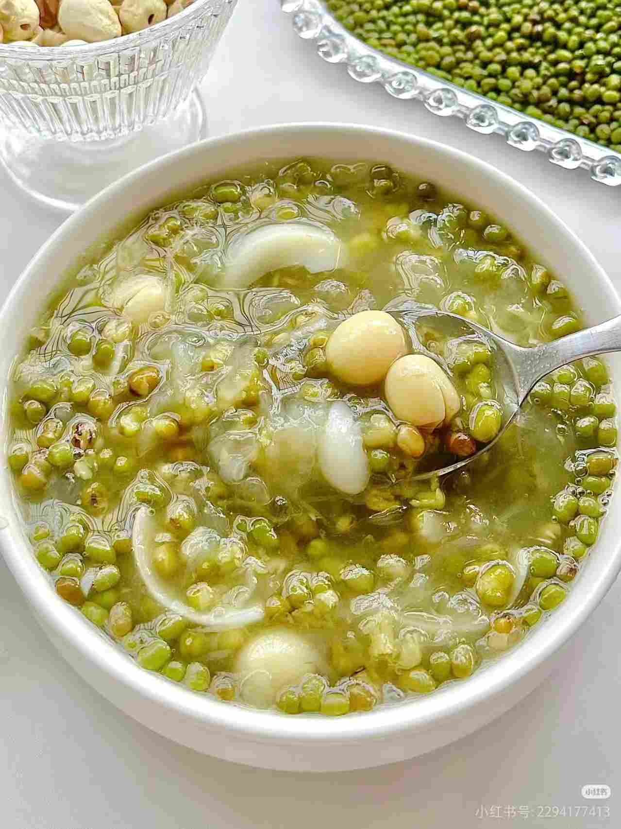
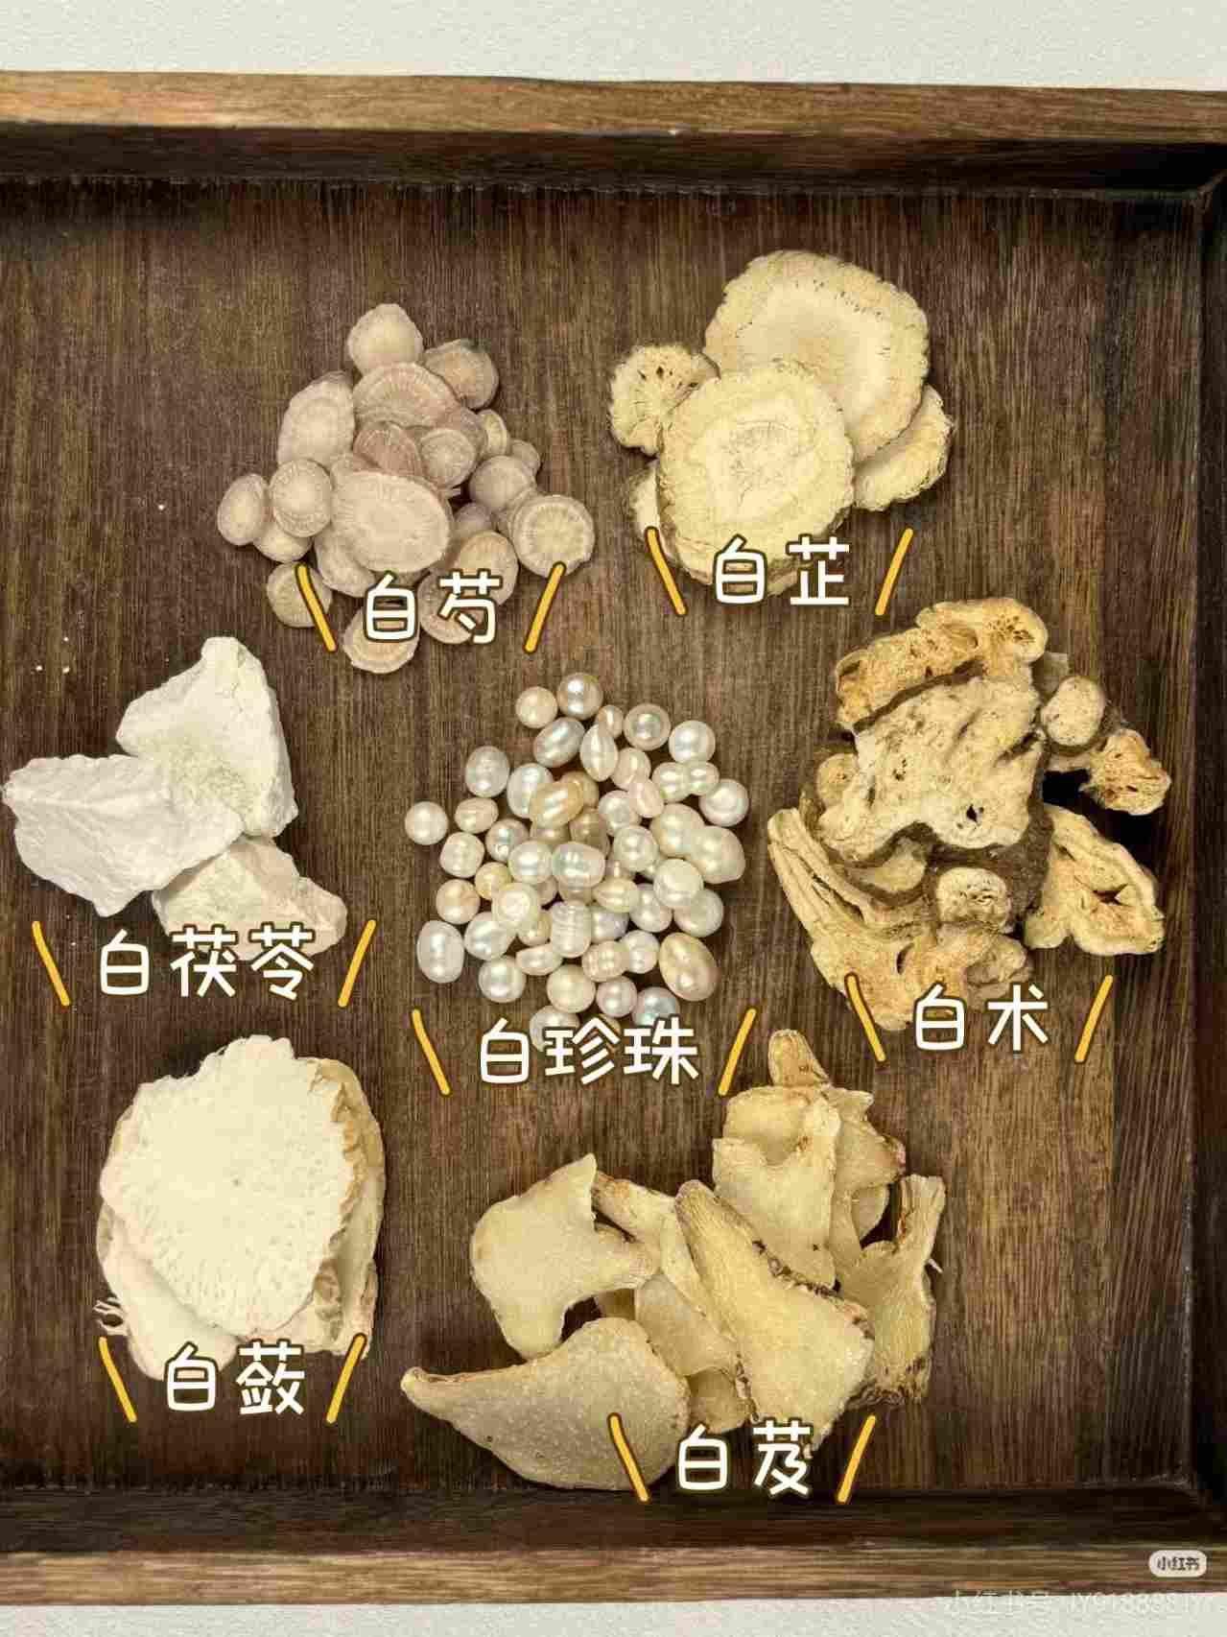
Traditional sun protection
  Dietary Care
  Herbal skin care
The ancients also paid attention to "internal-to-external" nourishment. The "Thousand Gold Prescriptions" records that in summer, it is advisable to consume more mung beans, lotus seeds, and pears, as they can not only cool the body and relieve heat but also prevent the appearance of spots due to the intense sun.
It is recorded in "Compendium of Materia Medica" that plants such as white peony, atractylodes, and purple root have skin-cleansing and moisturizing effects. Some people would make ointments or powders from these herbs and apply them to their faces, achieving a certain degree of isolation effect.

Slide 8
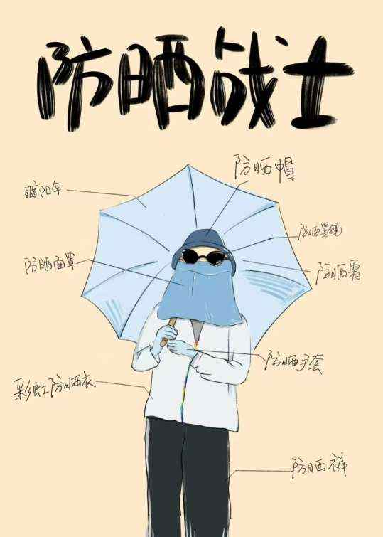
Contemporary sun protection
Modern sun protection, by contrast, aims for complete isolation. People often wear hats, sunglasses, masks, gloves, and UPF clothing in addition to applying sunscreen. For many Chinese women, the routine starts with physical sunscreen, followed by chemical sunscreen, ensuring double protection.

Slide 9
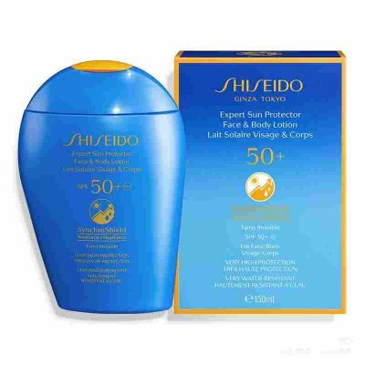
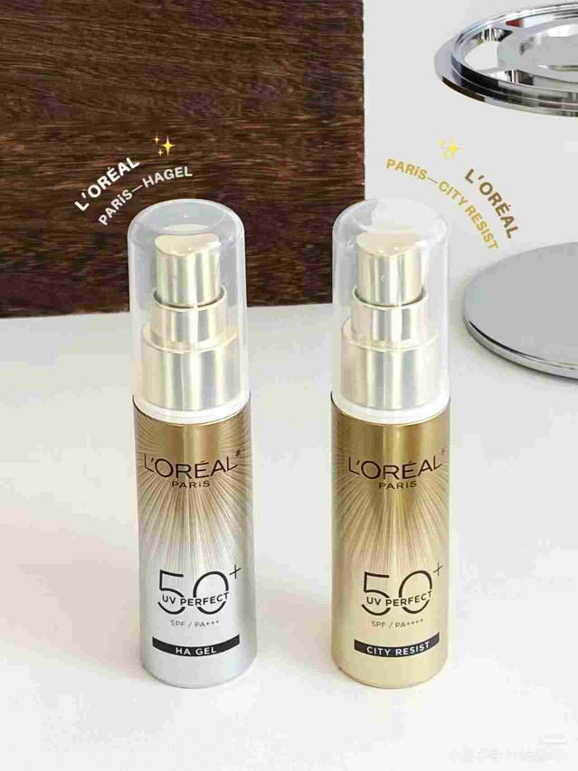
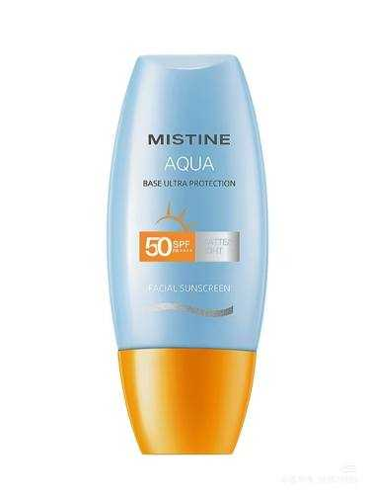
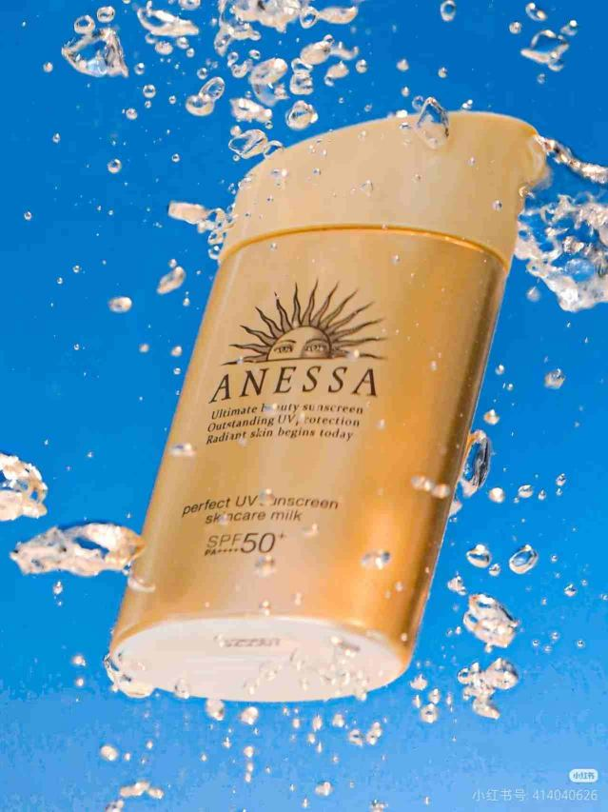
Contemporary sun protection
For Chinese women, the first step before going out on a sunny day is to apply physical sunscreen.
The second step is to apply sunscreen.

Slide 10
03
Chinese style
VS
Western style

Slide 11
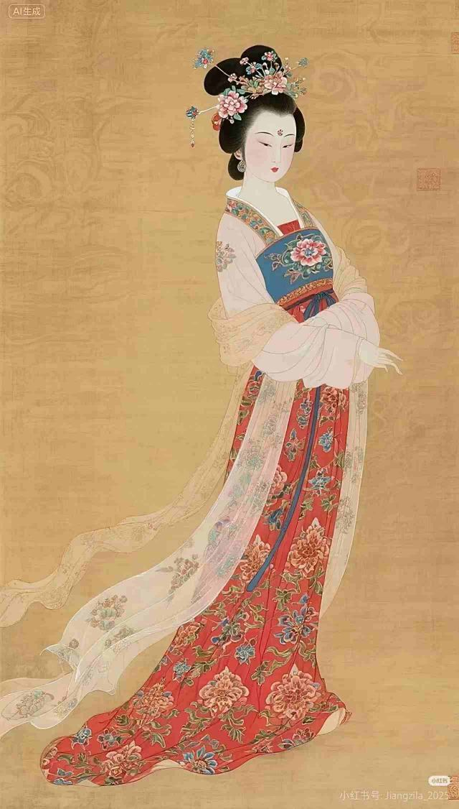

Aesthetics Standards - Pale VS Tan
  Chinese style
A fair complexion can covers three flaws.
Cultural core: subtlety, self-discipline, long-termism

Slide 12

Aesthetics Standards - Pale VS Tan
  Western style
Sunbating culture . Pursuing a bronze complexion. Tanning
Cultural core: Respect nature.Life vitality. Healthy aesthetics.

Slide 13

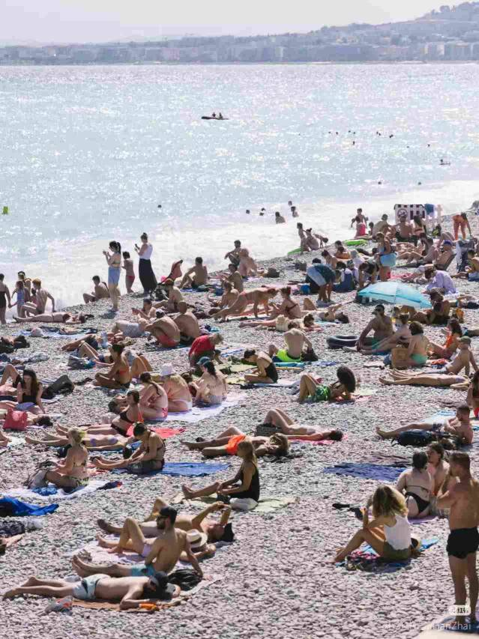
Behavior - Hiding VS Seeking
  Hiding the sun
  Seeking the sun
  parasols
  arm sleeves
  facekinis
  bikinis
  tanning oil

Slide 14
Pruduct Preferences - UVA VS UVB
  Chinese consumers
  Western consumers
  Focus on PA rating （Protection Grade of UVA）
  Fear : Aging & Pigmentation
  Texture : Prefer lightweight, non-greasy, watery feel
  Focus on SPF rating （Sun Protection Factor）
  Fear : Sunburn & Cancer
  Texture : Tolerate thicker lotions , focus on water resistance

Slide 15
04
Conclusion

Slide 16
Advantages and Disadvantages
Advantages:
1. Protects skin & resists aging
2. Prevents spots & fades wrinkles
3. Avoids sunburn & skin cancer
4. Keeps skin clear & translucent
5. Calms sensitive skin & stabilizes it
Disadvantages:
1. Lacks vitamin D
2. Causes dull skin tone
3. Reduces immunity
4. Leads to emotional depression
5. Slows down metabolism

Slide 17
01
Physical methood
  Build an external barrier
  Hardcore "Hard" Protection: Sun umbrellas, UPF clothing, face shields, sunglasses — direct, effective, no reapplication needed.
  Strategic "Soft" Protection: High-SPF/SPA sunscreen — covers exposed areas, the final shield.
  Behavioral Avoidance: Seeking shade, avoiding peak sun hours (10 AM - 4 PM) — working wisely with the environment.

Slide 18
02
Core Method
  Building resilience from within
  Antioxidant-Rich Diet: Increase intake of lycopene (tomatoes), Vitamin C (citrus, kiwi), Vitamin E (nuts), and polyphenols (green tea) to help skin combat photo-damage.
  Hydration & Nourishment: Drink plenty of water; consume moisturizing ingredients like snow fungus and lily bulb in traditional diets.
  Post-Sun Repair: Use soothing products (e.g., with aloe vera or centella asiatica) to calm skin after sun exposure.

Slide 19
03
Mindest Shift
  Correctly view sun protection
  Beyond "Fair" Skin: Understand that the goal is skin health and anti-aging, while appreciating diverse beauty standards.
  Delayed Gratification: Accept sun protection as a "preventive investment"—its greatest reward (youthful, healthy skin) is realized in the future.
  Avoid Anxiety: Don't pursue "zero exposure." Find your personal balance between effective protection and enjoying sunlight for Vitamin D.

Slide 20
Thanks for listening
数据来源：中国语言文化课本、小红书、Deepseek

