Slide 1
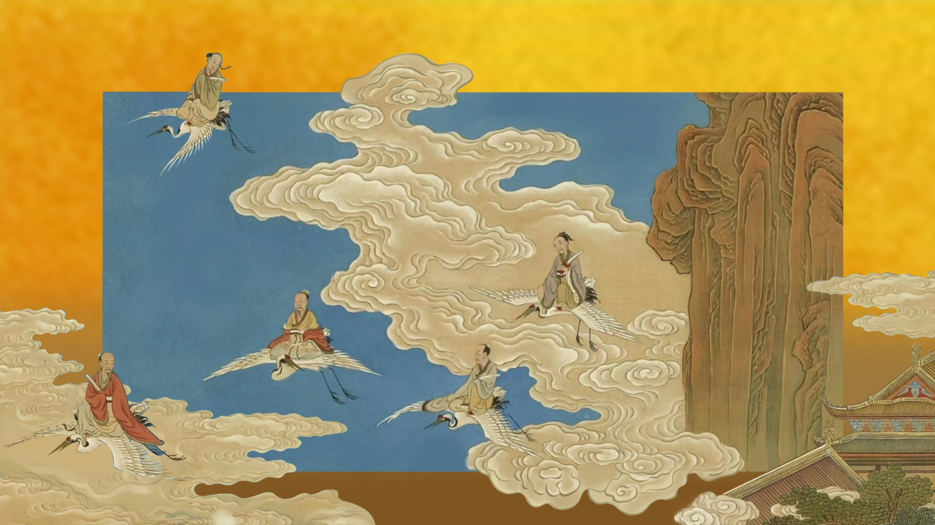
Mythology:
Chinese Gods and Immortals
Speaker: Wang Yue (Nora)

Slide 2
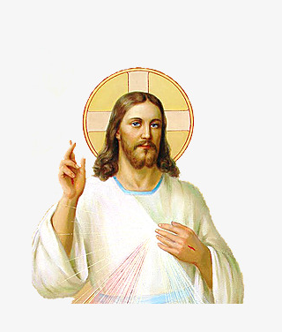
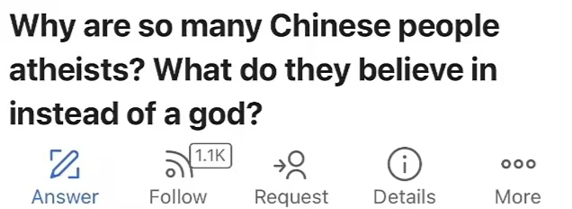
Karma
因果
Shén Xiān
神仙

Slide 3
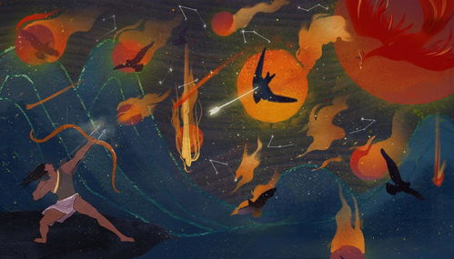
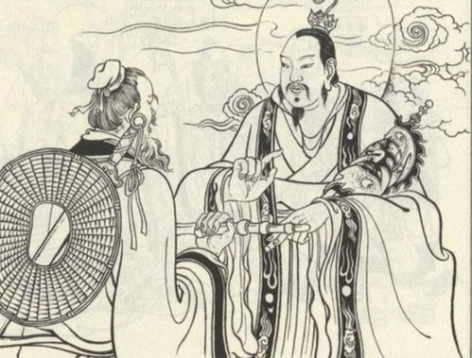
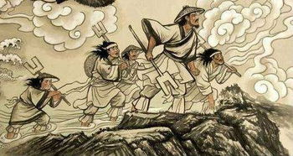
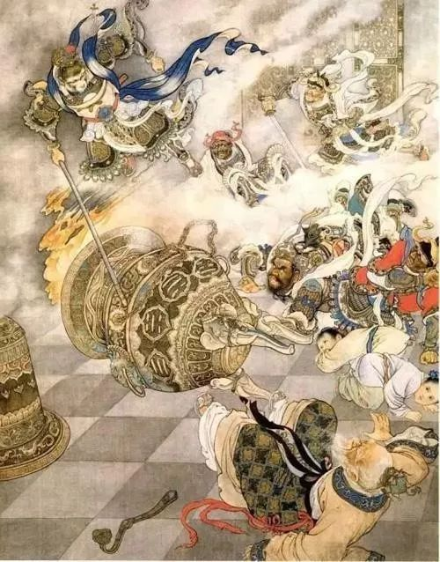
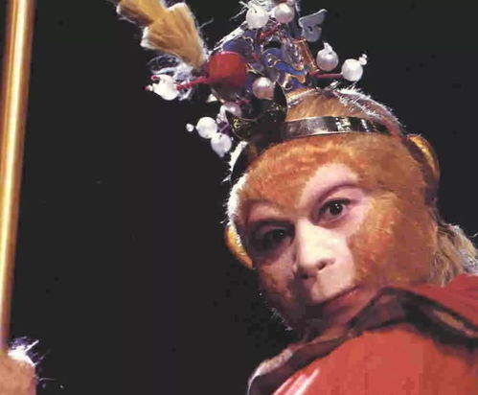
The
Legend of Deification
King Yi Shooting Down Nine Suns
Great Yu’s battle against the flood
Sun Wukong

Slide 4
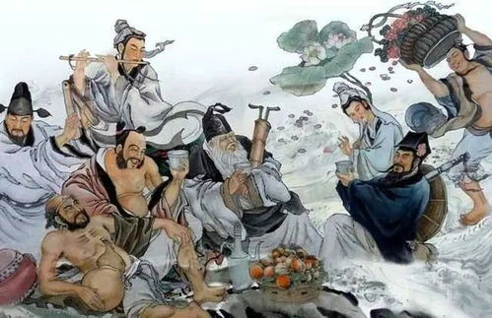
Eight Immortals Crossing the Sea
Who Are They？

Slide 5
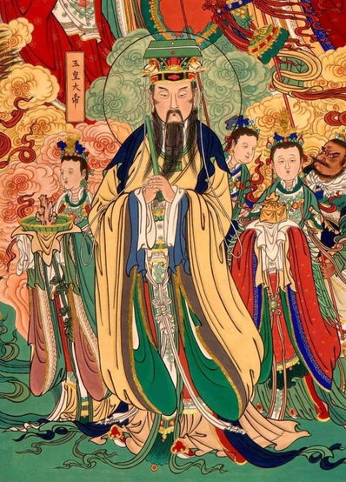
PRAGMATISM
实用主义
“Shenxian resides where men believe it resides.”
信则有，不信则无

Slide 6

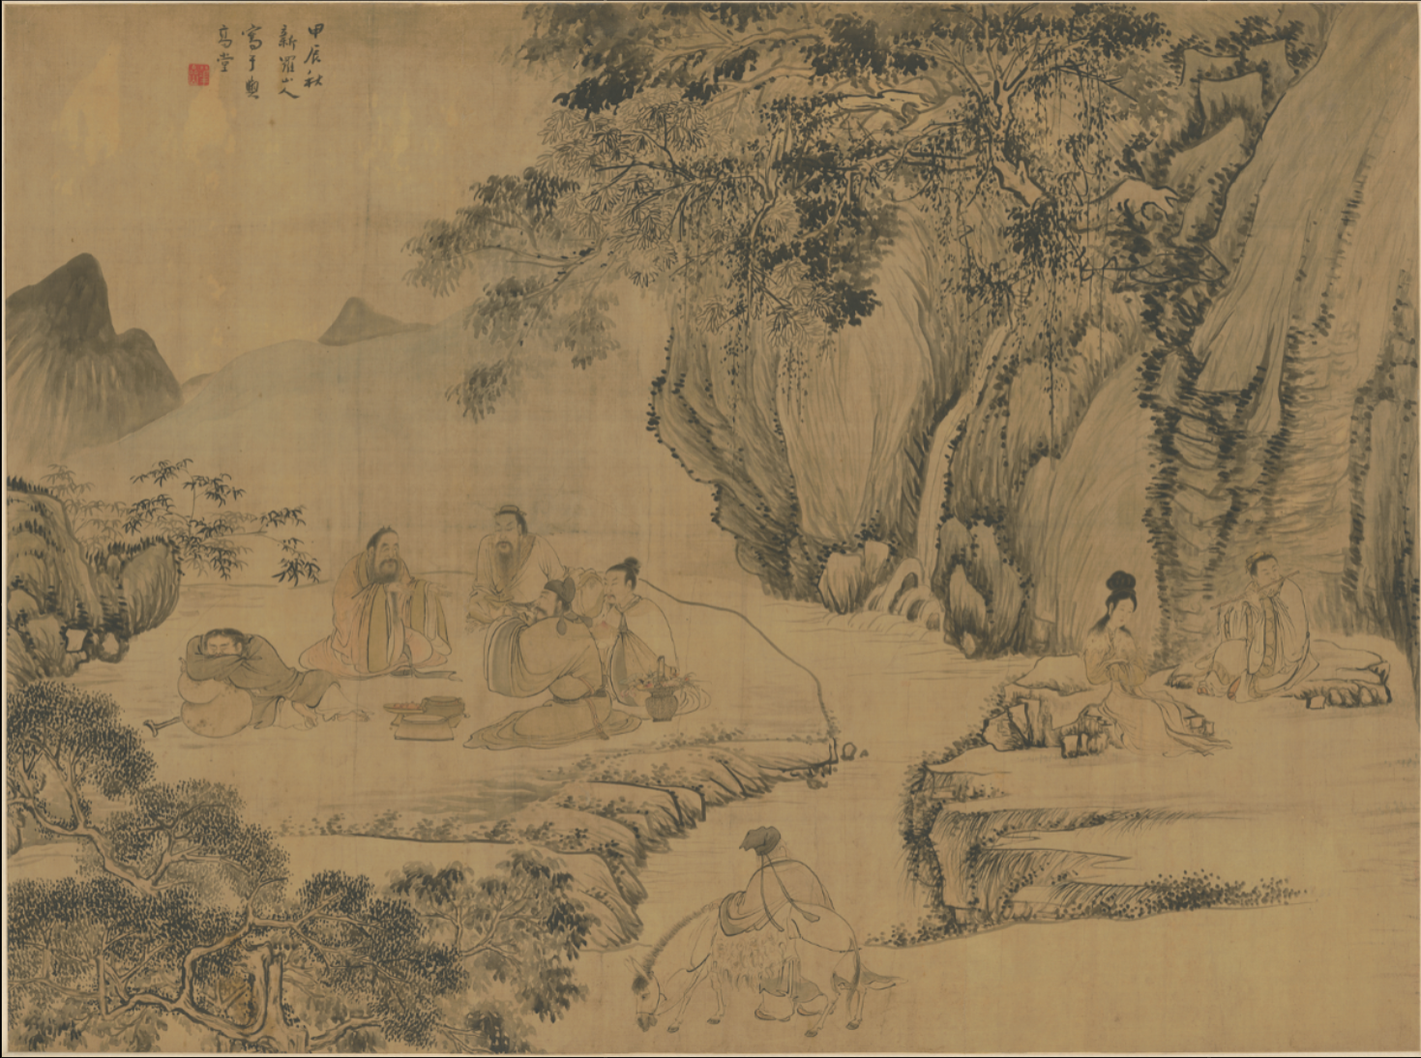
CONTENTS
Part 1 Chinese Mythology System
Part 2 Differences Among Shén, Dì and Xiān
Part 3 Immortal Cultivation

Slide 7
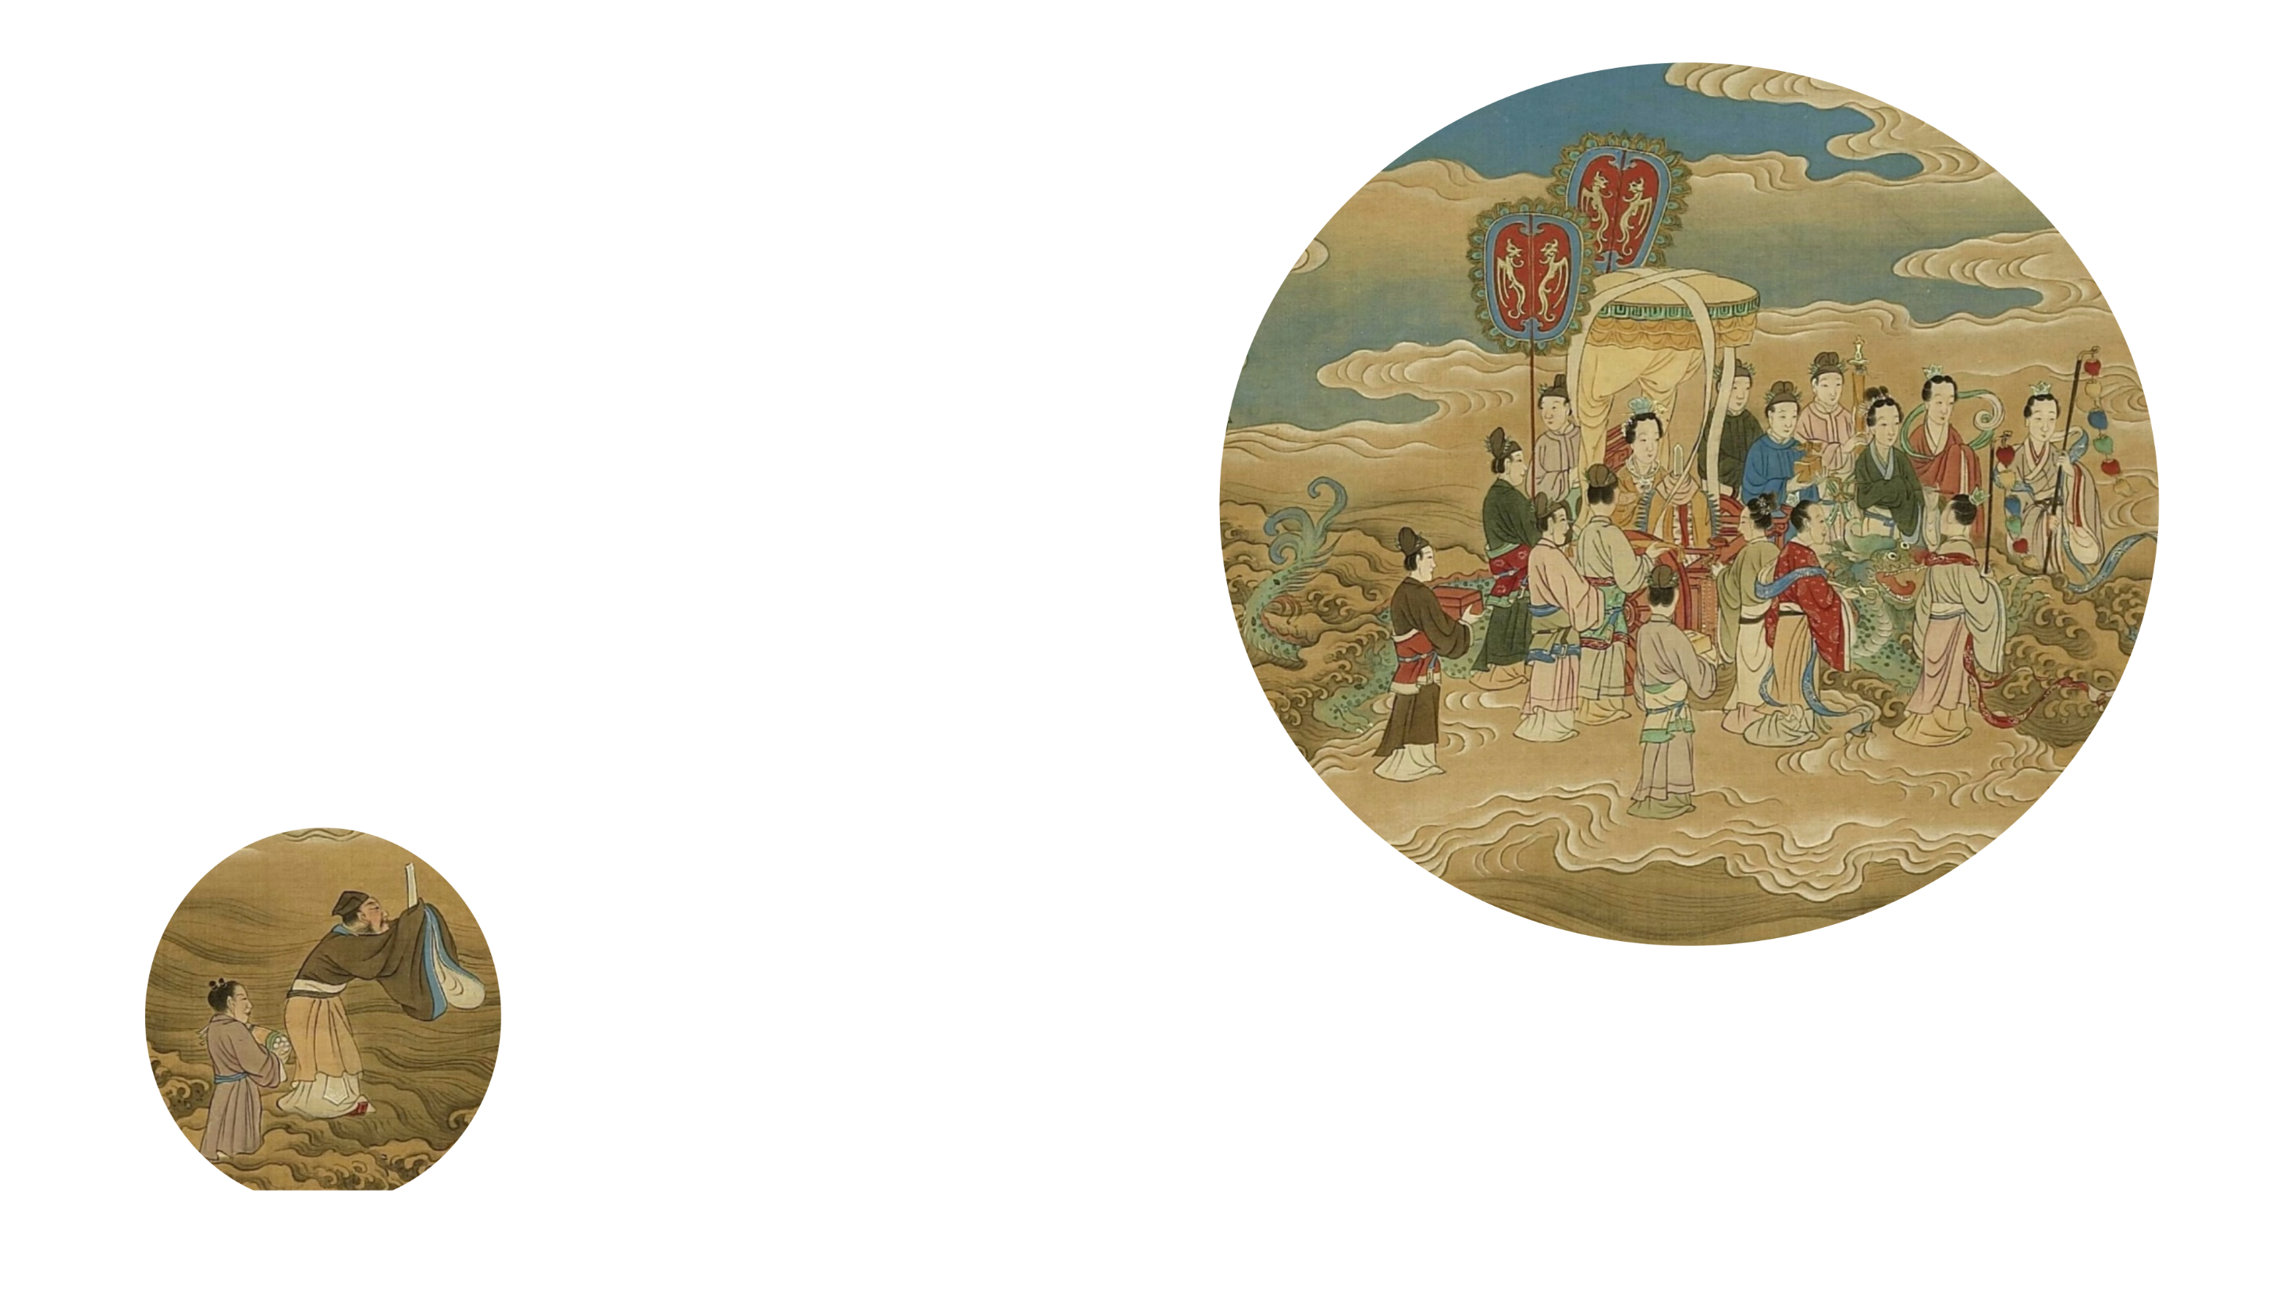
Chinese Mythology System
Ancient Mythology System
Taoist Mythology System
Buddhist Mythology System

Slide 8
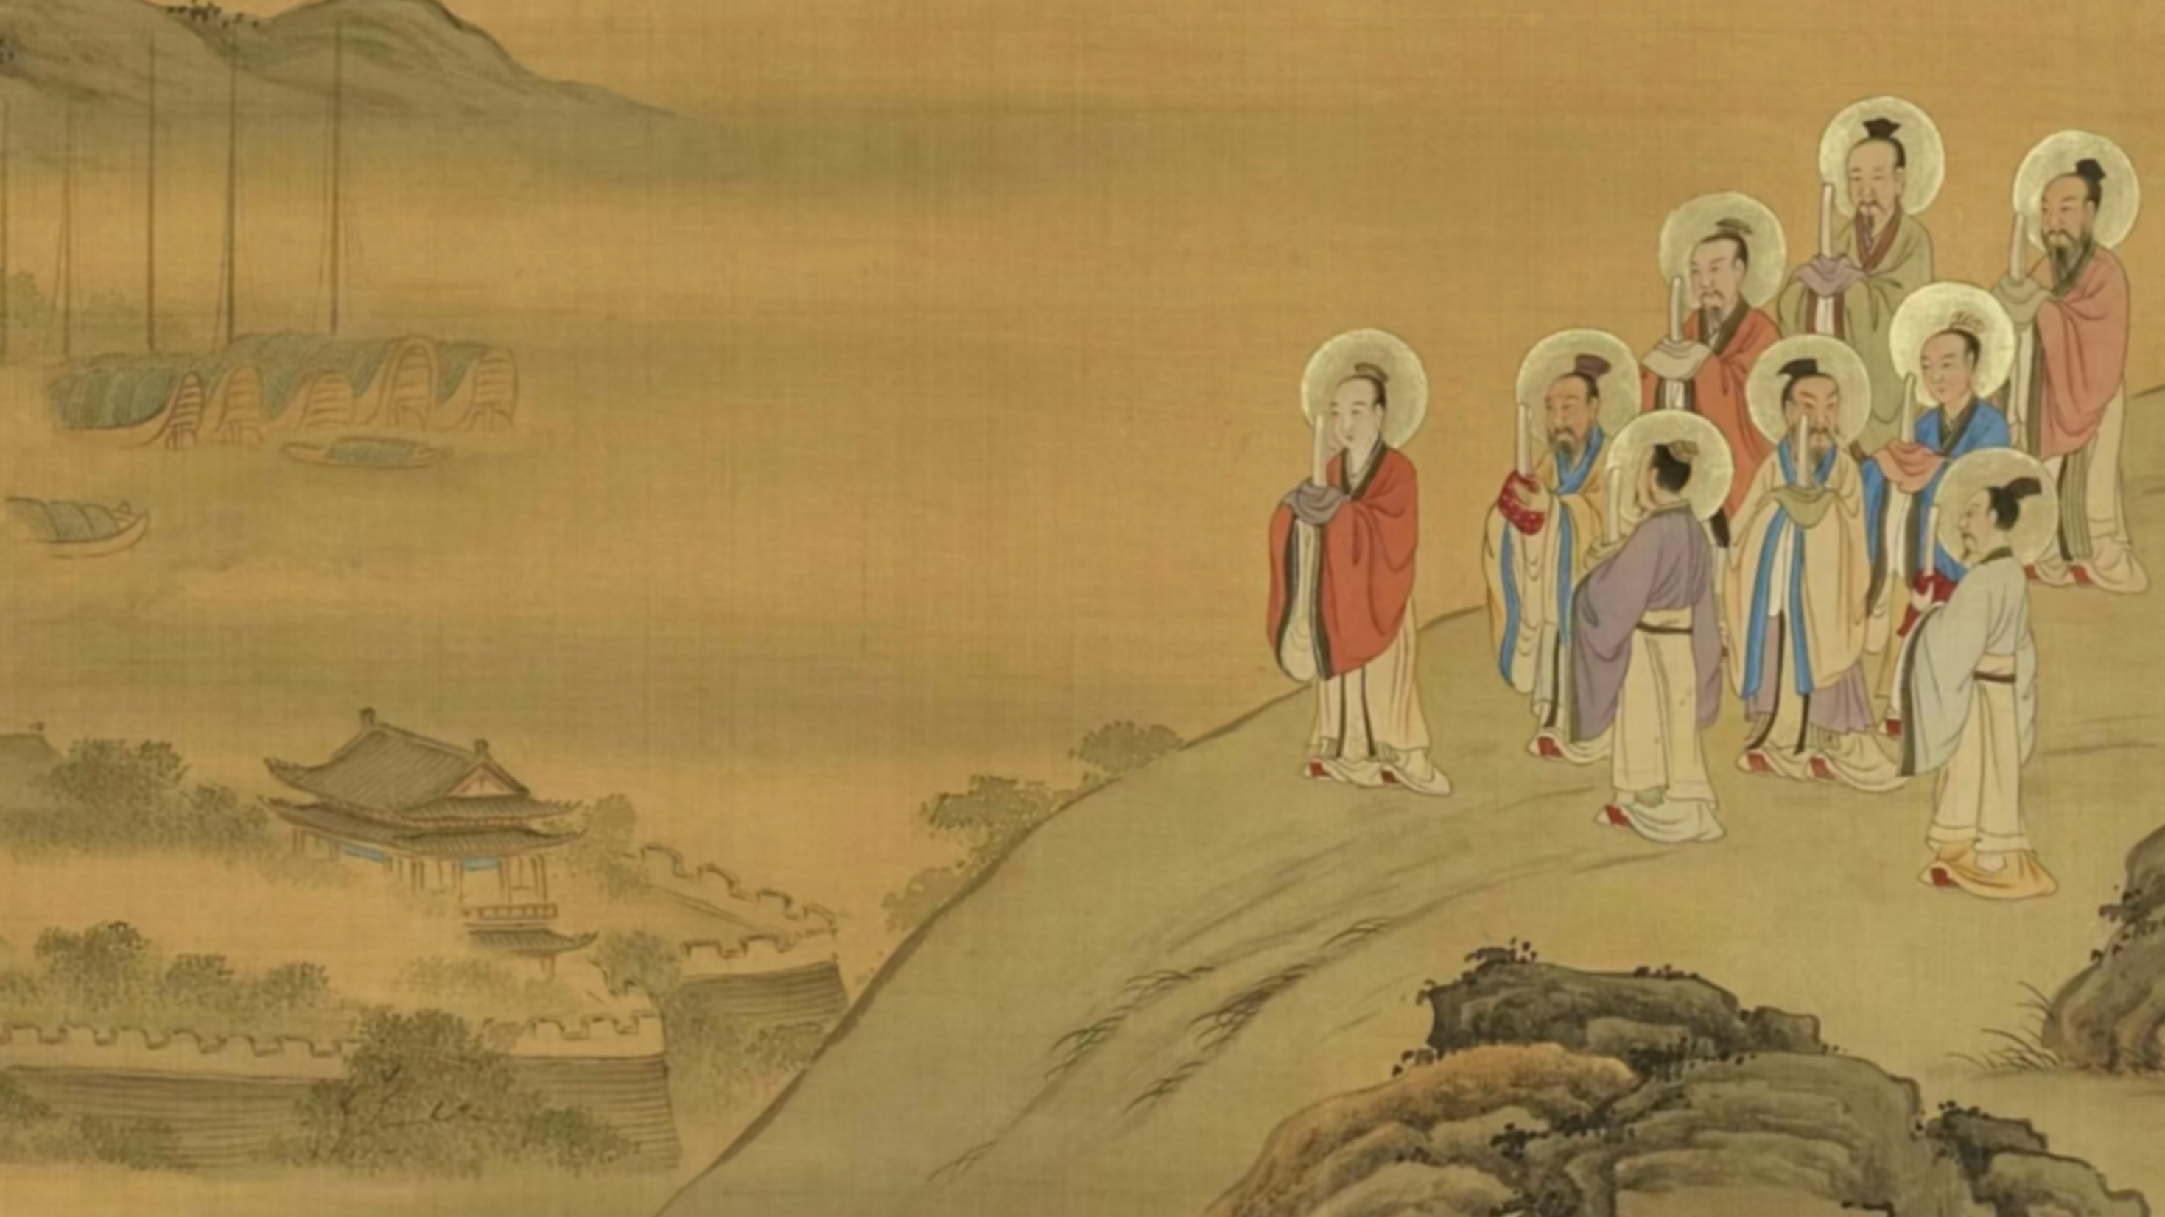
Ancient mythology
myths of human origins or creation myths
Chinese ancient mythology originated in ancient times in China (before the Xia Dynasty).
Mythical figures related to tracing human origins, hero and nature worship
The Classic of Mountains and Seas

Slide 9
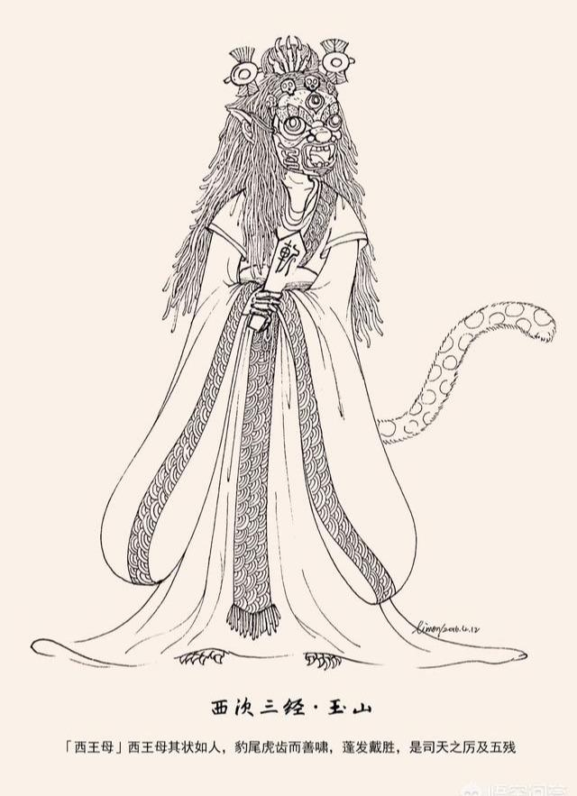
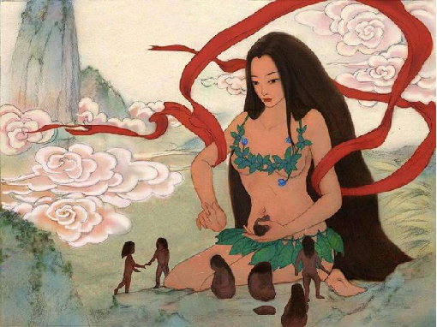
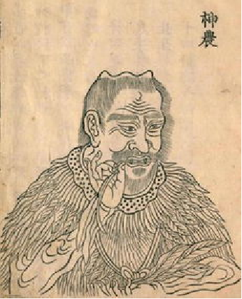
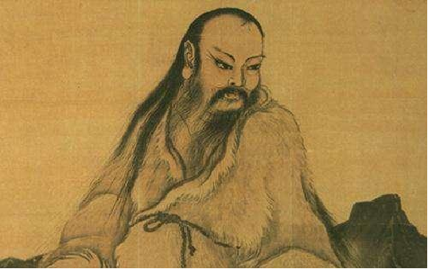
Mythical Figures in Ancient Mythology
Nü Wa
Shen Nong
Xi Wang Mu
Fu Xi

Slide 10
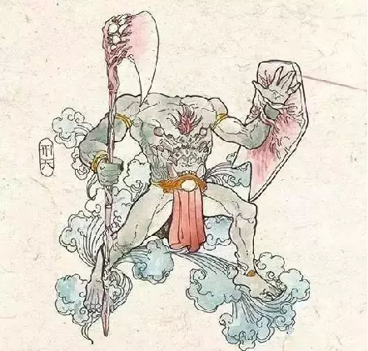
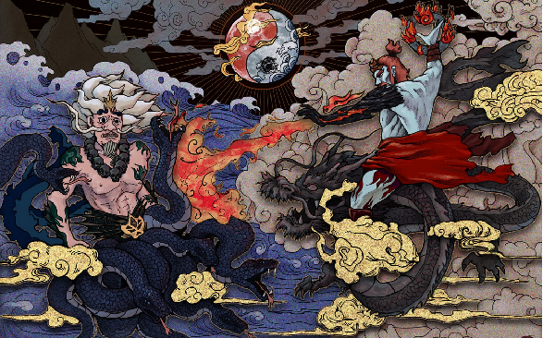
Mythical Figures in Ancient Mythology
Gong Gong
Zhu Rong
Xing Tian

Slide 11
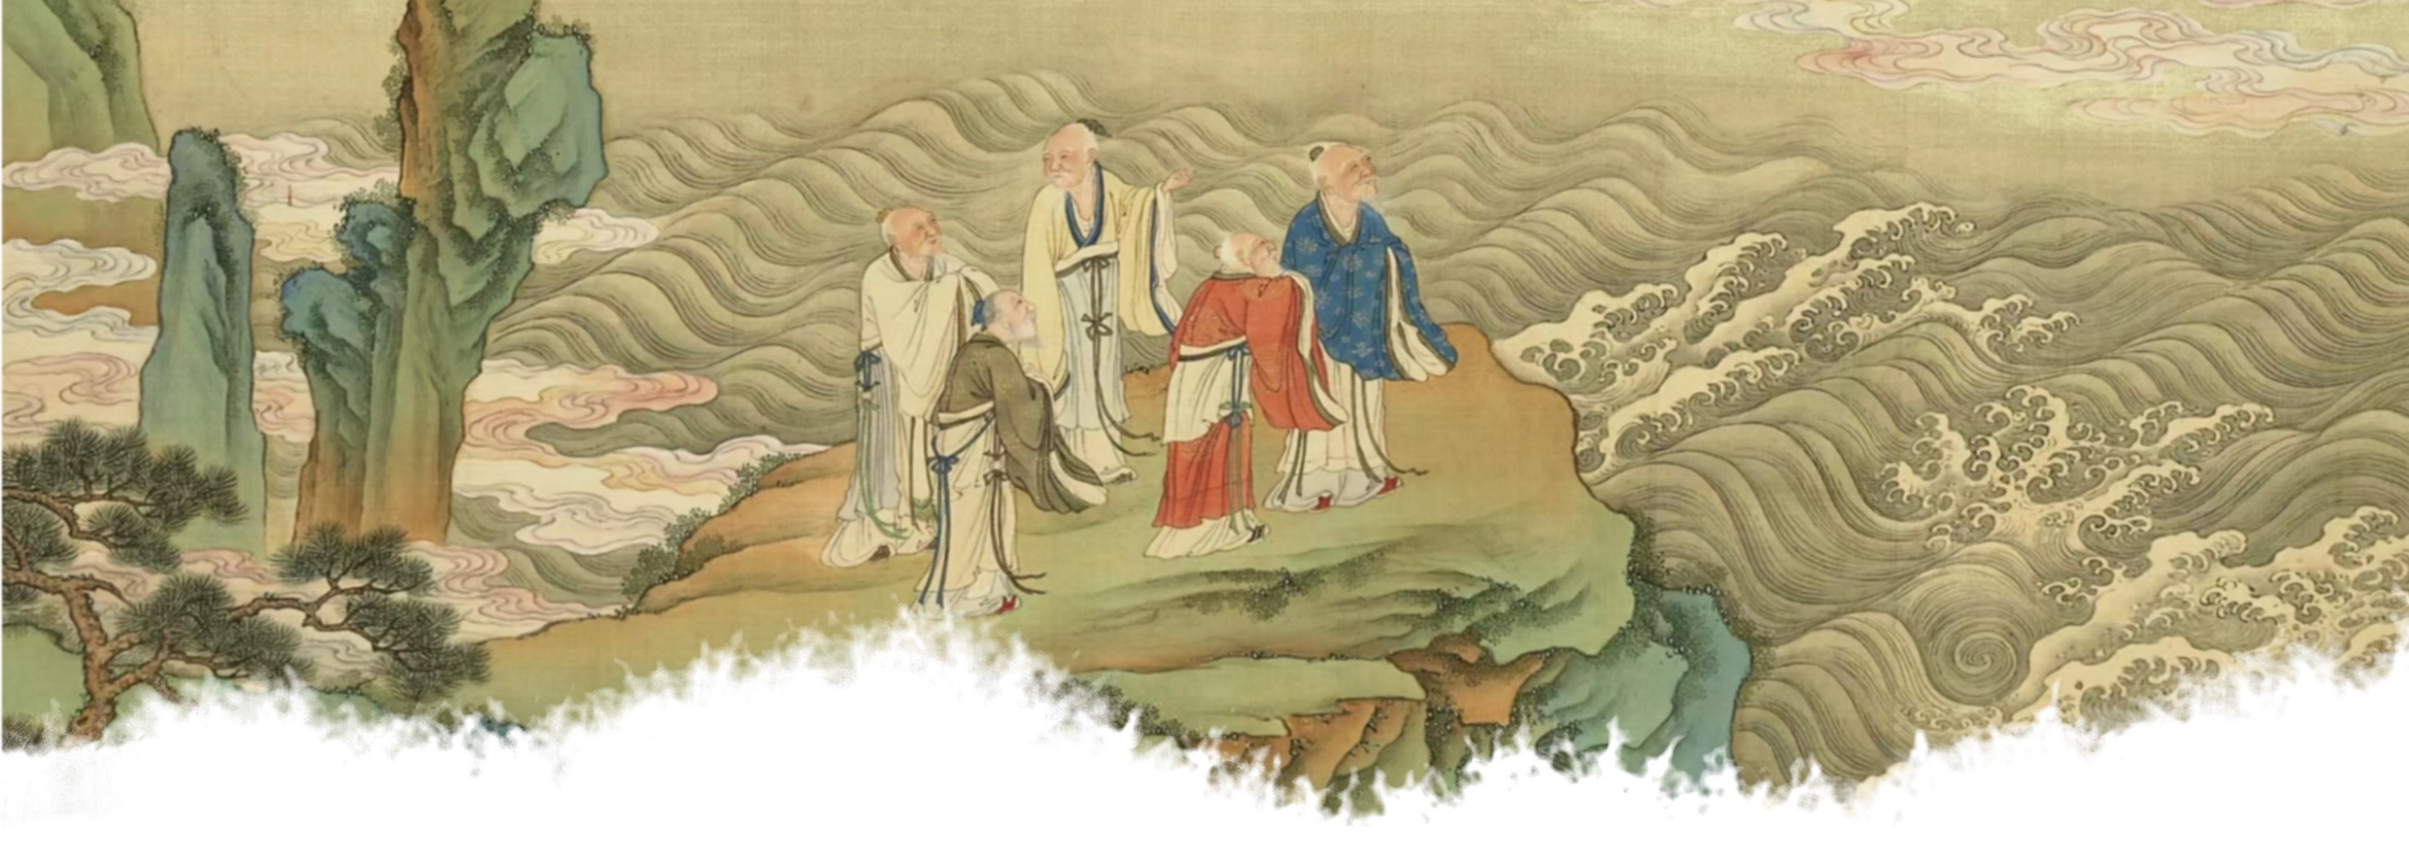
Taoism——the Taoist school (the Han Dynasty)
Taoism can be defined as pantheistic, given its philosophical emphasis on the formlessness of the Tao and the primacy of the “Way” rather than anthropomorphic concepts of God.
Taoist Mythology System
The Supreme Leader:
Sanqing Tian Zun (the Eastern Han Dynasty )
Yu Huang Da Di, the Jade Emperor (the Tang and Song Dynasties)

Slide 12
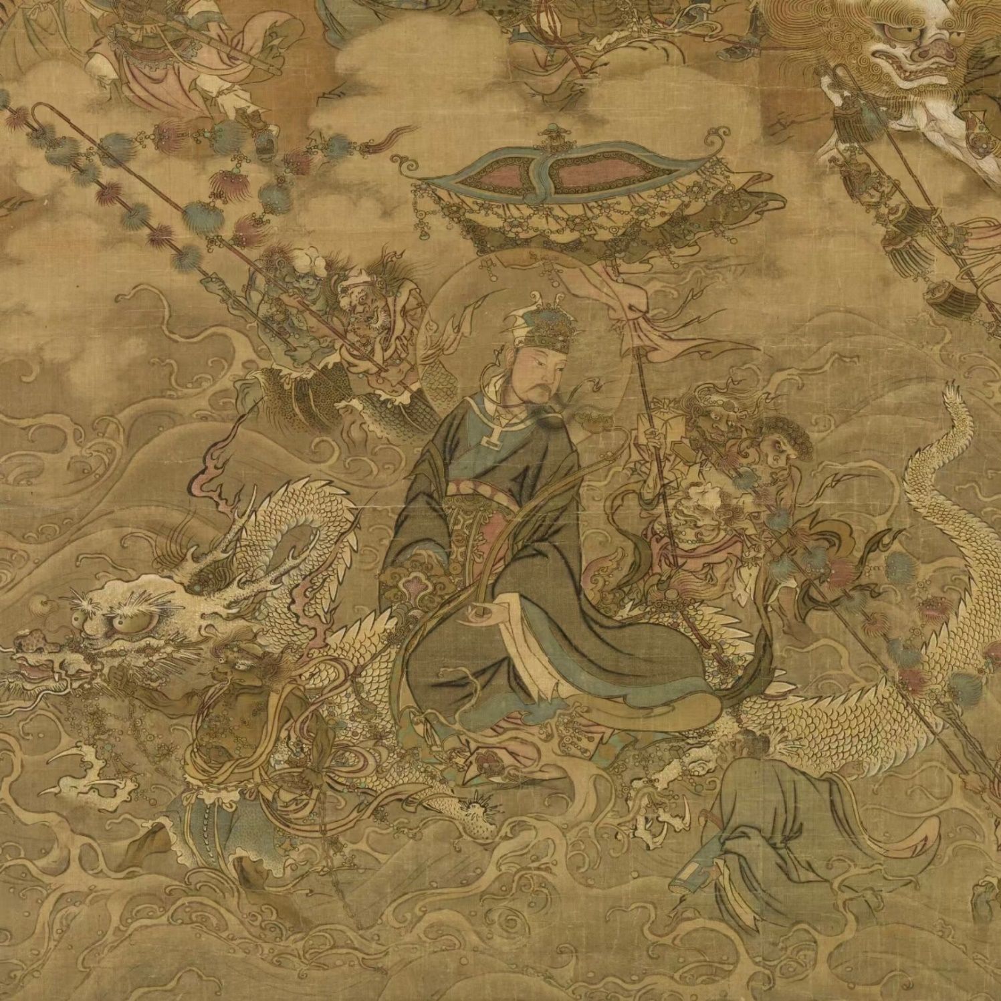
"Book of Nanhua"
"True Images of the Positions of the Spirits"
"Four Scriptures of Taoism"
In these scriptures, many immortals are created, and most of them are given official positions, reflecting the practicality valued by ancient Chinese ancestors.

Slide 13
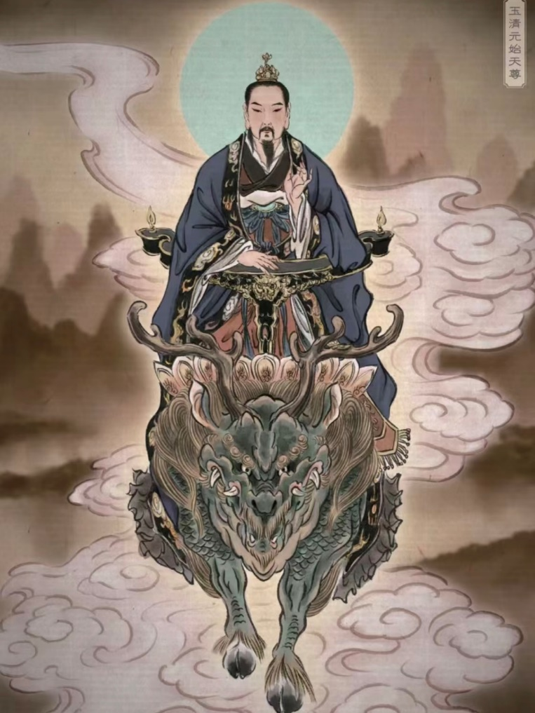
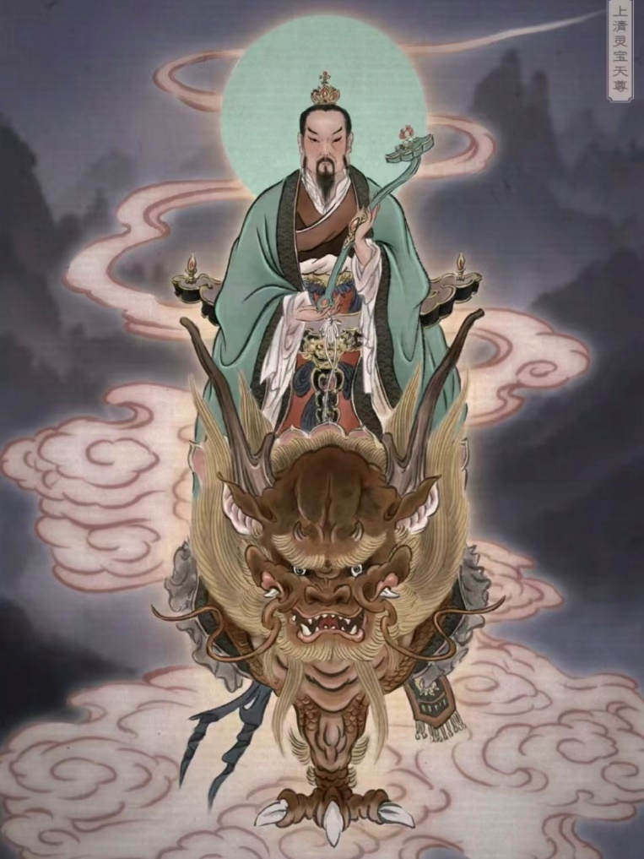
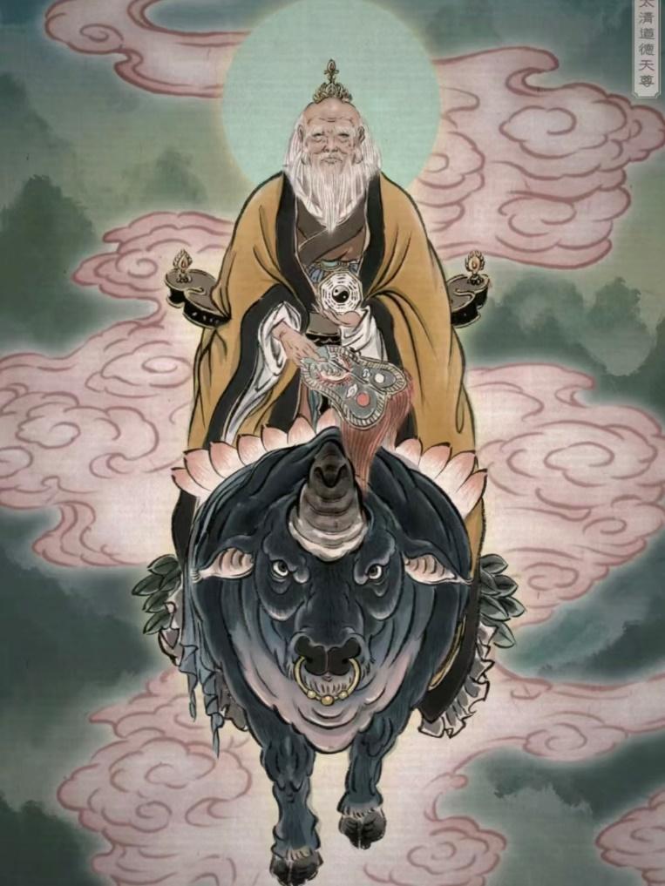
Main Taoist Immortals
The Three Pure Ones of Taoism
Yuanshi Tianzun
Lingbao Tianzun
Daode Tianzun

Slide 14
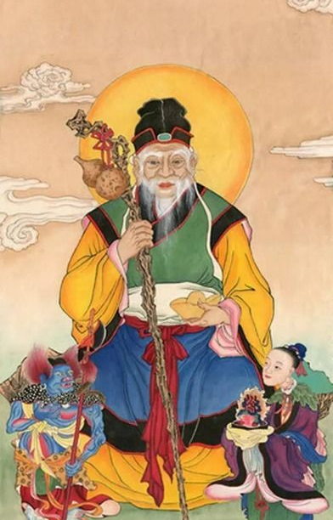
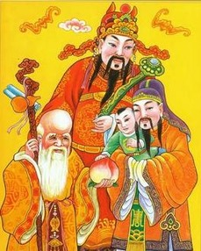
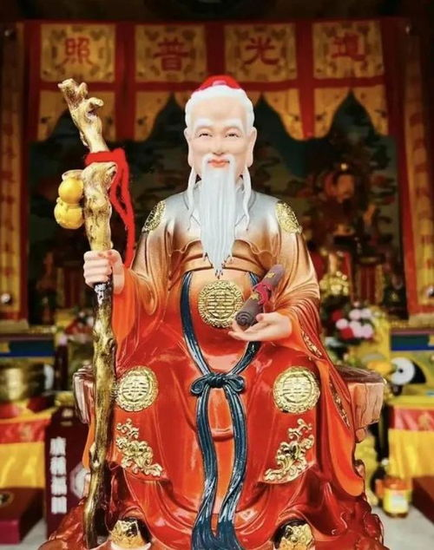
Main Taoist Immortals
Yue Lao
Three Stars
Tu Di Shen

