Slide 1

空白演示
Chinese Folk Argot
单击输入您的封面副标题
时友洁
Shi Youjie

Slide 2

Chinese Folk Argot
Argot was created by various groups, especially the secret societies, which usually characterized by evasion and metaphor. Sometimes it can exclude or mislead the outsiders of a specific group.
Chinese argot
among folk

Slide 3
euphemism
reason
euphemism： 下海xia hai；sail；prostitution or egaging in business
reason
mislead outsiders
mislead outsiders： 胡子hu zi；beard ；theif（northeast of china）
ancient local argot（古代地方黑话） wild cards(江湖/市井黑话),
normal argots（日常黑话） rock and roll argots（摇滚黑话）, modern argots（现代流行黑话）

Slide 4
空白演示
Wild Cards
江湖黑话
单击输入您的封面副标题

Slide 5



The Graver Robbers' Chronicles
Candle in the Tomb

Slide 6

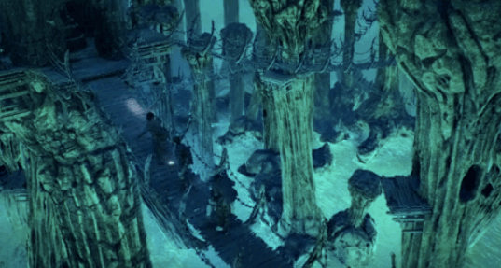
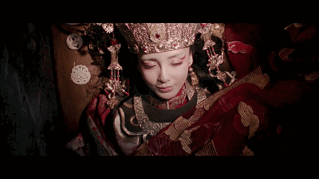
tomb robbers:
摸金校尉 mo jin xiao wei
土夫子 tu fu zi
土耗子 tu hao zi
tomb raiding:
倒斗 dao dou
demon in the tomb：
粽子 zong zi

Slide 7

Normal Argot
日常黑话

Slide 8

play mahjong
打麻将

Slide 9

庄家zhuang jia: Dealer / Banker
牌墙pai qiang： Wall
牌墩pai dun： Stack 牌墙中的上下两张牌成一墩
和(胡)牌hu pai: Win
摸牌mo pai: Draw
听牌ting pai: Ready Hand
刻子ke zi: Triplet
顺子shun zi: Sequence
明杠、暗杠ming gang/an gang: Exposed / Concealed Kong
碰、杠、吃 Pong / Kong / Chow
数番shu fan Scoring
番数fan shu Points

Slide 10

Modern Argot
现代黑话

Slide 11

online buzzword

Slide 12



popular punch line or joke from daily life
acronym
yyds;永远的神；Greatest of all time ;
nsdd；你是对的；you’re right
xswl；笑死我了；laugh my ass off
jms：姐妹们：girl‘s friends
Goat：Greatest of all time
subway-old man watches the phone ＝confused

Slide 13
Innovate a word to express the pragmatic effect of an argot.
Translate the connotation rather than the denotation.

Slide 14


