Slide 1
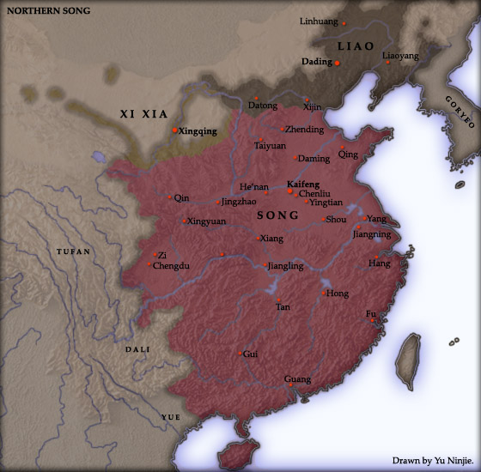
Liao and Southern Song Dynasties
907 to 1125 and 1127 to 1279
Presentation by Emmanuel Rivas

Slide 2
Liao Dynasty, 907-1125CE
The first of the dynasties of conquest.
The dynasty was established by the Khitan people. A proto-Mongol people from the steppe of Manchuria.
Before the founding of the Liao Dynasty, the Khitans participated in the tributary system of the Tang Dynasty.
With the downfall of the Tang Dynasty the Khitan took it as an opportunity to consolidate their power. Abaoji united eight tribes into a federation and established the Liao Dynasty in 907.
He proclaimed himself Grand Kahn of the Khitan. He would later be known as Emperor Taizu, the first Emperor of the Liao Dynasty.

Slide 3
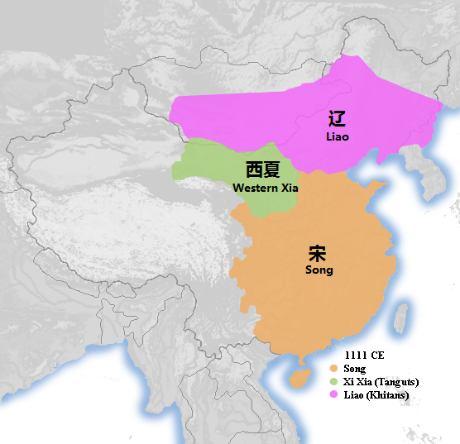

Slide 4
Liao Rule
Emperor Taizu utilized primogeniture to choose his successor and chose his son as his heir apparent.
At the peak of their power they ruled over most of Mongolia and Manchuria and a small strip of China Proper around modern day Beijing. They ruled over sixteen prefectures in Northern China.
They numbered about 750,000 and ruled over two to three million Chinese.
This led to a dual state system with distinct Khitan and Chinese areas. The north was ruled by Khitan tribal leaders, high ranking officials, and imperial relatives. Khitan institutions were utilized as well as the Khitan writing script.
In the south the government resembled the bureaucratic institutions of the Tang. Here both Chinese and Khitan were used to keep records. Important administrative functions were entrusted to their Chinese subjects.

Slide 5
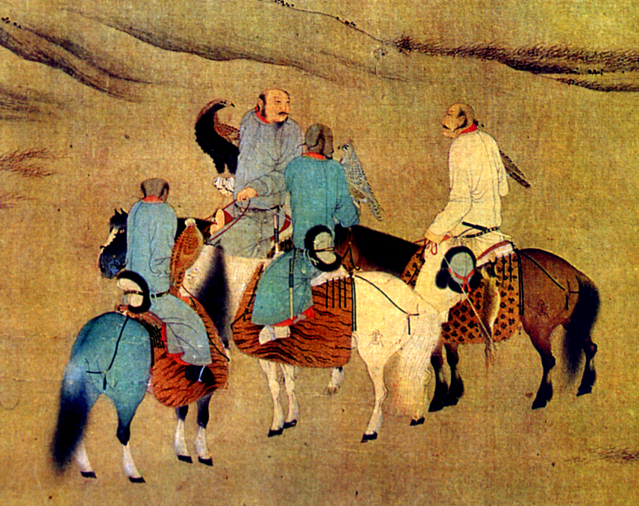

Slide 6
The Downfall of the Liao Dynasty
The Khitans intimidated their surrounding neighbors. Instead of attempting to defeat them in battle, The Song paid tribute to the Khitans to keep peace.
In the early twelfth century, the Jurchen people from eastern Manchuria under the leadership of Aguda, formed a confederation of Jurchen tribes and established the Jin dynasty.
The Jin Dynasty soon allied itself with the Song and attacked the Liao defeating them in 1125 with the capture of Emperor Tianzuo.
Some Khitans survived and established a new empire in central Asia. This Western Liao Dynasty survived until 1218 when it was conquered by the Mongol Empire.

Slide 7
Southern Song Dynasty, 1127-1279
After the defeat of the Liao, the Song thought they had found an ally in the Jin. This led to an alliance which called for the division of Khitan territory.
The alliance soon fell apart and the Jin turned on the Song. The Jin laid siege to the Song capital of Kaifeng. Emperor Huizong abdicated in favor of his son Qinzong. The Jin captured both men and the imperial family.
The Jin pushed the Song past the Huai River. The Song eventually controlled the area south of the river.
The Southern Song capital was established at Hangzhou with Gaozong, the only son of Emperor Huizong that escaped, proclaimed as Emperor.

Slide 8
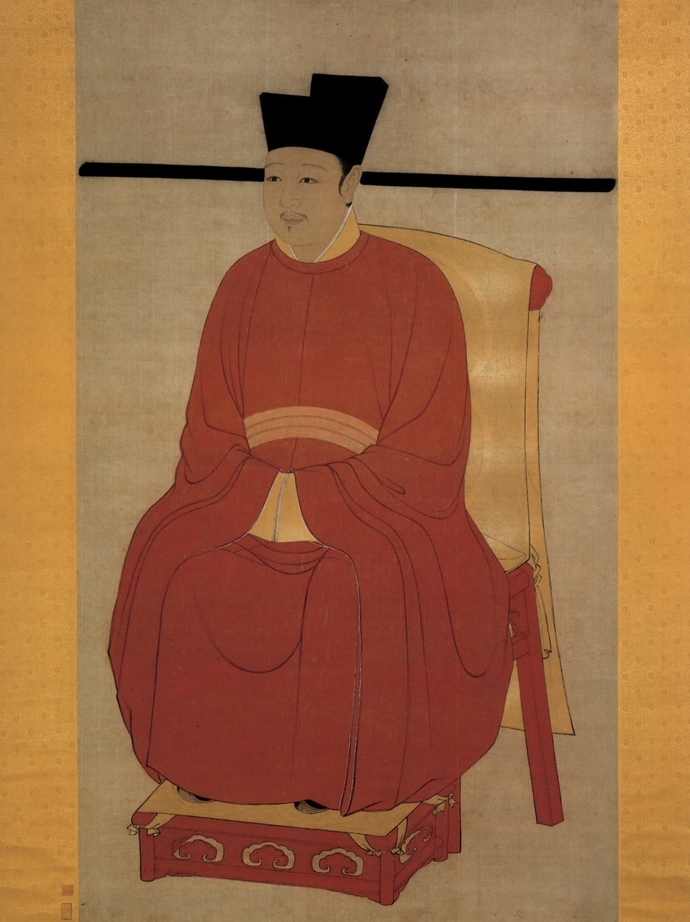
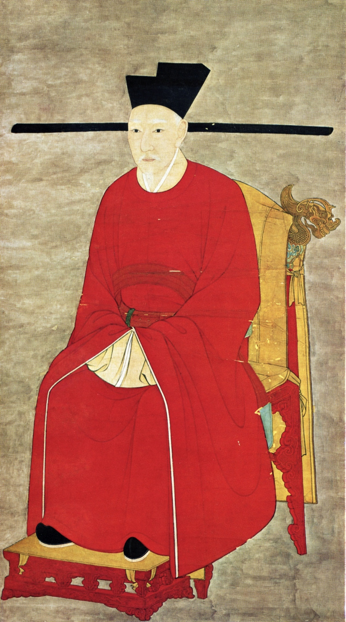
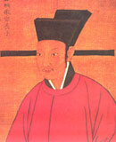

Slide 9
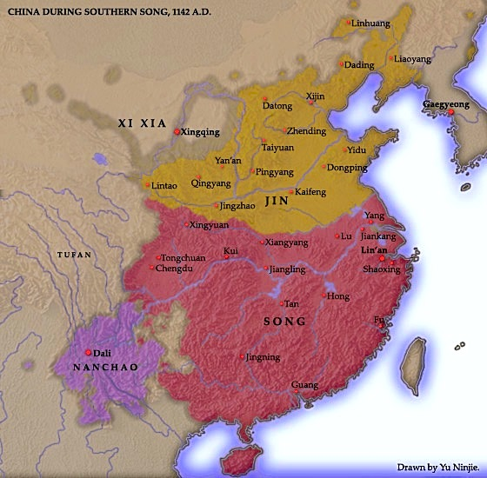

Slide 10
Southern Song Dynasty Rule
In 1142 the government concluded a treaty with the Jin which stipulated that the Song pay annual tribute payments. Some scholars saw this as a humiliation.
The Southern Song Dynasty is considered a weak dynasty and seen as a vassal state. Yet some scholars saw the Song period as a whole as the cultural high point of China.
During the period ceramics, painting, and calligraphy flourished and education was stressed as the only route to success. The bureaucratic system of government was further refined.

Slide 11
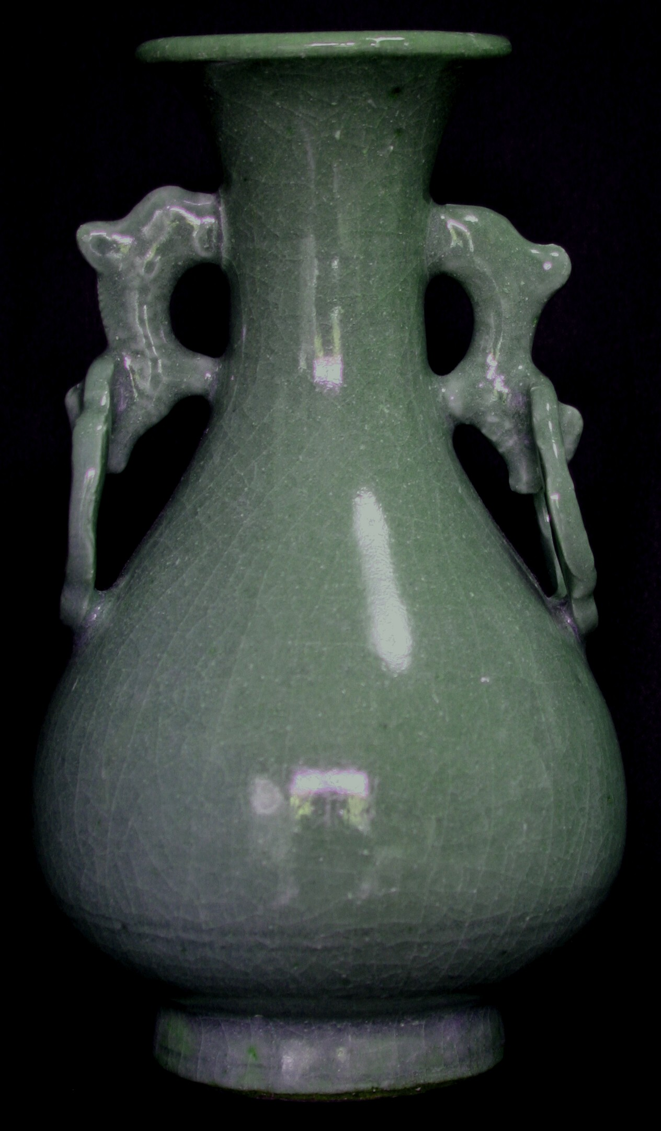
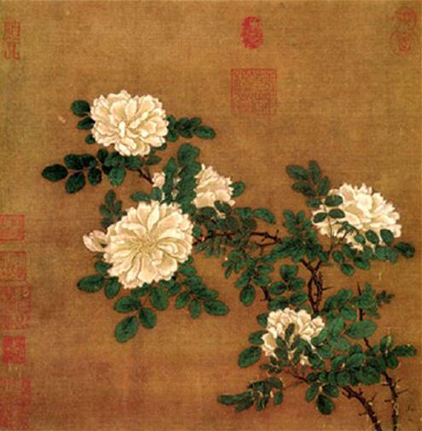

Slide 12
Economy
The capital in the south stimulated economic development. Goods could be transported more economically to Hangzhou by boat. The Jin continued to import vast quantities of tea, rice, sugar, and books from the south.
The ports of Guangzhou, Fuzhou, and Quanzhou became major maritime trading centers. The magnetic compass allowed ships to sail across the seas instead of hugging the coast. This spurned the development of stronger and more seaworthy ships.
The ships of the Southern Song were stronger and studier than the western ships of the period.

Slide 13
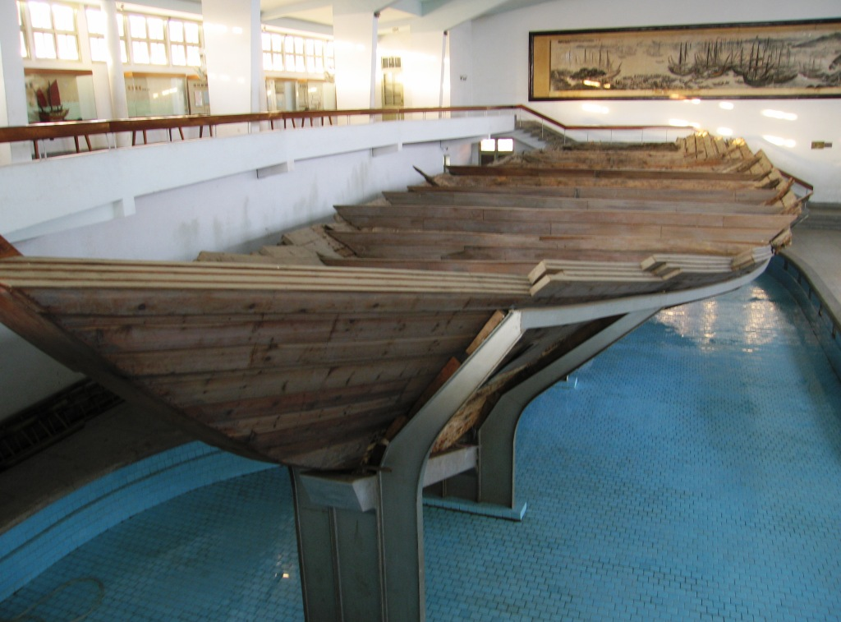
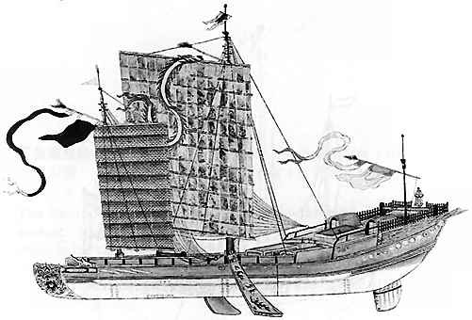

Slide 14
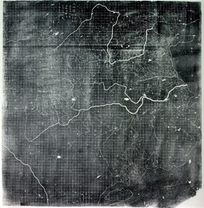

Slide 15
Confucianism in the Southern Song Dynasty
Confucian scholars were frustrated with the failure to regain the north.
They advocated ways of reforming society by starting at the bottom with families and communities. They established academies and published books to spread their message.
Zhu Xi was one of these advocates and played an active role in establishing academies. He focused on the “investigation of things.”
The expansion of printing allowed ideas and practices to spread. Ordinary people had access to knowledge they didn’t have access to before.

Slide 16
The End of the Song
Genghis Khan and the Mongols began a campaign of conquest across Asia. He succeeded in conquering Mongolia and Manchuria. He pushed the Jurchen south past the Yellow River.
In 1234 Ogodei, the song of Genghis, crushed the Jin and took over north China. The next ruler, Khubilai established the Yuan Dynasty in 1271 and moved to attack the Song.
After a siege of Xiangyang that lasted five years, the Mongols crossed the Yangzi. In 1279, in a naval battle off the coast of Guandong, the last of the Song loyalists were defeated ending the Song Dynasty.

Slide 17
Sources
De Bary, WM. Theodore, and Irene Bloom, eds. Sources of Chinese Tradition, vol 1, From Earliest Times to 1600. New York: Columbia University Press, 1999.
Ebrey, Patricia. Cambridge Illustrated History of China, Second Edition. Cambridge: Cambridge University Press, 2010.
Lary, Diana. Chinese Migrations: The Movement of People, Goods, and Ideas Over Four Millennia. Lanham: Rowman and Littlefield Publishers, 2012.
Twitchett, Denis, and John K. Fairbank, eds. The Cambridge History of China: Volume 5, Part One: The Sung Dynasty and its Precursors, 907-1279. Cambridge: Cambridge University Press, 2009.
Twitchett, Denis, and John K. Fairbank, eds. The Cambridge History of China: Volume 6, Alien Regimes and Border States, 907-1368. Cambridge: Cambridge University Press, 2009.

