Slide 1

China : Warring States Period - Unification under “Qin"
秦

Slide 2

Began 771 BC until 476 BC, the first half of the Eastern Zhou Dynasty
Called the Spring and Autumn Period
春秋時代

Slide 3
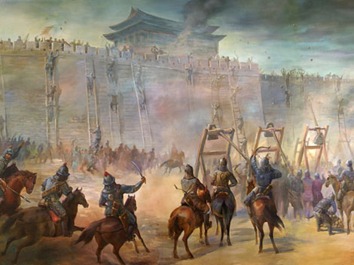
Warring States Period
The Warring States Period saw the introduction of many innovations to the art of warfare in China, such as the use of iron and of cavalry

Slide 4
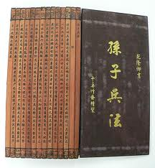
[370-340 BC]
King Hui of Wei started a large-scale attack on Zhao. uThe state of Qi intervened(Sun Tzu: Art of War)
Then Wei attacked Han
By using the same tactic, Qi feigned a retreat and then turned on the overconfident Wei troops and decisively defeated them.
Qi and Qin became the dominant states in China.

Slide 5

Attacks and Alliances [301-284 BC]
294 BC: Qi and Qin planned an attack on Zhao but were later persuaded against it.
285 BC: Wei and Yan formed an alliance.
Yan attacked Qi. Chu declared itself an ally of Qi. Qi's armies were destroyed and the King Min was slain.

Slide 6

[284-260] Zhao Period 趙
Since Chu was defeated along with Qi, the remaining powers were The Qin in the West and the Zhao in the North
Zhao increased its cavalry and defeated two Qin armies
In 265 BC Qin attacked Han, the gateway to Zhao, Zhao resisted but were weakened.
Because the other states did not form alliances against Qin, it became very powerful

Slide 7
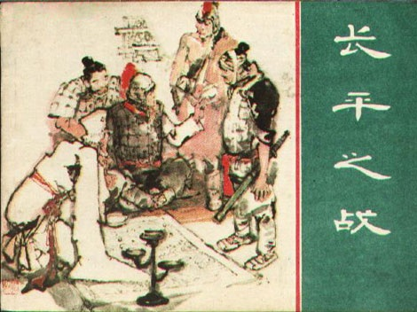
The Rise of Qin BC [280-221]
278 BC: captured the Chu capital
265 BC: Qin started a war with Han, to open up the Yellow River corridor xi.
260 BC: Zhao aided Han but its power was broken by Bai Qi at the Battle of Changping. Qin was now the strongest state in China.

Slide 8
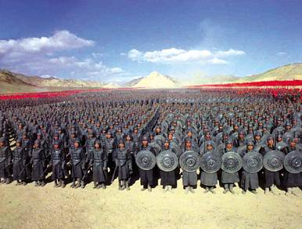
The Succession of Qin
In 230 BC, the Qin state conquered the Han state. Han was the weakest of the Seven Warring States.
225 BC: Qin conquers Wei. Flooding the strong city walls by use of the Yellow river.
223 BC: Qin defeats the Chu state but only after some effective counter-attacks. After a while Chu defenders disbanded and Qin completed a sucessful attack.
At their peak, the combined armies of Chu and Qin are estimated to have ranged from hundreds of thousands to a million soldiers.
In 222 BC, Qin conquered Yan and Zhao, after a failed assasination attempt.
221 BC: Qin conquers Qi, Qi had not previously allied with any other state and quickly surrendered.

Slide 9
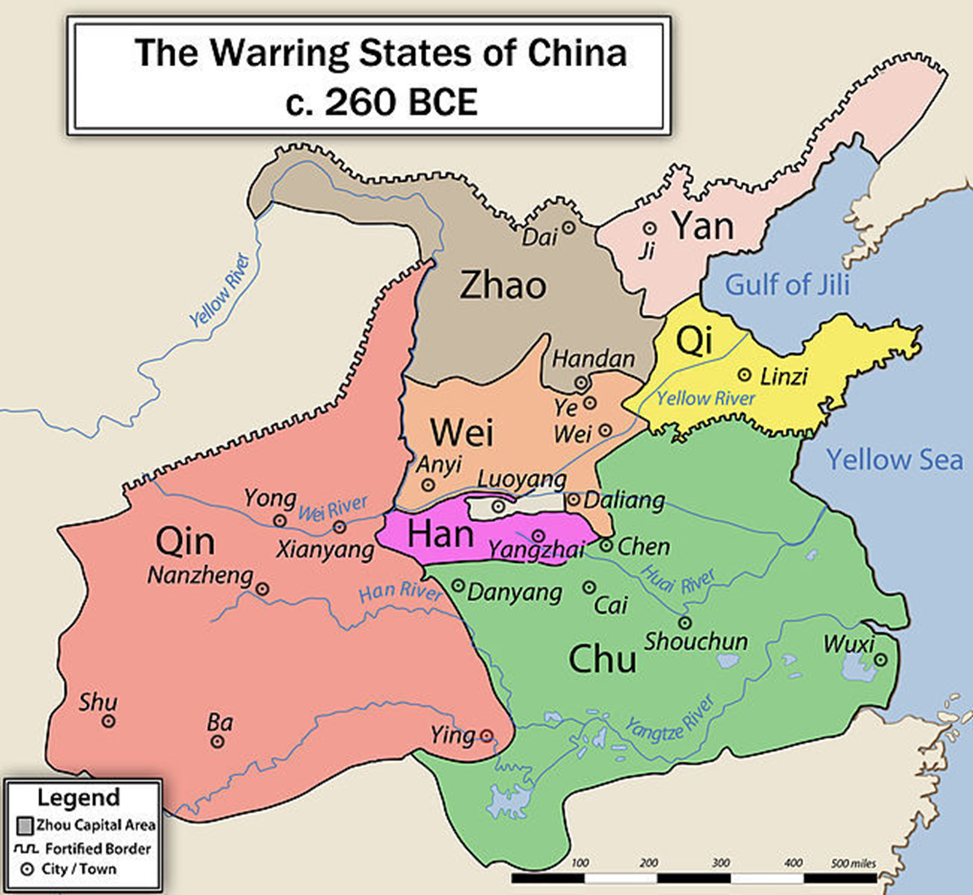

Slide 10
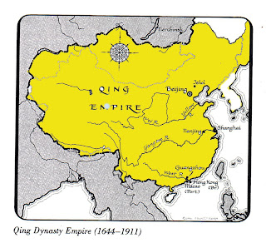
Unification under Qin
Society and culture could begin to flourish once again.
The Qin dynasty influenced many future Chinese empires
The European name for China is thought to be derived from it.

