Slide 1
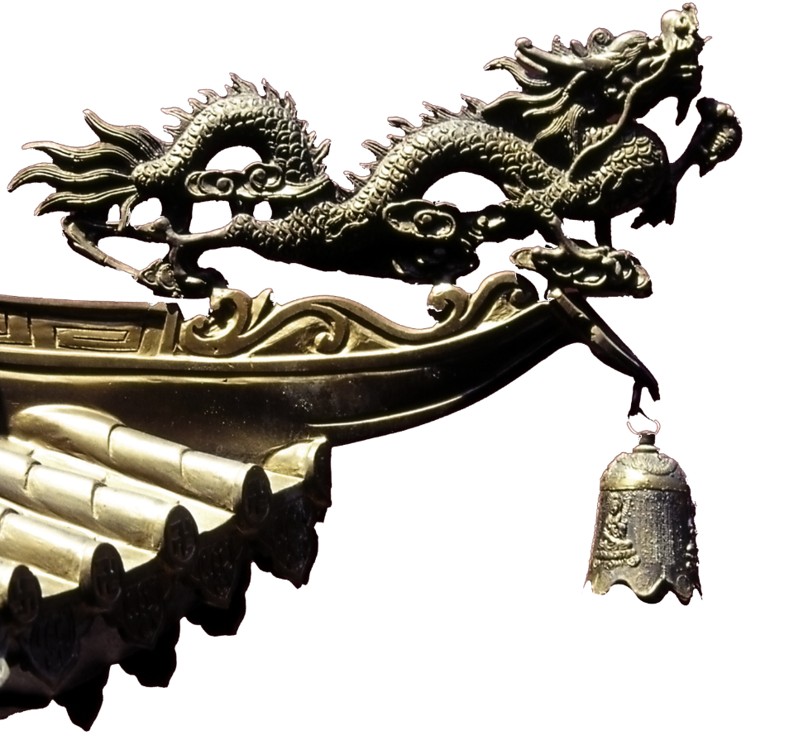



Chinese
Classical Fairy Tales

Slide 2

Jingwei Tries to Fill the Sea
The Great Flood of Gun-Yu
Content
The Legendary of Nian
The Type of Chinese Myth

Slide 3
Jingwei Tries to Fill the Sea
精卫填海

Slide 4
又北二百里，曰发鸠之山，其上多柘木，有鸟焉，其状如乌，文首，白喙，赤足，名曰：“精卫”，其鸣自詨（音同“笑”）。是炎帝之少女，名曰女娃。女娃游于东海，溺而不返，故为精卫，常衔西山之木石，以堙（音同“音”）于东海。漳水出焉，东流注于河。——《山海经》
精卫填海

Slide 5
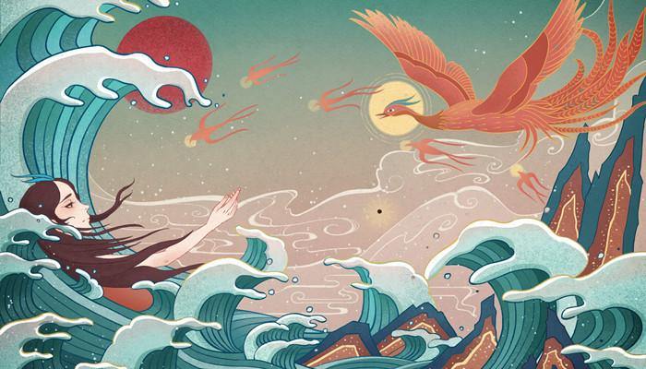
Three thousand ninety li farther southeast, then northeast, stands Departing-Doves Mountain（发鸠山）. On its heights are many mulberry trees（桑树）. There is a bird dwelling here whose form resembles a crow with a patterned head, white beak, and red feet. It is called Jingwei and makes a sound like its name. She is the younger daughter of Yandi named Nüwa. Nüwa was swimming in the Eastern Sea when she was unable to return to shore and drowned. She then transformed into the bird Spirit-Guardian（精卫） and regularly carries twigs and stones from the Western Mountains to fill up the Eastern Sea. The Zhang River（浊漳河） emanates（发源） from here and flows eastward into the Yellow River.

Slide 6
01. The ambition to conquer the sea.
02. Dogged determination and perseverance in the face of seemingly impossible odds.
03. A cherishing of life
04.The myth is a typical metamorphosis myth(变态神话）.
05.Belongs to the myth of "life after death".(the soul is entrusted to a real substance.)

Slide 7
The Great Flood of Gun-Yu
大禹治水（鲧禹治水）

Slide 8

·《山海经·海内经》：洪水滔天，鲧窃帝之息壤以堙洪水，不待帝命。帝令祝融杀鲧于羽郊。鲧复生禹，帝乃命禹卒布土以定九州岛。禹娶涂山氏女，不以私害公，自辛至甲四日，复往治水。禹治洪水，通轘辕山，化为熊。谓涂山氏曰：“欲饷，闻鼓声乃来。”禹跳石，误中鼓，涂山氏往，见禹方坐熊，惭而去。至嵩高山下，化为石，方生启。禹曰：“归我子！”石破北方而启生。
·《史记·夏本纪》“予娶涂山”，“禹伤先人父鲧功之不成受诛，乃劳身焦思，居外十三年，过家门不敢入”，司马贞索隐：“《系本》曰‘涂山氏女名女娲’，是禹娶涂山氏号女娲也。”亦称“ 女娇”、“ 女趫”。
·《尚书·虞书·益稷》篇云：“予创若时，娶于涂山，辛壬癸甲，启呱呱而泣。予弗子，惟荒度土功。”
·《孟子·膝文公上》：“禹八年于外，三过其门而不入。”
·《吕氏春秋》曰：“禹娶涂山氏女，不以私害公，自辛至甲四日，复往治水。”

Slide 9
The Great Flood of Gun-Yu, also known as the Gun-Yu myth, was a major flood event in ancient China that allegedly continued for at least two generations, which resulted in great population displacements among other disasters, such as storms and famine. People left their homes to live on the high hills and mounts, or nest on the trees. According to mythological and historical sources, it is traditionally dated to the third millennium BCE, or about 2300-2200 BC, during the reign of Emperor Yao. Yu tried a different approach to the project of flood control; which in the end having achieved success, earned Yu renown throughout Chinese history, in which the Gun-Yu Great Flood is commonly referred to as "Great Yu Controls the Waters". Yu's approach seems to have involved an approach more oriented toward drainage and less towards containment with dams and dikes. According to the more fancily embellished versions of the story it was also necessary for him to subdue various supernatural beings as well as recruit the assistance of others, for instance a channel-digging dragon and a giant mud-hauling tortoise.

Slide 10
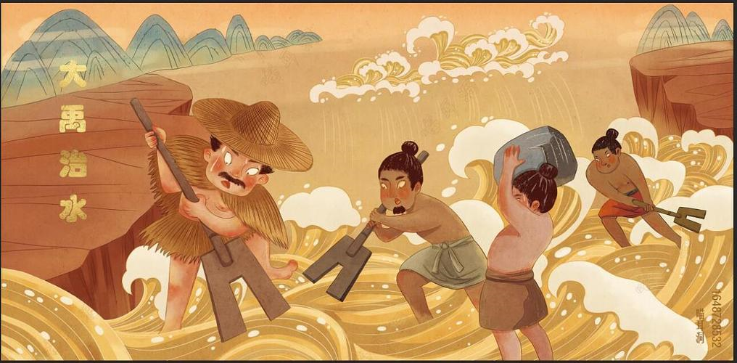
This led to the formation of the spirit of Da Yu's water management,which is based on the concepts of selflessness, national supremacy, people as the foundation of the nation, and scientific innovation. The spirit of the Great Yu is the source and symbol of the Chinese national spirit.
Yu relied on the concepts of hard work, making the best use of the situation, scientific treatment of water and putting people first, and overcame many difficulties to achieve success.

Slide 11
The Legendary of Nian（年）

Slide 12
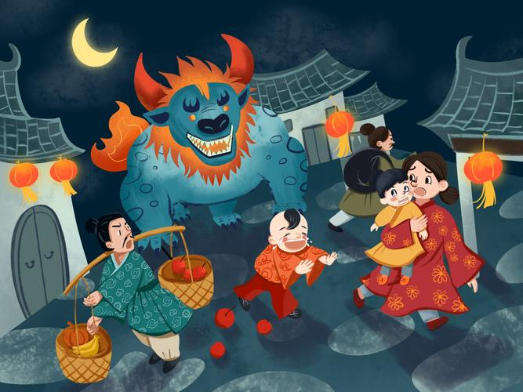
Once every year at the beginning of Chinese New Year, the nian comes out of its hiding place to feed, mostly on men and animals. During winter, since food is sparse, he would go to the village. He would eat the crops and sometimes the villagers, mostly children.
“年兽”这种动物并未出现于古书记载，据祝淳翔考证，首次提到“年兽”的文献来自20世纪30年代初的民国报纸中
The weaknesses of the nian are purported to be a sensitivity to loud noises, fire, and a fear of the color red.
《诗经·豳风·东山》记载：“自我不见，于今三年。”（意思是自从我们不相见，至今时隔已三年）
It resembles a flat-face lion with a dog's body and prominent incisor(门牙）.
It is larger than an elephant with two long horns（角） and many sharp teeth.
The reason why people consider the year as a monster is because the earth and sky bring food and clothing, as well as disasters. Therefore, it is important to start the year with a respect for nature and to pray for blessings through rituals.

Slide 13
The type of Chinese mythology

Slide 14

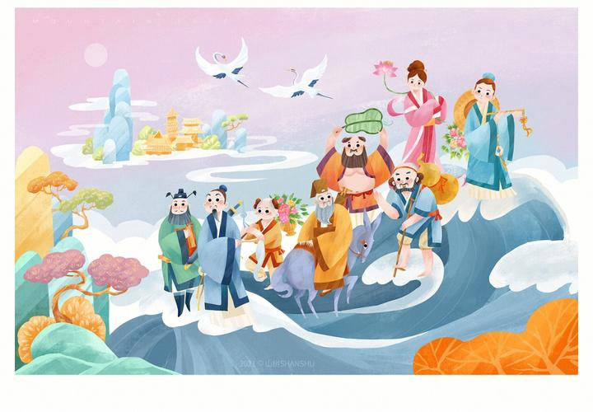
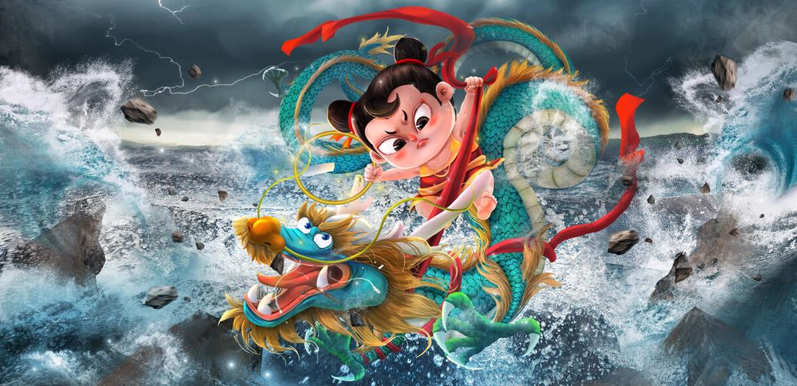
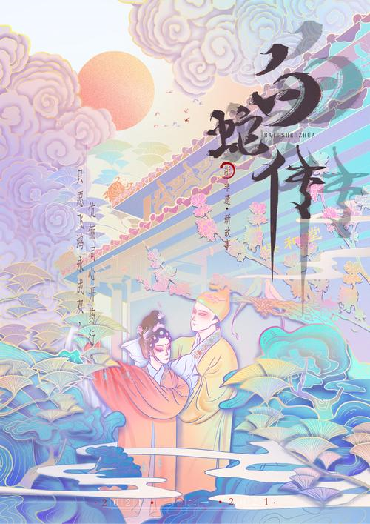
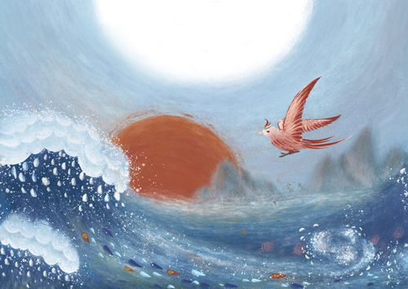
01
03
Chinese ancient myth
Folklore
Jingwei Tries to Fill the Sea
Madame White Snake
02
04
Religious myth
Literary myth
The Eight Immortals Crossing the Sea
哪吒闹海、西天取经

