Slide 1
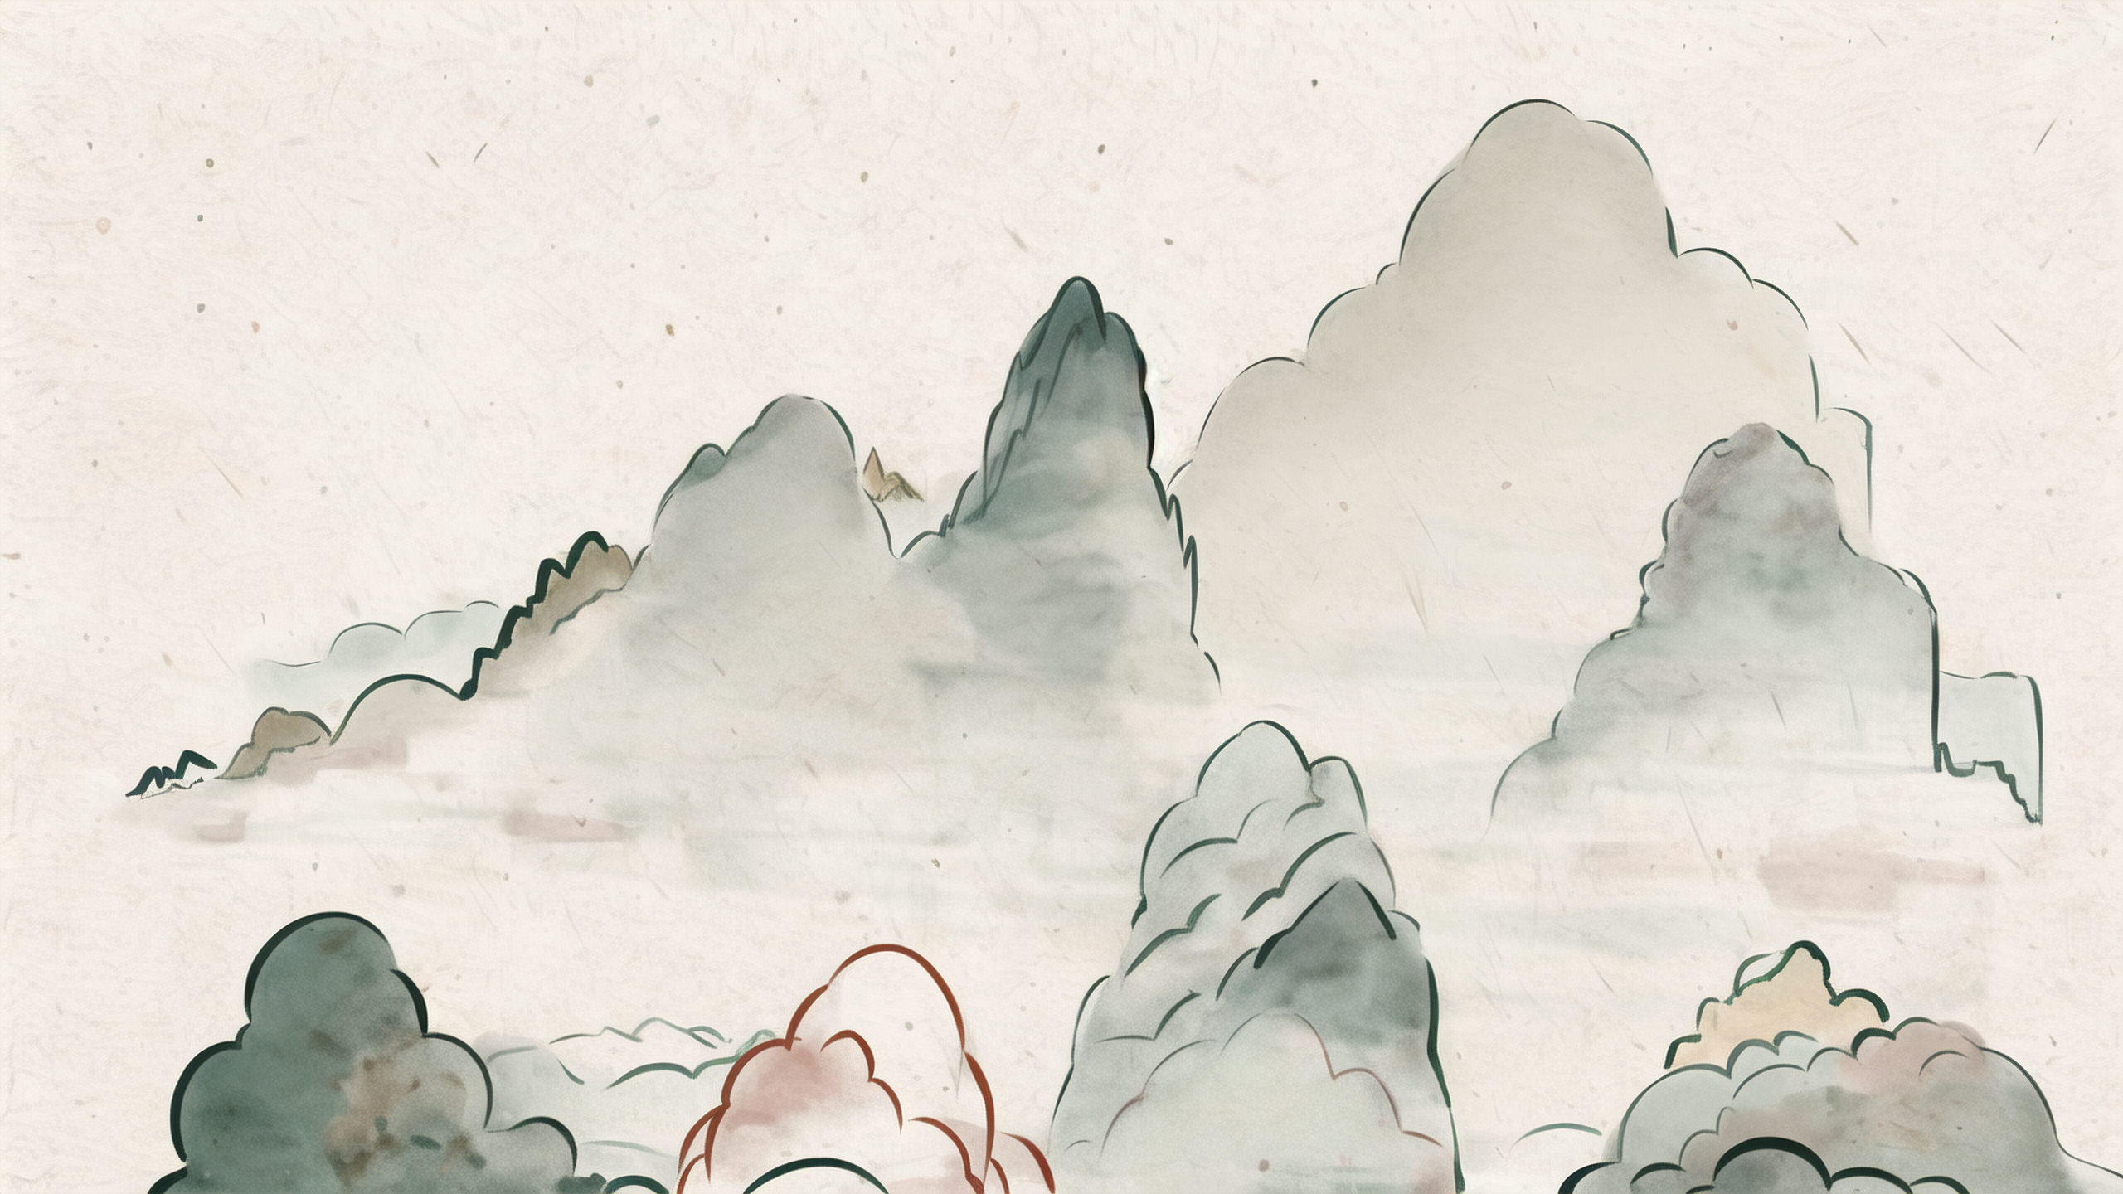
Ancient Chinese Pentatonic Scale
Gong, Shang, Jue, Zhi, Yu
Han Yaxuan

Slide 2
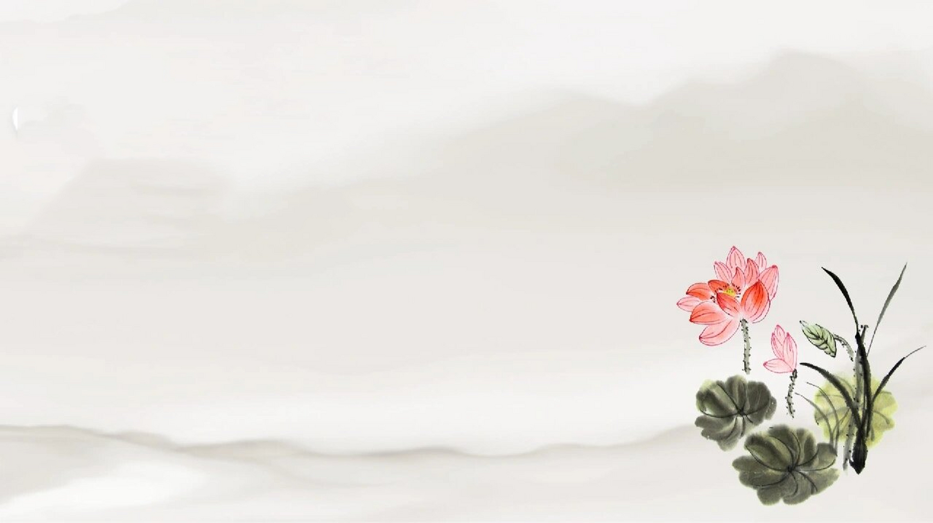
Contents
Introduction
Origin
Connotation
Characteristics

Slide 3

Introduction
Ancient Chinese pentatonic scale
a fundamental element of Chinese music
rooted in traditional aesthetics and philosophy.
a reflection of the ancient Chinese belief in the harmonious unity of nature and the cosmos
a cornerstone of traditional Chinese music

Slide 4
Origin
dates back to the prehistoric era
first used in primitive folk music and ritual
In Guanzi· Di Yuan Pian 《管子·地员篇》
a scientific method to obtain the five sounds of Gong, Shang, Jue, Zhi, Yu

Slide 5
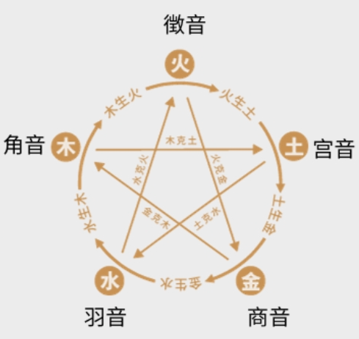
Connotation
Gong: earth; stability and grounding sound
Shang: metal; has a bright and resonant sound
Jue: wood; associated with a clear and piercing tone
Zhi: fire; known for its lively and energetic sound
Yu: water characterized by its smooth and flowing melody.

Slide 6
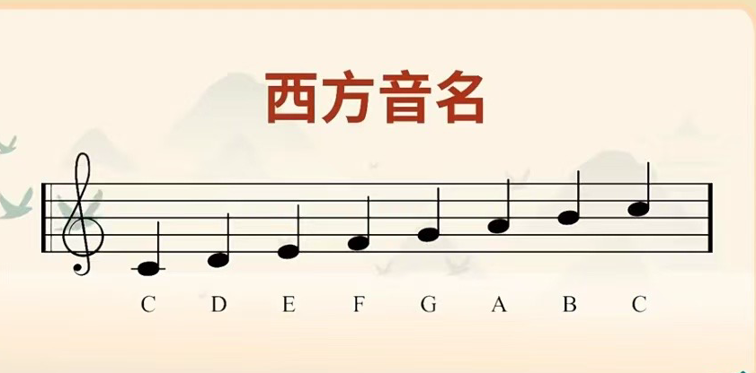

Characteristics
simplicity, purity, and balance
correspond to the Western musical scales-Gong to C, Shang to D, Jue to E, Zhi to G, and Yu to A
two fewer notes than the Western scale

Slide 7

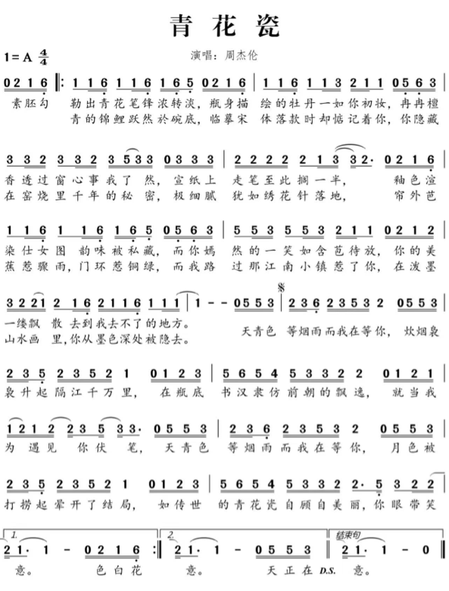

Slide 8
Thank you!

