Slide 1
中国文化
研究生课（研一）
Kultura chińska | Chinese Culture for first year Master Students
第三周 Session 3
5月5日——6月23日，周五下午3:30-5:00和5:15-6:45, (30 x 45 分钟)
Fridays 15:30-17:00 and 17:15-18:45, May 5 – June 23 (30 x 45 min.)
教室 Classroom 413
助教： Martyna 泊语丰 Bo Yufeng
吴漠汀助理教授 Assistant Professor Dr. Martin Woesler

Slide 2
Students Introduction 自我介绍
(Later also introduce yourself shortly during the Wiki Registration.)
Lukasz 黄旭明 Huang Xuming, 茶文化 Tea culture (ceremony), 日语Japanese， 广州带4个月上广外
Martyna 泊语丰 Bo Yufeng, 高中 High School 对亚洲语言感兴趣: Asian languages => Chinese, 国际企业？
Alicja 柯之川 Ke Zhichuan, 高中：语言很有用，找了挑战，对航空业感兴趣
Marianna 麻亮 Ma Liang, 喜欢语言，挑战，翻译
Kalina 吴凯庭 Wu Kaiting, 高中：要学一个跟学校的专业完全不一样的，Gdansk BA，中国历史（基督教）跟欧洲的不同，有意思，中文老师，作家（幻想小说）
Izabela 夏颖姗 Xia Yingshan，克拉科夫，韩语，口译？英语、德语、拉丁语等等
Aleksandra 韩美琳 Han Meilin，喜欢语言，对亚洲文化感兴趣，原来喜欢韩语，然后中文，学过德语、西班牙语、英文
Weronika 舒然 Shu Ran，Gdansk，对外汉语老师、对外英语老师
Daria 史蕤 Shi Rui, Torun 大学（于台湾高雄留学9个月），远东文化系，中国文学，要一份安静的工作
Milena Szczechowska Torun 大学（于台湾高雄留学9个月），中国文学老师
Milena Swieboda 米兰 Mi Lan，高中已经开始学中文，要当翻译（笔译）

Slide 3
Self-Introduction 自我介绍
AMU: Adiunkt 助理教授
HUNNU: Xiaoxiang Scholar Dist. Prof., PhD supervisor 潇湘学者特聘教授、博士导师
Academian, Europ. Acad. of Sciences & Arts, Salzburg 欧洲科学院院士
Jean Monnet Chair Professor 让莫内主席教授
Int‘l Chinese Studies Centre, Director 外语学院国际汉学中心主任
German China Association, President 德中協會主席
World Association of Chinese Studies, President 世界漢學研究會會長
Bochum, Peking, Harvard, Mainz/Germersheim, Witten, Harvard, Orem/USA, Rome, Peking Normal & Witten波鸿，北京，哈佛，美因茨/盖默斯海姆，威腾，哈佛，奥勒姆/美国，罗马，北师大&威腾
Essays (Western influence, social impact, cf.: blogs) 散文（西方的影响，社会影响）
Early literary translations 早期文学翻译
Literature Development (Canonization etc.) 文学的发展（经典，分类）
Early Western reception of Hongloumeng 《红楼梦》在西方的早期反响
Translation workshop (volunteers?) 翻译工作坊（有志愿者可以找我报名）

Slide 4
主题 Topics
下几节课的主题（请在后面加你的名字为了表示关于这个主题做ppt）：
Topics for the coming sessions (please write your name behind a topic to give a presentation):
May 5: 组织方面的事、测试 Organizational things, quizzes
May 12: 文化叙述 The Cultural Narrative, 地理性质是文化发展的基础 Geographic Nature as a Basis for Cultural Development (text book current version page 12 ff.)
May 19: 1 审美理想和社会习俗： 湖南的伴嫁歌 Aesthetic ideals and social customs: Marriage-Accompanying Songs in Hunan 29. 2 审美理想和社会习俗：中国的婚姻习俗 Aesthetic ideals and social customs: Chinese Marriage Customs 16
May 26 1 审美理想和社会习俗：习惯，接触方式。古代和当代的接触方式Aesthetic ideals and social customs: Habits, Ways of Contacting 22. 2 审美理想和社会习俗：土家族的哭嫁 Aesthetic ideals and social customs: Crying Marriage of Tujia 36
June 2 1 审美理想和社会习俗：中国古代的四大才子 Aesthetic ideals and social customs: The Four Most Handsome Men in Ancient China 42. 2 审美理想和社会习俗： 熊猫 Animals: Panda 48.
June 16 1 建筑 Architecture 53. 2 建筑：紫禁城 Architecture: The Forbidden City 60
我们还需要找机会补两个学时的课。另外的主题 Additional topics for 2 hours catch-up:
June 23 期末考试：论文 Final Exam

Slide 5
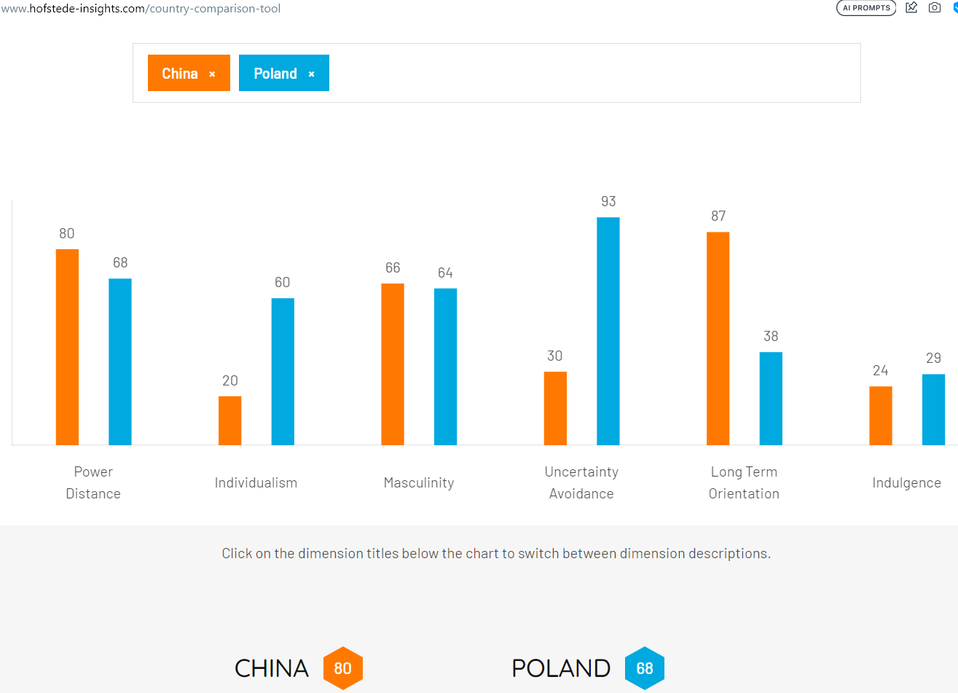

Slide 6
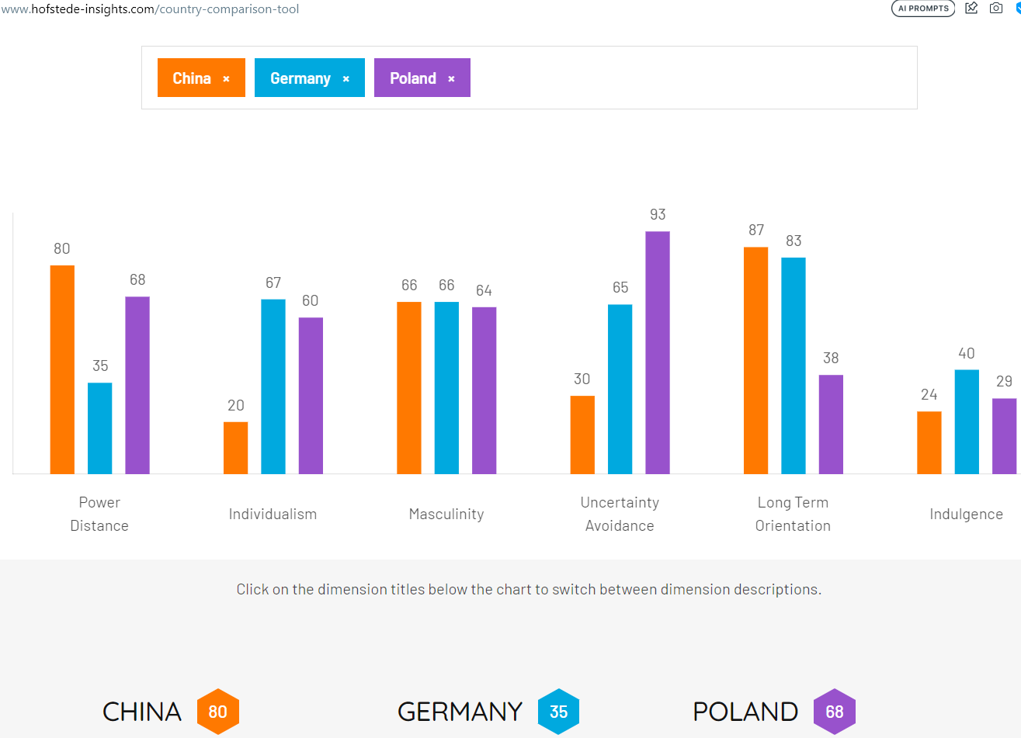

Slide 7
结婚问卷调查 Survey
Menti.com
5847 5618
https://www.menti.com/al9hzgdqxnia

Slide 8
第三周 Session 3
准备第三周的作业 Homework to prepare this session
1. 阅读 Read pages 16-21 and 29-35 of our textbook
2. 填多选题线上测试 Complete the quizzes
* 审美理想和社会习俗：中国的婚姻习俗 Aesthetic ideals and social customs: Chinese Marriage Customs: https://ks.wjx.top/vm/YJzn8Fl.aspx#
* 审美理想和社会习俗： 湖南的伴嫁歌 Aesthetic ideals and social customs: Marriage-Accompanying Songs in Hunan: https://ks.wjx.top/vm/mBp0heY.aspx
3. Choose a topic for your final exam paper (homework)
展示 Presentations
湖南的伴嫁歌
米兰 Milena Swieboda: 湖南的伴嫁歌 Aesthetic ideals and social customs: [[Media:Marriage-Accompanying_Songs_in_Hunan.pptx]]
中国的婚姻习俗
韩美琳 Aleksandra Miernik: 审美理想和社会习俗：中国的婚姻习俗 Aesthetic ideals and social customs: [[Media:Chinese_Marriage_Customs_2023.pptx]]

Slide 9
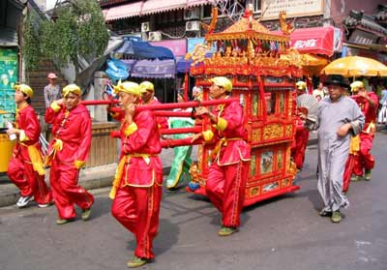
Marriage

Slide 10
Chinese Marriage Customs

Slide 11
Introduction
China is an ancient country of rites. When it comes to the most important thing in one’s life---marriage, Chinese people have developed a set of unique and grand ceremonies. Generally speaking, weddings in ancient China needed to be approved by parents and arranged by parents.

Slide 12
Contents
1
Six Procedures
2
Customs
3
Development

Slide 13
1
Six Procedures
Na Cai
Wen Ming
Na Ji
Na Zheng
Qing Qi
Qin Ying

Slide 14
1
Na Cai

Slide 15
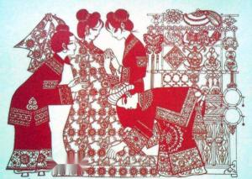
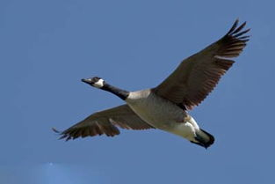
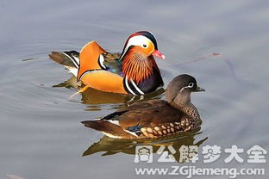
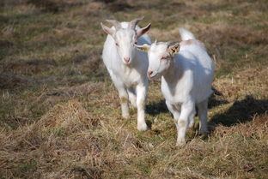
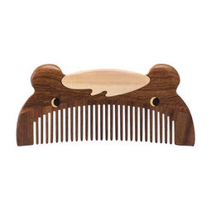
Na Cai is the begining of all the marriage processes. It refers to a practice that if a boy intends to marry a girl, firstly his family must invite a matchmaker to the girl's home to propose marriage
wild goose
mandarin ducks
wooden comb

Slide 16
2
Wen Ming

Slide 17
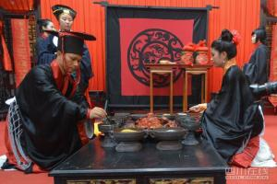
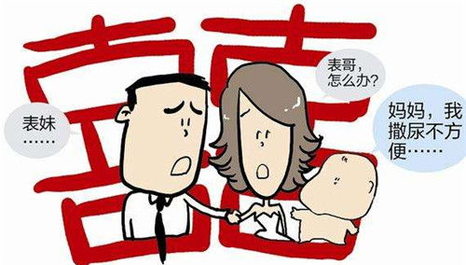
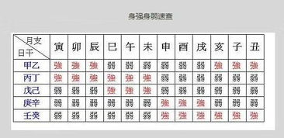
Wen Ming means that the boy's family asks the matchmaker to fetch the girl's name and date of birth.
assure the compatibility of the prospective bride and bridegroom through their “eight characters” of the birth moment.
prevent the marriage of close relatives with the same surname

Slide 18
3
Na Ji

Slide 19
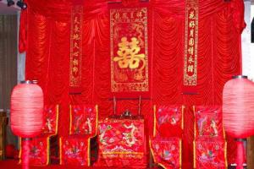
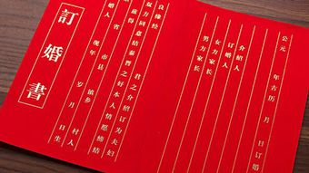
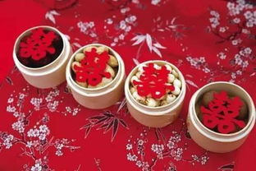
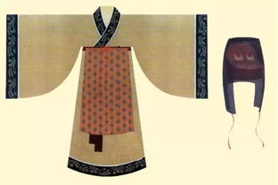
Naji happens after the matchmaker takes back the woman's name and eight characters. If divining an lucky portent, the boy's family will inform the girl’s parents and decide to engage the marriage.
What is more, Na Zheng is an important step when the boy sends engagement presents to the girl and for courtesy the girl will send back part of the presents such as food and some clothes.

Slide 20
4
Na Zheng

Slide 21
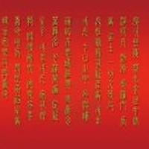
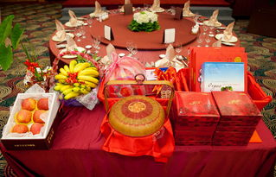
Nazheng is the ancient marriage custom of Han nationality“ The fourth of the six gifts, also known as "Nacheng", means that a man's Naji gives a bride price to a woman's.
The completion of acceptance marks the end of the engagement stage and is one of the main signs of the establishment of marriage.

Slide 22
5
Qing Qi

Slide 23
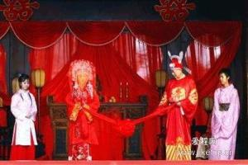
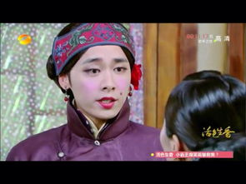
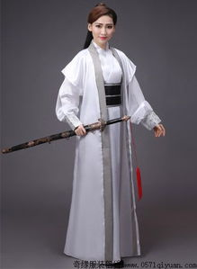
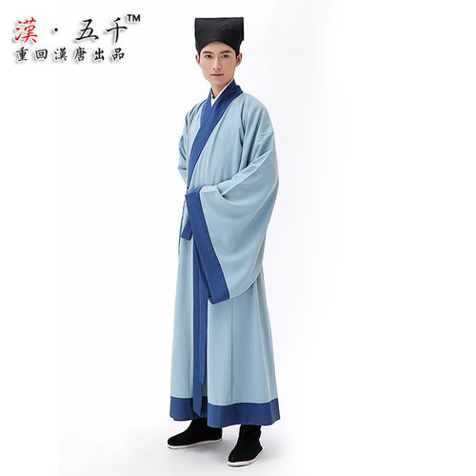
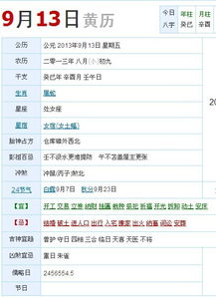
Qing Qi means that the boy's family choose a lucky day to hold the wedding ceremony and then dispatch the matchmaker to tell the girl’s family.
Qing Qi

Slide 24
6
Qin Ying

Slide 25

Qin Ying
Qin Ying is the last process of the six processes, that is, the groom goes to the bride's home to take the bride to his home.

Slide 26
2
Customs
In addition to the six steps mentioned above, there are many other customs in the traditional Chinese wedding ceremony. Generally speaking, ancient marriage was ordered by parents and matchmaker and many young people could not master their own marriage. Before wedding ceremony, men and women were not allowed to meet each other in that ancient people were very conservative and most girls were kept in boudoirs. If they met in private before marriage, it would be regarded as a kind of female infidelity and parents would also think it quite unlucky. Under this condition, newcouples could only see each other until the day of marriage.

Slide 27
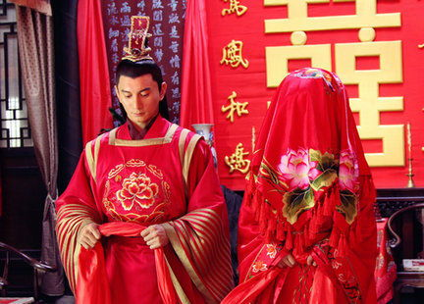
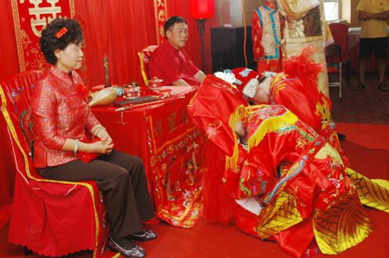
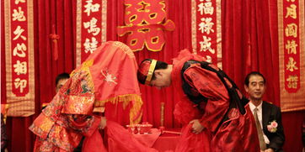
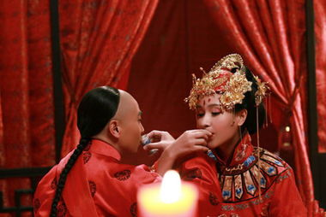
After that, the following step is the most grand one among the whole ceremony --- at the dusk moment, the groom and the bride, his parents as well as all the guests will gather together at the central room to witness the kneeling steps of the couple, which consists of 4 steps
Kneel down to heaven and earth
the new couple kowtow towards each other
drink “ cross-cupped wine ”
Kneel down to parents

Slide 28
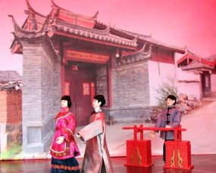
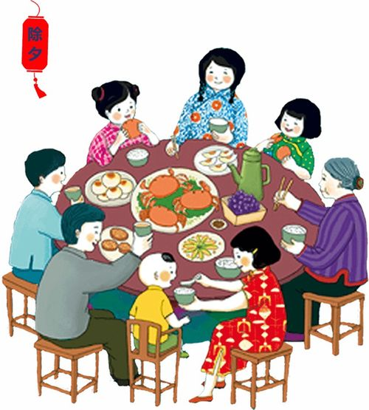
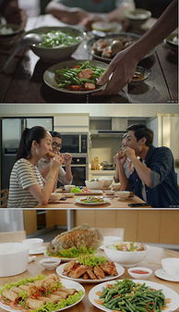
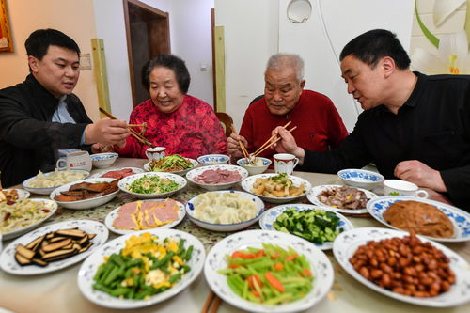
After wedding ceremony, the couple must return to the girl’s home together at the third day, which is called “Huimen” or “Guiling”. This step is indispensable. The groom should take some gifts for respect and change the way that he addresses the bride’s parents, and the latter will also prepare a good meal for the couple’s coming.
Hui Meng

Slide 29
4
Development

Slide 30
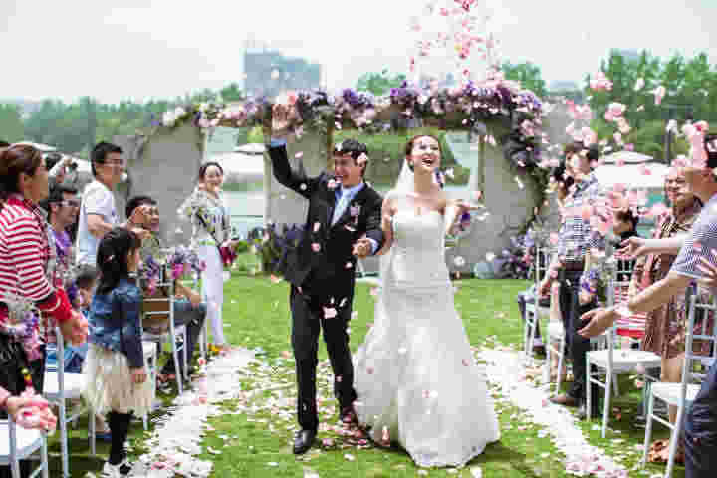

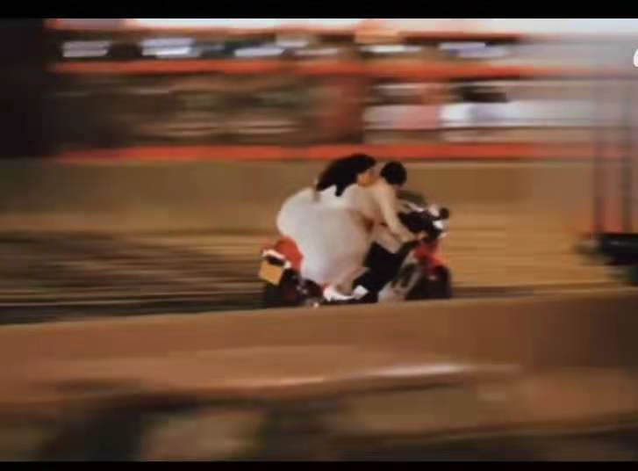
As time goes by, there are many reforms about marriage nowadays. Adults own the freedom to choose their form and they can meet each other every day if possible. Parents can’t master their “life event” any more. In addition, many couples skip the cumbersome rites in the wedding ceremony. Some of them choose to hold the ceremony in the church with some close relatives and friends and some even finish it through travel.

Slide 31
这是什么情况？
https://www.menti.com/al38zzobwpwa
8325 4726

Slide 32
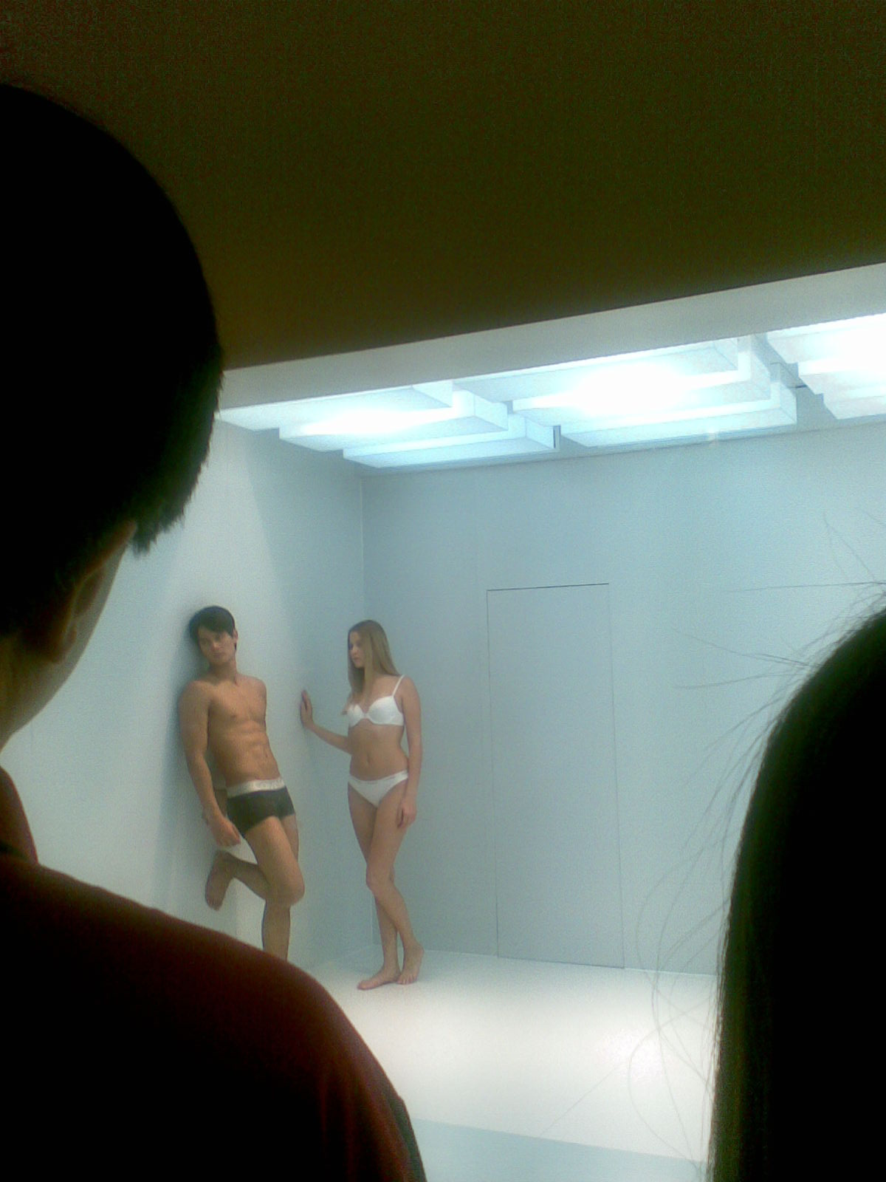
4. Kulturstandards am Bei-spiel Deutschland-China

Slide 33
为什么青年网络拥护者热烈讨论这个卡尔文·克莱恩广告？

Slide 34
态度？没有偏见？当你自己受到影响时……

Slide 35
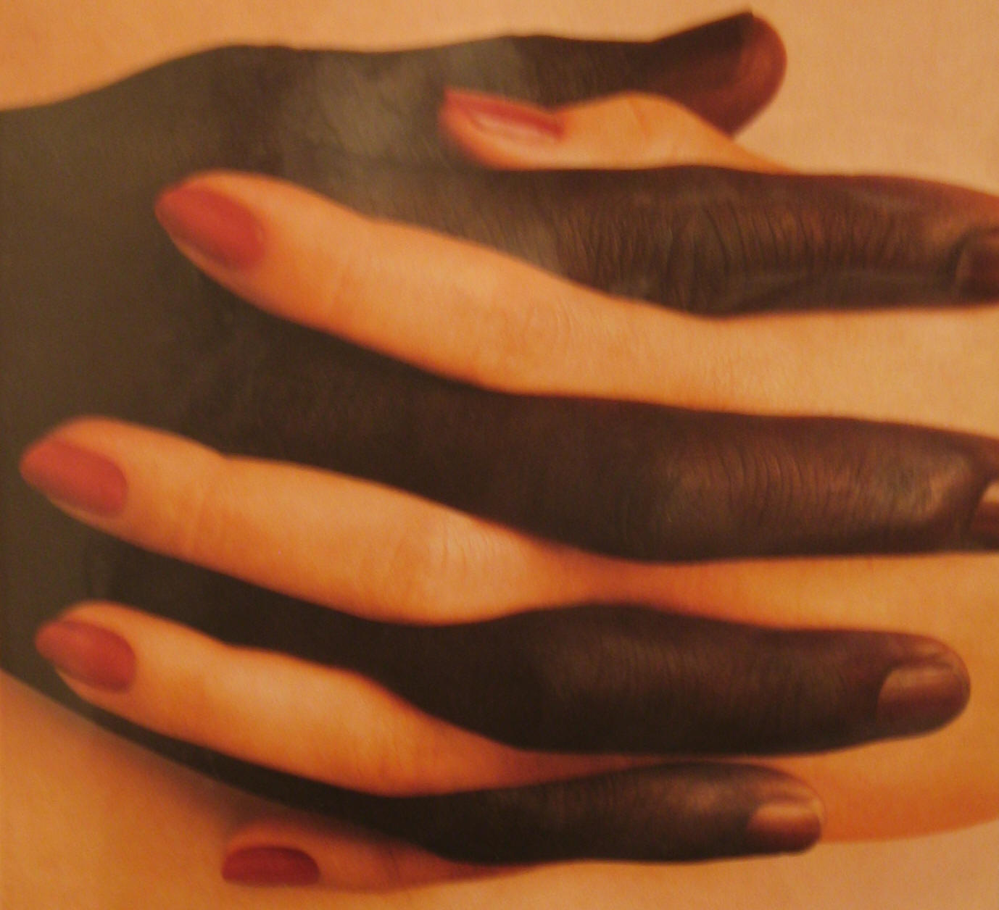
态度？没有偏见？当你自己受到影响时……

Slide 36
态度？没有偏见？当你自己受到影响时……
数据:
10 让她走，19不让她走。
„只不
要跟
这种
人结
婚！ “

Slide 37
今天最后一节课
在wiki上注册 https://bit.ly/WIKIREG
选“助教”、wiki admin、quiz assistants
请参加不同问卷调查https://bit.ly/100_questions, http://bit.ly/EU-SURVEY
选主题，看第二周那边，加你的名字（选下个礼拜的主题的同学麻烦准备ppt，课网页上上传）
准备下个星期的课文（主题1）
回答关于主题的问题

Slide 38
作业
在wiki上注册 https://bit.ly/WIKIREG
选“助教”、wiki admin、quiz assistants
请参加不同问卷调查https://bit.ly/100_questions, http://bit.ly/EU-SURVEY
选主题，看第二周那边，加你的名字（选下个礼拜的主题的同学麻烦准备ppt，课网页上上传）
准备下个星期的课文（主题1）
回答关于主题的问题

Slide 39
Preparation for next week
下週的課前預習
下几节课的主题（请在后面加你的名字为了表示关于这个主题做ppt）：
Topics for the coming sessions (please write your name behind a topic to give a presentation):
May 5: 组织方面的事、测试 Organizational things, quizzes
May 12: 文化叙述 The Cultural Narrative, 地理性质是文化发展的基础 Geographic Nature as a Basis for Cultural Development (text book current version page 12 ff.)
May 19: 1 审美理想和社会习俗： 湖南的伴嫁歌 Aesthetic ideals and social customs: Marriage-Accompanying Songs in Hunan 29. 2 审美理想和社会习俗：中国的婚姻习俗 Aesthetic ideals and social customs: Chinese Marriage Customs 16
May 26 1 审美理想和社会习俗：习惯，接触方式。古代和当代的接触方式Aesthetic ideals and social customs: Habits, Ways of Contacting Milena 22. 2 审美理想和社会习俗：土家族的哭嫁 Aesthetic ideals and social customs: Crying Marriage of Tujia 36 Daria
June 2 1 审美理想和社会习俗：中国古代的四大才子 Aesthetic ideals and social customs: The Four Most Handsome Men in Ancient China 42. 2 审美理想和社会习俗： 熊猫 Animals: Panda 48.
June 16 1 建筑 Architecture 53. 2 建筑：紫禁城 Architecture: The Forbidden City 60
我们还需要找机会补两个学时的课。另外的主题 Additional topics for 2 hours catch-up:
June 23 期末考试：论文 Final Exam

Slide 40
Always here for you!
隨時隨地为你们服务
Assistant Professor (Adiunkt) Dr. Martin Woesler
吴漠汀助理教授
Office / 办公室:
Phone / 电话: +49 178 2073538, +48 152 664204
Email / 电子邮件: martin@woesler.de, martin.woesler@amu.edu.pl

Slide 41
Thank You

