Slide 1



Written Translation
from and into Chinese
水墨
小组成员：朱丽娟、钟青、段小蝶、周哲
2022.4.15

Slide 2
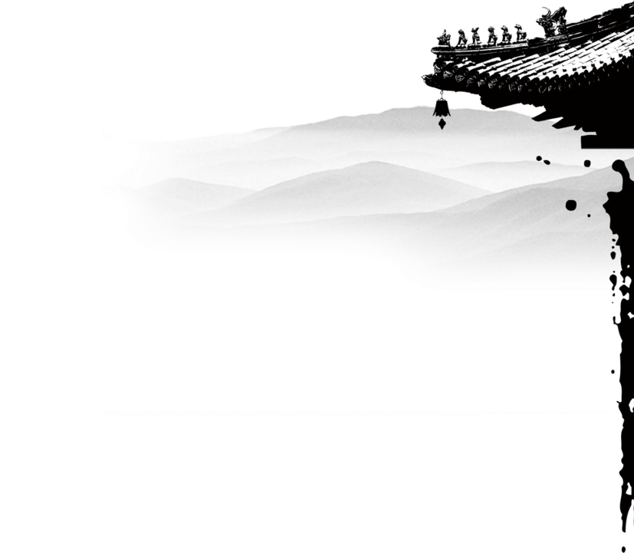


Part One
Western Classics Translated into Chinese

Slide 3


Ⅰ
Ⅱ
Ⅲ
Ⅳ
Late Qing Dynasty
and early Republic of China
New Democratic
Revolution Period
Early Period of New China
the Contemporary Era

Slide 4

Late Qing Dynasty and
early Republic of China
（1840s~1920s）

Slide 5
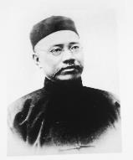
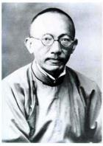
Translation of Western Social Science Classics
Evolution and Ethics 《天演论》
The Wealth of Nations 《原富》
Yan Fu（严复）
Principles of Sociology 《社会学原理》
Ma Junwu（马君武）

Slide 6
New Democratic Revolution Period
(1919~1949)

Slide 7

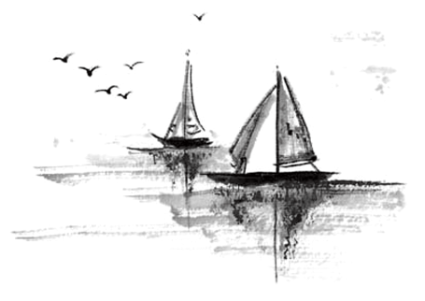
Translation of Marxist Works
The Materialist Conception of History
《唯物史观》
Dialectics of Nature
《自然辩证法》
The Communist Manifesto
《共产党宣言》

Slide 8
Early Period of New China
（1949~1965）

Slide 9
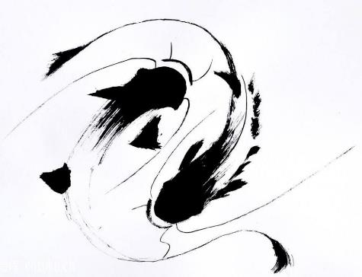
Translation of Russian-Soviet Literature
Maxim Gorky My Childhood 《童年》
马克西姆·高尔基 My Universities 《我的大学》
In the World 《在人间》
Leo Tolstoy War and Peace 《战争与和平》
列夫·托尔斯泰 Anna Karenina 《安娜·卡列尼娜》

Slide 10
the Contemporary Era
(1970s~)

Slide 11

Translation of the Works of Schools of Social Thought in Modern West
Freudian psychoanalysis A General Introduction to Psychoanalysis
弗洛伊德 精神分析理论 《精神分析概论》
Schopenhauer’s Volitionism The World as Will and Representation
叔本华 唯意志论 《作为意志和表象的世界》 ……
Translation of Western Modernist Literature
Hemingway The Old Man and the Sea
海明威 《老人与海》
Gabriel Garcia Marquez one hundred years of solitude
加夫列尔·加西亚·马尔克斯 《百年孤独》 ……
Translation of Contemporary Western Popular Literature
Agatha Christie Death on the Nile
阿加莎·克里斯蒂 《尼罗河上的惨案》
J. k. Rowling Harry Potter
J.K.罗琳 《哈利·波特》 ……

Slide 12
Part Two
Translation of Chinese Classics in Western World

Slide 13


01
In the Late Ming and Early Qing Dynasties
Contents
02
In the 19th Century
03
In the First Half of the 20th Century
04
After the 1960s

Slide 14
01
In the Late Ming and Early Qing dynasties

Slide 15
The western translation of Chinese classics started in the late Ming and early Qing dynasties
The Italian missionary Michele Ruggieri (1543-1607) translated parts of The Great Learning into Latin.
In 1593, Italian missionary Matteo Ricci translated The Four Books into Latin.
Nicolas Trigault (1577-1628), the first French missionary to China, translated The Five Classics into Latin in 1626.

Slide 16
Some Chinese literary works also attracted the attention of missionaries.
French missionary Joseph de Premare（1666- -1736) translated into French the Yuan poetic drama The Zhao's Orphan.
1722年，法国传教士傅圣泽（Jean-Francois Foucquet，1665-1741）回国时带走中国古籍共3980种，全部捐献给法国皇家图书馆，为法国以及其他欧洲国家的学者阅读和翻译中国古典经籍提供了极大方便。从18世纪到19 世纪，法国毫无争议地成为欧美汉学研究的中心。

Slide 17
02
In the 19th Century

Slide 18
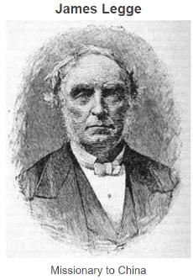
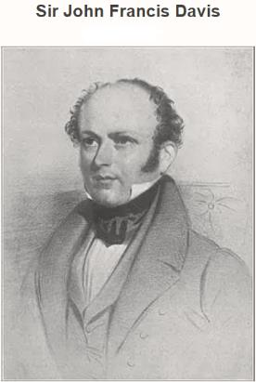
After the Opium War, the number of foreign expatriates in China increased. In order to provide materials for language learning and recreational reading for foreigners in China, more and more Chinese literary works were translated.
These translations were done for pragmatic reasons and they were mainly circulated in the colonial areas of China.
From the mid-19th century to the early 20th century, there appeared many excellent sinologists and translators, who had different identities, including Protestant missionaries, diplomatic officials and businessmen in China. Some of them are highly educated sinologists, like James Legge and Sir John Francis Davis.
Due to United Kingdom's early opening of trade ports in China and its large sphere of influence, Britain's translation of various Chinese classics has made great progress since then and gradually occupies a crucial position in the foreign translation of Chinese classics.

Slide 19
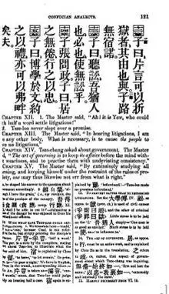


Authoritative sinologists from the early to mid-19th century translated Confucian classics and classical poems. For example, The Chinese Classics（多卷本《中国经典》） by James Legge, and On the Peotry of the Chinese（《汉文诗解》） by John Francis Davis.
As for narrative works, they mainly focused on novels and dramas written in the long past Yuan and Ming Dynasty, such as Romance of the Three Kingdoms. They didn't pay much attention to the 19th-century popular novels such as Dream of the Red Chamber and Strange Stories from a Chinese Studio.
Robert Brown, the British consul in Ningbo, translated part of Dream of the Red Chamber for the first time.
Notes:
Page 121 from first edition of James Legge's translation of Confucius Analects

Slide 20
03
In the First Half of the 20th Century

Slide 21
Since the beginning of the 20th century, Europe and the United States has become the center for the translation of Chinese classics.
Beginning in the 1920s, for more than two decades, Chinese-themed books were the best-sellers in the markets of Britain and America.
1929 | Chi-Chen Wang (王际真) | Dream of the Red Chamber
1933 | Pearl Sydenstricker Buck (赛珍珠) | All Men Are Brothers
1939 | Bernard Miall | Chin Ping Mei: The Adventurous History of Hsi Men and His Six Wives
1942 | Arther Waley | Monkey
Notes:
/dʒaɪlz/

Slide 22
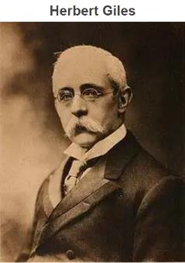
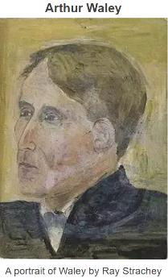
翟理思勤奋多产，在60余年的汉学生涯中，他翻译了大量的中国文学作品和文化典籍。他翻译的《聊斋志异》至今仍是最全的一个英文译本，他编译的《古文选珍》第一次向英语读者展示了中国古典诗词和散文的巨大魅力，他选译的《笑林广记》第一次向西方介绍了中国的幽默。翟理思还用英文著有世界上第一部中国文学史。
Arthur Waley (1889-1966), is a master of Chinese-English translation. Although he never set foot on Chinese soil in his lifetime, he translated many Chinese classics, including the Book of Songs, the Analects of Confucius, the Tao Te Ching. These books are not only popular in the English world, but also translated into many other European languages.

Slide 23
04
After the 1960s

Slide 24
After the 1960s, due to the soaring number of academic institutions and a contracting market, the English translation of Chinese cultural classics has entered a highly academic stage from a commercial stage.
After the outbreak of World War II, a large number of research institutions related to Asian studies were established in the United States.
Since the 1970s, different “full translations”, which is faithful to the original text, have emerged, replacing the various abridged translations that existed on the market.
The contemporary American sinologist C. T. Hsia(夏志清) refers to this period as the "age of total translation.”

Slide 25
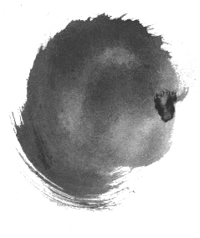


As C. T. Hsia argues, early translations of Chinese poetry and novels, such as those of Pound and Waley, had succeeded in attracting ordinary British and American readers. But at this time, English readers were overeating and therefore less interested, and the market for Chinese books was contracted. During the the 1960s and the 1990s, the sophisticated translations failed to interest the general reader.
学
术
化

Slide 26
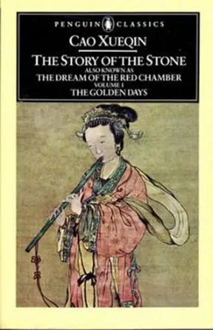
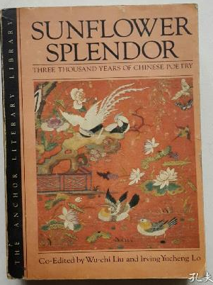


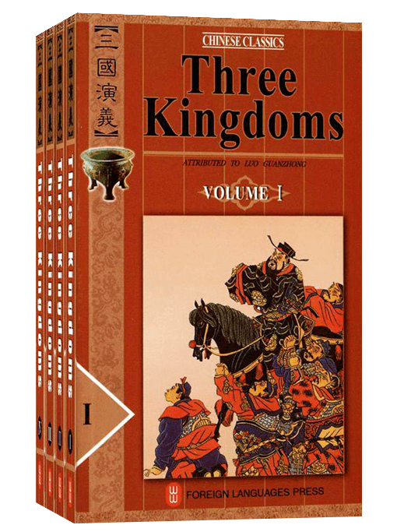
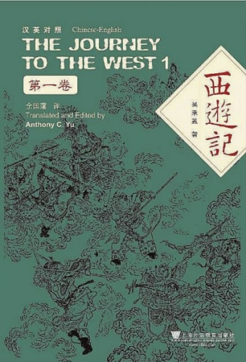


The Story of the Stone
SUNFLOWER SPLENDOR
《红楼梦》第一部英文全译本
霍克斯(David Hawkes)、闵福德(John Minford)
第一部较为完整的中国古典诗歌选集《葵晔集》
柳无忌(Wu-chi Liu)、
罗郁正(Irving Lo)编译
The Journey to the West
Three Kingdoms
《红楼梦》第一部英文全译本
余国藩（Anthony Yu）
《三国演义》全译本
罗慕士（Moss Roberts）
Notes:
https://www.sohu.com/a/434599198_614563

Slide 27
Thank You
水墨

