Slide 1
At the end of one’s life, one dreams not of the vastness of the world but of the beauty of Huizhou. ——徽文化
孔祥雅

Slide 2
background
01
CONTENTS
core components
02
significance
03

Slide 3
background
01

Slide 4
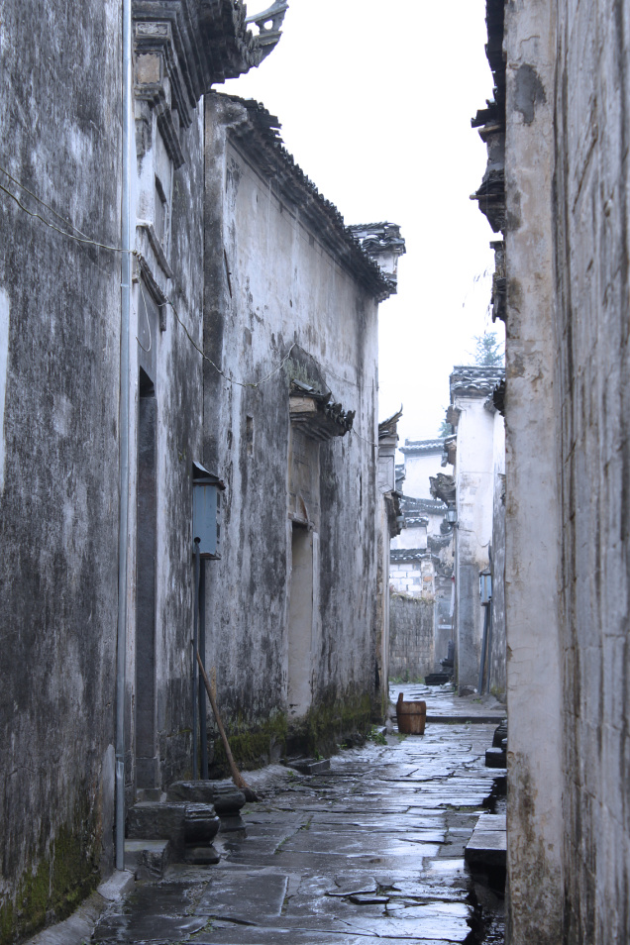
Background
about the name
·Xin’an(新安) Western Jin Dynasty;
·Shezhou(歙州) Tang Dynasty;
·Huizhou(徽州) from 1121 (the third year of the Xuanhe era of the Song Dynasty) to 1911;
·Huangshan city 1987 to now

Slide 5
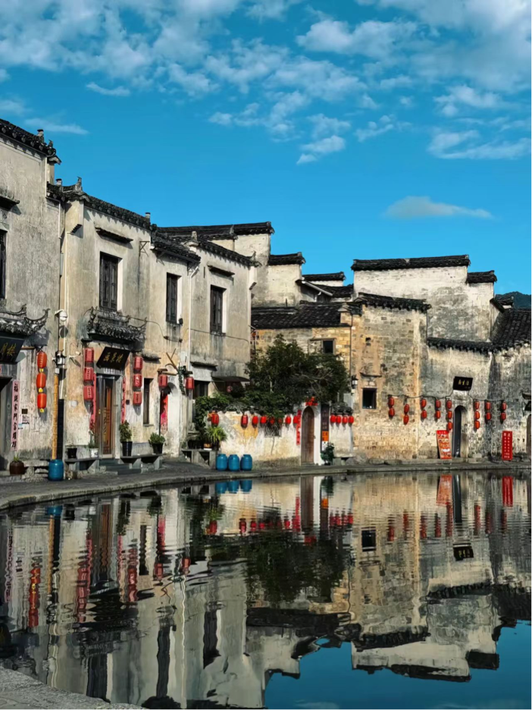
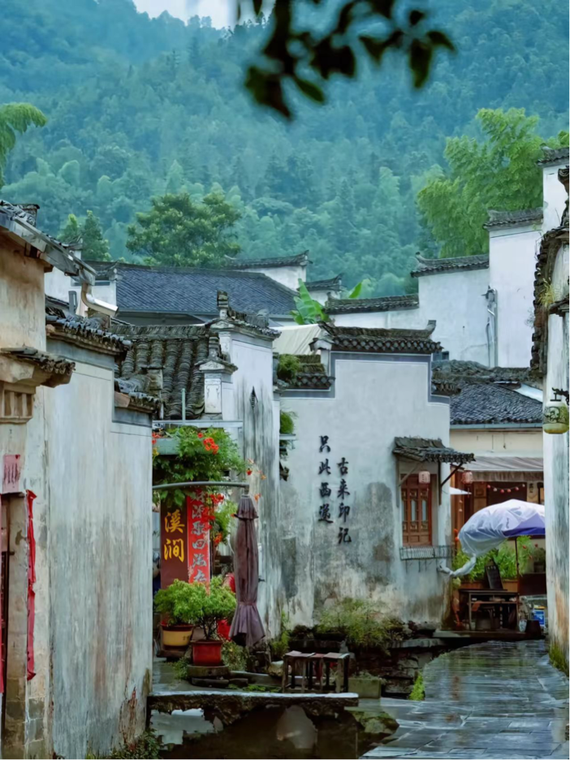
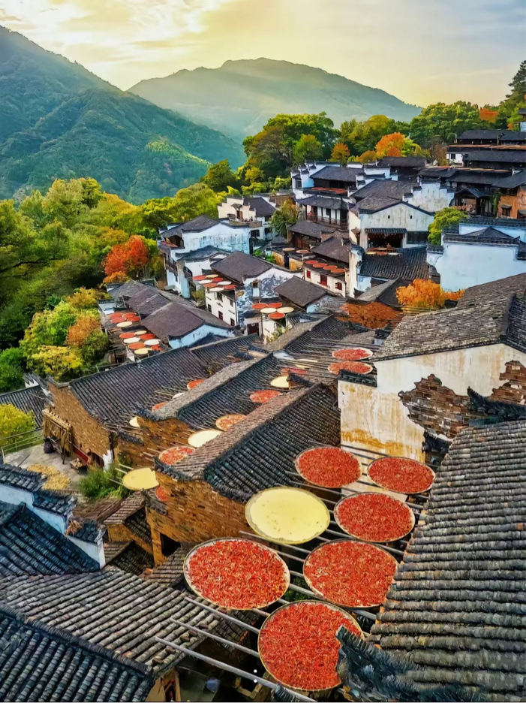
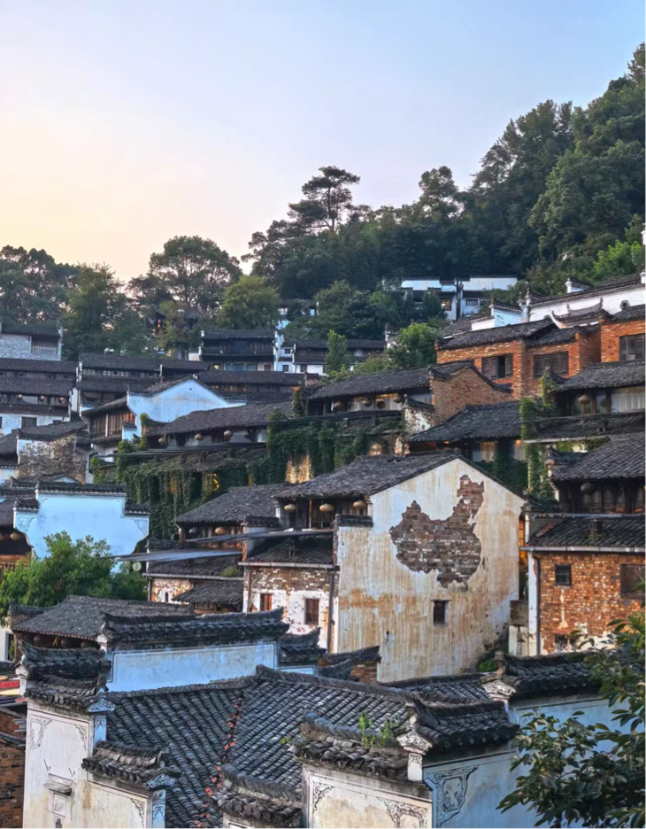
about the geographic range
Anhui province
Huangshan city: shexian(歙县) xiuning(休宁) yixian(黟县) qimen(祁门)
Xuancheng city: jixi(绩溪）
Jiangxi province
shangrao city: wuyuan(婺源）

Slide 6
core components
02

Slide 7
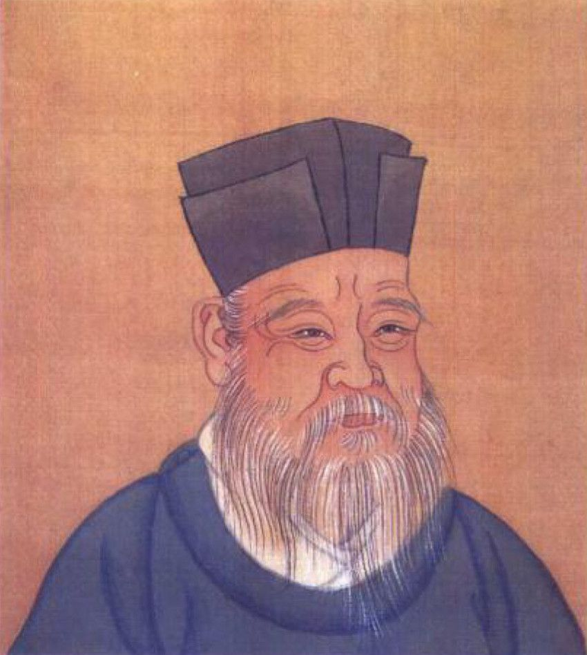
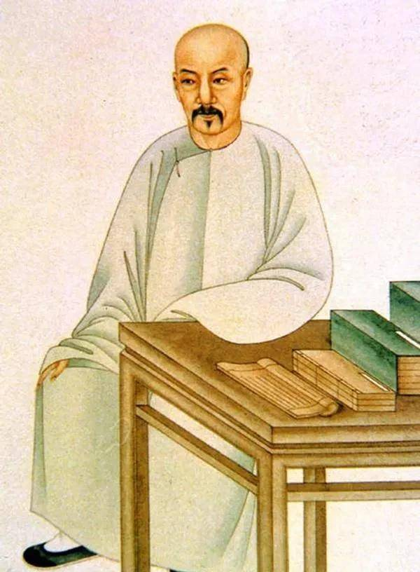
1、 thoughts and academic ideals
(1) Xin'An rationalism
The typical figures are Zhuxi, Chengyi, Chenghao. Zhu Xi put forward a series of important ideas. Cheng-Zhu Confucianism has become the orthodox academic thought of Huizhou, and Huizhou scholars are even more unswerving in Cheng-Zhu Confucianism.
(2) The Plain Learning of Huizhou
Hui School Puxue, also known as Xin'an Puxue, takes the study of the classics as the core, covers the fields of writing, phonology, exegesis, and uses empirical methods to study Confucian classics. The typical figure is Dai Zhen.

Slide 8



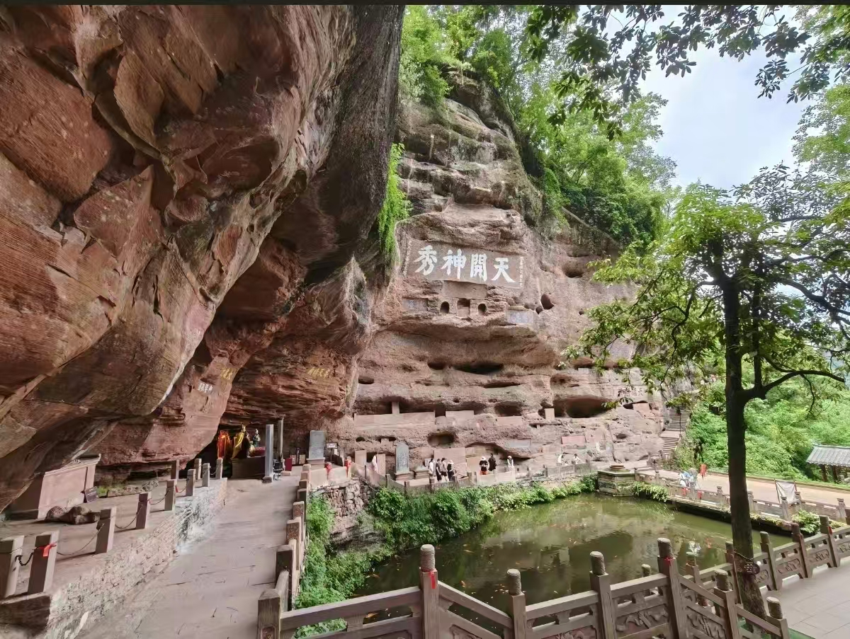
2、art and craft
(1) famous mountains
黄山
天柱山
九华山（佛教）
齐云山（道教）

Slide 9
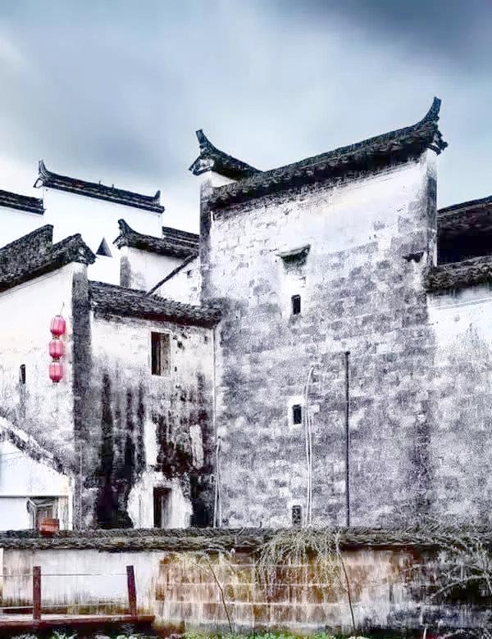
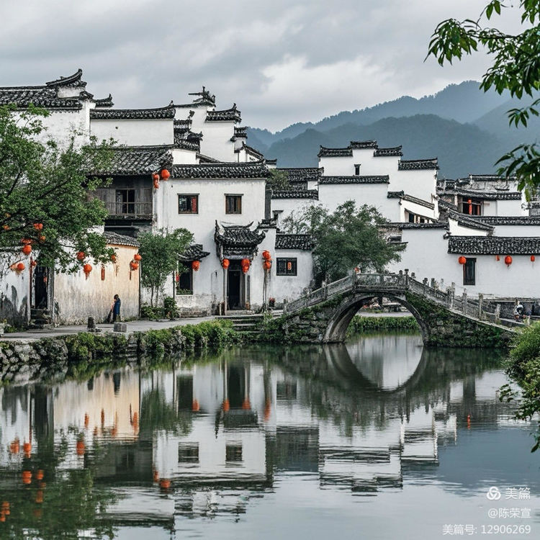
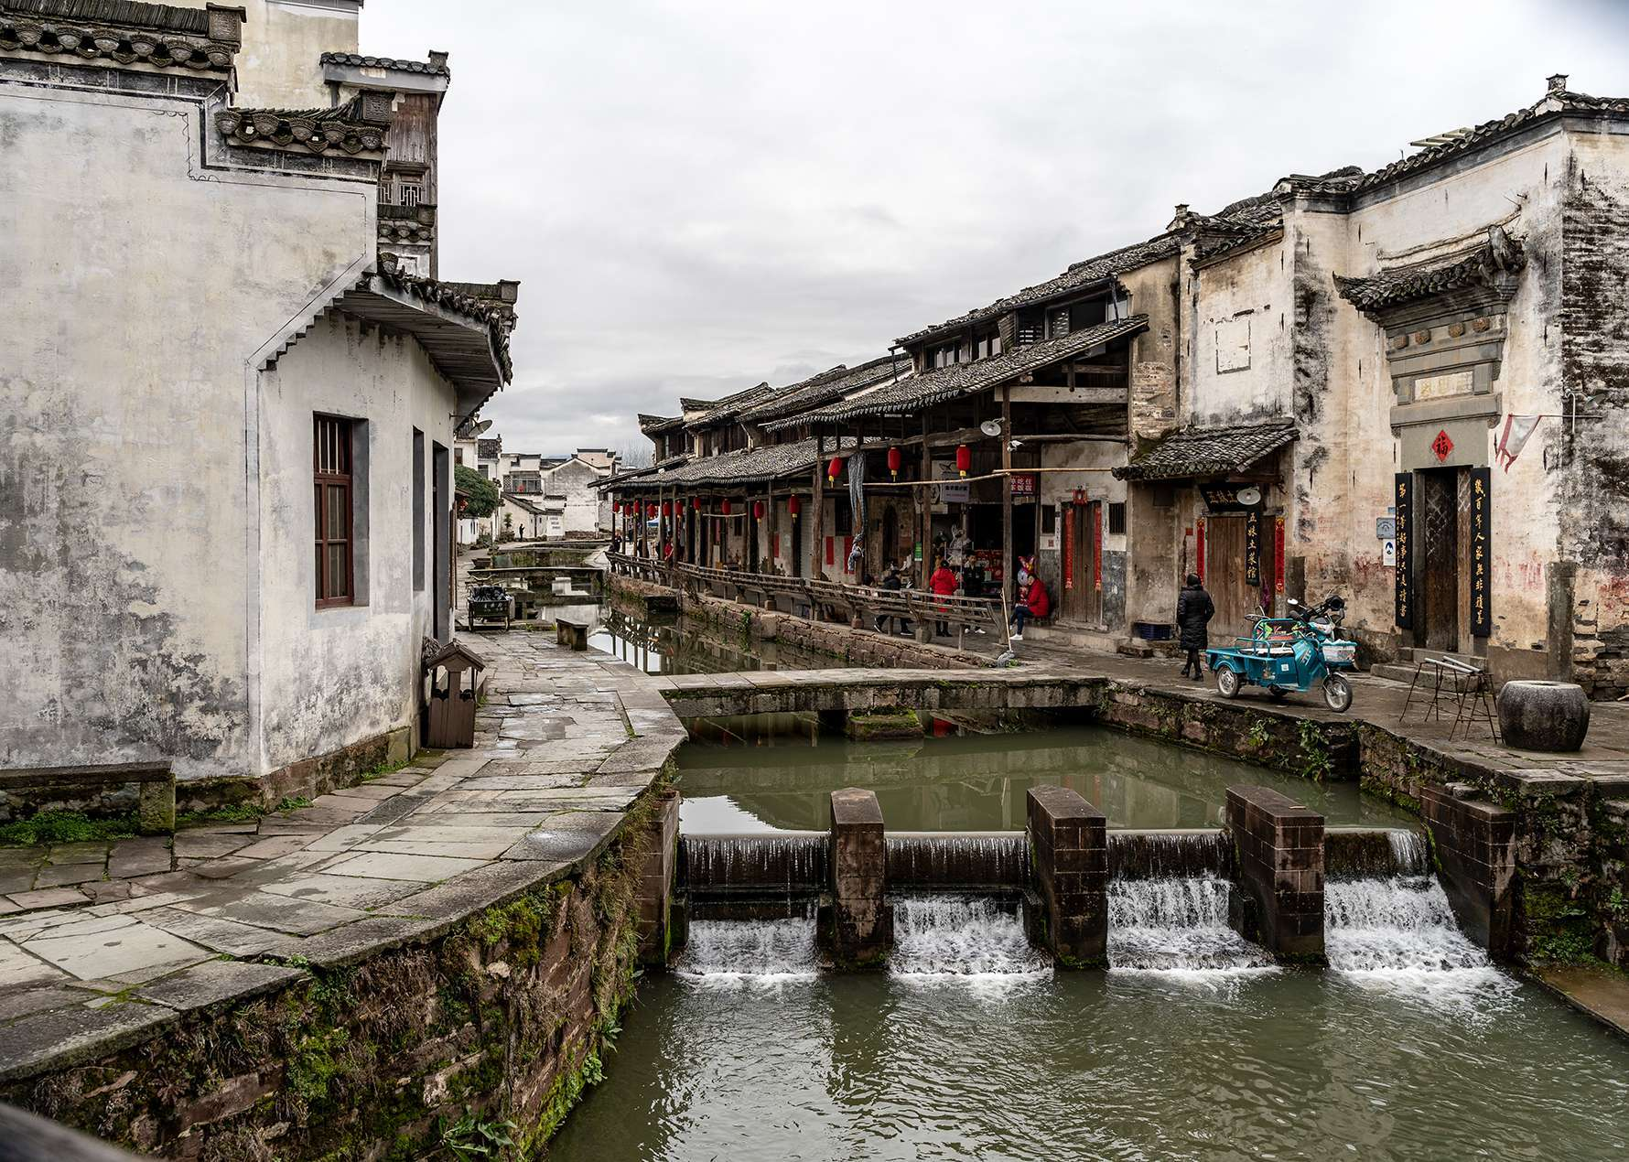
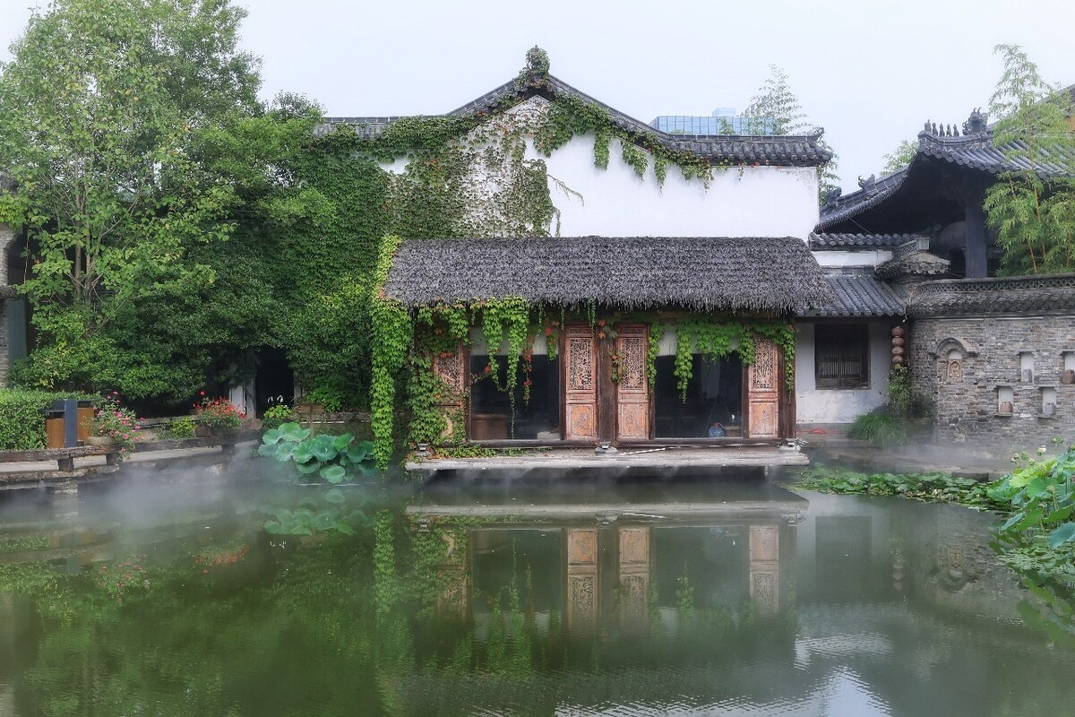
(2) Hui-style architecture
typical features: whitewashed walls, dark tiles, curved eaves, long corridors and pivilions, like Horse-Head wall.
design: adheres to strict principles of fengshui, emphasising the balance of yin and yang and five phases.

Slide 10
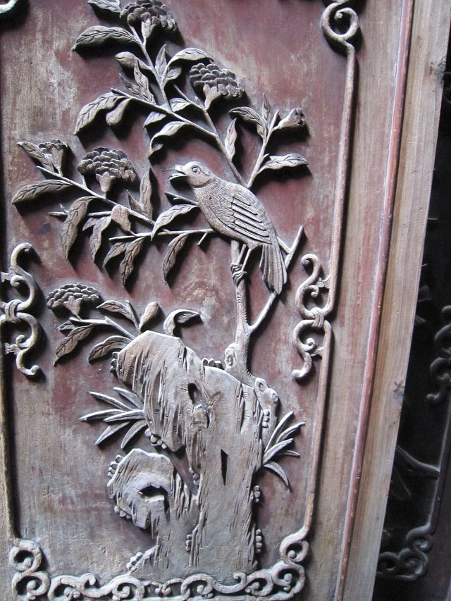
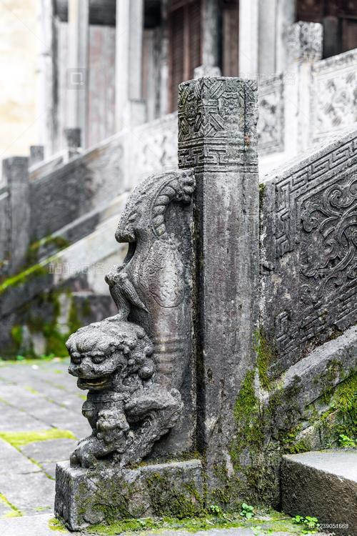
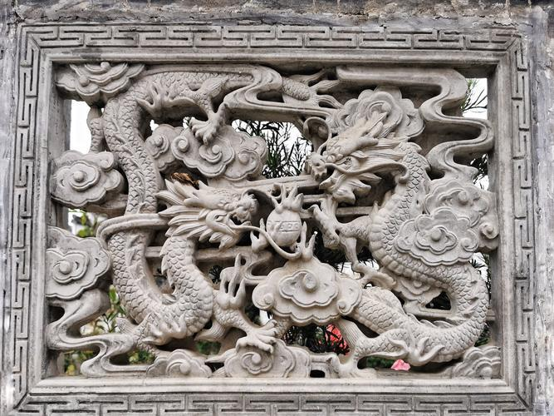
(3)the three sculptures of Huizhou
wood carving--meticulous detail and rigorous composition
stone carving--fluid lines and vivid composition
brick carving--intricate designs and clear layering

Slide 11
3、economy and society
(1) the spirit of Huizhou merchants
·culture spirit
Huizhou merchants love to read, and love of reading has brought Huizhou merchants a good way to draw rich business experience and wisdom from history, promote the development of their own business, and enhance the rational understanding of business.
·dedication spirit
After a large number of Huizhou businessmen became rich, they contributed to the society with various righteous deeds. The vast majority of Huizhou merchants attach more importance to the humanistic spirit and rational pursuit in business activities. Although they became rich, they were still frugal and diligent.
·team spirit
Huizhou merchants are merchant gang groups formed by blood and geography, and have a strong sense of kinship and geographical identity.

Slide 12
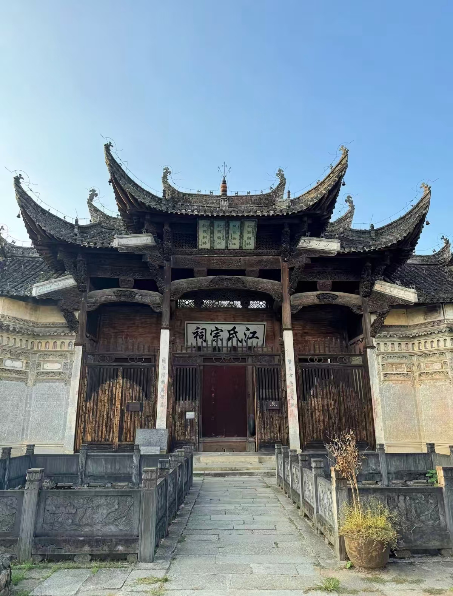
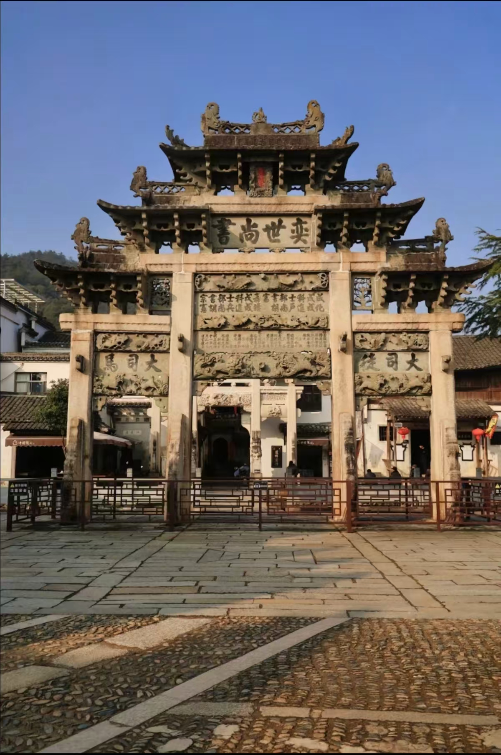
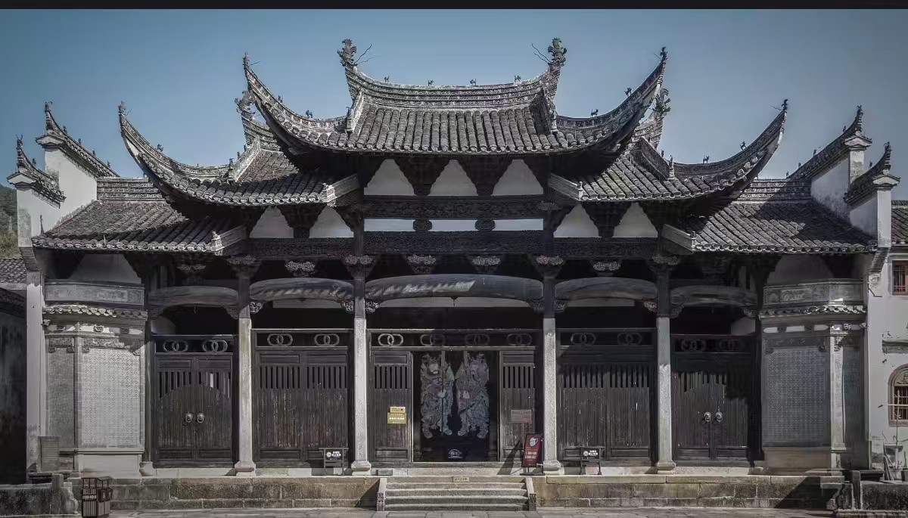
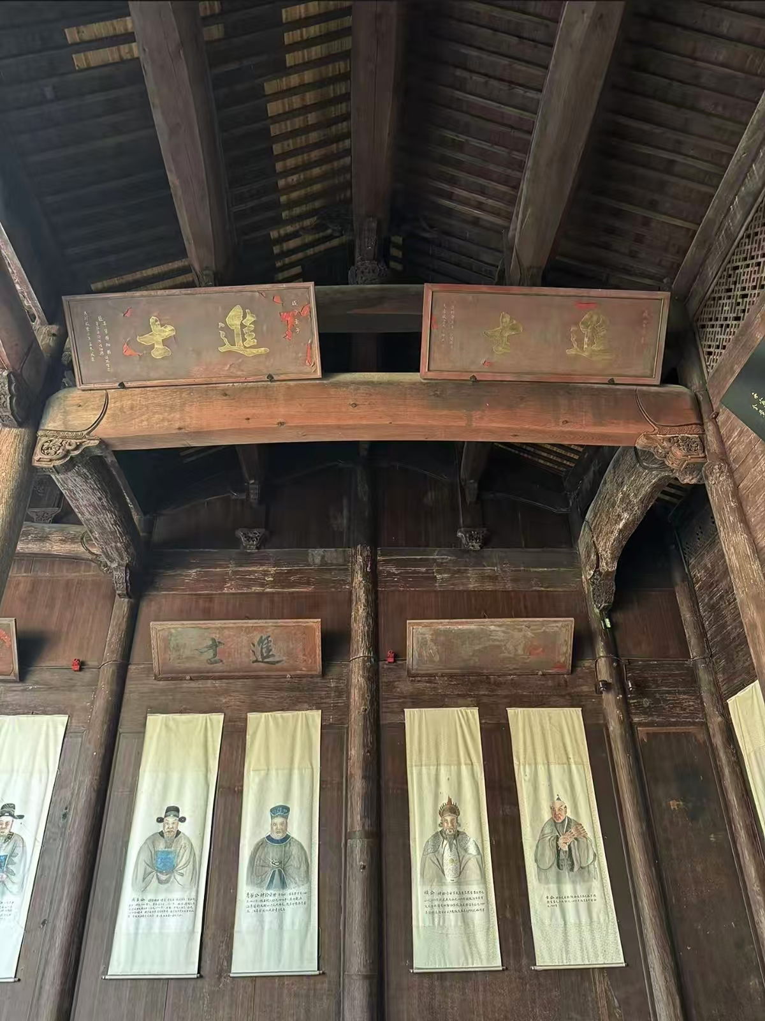
(2) clan system
The clan set up free schools and academies, and used the financial resources of Huizhou merchants to support their children's studies, forming a culture of "a village of ten households never abandoning reading", and listed education as a top priority.

Slide 13
significance
03

Slide 14
·Characterized by its pronounced local flavor, Huizhou
culture boasts rich content and strong coherence, effectively showcasing the overall characteristics of Eastern society and culture.
·It encompasses the fundamental elements of folk economy, society, life, and culture during the later stages of China's feudal society, earning it the reputation of being a typical specimen of this period.
·Huizhou studies, alongside Dunhuang studies and Tibetan studies, is one of the three prominent regional academic disciplines in China that have gained a recognition.

Slide 15
Thanks for listening

