Slide 1
Translation and Dissemination of Chinese Contemporary Science Fiction
202X
Presented by Jiang Yulu
From English Translation

Slide 2
Can you list some famous Chinese science fiction ?

Slide 3
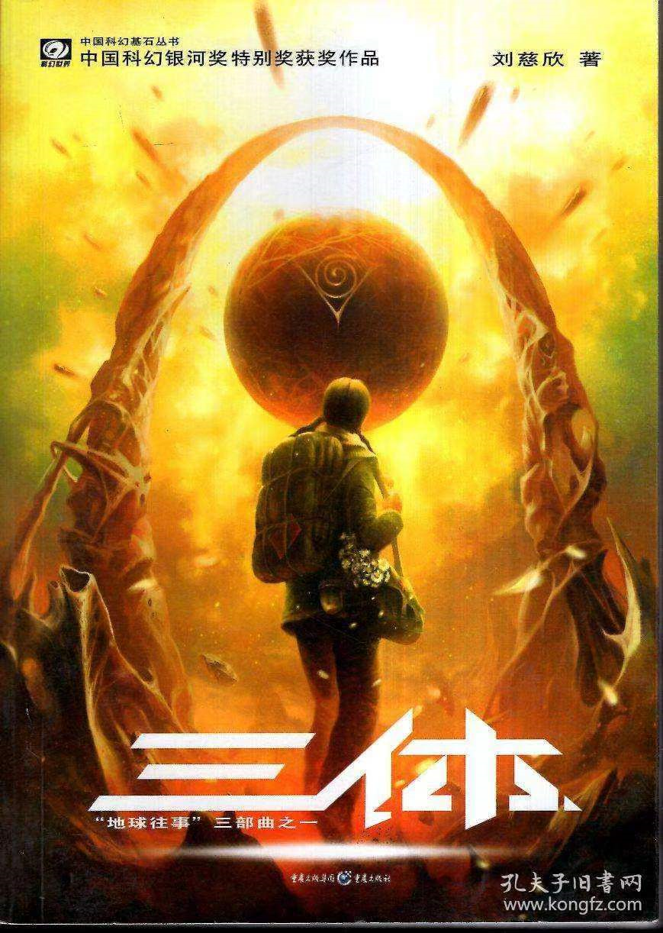
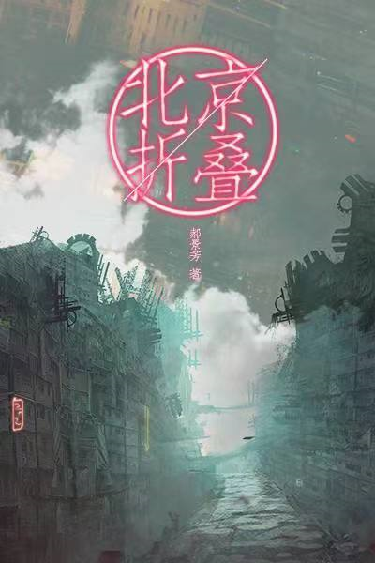
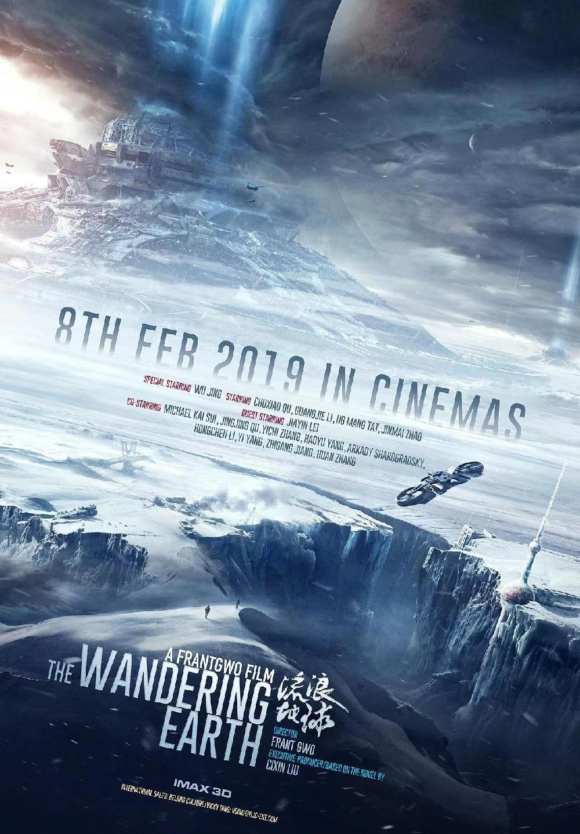
The Three-body Problem
Beijing Folding
The Wandering Earth

Slide 4


01
The history of the translation of Chinese science fiction
Content
02
Hugu Award and Liu Yukun
03
Translation technologies in Liu’s translation works

Slide 5
01
Let’ s review the history of the translation of Chinese science fiction.

Slide 6
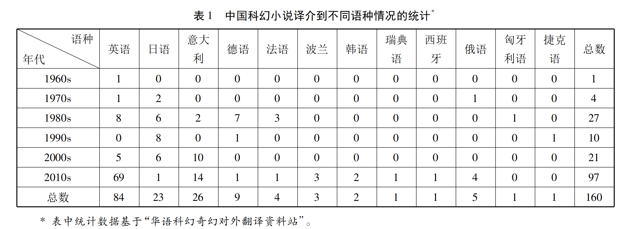



Statistics of Chinese science fiction translation in different languages
Chinese native science fiction has been accepted by the world since the middle of the 20th century, and its translation has grown steadily.
Before 2010, the main target languages were Japanese and Italian
After 2010, the number of foreign translations has exploded, especially in English and Italian.

Slide 7
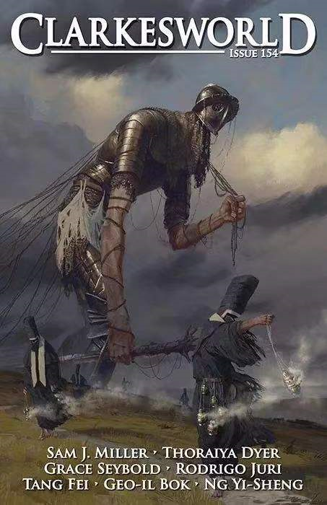
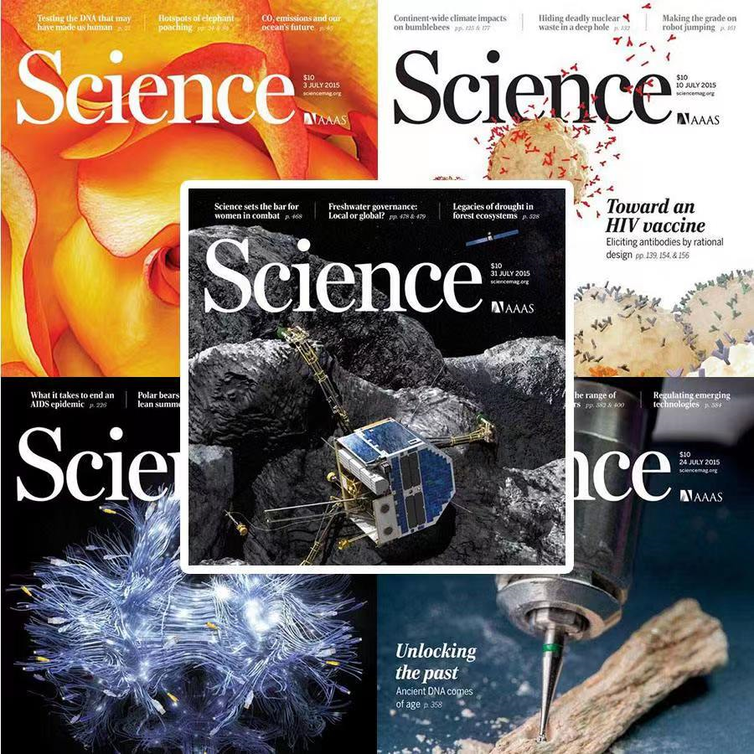
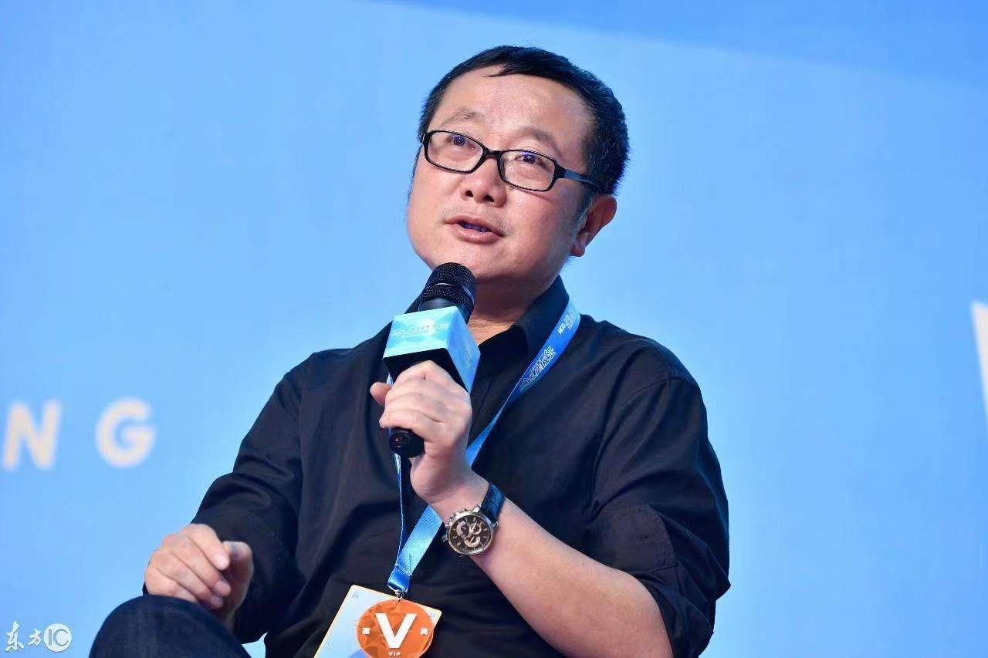
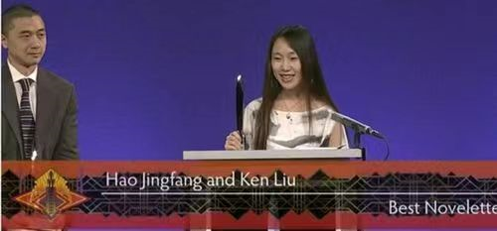
Milestones
Hugo Award
2012
2013
2015
2016
The Clarkesworld Magazine, an leading American science fiction magazine， regularly publishes Chinese science fiction works.
Science Fiction Studies， an authoritative world science fiction theory magazine, has published Chinese albums and articles by famous Chinese science fiction writers.
Liu Cixin won the 73rd Hugo Award for Best Novel for the Three-Body Problem series, becoming the first Asian writer to win the award.
Hao Jingfang won the 74th Hugo Award for Best Short Story for Folding Beijing.

Slide 8
02
Hugo Award and Liu Yukun

Slide 9
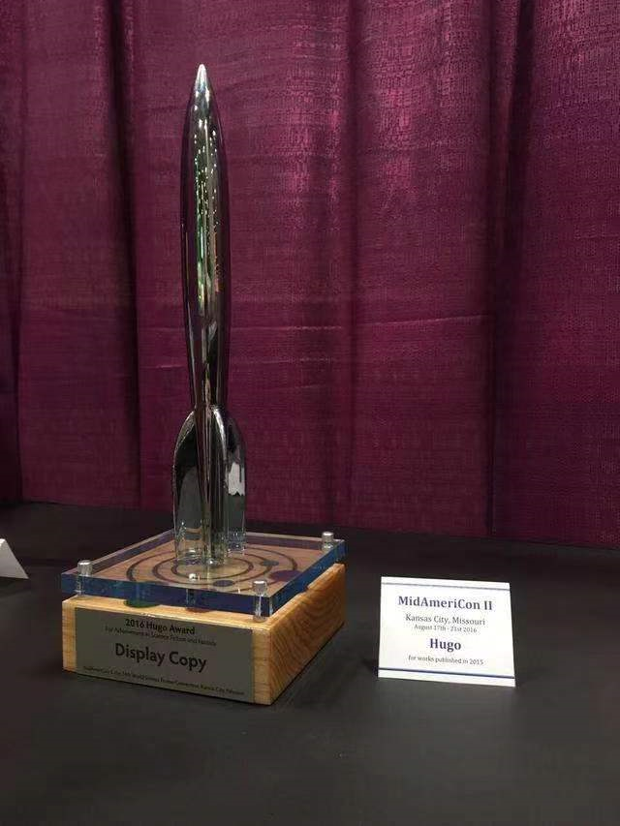
Hugo Award 雨果奖
The Hugo Award, awarded by the World Science Fiction Association, was awarded in honor of Hugo Gensback, the father of science fiction magazine.
The Hugo Award and the Nebula Award are the highest international awards in the field of science fiction literature, and they are known as the "The Nobel Prize in science fiction literature".
The 73rd Hugo Awards (Hugo Award) Award for Best Novel
The 74th Hugo Award for Best Short Story

Slide 10
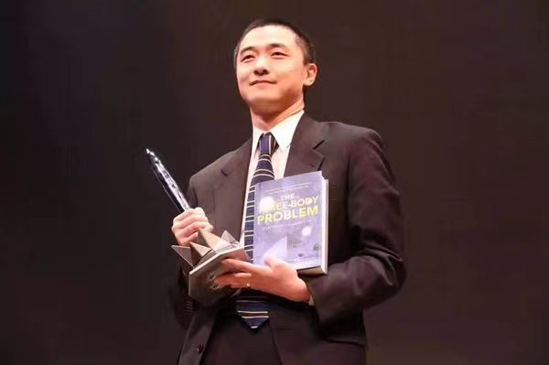
Liu Yukun 刘宇昆
Liu Yukun is a Chinese-American science fiction writer and translator. He was born in Lanzhou in 1976 and moved to the United States.
Because of the growing background of eastern and Western cultures, Liu Yukun has a profound understanding of both Eastern and Western cultures.
His translation works can always find a balance in the Eastern and Western cultures, which can not only retain the Chinese characteristics, but also make the translation easy to understand and resonate with foreign readers.

Slide 11
Liu Yukun 刘宇昆
“Japanese science fiction is not as influential as Chinese science fiction because Japan does not have a Yukun Liu.”
——said by Riwara, a Japanese writer, at the 2014 Chinese Nebula Awards.

Slide 12
03
Translation technologies in Liu’s translation works

Slide 13
The characteristcs of Liu’s translation works
He recreated the beauty of the original works by rhyme（押韵）、antithesis（对仗）、repetition（反复）
He rationally used the translation strategy of foreignization to convey Chinese culture and achieve cultural export.

Slide 14


The beauty in his works
Guess which rhetorical
device is used?
押韵rhyme、对仗antithesis、反复repetition
1、湿气从领口和袖口透入他的身体，让他觉得清醒，却又忍不住战栗。
The damp air seeped through collar and cuffs, keeping him alert and making him shiver.
2、老刀的父亲靠强健的意志在汹涌的人流中抓住机会的细草，待人潮退去，留在干涸的沙滩上，抓住工作机会，低头俯身，艰难浸在人海和垃圾混合的酸朽气味中，一干就是二十年。他既是这座城市的建造者，又是城市的居住者和分解者。
Strong-willed, Lao Dao’s father had held fast onto the thin reed of opportunity as the tide of humanity surged and then receded around him，until he found himself a survivor on the dry beach.

Slide 15
The beauty in his works
Guess which rhetorical
device is used?
押韵rhyme、对仗antithesis、反复repetition
3、一个区一个区改造旧城市， 像白蚁漫过木屋一样啃噬昔日的屋檐门槛，再把土地翻起，建筑全新的楼宇。 他们埋头斧凿，用累累砖块将自己包围在中间，抬起头来也看不见天空， 沙尘遮挡视线， 他们不知晓自己建起的是怎样的恢宏。 直到建成的日子高楼如活人一般站立而起，他们才像惊呆了一样四处奔逃，仿佛自己生下了一个怪胎。
District by district, they had transformed the old city. Like termites swarming over a wooden house, they had chewed up the wreckage of the past, overturned the earth, and constructed a brand new world. They had swung their hammers and wielded their adzes, keeping their heads down; brick by brick, they had walled themselves off until they could no longer see the sky. Dust had obscured their views, and they had not known the grandeur of their work. Finally, when the completed building stood up before them like a living person, they had scattered in terror, as though they had given birth to a monster.

Slide 16

Foreignization in Science Fiction Translation
——Take the Three-body Problem as an example
Aims：Retain Chinese cultural characteristics and introduce Chinese culture
Main translation methods：transliteration（音译）, literal translation（直译）, annotated translation（注译）, and some are supplemented by footnotes（增加脚注）

Slide 17
Foreignization in Science Fiction Translation
——Take the Three-body Problem as an example
1、Name
“我是汪淼，真对不起，这么晚打扰。
This is Wang Miao． I’m sorry to be calling so late．
“大史，你把烟熄了，这儿的烟味够浓了。”常伟思说，低头翻着文件。“
Da Shi，put out your cigarette．There’s enough smoke here，”General Chang said as he flipped through some documents． He called Shi Qiang by a nickname．
“Surname+name” the Chinese habit of appellation expression
In order to retain the cultural atmosphere and transmit the Chinese appellation culture, Liu used literal translation method to translate these names.

Slide 18
Foreignization in Science Fiction Translation
——Take the Three-body Problem as an example
2、Terminology
与其他牛鬼蛇神相比，反动学术权威有他们的特点。
Compared to other “Monsters and Demons”, reactionary academic authorities were special．
Liu used literal translation and also added a footnote on this page to explain this term—— “a term from Buddhism，used during the Cultural Revolution to refer to all the enemies of the revolution”.
In this way, the readers can not only understand this terminology, but also learn some social background at that time.

Slide 19
Foreignization in Science Fiction Translation
——Take the Three-body Problem as an example
3、History
”周文王不是战国时代的人吧?“汪淼问。
“I don’t think King Wen ( of Zhou) belongs to the Warring States Period，” Wang said．
Here Liu transliterated the name of historical figures "周文王" and applied literal translation to translate the dynasty "战国"，and then added a footnote on the same page——“The Warring States Period lasted from 475 BC to 221BC．But King Wen of Zhou reigned much earlier, from 1099 BC to1050 BC. He was considered the founder of the Zhou Dynasty，which overthrew the corrupt Shang Dynasty”
Not only help overseas readers to understand, but also introduce the information of dynasties and historical figures.

Slide 20
Foreignization in Science Fiction Translation
——Take the Three-body Problem as an example
4、Culture
“他认为，一切都要合乎礼，宇宙万物都不例外。他于是创造了一套宇宙的礼法系统，企图据此预测太阳的运行。
He believed that everything had to fit li，the Confucian conception of order and propriety，and nothing in the universe could be exempt from it． He created a system of rites and hoped to predict the motion of the sun with it．
礼 courtesy/etiquette
the "ritual" of ancient Chinese Confucianism
Therefore，Liu directly transliterates it into Li, and then expounds its connotation.
In this way, once English readers hear or witness "Li", they can deduce that this is the proposition of ancient Chinese Confucianism. So the Chinese culture has been spreaded invisibly.

Slide 21
Conclusion
With the progress of information technology and the deepening of globalization，the Chinese science fiction translation has no longer stayed on the surface of language translation, it has pay more attention on the cultural value behind the original works.
Therefore, as students of translation, we should learn some technologies and if we translate some science fiction or other kinds of works, we should find the best way to translate the cultural elements of the novels, so as to accelerate the overseas dissemination of Chinese culture.

Slide 22
References
[1] 梁昊文. 中国当代科幻小说外译及其研究述评[J]. 佳木斯大学社会科学学报，2019,30(01): 41-46.
[2] 车媛. 功能对等视角下《北京折叠》译本比喻修辞的翻译[J]. 教育观察，2017(6): 134-136．
[3] 陈芳蓉. 类型文学在美国的译介与传播研究——以《三体》为例[J]. 浙江师范大学学报( 社会科学版) ( 3) : 96-102．
[4] 韦珊珊，谢建奎. 科幻小说《三体》中文化缺省翻译补偿探索[J]. 英语广场，2020(4): 27-28．
[5] 何霜紫. 英语世界里的中国科幻——论《北京折叠》的译文评介与海外接受[J]. 创作与评论，2016(24): 53-58．
[6] 陈芳芳. 阐释学运作理论视域下《三体》文化负载词的英译研究[D]. 大连理工大学，2019．
[7] 杨春林.《三体》 英译本异化策略之文化价值探讨[J]. 厦门广播电视大学学报，2017(04): 31-36.
[8] 黄唯唯.《三体》的英译研究——让中国式科幻走向世界[J]. 湖北第二师范学院学报2016(9): 125-128．
[9] 张凯娣，董晓倩，王思宇，焦健翔. 从三美原则下看刘宇昆英译《北京折叠》[J]. 文教资料2017(29): 23-25.

Slide 23
Thanks for watching!

