Slide 1
Wang Shuo
Hooligan literature

Slide 2
Wang Shuo, as a very special writer of in 80,90s last century, has great effect in current circle of literature and art in China. He is drawn from a generation that experienced the hardships of the Cultural Revolution. His works are characterized by an underlying clue of his growing experience, from which we can see how the memories of Wang Shuo marks his works.

Slide 3
describe life with reality
(in his vision)
原来我一直轻视自己，认为自己的生活无聊、空洞、没意义，我认为应该过那种更有意义的生活，或者乃至在小说中描写更有意义的生活。我现在才觉得，我这个生活无比重要，不能轻视，就是我自己过的这个。我就把这个写出来就可以啦，我的生活才是我的根基，是我写作的原点，对我来说这么写就是表示我与伪生活的决裂，与那种按某种道理做人的生活的告别。
——王朔.写作与伪生活.[M].美人赠我蒙汗药，长江文艺出版社，2000.(8)：9.

Slide 4
describe life with reality
(in his vision)
This is Wang Shuo’s attitude and belief about writing, and life itself(in his novels). Wang Shuo's novels were famous of their subverting. They subverted love, order and all traditional value norm, and the writing style is not diverse, the content is not abundant, the thought is not profound. Life is not always so terrible or perfect, and Wang’s characters know this all too well. They don’t take life too seriously. They travel light, just like Wang Shuo himself.

Slide 5
Verbal Features
Wang's verbal features lie In his creation of language system in which elegant, common, ruffian languages are Integrated. Ridicule is Wang Shuo’s special feature language type. In his novels character has filled the comedy color, at the same time also has the tragedy, therefore on these characters displays is humorous is the black humor.

Slide 6
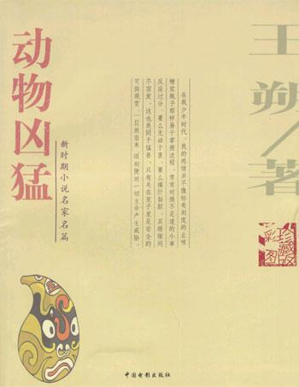
<Vicious Animals >
(<ferocious animals>)

Slide 7
汪若海还没说话，方方一声不吭地从人群中挤上来，用手里的砖朝这孩子的颅顶使劲一拍，大家同时把手里的砖头一起砸下去，并抡起钢丝锁没头脑地一通乱抽。
高洋松开手，那孩子贴着墙根瘫倒在地。我不声不响地用手中的砖头在他身上一通乱砸，直到大家都散开跑走，仍没歇手，最后把那块已经粘上血腥的砖头垂直拍在他的后脑勺上，才跑了。他们已经骑上自行车，乱箭般嗖嗖地消遁于昏暗的街头。
只记得我在街上没命地跑，路边一些面相凶恶的赤矛大汉瞪着我。路灯昏黄的光晕下，一地赭红的完全粉碎的砖头屑；
那同学软绵绵地脸朝下俯卧在黑黢黢的墙根，形若一段短短的焦炭。似乎还有他在一群人紧紧追赶下近乎痉挛抽搐的奔跑姿态和格外惨白的脸庞以及黑洞般绝望的两只睚眦欲裂的眼睛，实际上我当时根本不可能从另一个方向迎面看到他的表情。我们兴高采烈地回到院里，下车后便开始竟相夸耀。我的英勇无畏有目共睹，大家纷纷过来拍着我的肩膀称赞我：“别人都撤了你还在那儿打，手够黑的。”
我骄傲地挺着胸脯笑着，一边吹嘘着一边偷眼去瞧笑眯眯望着我的于北蓓。大家找出半盒皱巴巴的烟分了抽。按照我们吹嘘的战绩，那个挨打的孩子必死无疑。

Slide 8
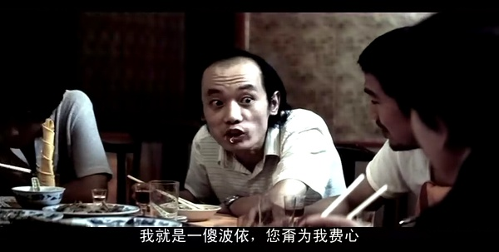
<Masters of Mischief, or The Operators>
(< The Troubleshooters>)

Slide 9
天气越来越热了，强烈的阳光劲射每条马路、街角，繁茂起来的街树在热风中摇曳翻
滚，绿得刺目，已经有人穿着短裤汗衫上街了，蝉鸣终日不绝于耳。
“三Ｔ”公司办公室里，敞开的窗户吹进来的热风使每张办公桌上都落满灰尘，人们淌
着汗把胳膊压在桌子上相互交谈。
“您说怎么办呀？我爱她她不爱我，可她明明该爱我因为我值得她爱她却死活也明白不
过来这个道理说什么全不管用现在的人怎么都这样男的不干活女的不让喇。”
“不破不立，破字当头，立也就在其中了。”
＊＊＊
“我们不能派人去打那个不让你调走的领导的儿子，那不象话，我们是体面人。我建议
您还是去找领导好好谈谈，到他家去，耐心地、和颜悦色地谈。不要拎点心匣子，那太俗气
也不一定管事，带着铺盖卷去，象去自己家一样，吃饭跟着吃，睡觉也跟着睡，象戏里说的
一样：‘在沙家浜扎下来了。’”

Slide 10
“你还是去交通队一趟，警察说什么你就听着，别自尊心那么强，就当你还小，你爸爸骂你一顿。替他们想想，马路上一天天站着，除了电线杆再没第三个这么倒霉的，钱也不多挣，再不让人家得词训训也太不人道了。他训够你自然就把自行车还给你了，毕竟是维持秩序不是盗车集团。”
＊＊＊
“实事求是地讲，人民生活水平是提高了，过去您没觉着肉贵那是过去您压根不怎么买肉，割二毛钱肥膘就全家饺子了。要是肉价还是前两年那价，国家就是把全国变成大猪圈也不够您狠吃的。”

Slide 11
＊＊＊
“您瞅着您媳妇就晕那就去吃些丸药‘六味地黄’‘金匮肾气’‘龟龄集’之类的抵挡
一阵，再不成就晚上熬粥时给你媳妇那碗里放点安眠药让她吃饱了就犯困看唐老鸭都睁不开
眼不洗脚就上床没心思干别的最多打打呼噜不至于危及您下半生健康。”
＊＊＊
“不要过早上床熬得不顶了再去睡内裤要宽松买俩铁球一手攥一个黎明即起跑上十公里
室内不要挂电影明星画片意念刚开始飘忽就去想河马想刘英俊实在不由自主就当自己是老山
前线一人坚守阵地守得住光荣守不住也光荣。”

Slide 12
Criticisms about
Wang Shuo’s
Hooligan Literature

Slide 13
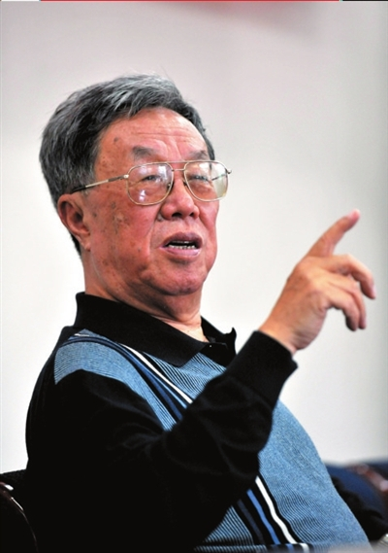
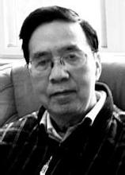
王蒙《躲避崇高》：
他撕破了一些伪崇高的假面
余开伟《王蒙是否转向
——对〈躲避崇高〉一文的质疑》：叛卖崇高，趋向丑恶、庸俗和卑下

Slide 14
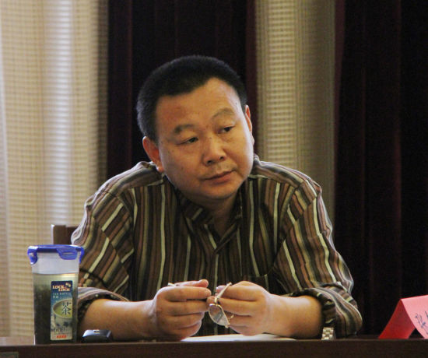
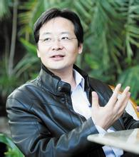
葛红兵《别忘了，王朔只有一个——与王彬彬的王朔批判商榷》：
“流氓”是英雄的化名。
王彬彬《中国流氓文化之王朔正传》：王朔是“大院文化”的继承者

Slide 15
bones of contentions
fight with fake sublimity VS lost in nihilism
deep irony VS blasphemous joke
civilian consciousness VS privileged class mentality
deep sorrow VS shallow happiness

Slide 16
Western perspective
Wang Shuo, may be depicted as a bastard child of the Cultural Revolution and postmodernism, one who manifests the ambivalent and indeterminate condition of a China stuck in the so-called era of reform from the late 1970s to the 1990s.

Slide 17
While both the present and the hooligan are, by definition, fluid and mutable, by tracing and locating different historical presents—or different historical moments of the present—of the formation and development of Wang Shuo’s hooligan protagonists, we may nevertheless find that Wang Shuo has been, from the very beginning of his career, a faithful embodiment of the zeitgeist of China’s reform era.

Slide 18
Feng Xiaogang & Wang Shuo
By
KE ZIYE

Slide 19
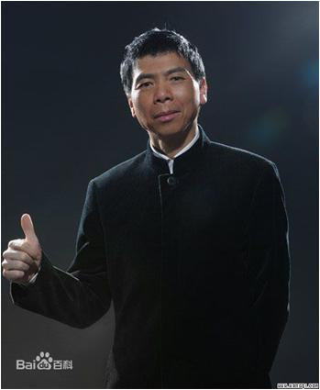
Wang Shuo’s friend is a famous director
Feng Xiaogang
<Dream Factory> (《甲方乙方》) · · ·Director
<Personal Tailor> (《私人订制》) · · ·Director
<If You Are The One （II）>
(《非诚勿扰2》) · · ·Director
<Mr. Six>（《老炮儿》）
· · ·Main Actor

Slide 20
Why we became Good Friends?
Both grew up in Beijing
Both in the army (before)
Both focus on the conflicts between the modern city and the trouble shooters
<The Trouble Shooters>→<Dream Factory>→<Personal Tailor>

Slide 21
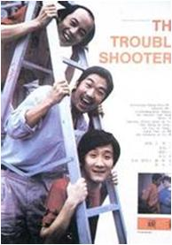
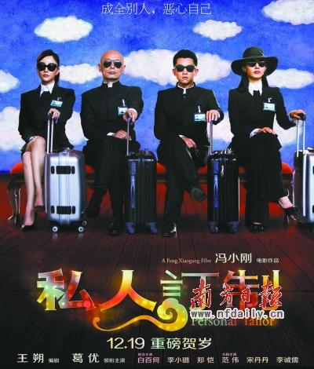
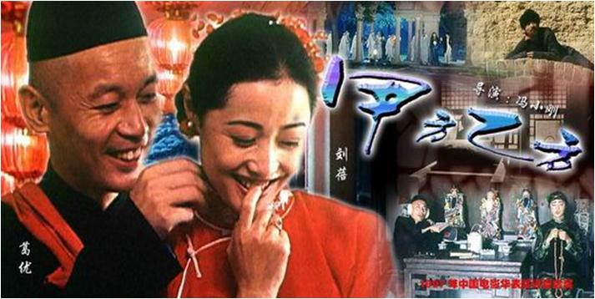
Lives of the trouble shooters

Slide 22
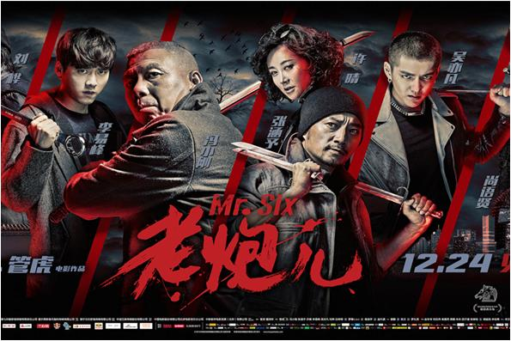

Slide 23
What do you think?
Will the trouble shooters change their lifestyles？
Will one of us be a trouble shooter one day？
What will the life be like in the future in Beijing？

Slide 24
Thank you！！！

