Slide 1

中国文化基础
Basics in Chinese Culture for Bachelor Students of Translation
湖南师范大学 2020年2月24日-6月8日
中国语言文化 周一16:30-18:15，
上课地点2-3月份在綫、4-6月份外院大楼515报告厅
吴漠汀特聘教授 Distinguished Professor Dr. Martin Woesler
湖南师范大学外国学院 Foreign Studies College, Hunan Normal University

Slide 2
Traditional Chinese Culture
About Chinese culture around the world: the importance
About the course: the contents
About the studying: preview the unit; answer questions; interpret the text; discuss and translate.
About homework: find 1 sentence for each topic in the internet and submit it with its English translation
About grading: 30% from homework; 10% from classroom performance; 70% from the final test

Slide 3
About the teaching
1. Tell students to answer the questions after each section and see if they have previewed the text and how well they’ve mastered it.
2. Interpret cultural phenomena and terms and expressions of high frequency in the text.
3. Introduce related topics and invite students to comment.
4. Grade students’ homework.
5. Grade students’ final exam.

Slide 4
Questions concerning Section A, Unit One
1. How large is China?
2. What are the countries that China borders?
3. What do you know about China’s coastline?
4. What’s China’s climate like?
5. What’s China’s general land surface like?
6. What do you know about China’s vegetation and animal life?

Slide 5
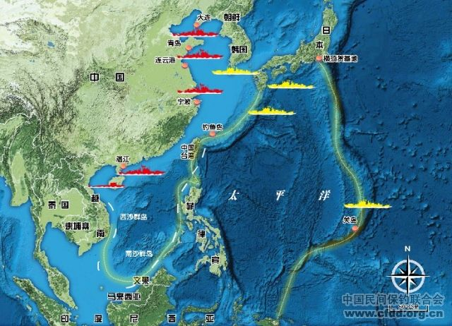
How large is China?

Slide 6
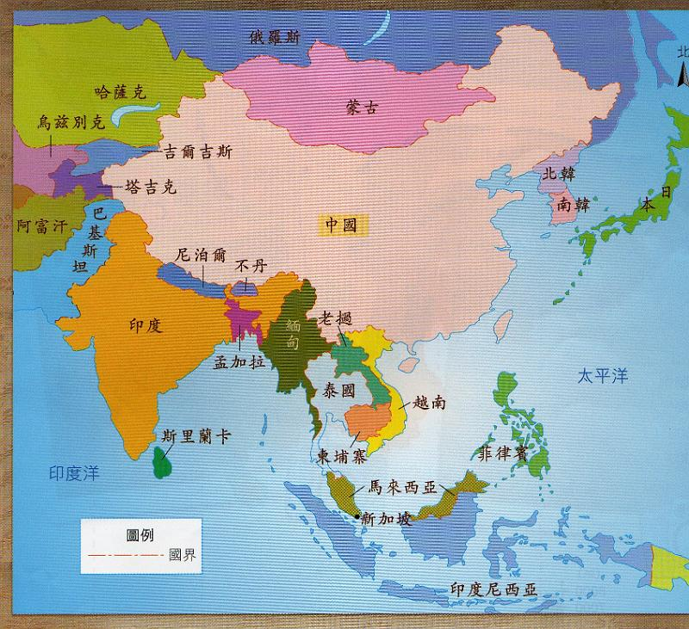
How many countries border China?

Slide 7
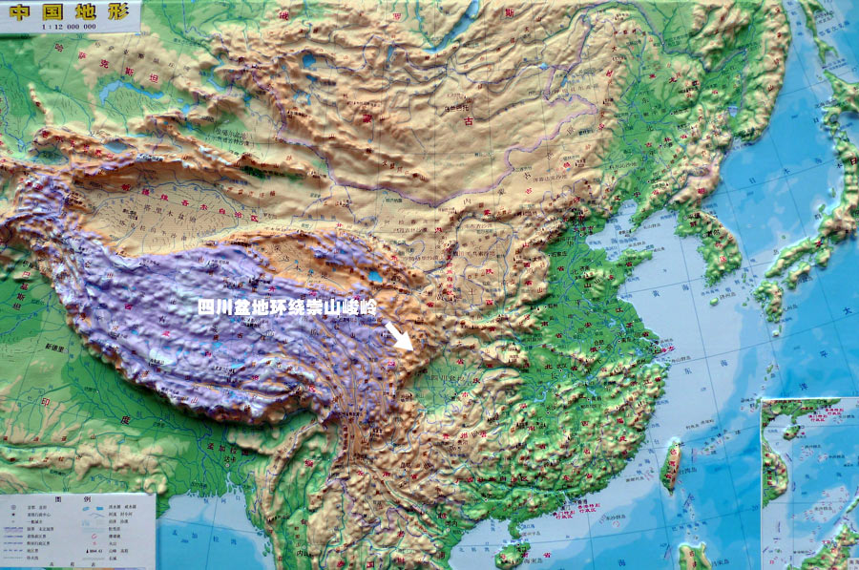
What is China’s land surface like?

Slide 8
Questions concerning Section B, Unit One
1. When did New China begin to open to the outside world?
2. What changes have taken place in China’s economy?
3. How many special economic zones of China can you name?
4. What progress has been made in China’s economy?
5. What problems are there with the economic development?
6. How shall we adapt state enterprises to the situation?

Slide 9
Questions concerning Section C, Unit One
1. What do you think of Confucius’ saying---“nothing is lofty except schooling?”
2. What do you know about China’s educational system?
3. What do you think of the Hope Project?
4. What do you know about China’s adult education?
5. What progress has been made in traditional Chinese medicine recently?

Slide 10
Questions concerning Section D, Unit One
1. Why has environmental protection been taken as a national policy of China? How serious is air and water pollution now in China?
2. What measures has China taken against pollution?

