Slide 1


Round Table Culture
By. Song Yifang

Slide 2


目录
1.
Brief Introduction
DIRECTORY
2.
Contrast and Compare
3.
Development of Round Table

Slide 3

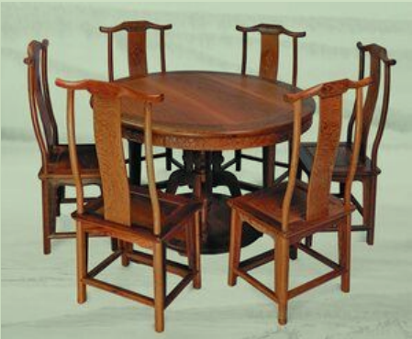
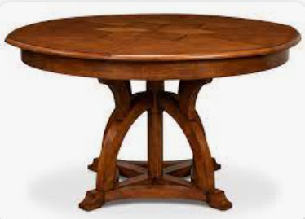


Brief Introduction
Most distinctive feature: roundness
Without beginning or end
Without sides or corners
Representing perfection and wholeness
A symbol of harmony, equality, tolerance, reunion

