Slide 1
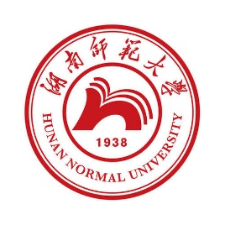
中国文化基础 Foundation of Chinese Cultures for Bachelor Students of Translation Studies
湖南师范大学 2021年3月3日-2021年6月16日 中国文化基础 周三第七和第八节课14:30-16:10，
上课地点：在线
助教：刘廷阳 Liu Tingyang, wiki 助教：陈柯汝 Chen Keru
吴漠汀特聘教授 Distinguished Professor Dr. Martin Woesler
湖南师范大学外国学院 Foreign Studies College, Hunan Normal University

Slide 2
Session 2 第二周
Session Overview 本节概览
Preparation:
Check: Have you chosen the topics, read the 3 texts, taken the quiz, made the homework, taken the EU Survey?
3 Students: Have you prepared ppt?
Topic Ranking List: This semesters‘ program

Slide 3
Session 2 第二周
Hitlist of Chinese cultural phenomena: This semesters‘ schedule
Order | Date | Topic | Chapter | Points | Popularity
1 | 10.03.2021 | Beverages: Milk Tea | 21 | 474 | 79%
2 | 10.03.2021 | Traditional Cuisine: Eight Major Cuisines in China | 28 | 468 | 78%
3 | 10.03.2021 | Beverages: Tea | 20 | 451 | 75%
4 | 17.03.2021 | Architecture: Architecture and Gardens, The Forbidden City | 36 | 433 | 72%
5 | 17.03.2021 | Traditional Festivals | 2 | 432 | 72%
6 | 17.03.2021 | Aesthetic ideals and social customs: The Four Most Handsome Men in Ancient China | 108 | 427 | 71%
7 | 24.03.2021 | Traditional Cuisine: Four Distinct Regional Cuisines | 24 | 423 | 71%
8 | 24.03.2021 | Education: Historical Figures, The Four Talented Women of Ancient China | 119 | 417 | 70%
9 | 24.03.2021 | Traditional Cuisine: Two Famous Dishes | 26 | 415 | 69%
10 | 31.03.2021 | Aesthetic ideals and social customs: Chinese Marriage Customs | 110 | 409 | 68%
11 | 31.03.2021 | Music and instruments: Pipa | 95 | 406 | 68%
12 | 31.03.2021 | Traditional Cuisine: The Art of Chinese Cooking | 25 | 404 | 67%
13 | 07.04.2021 | Silk and porcelain: Celadon and Celadon Song 《青花瓷》歌词 | 31 | 401 | 67%
14 | 07.04.2021 | Traditional Cuisine: Chinese Dining Etiquette | 23 | 396 | 66%
15 | 07.04.2021 | Facial Make-up: Cosmetics, Traditional Chinese Make-Up | 98 | 395 | 66%
16 | 14.04.2021 | Garden Culture: The Summer Palace | 41 | 385 | 64%
17 | 14.04.2021 | Money culture: The tradition of Red Envelope and Lucky Money | 106 | 384 | 64%
18 | 14.04.2021 | Stage entertainment: Crosstalk 相声 | 99 | 383 | 64%
19 | 21.04.2021 | Architecture | 35 | 377 | 63%
20 | 21.04.2021 | Music and instruments: Guzheng | 94 | 375 | 63%
21 | 21.04.2021 | Chinese Astrology: Twelve Animals of the Chinese Zodiac | 71 | 372 | 62%
22 | 28.04.2021 | Ancient literature: Four Folk Stories of Ancient China | 49 | 371 | 62%
23 | 28.04.2021 | Ancient literature: Chinese Classical Fairy Tales | 50 | 369 | 62%
24 | 28.04.2021 | Chinese language: Chinese Dialects | 45 | 368 | 61%
25 | 05.05.2021 | Animals: Panda | 128 | 366 | 61%
26 | 05.05.2021 | Facial Make-up: Face Changing in Sichuan Opera | 97 | 365 | 61%
27 | 05.05.2021 | Chinese Mythology: Huli-jing | 73 | 364 | 61%
28 | 12.05.2021 | Traditional Crafts: Folk Art - Chinese Paper-cutting | 19 | 364 | 61%
29 | 12.05.2021 | Science and Technology: Douyin (Tik Tok) | 8 | 362 | 60%
30 | 12.05.2021 | Chinese clothing / interieur: Chinese clothing | 112 | 361 | 60%
31 | 19.05.2021 | Facial Make-up | 96 | 360 | 60%
32 | 19.05.2021 | Beverages: The Liquor Culture of Ancient China | 22 | 357 | 60%
33 | 19.05.2021 | Premodern literature: Tang and Song (2 texts) | 51 | 357 | 60%
34 | 26.05.2021 | Chinese Medicine: The Development of Chinese Medicine | 68 | 356 | 59%
35 | 26.05.2021 | Modern and Contemporary Literature: Qian Zhongshu (Ch'ien Chung-shu) | 56 | 349 | 58%
36 | 26.05.2021 | Body movement performance: Traditional Chinese Dance | 103 | 346 | 58%
37 | 02.06.2021 | Chinese Astrology: Calendar, The 24 Solar Terms | 72 | 346 | 58%
38 | 02.06.2021 | Stage entertainment: Shadow Play | 100 | 344 | 57%
39 | 02.06.2021 | Chinese Astrology: Chinese Astrology | 70 | 338 | 56%
40 | 09.06.2021 | Chinese Writing: Chinese Characters | 9 | 336 | 56%
41 | 09.06.2021 | Landscapes and tourism: Landscape, Five Famous Mountains | 122 | 333 | 56%
42 | 09.06.2021 | Traditional Crafts: Carving | 17 | 326 | 54%
43 | 16.06.2021 | Landscapes and tourism: Tourism, Nanjing-An Ancient Capital of Six Dynasties | 126 | 319 | 53%
44 | 16.06.2021 | Garden Culture: Qingming Riverside Landscspe Garden | 42 | 317 | 53%
45 | 16.06.2021 | Traditional Crafts: Handcraft - Chinese Knots | 18 | 317 | 53%
46 |  | Fine Arts: Painting | 32 | 316 | 53%
47 |  | Chinese clothing / interieur: Cheongsam | 113 | 312 | 52%
48 |  | Silk Road - by land and by sea: Zhang Qian and the Silk Road | 89 | 309 | 52%
49 |  | Money culture: Currency, Jiaozi (A Paper Currency in Northern Song Dynasty) | 105 | 308 | 51%
50 |  | Beijing Opera: Actor Mei Lanfang | 61 | 306 | 51%
51 |  | Education: Ancient Chinese Education | 116 | 305 | 51%
52 |  | Chinese language | 44 | 304 | 51%
53 |  | Traditional Crafts: Embroidery | 14 | 304 | 51%
54 |  | Chinese Mythology: Gods and Immortals | 74 | 303 | 51%
55 |  | Chinese Writing: Calligraphy | 11 | 302 | 50%
56 |  | Landscapes and tourism: The Ancient Tea Horse Road | 123 | 300 | 50%
57 |  | Traditional Festivals: Spring Festival Couplets | 3 | 299 | 50%
58 |  | Premodern literature: Li Bai's 李白 《长干行》 and its translations | 52 | 297 | 50%
59 |  | Chinese Medicine: Acupuncture and Moxibustion | 67 | 296 | 49%
60 |  | Silk and porcelain: Silk | 29 | 296 | 49%
61 |  | Science and Technology: China's Four New Inventions | 7 | 294 | 49%
62 |  | Stage entertainment: Chinese cinema (dramas and movies) and its popularity and affection in Vietnam | 101 | 294 | 49%
63 |  | Games: Go 围棋 | 107 | 291 | 49%
64 |  | Premodern literature: Strange Stories from a Chinese Studio | 54 | 289 | 48%
65 |  | Religions: Daoism | 76 | 288 | 48%
66 |  | Science and Technology: Ancient Science and Technology | 5 | 286 | 48%
67 |  | Architecture: Bridges | 39 | 284 | 47%
68 |  | Education: Yuelu Academy (One of the Four Most Prestigious Academies) | 117 | 283 | 47%
69 |  | Landscapes and tourism: Mogao Grottoes | 124 | 283 | 47%
70 |  | Silk Road - by land and by sea: Zheng He and the Maritime Silk Road | 90 | 283 | 47%
71 |  | Ancient literature: Classical Literature | 46 | 281 | 47%
72 |  | Army and weapons: Chinese Ancient Weapons | 121 | 281 | 47%
73 |  | Aesthetic ideals and social customs: Habits, Ways of Contacting | 109 | 279 | 47%
74 |  | Architecture: Three Great Towers in China | 38 | 275 | 46%
75 |  | Fine Arts: Seal-cutting | 33 | 275 | 46%
76 |  | Silk Road - by land and by sea: Zheng He's Voyages | 91 | 275 | 46%
77 |  | Garden Culture: Gardens | 40 | 274 | 46%
78 |  | Chinese Medicine: Diagnosis and Pharmacology | 66 | 273 | 46%
79 |  | Beijing Opera | 60 | 272 | 45%
80 |  | Chinese Writing: Chinese Characters and Scripts | 10 | 272 | 45%
81 |  | Premodern literature: China's Four Great Classical Novels | 53 | 270 | 45%
82 |  | Chinese clothing / interieur: The Folding Screen | 115 | 267 | 45%
83 |  | Ancient literature: Chinese Mythology | 48 | 265 | 44%
84 |  | Chinese Medicine: Zhang Zhongjing | 69 | 264 | 44%
85 |  | Landscapes and tourism: Four State-Level Cultural Relics | 125 | 263 | 44%
86 |  | Martial Arts: Qigong | 64 | 262 | 44%
87 |  | Architecture: Four Great Pavilions | 37 | 261 | 44%
88 |  | Religions: Buddhism | 75 | 260 | 43%
89 |  | Traditional Cuisine: Chopsticks | 27 | 260 | 43%
90 |  | Westernization: The Eastward Spread of Western Learning | 92 | 260 | 43%
91 |  | Body movement performance: Chinese Lion Dancing | 104 | 259 | 43%
92 |  | Body movement performance: Stilts | 102 | 259 | 43%
93 |  | Science and Technology: Compass | 6 | 259 | 43%
94 |  | Chinese Writing: The Evolution of Calligraphy | 12 | 258 | 43%
95 |  | Chinese Writing: Ancient Writing and Painting Tool, Writing Brush | 13 | 255 | 43%
96 |  | Garden Culture: Bonsai (Penjing) | 43 | 253 | 42%
97 |  | Traditional Crafts: Lacquerware | 16 | 247 | 41%
98 |  | Chinese clothing / interieur: Batik | 114 | 242 | 40%
99 |  | Confucianism: Confucian Culture | 81 | 237 | 40%
100 |  | Westernization: The Westernization Movement | 93 | 236 | 39%
101 |  | Modern and Contemporary Literature: Novels | 57 | 234 | 39%
102 |  | Modern and Contemporary Literature: Literature, Science Fiction, and Fantasy | 59 | 233 | 39%
103 |  | Ancient literature: Yue Fu | 47 | 231 | 39%
104 |  | Modern and Contemporary Literature: Modern Literature | 55 | 231 | 39%
105 |  | Education: The Nine-Grade Official Selection System in Wei, Jin, Southern and Northern Dynasties | 118 | 229 | 38%
106 |  | Confucianism: Four Main Philosophic Schools | 79 | 226 | 38%
107 |  | Philosophical Schools (Daoism, Buddhism, Legalism): Classical Philosophy - Reading Tao Te Ching | 85 | 225 | 38%
108 |  | Minority cultures: Lisu People and Daogan Festival of Lisu Ethnic Minority | 111 | 219 | 37%
109 |  | Landscapes and tourism: Four Buddhist Shrines | 127 | 213 | 36%
110 |  | Beijing Opera: Beijing Opera Acrobatics | 62 | 211 | 35%
111 |  | Confucianism: Classical Philosophy - Confucius and Confucianism | 80 | 211 | 35%
112 |  | Martial Arts: Wushu | 63 | 211 | 35%
113 |  | Army and weapons: Terracotta Army | 120 | 210 | 35%
114 |  | Fine Arts: Bada Shanren and Qi Baishi | 34 | 210 | 35%
115 |  | Martial Arts: Huo Yuanjia | 65 | 210 | 35%
116 |  | Modern and Contemporary Literature: Contemporary Literature | 58 | 209 | 35%
117 |  | Philosophical Schools (Daoism, Buddhism, Legalism): Classical Philosophy - Daoism | 84 | 204 | 34%
118 |  | Traditional Festivals: Lattice on Ancient Chinese Windows | 4 | 203 | 34%
119 |  | Silk and porcelain: Porcelain | 30 | 197 | 33%
120 |  | Philosophical Schools (Daoism, Buddhism, Legalism): Legalism | 88 | 196 | 33%
121 |  | Confucianism: Chinese Traditional Culture-Five Constant Virtues | 83 | 195 | 33%
122 |  | Traditional Crafts: Cloisonne | 15 | 194 | 32%
123 |  | Religions: Christianity | 78 | 176 | 29%
124 |  | Religions: Islam | 77 | 171 | 29%
125 |  | Confucianism: Classical Philosophy - Reading The Analects | 82 | 170 | 28%
126 |  | Philosophical Schools (Daoism, Buddhism, Legalism): Classical Philosophy - Reading The Importance of Living | 87 | 168 | 28%
127 |  | Philosophical Schools (Daoism, Buddhism, Legalism): Classical Philosophy - Reading The Sutra of Hui-neng | 86 | 154 | 26%

Slide 4
Session 2 第二周
Order | Date | Topic | Chapter | Points | Popularity
25 | 05.05.2021 | Animals: Panda | 128 | 366 | 61%
26 | 05.05.2021 | Facial Make-up: Face Changing in Sichuan Opera | 97 | 365 | 61%
27 | 05.05.2021 | Chinese Mythology: Huli-jing | 73 | 364 | 61%
28 | 12.05.2021 | Traditional Crafts: Folk Art - Chinese Paper-cutting | 19 | 364 | 61%
29 | 12.05.2021 | Science and Technology: Douyin (Tik Tok) | 8 | 362 | 60%
30 | 12.05.2021 | Chinese clothing / interieur: Chinese clothing | 112 | 361 | 60%
31 | 19.05.2021 | Facial Make-up | 96 | 360 | 60%
32 | 19.05.2021 | Beverages: The Liquor Culture of Ancient China | 22 | 357 | 60%
33 | 19.05.2021 | Premodern literature: Tang and Song (2 texts) | 51 | 357 | 60%
34 | 26.05.2021 | Chinese Medicine: The Development of Chinese Medicine | 68 | 356 | 59%
35 | 26.05.2021 | Modern and Contemporary Literature: Qian Zhongshu (Ch'ien Chung-shu) | 56 | 349 | 58%
36 | 26.05.2021 | Body movement performance: Traditional Chinese Dance | 103 | 346 | 58%
37 | 02.06.2021 | Chinese Astrology: Calendar, The 24 Solar Terms | 72 | 346 | 58%
38 | 02.06.2021 | Stage entertainment: Shadow Play | 100 | 344 | 57%
39 | 02.06.2021 | Chinese Astrology: Chinese Astrology | 70 | 338 | 56%
40 | 09.06.2021 | Chinese Writing: Chinese Characters | 9 | 336 | 56%
41 | 09.06.2021 | Landscapes and tourism: Landscape, Five Famous Mountains | 122 | 333 | 56%
42 | 09.06.2021 | Traditional Crafts: Carving | 17 | 326 | 54%
43 | 16.06.2021 | Landscapes and tourism: Tourism, Nanjing-An Ancient Capital of Six Dynasties | 126 | 319 | 53%
44 | 16.06.2021 | Garden Culture: Qingming Riverside Landscspe Garden | 42 | 317 | 53%
45 | 16.06.2021 | Traditional Crafts: Handcraft - Chinese Knots | 18 | 317 | 53%
46 |  | Fine Arts: Painting | 32 | 316 | 53%
47 |  | Chinese clothing / interieur: Cheongsam | 113 | 312 | 52%
48 |  | Silk Road - by land and by sea: Zhang Qian and the Silk Road | 89 | 309 | 52%
49 |  | Money culture: Currency, Jiaozi (A Paper Currency in Northern Song Dynasty) | 105 | 308 | 51%
50 |  | Beijing Opera: Actor Mei Lanfang | 61 | 306 | 51%
51 |  | Education: Ancient Chinese Education | 116 | 305 | 51%
52 |  | Chinese language | 44 | 304 | 51%
53 |  | Traditional Crafts: Embroidery | 14 | 304 | 51%
54 |  | Chinese Mythology: Gods and Immortals | 74 | 303 | 51%
55 |  | Chinese Writing: Calligraphy | 11 | 302 | 50%
56 |  | Landscapes and tourism: The Ancient Tea Horse Road | 123 | 300 | 50%
57 |  | Traditional Festivals: Spring Festival Couplets | 3 | 299 | 50%
58 |  | Premodern literature: Li Bai's 李白 《长干行》 and its translations | 52 | 297 | 50%
59 |  | Chinese Medicine: Acupuncture and Moxibustion | 67 | 296 | 49%
60 |  | Silk and porcelain: Silk | 29 | 296 | 49%
61 |  | Science and Technology: China's Four New Inventions | 7 | 294 | 49%
62 |  | Stage entertainment: Chinese cinema (dramas and movies) and its popularity and affection in Vietnam | 101 | 294 | 49%
63 |  | Games: Go 围棋 | 107 | 291 | 49%
64 |  | Premodern literature: Strange Stories from a Chinese Studio | 54 | 289 | 48%
65 |  | Religions: Daoism | 76 | 288 | 48%
66 |  | Science and Technology: Ancient Science and Technology | 5 | 286 | 48%
67 |  | Architecture: Bridges | 39 | 284 | 47%
68 |  | Education: Yuelu Academy (One of the Four Most Prestigious Academies) | 117 | 283 | 47%
69 |  | Landscapes and tourism: Mogao Grottoes | 124 | 283 | 47%
70 |  | Silk Road - by land and by sea: Zheng He and the Maritime Silk Road | 90 | 283 | 47%
71 |  | Ancient literature: Classical Literature | 46 | 281 | 47%
72 |  | Army and weapons: Chinese Ancient Weapons | 121 | 281 | 47%
73 |  | Aesthetic ideals and social customs: Habits, Ways of Contacting | 109 | 279 | 47%
74 |  | Architecture: Three Great Towers in China | 38 | 275 | 46%
75 |  | Fine Arts: Seal-cutting | 33 | 275 | 46%
76 |  | Silk Road - by land and by sea: Zheng He's Voyages | 91 | 275 | 46%
77 |  | Garden Culture: Gardens | 40 | 274 | 46%
78 |  | Chinese Medicine: Diagnosis and Pharmacology | 66 | 273 | 46%
79 |  | Beijing Opera | 60 | 272 | 45%
80 |  | Chinese Writing: Chinese Characters and Scripts | 10 | 272 | 45%
81 |  | Premodern literature: China's Four Great Classical Novels | 53 | 270 | 45%
82 |  | Chinese clothing / interieur: The Folding Screen | 115 | 267 | 45%
83 |  | Ancient literature: Chinese Mythology | 48 | 265 | 44%
84 |  | Chinese Medicine: Zhang Zhongjing | 69 | 264 | 44%
85 |  | Landscapes and tourism: Four State-Level Cultural Relics | 125 | 263 | 44%
86 |  | Martial Arts: Qigong | 64 | 262 | 44%
87 |  | Architecture: Four Great Pavilions | 37 | 261 | 44%
88 |  | Religions: Buddhism | 75 | 260 | 43%
89 |  | Traditional Cuisine: Chopsticks | 27 | 260 | 43%
90 |  | Westernization: The Eastward Spread of Western Learning | 92 | 260 | 43%
91 |  | Body movement performance: Chinese Lion Dancing | 104 | 259 | 43%
92 |  | Body movement performance: Stilts | 102 | 259 | 43%
93 |  | Science and Technology: Compass | 6 | 259 | 43%
94 |  | Chinese Writing: The Evolution of Calligraphy | 12 | 258 | 43%
95 |  | Chinese Writing: Ancient Writing and Painting Tool, Writing Brush | 13 | 255 | 43%
96 |  | Garden Culture: Bonsai (Penjing) | 43 | 253 | 42%
97 |  | Traditional Crafts: Lacquerware | 16 | 247 | 41%
98 |  | Chinese clothing / interieur: Batik | 114 | 242 | 40%
99 |  | Confucianism: Confucian Culture | 81 | 237 | 40%
100 |  | Westernization: The Westernization Movement | 93 | 236 | 39%
101 |  | Modern and Contemporary Literature: Novels | 57 | 234 | 39%
102 |  | Modern and Contemporary Literature: Literature, Science Fiction, and Fantasy | 59 | 233 | 39%
103 |  | Ancient literature: Yue Fu | 47 | 231 | 39%
104 |  | Modern and Contemporary Literature: Modern Literature | 55 | 231 | 39%
105 |  | Education: The Nine-Grade Official Selection System in Wei, Jin, Southern and Northern Dynasties | 118 | 229 | 38%
106 |  | Confucianism: Four Main Philosophic Schools | 79 | 226 | 38%
107 |  | Philosophical Schools (Daoism, Buddhism, Legalism): Classical Philosophy - Reading Tao Te Ching | 85 | 225 | 38%
108 |  | Minority cultures: Lisu People and Daogan Festival of Lisu Ethnic Minority | 111 | 219 | 37%
109 |  | Landscapes and tourism: Four Buddhist Shrines | 127 | 213 | 36%
110 |  | Beijing Opera: Beijing Opera Acrobatics | 62 | 211 | 35%
111 |  | Confucianism: Classical Philosophy - Confucius and Confucianism | 80 | 211 | 35%
112 |  | Martial Arts: Wushu | 63 | 211 | 35%
113 |  | Army and weapons: Terracotta Army | 120 | 210 | 35%
114 |  | Fine Arts: Bada Shanren and Qi Baishi | 34 | 210 | 35%
115 |  | Martial Arts: Huo Yuanjia | 65 | 210 | 35%
116 |  | Modern and Contemporary Literature: Contemporary Literature | 58 | 209 | 35%
117 |  | Philosophical Schools (Daoism, Buddhism, Legalism): Classical Philosophy - Daoism | 84 | 204 | 34%
118 |  | Traditional Festivals: Lattice on Ancient Chinese Windows | 4 | 203 | 34%
119 |  | Silk and porcelain: Porcelain | 30 | 197 | 33%
120 |  | Philosophical Schools (Daoism, Buddhism, Legalism): Legalism | 88 | 196 | 33%
121 |  | Confucianism: Chinese Traditional Culture-Five Constant Virtues | 83 | 195 | 33%
122 |  | Traditional Crafts: Cloisonne | 15 | 194 | 32%
123 |  | Religions: Christianity | 78 | 176 | 29%
124 |  | Religions: Islam | 77 | 171 | 29%
125 |  | Confucianism: Classical Philosophy - Reading The Analects | 82 | 170 | 28%
126 |  | Philosophical Schools (Daoism, Buddhism, Legalism): Classical Philosophy - Reading The Importance of Living | 87 | 168 | 28%
127 |  | Philosophical Schools (Daoism, Buddhism, Legalism): Classical Philosophy - Reading The Sutra of Hui-neng | 86 | 154 | 26%

Slide 5
Session 2 第二周
Milk tea (presentation by Shu Lin 舒琳)
Eight Major cuisines in China (pres. by Su Xiao 苏潇)
Tea (presentation by Teng Bixia 滕璧霞)

Slide 6
Milk Tea
Milk Tea
We live in a modern world with countless yummy food where youngsters can’t live without milk tea. There is even one popular cyber saying that goes like this:”Youngsters continue their lives by drinking milk tea.”
Milk tea, popular throughout the whole country, even the world, originated from bubble tea of Taiwan. Currently, we have entered “Milk Tea 4.0 Era”. Such an era has endowed milk tea with a brand-new meaning, becoming a cultural symbol of modern civilization human life, especially youngsters’ lives, namely, a pursuit of identity recognition for youngsters.（Li Xintong 2020，14）
So, is milk tea really so miraculous? Is it really so tasty? We may as well discuss the past and current situations of milk tea!
A.The Origin of Milk Tea
Each school holds its own opinion about the origin, but in fact, if we carefully analyse the fact, we can easily find its true origin, that is---”Mongolia Milk Tea” drunk by nomadic tribes in Mongolia Plateau. Till now, the nomadic tribes living in Inner Mongolia Autonomous Region of PRC still treat visitors with milk tea, which is an unshakable traditional custom.

Slide 7
Milk Tea
B. The Development of Milk Tea
Due to the rampant global expansion of British colonists, lots of oriental local products, including milk tea of China, were also transported to the occidental world. Later, it was improved and developed in Britain. Since the introduction of milk tea into Britain, due to the distinction of climate and dietary habits, British gave up the utilization of spice, but mixed sundry kinds of tea to replace spice to make milk tea, and added maple sugar as condiment, thus giving birth to the rudiment of modern milk tea and its basic ingredients.（《世界著名奶茶大全》 厨影美食）
Later, Taiwan introduced milk tea.
In the spring of 1987, manager of a Taiwanese cold drink department---Ms. Lin Xiuhui of "Chunshuitang" , added local snack flour into milk tea, and after her successful promotion to consumers, Lin and her colleagues Shen Tonge, Lin Lingru and Wang Yufeng, were inspired by cooked flour whose shape is similar to black pearl, thus creating the name “Pearl Milk Tea”(Bubble tea, currently). Henceforth, the name full of aesthetic feeling was spread.（《世界著名奶茶大全》 厨影美食） By far, modern milk tea has preliminarily come into shape.

Slide 8
Milk Tea
C. A Comparison of Oriental and Foreign Milk Tea
1. Local Changsha Milk Tea
When in Changsha, talk as Changshanese do, so let’s talk about Changsha local milk tea first. As we all know, Changsha is famed as an Internet celebrity city, mostly due to “Sexytea”. Sexytea was founded in 2013 as Changsha’s original Chinese style tea brand, uniquely practicing the creation of “new Chinese-style fresh tea”, and staying committed to growing to an original tea beverage design brand. What Sexytea brings to customers is not only a cup of tea, but also an interesting lifestyle, thus showing the beauty of China on the basis of tea. All Sexytea milk tea is produced with Nestle fresh milk and excellent quality tea leaves as ingredients.
The logo of Sexytea is mainly composed of a Jiangnan woman. A fan and a beauty vividly show the majesty and quaintness of antique Chinese style. Compared with other current milk tea brand logos, that of Sexytea has left a great impression on people.（茶颜悦色密码 2020,68）
The signature milk tea of Sexytea is “black tea latte”, comprised of Ceylon black tea, Zelanian Anchor whipping cream and American pecans. On the top of the paper cup is Anchor whipping cream with pecans. Black tea latte emphasizes both milk and tea, with each flavor balanced pretty well.

Slide 9
Milk Tea
2. Hong Kong-style milk tea
The inventor of Hong Kong-style milk tea is Lin Muhe, the founder of the time-honored brand Lanfangyuan in Central, Hong Kong. The 81-year-old "Father of Hong Kong-style milk tea" has never used silk stockings to make tea. When Lanfangyuan was firstly opened, silk stockings were not yet fashionable in Hong Kong. When Lin Muhe was about 10 years old, he worked in Hong Kong, with his wife and a clerk opened Lanfangyuan Food Stall in Baihua Street of Central in 1952. During those days, the small stall always attracted nearby dockers every afternoon, who enjoyed themselves watching Lin Muhe and his colleagues washing their tea bags to and fro. When they saw the brown color of tea bags, they thought it was silk stockings. After that, they would shout "a cup of silk stockings milk tea". This is the origin of silk stockings milk tea(currently Hong Kong-style milk tea).（《百度百科——丝袜奶茶》)
3.Indian Masala Chai
Authentic Masala Chai can only be drunk in India, which is cooked by delicate handicrafts. Due to the addition of various spices, the taste is strong, mellow, hot and spicy at the beginning. However, if the flavor is slightly changed, it will be sweet or spicy, or the various flavors will react with each other. It is just as confusing as Indian curry, but pretty fascinating. Maybe this is what Masala Chai should be. Drinking Indian milk tea is not only a baptism to taste, but also a return to primitive nature.（《世界著名奶茶大全》 厨影美食）

Slide 10
Milk Tea
C.Milk Tea and Health
1.Advantages
Drinking milk tea can quickly supplement sugar, increase body energy, mitigate fatigue and improve working efficiency.
2.Disadvantages
Drinking too much milk tea will increase the possibility of getting fat. It will also increase cholesterol, and even lead to hyperlipidemia and hyperglycemia, doing harm to liver and kidney, increasing risks of angiocardiopathy, thus affecting study and memory, and damaging normal gastrointestinal function. It will even cause cancer if drunk for a long time.
References
1.李欣童.（2020）浅谈台湾奶茶文化的三十年变迁.传播力研究,4(14)14-15
2.《世界著名奶茶大全》 厨影美食
3.《百度百科——丝袜奶茶》
4.茶颜悦色密码 （2020）国企管理,(20)68.

Slide 11
Milk Tea
Terms and Expressions
Milk tea 奶茶
Spice 香辛料
Rudiment 雏形
Sexytea 茶颜悦色
Black tea latte 幽兰拿铁
Hong Kong-style milk tea 丝袜奶茶
Cholesterol 胆固醇
Hyperglycemia 高血糖
Mongolian Plateau 蒙古高原
Maple sugar 枫糖
Bubble tea 珍珠奶茶
Internet celebrity city网红城市
Pecans 碧根果
Masala Chai 马萨拉奶茶
Hyperlipidemia 高血脂
Angiocardiopathy 心血管疾病
Gastrointestinal 肠胃的

Slide 12
Milk Tea
Questions
1.What is the origin of milk tea?
2.Who promoted milk tea?
3.What is the birth place of modern milk tea?
4.What is Changsha’s most famous Internet celebrity milk tea shop’s name?
5.Is Hong Kong-style milk tea produced with silk stockings?
6.What are the advantages of drinking milk tea?
7.What are the disadvantages of drinking milk tea?

Slide 13
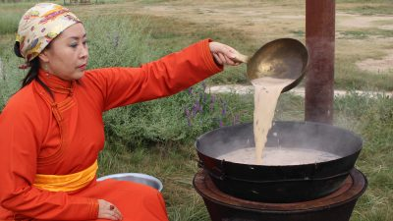
Session 2 第二周

Slide 14
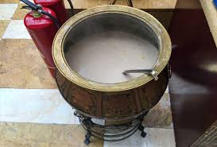
Session 2 第二周

Slide 15
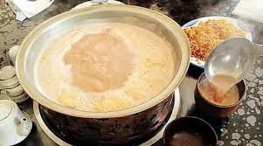
Session 2 第二周

Slide 16
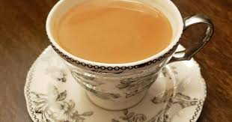
Session 2 第二周

Slide 17
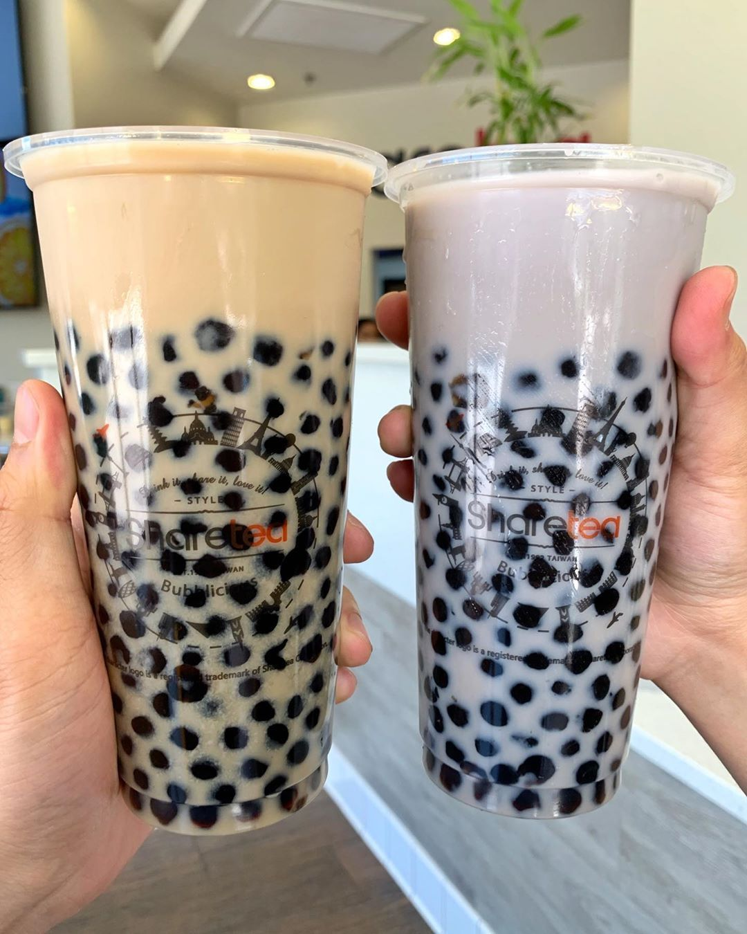
Session 2 第二周

Slide 18
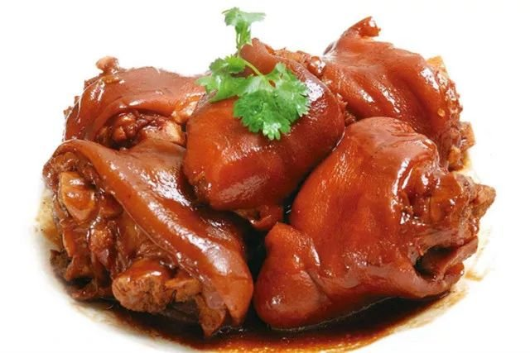
Eight Major Cuisines of China
1. A Brief Introduction About Chinese Cuisines
As early as the Shang and Zhou dynasties, China's food culture began to take shape. At that time, Tai Gongwang was the most representative. In the Spring and Autumn Period and Warring States Period under the reign of Duke Huan of Qi, the flavors of North and South dishes showed differences. In the Tang and Song Dynasties, the southern cuisine and the northern cuisine formed their own systems. In the Southern Song Dynasty, sweet in south and salty in north was formed. At the beginning of the Qing Dynasty, Shandong Cuisine, Sichuan Cuisine, Cantonese Cuisine, and Su Cuisine became the most influential local dishes at that time, and they were called the "four major cuisines." By the end of the Qing Dynasty, four new local cuisines, Zhejiang Cuisine, Fujian Cuisine, Hunan Cuisine, and Anhui Cuisine, were differentiated and formed, which together constituted the "eight major cuisines" of traditional Chinese cuisine. (Lv Xiaomin 2009, 64)
2. The Classification of Chinese Cuisines
China covers a large territory and has many nationalities, hence a variety of Chinese food with different but fantastic and mouthwatering flavors. Since China's local dishes have their own typical characteristics, generally, Chinese food can be roughly divided into eight regional cuisines, which has been widely accepted. (Shi Hongmei 2009, 34)
Click [ https://wiki.ruhr-uni-bochum.de/uvu/index.php/File:Cuisines_-_Eight_Major_Cuisines_in_China.jpg]for original source.

Slide 19

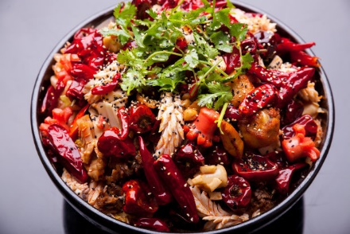
Eight Major Cuisines of China
2.1 Shandong Cuisine
Consisting of Jinan Cuisine and Jiaodong Cuisine, Shandong Cuisine, clear, pure and not greasy, is characterized by its emphasis on aroma, freshness, crispness and tenderness. Shallot and garlic are usually used as seasonings so Shangdong dishes tastes pungent usually. Besides, Soups are given much emphasis in Shangdong dishes. Thin soup features clear and fresh while creamy soup looks thick and tastes strong. Jinan Cuisine is adept at deep-frying, grilling, frying and stir-frying while Jiaodong division is famous for cooking seafood with fresh and light taste. (Shi Hongmei 2009, 45)
Click [ https://wiki.ruhr-uni-bochum.de/uvu/index.php/File:Cuisines_-_Eight_Major_Cuisines_in_China2.jpg]for original source.
2.2 Sichuan Cuisine
Sichuan Cuisine, known often in the West as Szechuan Cuisine, is one of the most famous Chinese cuisines in the world. Characterized by its spicy and pungent flavor, Sichuan Cuisine, prolific of tastes, emphasizes on the use of chili. Pepper and prickly ash also never fail to accompany, producing typical and exciting tastes. Besides, garlic, ginger and fermented soybean are also used in the cooking process. Wild vegetables and animals are usually chosen as ingredients, while frying, frying without oil, pickling and braising are applied as basic cooking techniques. The major Sichuan dishes include Kung Pao Chicken and Bean Sauce Tofu. (Shi Hongmei 2009, 48)
Click [ %5b%20https:/wiki.ruhr-uni-bochum.de/uvu/index.php/File:Cuisines_-_Eight_Major_Cuisines_in_China2.jpg%5d]for original source.

Slide 20
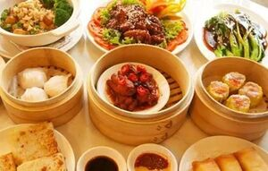
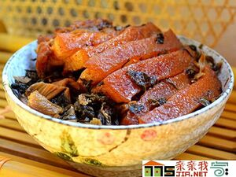
Eight Major Cuisines of China
2.3 Guangdong Cuisine
Tasting clear, light, crisp and fresh, Guangdong Cuisine, familiar to Westerners, usually chooses raptors and beasts to produce originative dishes. Its basic cooking techniques include roasting, stir-frying, sauteing, deep-frying, braising, stewing and steaming. Among them steaming and stir-frying are more commonly applied to preserve the natural flavor. Cantonese are known to have an adventurous palate, able to eat many different kinds of meats and vegetables, which originate from other parts of the world. It doesn't use much spice, just bringing out the natural flavor of the vegetables and meats. (Shi Hongmei 2009, 52)
2.4 Fujian Cuisine
Click [ https://wiki.ruhr-uni-bochum.de/uvu/index.php/File:Cuisines_-_Eight_Major_Cuisines_in_China4.jpg]for original source.
Consisting of Fuzhou Cuisine, Quanzhou Cuisine and Xiamen Cuisine, Fujian Cuisine is distinguished for its choice of seafood, beautiful color and magic taste of sweet, sour, salty and savory. The most distinct feature is their "pickled taste". (Shi Hongmei 2009, 55)

Slide 21
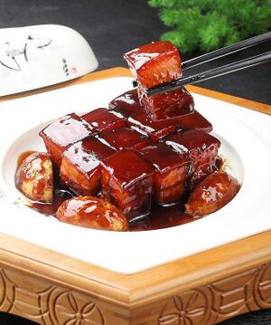
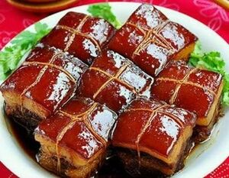
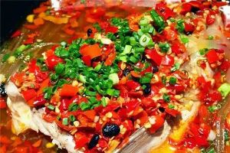
Eight Major Cuisines of China
2.5 Jiangsu Cuisine
Jiangsu Cuisine, also called Huaiyang Cuisine, is popular in the lower reach of the Yangtze River. Aquatics as the main ingredients, it stresses the freshness of materials. Its carving techniques are delicate, of which the melon carving technique is especially well known. Cooking techniques consist of stewing, braising, roasting, simmering, etc. The flavor of Huaiyang Cuisine is light, fresh, sweet and delicate. Jiangsu Cuisine is well-known for its careful selection of ingredients, its methodology of meticulous preparation methodology, and its not-too-spicy, not-too-bland taste. (Shi Hongmei 2009, 58). Click [ http://k.sina.com.cn/article_6439974127_17fda34ef00100da0v.html]for original source.
2.6 Zhejiang Cuisine
Comprising local cuisines of Hangzhou, Ningbo and Shaoxing, Zhejiang Cuisine, not greasy, wins its reputation for freshness, tenderness, softness, smoothness of its dishes with mellow fragrance. And Hangzhou Cuisine is the most famous one among the three. (Shi Hongmei 2009, 62)
Click [ %5b%20http:/k.sina.com.cn/article_6439974127_17fda34ef00100da0v.html%5d]for original source.
2.7 Hunan Cuisine
Hunan Cuisine consists of local cuisines of Xiangjiang Region, Dongting Lake and Xiangxi Coteau. It characterizes itself by thick and pungent flavor. Chili, pepper and shallot are usually necessities in this division. (Shi Hongmei 2009, 65)
Click [ http://img.mp.itc.cn/upload/20170602/aa062f4f21f54de594cc451c9dd40ea2_th.jpg]for original source.

Slide 22
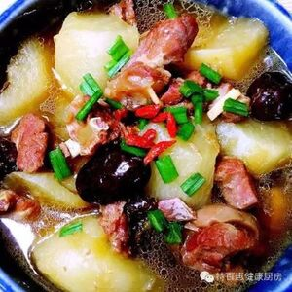
Eight Major Cuisines of China
2.8 Anhui Cuisine
Anhui Cuisine focuses much more on the temperature in cooking. Its major cooking methods are braising and stewing. Often hams and sugar will be added to improve taste and flavour of the dishes. (Shi Hongmei 2009, 68)
Click [ %5b%20http:/img.mp.itc.cn/upload/20170602/aa062f4f21f54de594cc451c9dd40ea2_th.jpg%5d]for original source.
3. A Comparison of Chinese-Western Diet Culture
Chinese and western cultures have always been two major factions in the world culture, and diet plays a very important role in the two cultures. The differences in cultures create the differences between Chinese and Western food cultures. So there are many differences between Chinese and Western food under the two different cultural backgrounds.(Caihua 2009, 56)
Firstly, the western diet is mainly based on flour, with abundant raw materials, and its cooking method is simpler than that in China. But it also pays great attention to taste. Besides, western diet takes nutrition as the highest criterion, with special emphasis on the nutritional components of food. For example, whether the contents of protein, fat, carbohydrate, vitamins and various inorganic elements are properly matched, whether the heat supply is just right, whether these nutritional components can be fully absorbed by eaters and whether there are other side effects. (Caihua 2009, 55)

Slide 23
Eight Major Cuisines of China
However, Chinese cuisine pays more attention to the color, aroma and taste of dishes. The purpose of Chinese people's diet is not only to satisfy their hunger, but also to satisfy their desire for delicious food, which brings pleasure to both their body and mind. Compared with Chinese diet which pays attention to taste, western diet is a rational diet. Furthermore, westerners prefer cold dishes while Chinese like hot food. For Chinese, one should eat the food while it is still hot. What’s more, westerners believe that dishes are hunger-filled, so they specialize in "hard dishes" such as large pieces of meat and whole chickens; while Chinese mainly eat lots of vegetables and little meat. (Caihua 2009, 56)
There are also differences in the names of dishes. Many Chinese dishes often contain a lot of historical and cultural information. For example, Dongpo Meat(Braised Dongpo Pork) is said to be cooked according to recipes handed down by Su Dongpo, a literary giant in Song Dynasty. Some dishes are also related to allusions and legends, for example, Fotiaoqiang(Buddha jumps over the wall) is a legend. In contrast, the names of western food are much simpler. For example, fried chicken legs, hamburgers and seafood soup are almost all named after the raw materials and cooking methods. (Caihua 2009, 57)
References
Bi Jiwan 毕继万. (1999). 跨文化非语言交际 [Cross-cultural Nonverbal Communication]. 外语教学与研究出版社 Foreign Language Teaching and Research Press 78-83.
Cai Hua 蔡华. (2009). 试论中西饮食文化的差异 [On the Differences between Chinese and Western Food Culture]. 邵阳学院学报 Journal of Shaoyang University 56-67.
Du Xuezeng 杜学增. (1999). 中英文化习俗比较 [Comparison of Chinese and English Cultural Customs]. 外语教学与研究出版社 Foreign Language Teaching and Research Press 212-217.
Lv Xiaomi, Ding Xiao, Dai Yangyong 吕晓敏, 丁骁, 代养勇. (2008). 中国八大菜系的形成历程和背景 [The Formation Process and Background of Eight Major Cuisines in China ]. 中国食物与营养 Food and Nutrition in China (10) 62－64．
Shi Hongmei 史红梅. (2009). 地理教学中我国地域饮食文化差异研究 [Study on the Differences of Regional Diet Culture in Geography Teaching in China]. 河北师范大学 Hebei Normal University 34-68.

Slide 24
Eight Major Cuisines of China
Terms and Expressions
pot-stewed fowl 卤味
stewing and simmering 炖，煨
prickly ash 花椒
fermented soybean 豆鼓
Braised Dongpo Pork 东坡肉
Buddha Jumps over the Wall 佛跳墙
Kung Pao Chicken 宫保鸡丁
Bean Sauce Tofu 麻婆豆腐
Questions
1. How many types of cuisines are there in china?
2. What’s differences between Chinese and western diets?
3. What is the origin of Dongpo Meat?

Slide 25
Unit 5 Cuisine

Slide 26
Questions Concerning Section A Distinct Regional Cuisine
1. What are the 4 most popular regional cuisines of China?
2. What school of China’s culinary art is perhaps the most popular? What is it famous for?
3. What dishes are typical of Sichuan cuisine?
4. What do you know about Pock-marked Wife’s Bean Curd?
5. What are the characteristics of Shandong Cuisine?

Slide 27
6. Why are small amounts of cooking oil used in Shangdong Cuisine?
7. What do you know about Beijing Roast Duck and Confucius Family Dishes?
8.Why must Guangdong dishes be lightly seasoned? What Guangdong dishes can you name?
9. What is the greatest characteristic of Huaiyang cuisine? What Huaiyang dishes can you name?
10. What other schools of China’s culinary art do you know?

Slide 28
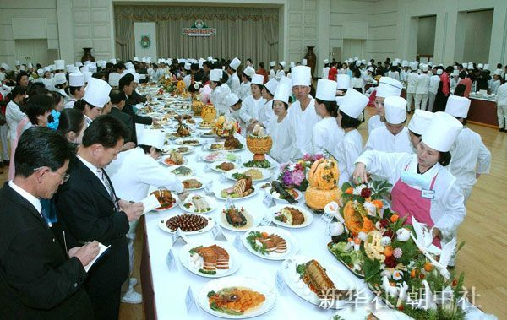
A culinary art competition

Slide 29
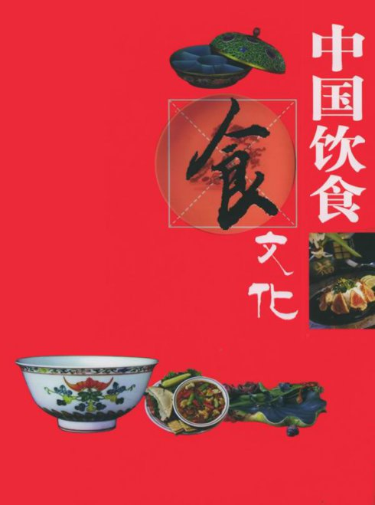
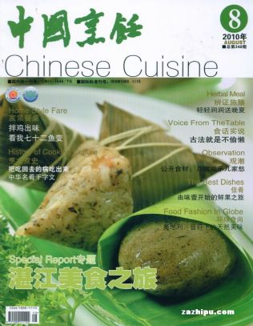
Chinese cuisine

Slide 30
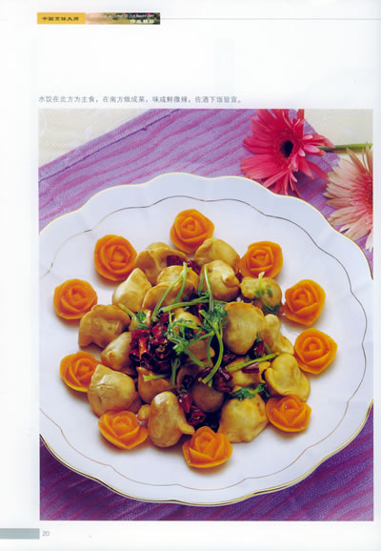
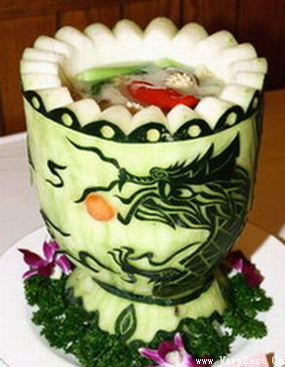
Chinese cuisine as art of cooking

Slide 31
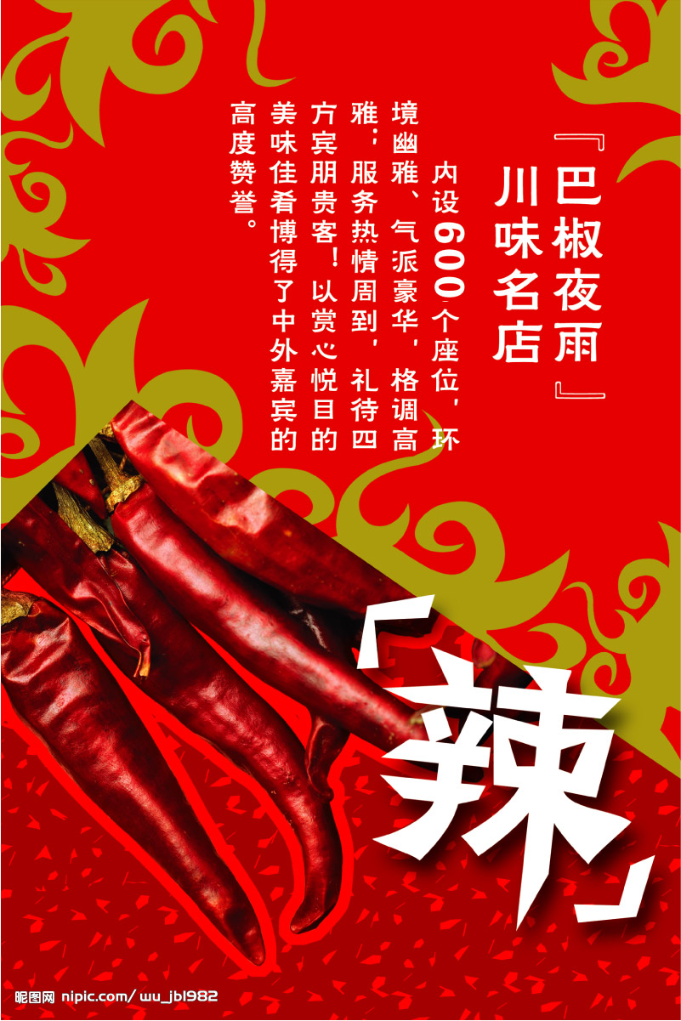
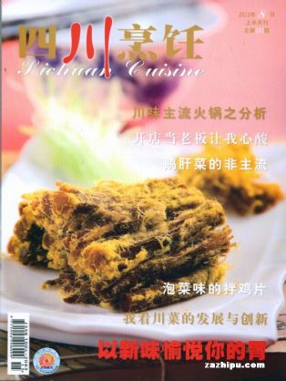
Magazine and poster

Slide 32
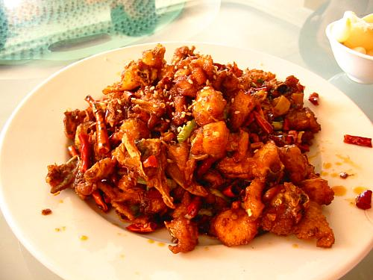
川菜之 麻 辣 鸡 丁

Slide 33
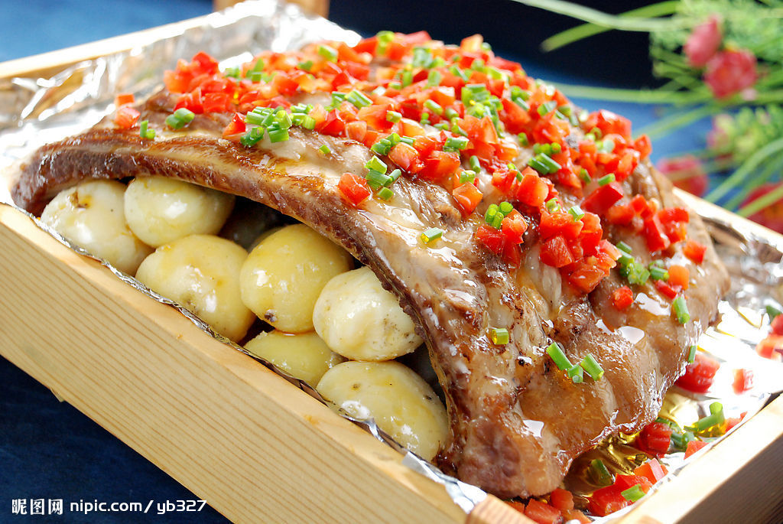
川菜之 排骨飞虹

Slide 34
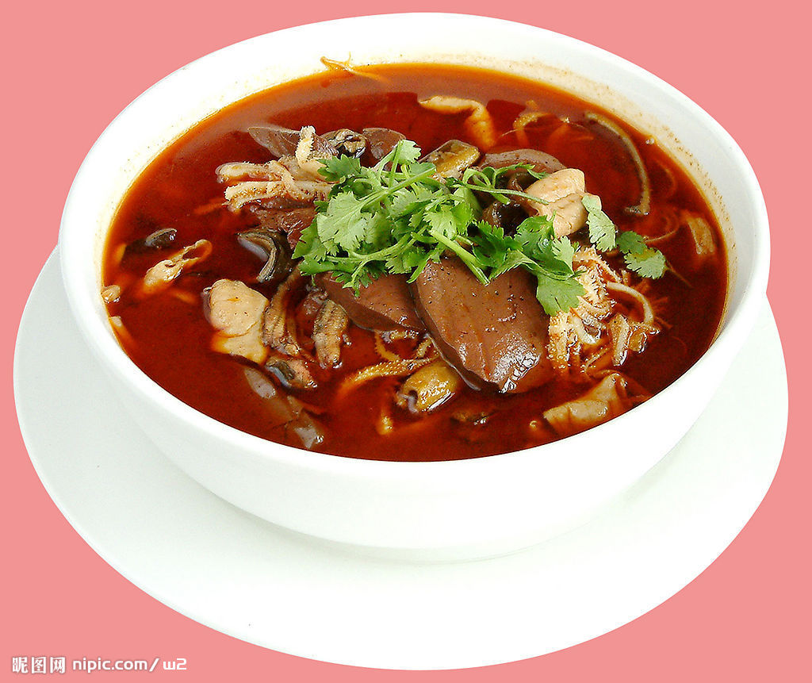
川菜之 毛血旺

Slide 35
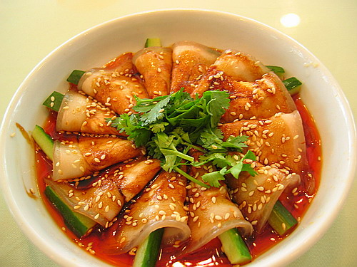
川菜之 麻辣肉片

Slide 36
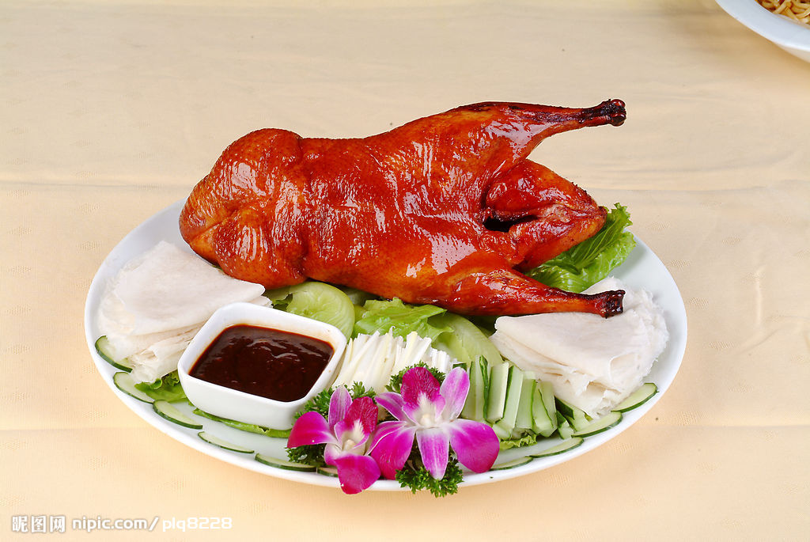
鲁菜之 北京烤鸭

Slide 37
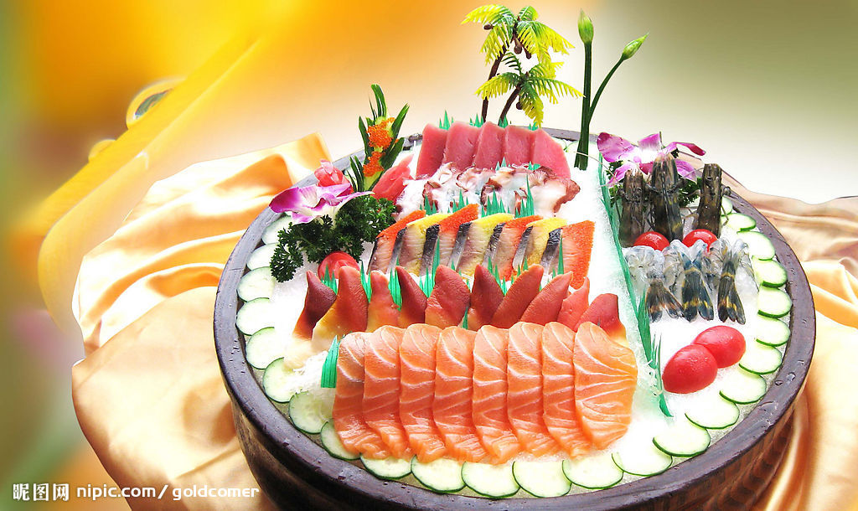
粤菜之 生鱼片

Slide 38
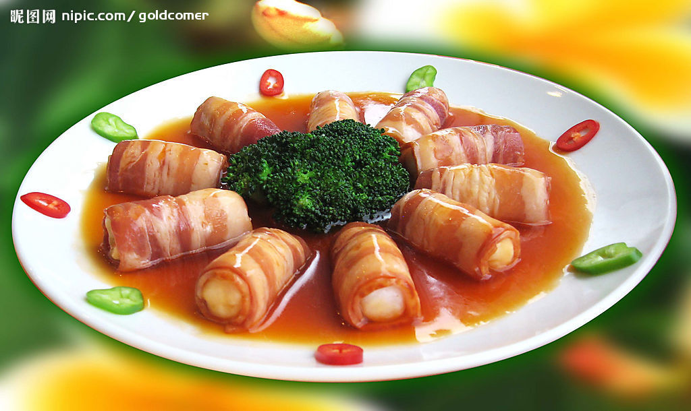
粤菜之 鱼丸肉卷

Slide 39
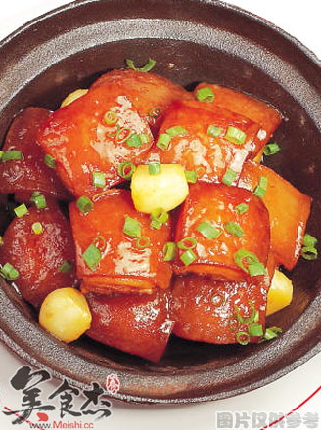
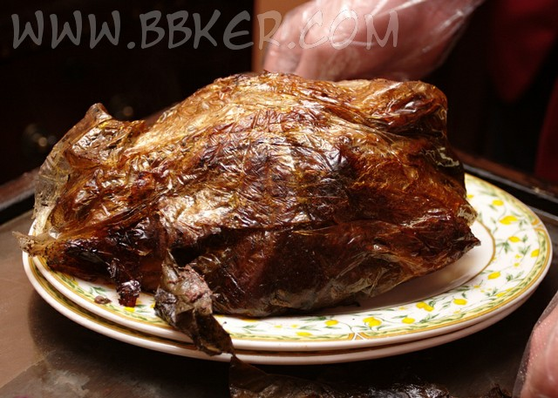
淮扬菜之 Beggar’s Chicken & Dongpo Pork

Slide 40
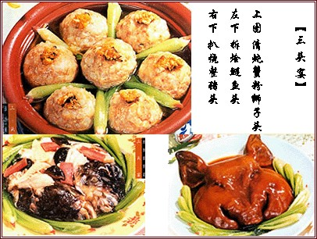
淮扬菜之 三头宴

Slide 41
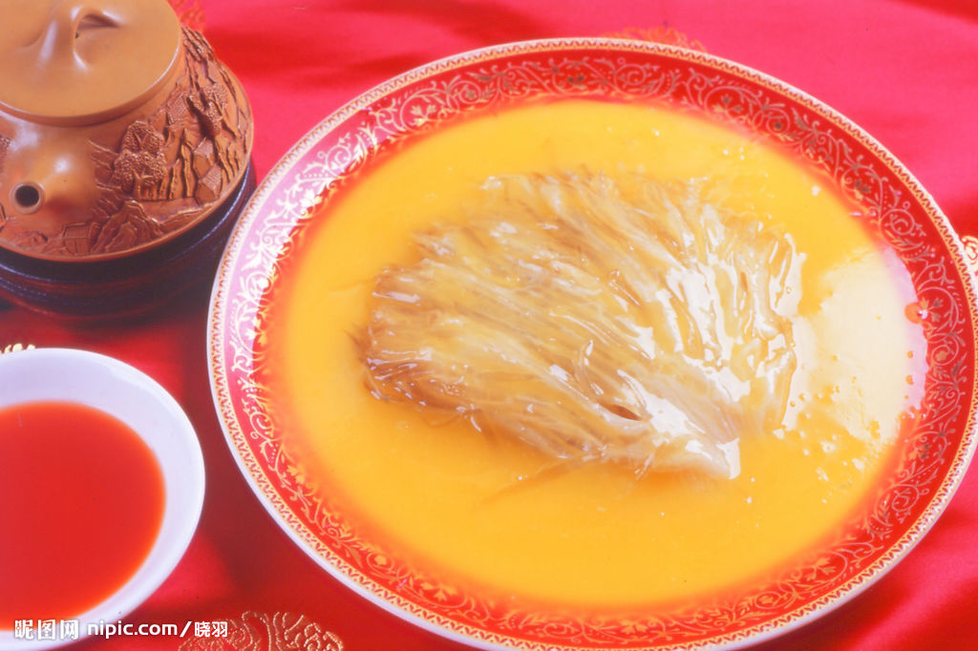
淮扬菜之 ？

Slide 42
Questions Concerning Section B. The Art of Chinese Cooking
1. What differences are there between Chinese cuisine and Western cuisine?
2. What else is emphasized in Chinese cuisine besides the function of food satisfying the stomach?
3. What do you know about the choice of raw materials?
4. What do you know about the combination of main ingredients and auxiliary materials?
5. What do you know about the art of food cutting?
6. What do you know about the art of cooking Dongpo Braised Pork?

Slide 43
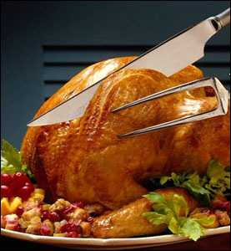
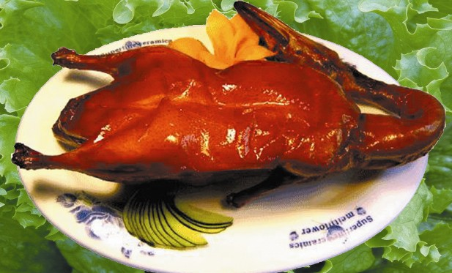
C. 2 Famous Dishes Beijing Roast Duck

Slide 44
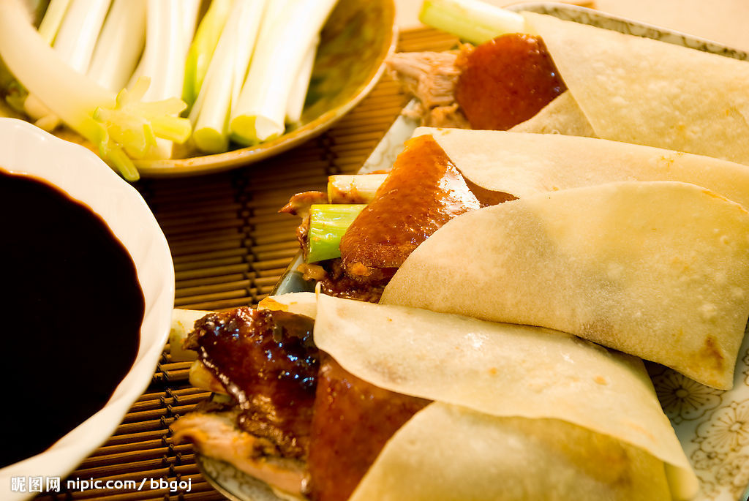
Beijing Roast Duck

Slide 45
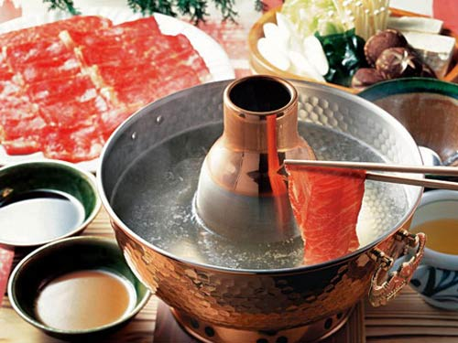
中国名菜之 羊肉火锅

Slide 46
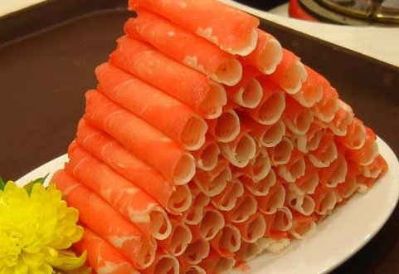
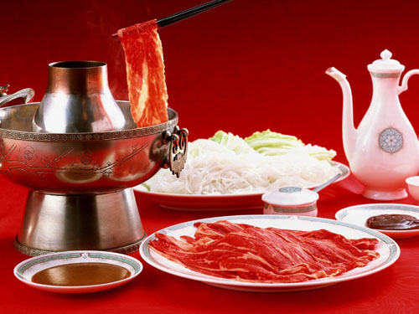
中国名菜之 涮羊肉

Slide 47
北京涮羊肉
据考证，我国南北朝时期已有火锅了，不过那时的火锅形状和质料并不像现在的铜质炭火锅，涮的肉也不像现在这样单一，有鸡、鱼、猪肉等。唐宋时的诗词中，不乏对火锅的吟诵。清代火锅已盛行，据载，嘉靖元年（1796），太上皇乾隆设的著名“千叟宴”，主菜就是涮羊肉。此宴用火锅多达1550多个，规模之大可以想见。第一家正式经营涮羊肉的店家，是开业于咸丰四年（1854）的前门外正阳楼。1914年，河北人丁德山开东来顺涮羊肉店。

Slide 48
乾隆做太上皇的第一年，为了庆祝国泰民安，在这个大殿里举行了一次别开生面的盛大宴会——“千叟宴”。这是清朝历史上规模最大、耗资最多、参加人数也最多的宴会。参加宴会的老叟有3000多人，故名。其实，清代一共举行过四次“千叟宴”，都是在康乾盛世时期，康熙和乾隆各有两次。这次宴会是在冬天举行的，天气很冷，而年岁最大的老人已经106岁了，乾隆怕把老人们冻坏了，不知吃什么好。这时，和绅提出吃火锅，又暖和又热闹。于是历史上最后一次“千叟宴”吃的就是火锅，这些老人们一边饮酒一边作诗，场面非常壮观。

Slide 49
Questions Concerning Section D. Chopsticks
1. What do you know about the history of chopsticks?
2. What scientific principle does the use of chopsticks illustrate?
3. Why did fishermen prefer the character for chopsticks 筷 than 箸?
4. What manners of using chopsticks are considered bad in China?
5. How should we use chopsticks?
6. Do you know any story concerning chopsticks?
7. Is the use of chopsticks a good physical exercise?

Slide 50
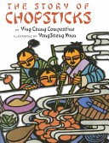
The author, Ying Chang Compestine, offers facts about the history of chopsticks, describes good table manners in a Confucian context, and gives a simple recipe for a dish served at the wedding feast. Xuan's illustrations, boldly colored cut-paper designs, are abstract enough to suggest the "high and far-off times" of this modern tale, yet lively enough to engage viewers. This story is rooted in Chinese culture and offers Americans an authentic glimpse of its traditions.

Slide 51
The Story of Chopsticks
Long ago, when all Chinese people ate with their hands, Keai (Quick), the youngest of three boys, was never fast enough to grab some nourishment before his brothers. In desperation, he pulled two sticks from the kindling pile and used them to spear chunks of hot food. His family members immediately copied the tools and named them Keai zi (quick ones) after him. When they were invited to a wedding banquet, the brothers, wielding their sticks, gobbled up the delicious, festive dishes. The village children caught on quickly, but the elders had to consider whether using the new implements conflicted with established etiquette.

Slide 52
筷子的故事
美国前总统尼克松在中国的欢迎宴会上也使用了筷子。他刚离桌，一名外国外交人员就抓起他的筷子，作为历史纪念。
《竹箸诗》云：“殷勤问竹箸，甘苦尔先尝；滋味他人好，尔空来去忙” 。古人之箸，多是竹木型，当然也有铜箸、铁箸、金箸、银箸、玉箸和象牙箸等。千年过去，筷子的形状、种类并无太大变化。使用最广的还是竹木筷子。筷子兼有多种功能，中国选手在国际乒坛多次囊括全部金牌，西人谓这是筷子练就的童子功。
“借箸代筹”：楚汉相争，郦食其建议刘邦分封战国时的六国后代，以争取多数贵族的支持。张良坚决反对，从食案上抓起一把筷子，提出一条理由就摆出一根筷子；他从八个方面力驳郦食其主张的危害，使刘邦收回成命，避免了割据分裂，成就了汉朝四百年的统一大业。

Slide 53
中国的筷子前圆后方，这种款式最早见于明朝，是当时理学盛行的一个见证，是“天圆地方”思想在筷子上的运用。日本的筷子比中国的筷子短，头是尖的。据说吃鱼比较方便，刺、肉容易分离。韩国的筷子是不绣钢和银制的，是两根扁扁细细的金属条，前后宽度一致。韩国人多食盖浇饭，用匙搅拌后舀着吃，筷子只用来夹泡菜之类，所以筷子居匙之后。
日本有家公司生产精密的光学仪器，他们的器材可用在航天飞机和脑外科显微镜上。招募新人时，这个公司先要通过画自画像和做飞机模型两关，最后把应聘者带到吃鱼的店子，看他怎样用筷子吃鱼。就算前两关过了，吃鱼不利索的，也会被淘汰，因为筷子的使用反映了一个人手脑的精细度。
从筷子可以看出中、日、韩三国国民性的差异。日本人比中国人更习惯、更擅长于精细化；中国人“讲究实用”，生活较随意，能用就好，不做进一步的探究，不在乎具体的细节和程度。日本人对这种‘模糊性’是生来就抵触的，他们一定要把筷子头弄细，这样就是米粒也能夹得起来。

Slide 54
Topics for discussion
1. Do you know any story or legend concerning Chinese cuisine?
2. What role does the use of chopsticks play in Chinese cuisine?
3. What differences are there between Chinese cuisine and Western cuisine?

Slide 55
See you next time!

Slide 56
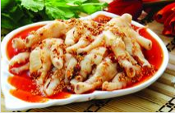
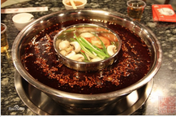
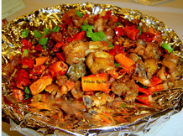
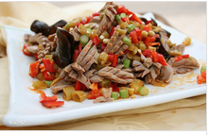
What school of China’s culinary art is perhaps the most popular? What is it famous for?

Slide 57
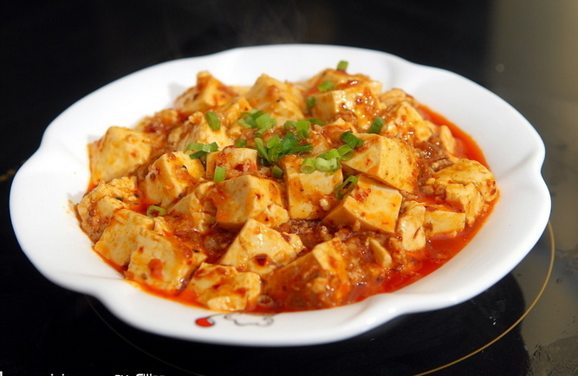
What do you know about Pock-marked Wife’s Bean Curd?

Slide 58
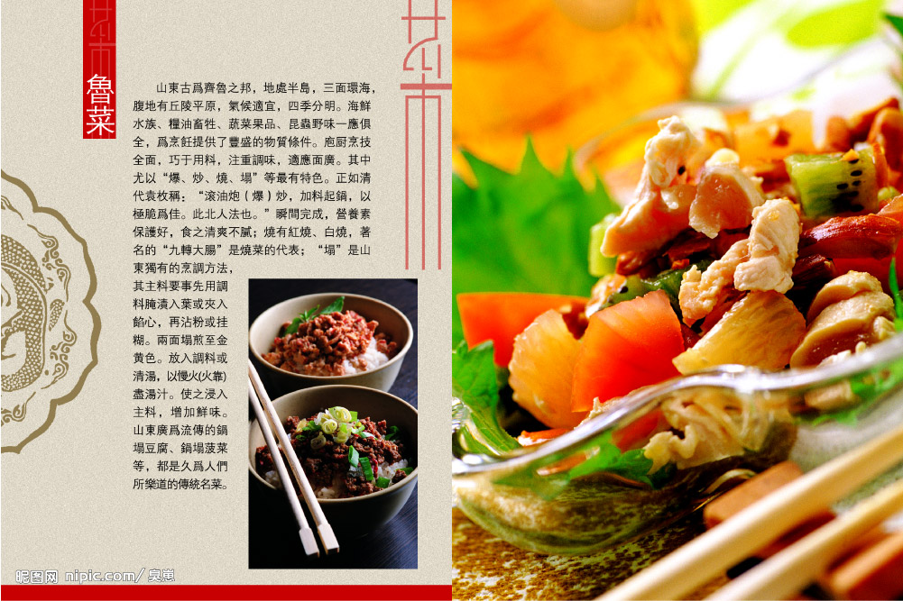
What are the characteristics of Shangdong Cuisine?

Slide 59
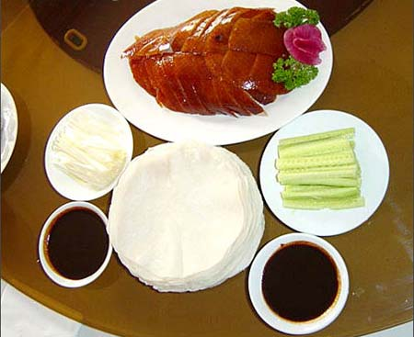
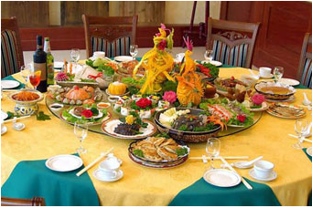
What do you know about Beijing Roast Duck and Confucius Family Dishes?

Slide 60
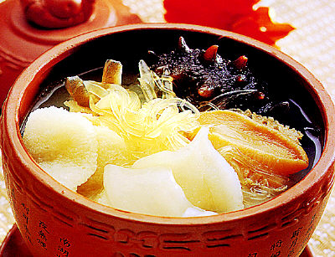
Why must Guangdong dishes be lightly seasoned? What Guangdong dishes can you name?
粤菜之 海参鲍鱼汤

Slide 61
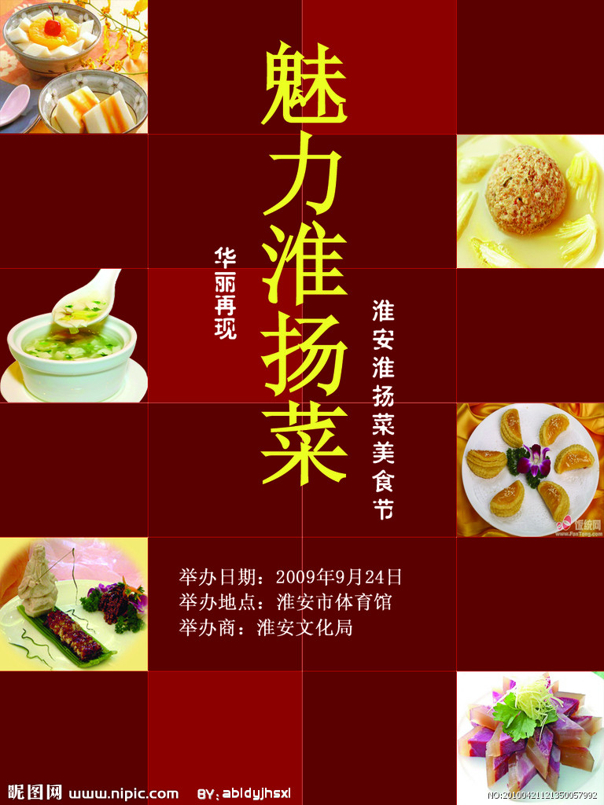
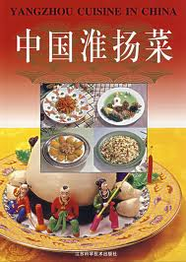
What is the greatest characteristic of Huaiyang cuisine? What Huaiyang dishes can you name?

Slide 62


What differences are there between Chinese cuisine and Western cuisine?

Slide 63

What do you know about the choice of raw materials?

Slide 64

What do you know about the art of cooking Dongpo Braised Pork?

Slide 65


What scientific principle does the use of chopsticks illustrate?

Slide 66

What manners of using chopsticks are considered bad in China?

Slide 67
Tea

Slide 68
Tea
Presently, over 50 countries produce tea, which is a sure sign of its popularity. Of hundreds of varieties of Chinese tea, there are six major types. They are green tea, black tea, Wulong tea, white tea, scented tea, and tightly pressed tea. In recent years, newly appeared bag tea, instant tea, medicated tea, and health tea have also become popular.
Green tea has the longest history and still ranks first in output and variety today. People like its freshness and natural fragrance. Famous green tea includes Longjing (Dragon Well) Tea from the West Lake in Hangzhou, Maofeng Tea from Mount Huangshan, Yinzhen (Silver Needle) Tea from the Junshan Isle and Yunwu (Cloud and Mist) Tea from Mount Lushan. Black tea is also popular both at home and abroad. Different from green tea, it is thoroughly fermented. In the fermentation, the tea turns from green to black and rare and healthful fungi grow so that it is more fragrant and nutritious. White tea is as white as silver, and its water is almost clear. It is mainly produced in Fujian Province. Famous varieties include “silver needle” and White Peony.
Wulong Tea possesses the freshness of green tea and the fragrance of black tea. In recent years, it has become popular with more and more people for its properties in helping bodybuilding and dieting. Wulong tea is found in Fujian, Guangdong and Taiwan. Because the tea grows on cliffs, it is difficult to pick. For this reason, Wulong tea is considered the most precious. Scented tea, which smells of flowers, is a variety unique to China. Scented tea is made by mixing green tea with flower petals through an elaborate process. Sweet osmanthus, jasmine, rose, orchid and plum flowers can all be used. Another special tea is called tightly-pressed tea lumps---black tea or green tea is pressed into brick, cake, or ball shapes. The tea lump is convenient to store and transport and is popular with minority people in border regions, especially nomadic herdsmen. This kind of tea is mainly produced in such provinces as Hunan, Hubei, Sichuan, Yunnan and Guangxi Zhuang Autonomous Region.

Slide 69
Tea
The Chinese people were the first to find tea as well as the first to find its medical and health preserving functions. According to modern scientific analysis, tea contains many mineral elements such as iron, manganese, aluminum, potassium, sodium, calcium, phosphorus and magnesium. It also contains such rare organic compounds as phenol, alkaloid, sugar, protein, amino acid, aromatic, pigment, vitamins and enzymes, which are good for people’s health.
Water is very important for making tea because too many foreign substances in the water will spoil the tea. Spring water is ideal. Other good-quality water includes unpolluted snow water, water from flowing wells or rivers far from habitation. When the Chinese make tea, they pour in water that is not at the boiling point, so that leaves tend to float in the tea. Usually tea is pot-brewed but the first pot is not prized. Tea is considered the best at the second infusion. Then infusion after infusion is made and connoisseurs observe how the taste and fragrance change until it is very weak.
Tea-houses in China are traditional refuges for men. Customers to the tea-house pay a small amount for a place to sit, a cup of tea, and as many refills as they like. Many tea-houses provide entertainment from musicians, singers, and storytellers as well. Tea-houses are also places for people to handle business, mediate disputes, exchange gossips, or simply sit and relax.
Tea makes a good present when you visit friends. In return, hosts also entertain guests with tea. The standard Chinese invitation to tea is normally an invitation to drink hot water with tea leaves in it. In Guangdong, however, an invitation to tea may suggest having some snacks as well as tea water.

Slide 70
Tea
Terms and Expressions
Variety n. 品种 Black tea 红茶
Scented tea 花茶 Tightly pressed tea 砖茶
Ferment v. 发酵 Petal n. 花瓣
Osmanthus n. 桂花 Jasmine n. 茉莉
Orchid n. 兰花 Plum flower 梅花
Herdsman n. 牧民 Instant tea 速溶茶
Medicated tea 药茶 Manganese n. 锰
Aluminum n. 铝 Potassium n. 钾
Sodium n. 钠 Calcium n. 钙
Phosphorus n. 磷 Magnesium n. 镁
Organic compound n. 有机物 Phenol n. 酚
Alkaloid n. 生物碱 Protein n. 蛋白质
Amino acid n. 氨基酸 Aromatic n. 芳香料
Vitamin n. 维生素 Enzyme n. 酶
Foreign substance 杂质 Tea pot 茶壶
Connoisseur n. 鉴赏家，行家

Slide 71
Tea
Questions
1. Why is Chinese tea healthful?
2. What variety ranks first in output? Can you name some of its types?
3. What makes black tea different from green tea?
4. Why is white tea so named?
5. What is the most precious variety of Chinese tea?
6. What variety is unique to China?
7. What variety is popular with minority people?
8. How shall we prepare tea?
9. Is the tea-house different from the coffee bar?

Slide 72
Questions Concerning Tea
1. Why is Chinese tea healthful?
2. What variety ranks first in output? Can you name some of its types?
3. What makes black tea different from green tea?
4. Why is white tea so named?
5. What is the most precious variety of Chinese tea?
6. What variety is unique to China?
7. What variety is popular with minority people?
8. How shall we prepare tea?
9. Is the tea-house different from the coffee bar?

Slide 73


Tea pot & cups

Slide 74
Translation exercise
乌龙茶是一种半发酵茶，特征是叶片中心为绿色，边缘为红色，俗称绿叶红镶边。它有红茶的醇厚，而又比一般红茶涩味浓烈；有绿茶的清爽，而无一般绿茶的涩味。其香气浓烈持久，并具有提神、消食等功效。清初就远销欧美诸国，目前最受日本游客欢迎。

Slide 75


What variety ranks first in output? Can you name some of its types?

Slide 76


What makes black tea different from green tea?

Slide 77


Why is white tea so named?

Slide 78


What is the most precious variety of Chinese tea?
Wulong tea

Slide 79


What variety is unique to China?
scented tea

Slide 80


What variety is popular with minority people?
Tightly-pressed tea lumps

Slide 81

How shall we prepare tea?

Slide 82


Is the tea-house different from the coffee bar?

Slide 83
Preparation for next week
Please prepare the three topics for session 3 (March 17, 2021):
4 赵轲 on Architecture: Architecture and Gardens, The Forbidden City (on March 17, 2021)
5 易明霞 Traditional Festivals (on March 17, 2021)
6 彭佳钰 Aesthetic ideals and social customs: The Four Most Handsome Men in Ancient China (on March 17, 2021)

Slide 84
Always here for you! 随时为你们服务
Professor Dr. Martin Woesler 吴漠汀 湖南师范大学特聘教授，博士导师
Office / 办公室: 外国语学院406
国际汉学中心308
Phone / 电话: (150) 1138 8818 (德国+49 178 2073538) Email / 电子邮件: wmt@hunnu.edu.cn

Slide 85
Thank You

