Slide 1

A Beautiful Life (2011)
Or Don't Be Lonely (2011)
Mei Li Ren Sheng (2011)
or 不再让你孤单 (2011)

Slide 2
Director: Andrew Lau/Wai Keung Lau
Began his career as a cinematographer, but eventually moved on to being a director as well.
Served as cinematographer and co-director on the Infernal Affairs films.
Frequently co-directs with Alan Mak.
"...I like directing, so I can be in control of the cinematography, the acting, etc. In Hong Kong , normally the actors have a lot of control, but I need to fully control everything. When I was a cameraman, I was very upset sometimes because I could not control everything. Even when you shoot a shot you don't like, the director can say it's okay, and it will end up in the film. So that's why I want to be the director."

Slide 3
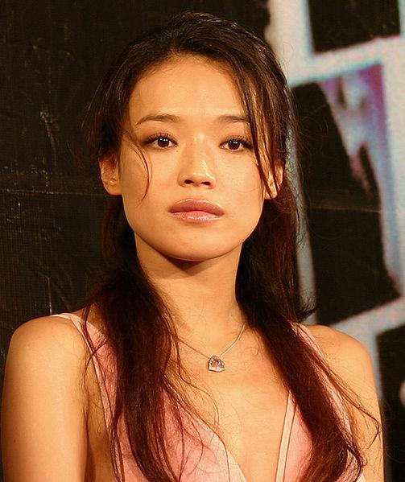
Qi Shu
Plays Li Peiru
Played roles in over 70 films
Played roles in many Kung Fu movies
Known for her "manic" acting style.
Born in Taiwan

Slide 4
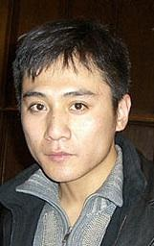
Ye Liu
Plays Fang Zhendong
Nominated for best supporting actor in China after just his first movie.
Generally chooses difficult roles.

Slide 5
A Beautiful Life in opposition to western film
Manic Pixie Dream Girl
Mr. Nice Guy
Disabled family member
"Happily Ever After"
etc.
Stock Character Trailer

Slide 6
Manic Pixie Dream Girl
Natalie Portman in Garden State (2004)
Kirsten Dunst in Elizabethtown (2005)
Kate Hudson in Almost Famous (2000)
Barbra Streisand in What's Up Doc? (1972)
Zooey Deschanel in ... a bunch of stuff...

Slide 7
Boy Next Door/Mr.Nice Guy
Innocent
Always does the right thing
Helpful
Kind
Topher Grace in Win a Date With Tad Hamilton (2004)
Adam Sandler in The Wedding Singer (1988)
Joseph Gordon Leavitt in (500) Days of Summer (2009)
Brendan Fraser in Blast From the Past (1999)
15:10

Slide 8
Disabled side characters
Loveable
Needs caretaking for rest of life
Talented
Gains quick and easy friendship with love interest.
Blind character.

Slide 9
Happily Ever After
Things end on a happy note
Solutions are found for many of the problems.
Characters are assumed to be forever happy and not have any struggles later on.
1:23

