Slide 1

2025
Changde Spicy Salted Duck
汇报人： 张悦

Slide 2

CONTENT
01
Brief Introduction
02
Historical Origins
03
Cultural Heritage
04
Highlight Reel
https://www.ypppt.com/

Slide 3
2025
PART ONE
Brief Introduction

Slide 4
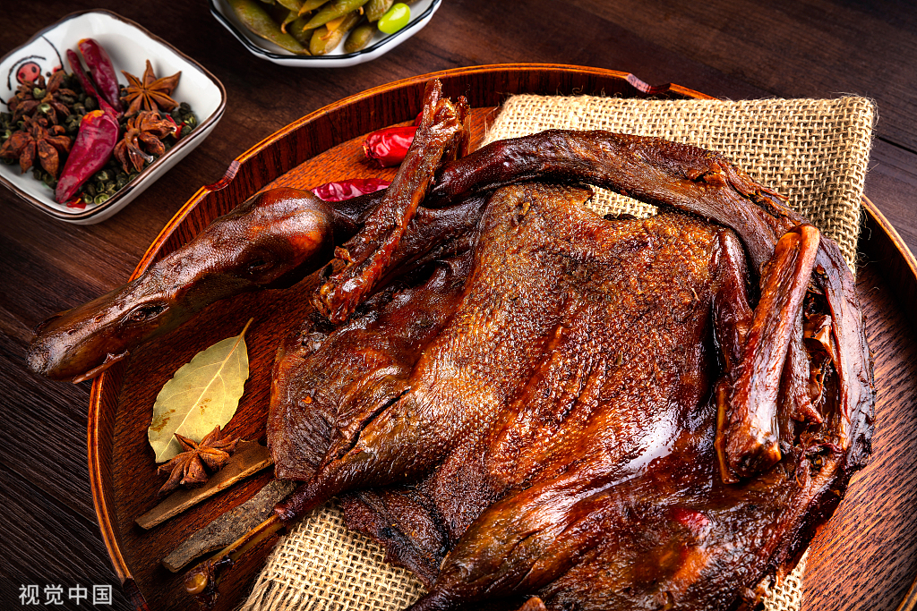
Brief Introduction
A specialty snack originating from Changde, Hunan—changde spicy salted duck—has become a shining pearl in Hunan’s culinary culture with its distinctive sauce aroma and tender meat. The unique charm of Changde spicy salted duck lies in its rich sauce aroma and tender, flaky meat.

Slide 5

Brief Introduction
Spicy salted duck can be seen easily in the high-speed railway station of Hunan province. It is one of the representative food of Hunan province, becoming an important part of Hunan cuisine culture.

Slide 6
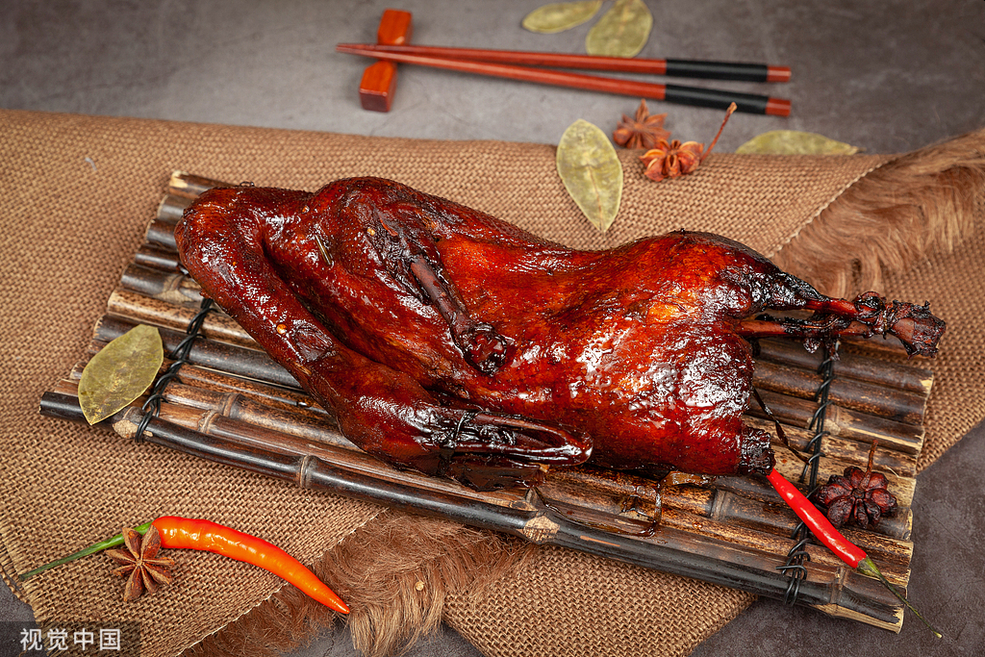
Brief Introduction
Appearance
Flavor
Craftsmanship
The duck has a golden yellow color and a glossy appearance, emitting an enticing aroma.
Taking a bite reveals tender, juicy meat with a rich texture,combining the delicacy of duck with the mellow fragrance of the sauce.
It requires the use of high-quality local water ducks,and multiple steps are made it including marinating, drying, and sauce-cooking.

Slide 7

Brief Introduction
an unforgettable experience about the duck
Roomates around the desk had the big pocket changde spicy salted duck to chat with each others and relax our minds.

Slide 8
2025
PART TWO
Historical Origins

Slide 9
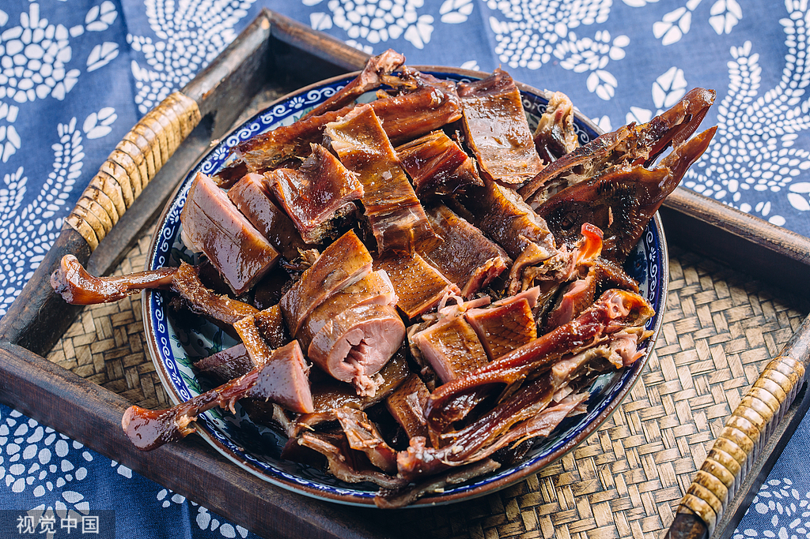
Historical Origins
Version One:Mistake
Version Two:Acknowledgement
Version Three:Preservation

Slide 10
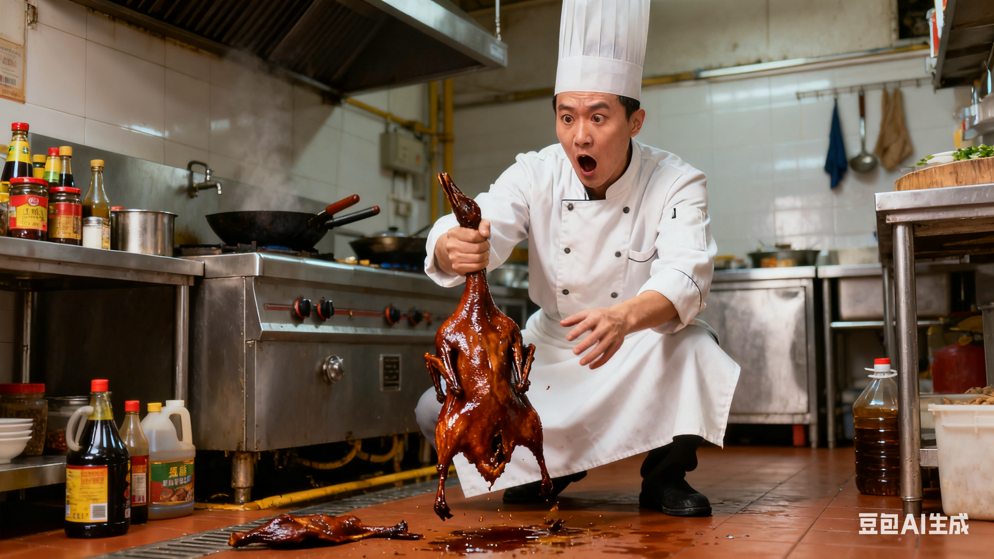
Historical Origins
Version One: Mistake
To remedy this mistake, he hung the duck in the air to dry and added seasonings,
thus unexpectedly creating a delicious spicy salted duck.
It relates to a chef named Tao in the southern song dynasty. When making roast duck, he accidentally dropped a duck on the ground.

Slide 11
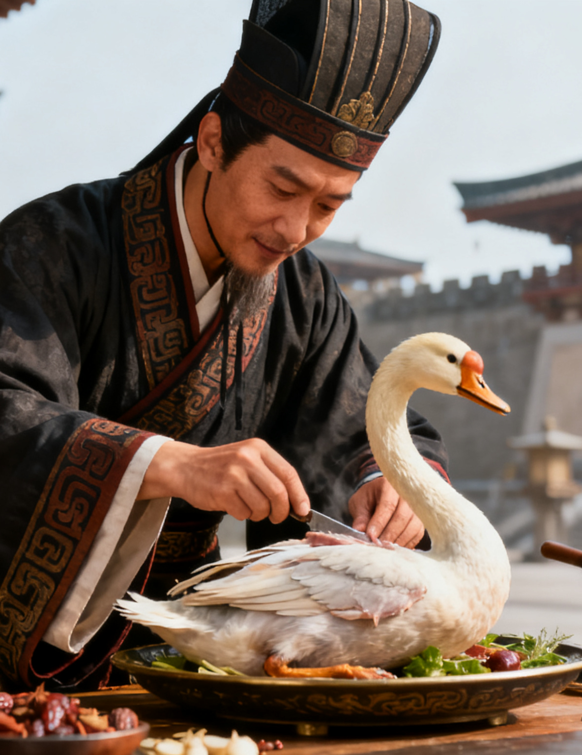
Historical Origins
Version Two:Acknowledgement
It is said that more than 2000 years ago, to repay the duck farmer who saved his mother,he used his skill in marinating swans from the palace to process the local ducks into marinated ducks for benefiting neighbors.
Because of its unique and complicated craftsmanship and its outstanding taste, it was later named “Tribute spicy salted duck ”by the King of Chu.
Shi Jiao,the royal chef of the King of Chu.

Slide 12
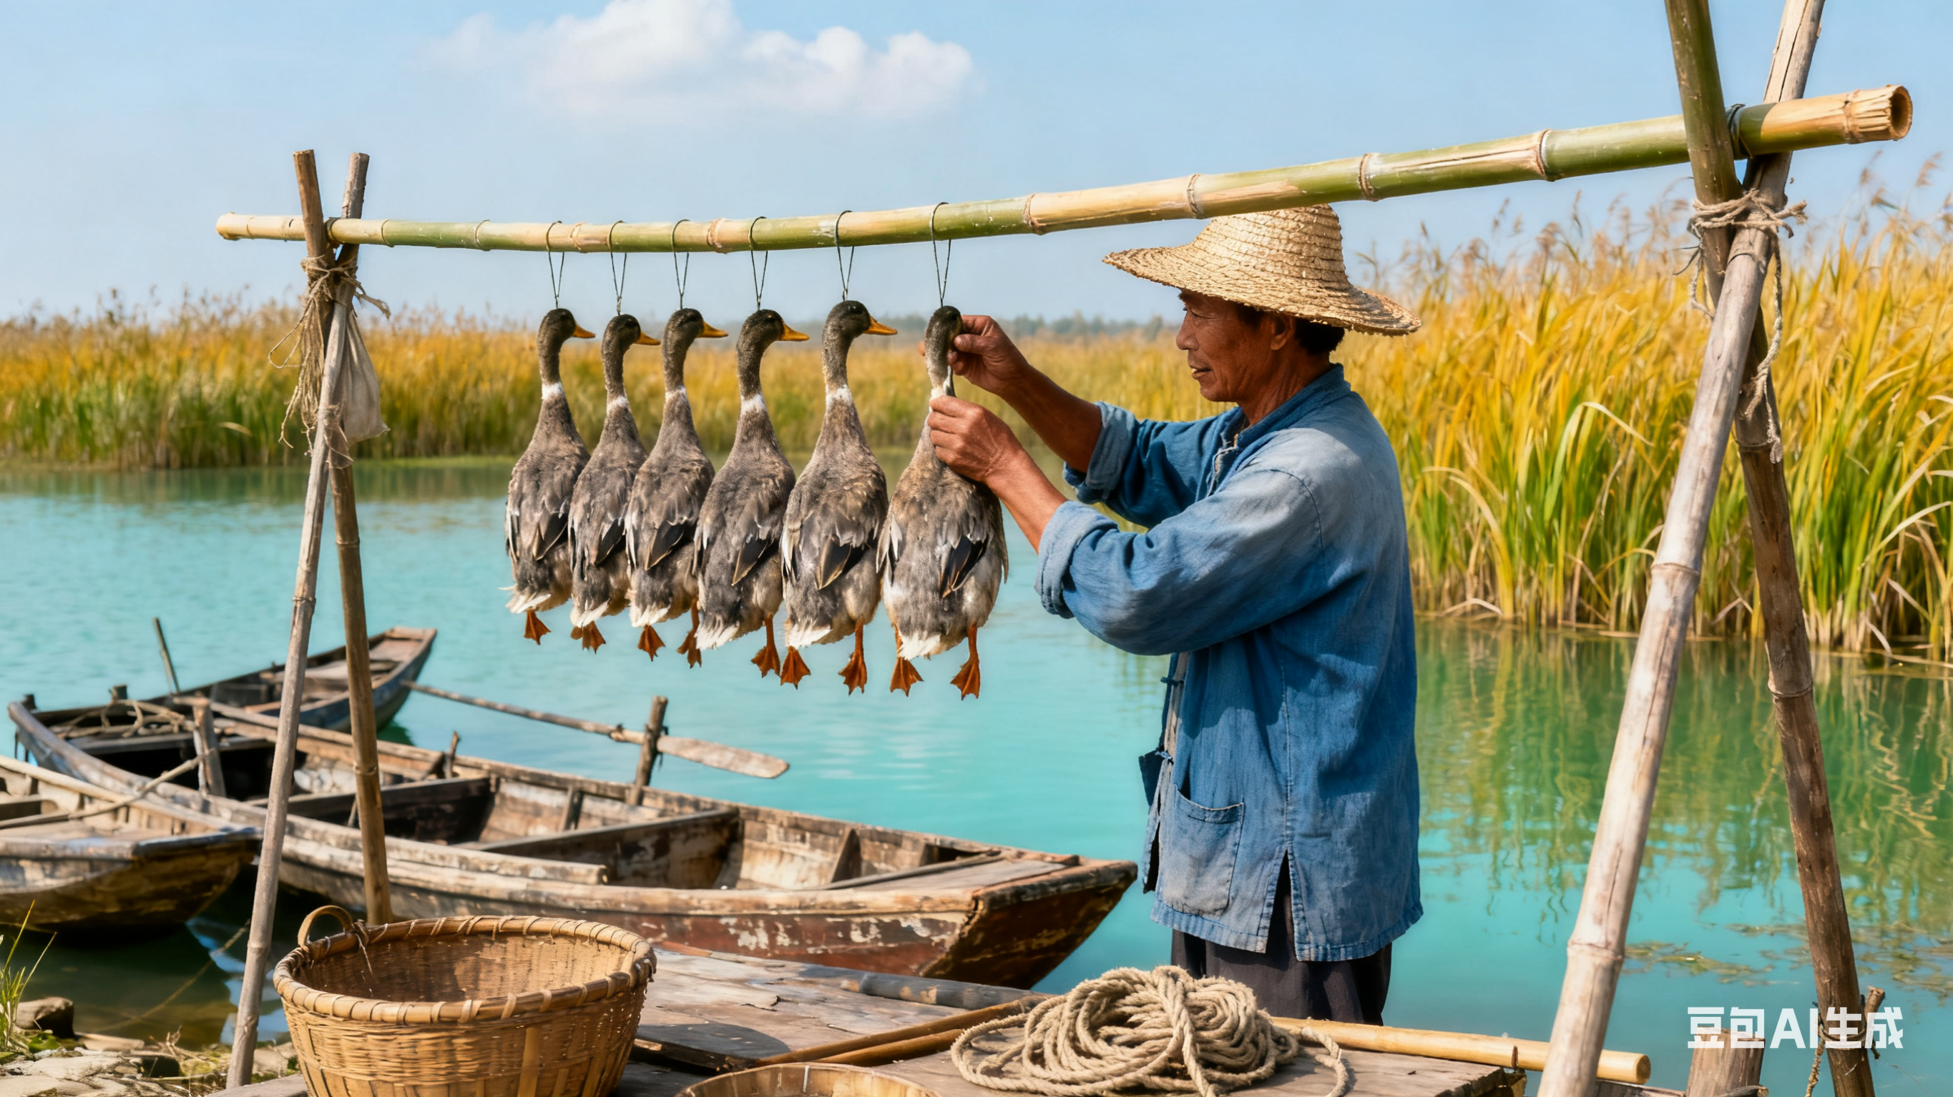
Historical Origins
Version Three:Preservation
The origin of Changed spicy salted duck is related to fisherman in Changde,Hunan.
In order to preserve the caught ducks, the fisherman marinated and air-dried them, and found that the processed ducks not only had a unique flavor but also tender and crisp meat.
As a result, the craftsmanship of making changde spicy salted duck spread locally.
Fisherman in Changde,Hunan.

Slide 13
2025
PART THREE
Cultural Heritage

Slide 14
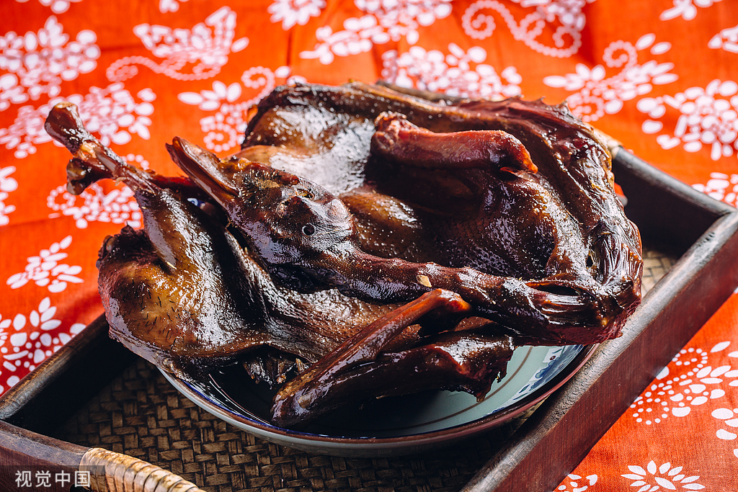
Cutural Heritage
1
Relationship
2
Chinese culinary culture
3
Chinese dietary culture
Changde spicy salted duck is not only a delicious dish but also embraces rich cultural connotations.

Slide 15
Cutural Heritage
It connects the people and help us develop an intimated relationship
Relationship
The craftsmanship of making Changde spicy salted duck reflects the essence of Chinese culinary culture.
Chinese culinary culture
Chinese dietary culture
It is closely related to Chinese festival culture, often serving as one of the delicacies during festival seasons.

Slide 16
2025
PART FOUR
Highlight Reel

Slide 17
Highlight Reel
Sharing the spicy salted duck with
others and welcoming them to Hunan province and wishing them everything goes well!

Slide 18
2025
THANKS
来源：中国文化课本、豆包、视觉中国官网
汇报人：张悦

