Slide 1

Social phenomenon:
Marriage
Women Being urged to get married
LIU XINYU

Slide 2

行业PPT模板http://www.1ppt.com/hangye/
CONTENTS
Chaozong Street
Late marriage phenomenon
Women being urged to get married
Some reasons for late marriage
Summary and reflection

Slide 3
PART 1
Chaozong Street

Slide 4
On October 10, the nation’s first New-Style Marriage and Childbearing Culture Street was inaugurated on Chaozong Street in Kaifu District, Changsha.
The street features various cultural installations such as the Matchmaker’s Pavilion, “Marriage School,” and the Fate Platform, attracting visitors to take photos and check in.

Slide 5



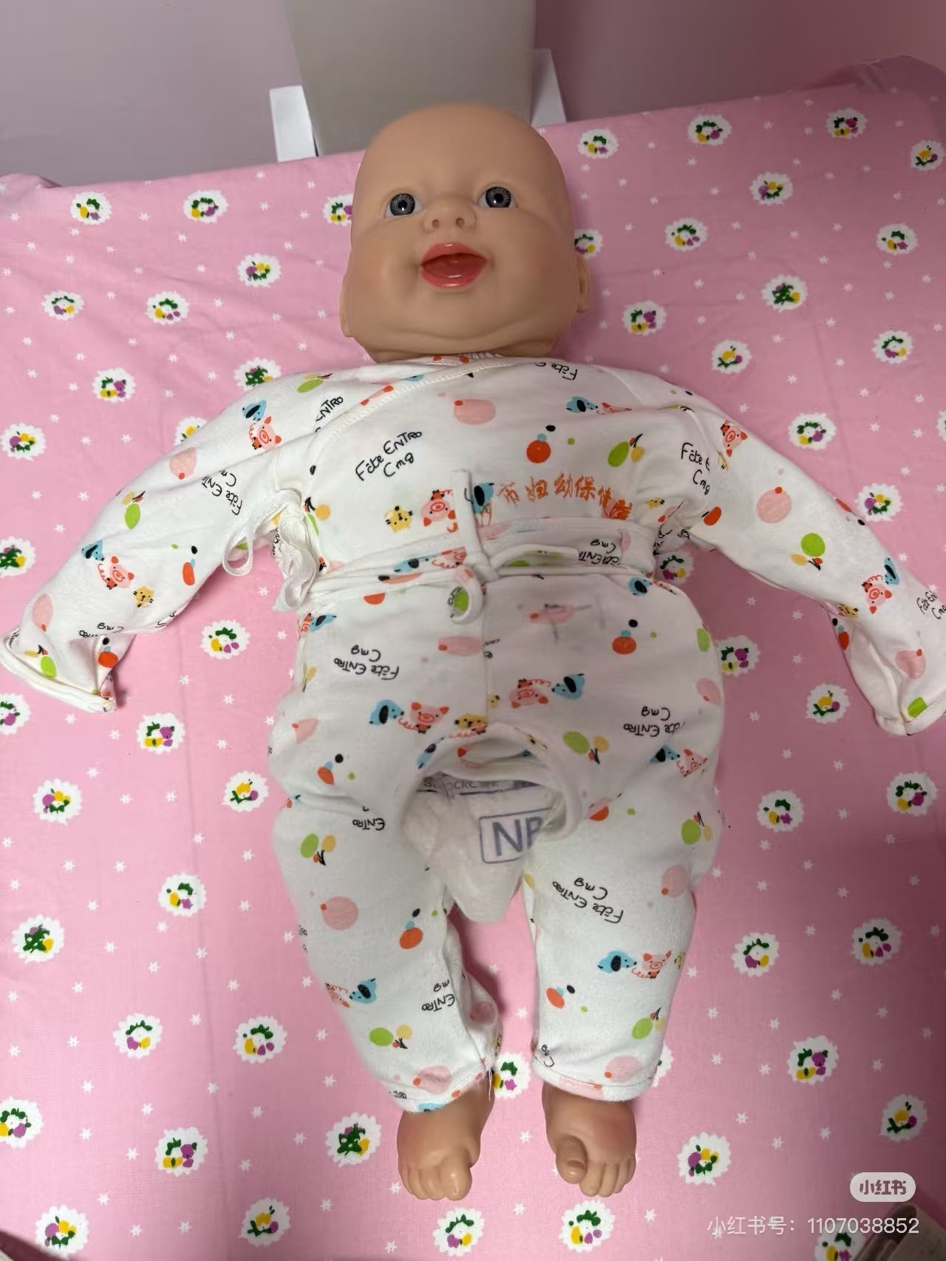


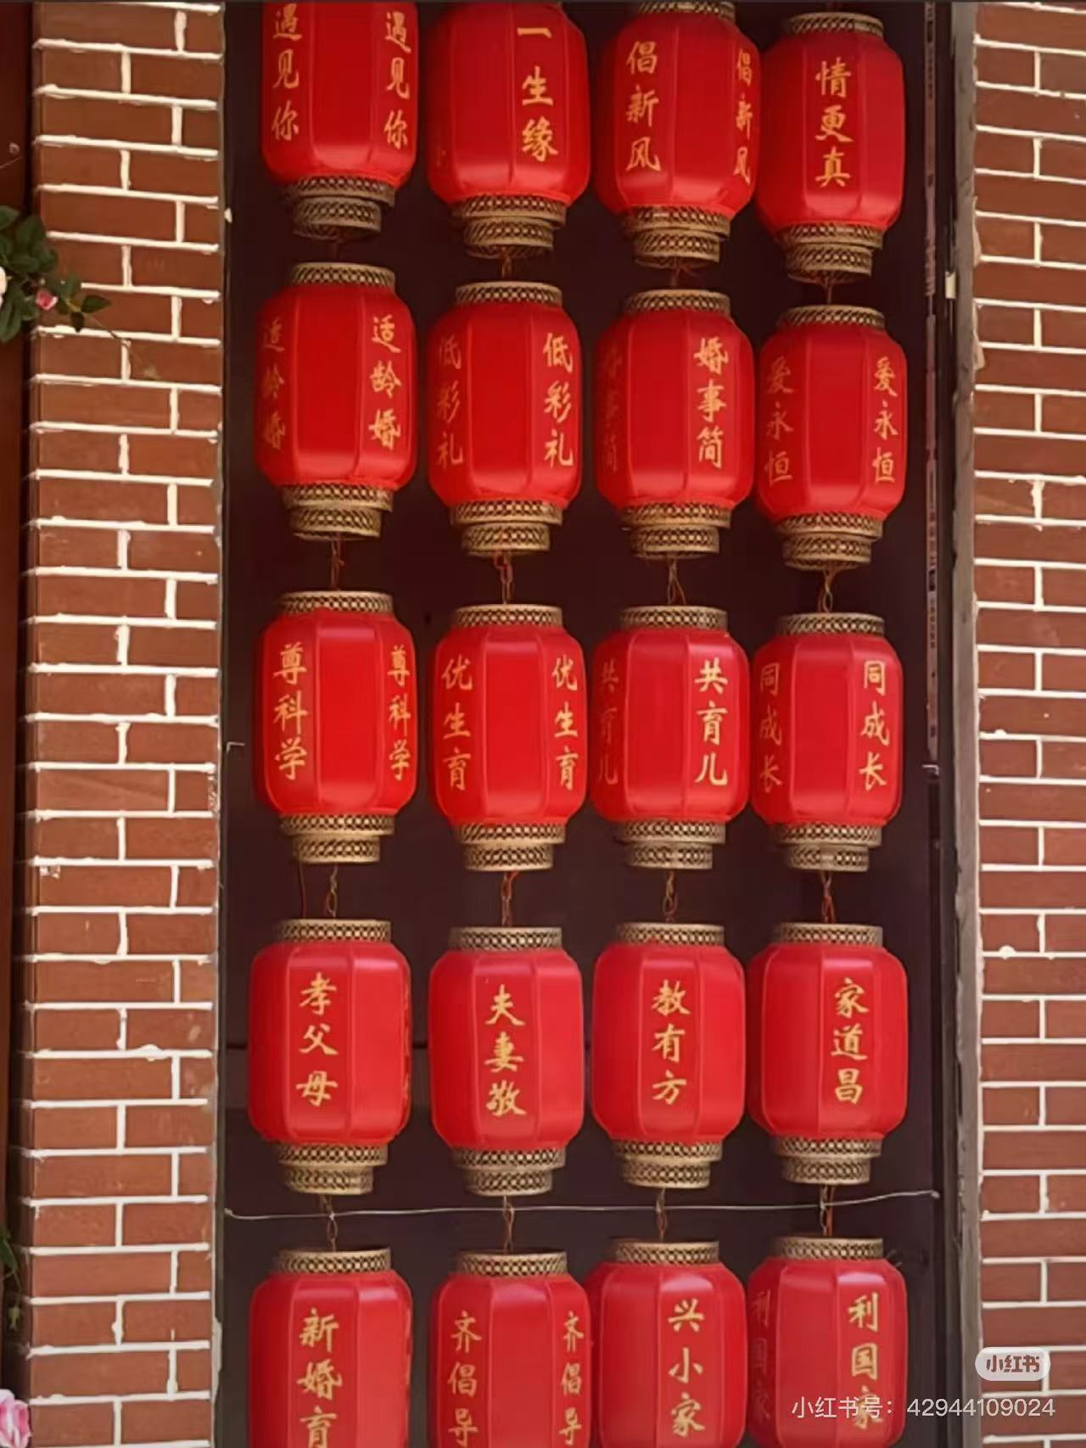

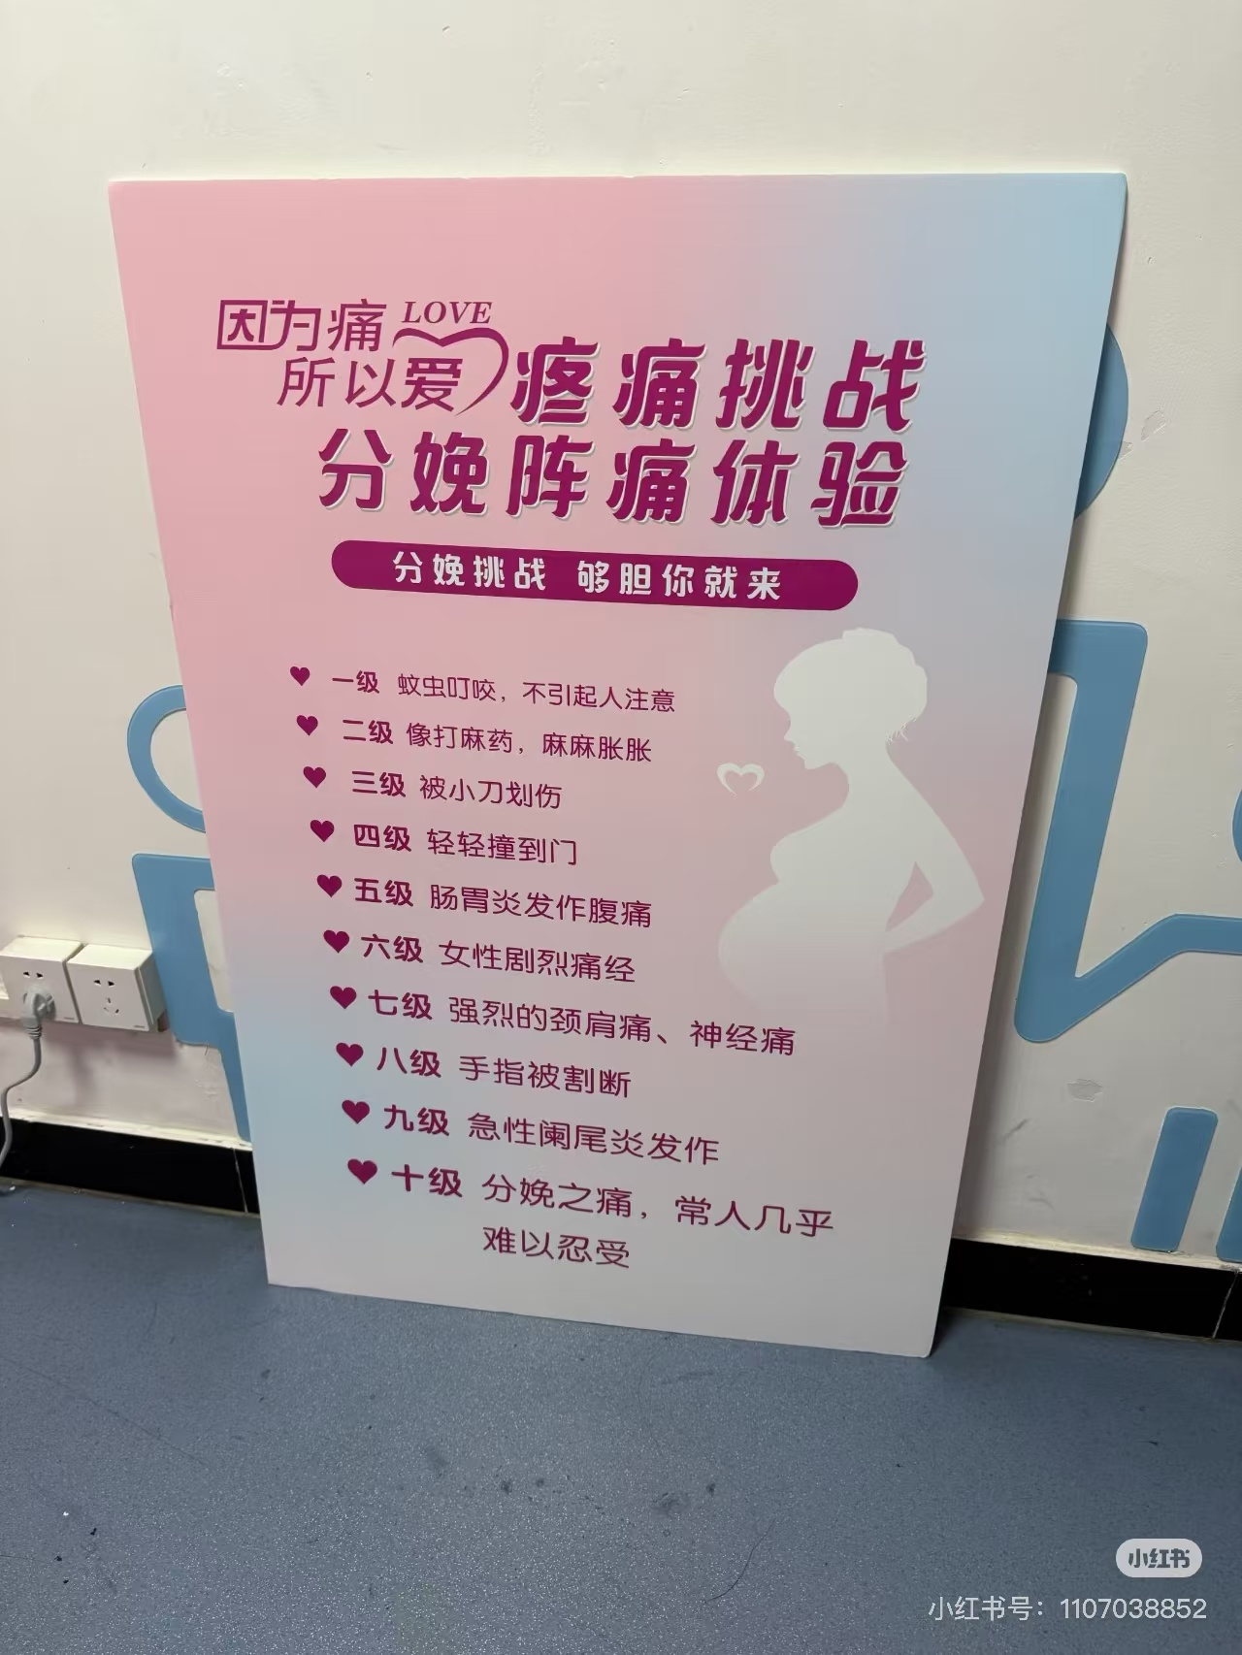

Slide 6








Slide 7
PART 2
Late marriage phenomenon

Slide 8
According to the China Population and Employment Statistical Yearbook 2023, by the end of 2022, China’s single population had exceeded 240 million and is projected to reach 300 million by 2024, meaning one in every four Chinese people will be single. Although this figure includes the elderly and children, there are already 134 million singles in the marriageable age group of 20 to 49. Notably, the unmarried rate among those aged 25 to 29 has reached 51.3%, and the proportion of unmarried individuals around the age of 30 in urban areas has climbed to 30.7%.

Slide 9
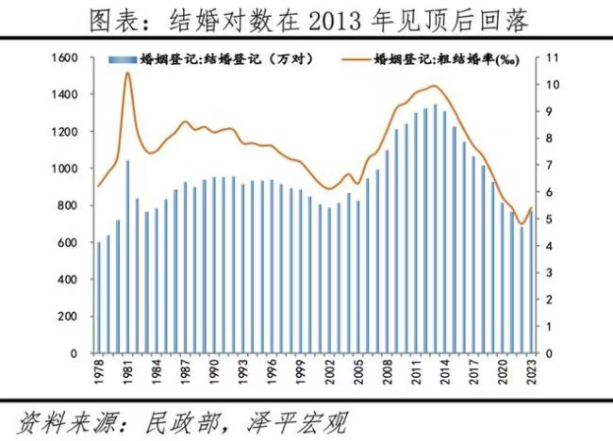
Between 2013 and 2022, the number of marriage registrations dropped from 13.469 million to 6.835 million, a decrease of 49.3%. In 2023, the number of marriage registrations rebounded to 7.682 million, but it declined again in the first three quarters of 2024, indicating that the compensatory demand has largely subsided.

Slide 10
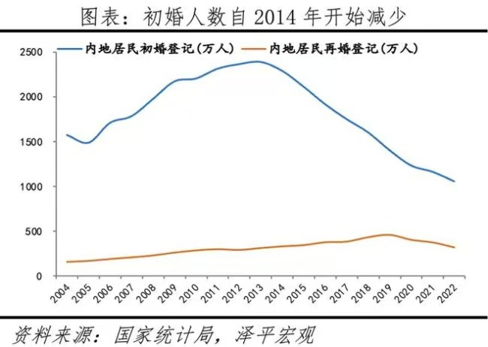
In 2020, the average age at first marriage in China was 28.67, an increase of 3.78 years compared to the average age of 24.89 in 2010.

Slide 11
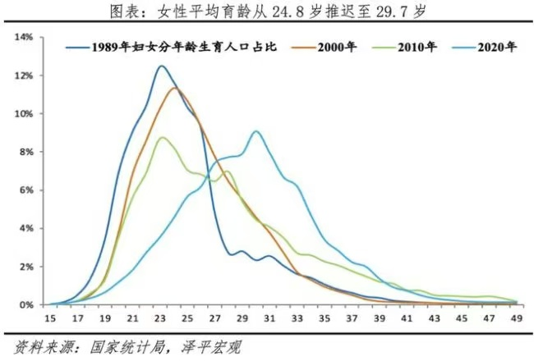
Delayed marriage leads to delayed childbirth.

Slide 12
PART 3
Women being urged to get married

Slide 13
The best age for women to conceive is between 23 and 30 years old. Single women over 30, having missed the optimal childbearing age, see their value in the marriage market significantly reduced.
Fu, a matchmaker at Wansong Academy, said in an interview with a reporter, "In the blind date market, 30 years old is a threshold for women. Under 30, there is mutual selection; over 30, women have to take a 30% or 40% discount. 'We charge a fee, so we must arrange blind dates for older women. Every time, we have to plead with the boys to meet them, saying a lot of good words.'"

Slide 14
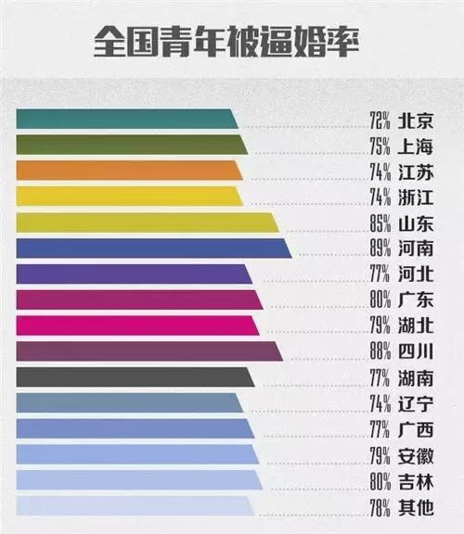
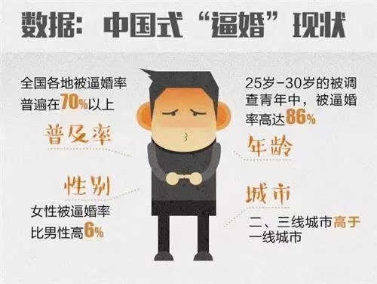

Slide 15
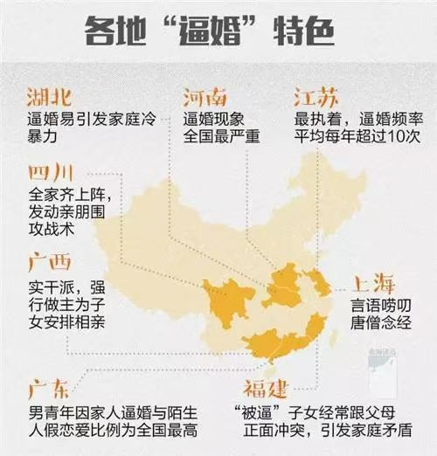
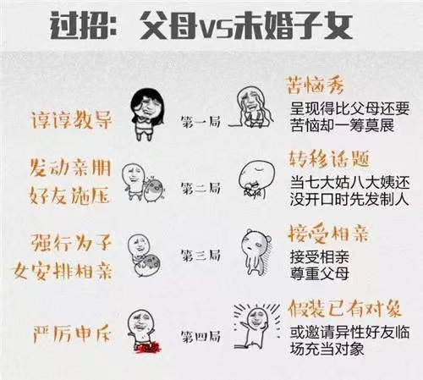

Slide 16
According to data from the seventh national population census, 51.30% of women aged 25-29 are unmarried, 18.40% of women aged 30-34 remain single, and only 5% of women over 35 are unmarried.
This indicates that under the pressure of forced marriage, most Chinese women eventually have no choice but to get married. Particularly for women, society's disapproval of unmarried women of a certain age places those beyond the so-called "marriageable age" in a passive situation.

Slide 17
PART 4
Some reasons for late marriage

Slide 18
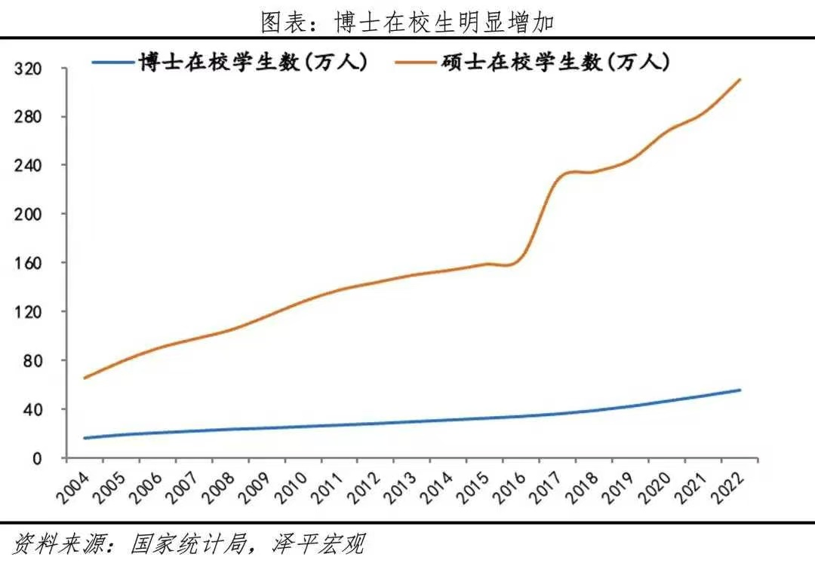
(1) The best years were spent in school
It’s not that women want to be “leftover”; it’s the result of university enrollment expansion. Women who complete graduate studies enter the market already at the threshold of the late-marriage age.

Slide 19
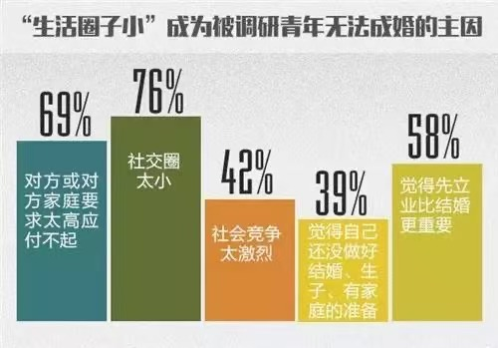
(2) The limited social circle
“The limited social circle” is the biggest obstacle. Daily routines revolve around commuting between classrooms and dormitories or between workplaces and home, leaving them little opportunity to meet members of the opposite sex.

Slide 20

（3）Love > Everything
Most women prioritize love in marriage. They’d rather wait patiently for their true love to appear than marry someone hastily just for the sake of getting married.
Finding someone they love and establishing an equal partnership in marriage is the goal of modern independent women as they explore new models of marriage.

Slide 21
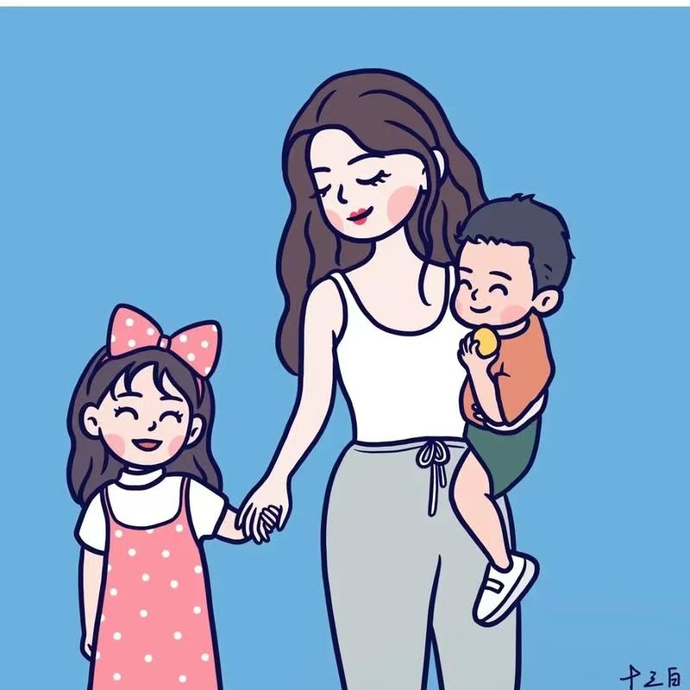
（4）Fear of being a wife
A wife is expected to undertake more responsibilities for family life in Chinese culture, including doing the housework, taking care of husband’s parents, bringing up the children and so on, which takes them a lot of time and energy.

Slide 22
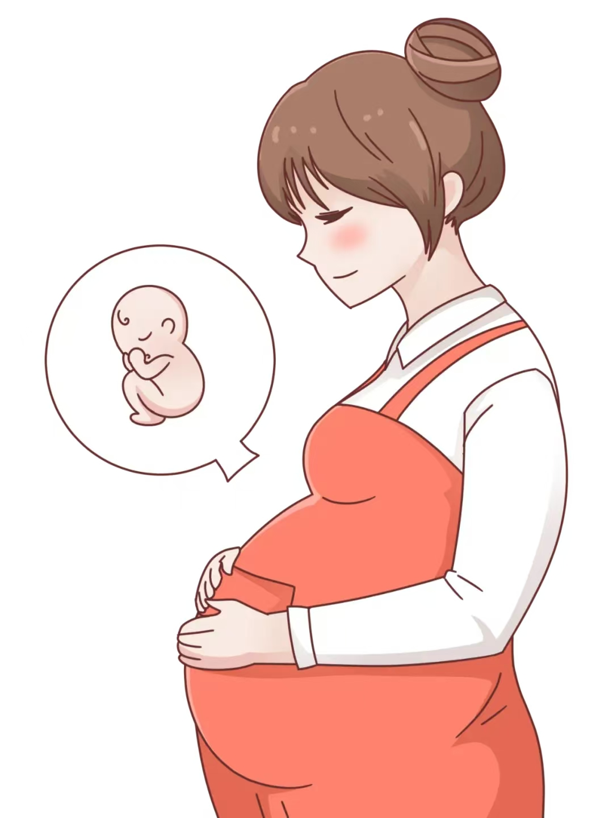
（5）Fear of being pregnant
For women, marriage also often means pregnancy. While pregnancy is a joyful experience, it is also challenging and can cause irreversible damage to a woman’s physical and mental well-being. Moreover, pregnant women are often at a disadvantage in the highly competitive workplace.

Slide 23

（6）Women are becoming stronger
Nowadays, more and more females have more chances to higher education and the well-paid job. They are economically and psychologically independent, available to consider whether to enter into the marriage.

Slide 24
PART 5
Summary and reflection

Slide 25
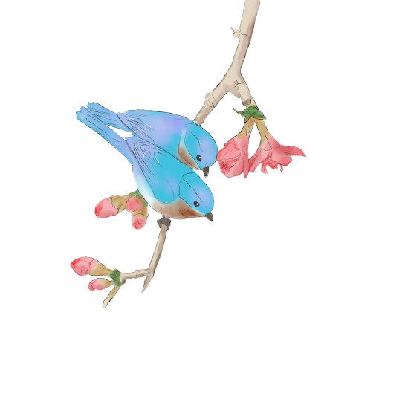
In recent years, the number of singles has increased steadily, singleness has increasingly attracted social attention and become a social phenomenon.
One study has shown that men is more difficult to find their partner than woman, but the society pay more attention to "leftover lady" than "leftover man". nowadays "leftover woman" has gradually become a negative evaluation label, even formed a universal social anxiety.

Slide 26
China is a “universal marriage” society, where being unmarried at an older age can stand out in a group where most people are married. However, in many countries, marriage rates are low.
For example, in Hungary, only 12% of people choose to enter the institution of marriage. In contrast to China, those who marry in Hungary become the unique ones. “In Northern Europe, half of the population is single. So, is the married half considered ‘leftover women,’ or is it the unmarried half? The term ‘leftover women’ itself is problematic,” says Li Yinhe.

Slide 27
In ancient societies, the concept of “leftover women” did not exist because women had no decision-making power over their marriages, which were entirely arranged by their families. As Chinese society evolved, women have moved away from the traditional reliance on men for financial support.
However, societal values have not kept pace with women’s growing independence. The lack of a respectful, diverse, and equal environment has hindered the full acceptance of women’s autonomy.

Slide 28
感
谢
观
看

