Slide 1
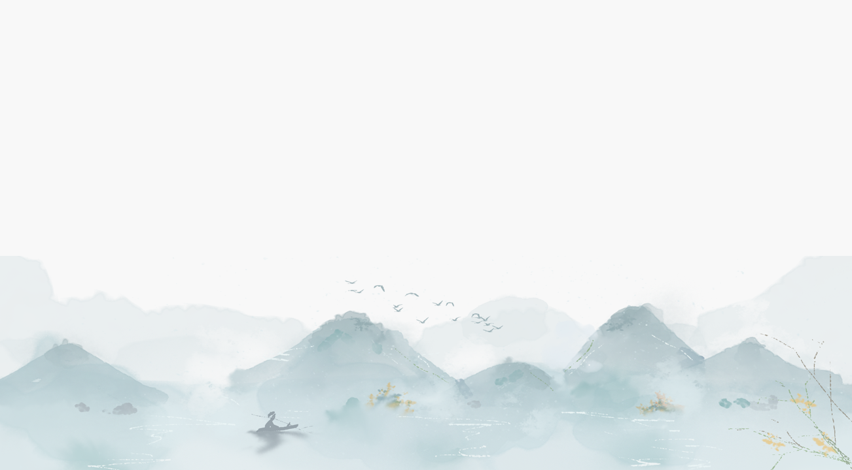
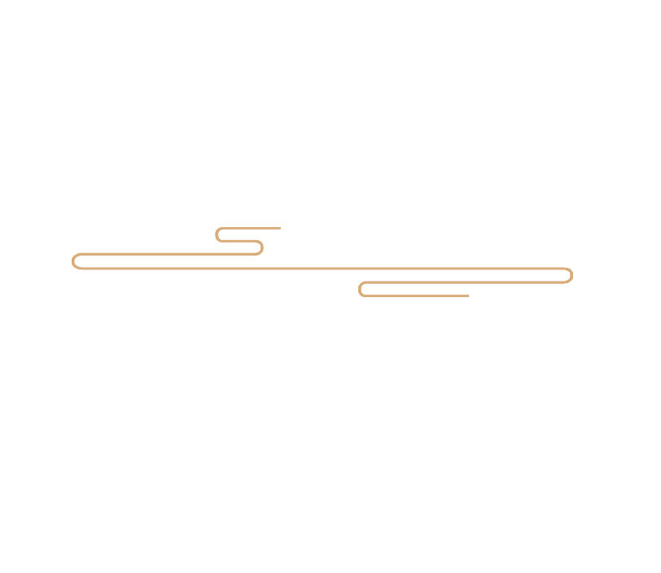
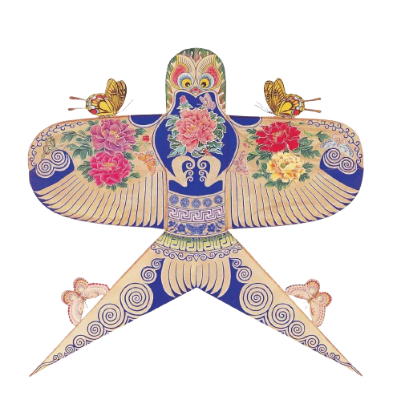
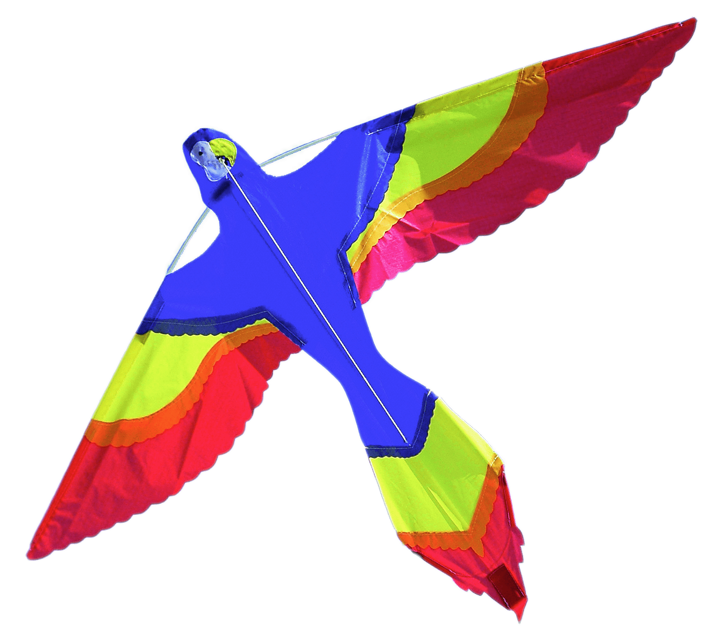
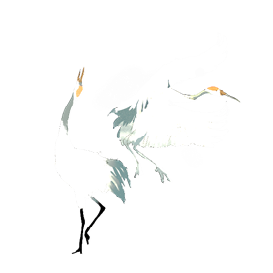
Kites

Slide 2

Contents
1
Introduction
2
Origin
3
Use
4
Production
5
Types

Slide 3
1
Introduction

Slide 4
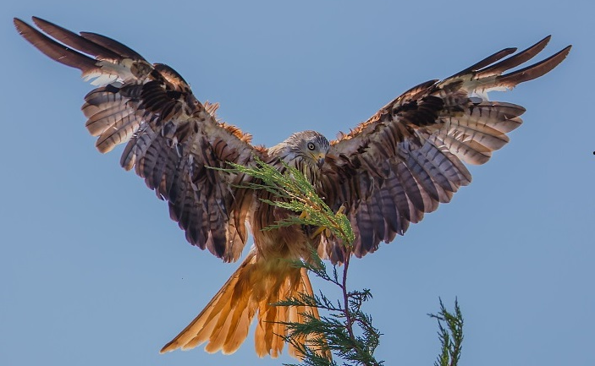
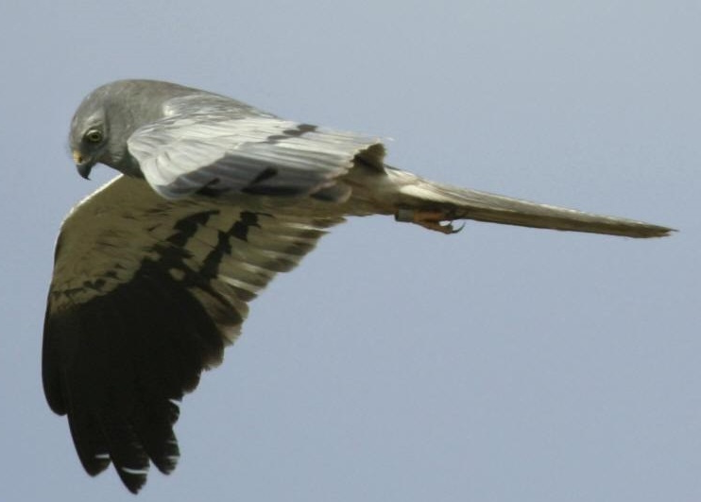
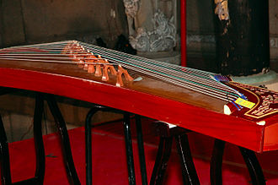
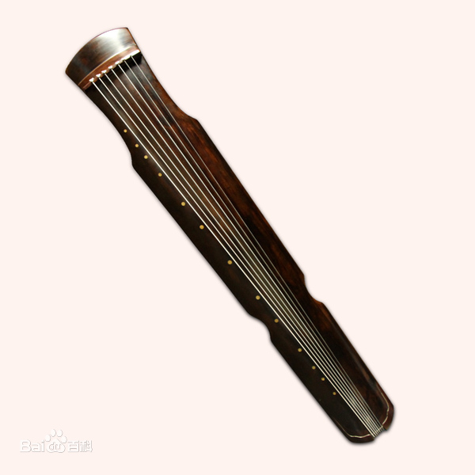
Introduction
鸢
鹞
纸鸢
纸鹞
风筝
琴
筝
风琴

Slide 5
Introduction
Kite flying has a long history in China, and it has been a long-standing sport to this day. Kites can be seen flying in parks, squares and open grasslands, and the various shapes of kites are spectacular, adding much fun to people's leisure time. At the same time, as a traditional national sport, kite flying is deeply imprinted with Chinese culture, fully expressing people's beautiful aspirations and fitness interests, and rich in national characteristics and local flavor. As a kind of folklore, kite flying is a kind of game and recreational activity for the purpose of leisure and physical and mental conditioning, so that people can rest after their work and benefit their physical fitness, mental and emotional, creativity and moral sense.

Slide 6
2
Origin

Slide 7
Origin
According to some researches, the earliest kites in China were made of wood. During the Spring and Autumn and Warring States period, Mo Zhai (478-392 B. C. ), the founder of the mohism, took three years to make a bird out of wood and flew it into the sky for one day before it landed. This "wooden kite" made by Mozi is said to be the earliest kite in China and the earliest kite in the world, with a history of more than 2000 years.
Invented by Mozi
According to this view, kites originated in the late Han Dynasty. This view is based on the legend that Han Xin made kites in history. In the description of the kite in the eighth volume of Gao Cheng‘s The Chronicle of Things（《事物纪原》）, Hanxin used kite to measure the length of a field in a war. In addition, according to Studio Miscellaneous Records, Han Xin made various kites out of cowhide and had musicians sit on them to fly over the Chu army and play Chu songs to try to make them miss their hometown and not be interested in fighting.
Originated from war
In the biography of Li Ye in the Records of the Five Dynasties, there is a record of the history of the Emperor and other people guessing riddles and flying kites in the palace. In addition, Li Ye made a paper kite game in the palace and made a flute out of bamboo and tied it to the head of the paper kite. When it flew in the air, with the wind springing up, it sounded like that someone is playing Chinese zither, thus the name "kite" was given. It can be seen that kites originated from the leisure activities of ancient people.
Originated from entertainment

Slide 8
3
Use

Slide 9
Use
Physical Exercise
Military Tools
Entertainment

Slide 10
4
Production

Slide 11
Production
Tying the frame
Gluing the
paper
Traditional：Bamboo、Paper
四艺
Flying the kite
Painting the flowers
Modern：Metal、Fabric

Slide 12
5
Types

Slide 13
Types
The fighter kite
Fighter kites are kites used for the sport of kite fighting. Traditionally most are small, unstable single line flat kites where line tension alone is used for control, and an abrasive line is used to cut down the string of other kites.

Slide 14
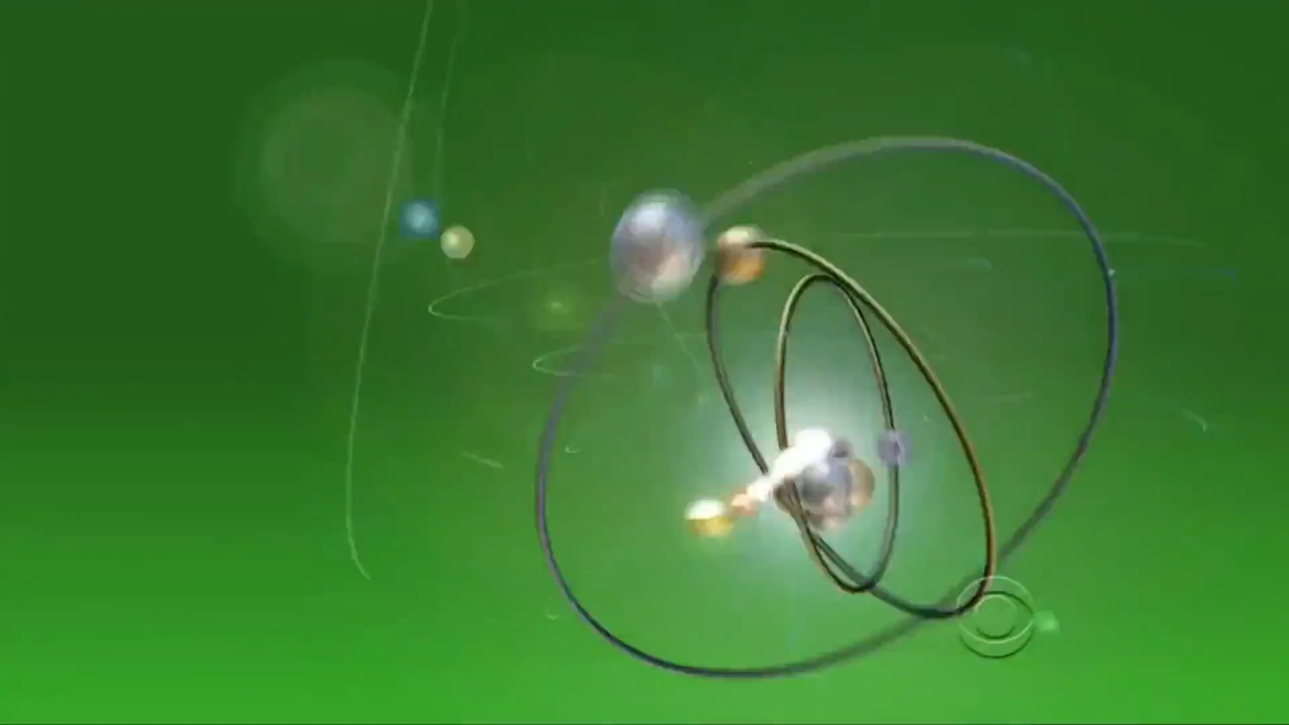
Types

Slide 15
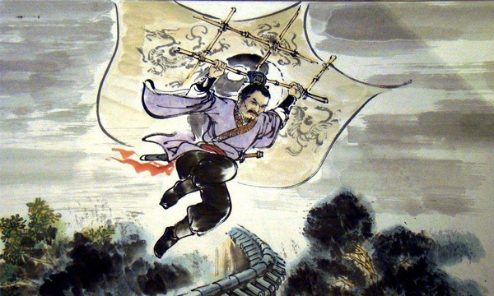
Types
The man-lifting kite
A man-lifting kite is a kite designed to lift a person from the ground. Historically, man-lifting kites have been used chiefly for reconnaissance and entertainment. Although, with the advent of powered flight at the beginning of the 20th century, interest in their development declined.

Slide 16
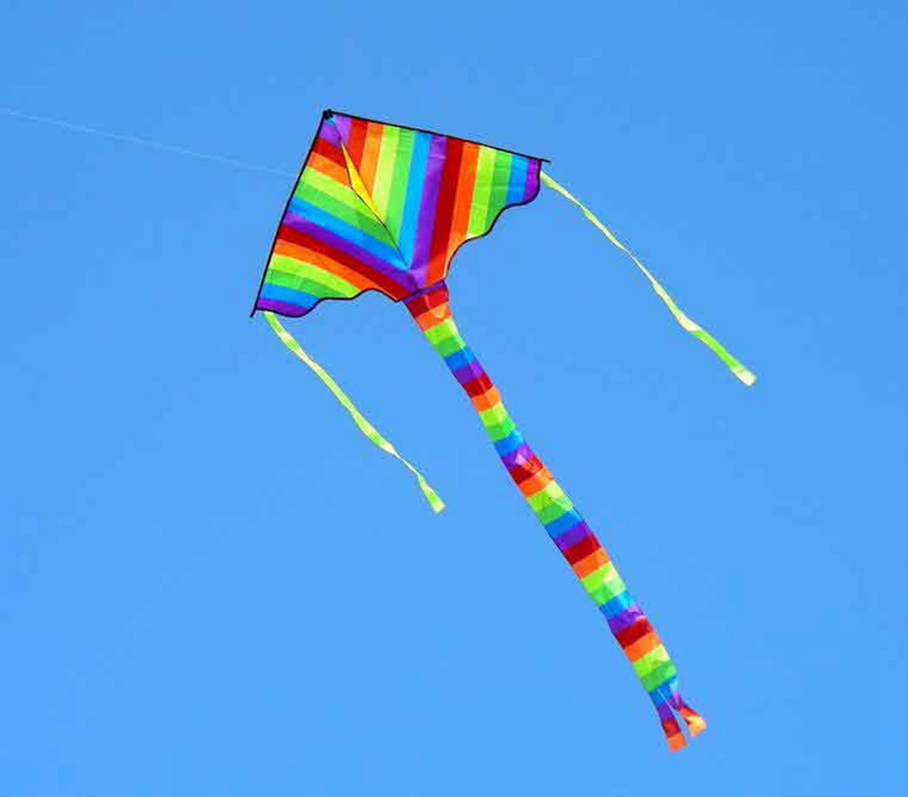
Types
The indoor kite
The inflatable single-line kite
Indoor kites are kites designed to fly in a windless environment. They are flown by using the relative wind provided by the motion of the kite-flier. This motion is typically generated by the user walking slowly backwards (and often within a circle), but it can also be achieved with suitable pulls and jerks along the kite lines.
An inflatable single-line kite is a ram-air kite. The shape is loosely derived from an airfoil with air inlets usually at the front, and a bridle which distributes the tether line loads evenly across the whole base of the kite. These kites have no rigid spars. As with hot air balloons, artistic creativity is often applied, so that fish, cats, and many other animals and characters are depicted.

Slide 17
T
H
A
N
K
S
Thank you

