Slide 1
Writing in Blood

Slide 2
Background
Origins are from Indian Buddhism but it was sustained in China.
Wasn't pure blood but a mix of blood and ink.
Most often blood writing was used to copy Buddhist scriptures.
Many monks wrote in blood.
Haishun
Guaxiu
Zengren

Slide 3
Merit
Writing in blood could be used for "merit"
Many did so for dead relatives
Blood writing was not restricted due to religion, gender, or wealth.
Anyone could use blood writing to gain merit

Slide 4
Merit
A monk named Hanshan Deqing copied scripture for his parents after they died in the hope that they would be reborn into a better life.
"In the Spring of my thirty-second year, I returned from Yanmen. At this time I recalled the benevolence of my [deceased] parents and the care they had given me. I also thought of all of the obstacles that stood between me and the [Buddha] Law.. I vowed to make a copy of the Scripture of the Expanse of Buddhas of the Flower Adornment by mixing my own blood with gold...and below it would repay my parents for their benevo­lence."

Slide 5
Self Mutilation
Great acts of self sacrifice and piety
fingers and ears were most common but in extreme cases arms and eyes.
This also was thought to bring a better chance of rebirth in a "pure land".
Oaths
Blood could be used to bind an oath.

Slide 6
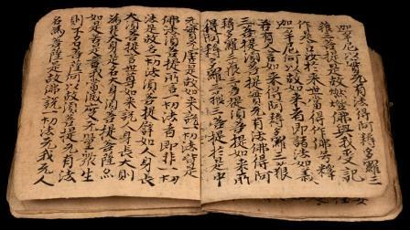
Copied by a 83 year old man by pricking his finger for blood to mix with ink.. Dated at 906.

Slide 7
Royalty
Prince Chen Shuling copied Buddhist texts with his blood in 579.
When Emperor Suzong of Tang became ill his wife copied scripture in the hope that the merit from her actions would help him recover.

Slide 8
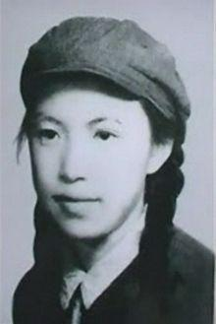
Lin Zhao
Lin Zhao is her pen name.
Born in 1932
From the time she was a teen she was writing essays condemning the corruption in the government.
She was eventually arrested
and executed at the age of 35.
Video

Slide 9
Lin Zhao
"“The cunning villains used our innocence, naivety and honesty; they incited and steered our virtue, purity and fervent temperaments. When we realized the actual absurdity of the situation and began to demand our democratic rights, we were subjected to unprecedented persecution and suppression. Our youth, passion, learning, idealism and joy were all sacrificed to the terrible rule of this wicked tyranny."

