Slide 1
Literature: Ancient literature: Chinese Classical Fairy Tales
2022 English interpreting 黄舒威

Slide 2
definition
What are fairy tales?
Fairy tales are stories created orally by the people collectively, expressing the worship and struggles of superpowers, the pursuit of dreams and the understanding and imagination of cultural phenomena.
They belong to folk literature, with high philosophical and artistic qualities.
For thousands of years, it has been a monumental source of creativity for literati and artists, and has had a profound impact on future generations.

Slide 3
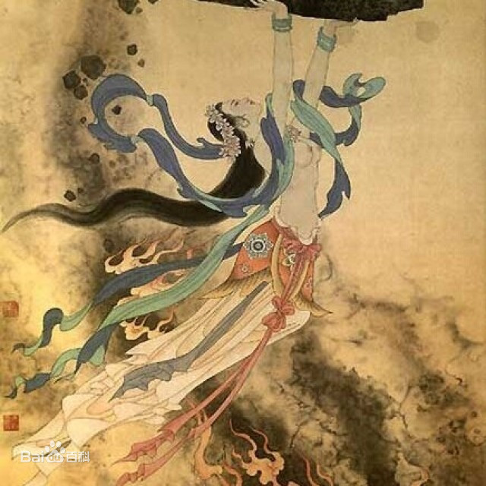
Definition
Examples
Combinations
(1)The Goddness Mending the Sky

Slide 4
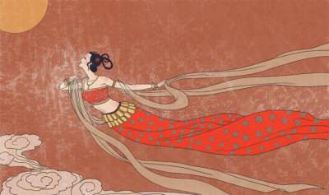
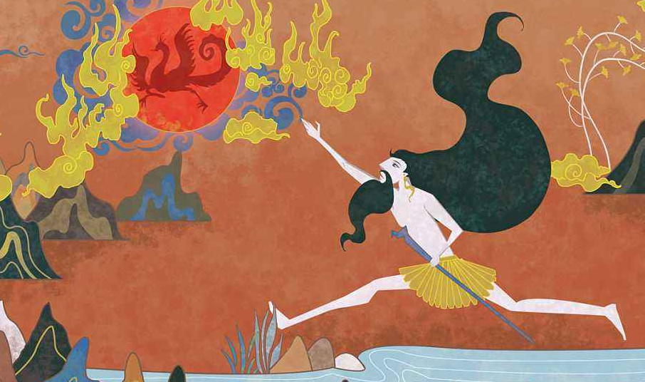
definition
Why fairy tales form?
In general, fairy tale is not a scientific reflection of real life, but a result of the ancient times when humans began to think and explore nature and combined their imagination with reality.
(2)The Goddess Chang's fly to the moon
(3) Kuafu Running After the Sun

Slide 5
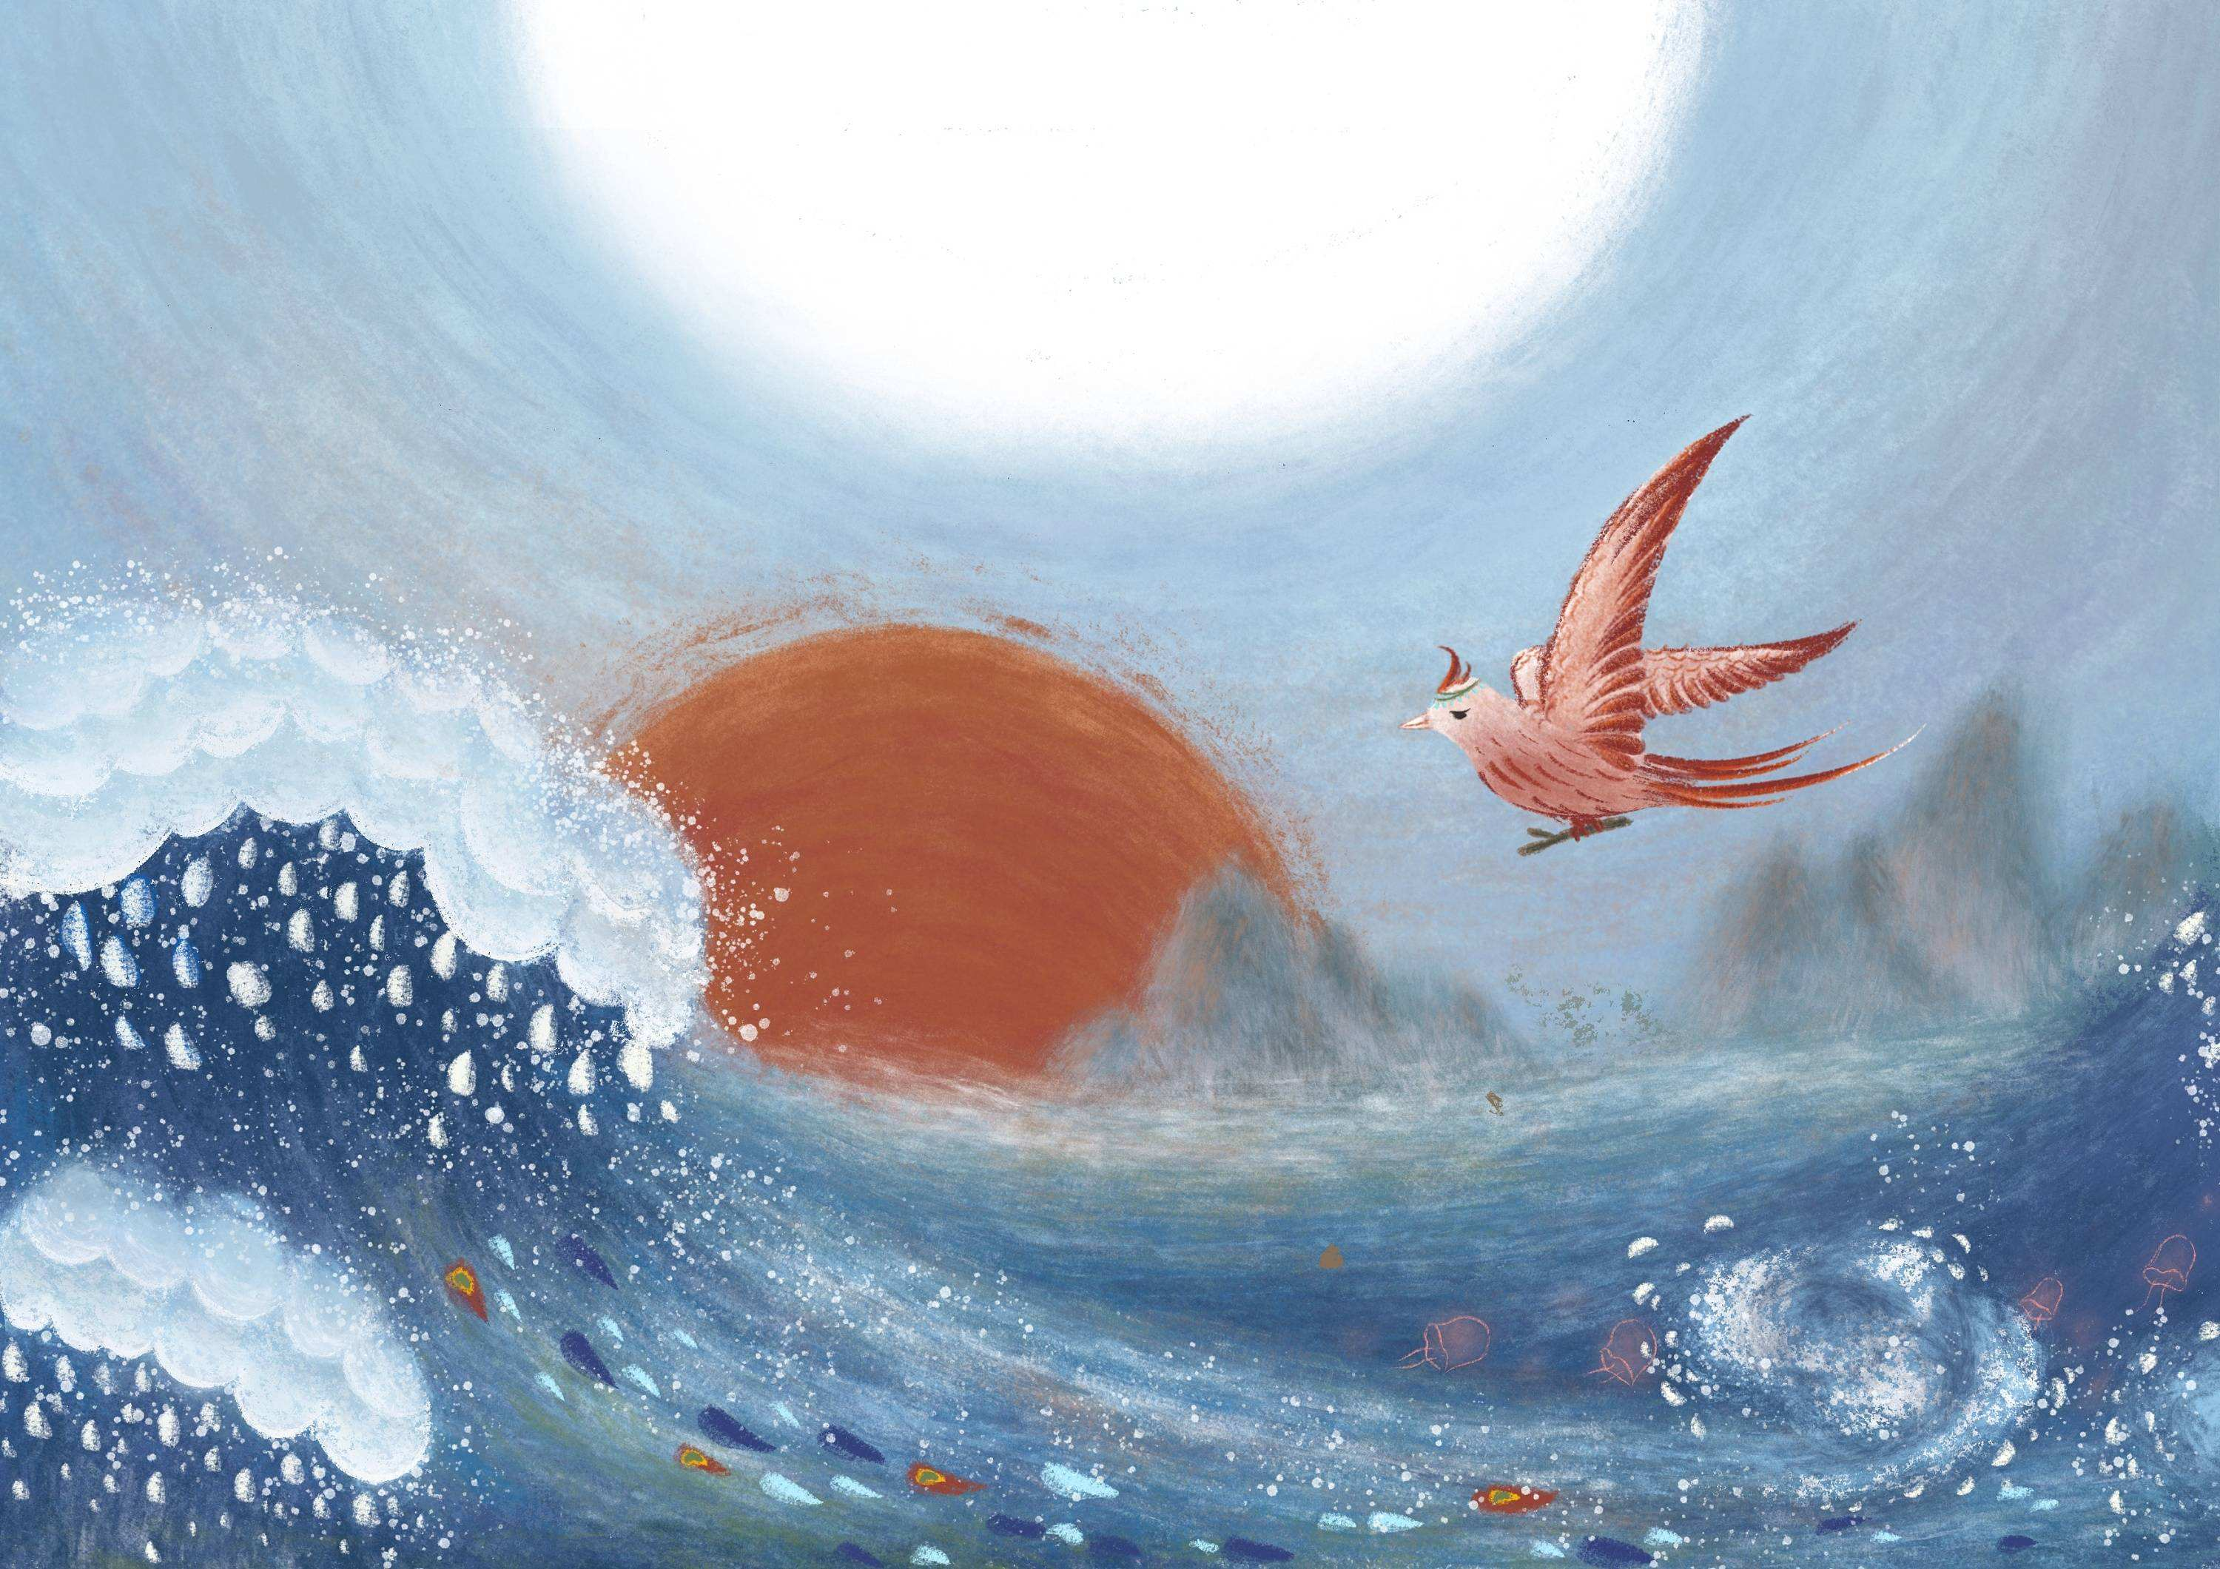
EXAMPLES
It has said that Jingwei was the daughter of Yan Emperor. One day she played in the East China Sea, and unfortunately drowned in the water.
The dead girl turned into a kind of divine bird with a flower head, a white beak and red claws. In revenge for her death, she brought stones and plants from the mountains and threw them into the East China Sea every day. Then she uttered a sad cry of "Jingwei, Jingwei", as if calling to herself.
（4）Jingwei reclamation
According to some researchers, there are many typical unnatural deaths recorded in ancient Chinese fairy tales.The accidents show the weakness and powerlessness of our ancestors in the face of nature and also reveal the fragility of life.
According to Mao Dun, the famous Chinese writer, Jingwei expresses the indomitable will, which belongs to the moral consciousness of fairy tales.

Slide 6
combinations
To integrate traditional culture with other media, "package" culture in a new form and make traditional culture alive, so as to better interpret the charm of culture and spread the voice of China. The application of Chinese fairy tales in animation to interpret cultural charm is a dynamic process. We should promote innovative thinking and give fairy tales a new form instead of keeping them static.

Slide 7
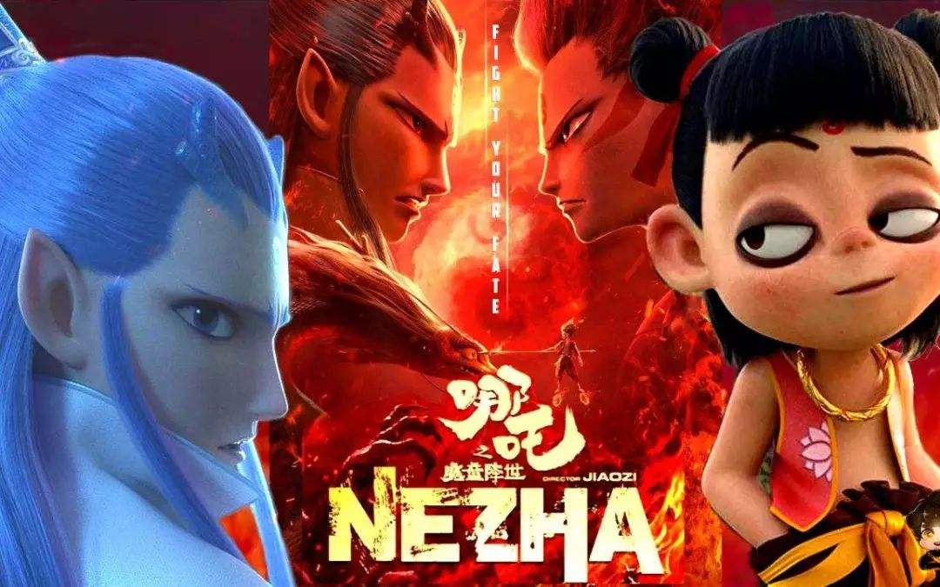
combinations
(1)Ne Zha
Based on a Chinese fairy tale, the film Ne Zha tells the story of Ne Zha's upbringing as a "demon born" but fighting against the heavens to the end.
On Oct 8, 2019, the film Ne Zha represented the Chinese mainland in the race for Best Foreign Language Film at the 92nd Academy Awards in 2020.

Slide 8
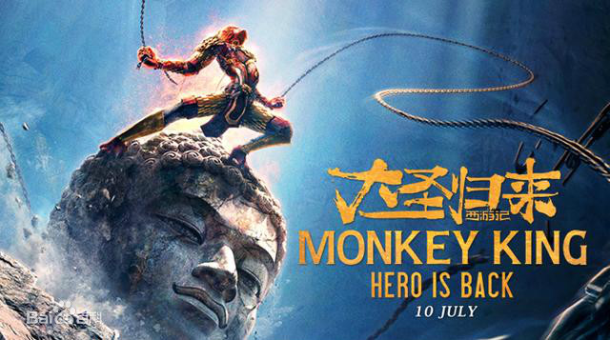
combinations
The film tells the story of Monkey King, who has been sleeping alone at the foot of the Five Elements Mountain for 500 years, after being accidentally unsealed by the childhood Tang Monk, a little monk commonly known as Jiangliu’er. In the adventure of accompanying each other, Monkey King regains his original intention and completes self salvation.
In 2015, the film won the Best Fine Arts Film Award of the 30th China Golden Rooster Award and the Excellent Feature Film Award of the 16th China Huabiao Award.
On August 6, 2016, the film ranked 16th in the list of top 50 films released by the 20th Huading Award Organizing Committee
(2)Monkey King
Hero is Back

Slide 9
Thank you!

