Slide 1
Tik TOK
Douyin

Slide 2

01
What
Content
02
Why
03
How
04
Conclusion

Slide 3

01
What?

Slide 4

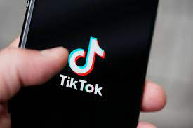
TikTok is a short-form, video-sharing app that allows users to create and share 15-second videos, on any topic.
TikTok maintains a separate app for the Chinese market, known as Douyin, which has over 300 million
active monthly users.

Slide 5
02
Why?

Slide 6
Relax
Learn new things

Slide 7




Study
Tourism
Entertainment

Slide 8



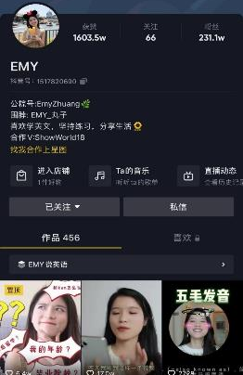
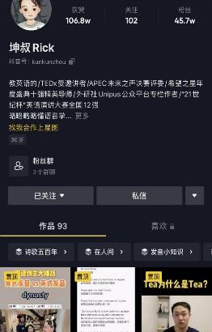
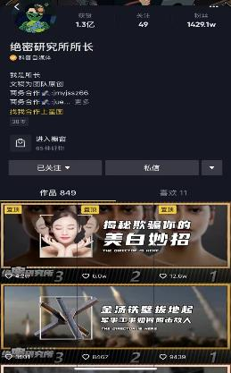
study

Slide 9


Tourism

Slide 10
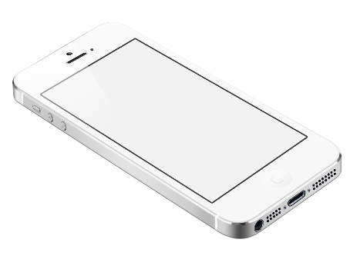
Food
Music
Entertainment
Vlog
Touching Moments

Slide 11
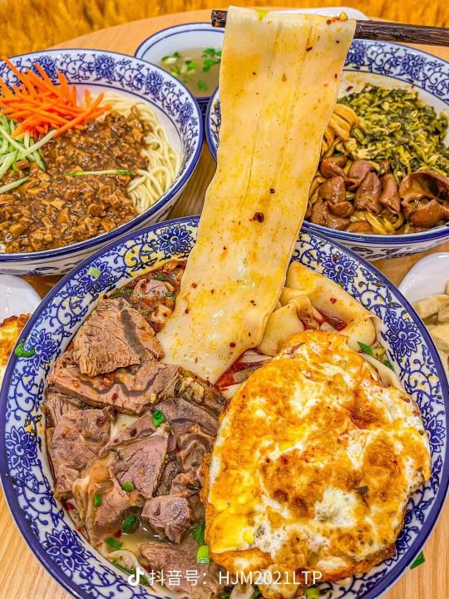
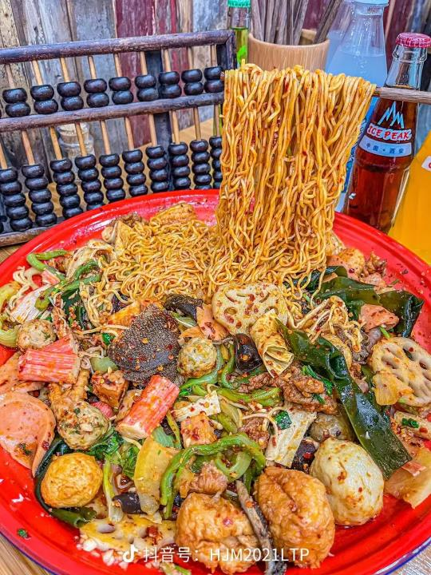
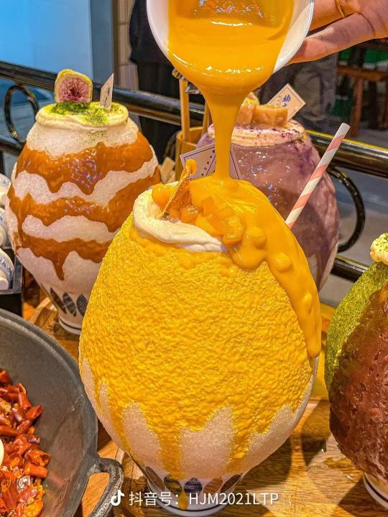
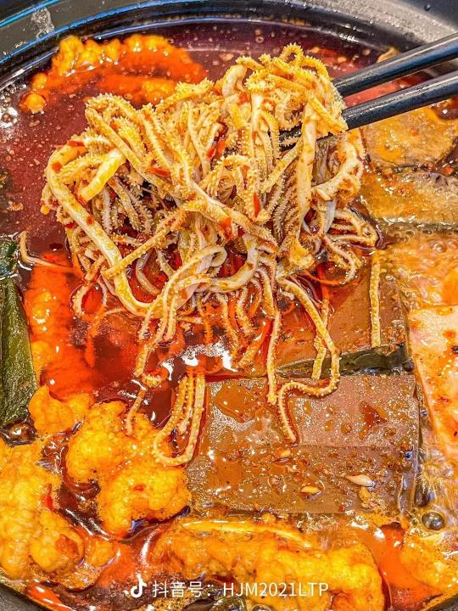

Slide 12
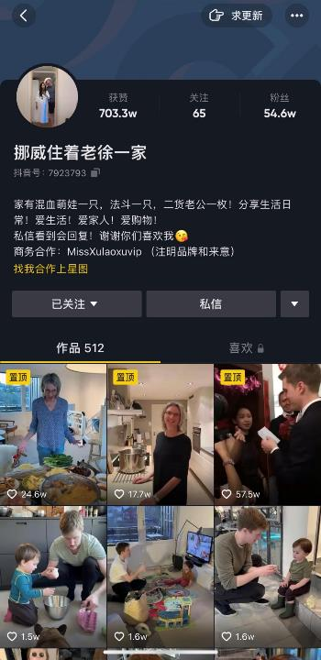
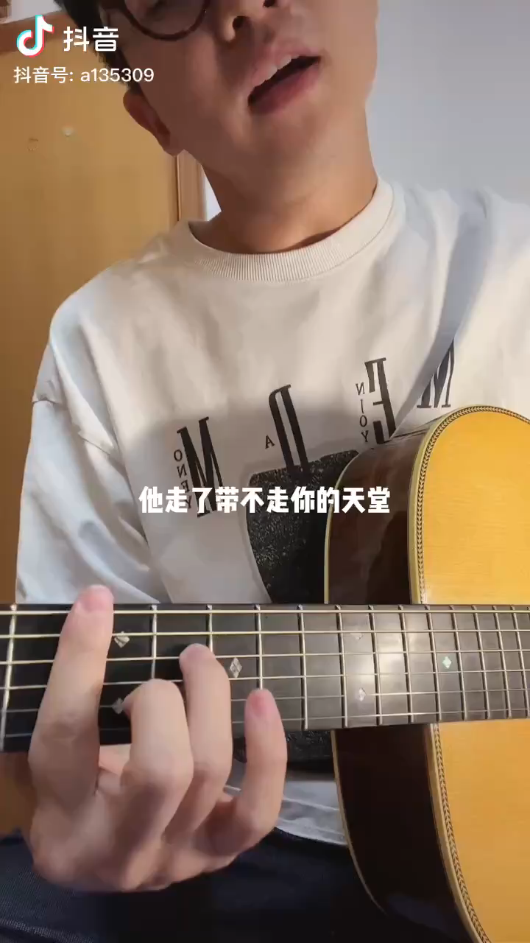

Slide 13
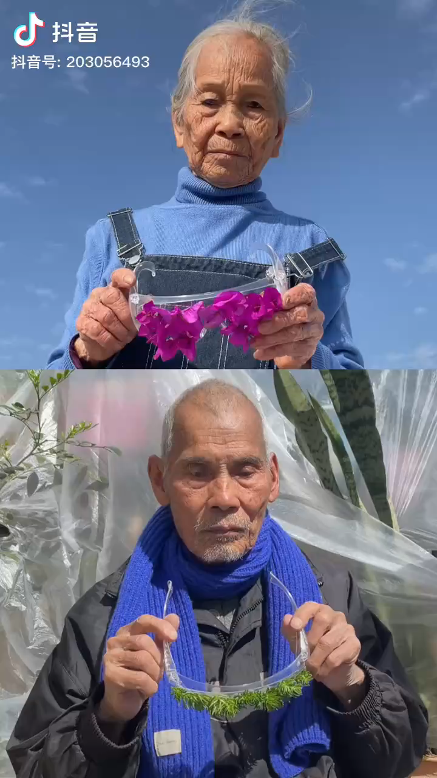

Slide 14
03
How?

Slide 15
Influence
04
vulgar content
03
Addicted
02
Exchanges
01
Information

Slide 16
04
Conclusion

Slide 17
Thank You

