Slide 1
中國語言文化
Session 6, Thursday Oct 17, 2024, Zhishan Bldg. 至善楼105, room 105
Martin Woesler

Slide 2
TOPICS
137. The Long-life Lock p. 1241 Shu Lin/Shirleen
138. Social: Round Table Culture p. 1249Yu Yi/Memo
139. Crosstalk 相声 p. 1257 Lü Di/Ludy
142. Jade Culture p. 1280 Zhang Yange (Mia)
148. Chinese Knots p. 1336 (Chen Zilan/Landy)
152. Chopsticks p. 1376(Peng Yingying/Becca)

Slide 3
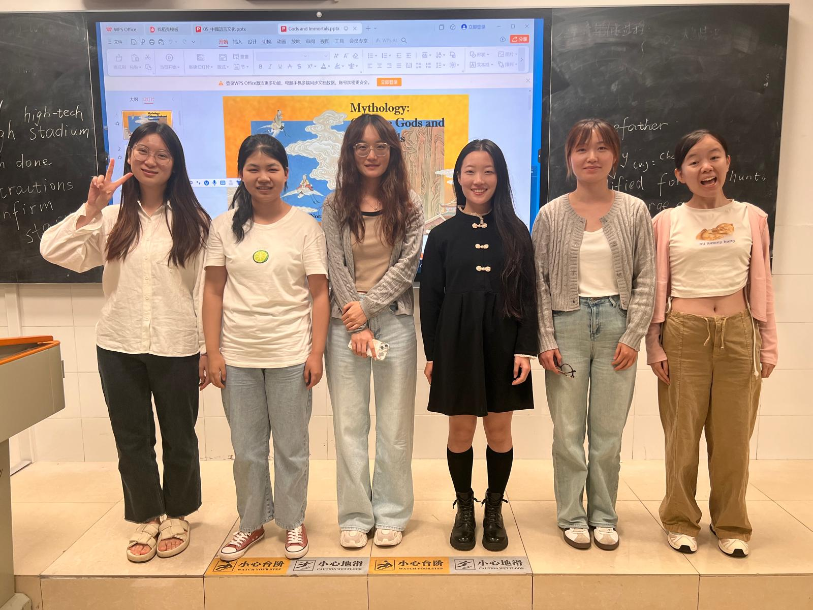
TOPICS
Shu Lin/Shirleen | Yu Yi/Memo | Lü Di/Ludy | Zhang Yange/Mia | Chen Zilan/Landy | Peng Yingying/Becca

Slide 4
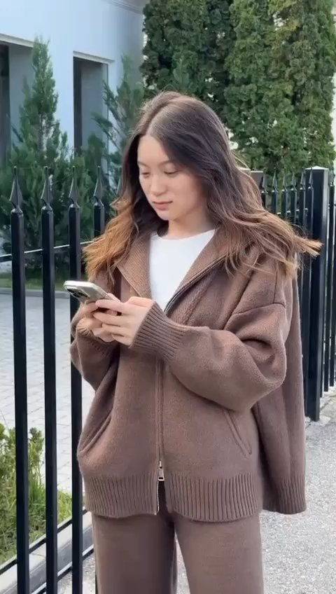
TOPICS
137. The Long-life Lock p. 1241 Shu Lin/Shirleen

Slide 5

TOPICS
138. Social: Round Table Culture p. 1249Yu Yi/Memo

Slide 6

TOPICS
139. Crosstalk 相声 p. 1257 Lü Di/Ludy

Slide 7
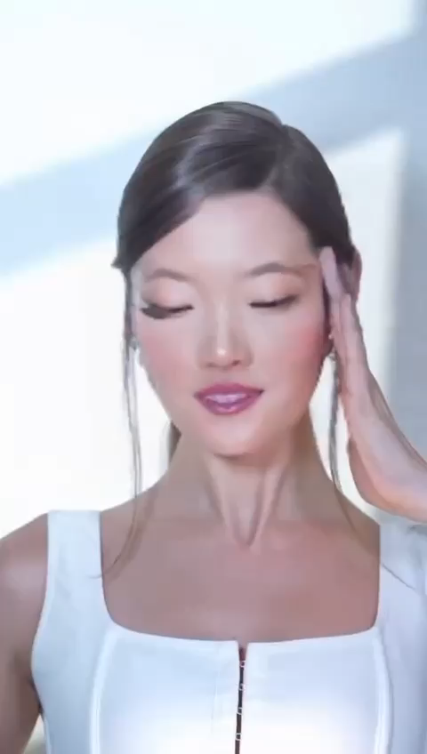
TOPICS
142. Jade Culture p. 1280 Zhang Yange (Mia)

Slide 8
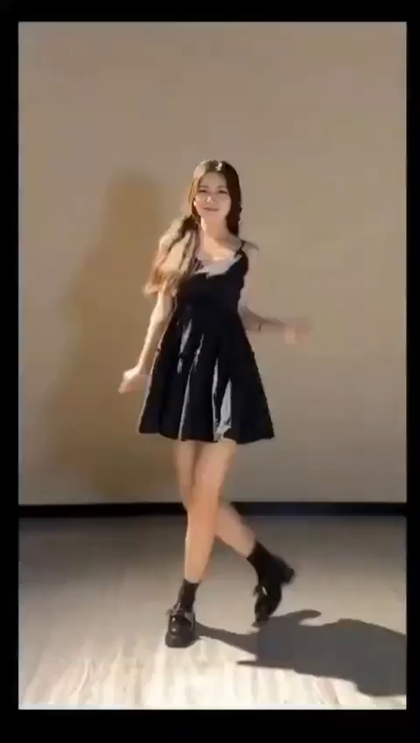
TOPICS
148. Chinese Knots p. 1336 (Chen Zilan/Landy)

Slide 9
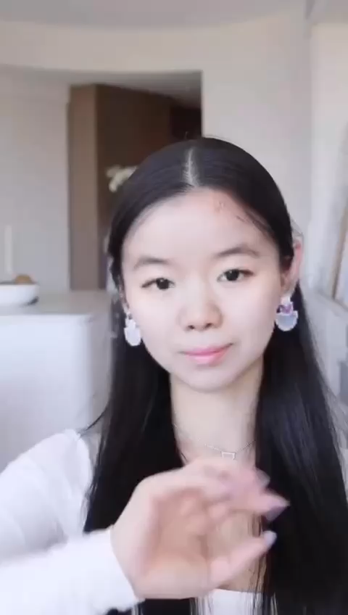
TOPICS
152. Chopsticks p. 1376(Peng Yingying/Becca)

Slide 10
Shu Lin/Shirleen | Yu Yi/Memo | Lü Di/Ludy | Zhang Yange/Mia | Chen Zilan/Landy | Peng Yingying/Becca

Slide 11
Shu Lin/Shirleen | Yu Yi/Memo | Lü Di/Ludy | Zhang Yange/Mia | Chen Zilan/Landy | Peng Yingying/Becca

Slide 12
Shu Lin/Shirleen | Yu Yi/Memo | Lü Di/Ludy | Zhang Yange/Mia | Chen Zilan/Landy | Peng Yingying/Becca

Slide 13
Shu Lin/Shirleen | Yu Yi/Memo | Lü Di/Ludy | Zhang Yange/Mia | Chen Zilan/Landy | Peng Yingying/Becca

Slide 14
Shu Lin/Shirleen | Yu Yi/Memo | Lü Di/Ludy | Zhang Yange/Mia | Chen Zilan/Landy | Peng Yingying/Becca

Slide 15
Shu Lin/Shirleen | Yu Yi/Memo | Lü Di/Ludy | Zhang Yange/Mia | Chen Zilan/Landy | Peng Yingying/Becca

Slide 16
Shu Lin/Shirleen | Yu Yi/Memo | Lü Di/Ludy | Zhang Yange/Mia | Chen Zilan/Landy | Peng Yingying/Becca

Slide 17
Shu Lin/Shirleen | Yu Yi/Memo | Lü Di/Ludy | Zhang Yange/Mia | Chen Zilan/Landy | Peng Yingying/Becca

Slide 18
Prepare for next time
Homework:
1. Please read the six texts for next time in the textbook.
2. Please add your final exam paper topic and your name in the respective section above.
3. Take the surveys (EU: https://wn8ae3qwafbc11zv.mikecrm.com/9gdWrQT
, 2024: https://wn8ae3qwafbc11zv.mikecrm.com/CTrdOjm).

Slide 19
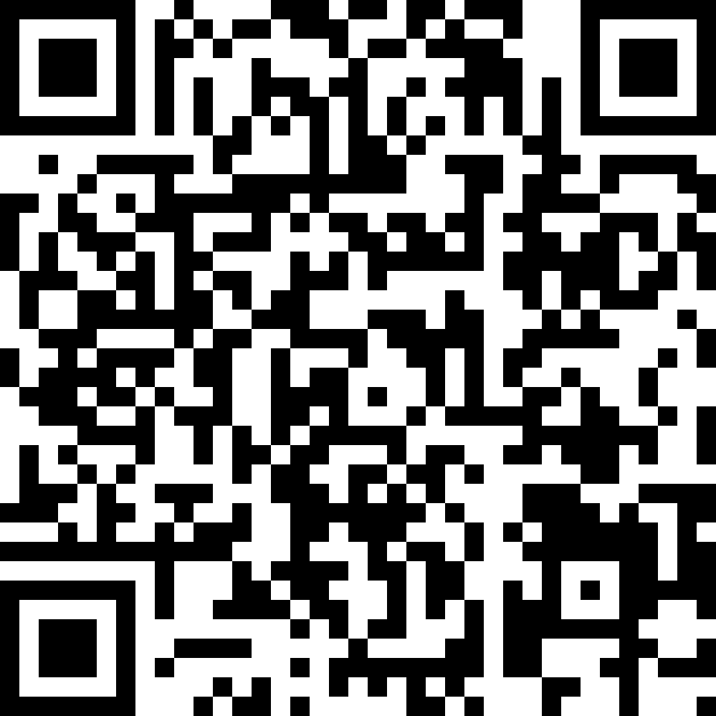
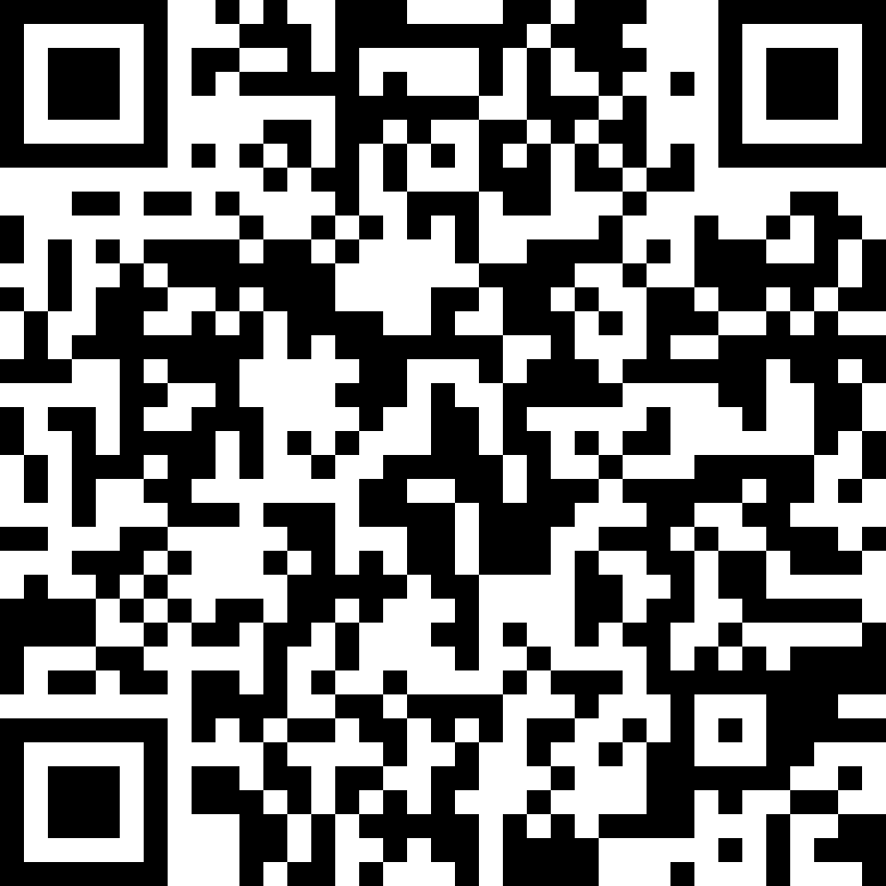
Questionnaires
EU
https://wn8ae3qwafbc11zv.mikecrm.com/9gdWrQT
2024 https://wn8ae3qwafbc11zv.mikecrm.com/CTrdOjm

