Slide 1
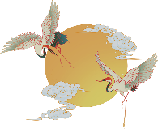
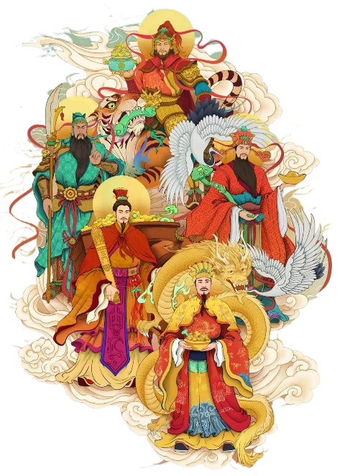
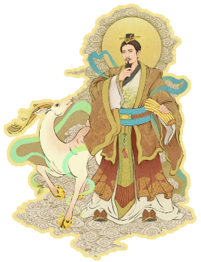
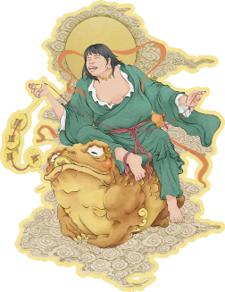
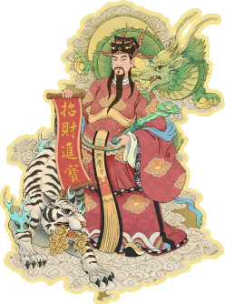

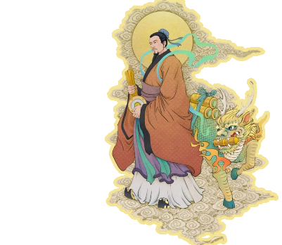


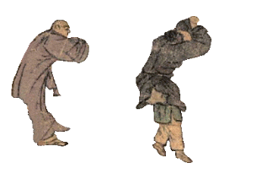
God of wealth
财
神
爷
刘瑛
学号：202470081618

Slide 2
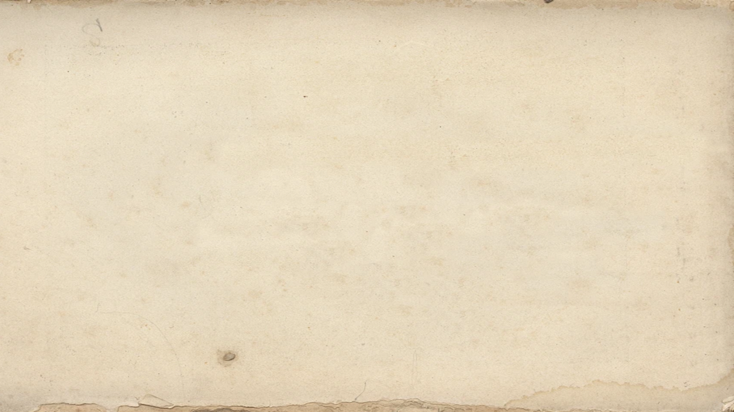
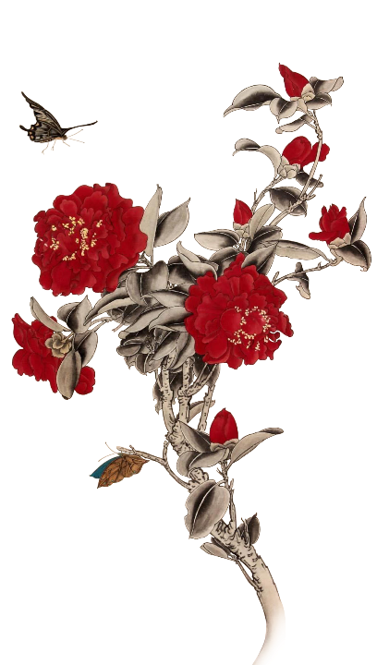
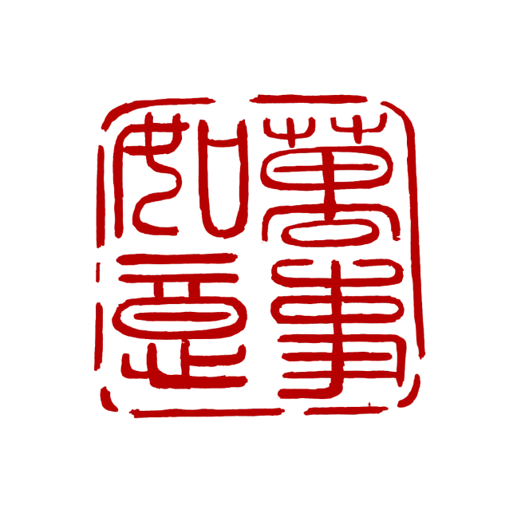

GOD OF WEALTH
01 Origin and Development of GOD OF WEALTH
02 Group of GOD OF WEALTH
03 Chinese view of money from the worship of GOD OF WEALTH
财
神

Slide 3
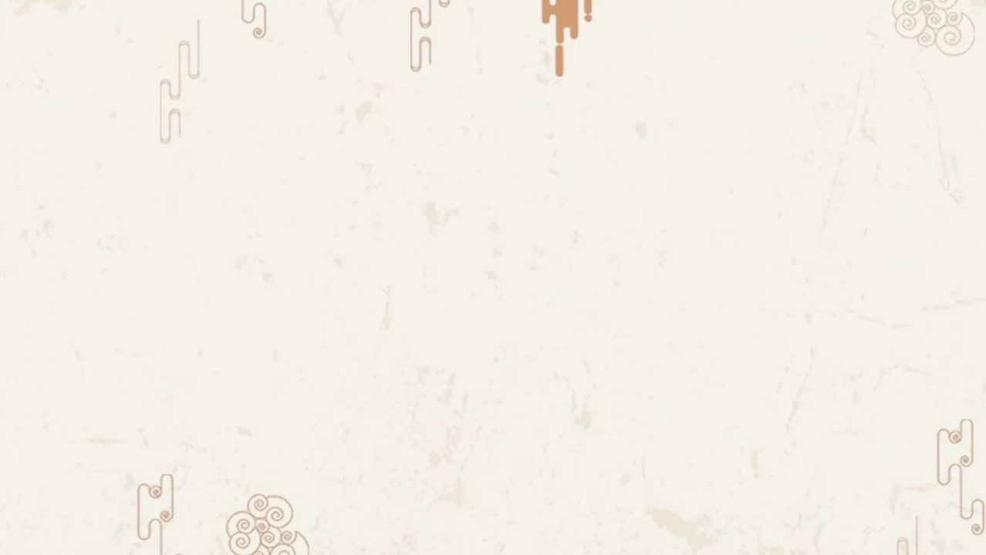
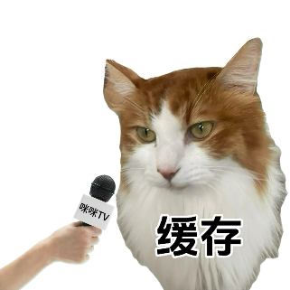
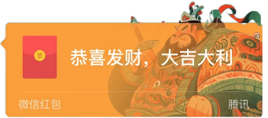

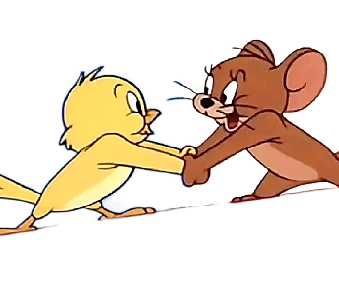
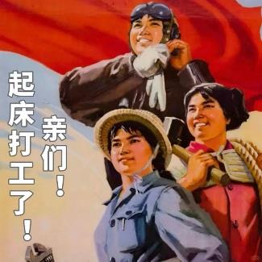
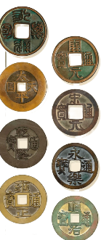
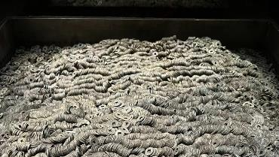
Chinese people love money so much！
We Chinese have unique views for money.
存钱了吗？
Make it. 勤劳致富
Spend it. 精准消费
Save it. 家有余利Bury it. 代代传承
礼尚往来
Give it. Receive it.

Slide 4

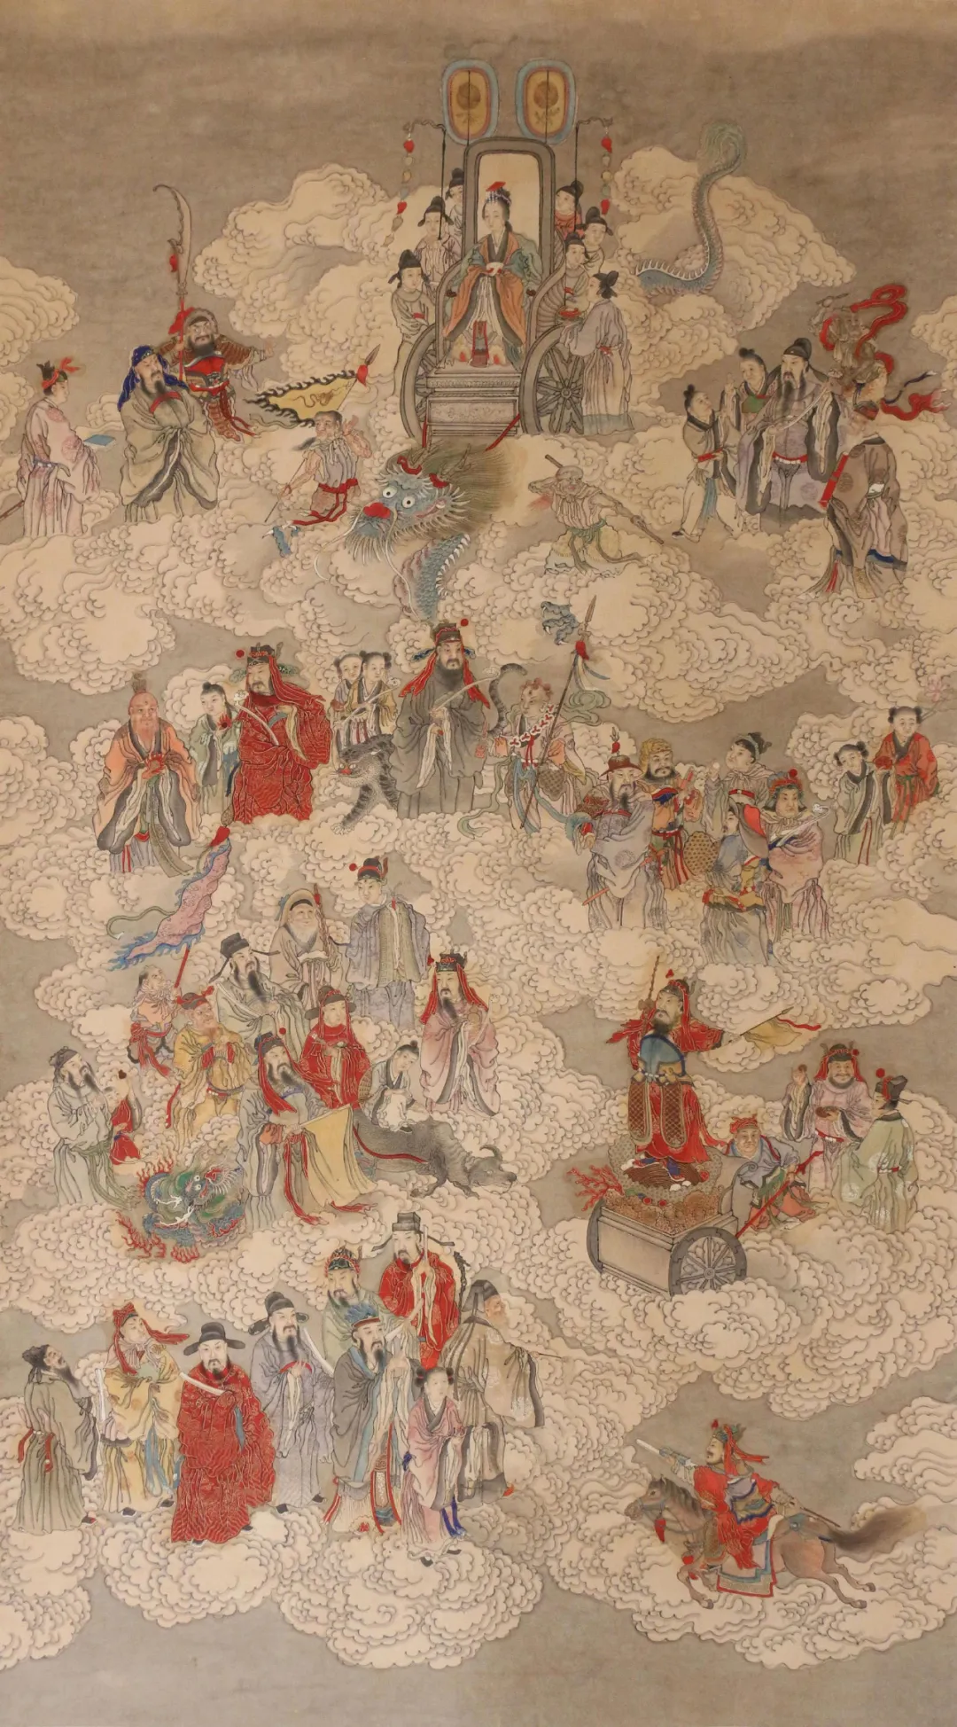


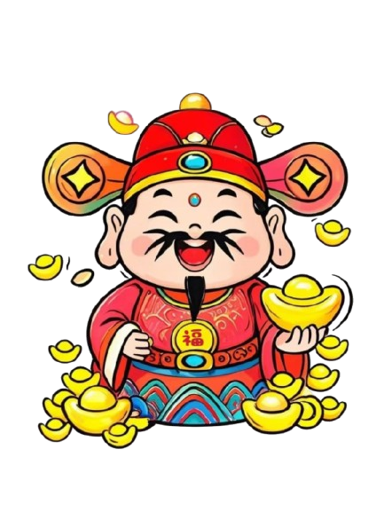
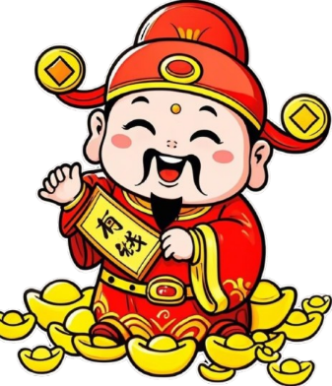

恭喜发财 means ‘hope you get rich’
And we have gods of money, more than one!
清代 《全财神像轴》，现藏于首都博物馆

Slide 5
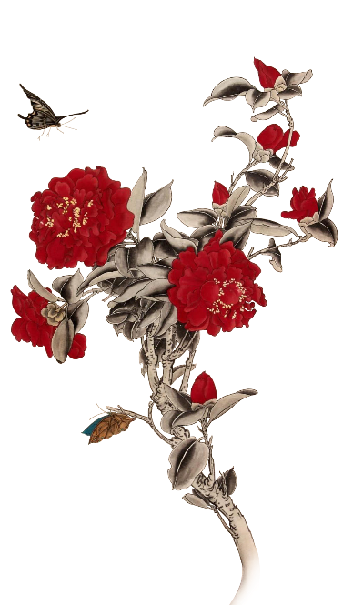
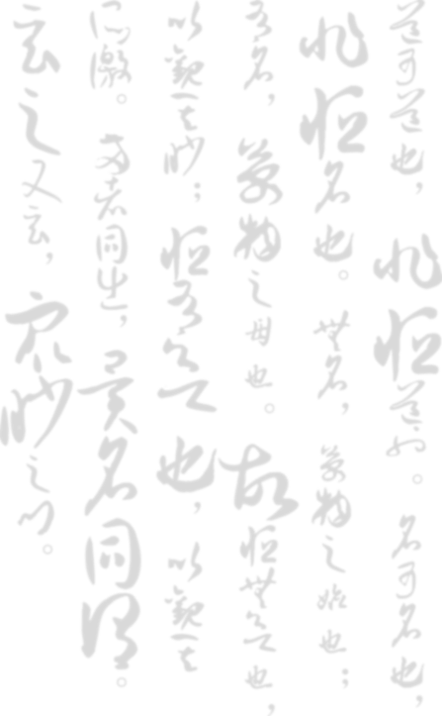

GOD OF WEALTH
财
神
01 Origin and Development of GOD OF WEALTH

Slide 6
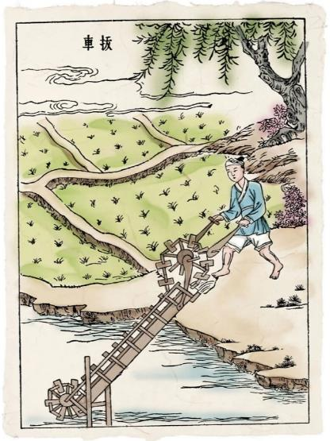

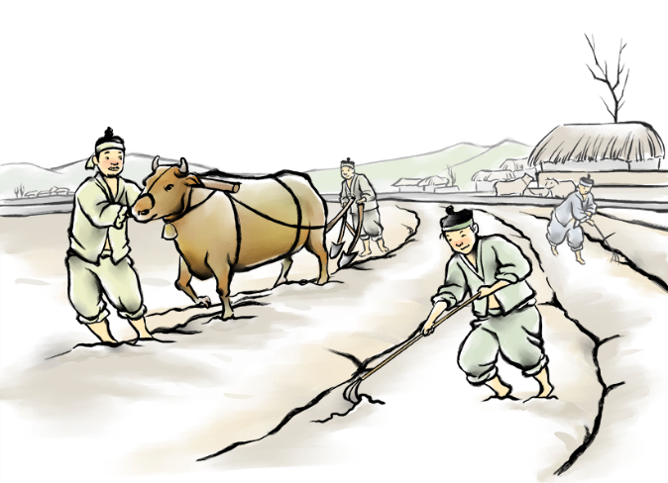
In the Pre-Qin period
Land is one of the most important means of production, and rivers and water sources are crucial for agricultural irrigation, so there are traditions everywhere to worship the god of land, river or water.

Slide 7

Sacrificial activities usually take place at specific times, such as before the spring ploughing or after the autumn harvest, and the family will prepare sacrifices (such as food and wine) to worship these gods, in order to pray for good weather and good crops in the coming year.

Slide 8
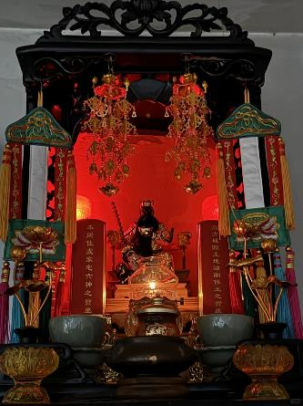
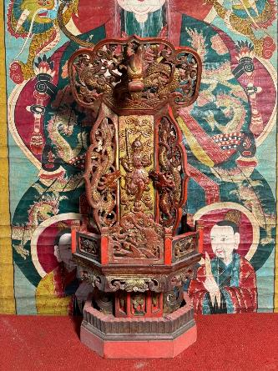
The Tang (618–907) and Song (960–1279) dynasties
Almost every family will worship the god of wealth. They set up small shrines at home ,offering incense and food during festivals like Spring Festival and on the fifth day of the first lunar month 农历正月初五, believed to be Caishen’s birthday.

Slide 9
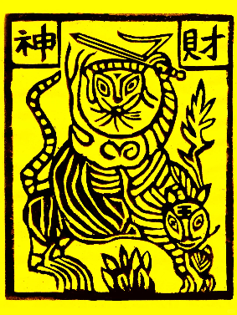
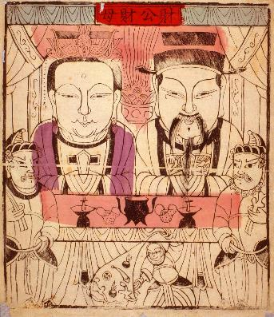
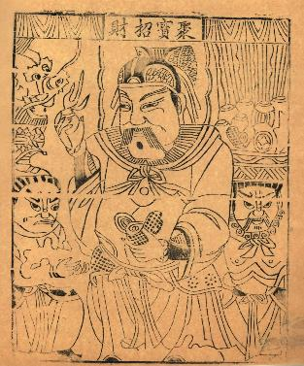
People’s worship of wealth gradually shifted to Objects Endowed with Special Meanings. Paper shops specialized in selling elaborate paper offerings for various ceremonies. Cai Ma, an image of god printed on paper, was widely used to pray for the wealth.

Slide 10
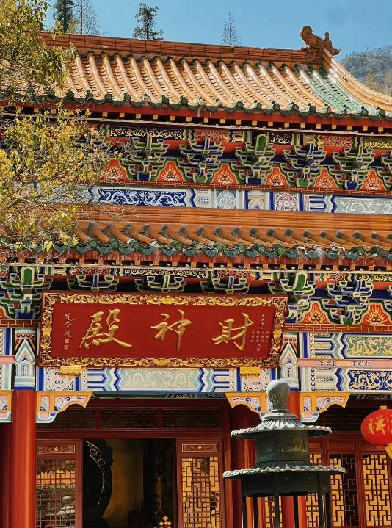
The Ming and Qing dynasties (1368–1912)
The image of the God of Wealth has been solidified as familiar figures like Guan Yu and Fan Li.
Temples dedicated to Caishen attracted widespread Taoists, especially among merchants.

Slide 11
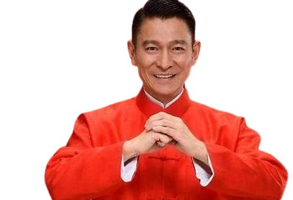
1、When do people celebrate Caishen’s birthday during the Spring Festival ?
A. The fifth day of the first lunar month (农历正月初五)
B. The fifteenth day of the first lunar month(农历正月十五)
The Lantern Festival 元宵节
C. The fifth day of the fifth lunar month（农历五月初五）
The Dragon Boat Festival 端午节

Slide 12
GOD OF WEALTH
财
神
02 Group of GOD OF WEALTH

Slide 13
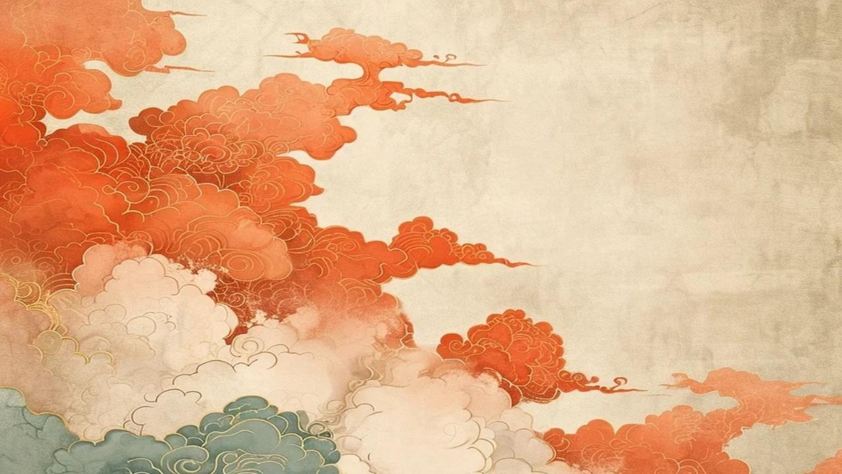





财
神
天
团

Slide 14
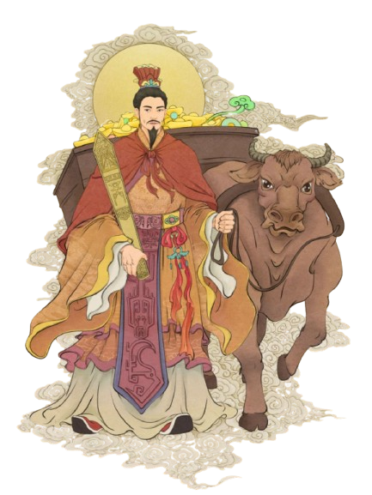
Wang Hai 王亥
The middle god of wealth. He is in charge of trade.
He tamed oxen and invented ox-drawn carts, using them to transport goods, which facilitated trade exchanges between tribes.

Slide 15
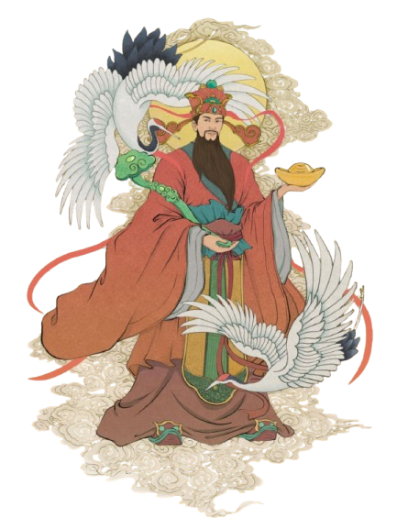
Bigan比干
The Eastern god of wealth. He is in charge of treasury.
He symbolizes impartiality in trade and finance.

Slide 16
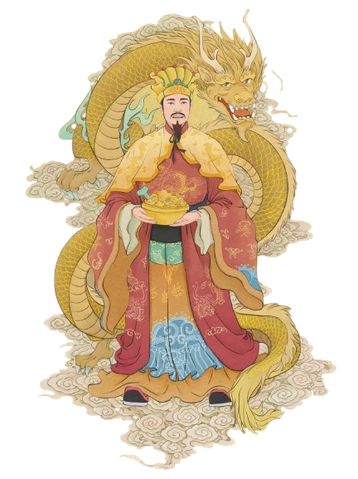
Chai Rong 柴荣
The Southern god of wealth. He is in charge of fortunes of officialdom.
Because he journeyed southward with a small cart in his youth and amassed wealth, he was revered by people as the Southern god of wealth

Slide 17
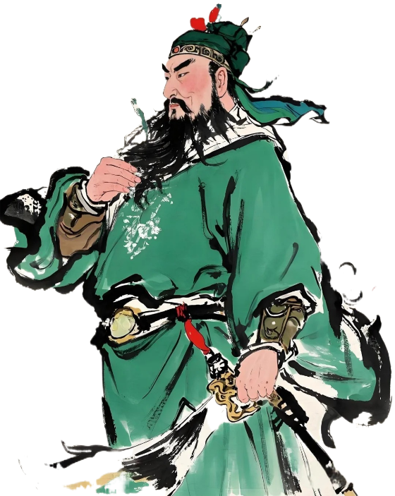
Guanyu关羽
The Western god of wealth. He is in charge of commerce.
He was not swayed by money many times, and he was gradually deified as the god of wealth who protected the interests of businesses.

Slide 18
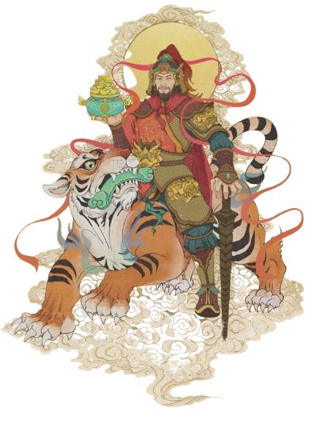
Zhao Gongming 赵公明
The Northern god of wealth.
In matters of trade and wealth-seeking, he ensures fairness, profit, and harmonious partnerships.

Slide 19
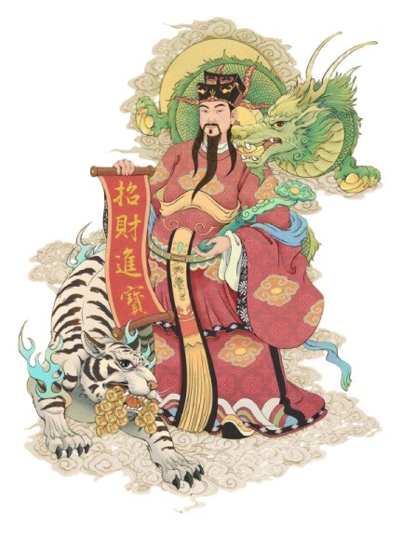
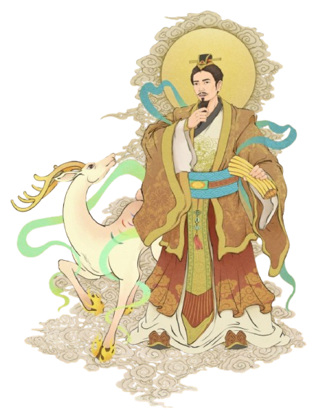
Li Guizu 李诡祖
The northeast god of wealth. He is in charge of fortune and luckiness.
Fan Li 范蠡
The southeast god of wealth. He is in charge of economy.

Slide 20
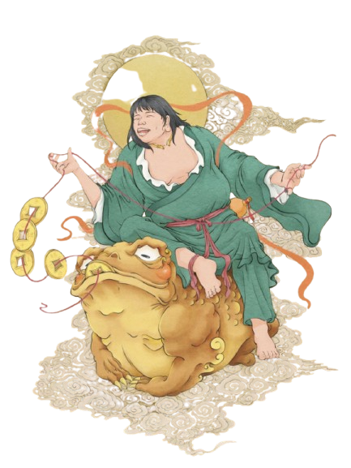
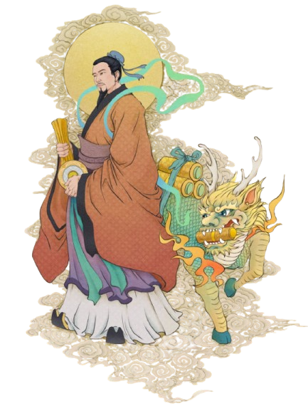
Liu Haichan 刘海禅
The northwest god of wealth. He is the only intern in the group, in responsible for nothing.
Duanmu Ci 端木赐
The southwest god of wealth. He is in charge of culture

Slide 21
2、Who among the following options is not the God of Wealth ？
A. 关羽
B. 端木赐
C. 刘德华
D. 比干
E. 以上都是

Slide 22
GOD OF WEALTH
财
神
03 Chinese view of money from
the worship of GOD OF WEALTH

Slide 23

The Chinese God of wealth does not necessarily have endless wealth, but because of their excellent qualities, they are widely believed and regarded as the God of wealth. The reason why they were offered as the god of wealth was that people respected their morals.
The Chinese worship of the God of Wealth reflects a balanced view of money. Rooted in Confucian ideals, it emphasizes righteousness, diligence, and fair wealth acquisition.

Slide 24
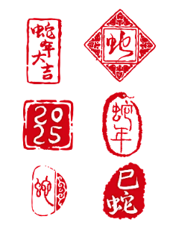
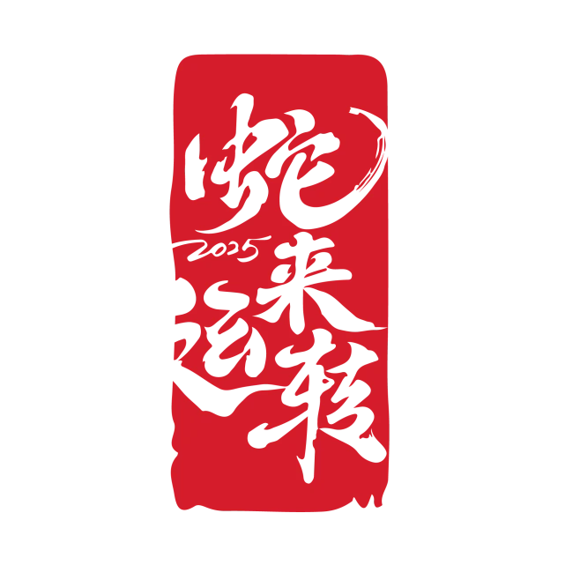
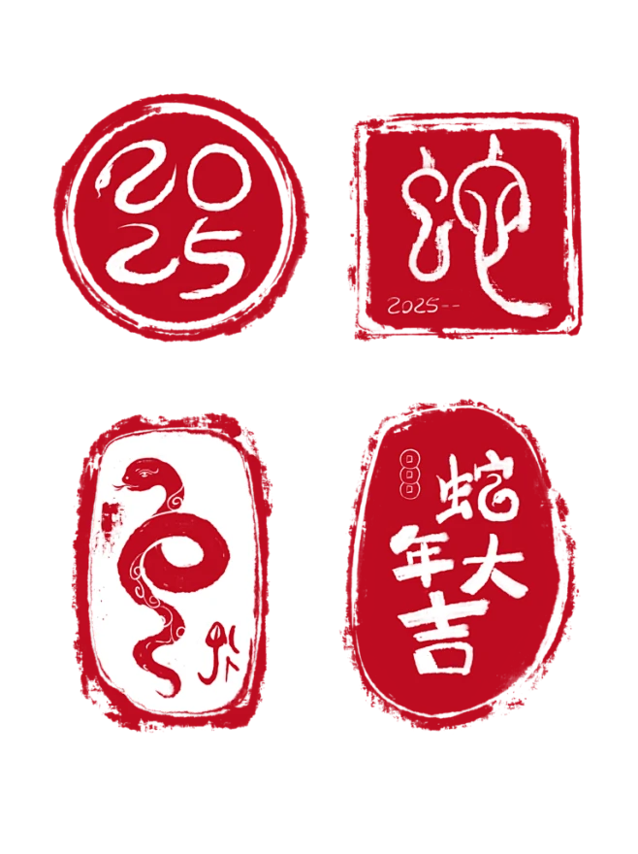
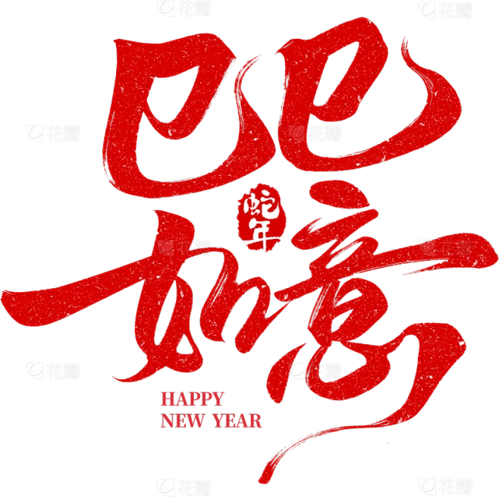
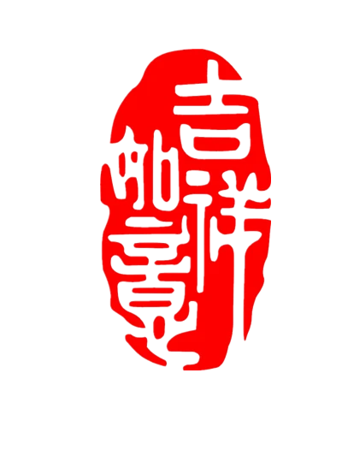
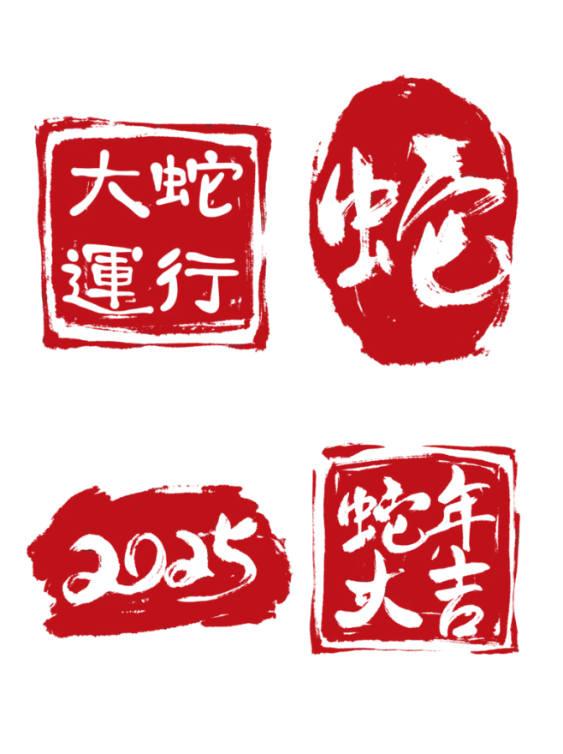
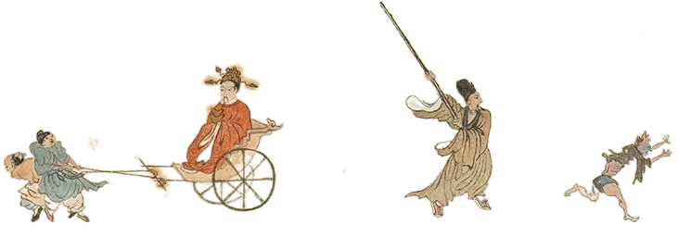
一棍打出穷鬼去
双钩搭进财神来

