Slide 1
Later Han Dynasty
Eastern Han-220 C.E
Colby Gale

Slide 2
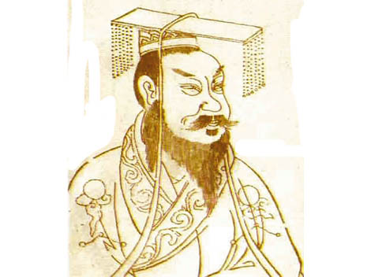
Eastern Han
The Eastern Han Dynasty began in 25 CE when the Xin dynasty failed and Emperor Guangwu of Han took the throne.
The first few years of the Eastern Han’s rule were turbulent because of troubles left behind by Wang Mang’s rule.

Slide 3
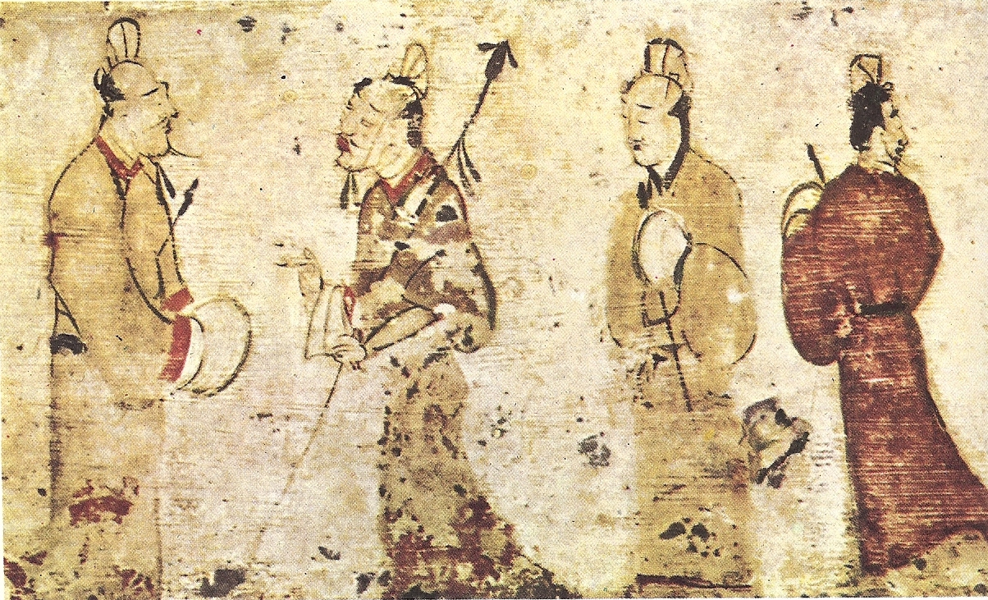
Eunuchs
The Later Han dynasty is seen to be a high point of power for the eunuchs in the dynastic house.
The eunuchs would actively participate in social and political conflicts.

Slide 4
Decline of the Han
The Han Dynasty began to majorly decline in 184 CE with the Yellow Turban Rebellion ushering in a new era of chaos.
Further chaos ensued when He Jin and Yuan Shao plotted to overthrow the eunuchs. The plan backfires and He Jin is assassinated by the eunuchs.

Slide 5
Imperial Turbulence
Dong Zhuo a local warlord found the fleeing emperor and took him in. Dong Zhuo deposed Emperor Shao and replaced him with a figurehead Emperor Xian.
Dong Zhuo was soon killed by his adopted son Lu Bu and the young Emperor Xian was forced to flee again.

Slide 6
A New Protector
Cao Cao took the young Emperor Xian in under his wing and used Xian’s influence to his benefit.
Cao Cao soon asserted his power and became a dominating power in China.
It was only the combined efforts of Liu Bei and Sun Quan that could challenge Cao Cao’s power.

Slide 7
The End of the Han
The Han Dynasty officially ended when Cao Cao’s son Cao Pi made Emperor Xian relinquish the throne to him in 220 CE.
This effectively ended the Han Dynasty and began the Three Kingdoms Era where the kingdoms of Wu, Wei, and Shu struggled to rule all of China.

Slide 8
Bibliography
Berggren, Lennart, Jonathan M. Borwein, and Peter B. Borwein. (2004). Pi: A Source Book. New York: Springer. ISBN 0-387-20571-3.
Bielenstein, Hans. (1980). The Bureaucracy of Han Times. Cambridge: Cambridge University Press. ISBN 0-521-22510-8.
Bielenstein, Hans. (1986). "Wang Mang, the Restoration of the Han Dynasty, and Later Han," in The Cambridge History of China: Volume I: the Ch'in and Han Empires, 221 B.C. – A.D. 220, 223–290. Edited by Denis Twitchett and Michael Loewe. Cambridge: Cambridge University Press. ISBN 0-521-24327-0.
Block, Leo. (2003). To Harness the Wind: A Short History of the Development of Sails. Annapolis: Naval Institute Press. ISBN 1-55750-209-9.
Bower, Virginia (2005). "Standing man and woman," in Recarving China's Past: Art, Archaeology, and Architecture of the 'Wu Family Shrines', 242–245. Edited by Naomi Noble Richard. New Haven and London: Yale University Press and Princeton University Art Museum. ISBN 0-300-10797-8.

