Slide 1
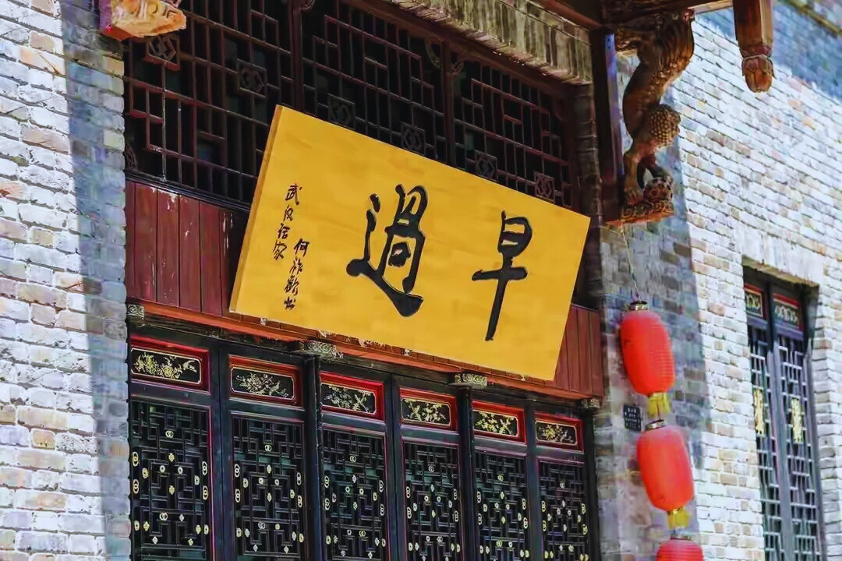
Wu
Han
Guo
Zao

Slide 2
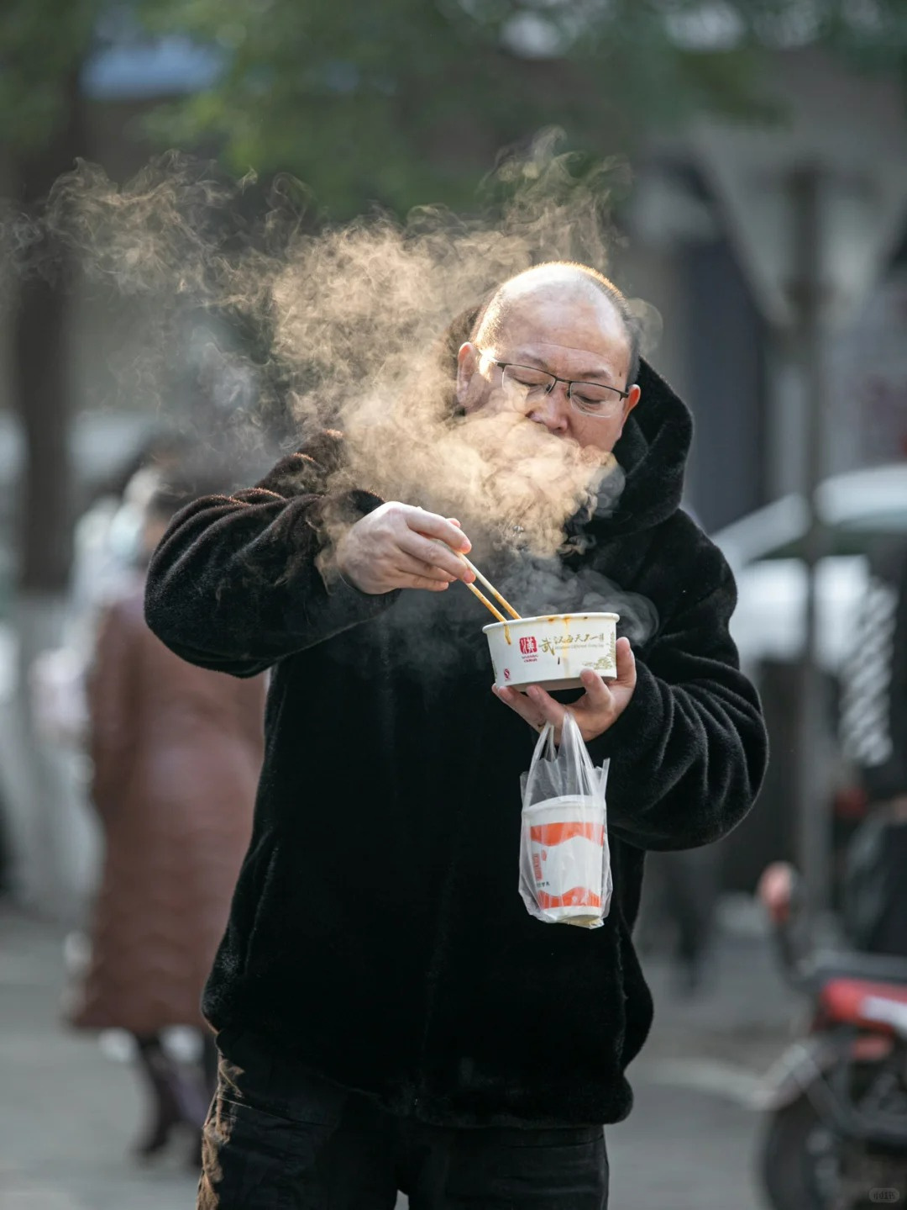
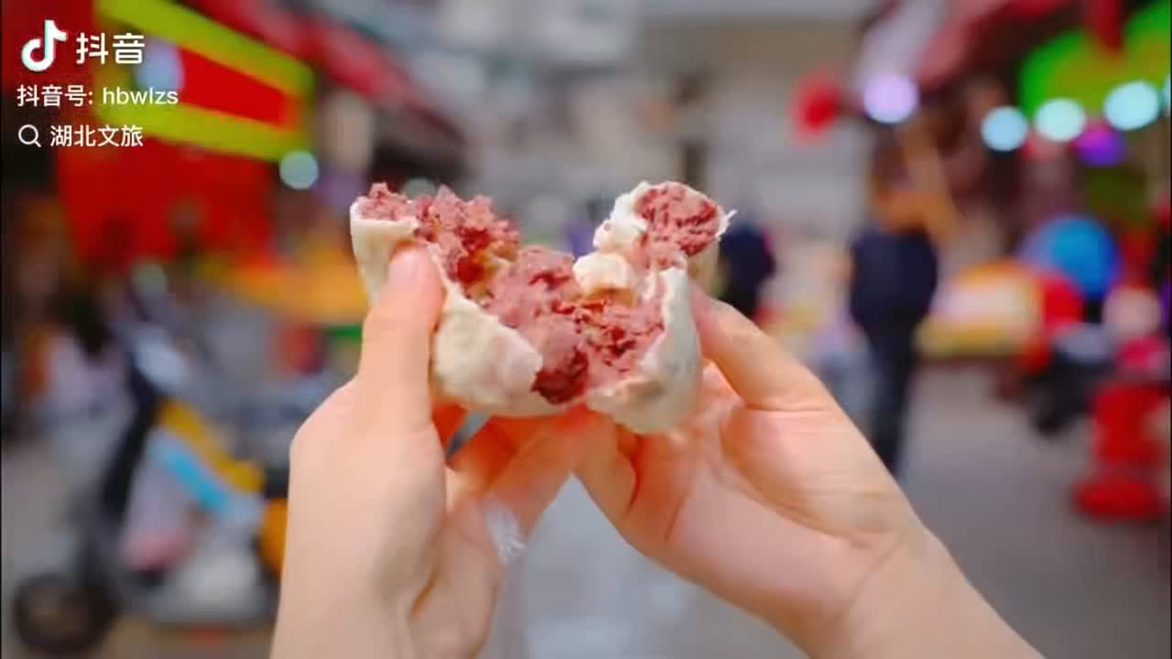
Guo
Zao
The short vedio is from the official account of Hubei Provincial Department of Culture and Tourism in Tiktok.

Slide 3
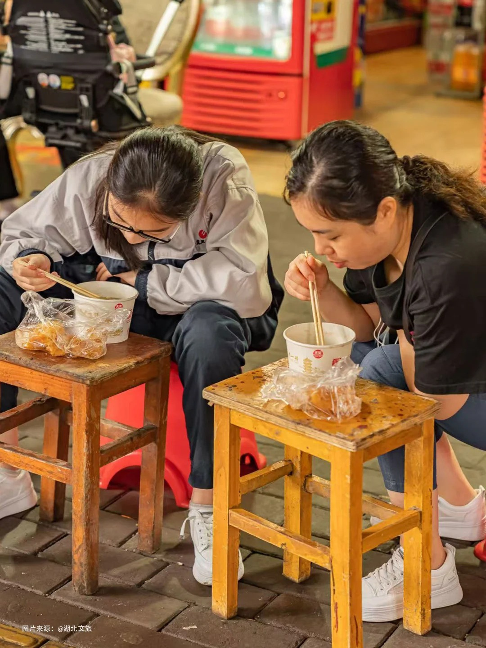
GUO
ZA
O
Specialities

Slide 4
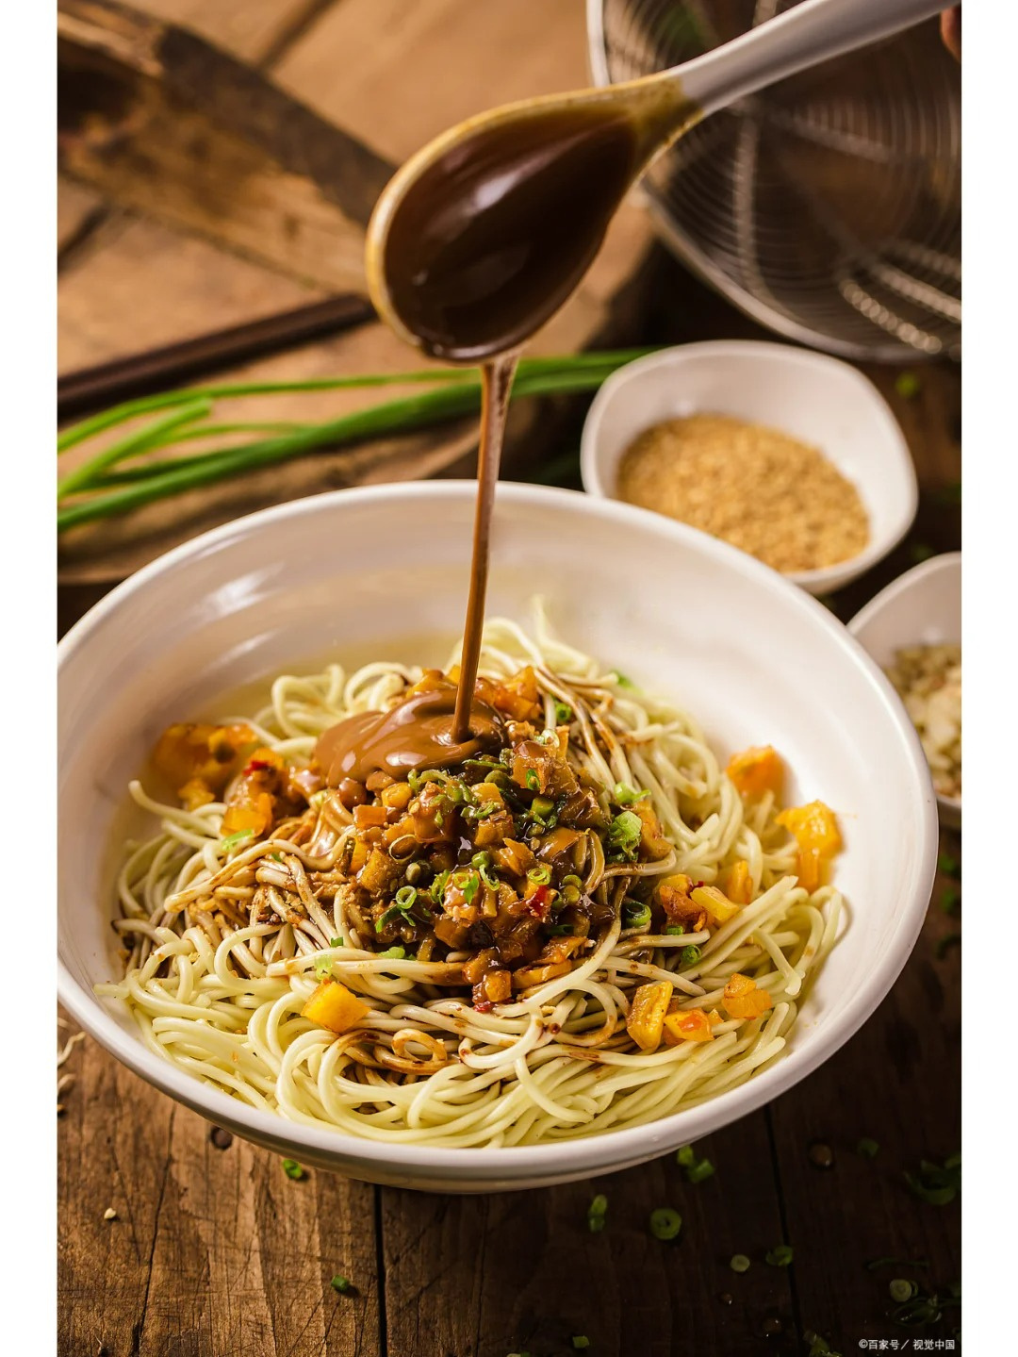
Specialities
Hot Dry Noodles
boil alkaline noodles and drain them
magic sauce: sesame paste, sesame oil, light soy sauce and dark soy sauce
additional garnishes: chopped scallions, cilantro, pickled long beans, and crispy soybeans

Slide 5
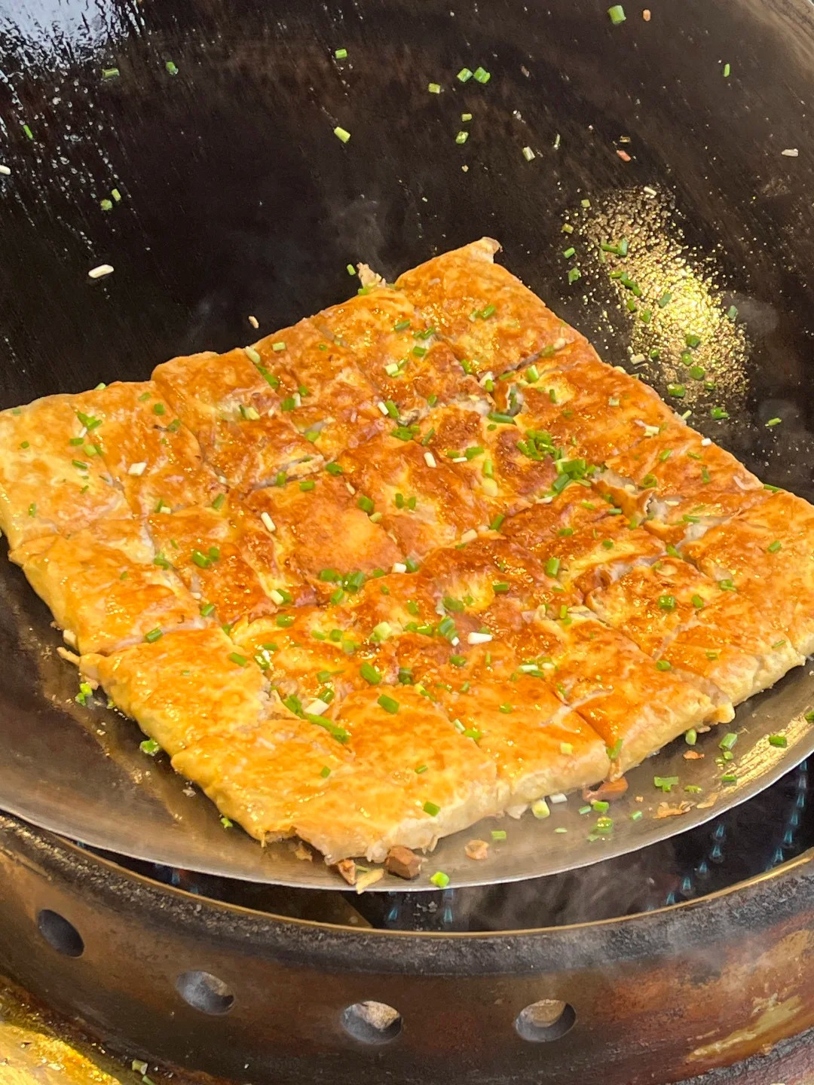
Specialities
Bean Pies
layers: tofu skins or pancake lookalikes consisting of mung beans, flour, milk, and eggs
stuffed between the top and bottom layer:
rice, pork, mushrooms, and bamboo shoots
pan-fry it until golden color, and then cut it up into small pieces, sprinkled with chopped scallions

Slide 6
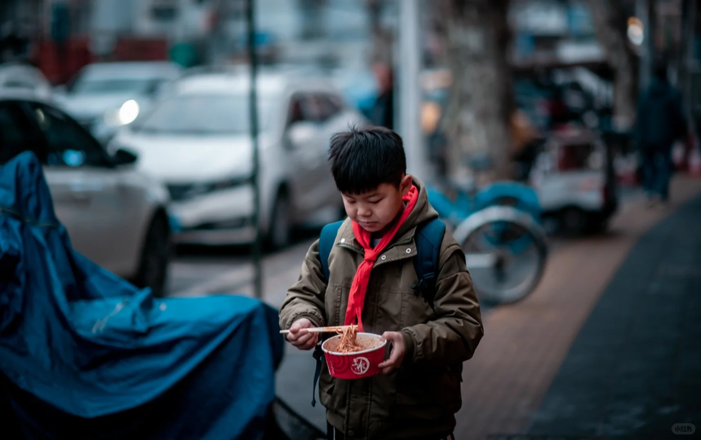
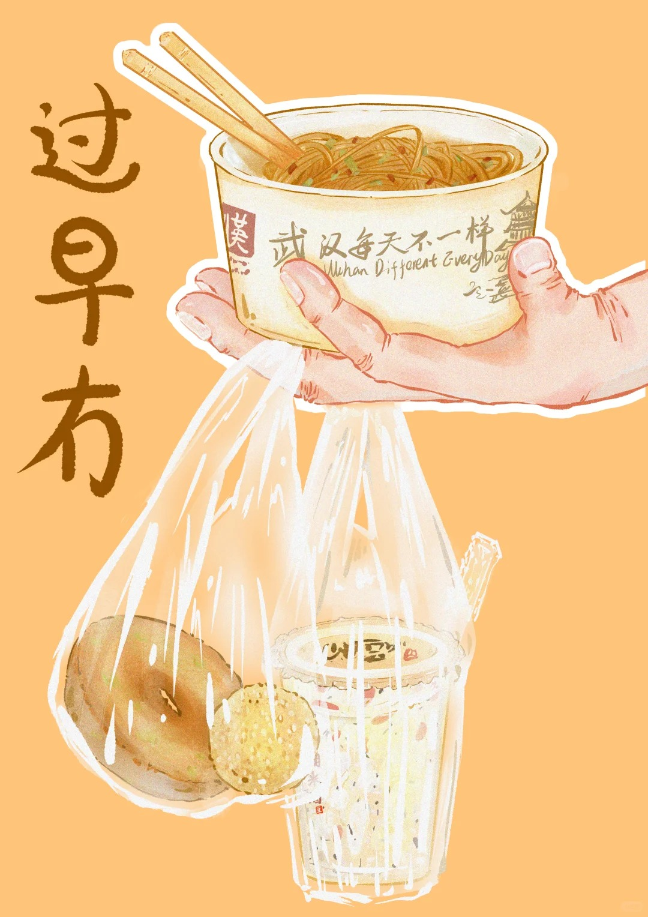
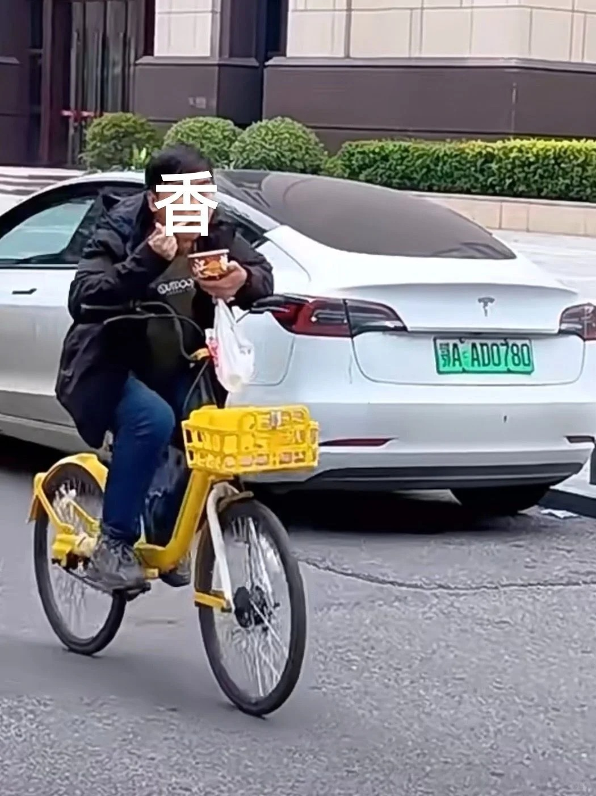

Slide 7
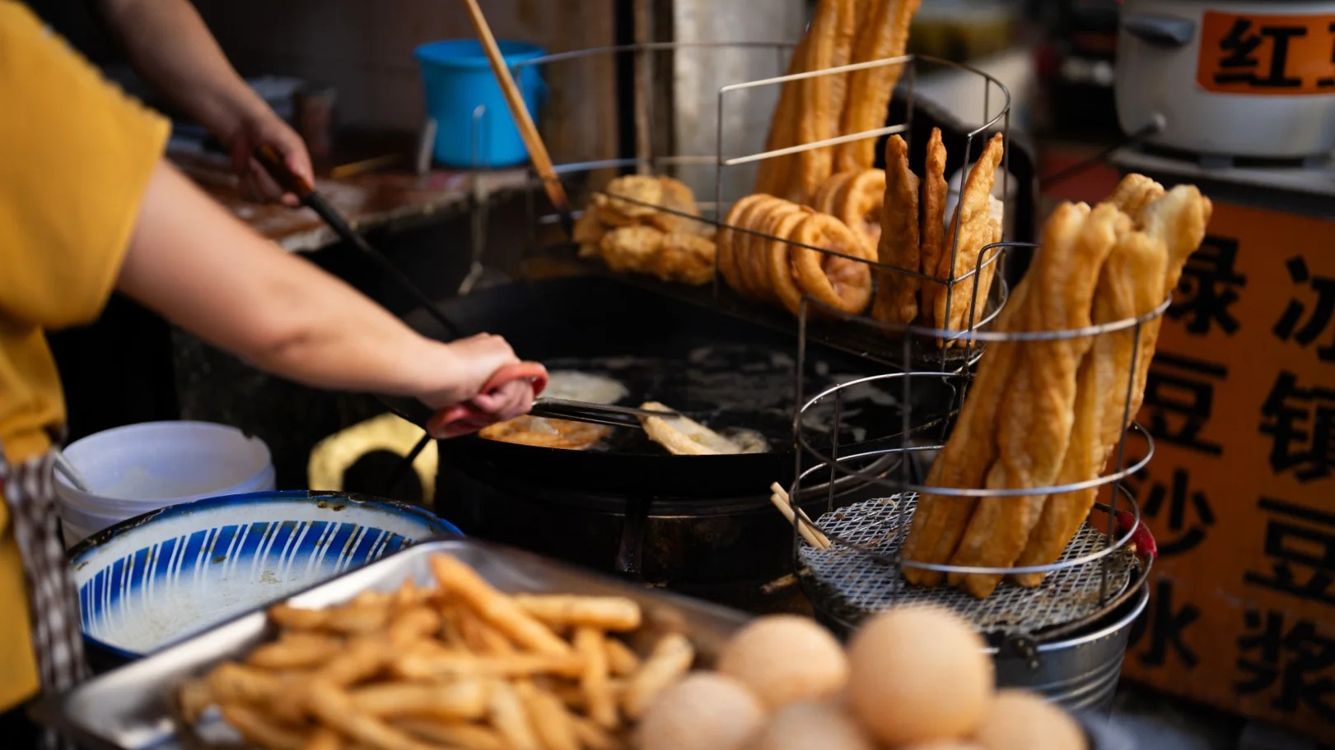
Culture

Slide 8
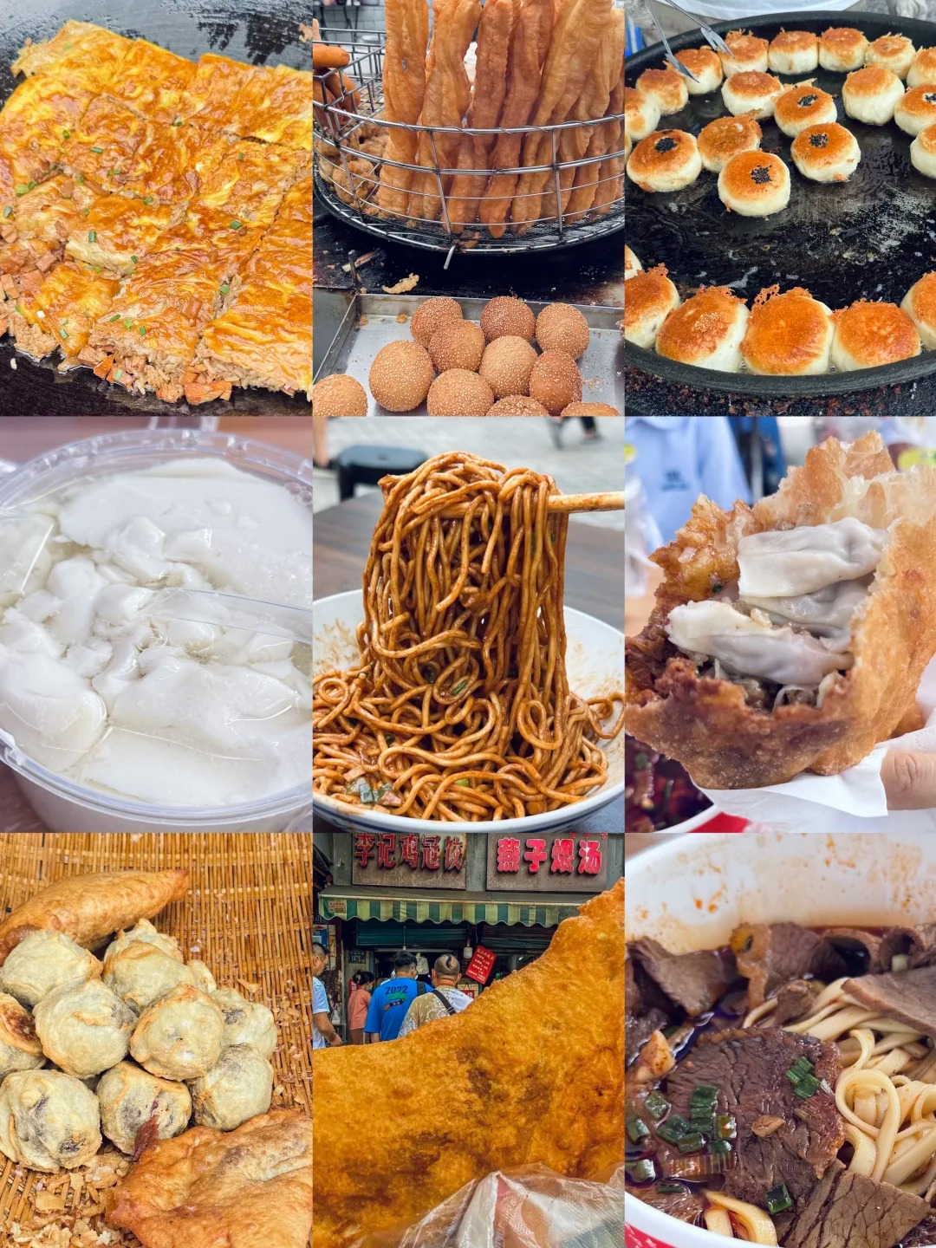
calorie bomb
dock culture
as stevedores on the docks
engage in heavy manual labor
be filling and long-lasting
to withstand hunger
As a result, Wuhan’s breakfast snacks are often heavy on oil and salt, and rich in carbohydrates.

Slide 9
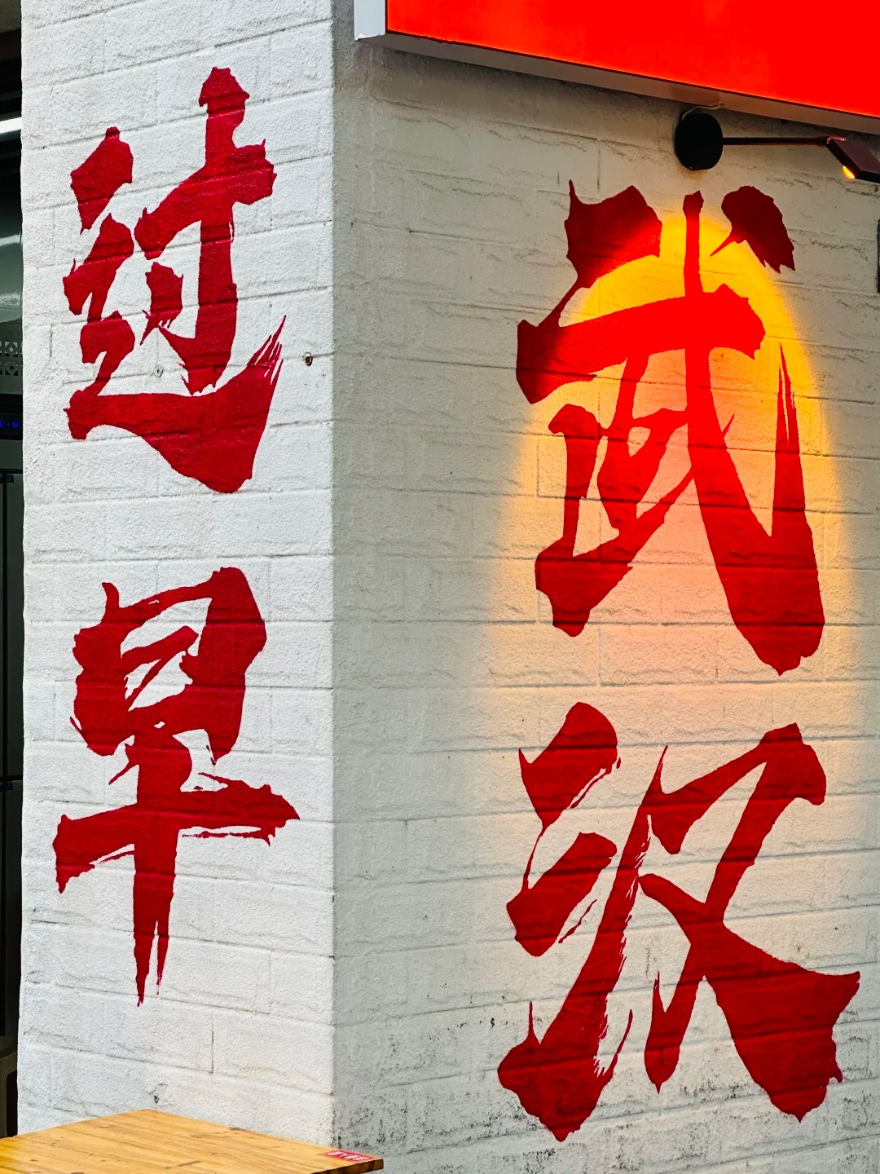
Thanks

