Slide 1

The Development
of Audiovisual Translation
Presented by Cheng Yusi 成于思

Slide 2

CONTENTS
01
Background
02
What is AVT?
03
Development
04
Discussion

Slide 3
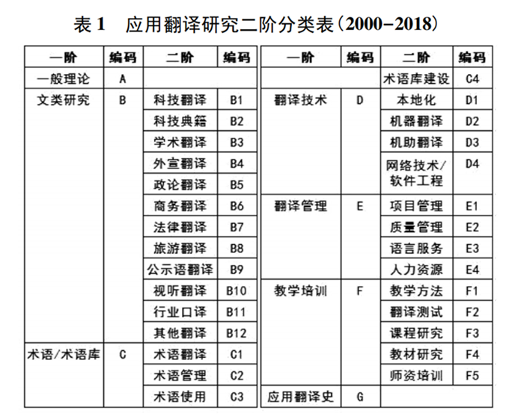
Culture
Society
Others
Economy
Economic growth promotes the emergence of new media
Multicultural environment
Background
Highly refined labor division leads to the specialization of translation
Inter-disciplinarity

Slide 4
Audiovisual Translation
Definition
Audiovisual
“Audiovisual”, used to serve as an audio-visual aid in education, now relates to texts in film and television and other audiovisual works and products. (刘大燕，2010)
Audiovisual Translation
Audiovisual translation (AVT) is a specialized branch of translation which deals with the transfer of multimodal and multimedial texts into another language and/or culture.
Type
Subtitling: shows written text on a screen that conveys a target language version of the source speech.
Dubbing: involves both the translation and its synchronization as well as dubbing the actors' and actresses' performance.
Voice-over: involves the original soundtrack and the translation being broadcast simultaneously.
Audio discription: is intended for those who are blind, visually-impaired or partially-sighted and assists by providing a narration concerning the visual aspects of a film or television show.

Slide 5

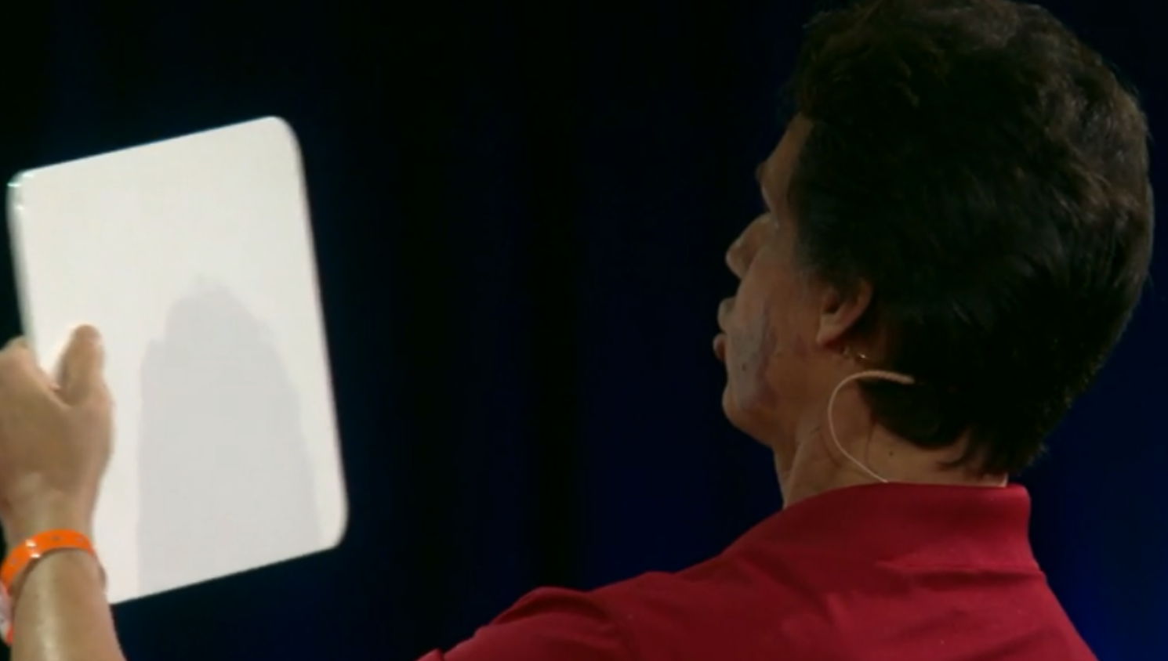
Listen and imagine how the speaker’s voice began to change?

Slide 6
Development
During the first half of 20th Century
1995
Present
Future
Film translation
Screen translation
Audiovisual translation
Focus on the quality of audiovisual texts through the lens of traditional translation theories.
Multimedia translation

Slide 7
Discussion
01
How to translate non-linguistic texts in Audiovisual Translation?
Does audio description violate the translation standards of faithfulness
and expresiveness? Which translation standards should be built?
02
How to make bilingual subtitles more accessible in spite of its instantaneity?
03
04

Slide 8
Thanks for your listening!

