Slide 1

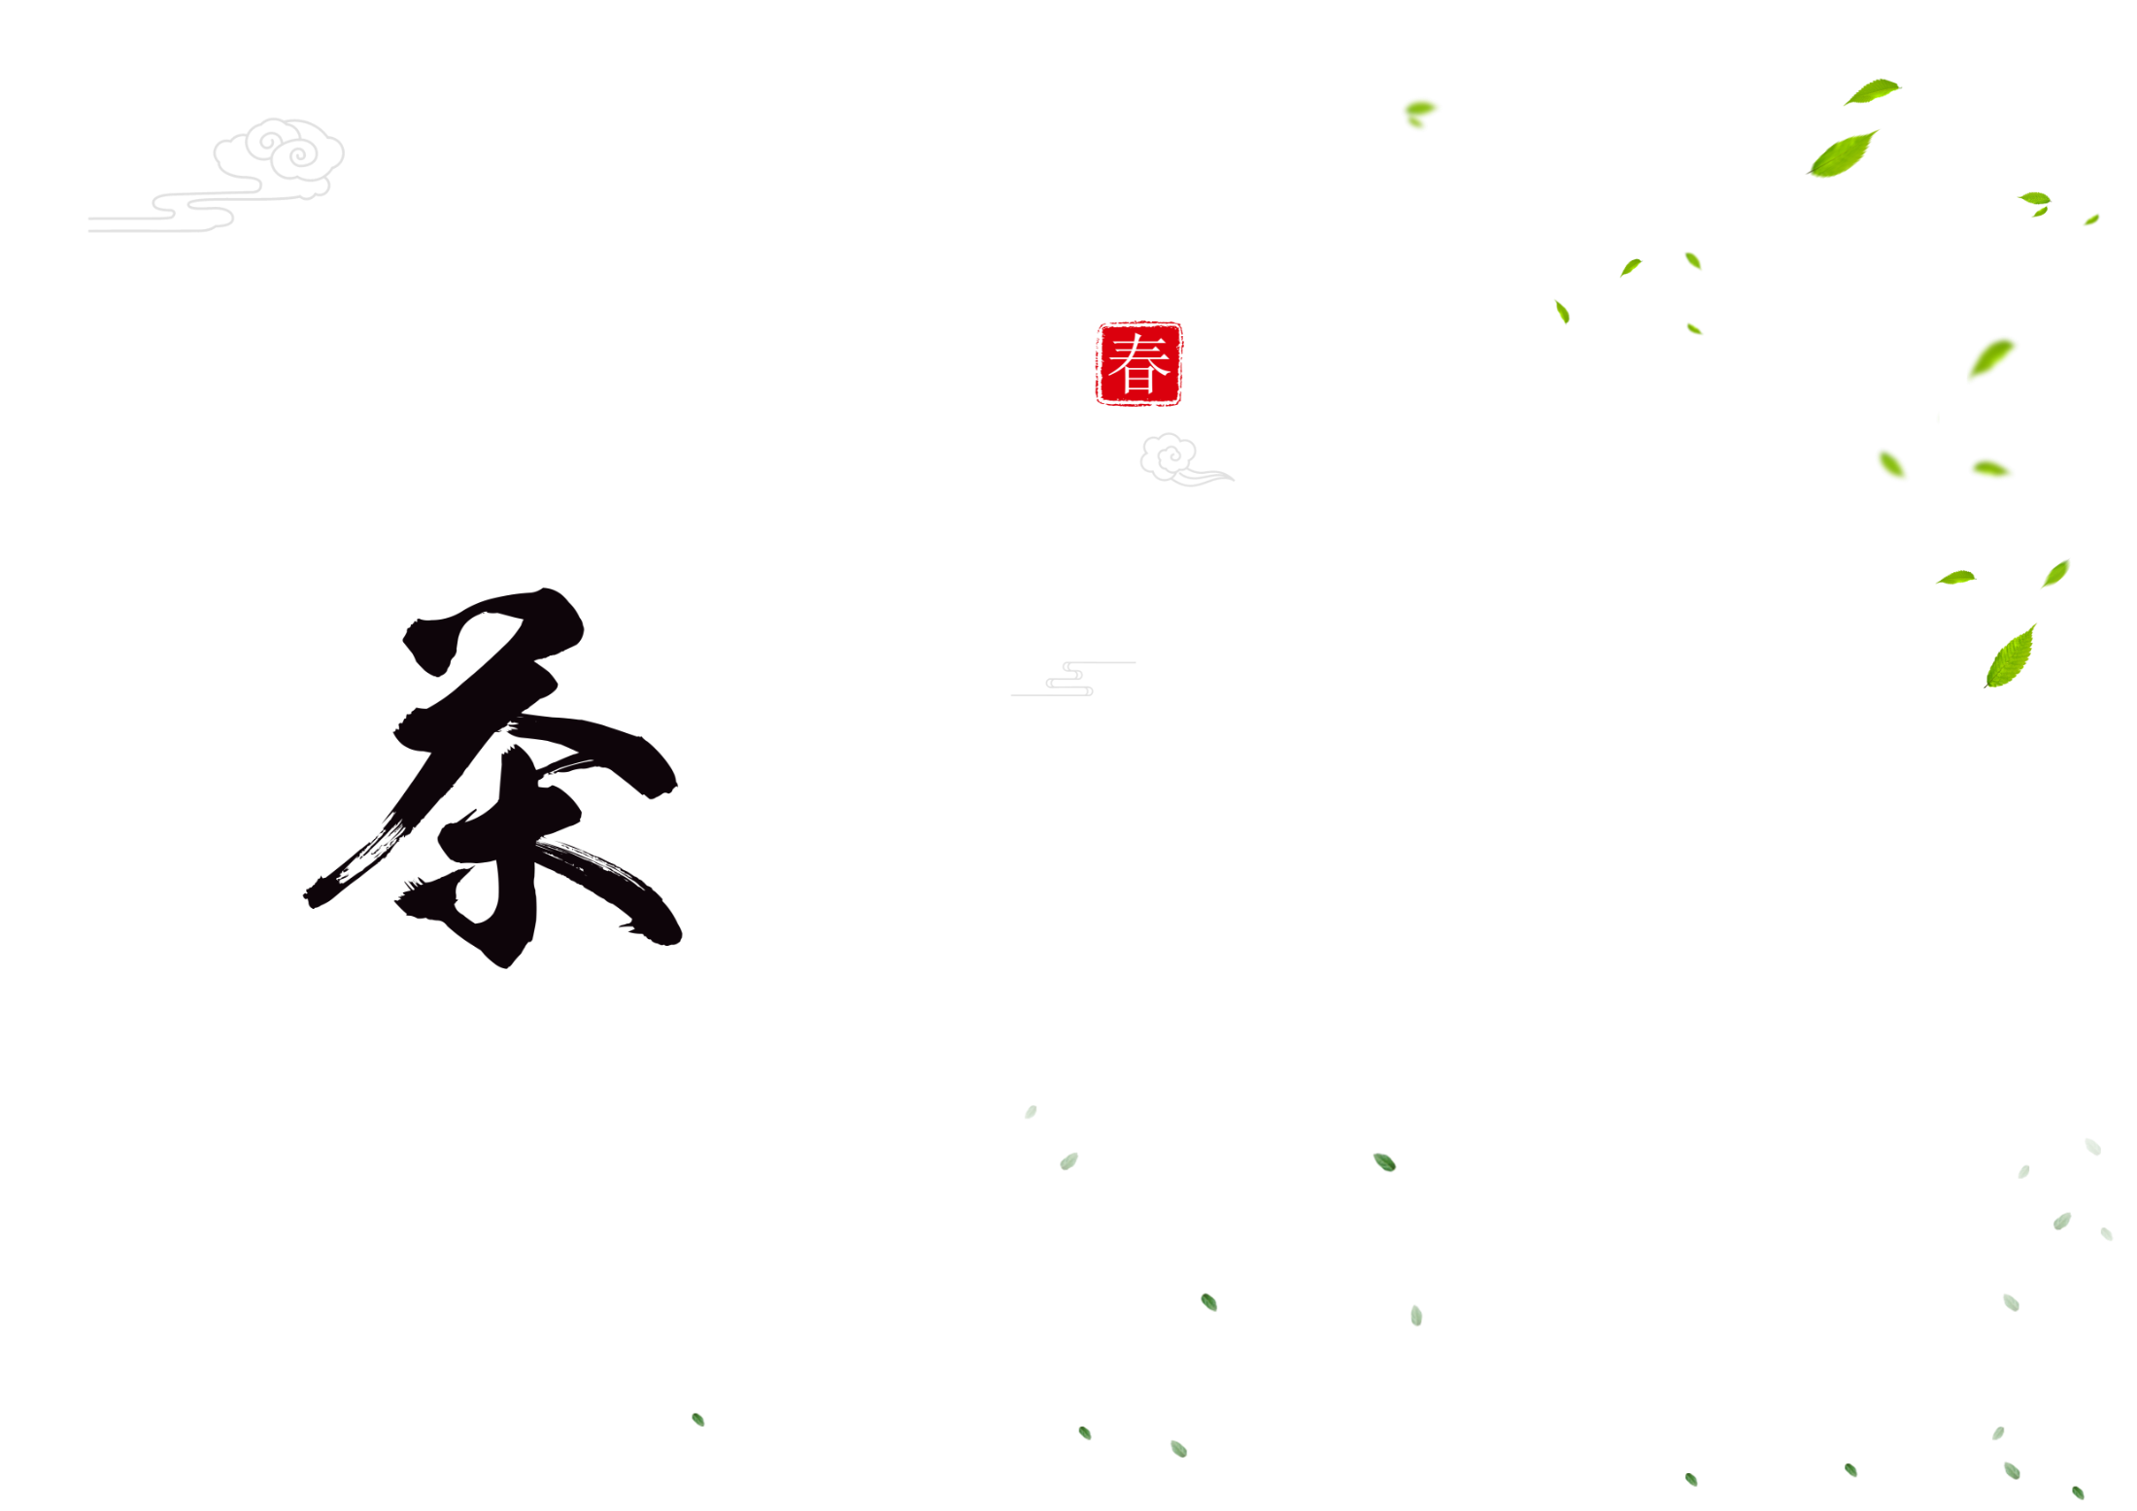
Chinese
Tea Culture
Zeng Jinquan

Slide 2
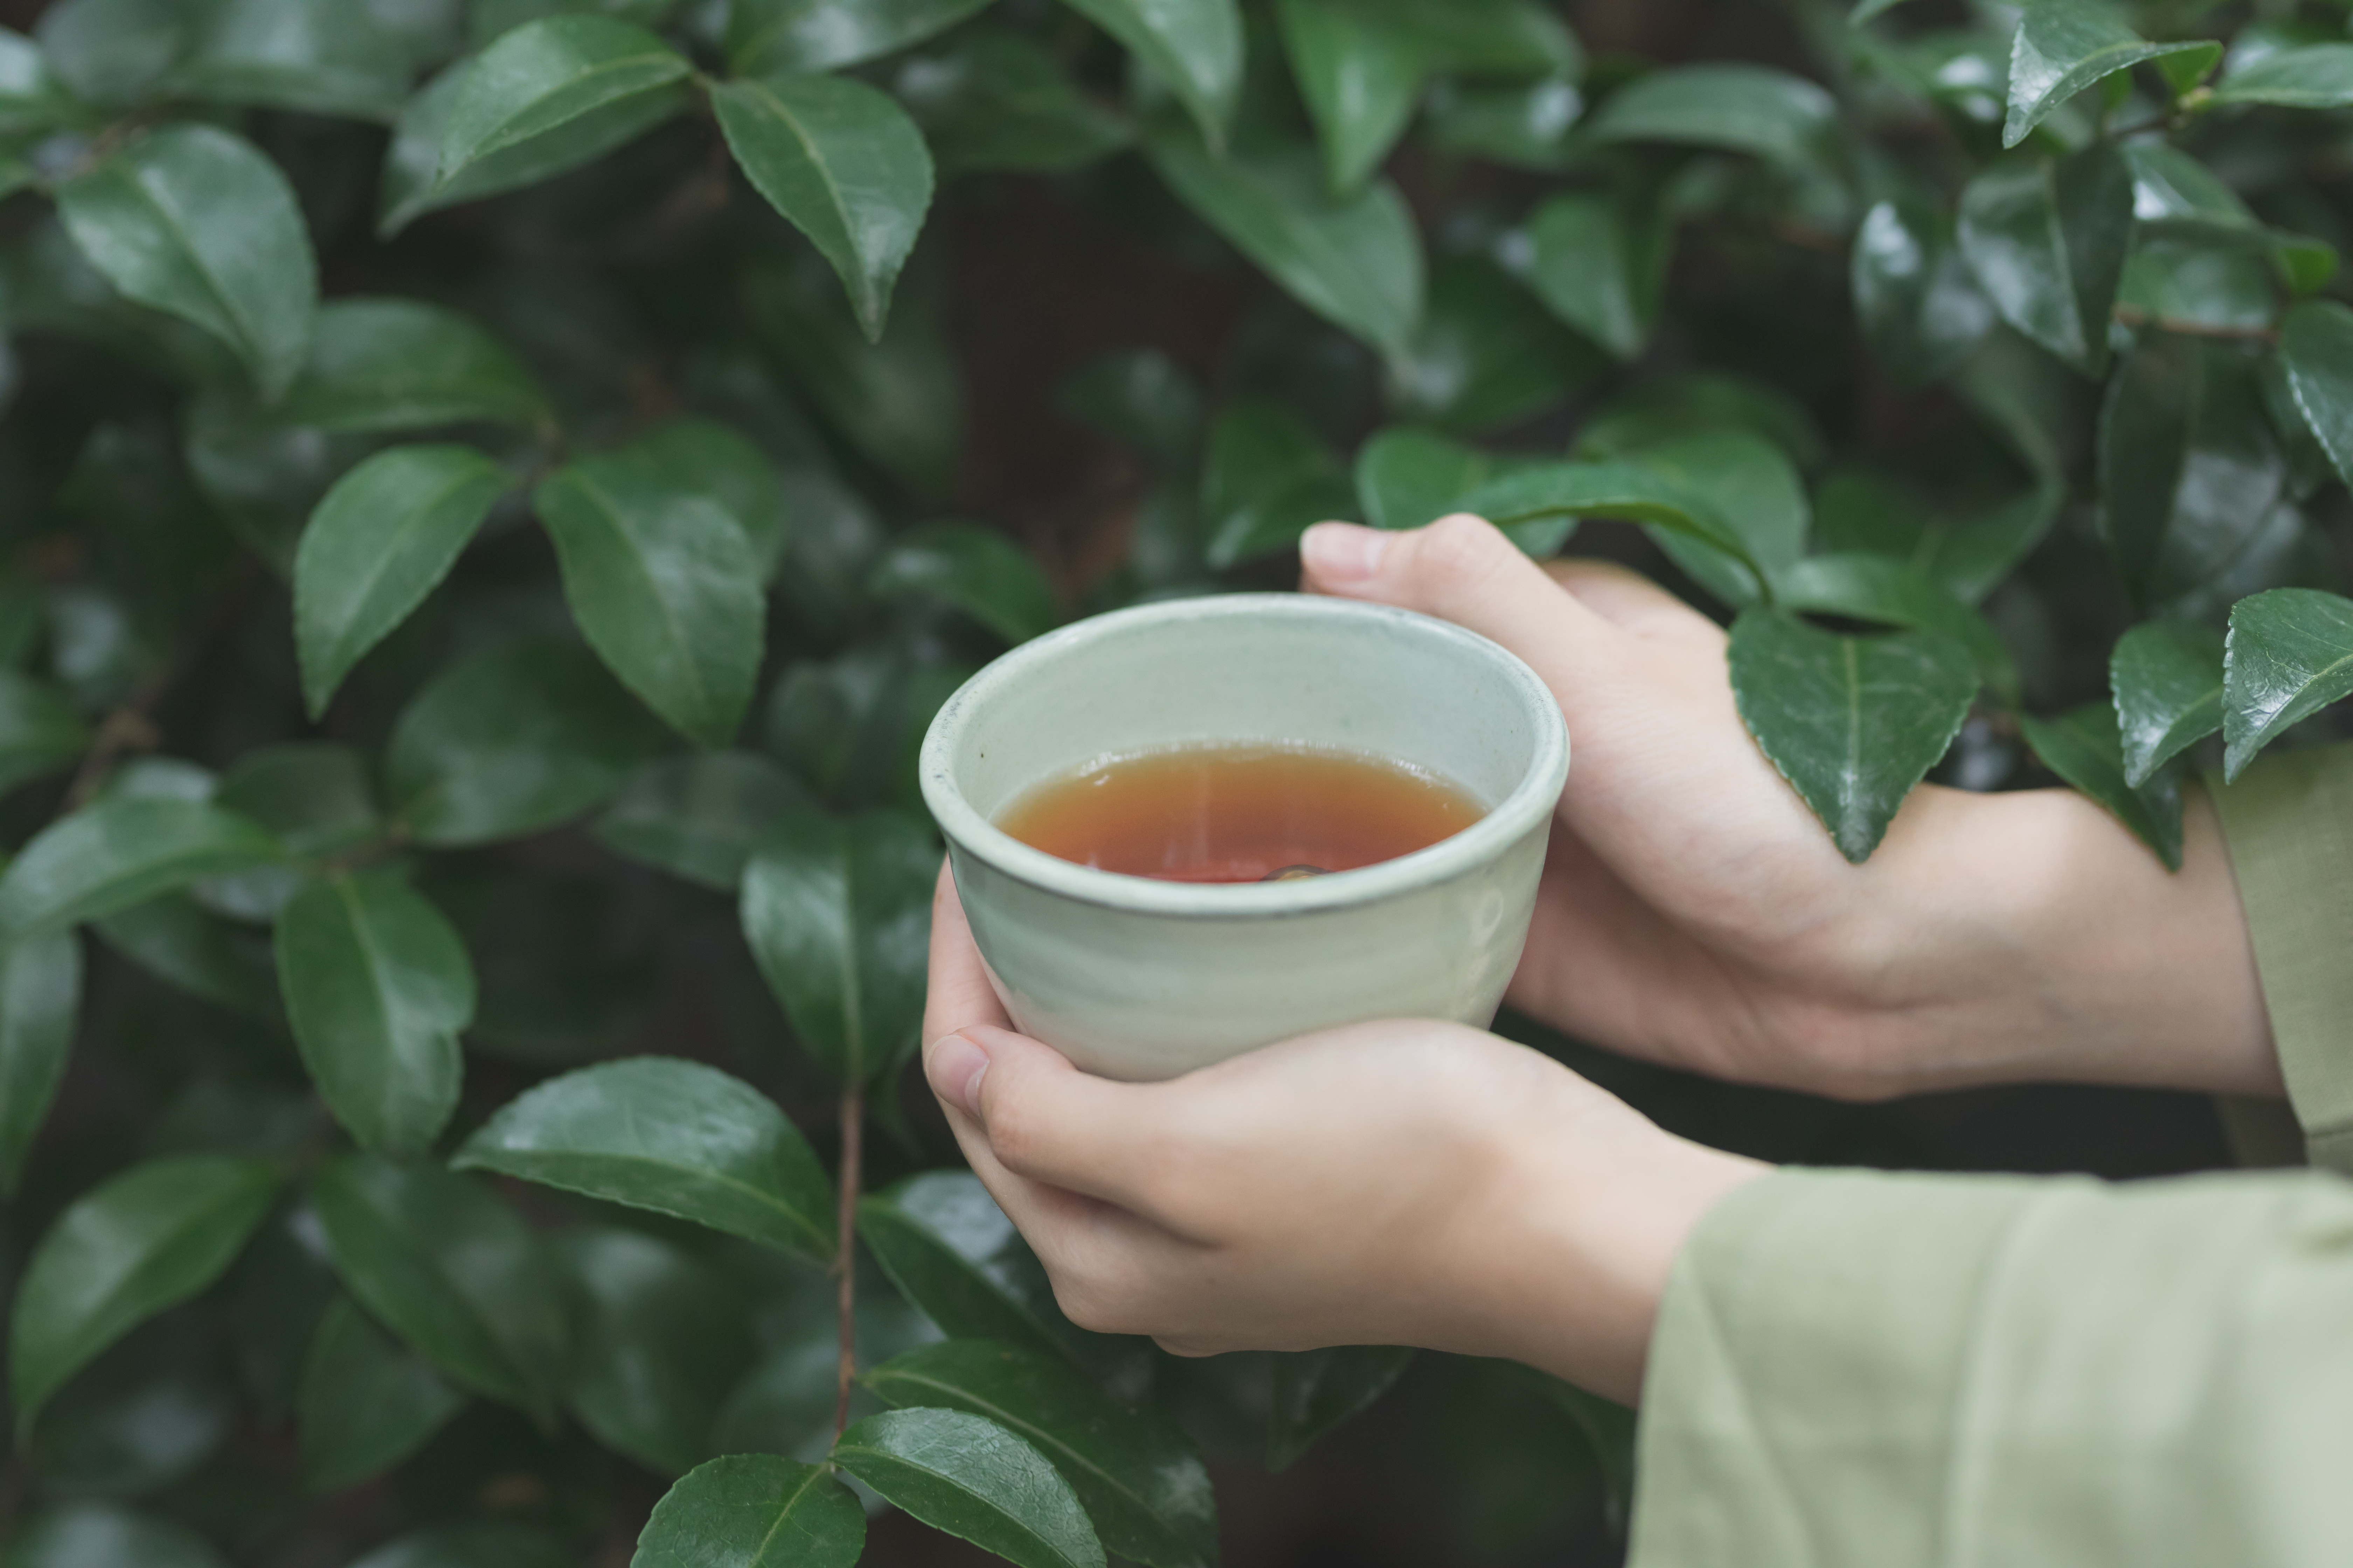
Contents
1. What is tea culture ?
2. History of Chinese Tea
3. Types of Tea
4. Tea Ceremony Spirit of China

Slide 3

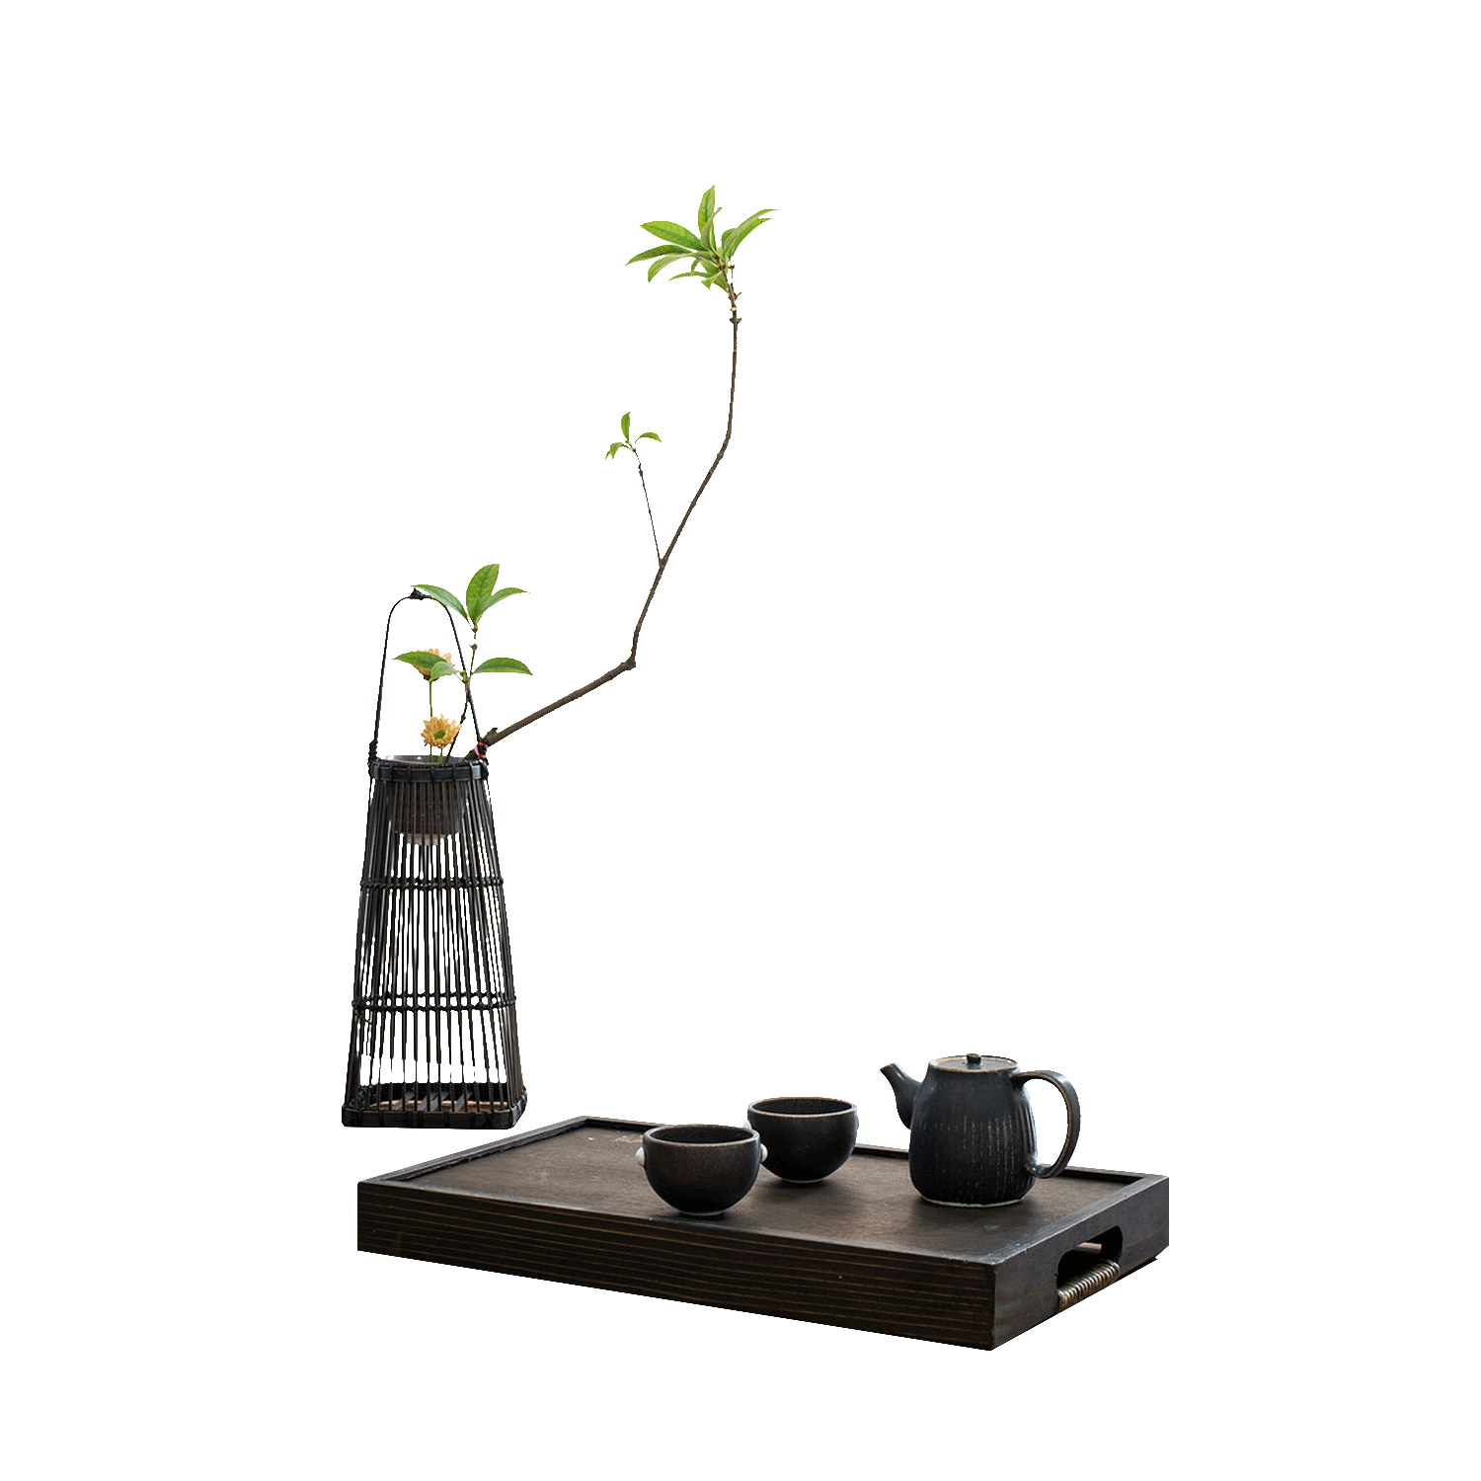
1. What is tea culture ?

Slide 4
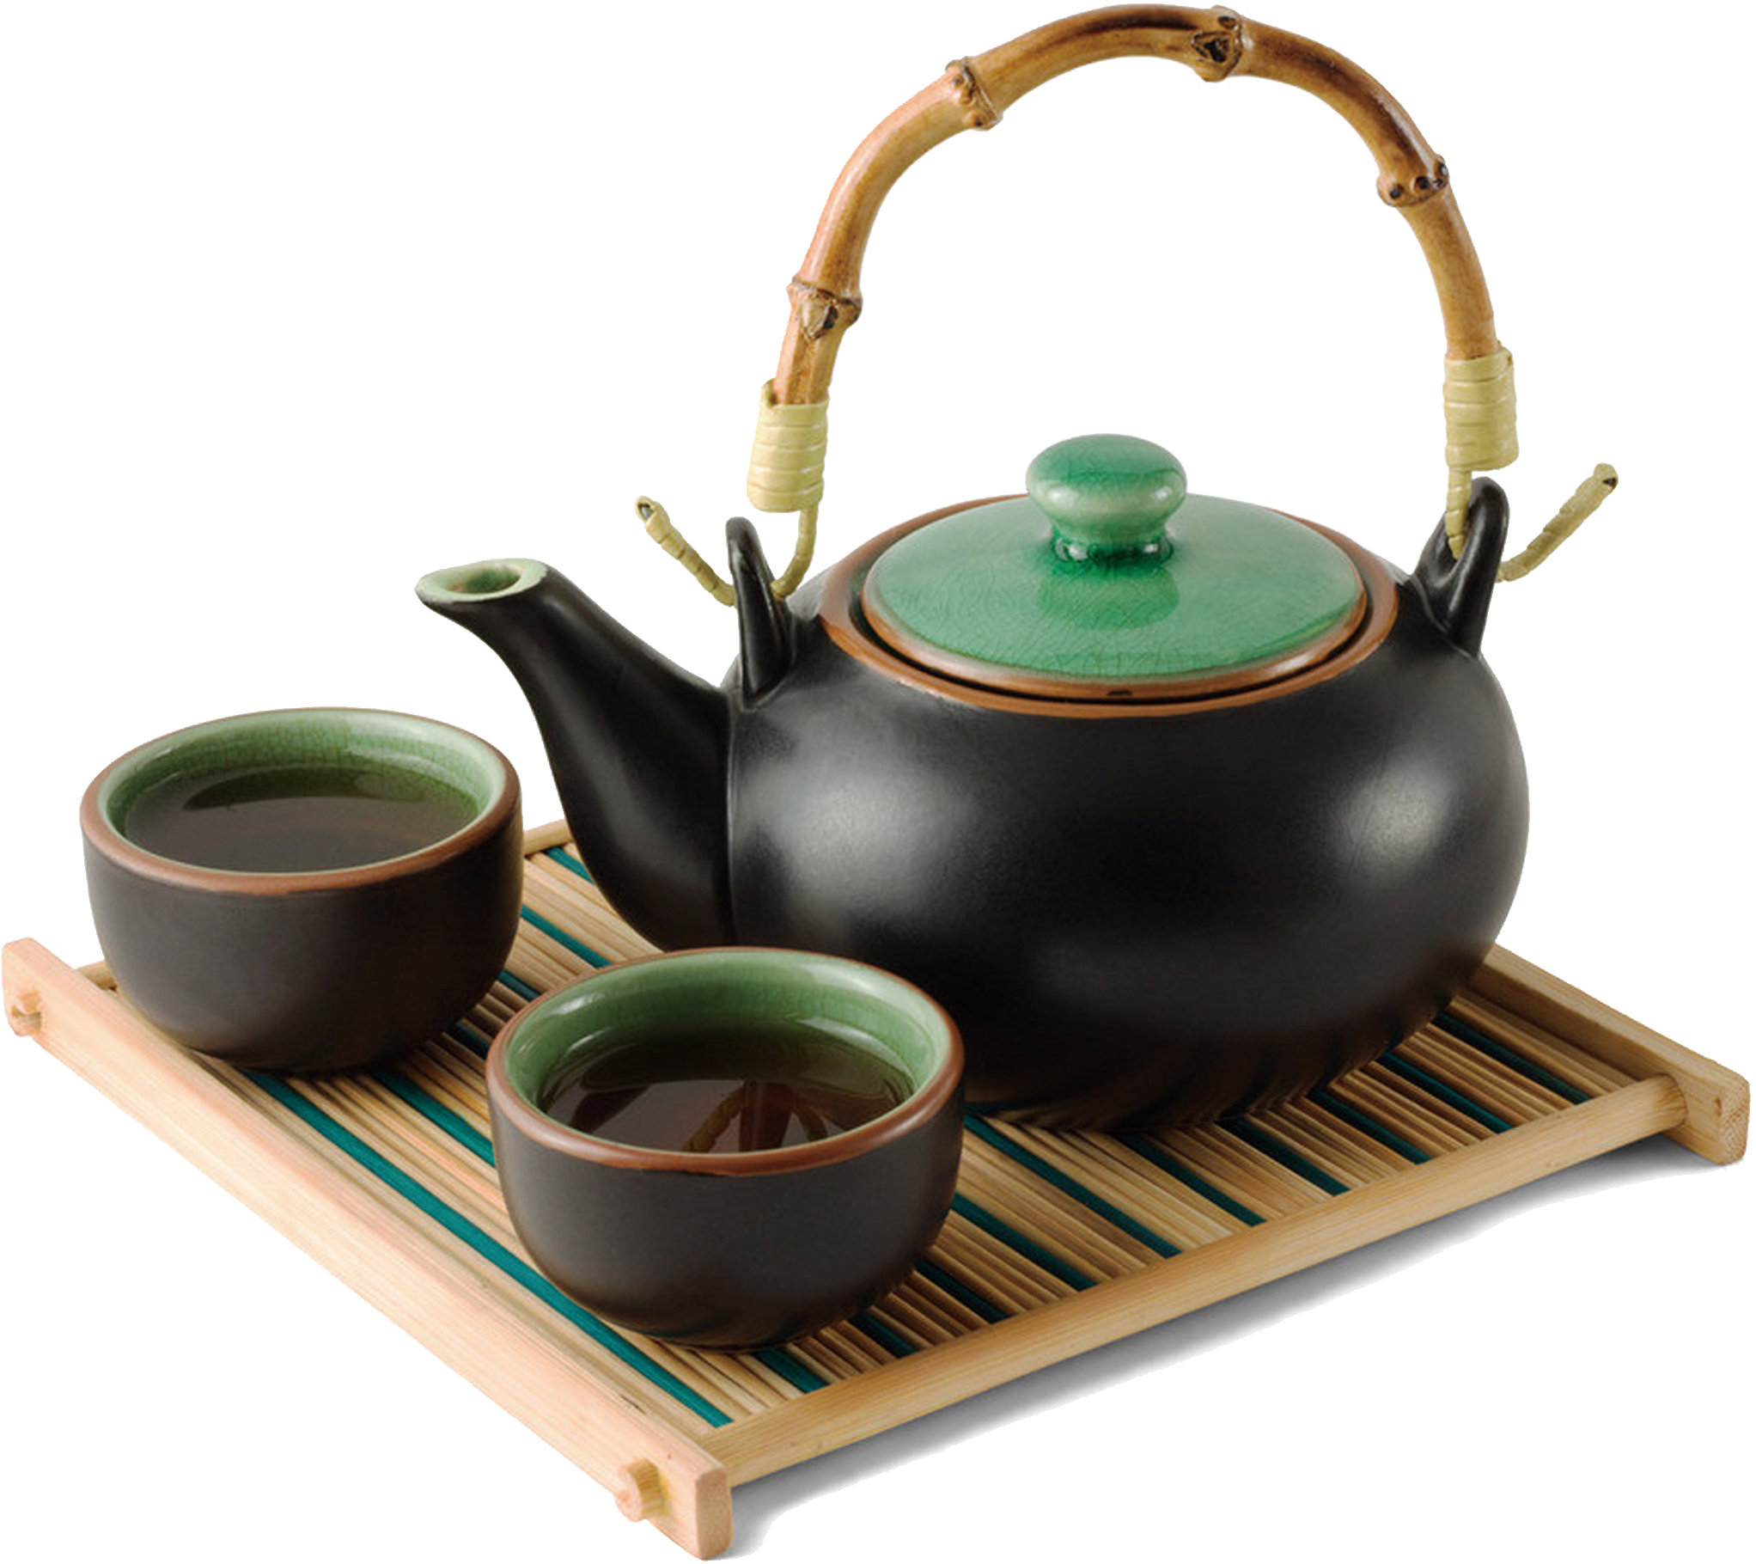
Tea culture
Introduction
Tea culture is a collection of the cultural characteristics formed in the process of tea drinking, including tea ceremony, tea spirit, tea art, tea set and so on. Tea culture originated in China, the history of which is about 4700 years. Chinese tea culture reflects the long-standing civilization and propriety of the Chinese nation.

Slide 5
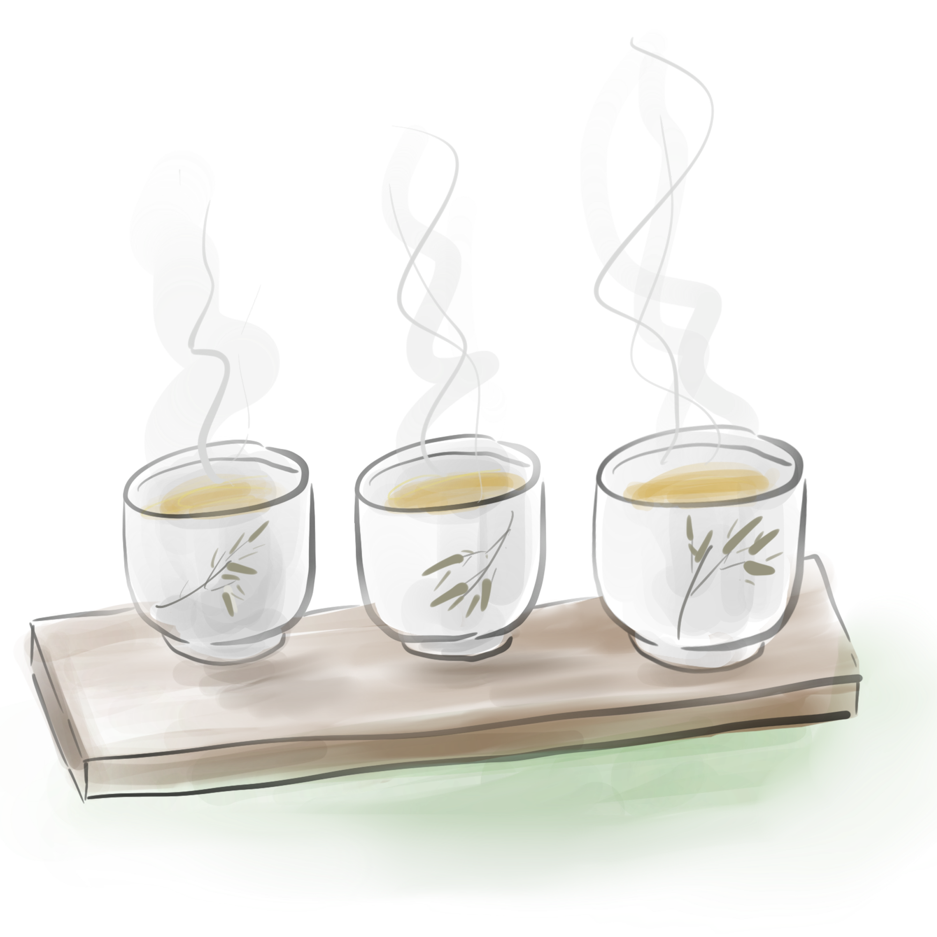
2. History of Chinese Tea

