Slide 1
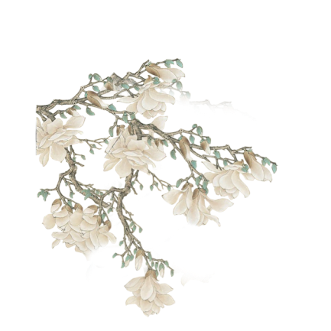
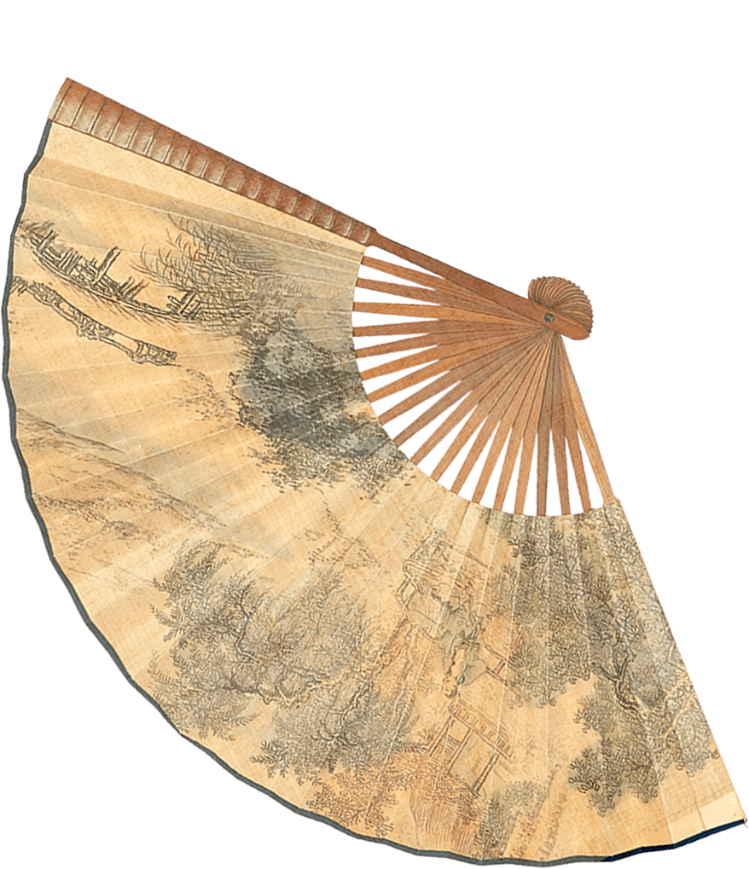
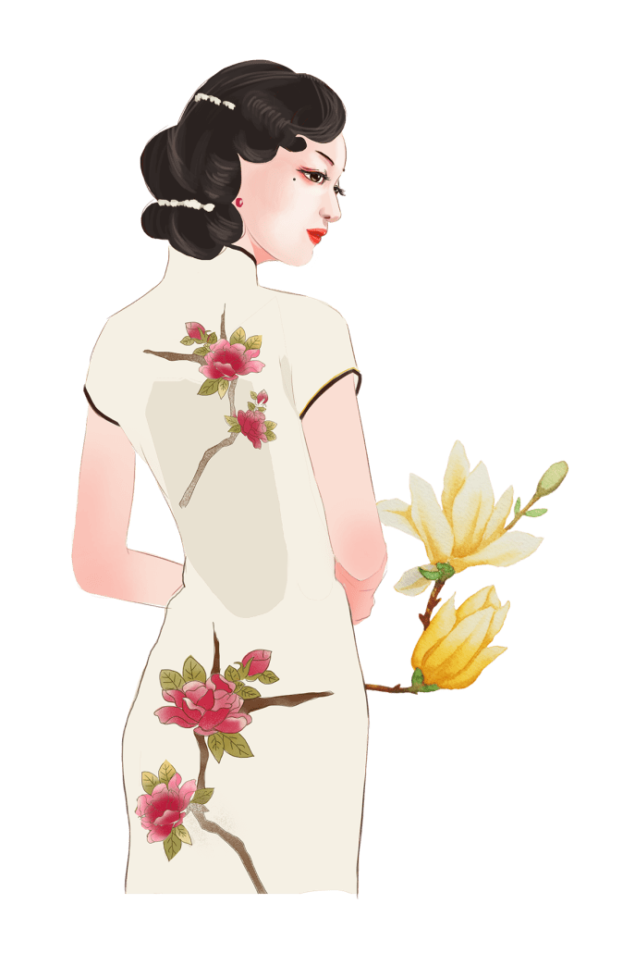

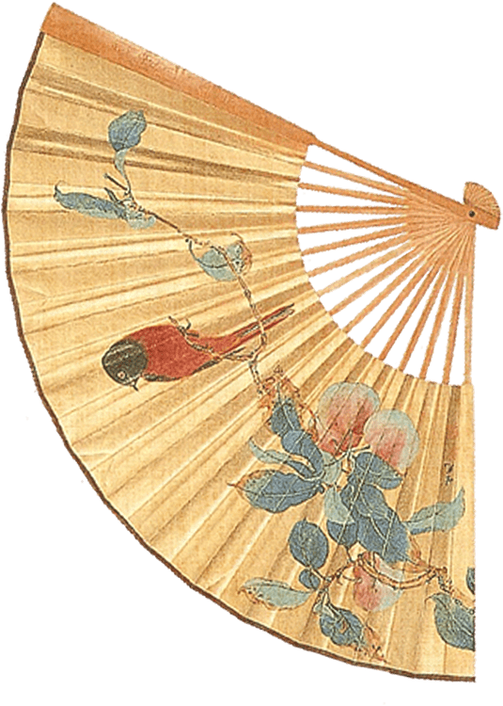
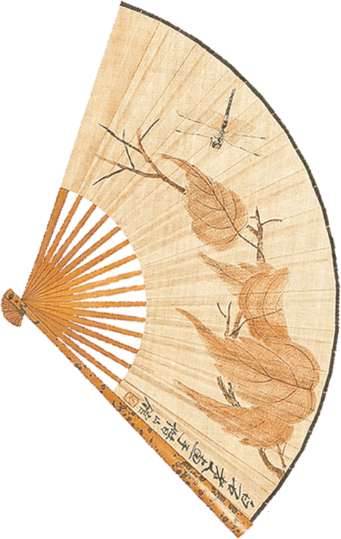

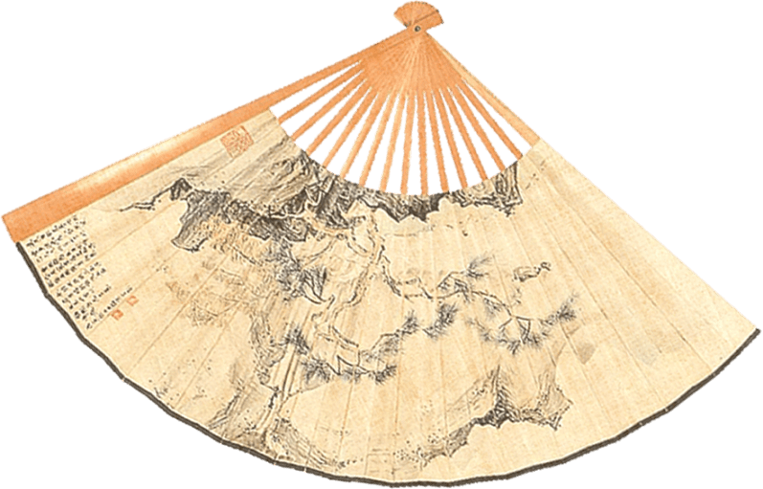
Cheongsam
Tang Yuewei
2024.9.8

Slide 2
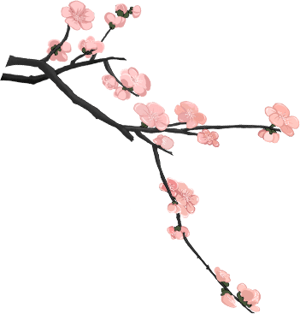
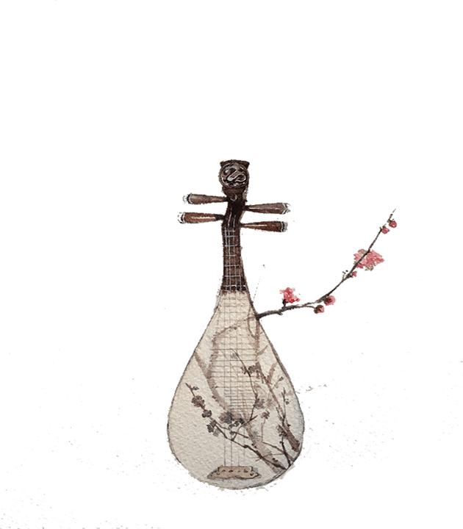
Contents
1. Terminology
2. History
3. Design and structure
4. Modern significance

Slide 3
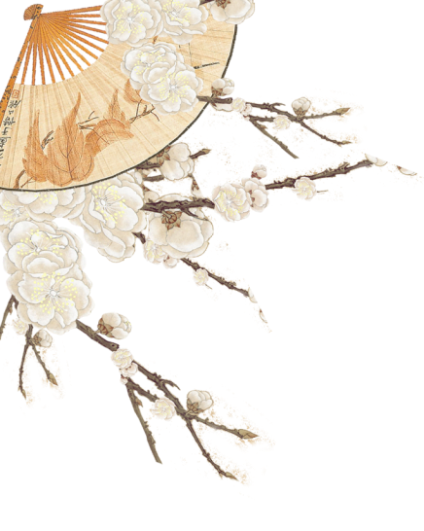

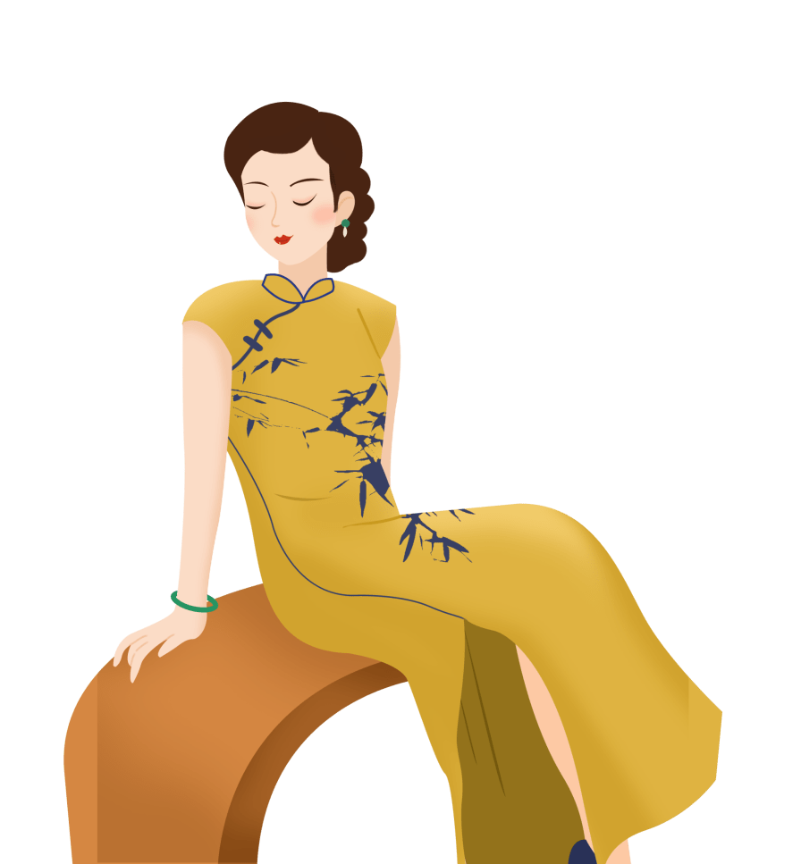
1. Terminology

Slide 4

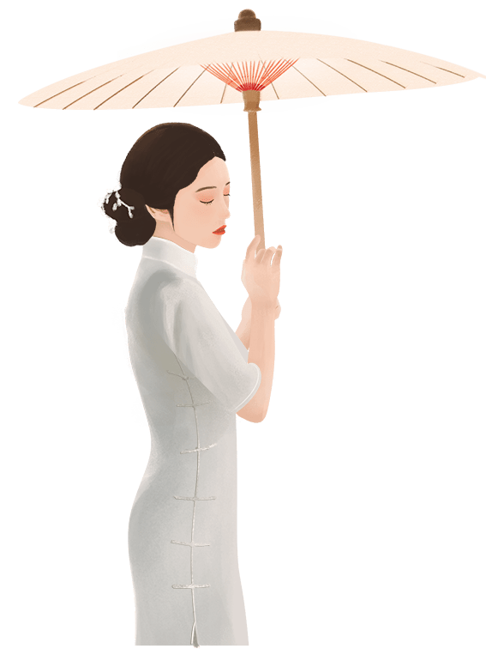
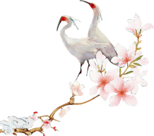
1 Terminology
English loanword: “Cheongsam” “qipao” body-hugging dress
Cheongsam is a romanization of Cantonese word chèuhngsāam (長衫; 'long shirt/dress’), which comes from the Shanghainese term zansae.
Mandarin Chinese: chángshān (長衫) male garment;
qípáo(旗袍） female version

Slide 5
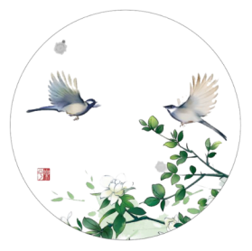
1 Terminology
Many Shanghainese tailors fled to Hong Kong after the revolution in 1949, the word chèuhngsāam became gender-neutral, referring to both male and female garments.
qipao(keipo):
“Bannerman robe”
loose-fitting, trapezoidal-cut garment Manchu men and women
became a more formal term for the female chèuhngsāam.
Usage of the term "cheongsam" in Western countries mostly followed the original Cantonese meaning and applies to the dress worn by women only.

Slide 6
2.History

Slide 7
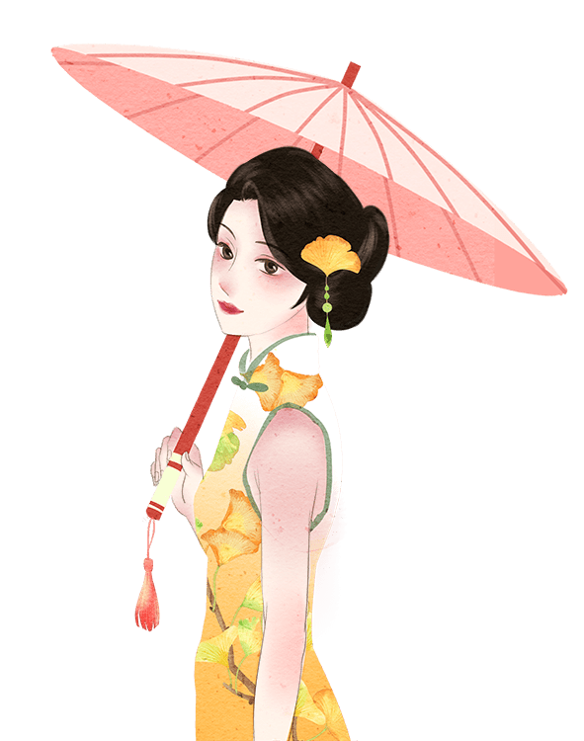
2 History
Origin
Qing dynasty
1920s
1930s
1940s

Slide 8
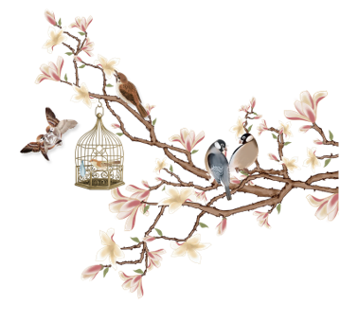
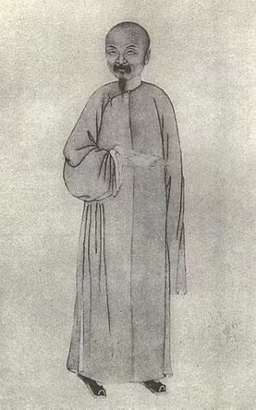
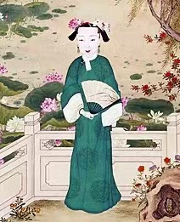
2.History
The Manchu: ethnic minority; founded the last of China’s imperial dynasties: the Qing dynasty
Administrative division: the Eight Banner system（八旗制度）
Manchu men wore Changpao（长袍）
Some imperial Manchu women wore Changfu or Changyi or Chenyi, from which Cheongsam was derived.
Notes:
1.The Manchu, and anyone living under the Eight Banners system, wore different clothing from ordinary civilians. Thus, they became known as the Banner People (Chinese: 旗人; pinyin: qírén; lit. 'banner person’).

Slide 9
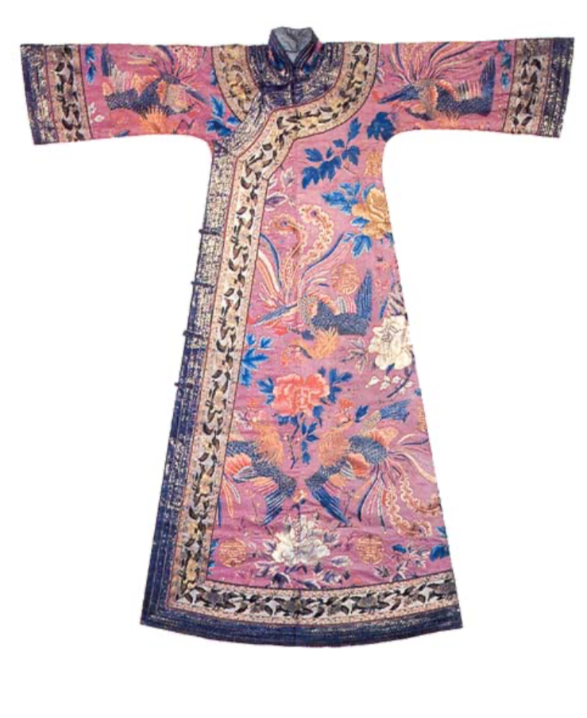
2 History
Cheongsam became popular among ladies of the royal family in the Qing dynasty.
At that time, cheongsams were fitted loosely and long enough to reach the insteps.
Usually, they were made of silk and the whole dress was embroidered, with broad lace trimmed at the collar, sleeves and edges.

Slide 10
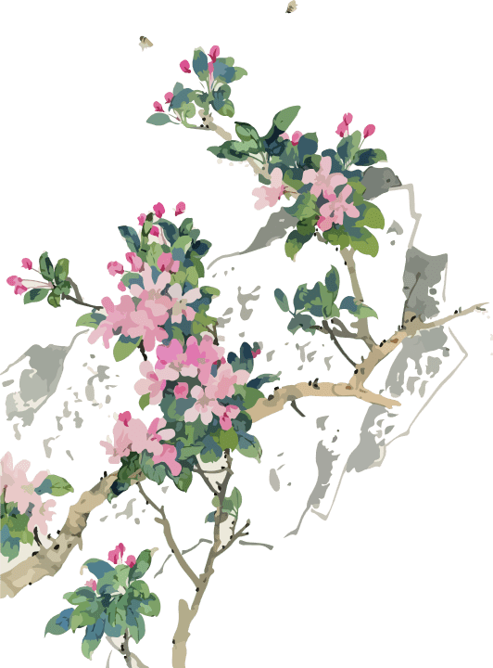
2 History
In the 1920s, cheongsam was chosen by the government to be one of the country's national dresses. Government also promulgated the new Clothing Regulations of 1929, which specified the cheongsam should be worn with trousers and be calf-length.
However, even before 1929, women had already stopped wearing trousers in favor of silk stockings. Chinese women held no respect to the rule, as it was seen as an attempt by the government to control individual rights and woman's liberty.

Slide 11
2 History
Starting from the early 1930s, there was a further transformation of the qipao as it became increasingly shorter, tighter, and body-hugging, with side slits that reached up to the thigh.
Consumer culture rose as Western and Chinese merchants cooperated to move towards early capitalism. People eagerly sought a more modernized dress style and transformed the old cheongsam to suit new tastes.

Slide 12
2 History
By the 1940s, women who wore the cheongsam were regarded by the intelligentsia as anti-traditional, independent, and free women.
The westernized cheongsam has been regarded as a symbol of female liberation. Coupled with the social atmosphere of China being invaded by foreign powers at that time, wearing the original Qing Dynasty cheongsam was considered as feudal and reactionary.
All of this led to the cheongsam eventually breaking away from the Manchu clothing system and starting to form its own style. This trend spread from Shanghai to the whole of China, making the cheongsam the main garment for urban women and intellectual young women in China.

Slide 13
3.Categorization and Structure

Slide 14
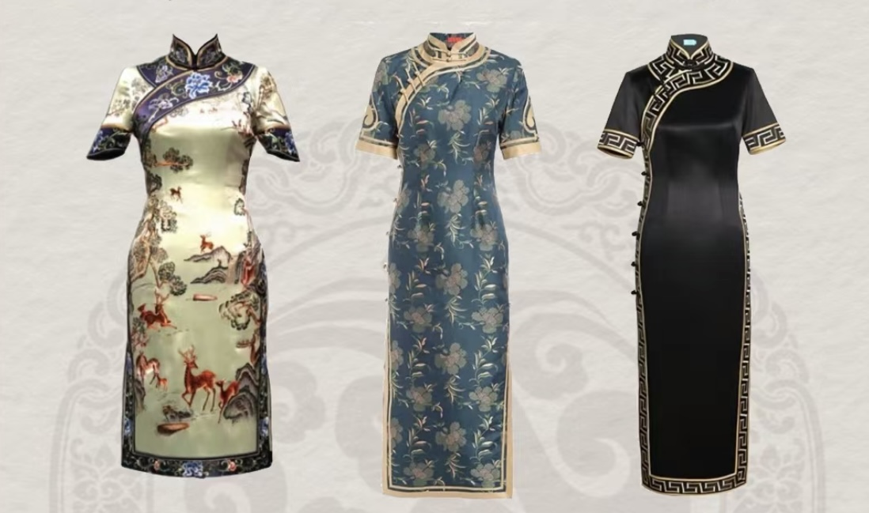
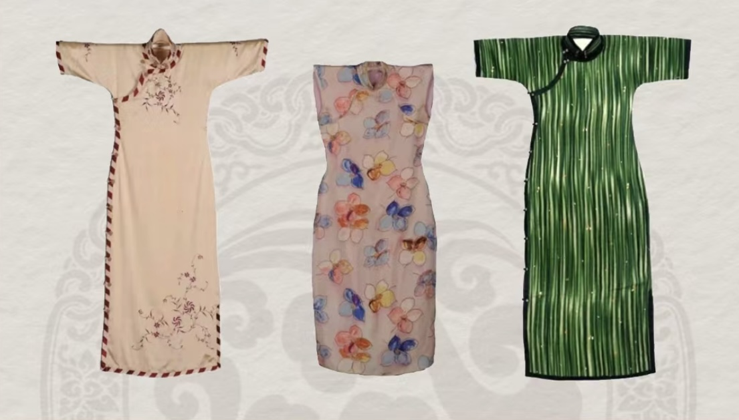
Categorization
Beijing-style Cheongsam
Shanghai-style Cheongsam
Notes:
Beijing: influenced by imperial culture, it’s more noble, elegant and grand
Shanghai: combine western tailoring techniques with Chinese elements. It focuses on the smoothness of the lines and the overall harmony.

Slide 15
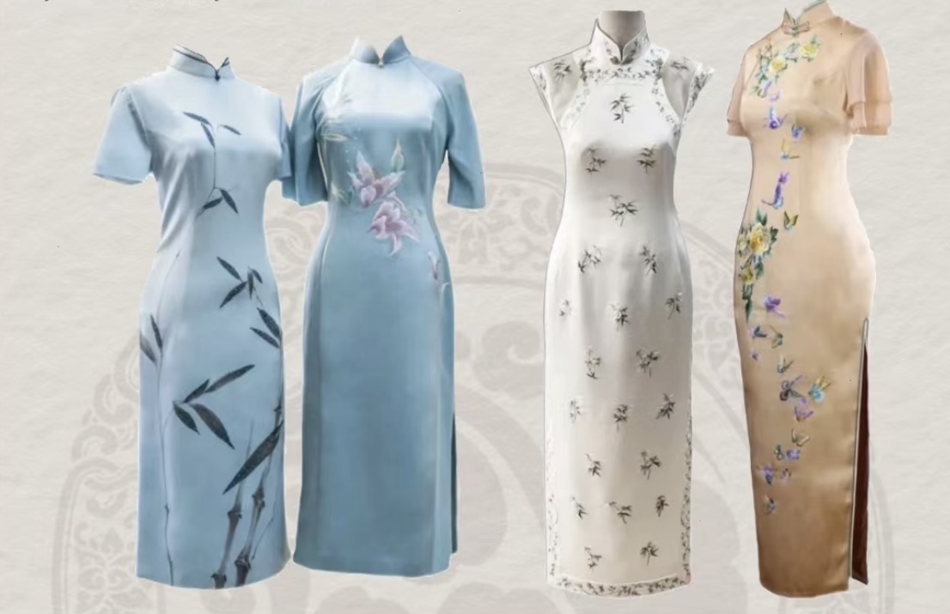
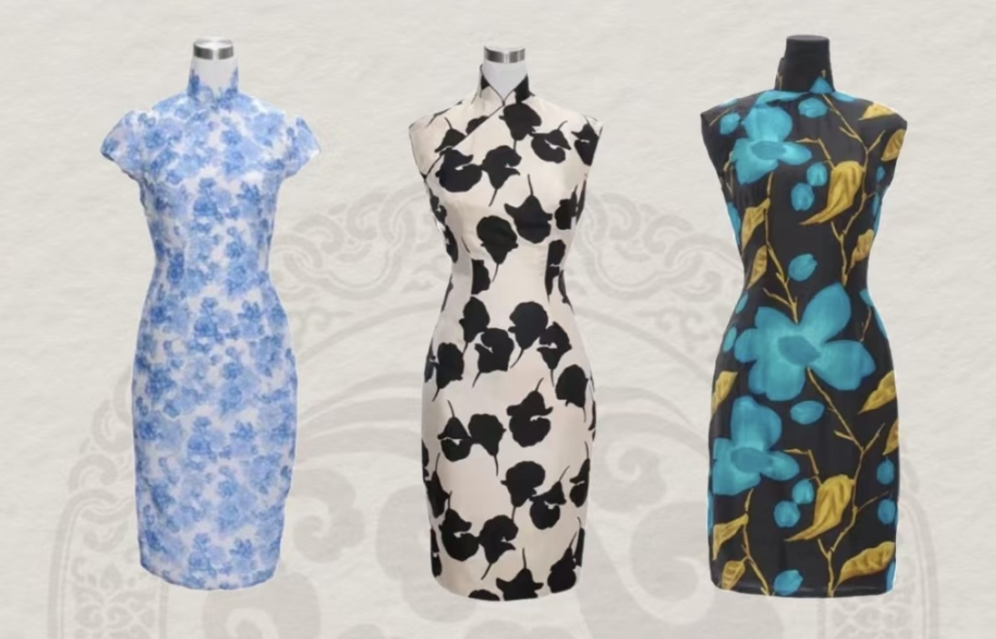
Categorization
Jiangnan-style Cheongsam
Hong Kong-style Cheongsam
Notes:
Jiangnan style: The design style is classical, graceful and restrained. It represents the charm of Jiangnan region.
Hong Kong style: The design style is simple, practical and neat.

Slide 16
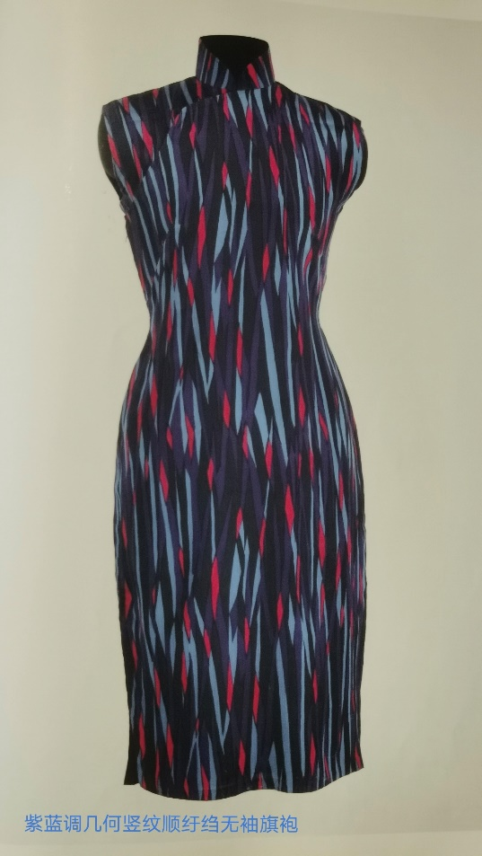
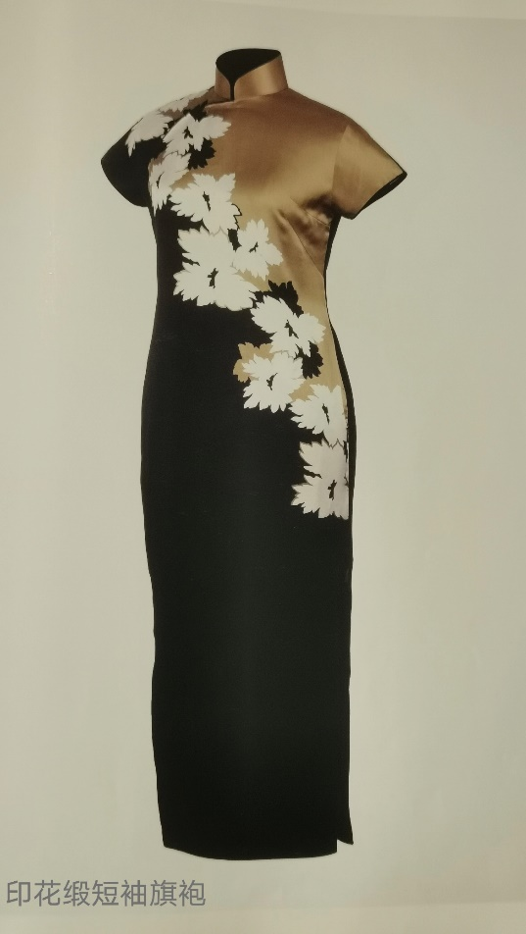
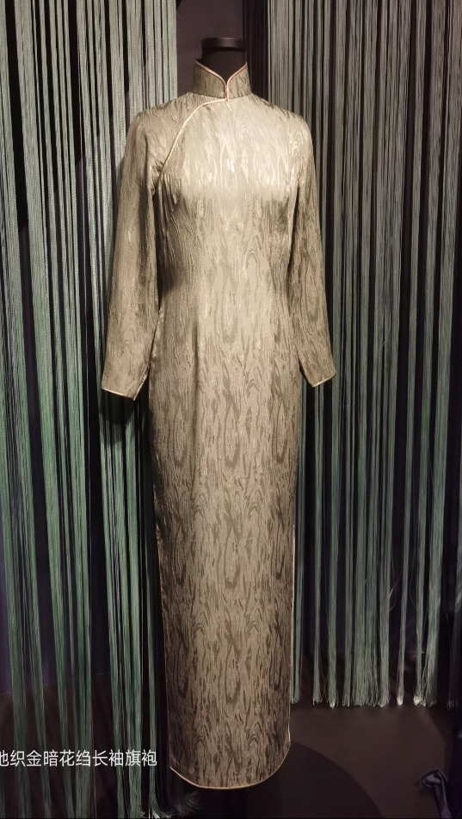
Construction
Sleeveless
Short sleeves
Long sleeves

Slide 17
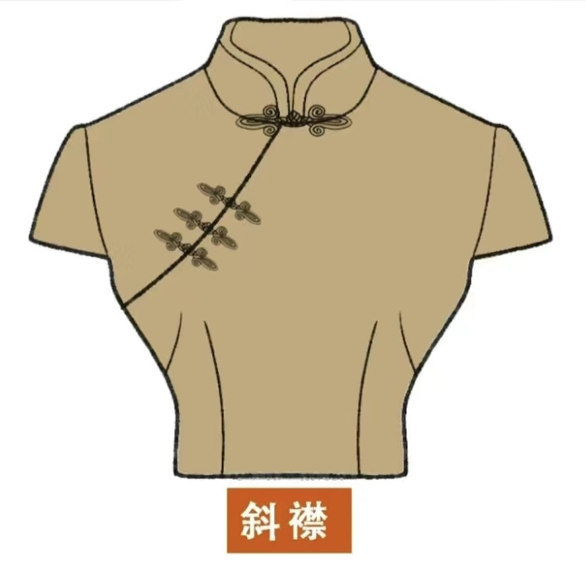
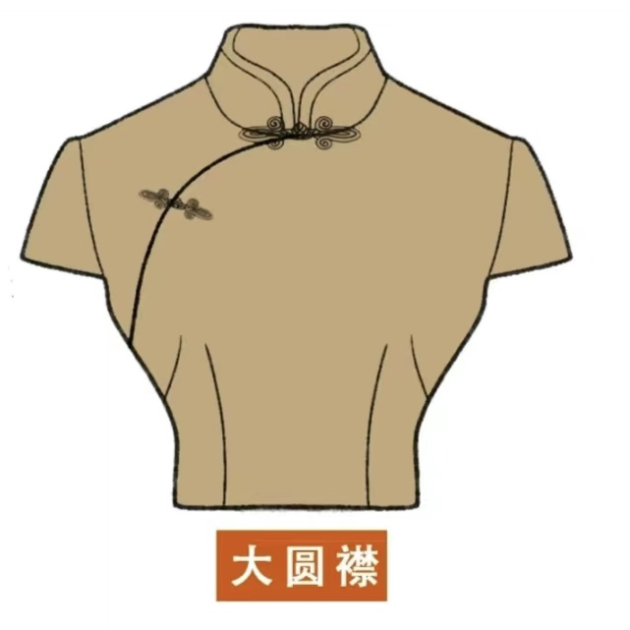
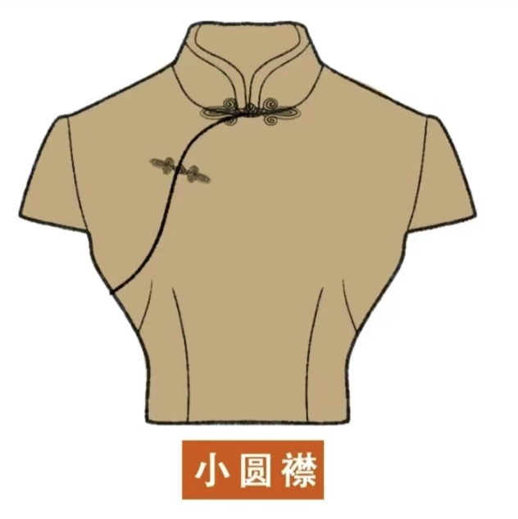
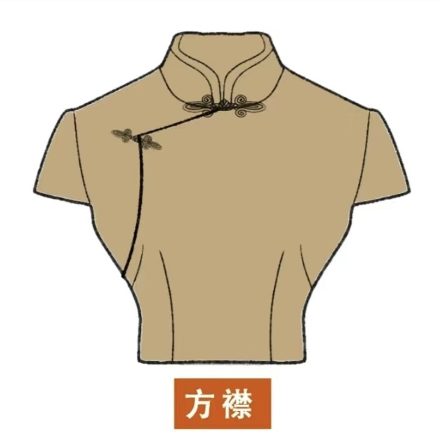
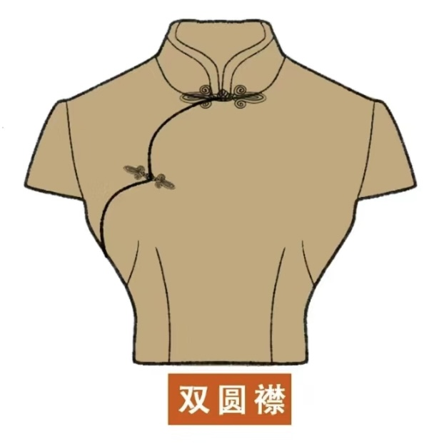
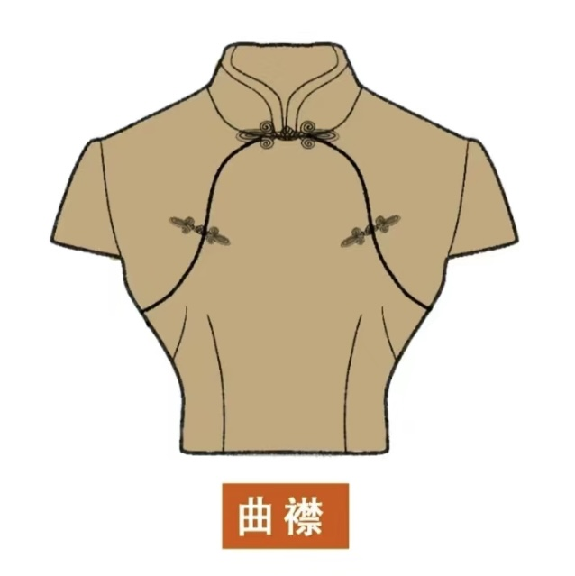
Slanted front Big round front small round front
Square front Double round front Double front

Slide 18
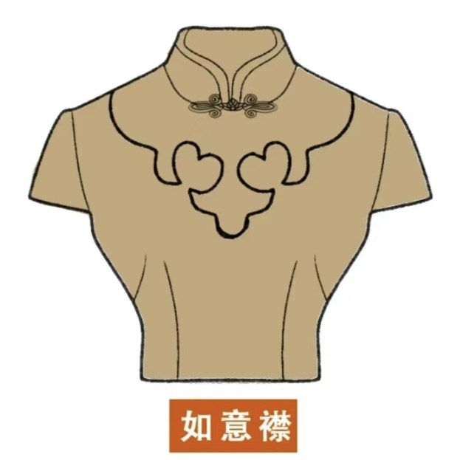
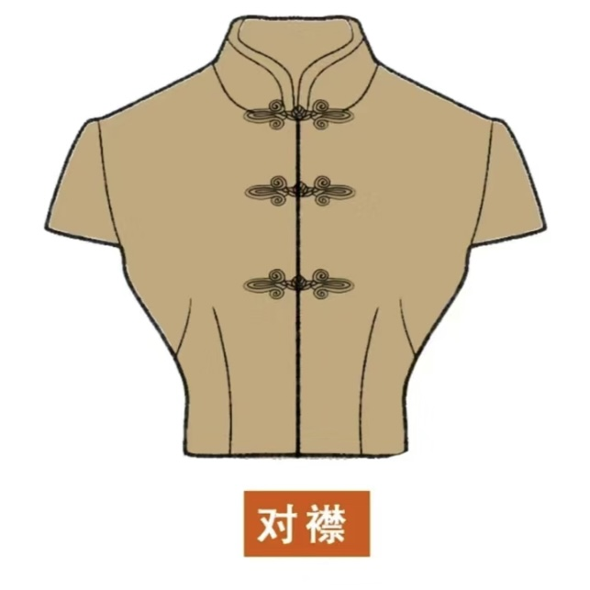
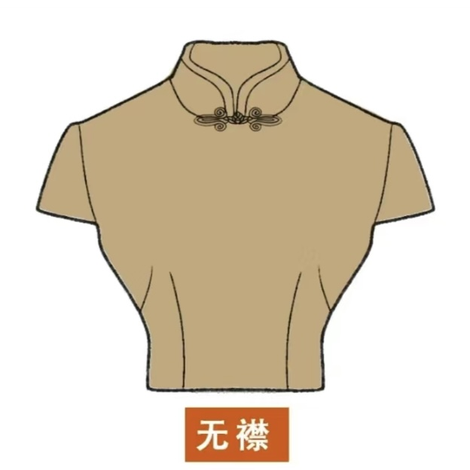
Jade-shape front Asymmetric front No front

Slide 19
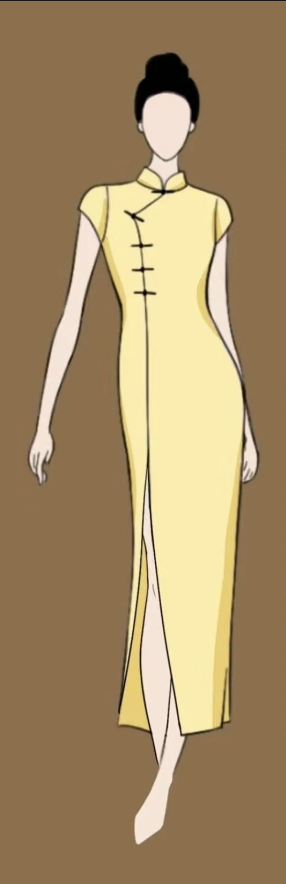
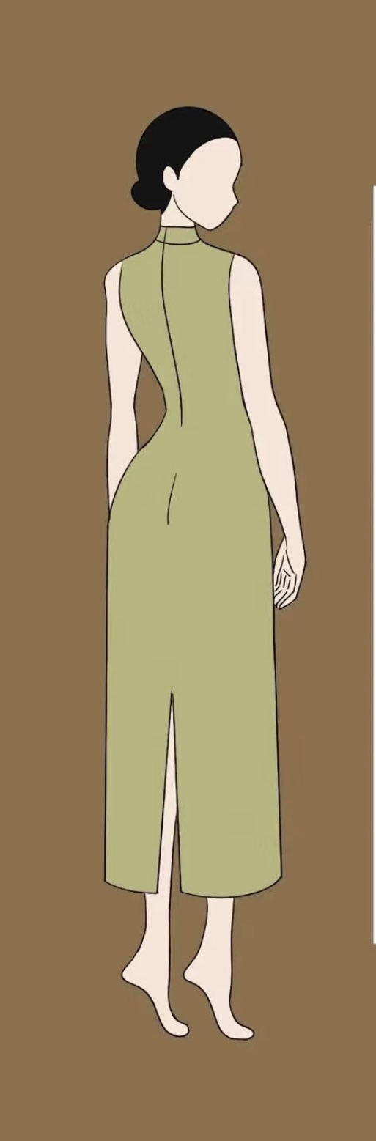
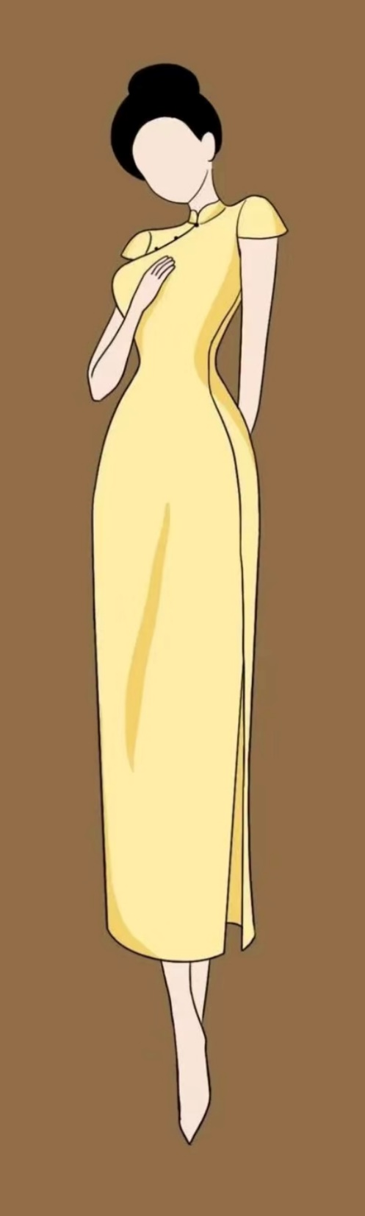
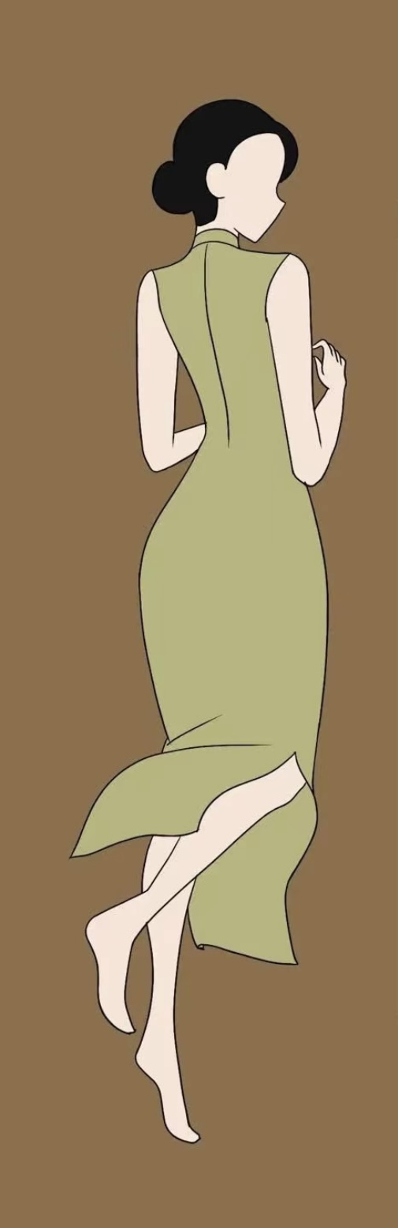
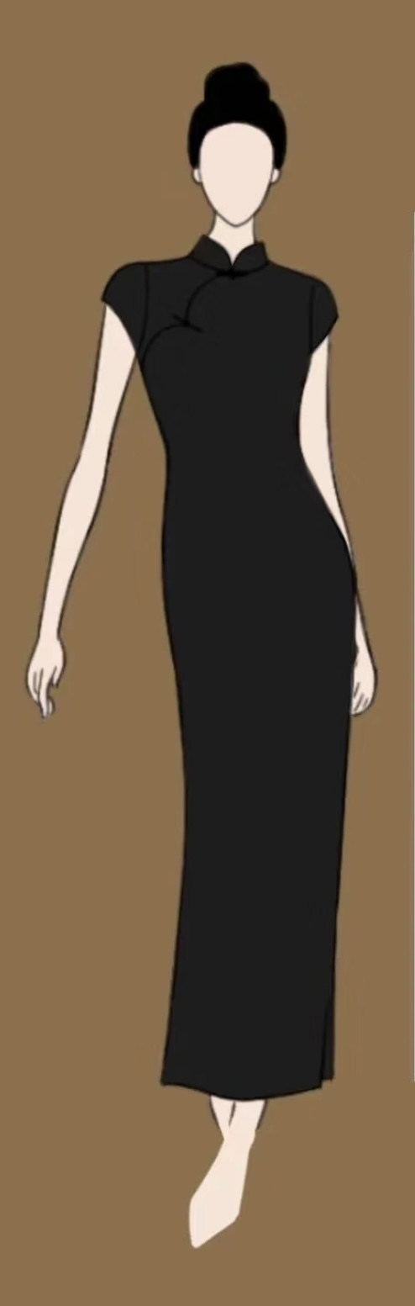
Front slit
Back slit
Side slit
Slit on both sides
No slit

Slide 20
4.Modern significance

Slide 21
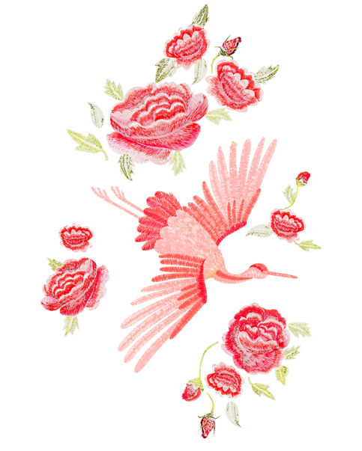
4 Modern significance
Intangible cultural heritage
Authenticity as ethnic wear
International fashion

Slide 22
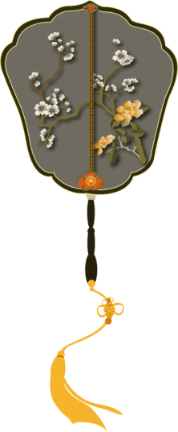
Intangible cultural heritage
Due to its long history dating back to the Manchu clothing of the early Qing dynasty, the Beijing-style cheongsam-making technique is listed as a city-level intangible cultural heritage.
The Hongkong Cheongsam-making technique incorporates both Eastern and Western clothing designs. Therefore, in 2021, Hong Kong cheongsam making technique was successfully listed on the fifth National List of Intangible Cultural Heritage.

Slide 23
Authenticity as ethnic wear
In Western countries, the cheongsam is widely perceived as being a quintessential Chinese garment. But the cheongsam is actually a type of Chinese clothing which was developed in the 20th century under the influences of several cultures, including Western culture, Manchu culture, and the Han Chinese culture. Descendants of Chinese immigrants or overseas Chinese in Western countries may wear cheongsam on events such as weddings, graduation ceremonies and other occasions.

Slide 24
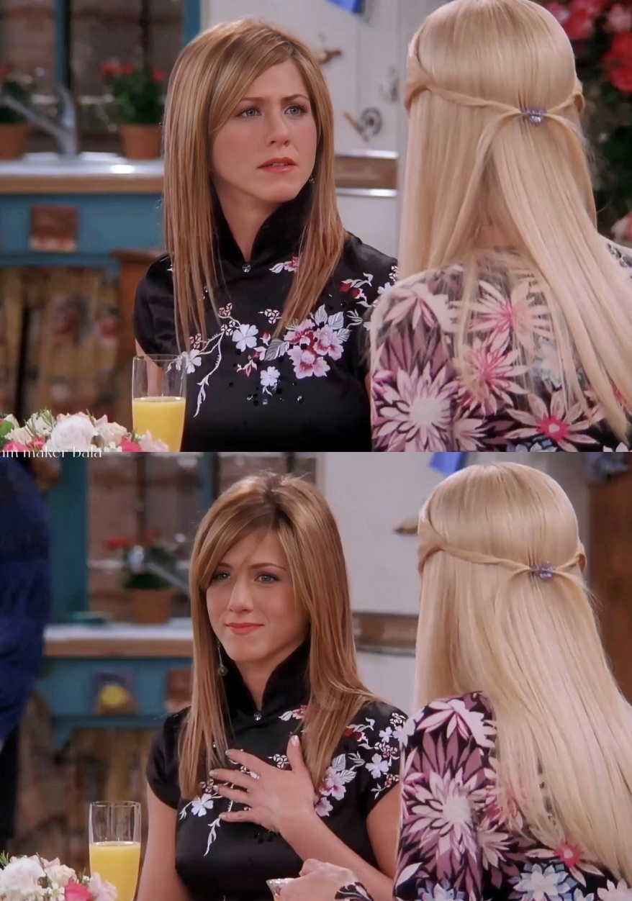
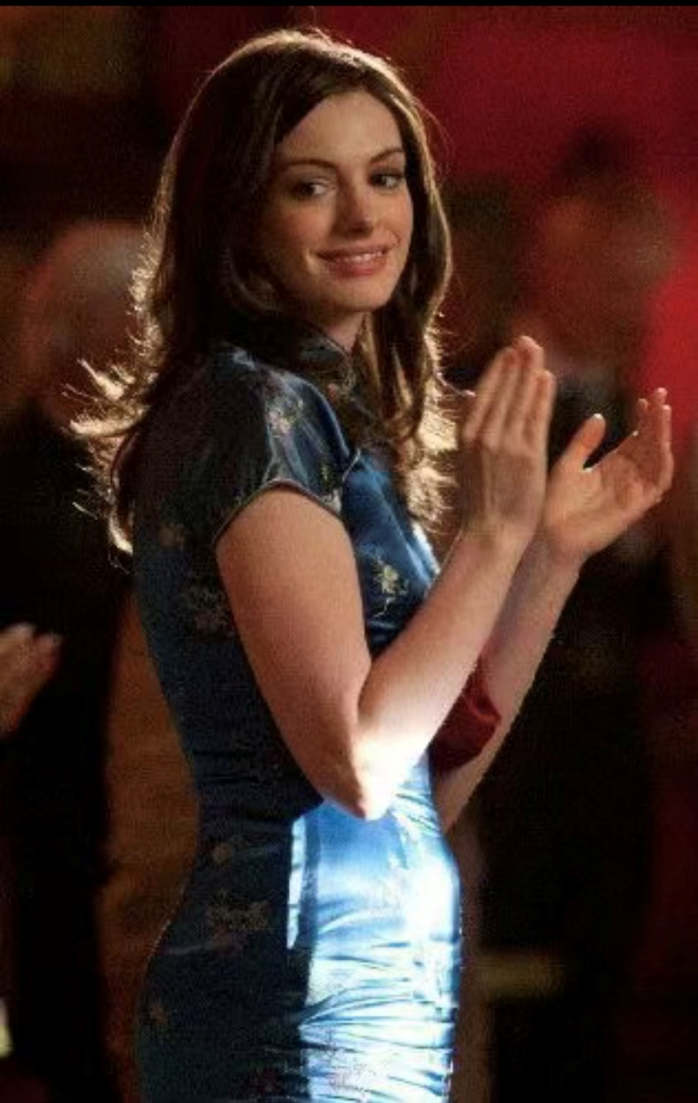
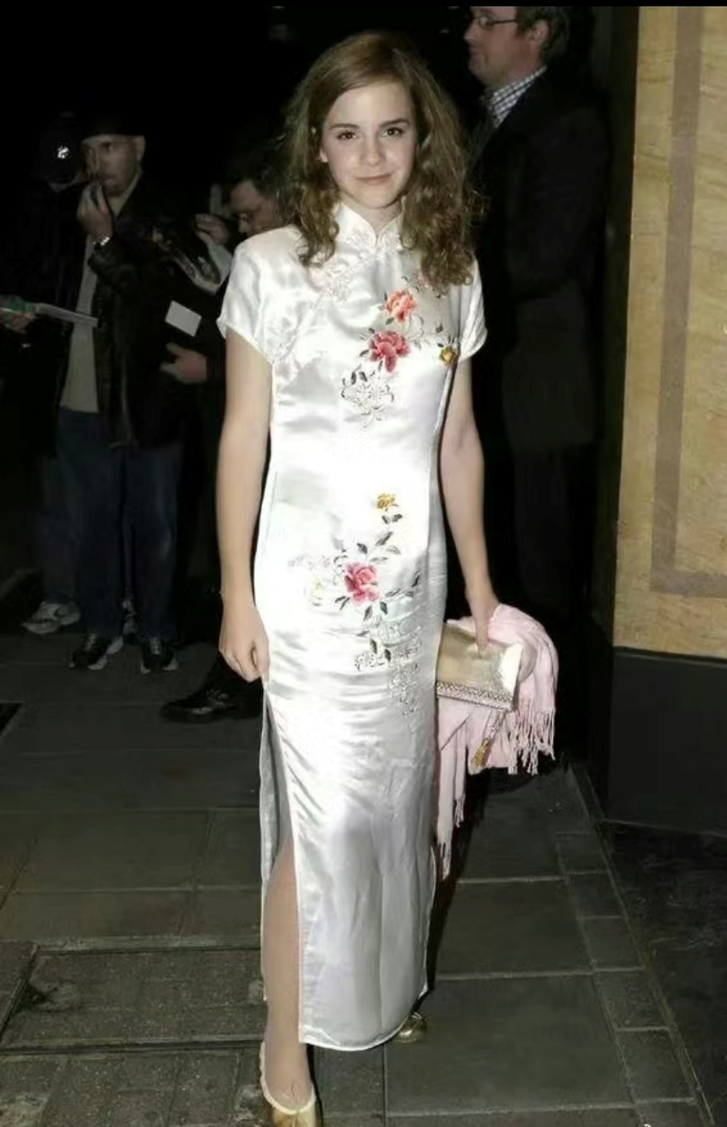
International fashion
The cheongsam also had a significant impact on international fashion centers in the 1950s and 1960s, due to its perceived exoticism and its slim line silhouette which was also fashionable in Europe at those times.
With the growth of the Chinese economy, cheongsam has experienced a renewed popularity. Many Western designers have integrated elements of cheongsam into their fashion collections.

Slide 25
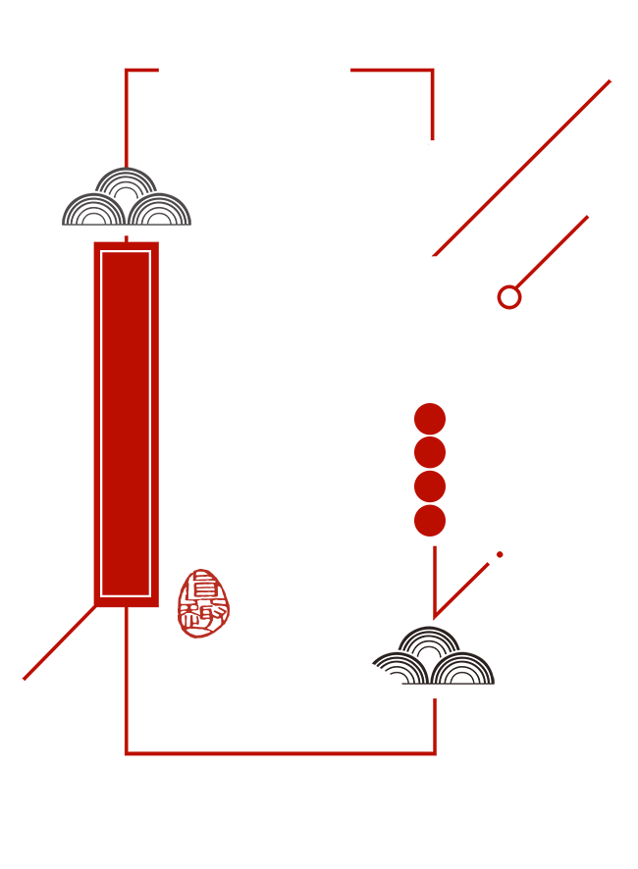
Thanks for
watching

