Slide 1
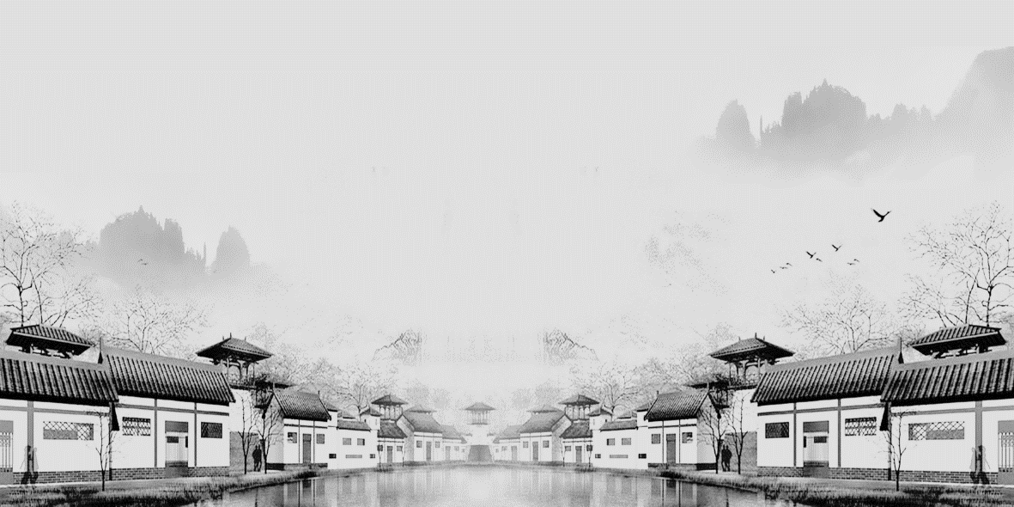
Strange Stories
from a Chinese Studio
Speaker：伍佳惠 Wu Jiahui
Strange Stories from a Chinese Studio.mp3
Strange Stories from a Chinese Studio.mp4
Notes:
[-婷婷]旗舰店https://[-婷婷]

Slide 2



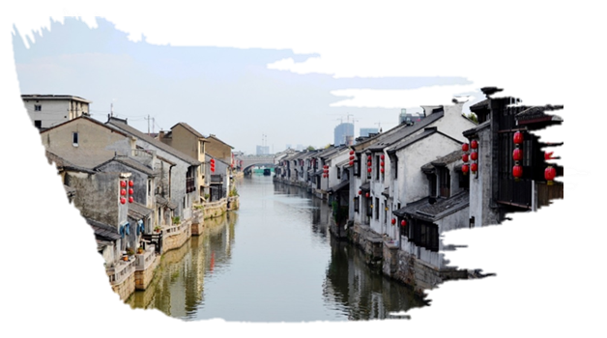
Contents
壹
Brief Introduction
贰
Publication History
叁
Main Contents
肆
Artistic Features
伍
Influence

Slide 3


壹
Brief Introduction

Slide 4
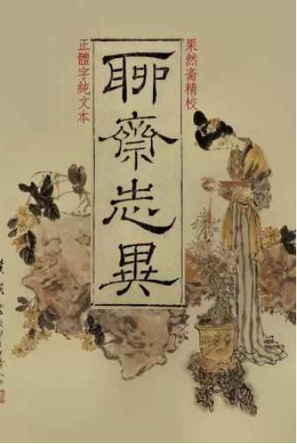
Brief Introduction-Book
Name: Strange Stories from a Chinese Studio or Strange Tales from a Chinese Studio, known in Chinese as Liaozhai zhiyi.
Author: Pu Songling
Time of publication: the Qing Dynasty
Styles: zhiguai and chuanqi (strange stories)
聊
斋
志
异

Slide 5
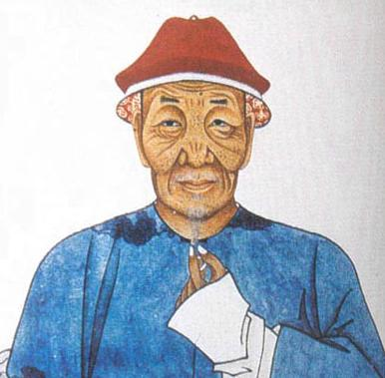
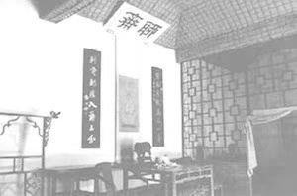
Brief Introduction-Author
failed to pass the imperial examinations
made a living by teaching
opened a teahouse
collected a large number of bizarre stories
finished Strange Stories from a Chinese Studio
蒲松龄
山东淄川蒲松龄聊斋

Slide 6
贰
Publication History

Slide 7

Publication History
The earliest surviving print version was printed.
The Pu family donated the surviving four volumes (237 short stories).
Pu completed the majority
of the tales.
1707
1871
1679
1715
1950
The work was officially published.
The original manuscript, consisting of 20 volumes, was bound in 8 volumes.

Slide 8
叁
Main Contents

Slide 9
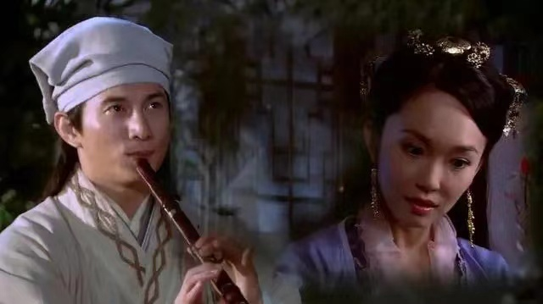
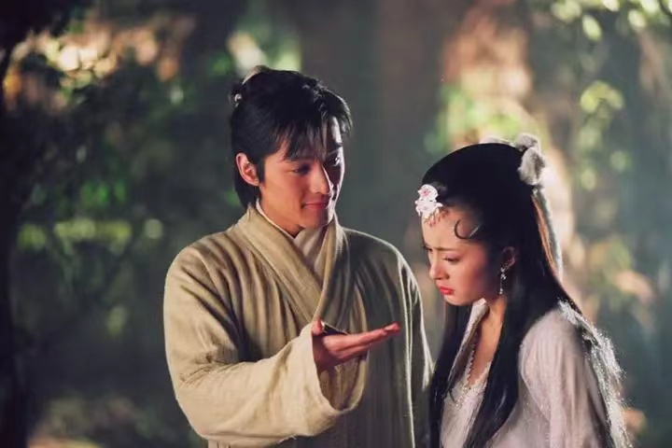
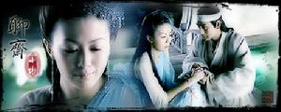
Love Story
Most of the main characters are not afraid of feudal rituals and bravely pursue free love.
It celebrates the great power of the undying love to transcend time and space.
Examples: Xiao Xie, Lian Cheng.

Slide 10
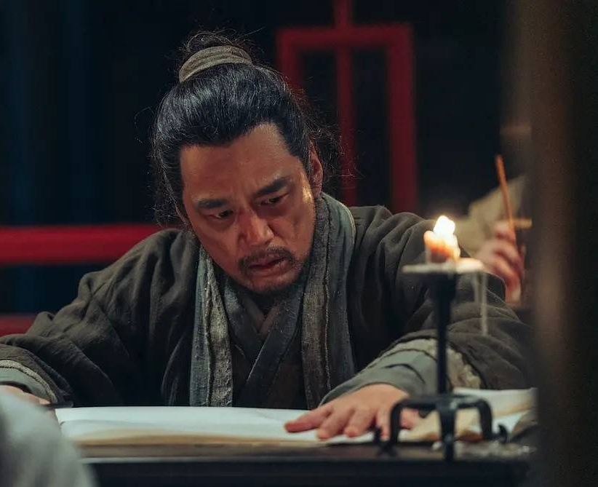
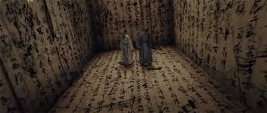
Criticism of the Imperial Examination System
The author talks about the corruption of the imperial examination system.
The author talks about the evils of the imperial examination system that buried talents.
Examples: Miao Sheng, Su Qiu.

Slide 11
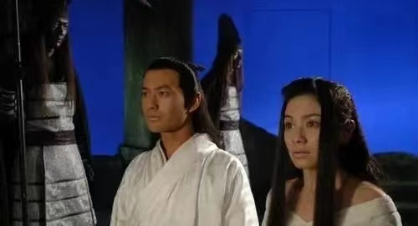
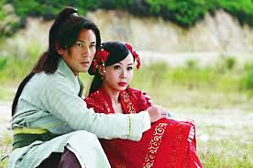
Brutality of the Ruling Class and the Oppression of the People
These works reflect the fundamental contradictions of feudal society.
These works have a higher ideological value.
Examples: Xi Fangping, Mei Girl.

Slide 12
肆
Artistic Features

Slide 13
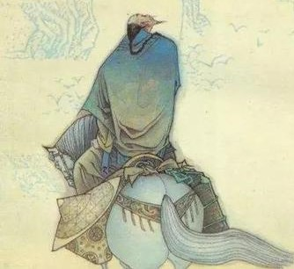
Artistic Features
The author adopts the legendary approach and the stories are bizarre.
The descriptions are rich in many aspects, and the images are vivid.
It makes the plants and animals full of natural characters and the features of human.
The language is concise, rich in vocabulary and sentence structure.

Slide 14
伍
Influence

Slide 15
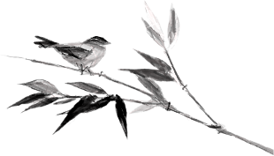
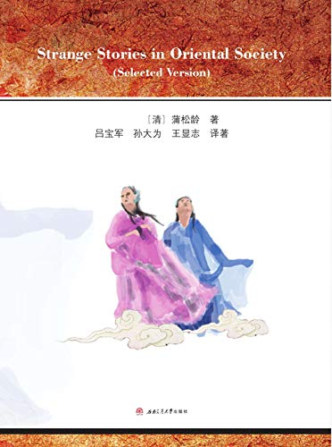
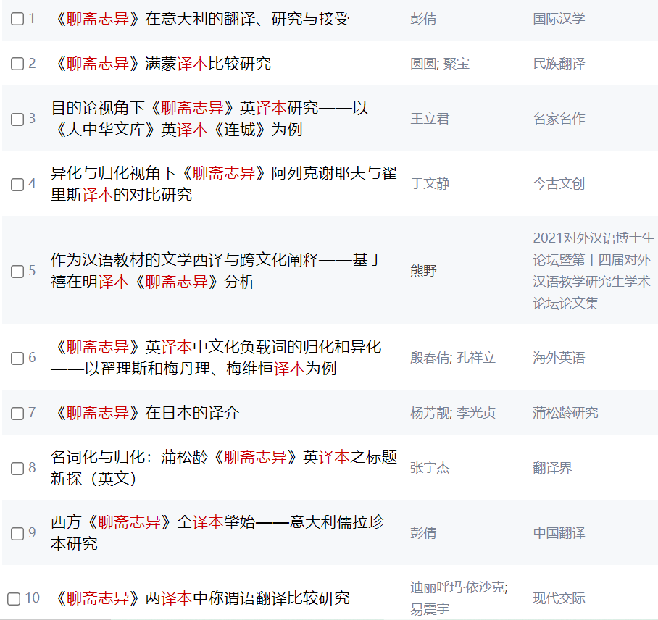
Influence-Literary
In China
Strange Stories from a Chinese Studio brought the ancient Chinese literary short story to a new height, and since then, the literary novel has not been majestic anymore.
In the world
Since the 19th century, more than sixty foreign translations have appeared in English, German and other languages. It has been written in the encyclopedias of all major countries in the world, thus becoming a world masterpiece with a high reputation.

Slide 16
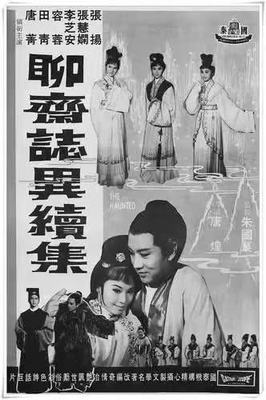
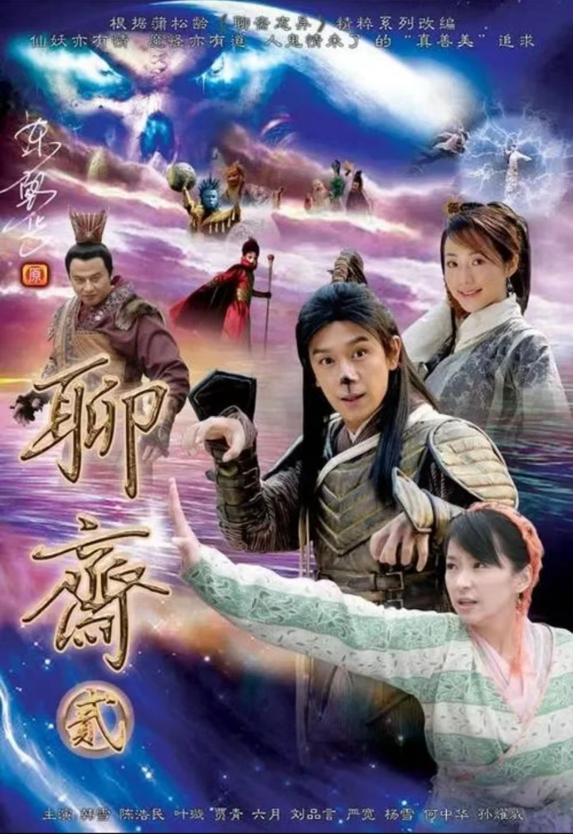
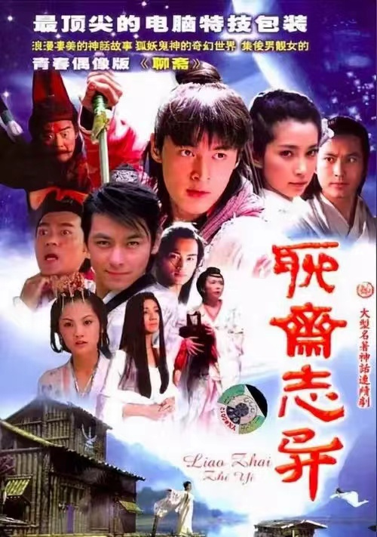
Influence-Film and Television Adaptations
Since the 1920s, there have been films and television dramas based on the original novel, with more than 70 versions.

Slide 17
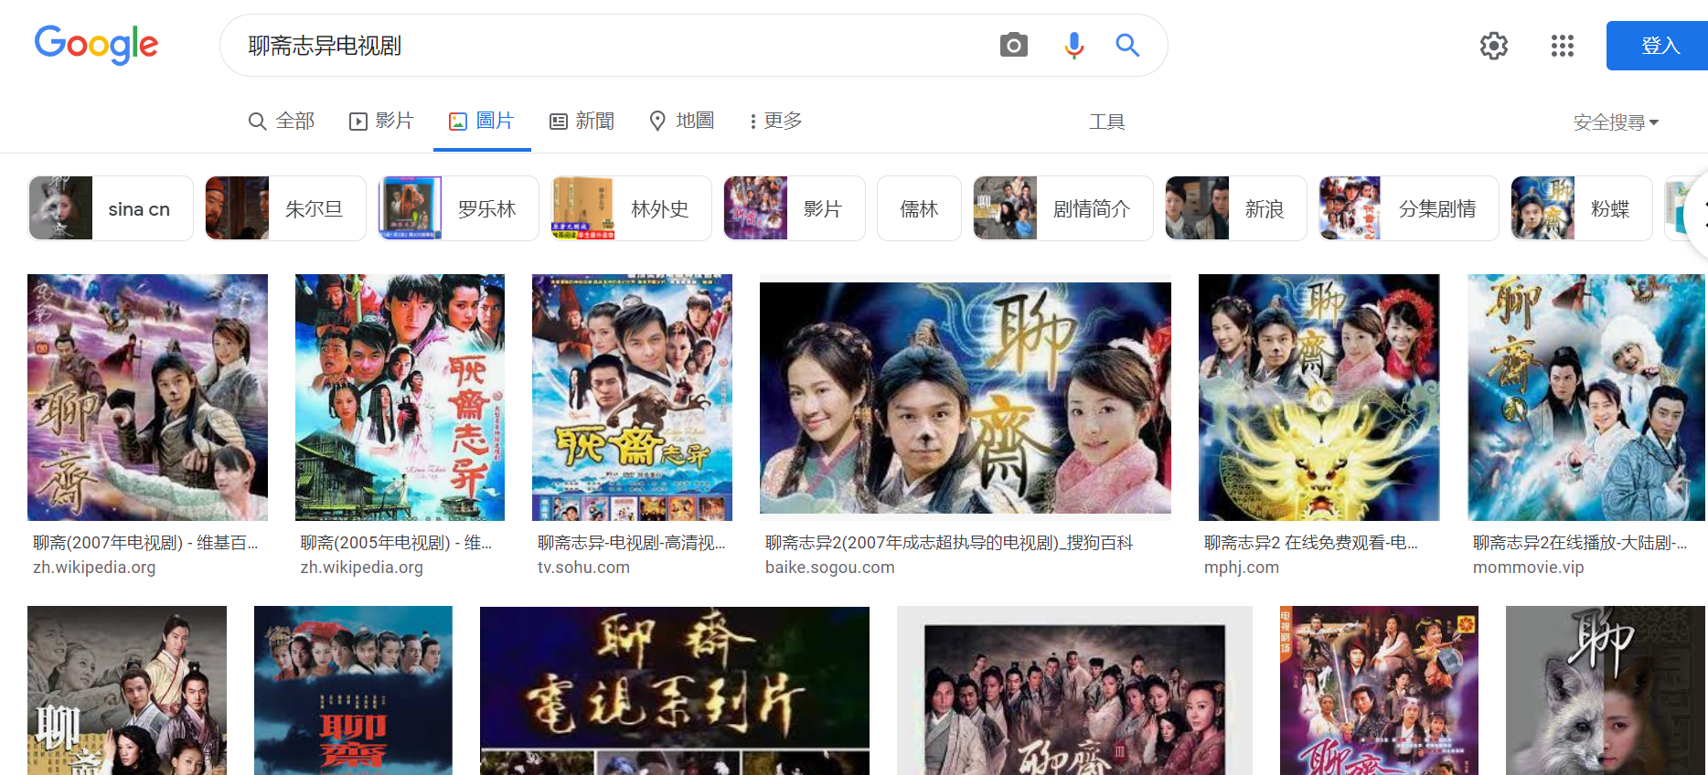
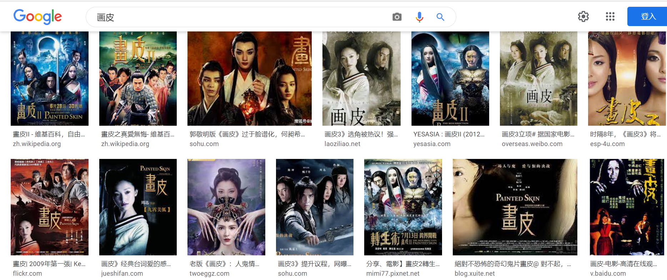
Influence-Film and Television Adaptations

Slide 18
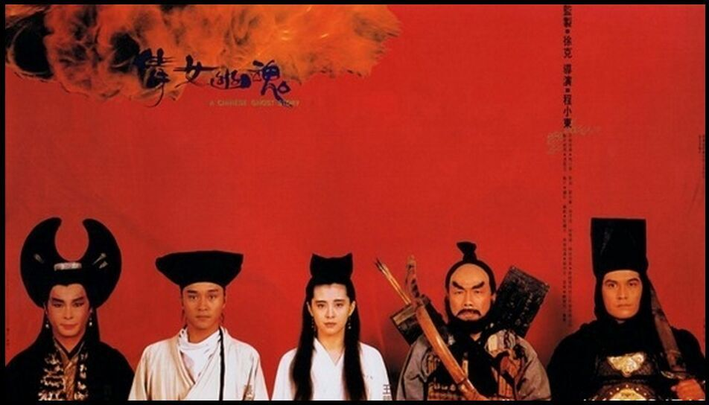
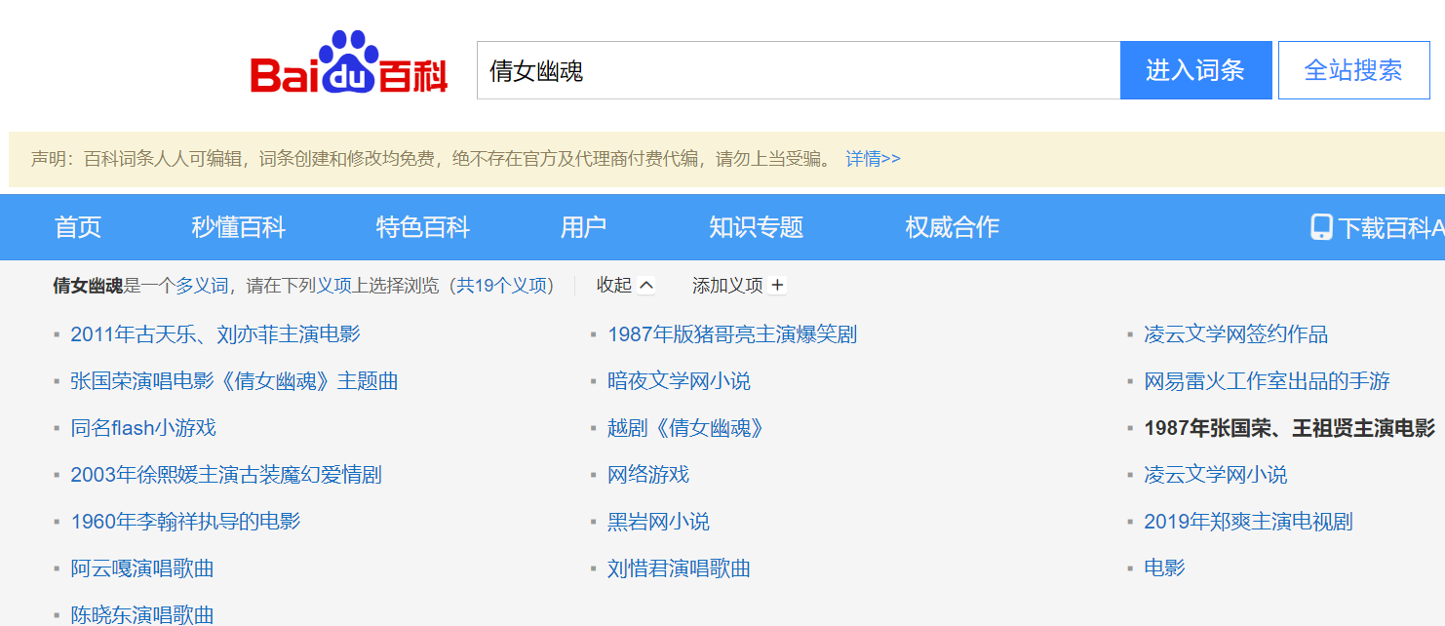
Influence-Derivative Works
Example：
A Chinese Ghost Story（倩女幽魂）

Slide 19
References & Sources
[1]陈昊.《聊斋志异》影像传播研究[D].长春:东北师范大学,2020.
[2]张稔穰.《聊斋志异》语言特色简论[J].文学遗产,1983(2):107-114.
[3]百度百科：聊斋志异
[4]搜狗百科：聊斋志异
[5]维基百科：聊斋志异
[6]Wikipedia: Strange Stories from a Chinese Studio

Slide 20
Thank You
Notes:
[-婷婷]旗舰店https://[-婷婷]

