Slide 1

The Brief History of Chinese Translation
Presented by Hu Shuqing

Slide 2

The translation of Buddhist texts
The translation of technology
The translation of sociology and literature
CONTENTS
The translation during the May Fourth period
The translation of since 1978

Slide 3

一
The translation of Buddhist texts

Slide 4
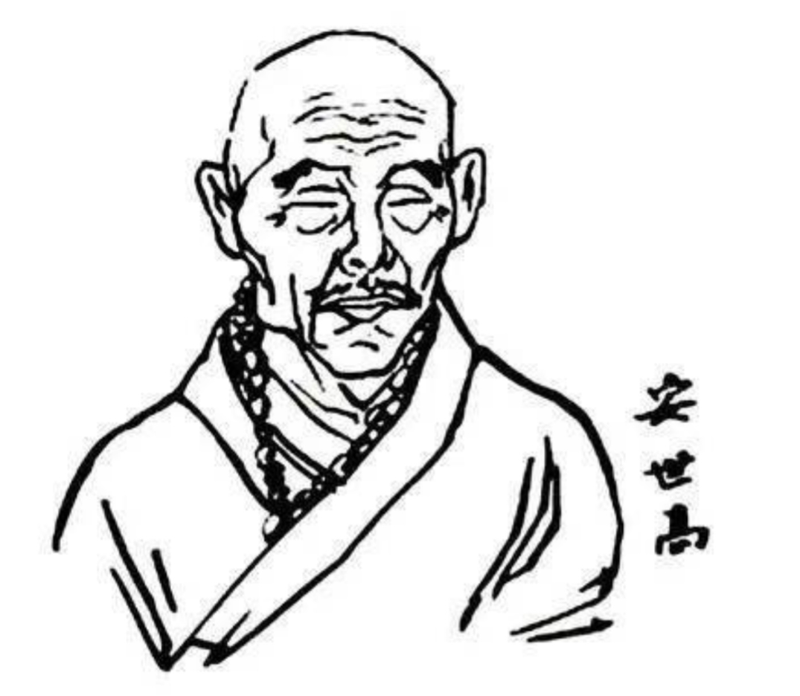


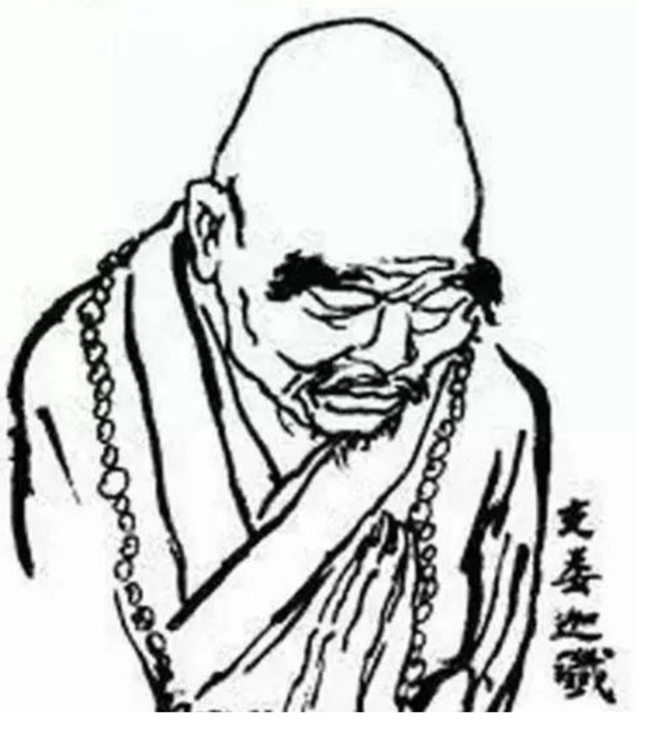
1
The beginning（148～316）
An Shigao：
translated more than 30 Buddhist sutras
Zhi Qian：
1、created the translation with clear explanatory notes
2、believes that we should follow the original text

Slide 5
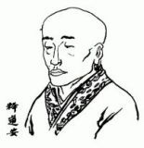
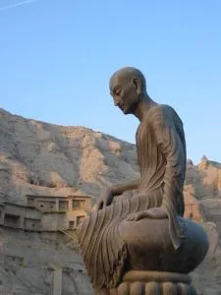
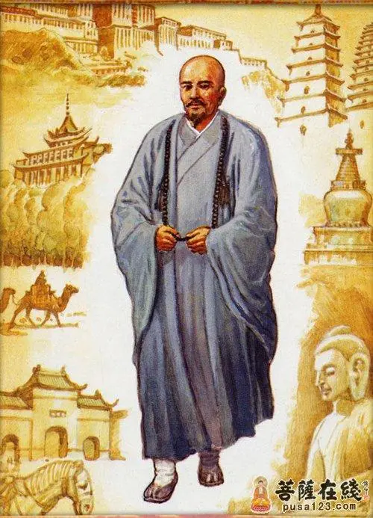
2
The prosperous period（317～617）
Shi Daoan
Kumarajiva
Yan Cong
put forward “ five instances of losing the source and three instances of difficulties”
translated 22 Buddhist texts
tend to choose free translation

Slide 6
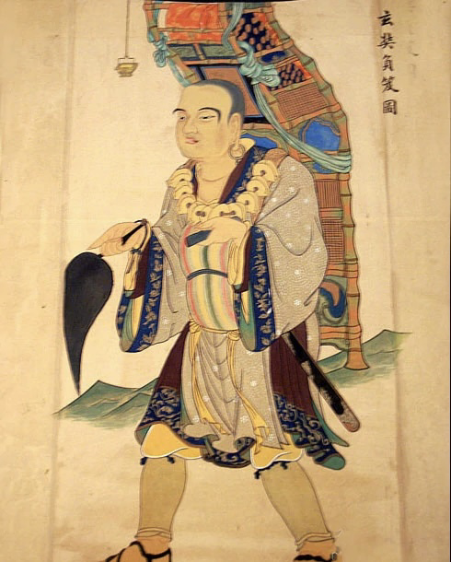
3
The Heyday（618～906）
1、brought back 657 Buddhist sutras
2、hosted the largest and most well-
organised translation forum in ancient
Chinese history
proposed “seeking truth as well as
popular and easy to understand”
Xuanzang

Slide 7
二
The translation of technology
From the end of the Ming dynasty to the beginning of the Qing dynasty

Slide 8
二
The translation of technology
01
02
03
04
Content
Translator
Works
School
translted works about western sicence、Greek philosophy and sience
Missionary：：Matteo Ricci、Johann Adam
Chinese Intellectuals：Wei Yuan、Lin Zexu、Xu Guangqi
1、 Elements of Geometry 《几何原本》
2、The Encyclopedia of Geography 《四洲志》
1、Si Yi Guan
2、Tong Wen Guan

Slide 9
三
The translation of sociology and literature
From the end of the Qing dynasty to the beginning of Republic of China

Slide 10
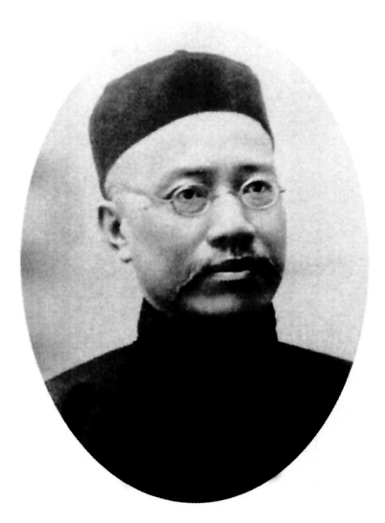
三
The translation of sociology and literature
Yan Fu：
1、famous for the translation of sociology works
2、proposed “faithfulness、expressiveness and elegance”
Lin Shu：
1、famous for the translation of literature
2、His translation method is very special
Translations：
1、 Evolution and Ethics and Other Essays
2、Robinson Crusoe

Slide 11
四
The translation during the May Fourth period

Slide 12
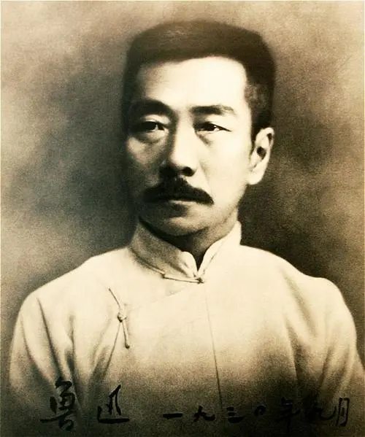
四
The translation during the May Fourth period
1、Translation and literature association constituted by translators carried out translation work
2、Chinese translation started a new historical period
and began to introduce Marxism-Leninism classics and proletarian literature.
Lu Xun
3、Mainly Russian and Soviet works began to be introduced by Lu Xun and Qu Qiubai.

Slide 13
五
The translation of since 1978

Slide 14
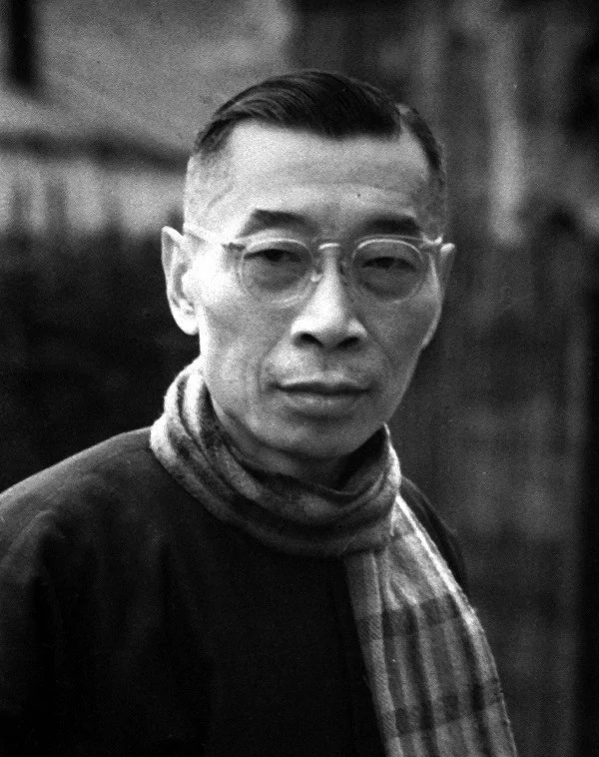
五
The translation of since 1978
The focus of translation has shifted to the translation of Marxist-Leninist social science works and realist writers, represented by Fu Lei and Yang Bi.
Literary translation and non-literary translation have been promoted simultaneously, and translation theory and practice have been paid equal attention.
Translations：
The modern translation theory was established in 1990.
Fu Lei

Slide 15
Thank You

