Slide 1
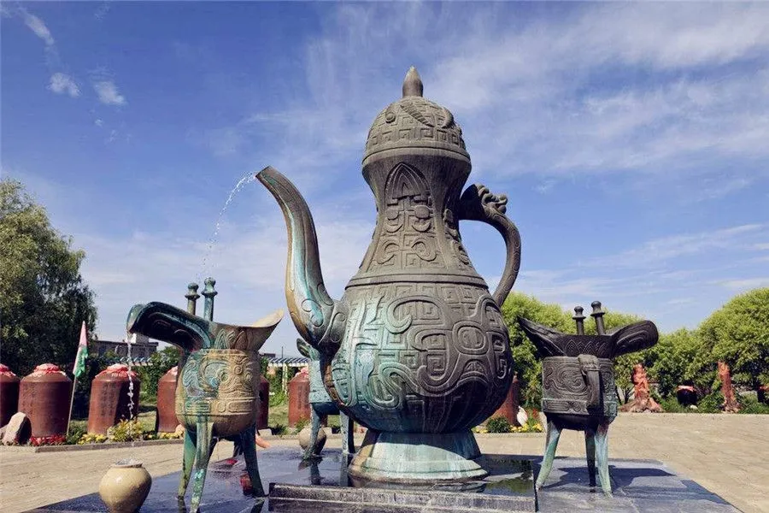
The Liquor Culture of
Ancient China
舒思靖 Rosie

Slide 2
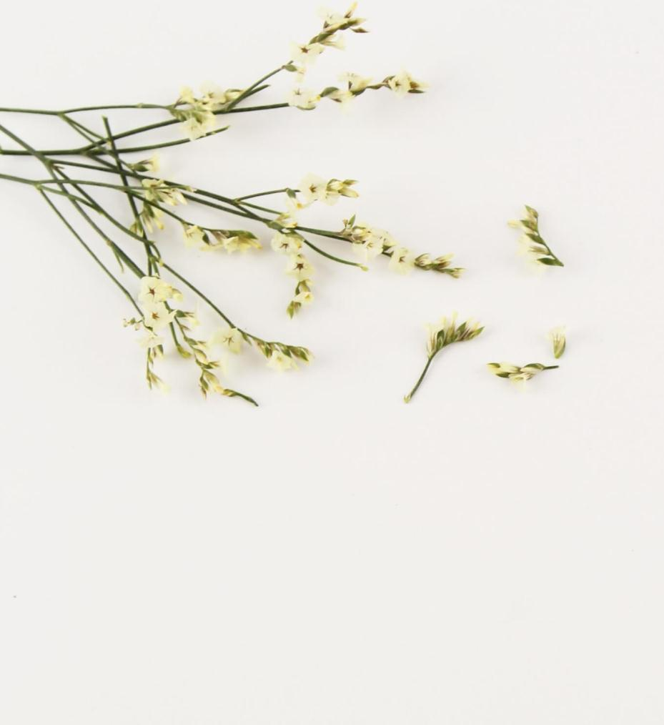
目 录
CONTENT
Ⅰ.Tracing Back to the Source of Liquor
Ⅱ.Introduction to Liquor Culture in Past Dynasties
Ⅲ.Liquor Types and Drinking Vessels
Ⅳ.The Liquor Culture

Slide 3
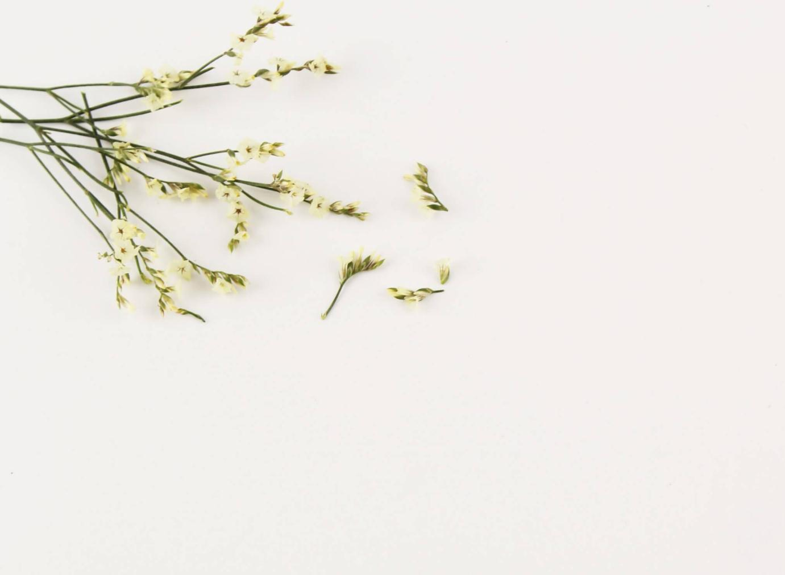
01
Ⅰ.Tracing Back to the Source of Liquor

Slide 4
Mainly four Legends
Liquor making starts from an ape
Liquor making starts from Yi di
Liquor making starts from Du kang
Liquor making starts from God
These legends are full of interest and charm along with the parts of imagination which are all derived from the respect and praise for liquor.
In the several thousand years of development of civilization, liquor and liquor culture are mainly developing along with each other. So the rise of Chinese liquor started from 5, 000 years ago.

Slide 5
02
Ⅱ. Introduction to Liquor Culture in Past Dynasties

Slide 6
Introduction to Liquor Culture in Past Dynasties
Liquor had a great influence in the Xia, Shang and Zhou Dynasties. Although the upper class was addicted to alcohol, "liquor" was first used for sacrifice and then enjoyed by people.
Liquor had a "popular brand" in the late Warring States period.
The self-sufficient strongmen manor also has its own advantages in liquor making during the Eastern Han Dynasty.
During the Wei,Jin,Northern and Southern Dynasties, the political situation was turbulent, and the gentry（士族） are sinking in liquor.
With the unification of Sui and Tang Dynasties, liquor culture has also reached its peak.
In the Zhao and Song Dynasties, The poet lost his pride in liquor and began to become attached to tea.
Then, the Yuan and Ming Dynasties failed to revive the lofty sentiments in liquor.

Slide 7
03
Ⅲ. Liquor Types and Drinking Vessels

Slide 8
(1)Liquor Types
Liquor
Yellow rice liquor
Beer
Grape liquor
杨梅烧酒
竹叶青
人参酒
White liquor
Brewed Alcoholic Beverage
Distilled Liquor
Blending Type
The base liquor of blending liquor is normal juice liquor or distilled liquor, which is blended with alcohol or non-alcohol materials. After soaking and mixing, the blending liquor is obtained.
It is made from the fermented raw materials such as fruit or grain and distilled fermented liquor and usually strong.
It's the liquor extracted or pressed from the raw materials such as fermented(发酵的） fruit or grain. Usually, this kind of liquor is not strong and have nutritional Ingredients.

Slide 9
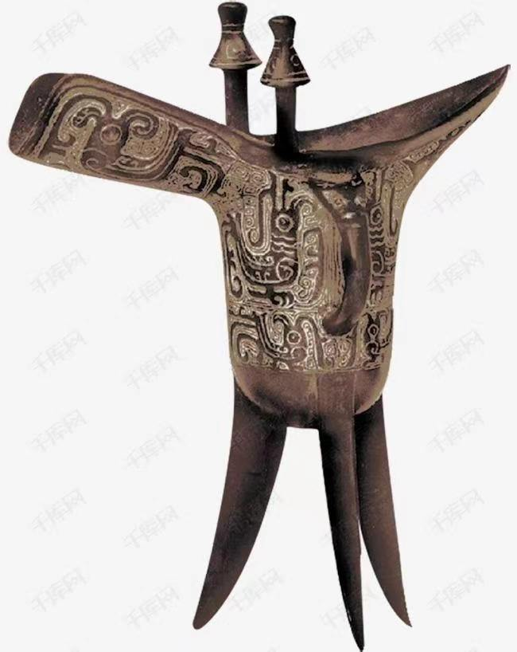
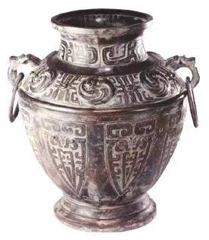
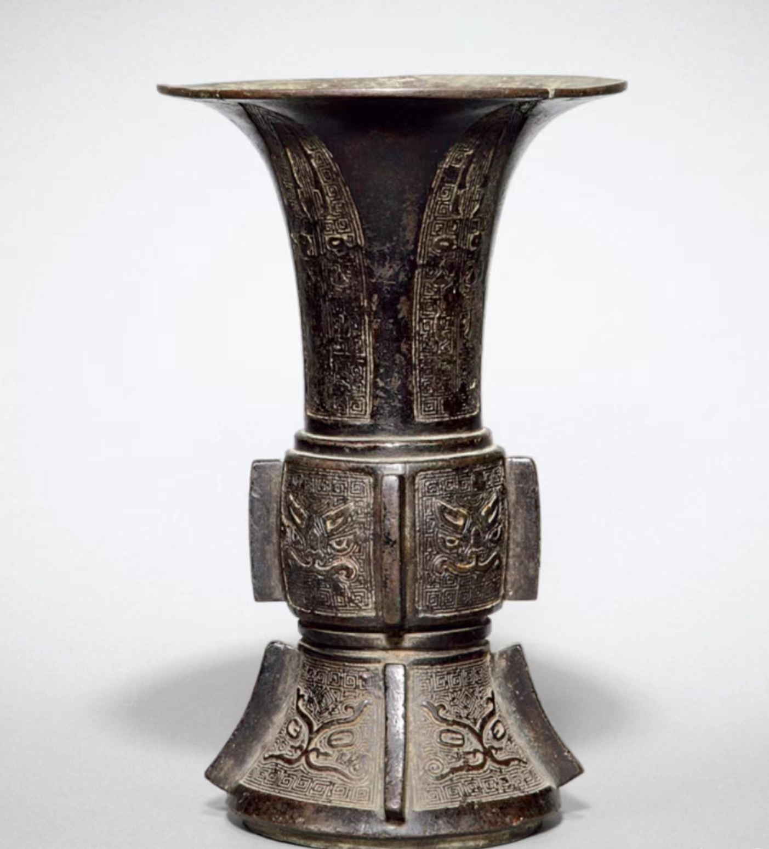
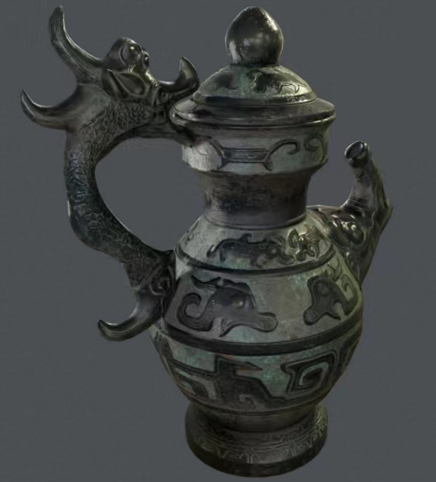
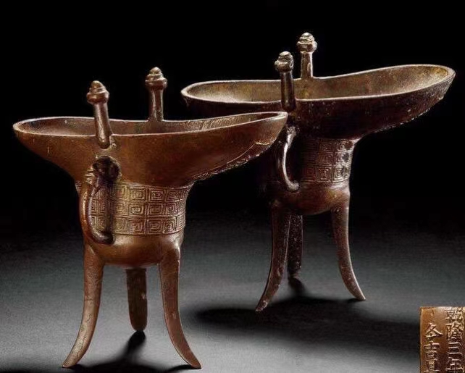
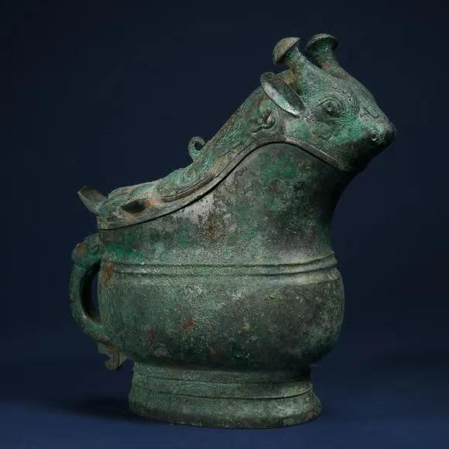
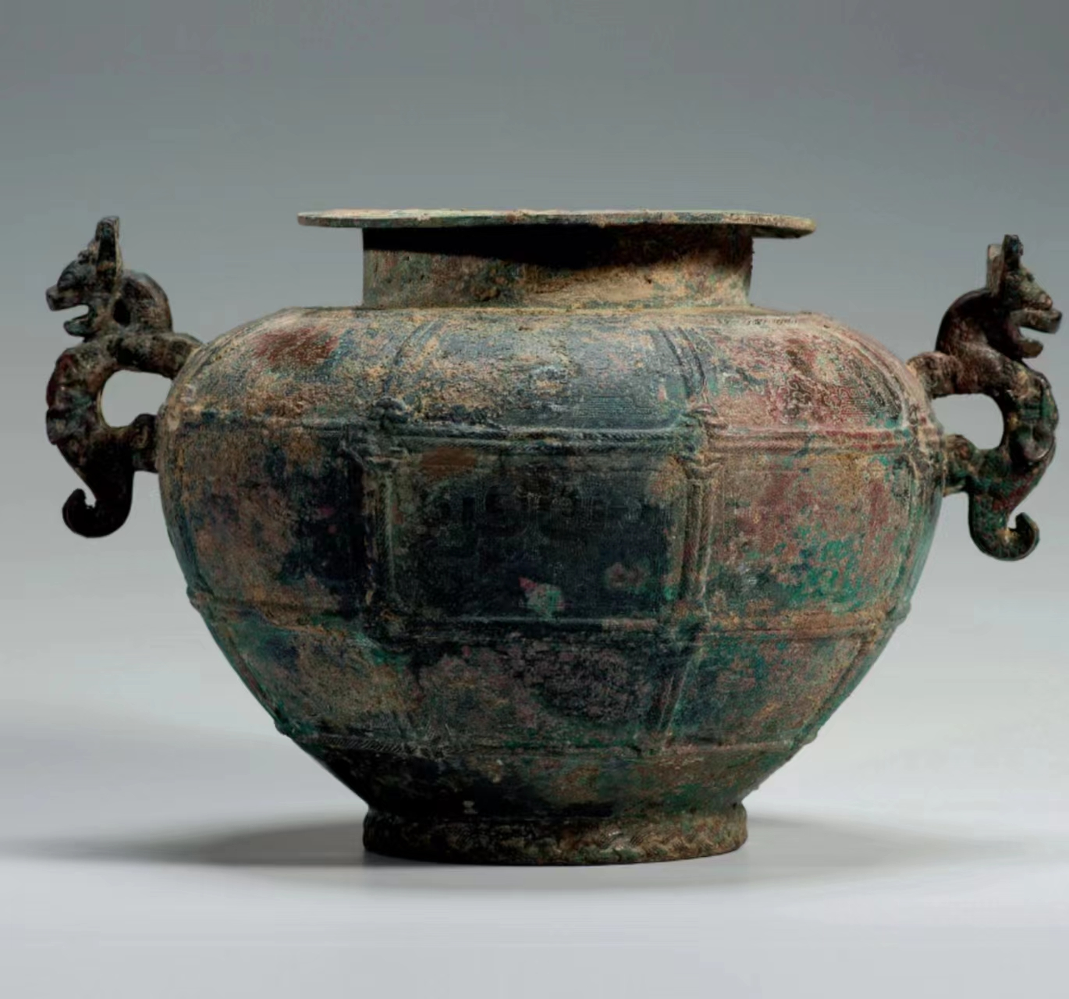
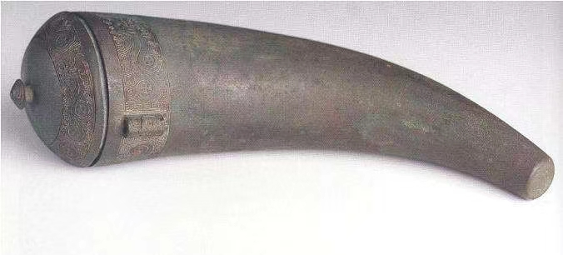
(2)Drinking Vessels
The drinking vessels, which are an important carrier of the liquor culture, are born with the invention of liquor. Through the drinking vessels of different dynasties, we can not only learn the traditional culture but also study the long history in China.
尊
罍（léi ）
觚（ɡū ）
壶
爵
觥（ɡōnɡ）
缶（fǒu）
角（jué）

Slide 10
04
Ⅳ. The Liquor Culture

Slide 11
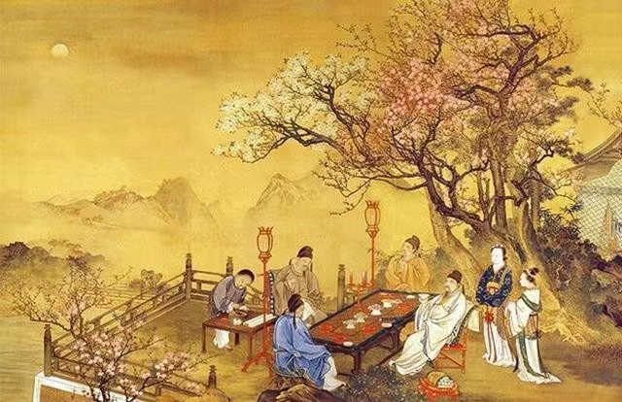
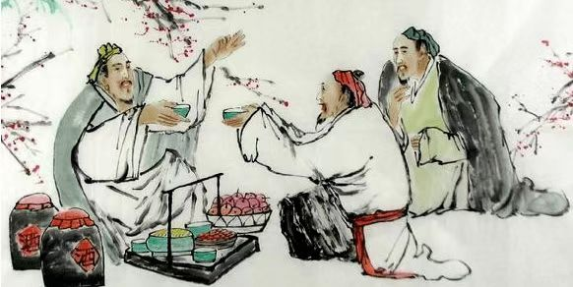
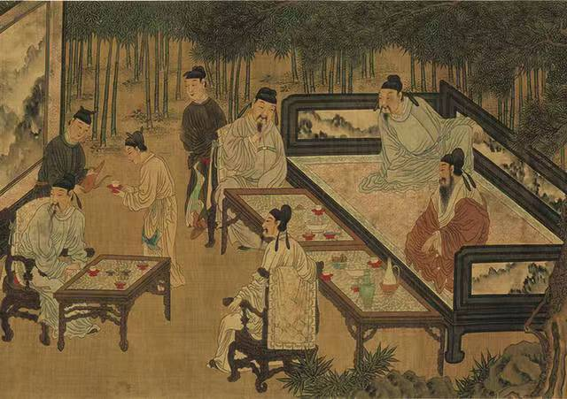
(1) Liquor and Social Communication
In human society, liquor is used frequently as the medium in varieties of intercourse activities. For example, the liquor has widely been used in sacrificing, celebrating a birthday, organizing a wedding party, making friends, speaking of ambitions, encouraging, enjoying, driving grief away and so on.

Slide 12
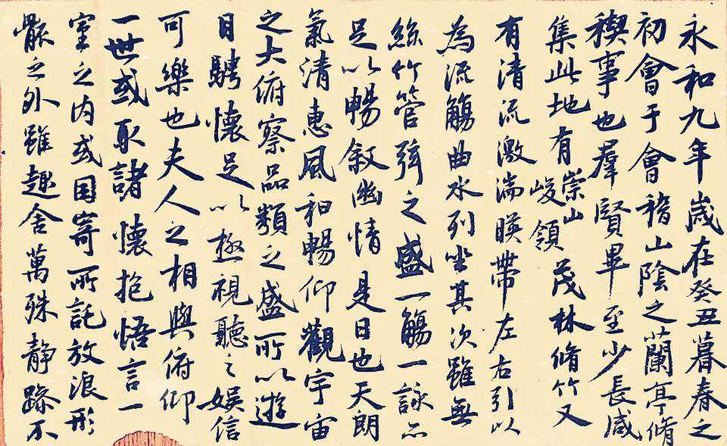
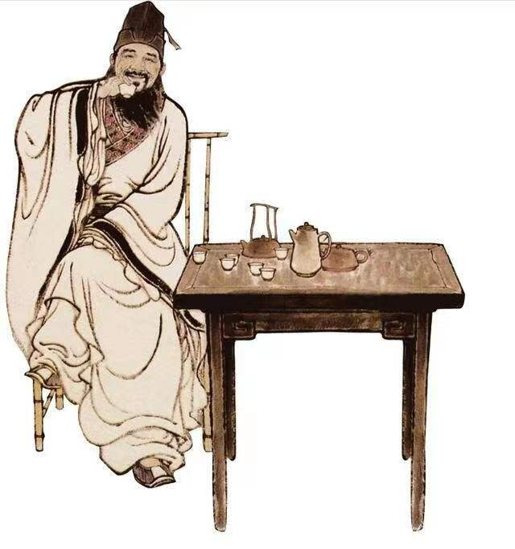
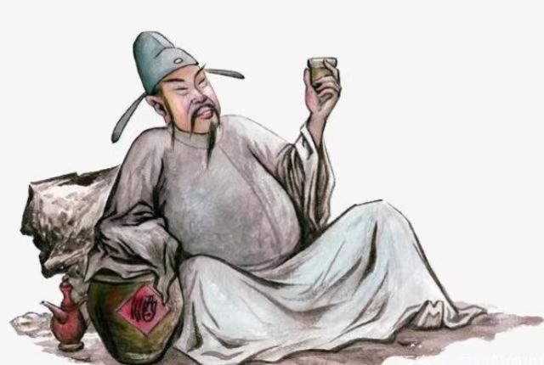
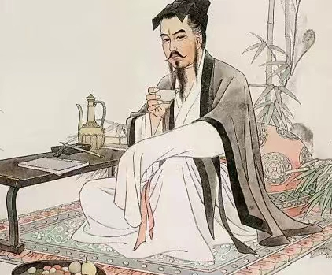
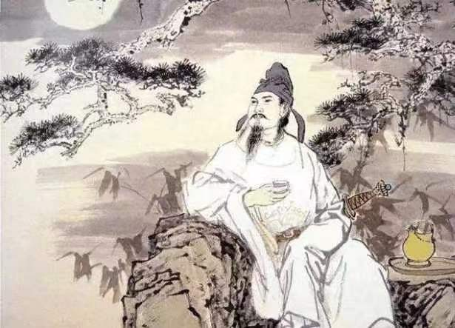
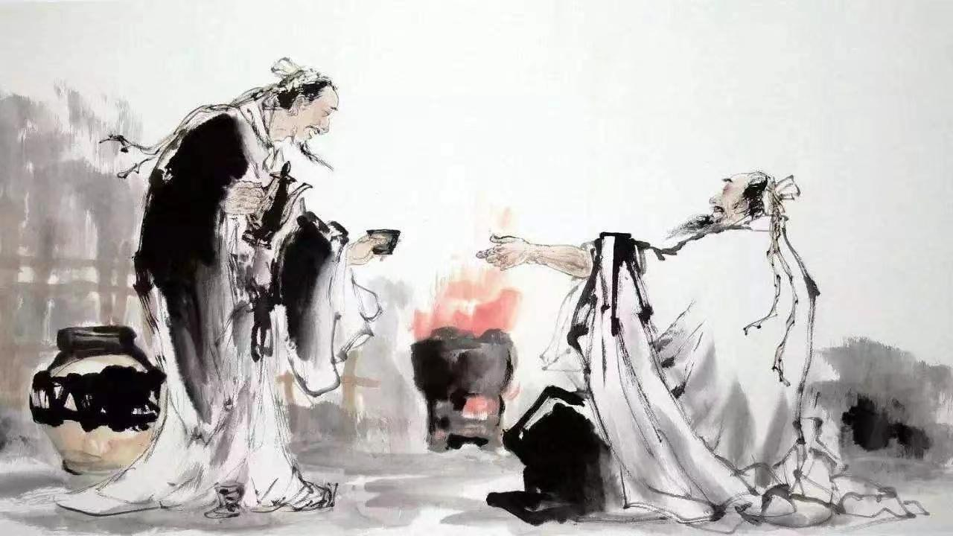
(2) Liquor and Chinese Literature
As the catalyst（催化剂） of intelligence and courage, it has encouraged the emergence of many heroes, litterateurs, and artists and has helped their achievements and works to be immortal.
Wang Xizhi’ masterpiece Lantingji Xu is done when he was comfortably drunk and wrote at ease.
Famous poets in ancient China all like Liquor.

Slide 13
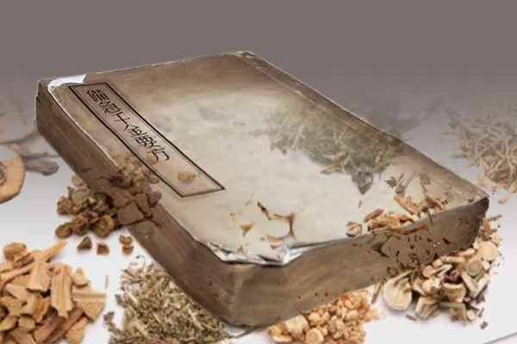
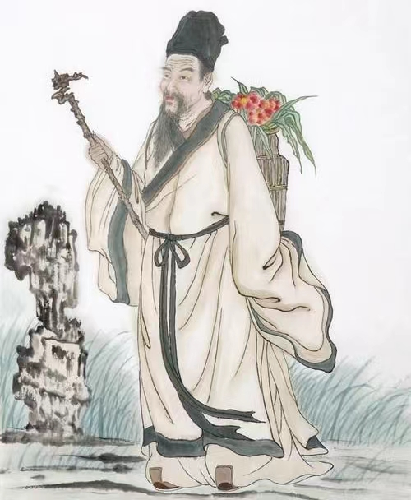
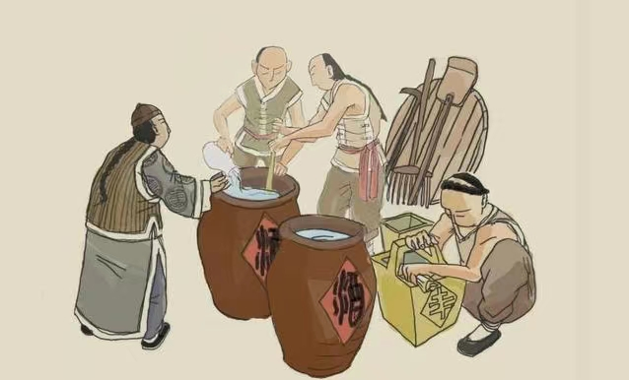
(3) Liquor and Medical Care
Liquor is the remedy for treating a cold and refreshing oneself. According to Li Shizhen an ancient medical scientist in China in the Ming Dynasty, liquor heads the list of medicines.

Slide 14
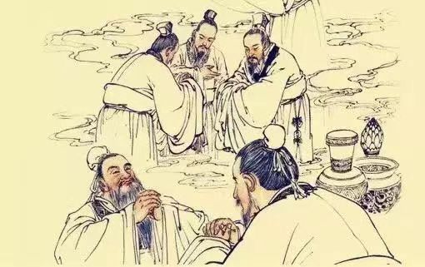
(4) Liquor and Ceremony
The way of ceremony and order is embodied in the way of drinking. The monarch drinks first, and the minister drinks later. The monarch and the minister can drink together but not with each other, and so can the father and son.

Slide 15
Thank You

