Slide 1

Northeastern Chinese cuisine
翻译班 Cai Lanying
Notes:
本模板中所用的汉仪字体仅用于个人非商业行为使用,如需商用请自行购买商用版权;

Slide 2

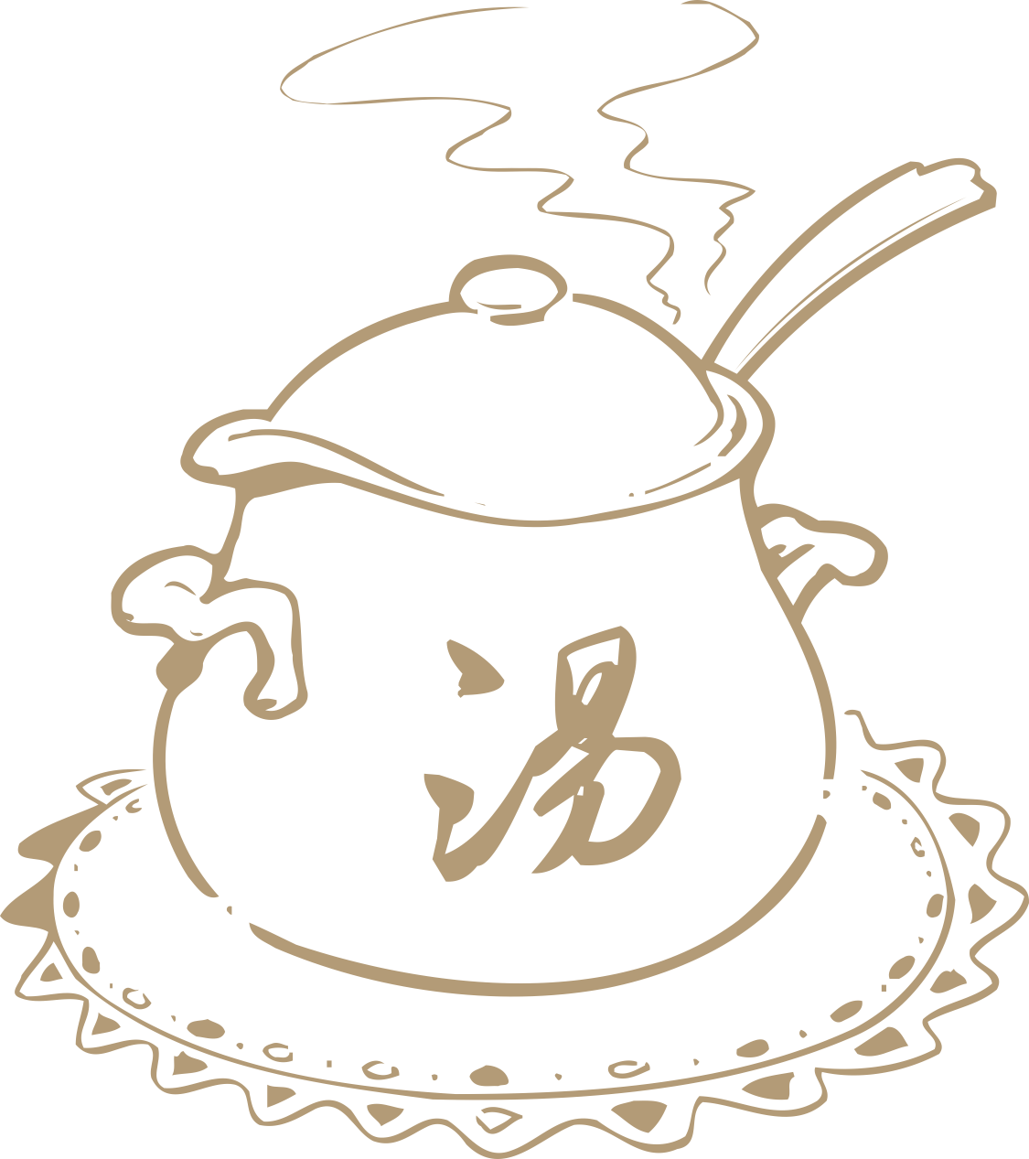
1
Causes and Characteristics

Slide 3
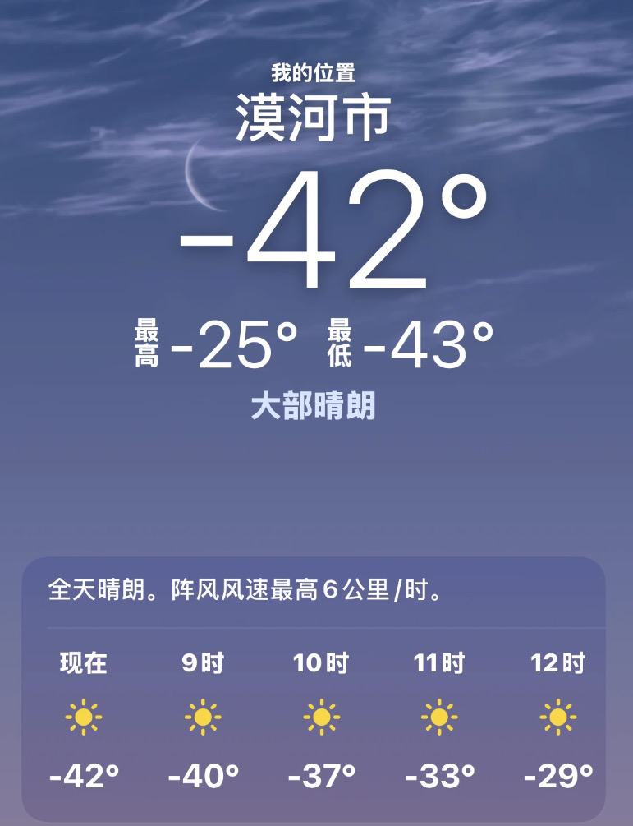
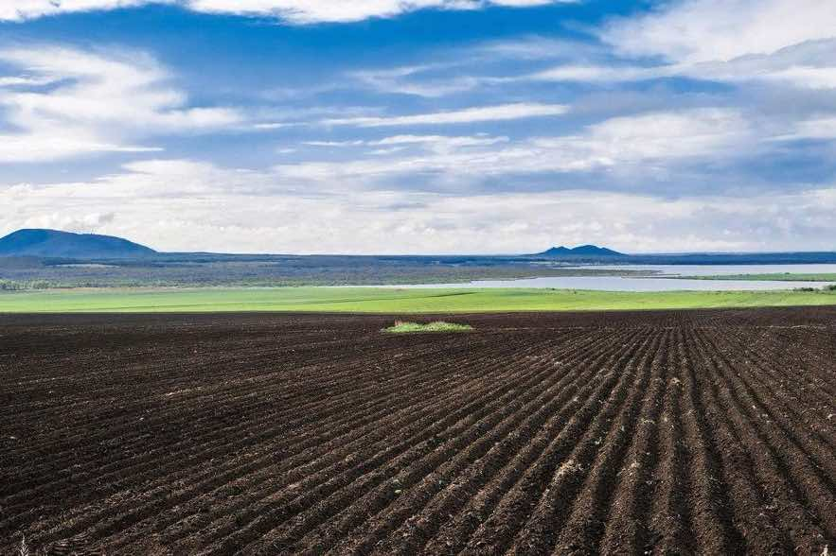
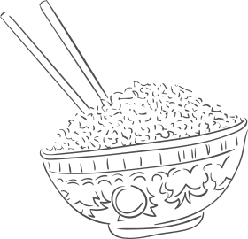
Causes and Characteristics

Slide 4
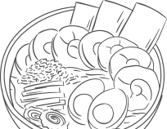
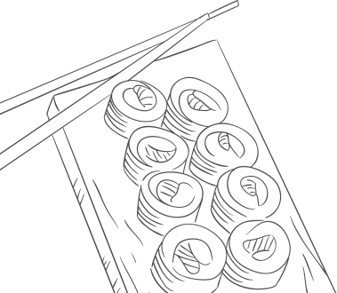
2
Classic dishes

Slide 5
Classic dishes
Flavor | Sweet and sour
Main ingredients | Pork tenderloin, eggs
Founder | Zheng Xingwen
Auxiliary ingredients | Potato starch, sugar, vinegar, soy sauce, etc.
Fried Pork in Scoop
锅包肉
Guō Bāo Ròu

Slide 6
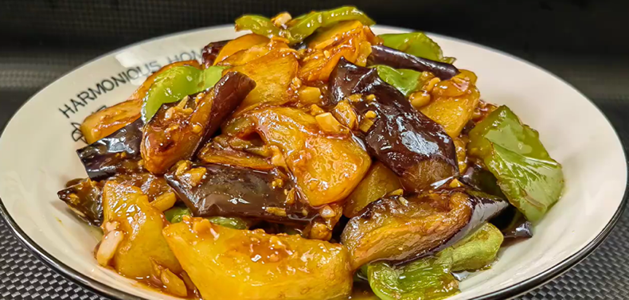
Classic dishes
Flavor | salty and savory, delicious, smooth
Main ingredients | potato, eggplant, green pepper
Calories | 78 kcal (per 100g)
Mean Seasonings | light soy sauce, dark soy sauce, oyster sauce, sugar, starch, salt, minced garlic
Sauteed Potato
地三鲜
Dì Sān Xiān

Slide 7
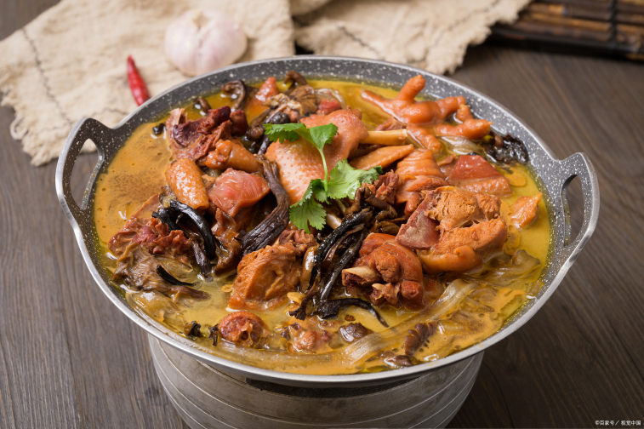
Classic dishes
Flavor | Salty and savory
Main ingredients: | Native chicken (free-range chicken), hazel mushrooms, vermicelli, vegetable oil, dark soy sauce
Auxiliary ingredients | Chili, ginger, scallion, star anise, cinnamon, bay leaf, refined salt
Nutritional value | Rich in animal protein
Effects | Reduces blood lipids, blood sugar, and blood pressure; helps resolve phlegm, regulate qi, protect the liver, and reduce edema
Stewed chicken with mushroom
小鸡炖蘑菇
Xiǎo Jī Dùn Mó Gu

Slide 8
3
Summary

Slide 9
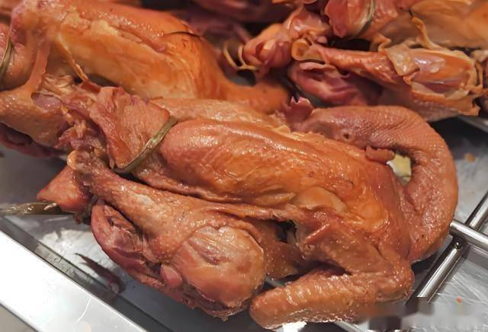
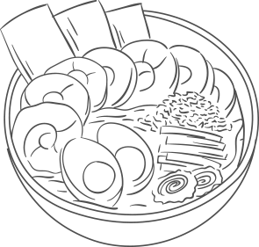
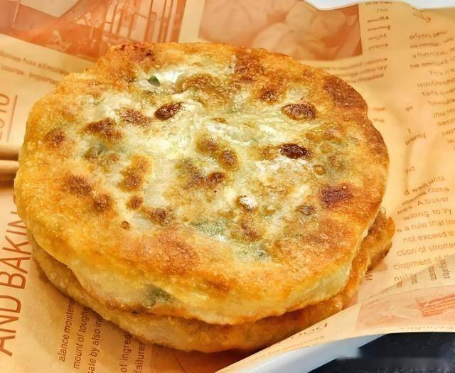
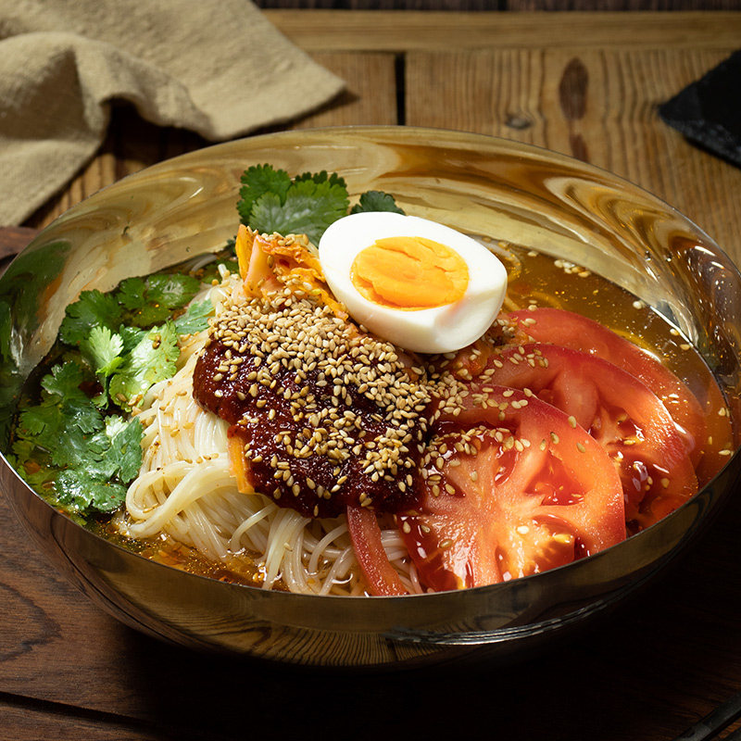
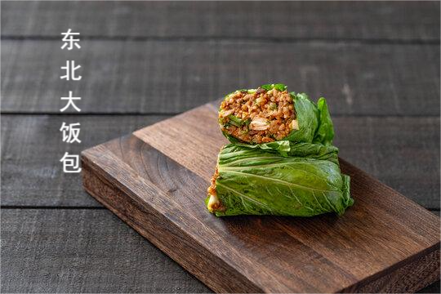
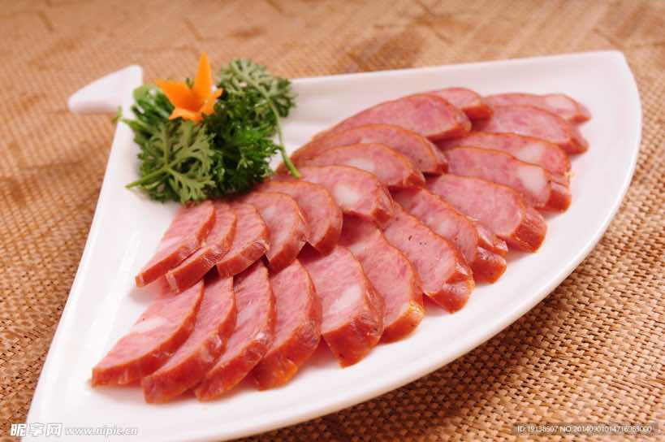

Slide 10
Thank you for your patience
翻译班 Cai Lanying
Notes:
本模板中所用的汉仪字体仅用于个人非商业行为使用,如需商用请自行购买商用版权;

