Slide 1
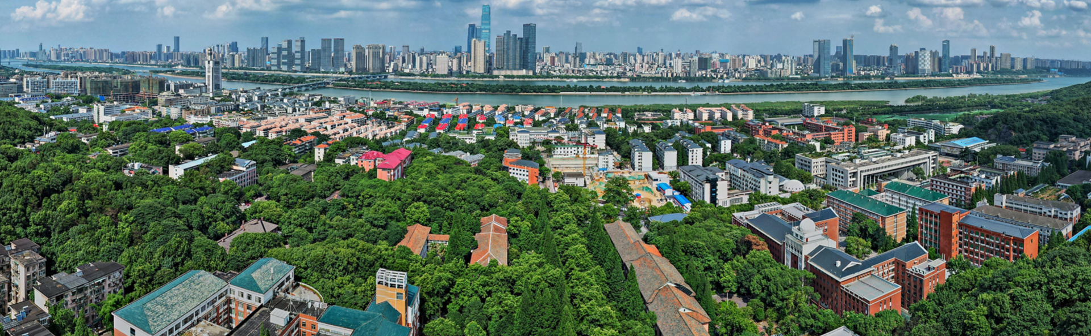


China's Modern Marvels: The New Four Great Inventions
By：Huey Wang
10th.October.2024

Slide 2
01
Introduction
02
High-Speed Rail
CONTENTS
03
Mobile Payments
04
Shared-Bick
05
Summary

Slide 3
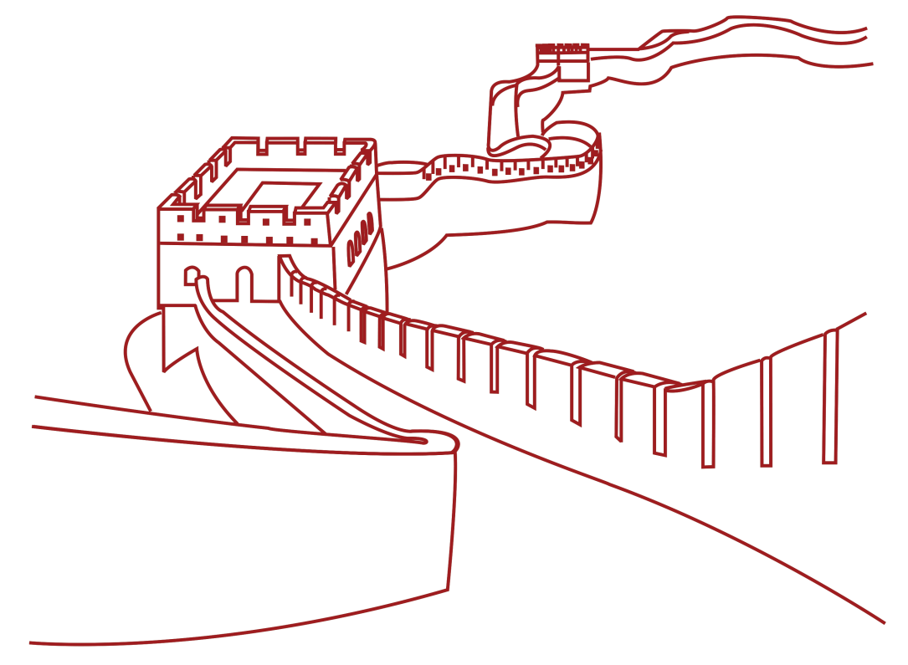
Introduction:
The Rise of Modern Marvels

Slide 4


Slide 5
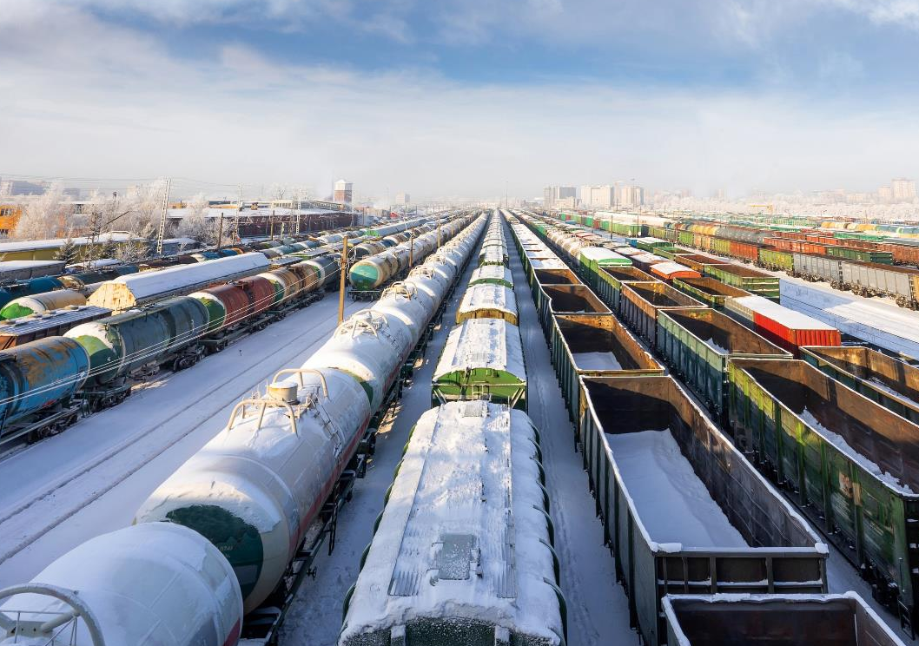





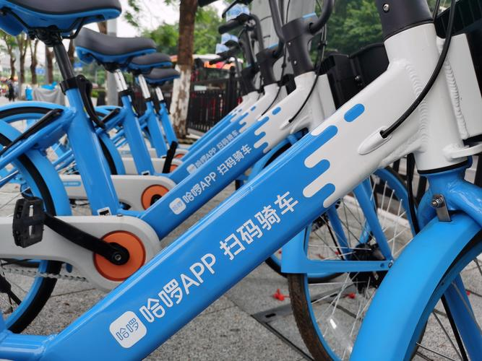


An Overview of The New
Four Great Inventions
High-Speed Rail
Connecting cities at unprecedented speeds, reshaping transportation across China.
Mobile Payments
Revolutionizing transactions, making cash obsolete in many urban areas.
E-commerce
Transforming retail, bringing diverse products to consumers' fingertips.
Shared-Bike
Promoting eco-friendly urban mobility, reducing traffic congestion in cities.

Slide 6

Questionnaire
Do you use these things?

Slide 7



China's High-Speed Rail Revolution
1
2008: Beijing-Tianjin Line
China's first high-speed rail line opens, marking the beginning of a new era.
2
2011: Beijing-Shanghai Line
The 1,318 km journey is reduced to just 4.5 hours, showcasing impressive speeds.
3
2020: 35,000 km Network
China's high-speed rail network becomes the world's largest and most extensive.

