Slide 1

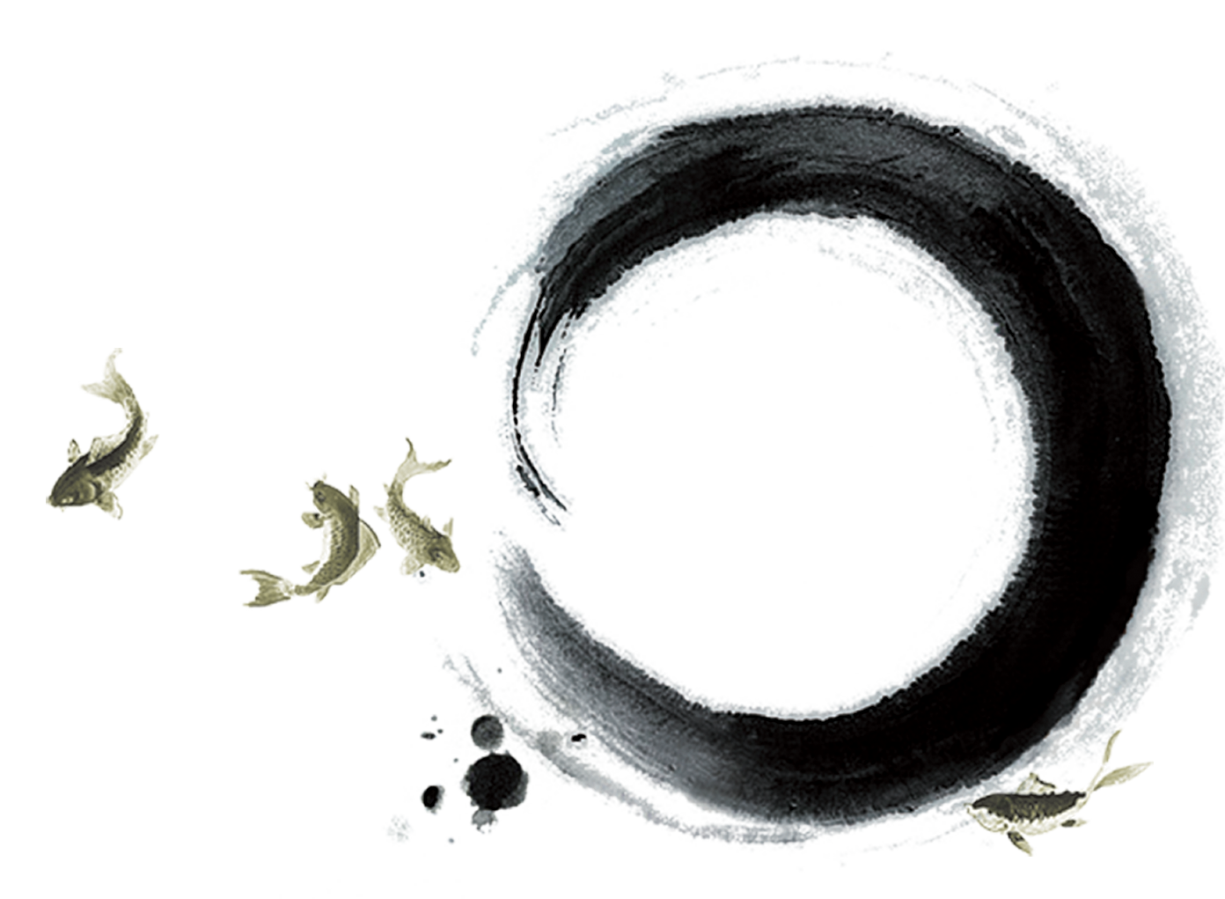
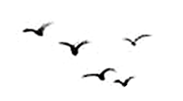


Classical Literature
——Shi Jing as the Beginning
Xu Jing & You Yuting

Slide 2
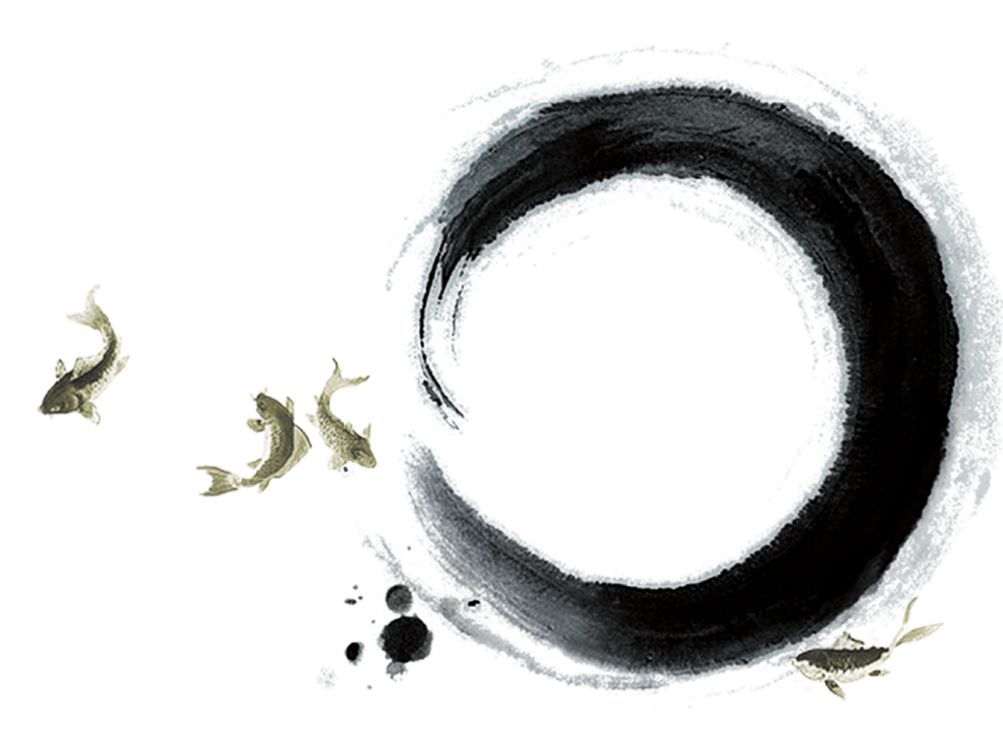
1
About Shi Jing
2
Translation Pieces
Contents

Slide 3

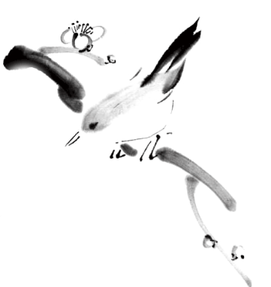
Ⅰ
About Shi Jing

Slide 4
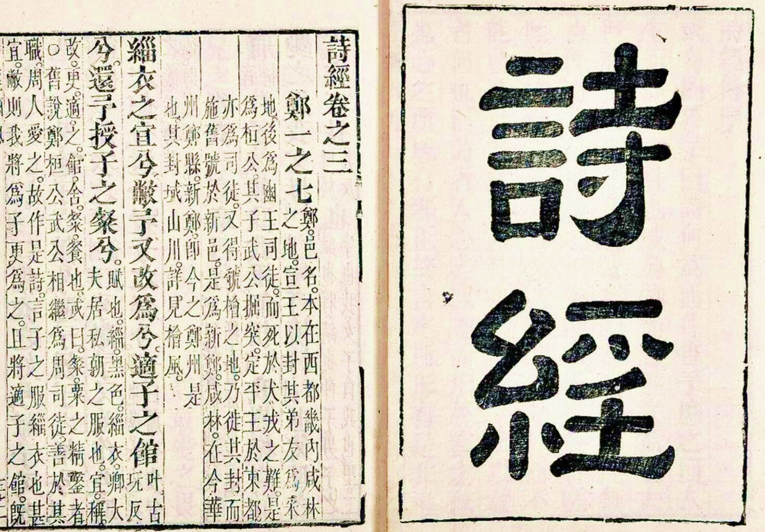
Introduction
Shi Jing is the earliest anthology of verse in China, consisting of 305 poems dating from between the 11th and the 6th century B.C., encompassing works dedicated by nobles and high-ranking officials, poems collected by government officials sent by the central government.

Slide 5
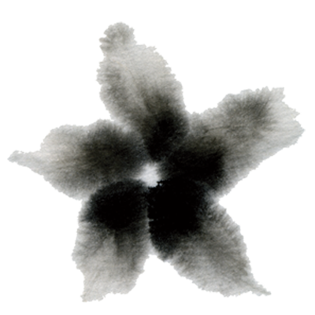
PartⅠ About Shi Jing
Revision of Its Name
Categories
Themes
Influence
Artistic Features

Slide 6
Evolution of Its Name
Shi
Shi Sanbai
Shi Jing

Slide 7
Themes
Sacrifice
Love
Grievances of the Lower class
Ancestor Worship
Farming
Arming Life
Feasts
War

Slide 8


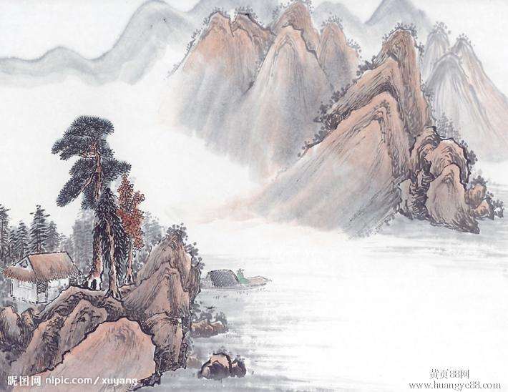
Categories
Feng
Song
Also known as Guofeng(《国风》). These songs number 160 titles and makes the major part of the Shi Jing.
Song, or odes, consists of 40 poems including the sacrificial hymns and songs sung at ceremonious.
颂
风
雅
Ya, including 105 songs, falls into 2 groups: The Major Festal Odes(《大雅》) and The Minor Festal Odes(《小雅》).
Ya

Slide 9
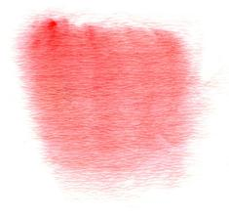
Artistic Features
Ⅰ
Simplicity.
Ⅱ
Frequent repetitions.
Three rhetorical devices: Fu(赋), Bi(比), Xing(兴).
Ⅲ

Slide 10
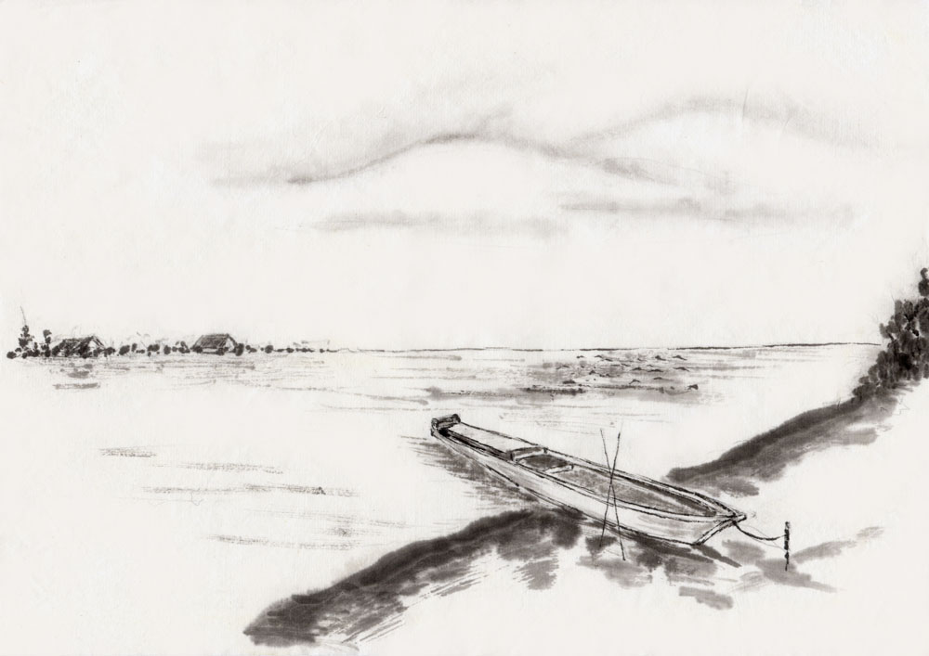

Influences
A far-reaching influence on the development of Chinese literature.
An important historical data for the study of ancient China.
…

Slide 11
Translation Pieces
Ⅱ

Slide 12
Part Ⅱ Translation Pieces
小雅·采薇（选段）
昔我往矣，杨柳依依。
今我来思，雨雪霏霏。
行道迟迟，载渴载饥。
我心伤悲，莫知我哀。
WE PICK FERNS. WE PICK FERNS
Long ago we set out
When willows were rich and green.
Now we come back
Through thickly falling snow.
Slow slow our march
we are thirsty, we are hungry,
Our hearts worn with sorrow,
no one knows our woe.
——Burton Watson 1984

Slide 13
HOME-COMING AFTER WAR
When I left here,
Willows shed tear.
I come back now,
Snow bends the bough.
Long, long the way;
Hard, hard the day.
Hunger and thirst
Both press me worst.
My grief overflows.
Who knows! Who knows!
——Xu Yuanchong.1998
小雅·采薇（选段）
昔我往矣，杨柳依依。
今我来思，雨雪霏霏。
行道迟迟，载渴载饥。
我心伤悲，莫知我哀。

Slide 14
THANKS
Xu Jing & You Yuting

