Slide 1
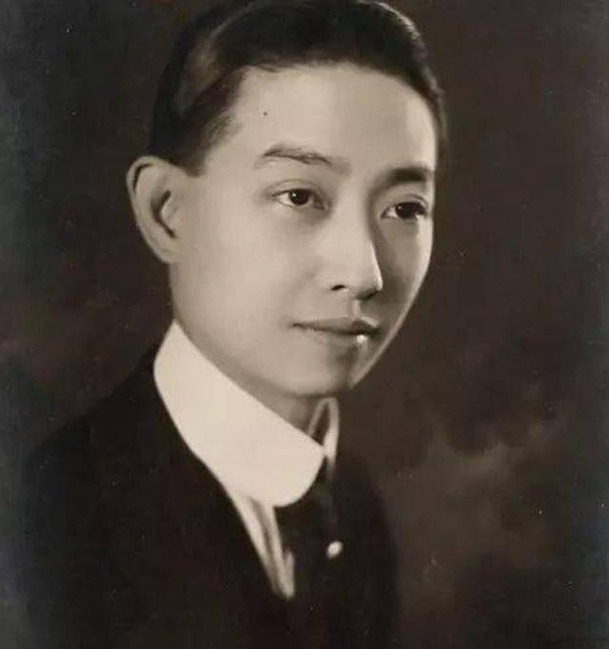
MeiLanfang:The
Legedary Peking Opera
Master
Mei Lanfang revolutionized Peking Opera through his masterful
portrayals of female roles. His artistry transcended cultural boundaries.

Slide 2
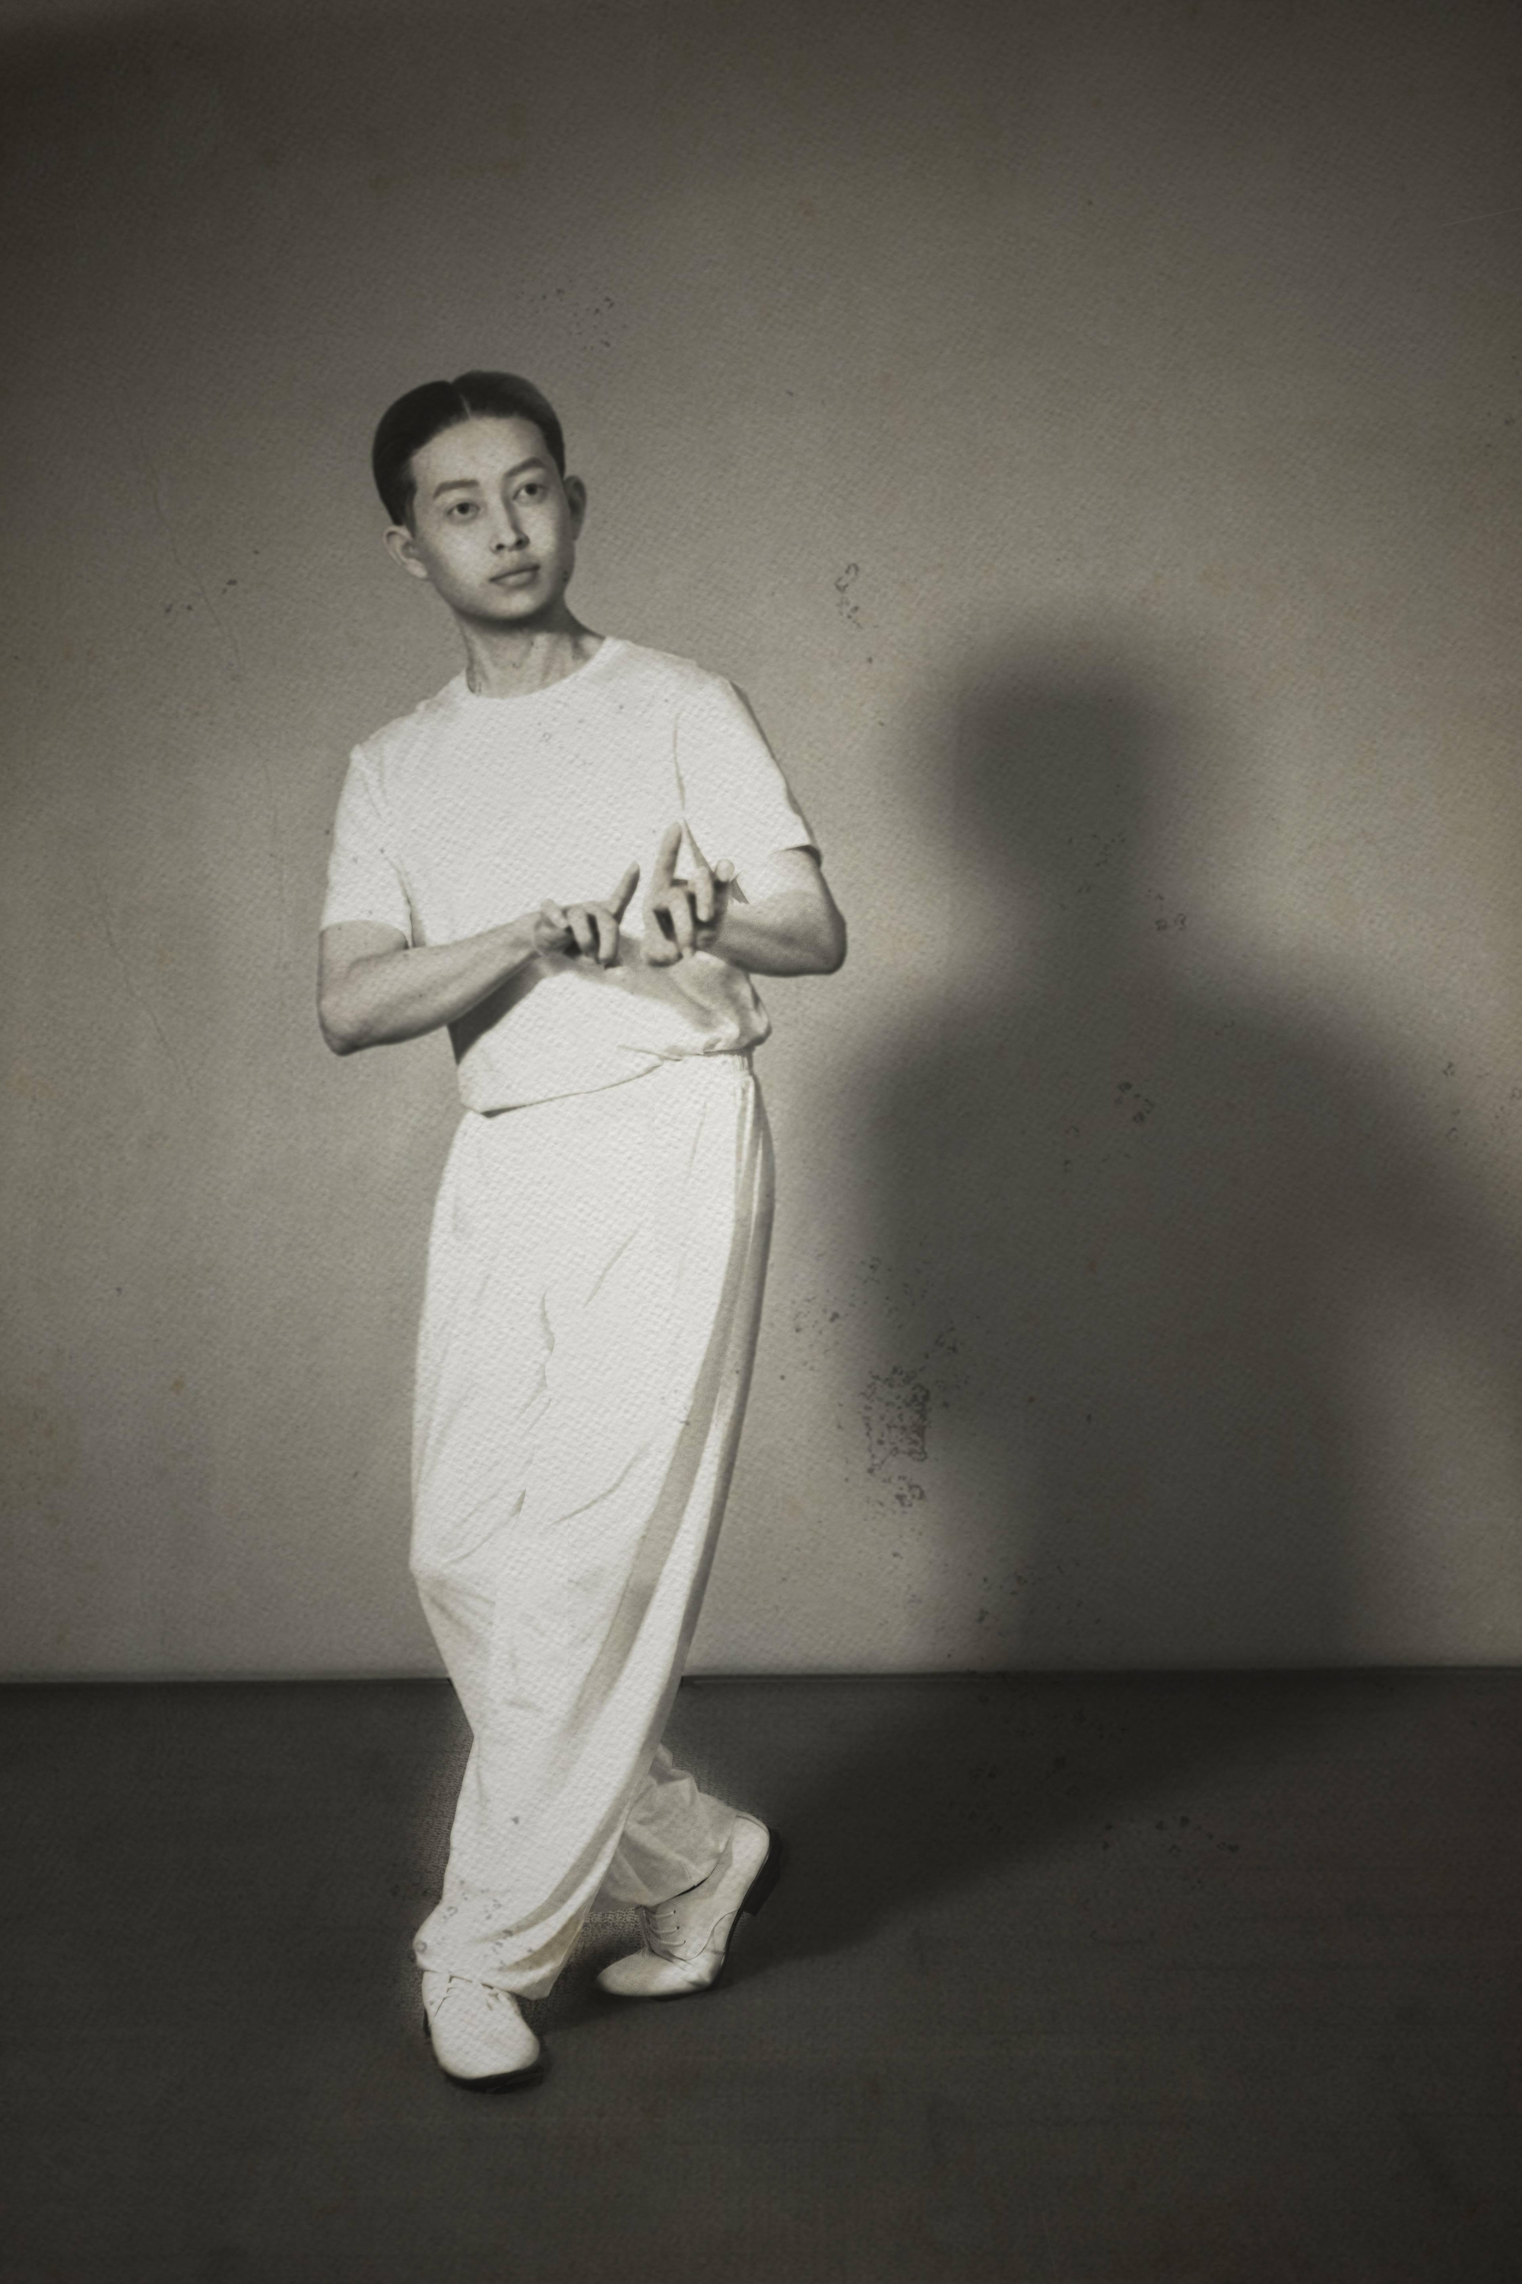

Early Life and Family
Backgroud
Birth in 1894
Mei Lanfang was born into a theatrical family in Beijing. His grandfather and father were both celebrated opera artists.
Opera Lineage
He inherited four generations of performing tradition. This legacy provided a strong foundation for his career.

Slide 3
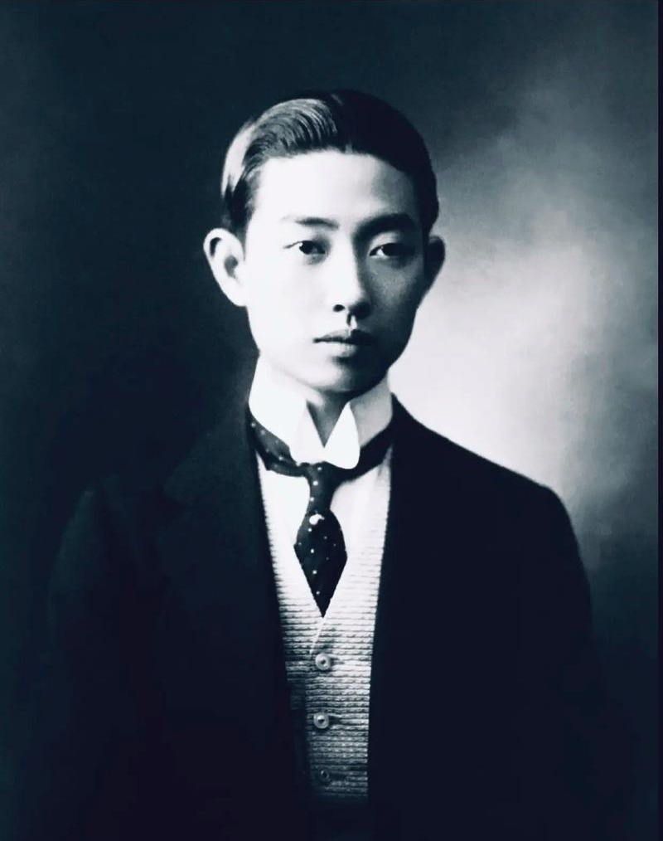
Training at Age 8
His formal training began early. He mastered the complex
techniques of female role performance.
Debut at Age 11
His first performance captivated audiences. His natural
talent was immediately apparent.

Slide 4
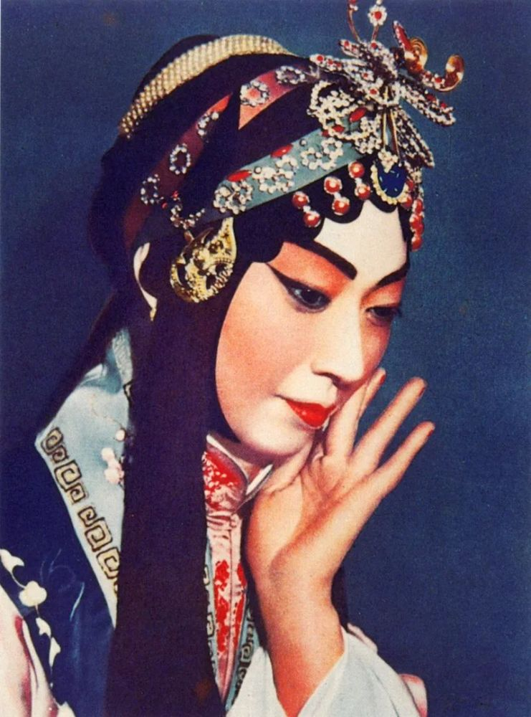
The Mei School of Performance
Mei School Matery
Female Role Specialist
Huashan Innovation
Elegant Performance Foundation

Slide 5
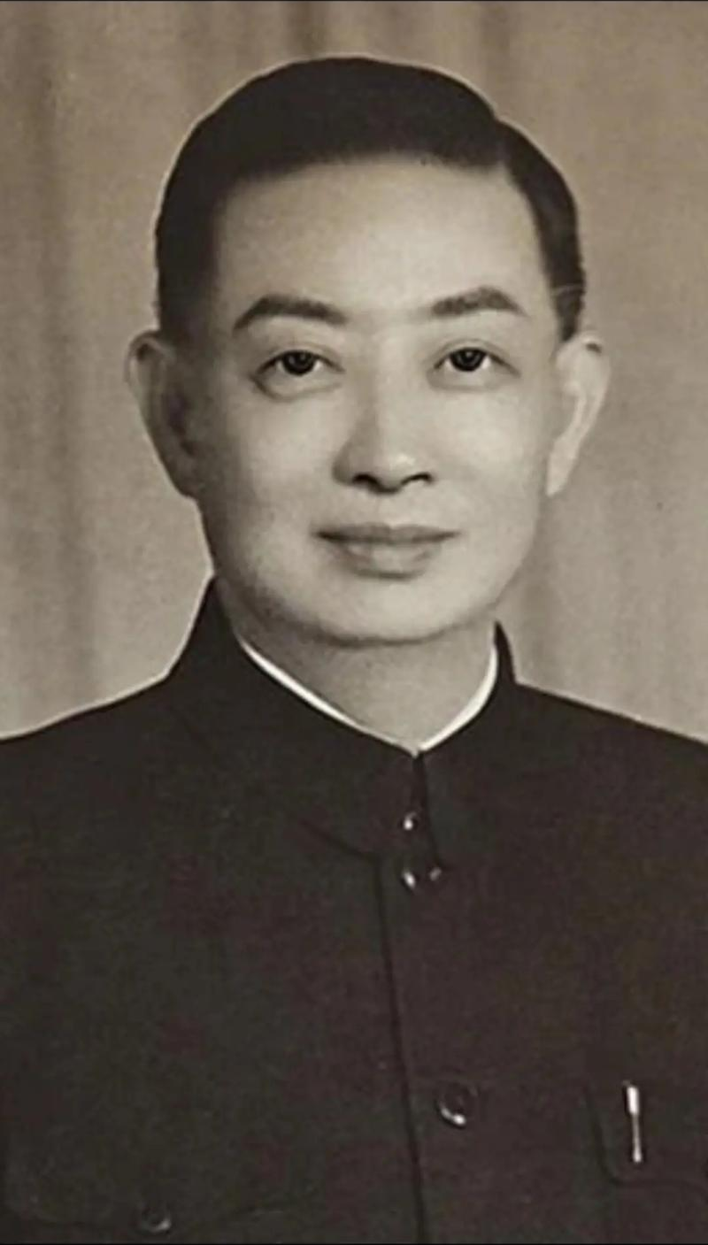
Innovation in Peking
Opera
Costume Modernization
Stage Design
Musical Expansion
Dance Creation

Slide 6
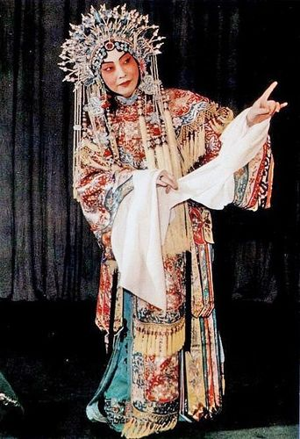
Notable Performance
The Drunken Beauty
Farewell My Concubine
Mu Guiying Takes Command

Slide 7
International Tours and Recognition
Japan(1919,1924)
His performances inspired Japanese theater practitioners. Cultural exchange flourished between China and Japan.
United States(1930)
His New York debut created a sensation. American audiences were mesmerzed by his artistry.
Soviet Union (1935)
His Moscow performances sparked artistic dialogue. Soviet theater luminaries praised his technique.

Slide 8
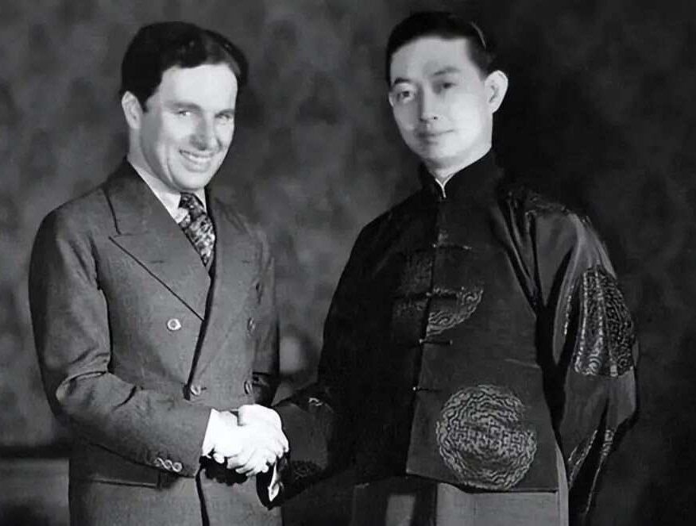
Cultural Ambassador
East-West
Bridge
Mei introduced
Western audiences to
Chinese theatrical
traditions.
Academic
Recogition
USC awarded him an
honorary doctorate.
Artistic
Influence
Charlie Chaplin
studied his
movements.

Slide 9
Later Career and Legacy
1946
Performance Return
After the war, Mei retumed to the stage. Audiences celebrated his triumphant comeback.
1950
Theater Director
He led the China Bejing Opera Theater. His leadership preserved traditional techniques.
1959
Communist Party
He joined the CPC before his death. This reflected changing political realities in China.

Slide 10
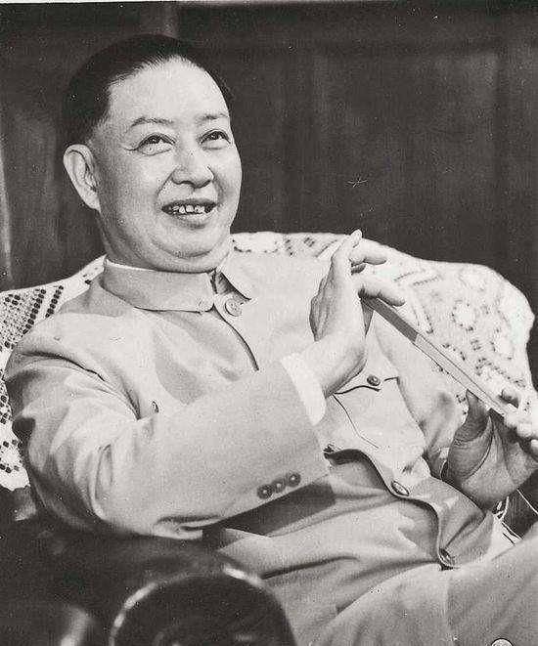
Mei Lanfang's Lasting Impact
Global Recognition
Art Preservation
Continuing Inspiration

