Slide 1
中國語言文化
Session 14, Thursday Dec 12, 2024, Zhishan Bldg. 至善楼105, room 105
Martin Woesler

Slide 2
12 TOPICS, 10 min. each
19:00 239. Social Phenomenon: Mobile Population 社会现象：流动人口 p. 2204(Hu Zetao/Francis)
19:10 240. Chinese tradition culture: Zanhua 簪花 p. 2213 （Xie Ke）
19:20 241. Incense Culture 香道文化 p. 2221 （Zeng Xin）
19:30 243. Literature: Qu Yuan 文学：屈原 p. 2238(Jiang Caiyun/Tony)
19:40 BREAK
19:50 244. Games: pitch-pot game (Touhu) 投壶游戏 p. 2244(Kuang Jing/Jin)
20:00 245. Folk Art: Piao Se 民间艺术：飘色 p. 2253(Huang Mengyan/Mandy)
20:10 246. Jingdezhen Porcelain 景德镇陶瓷 p. 2261(Li Dinghao/Leo)
20:20 247. Folk Traditional Customs: Fireworks and Firecrackers 民间传统习俗：烟花和爆竹 p. 2270 (Cao Jialong/caron)
20:30 BREAK
20:40 249. Thangka 唐卡 p. 2285（Yang Lingyue/Judy）
20:50 250. Striking iron flower 打铁花 p. 2294 (Fu Xinke/Finger)
21:00 251. Chinese Cuisine: Xiang Cuisine – One of the Eight Major Cuisines 湘菜 p. 23029（Liu Li/Glen）
21:10 252. The Evolution of the Official Selection System 仕进制度 2312（Xia Rong/Sharon)
21:20-35 PUFFER AND DISCUSSION

Slide 3
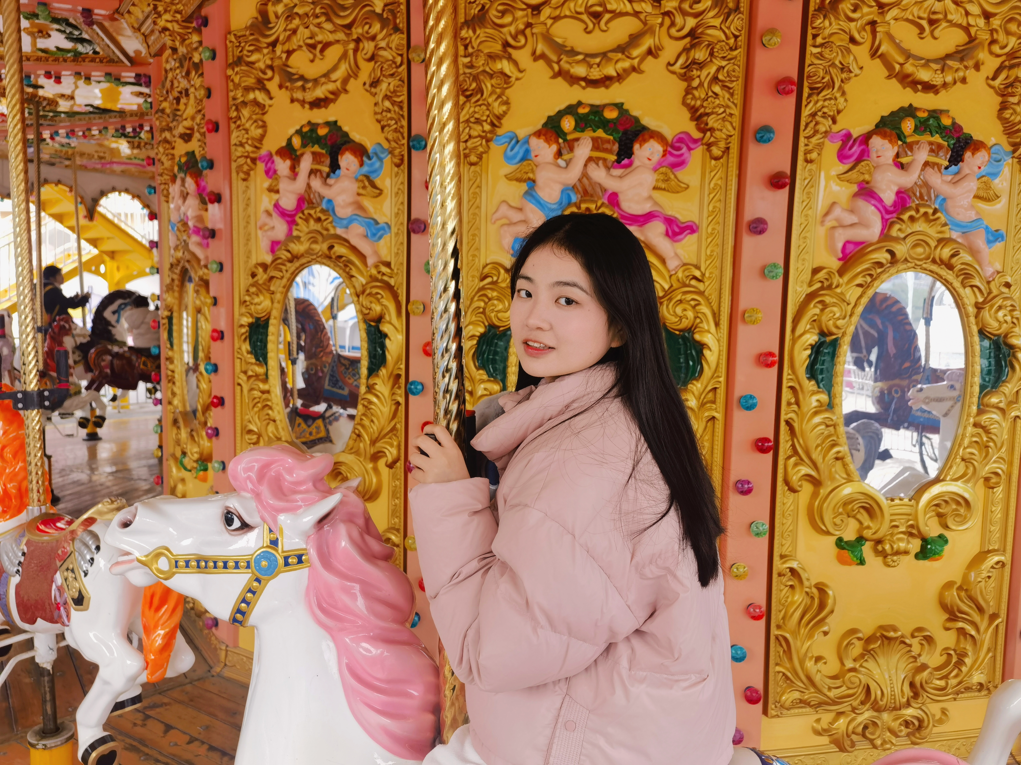
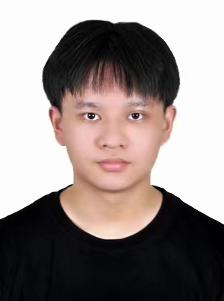
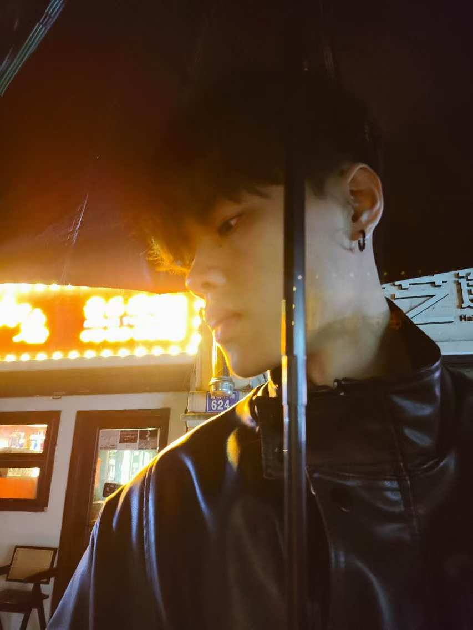
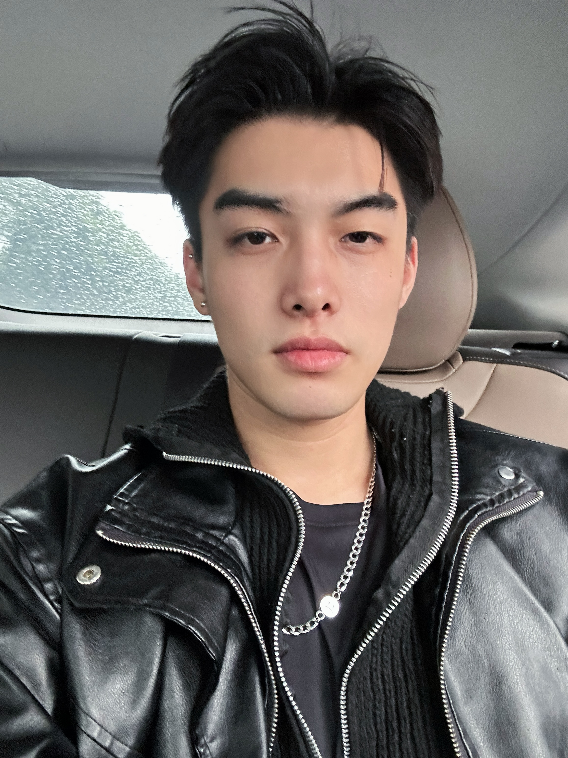
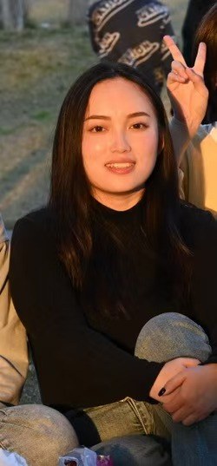
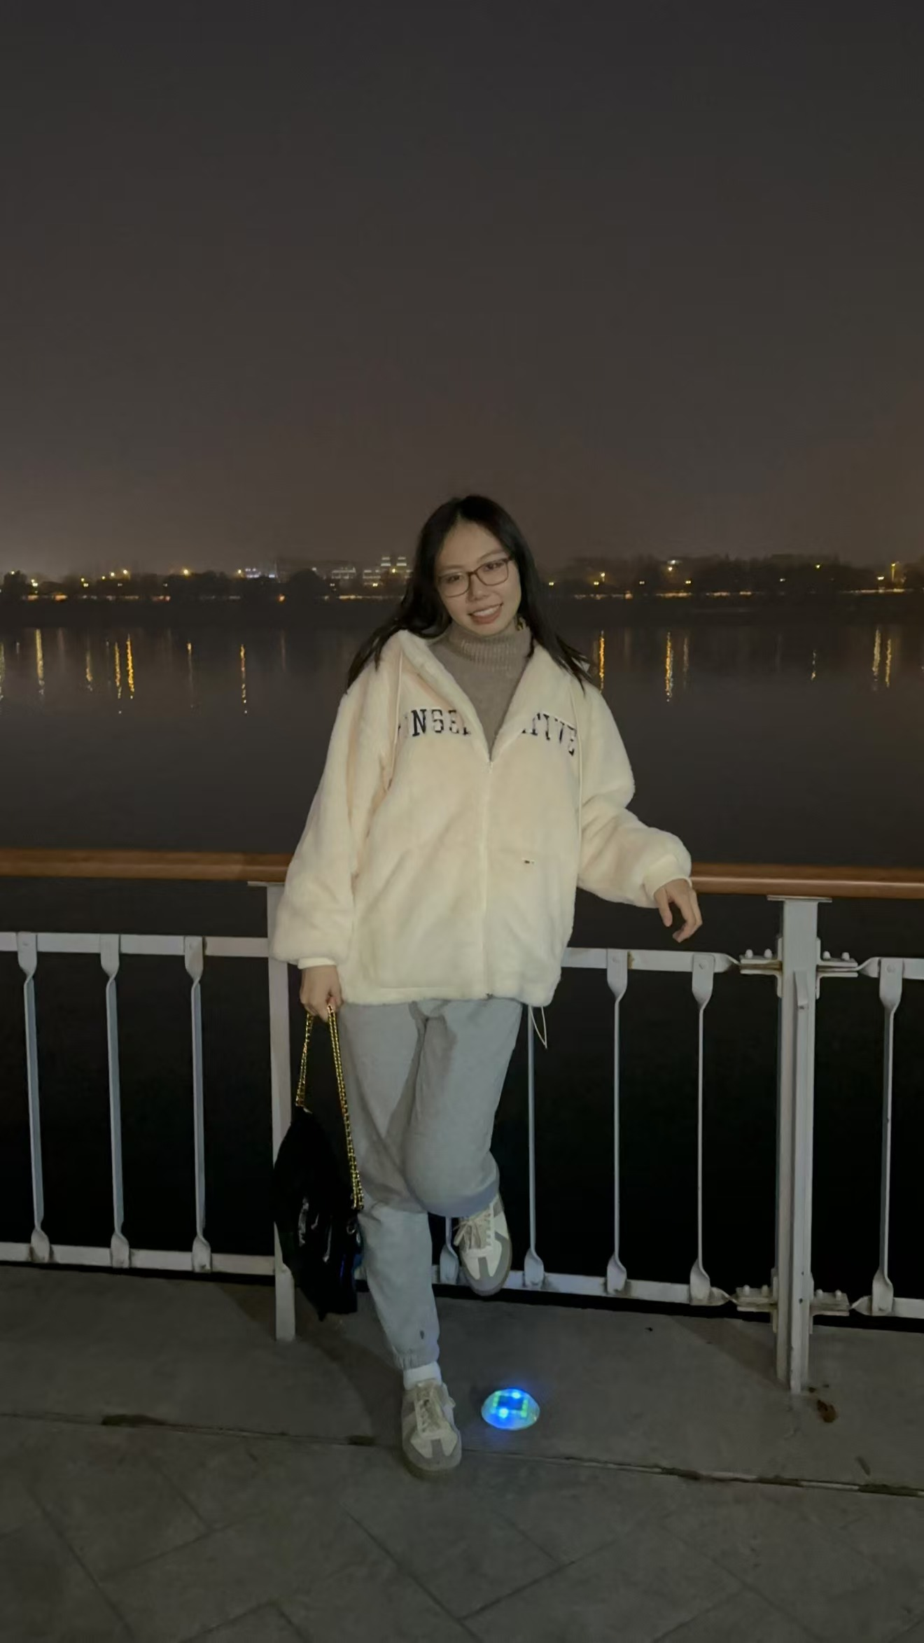
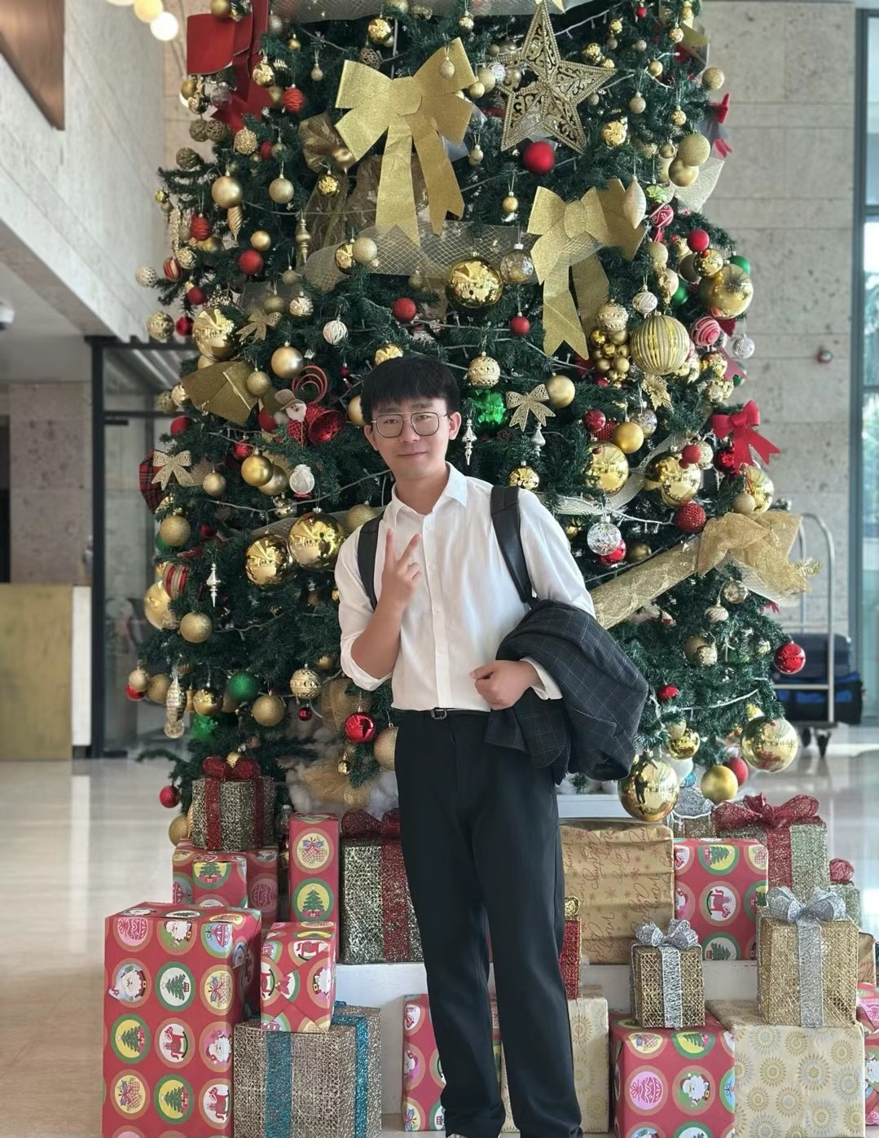
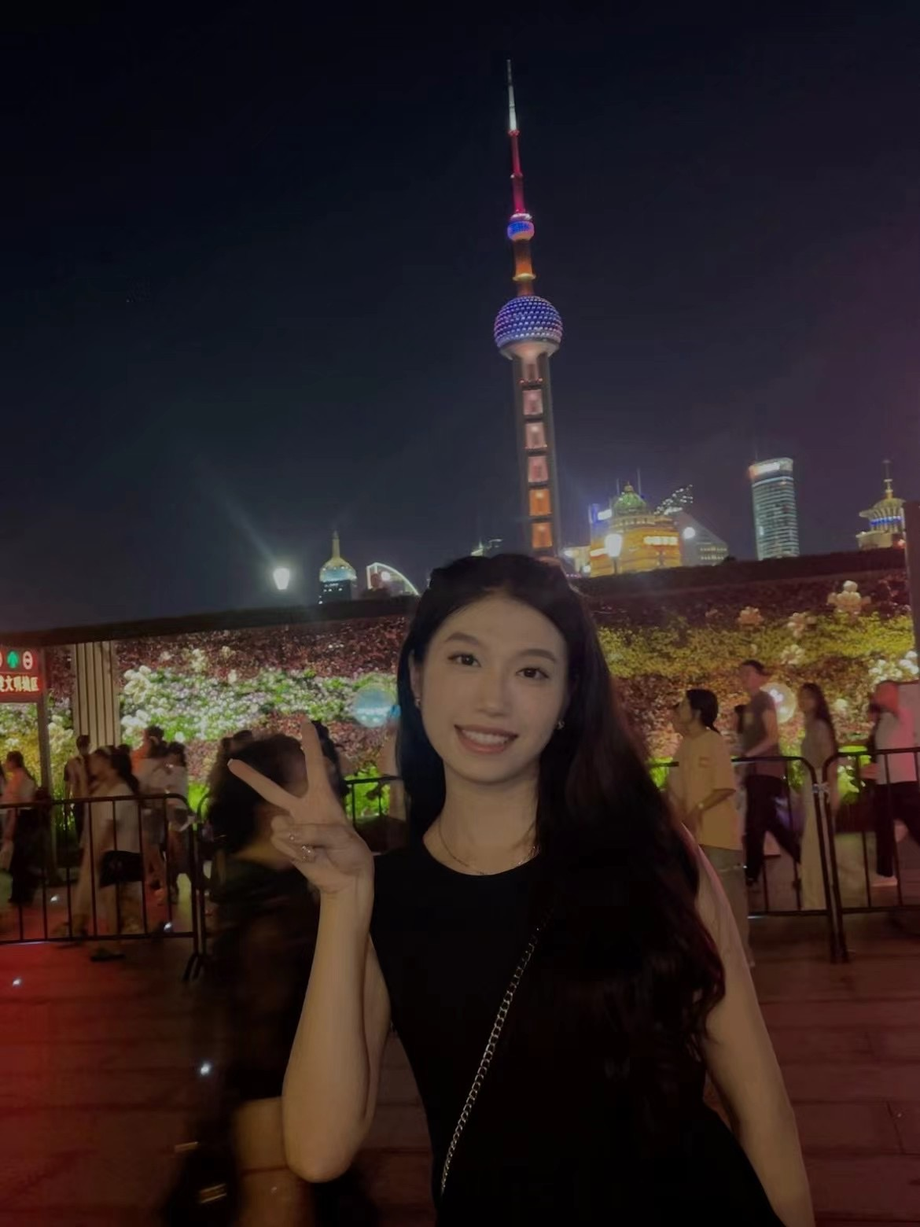
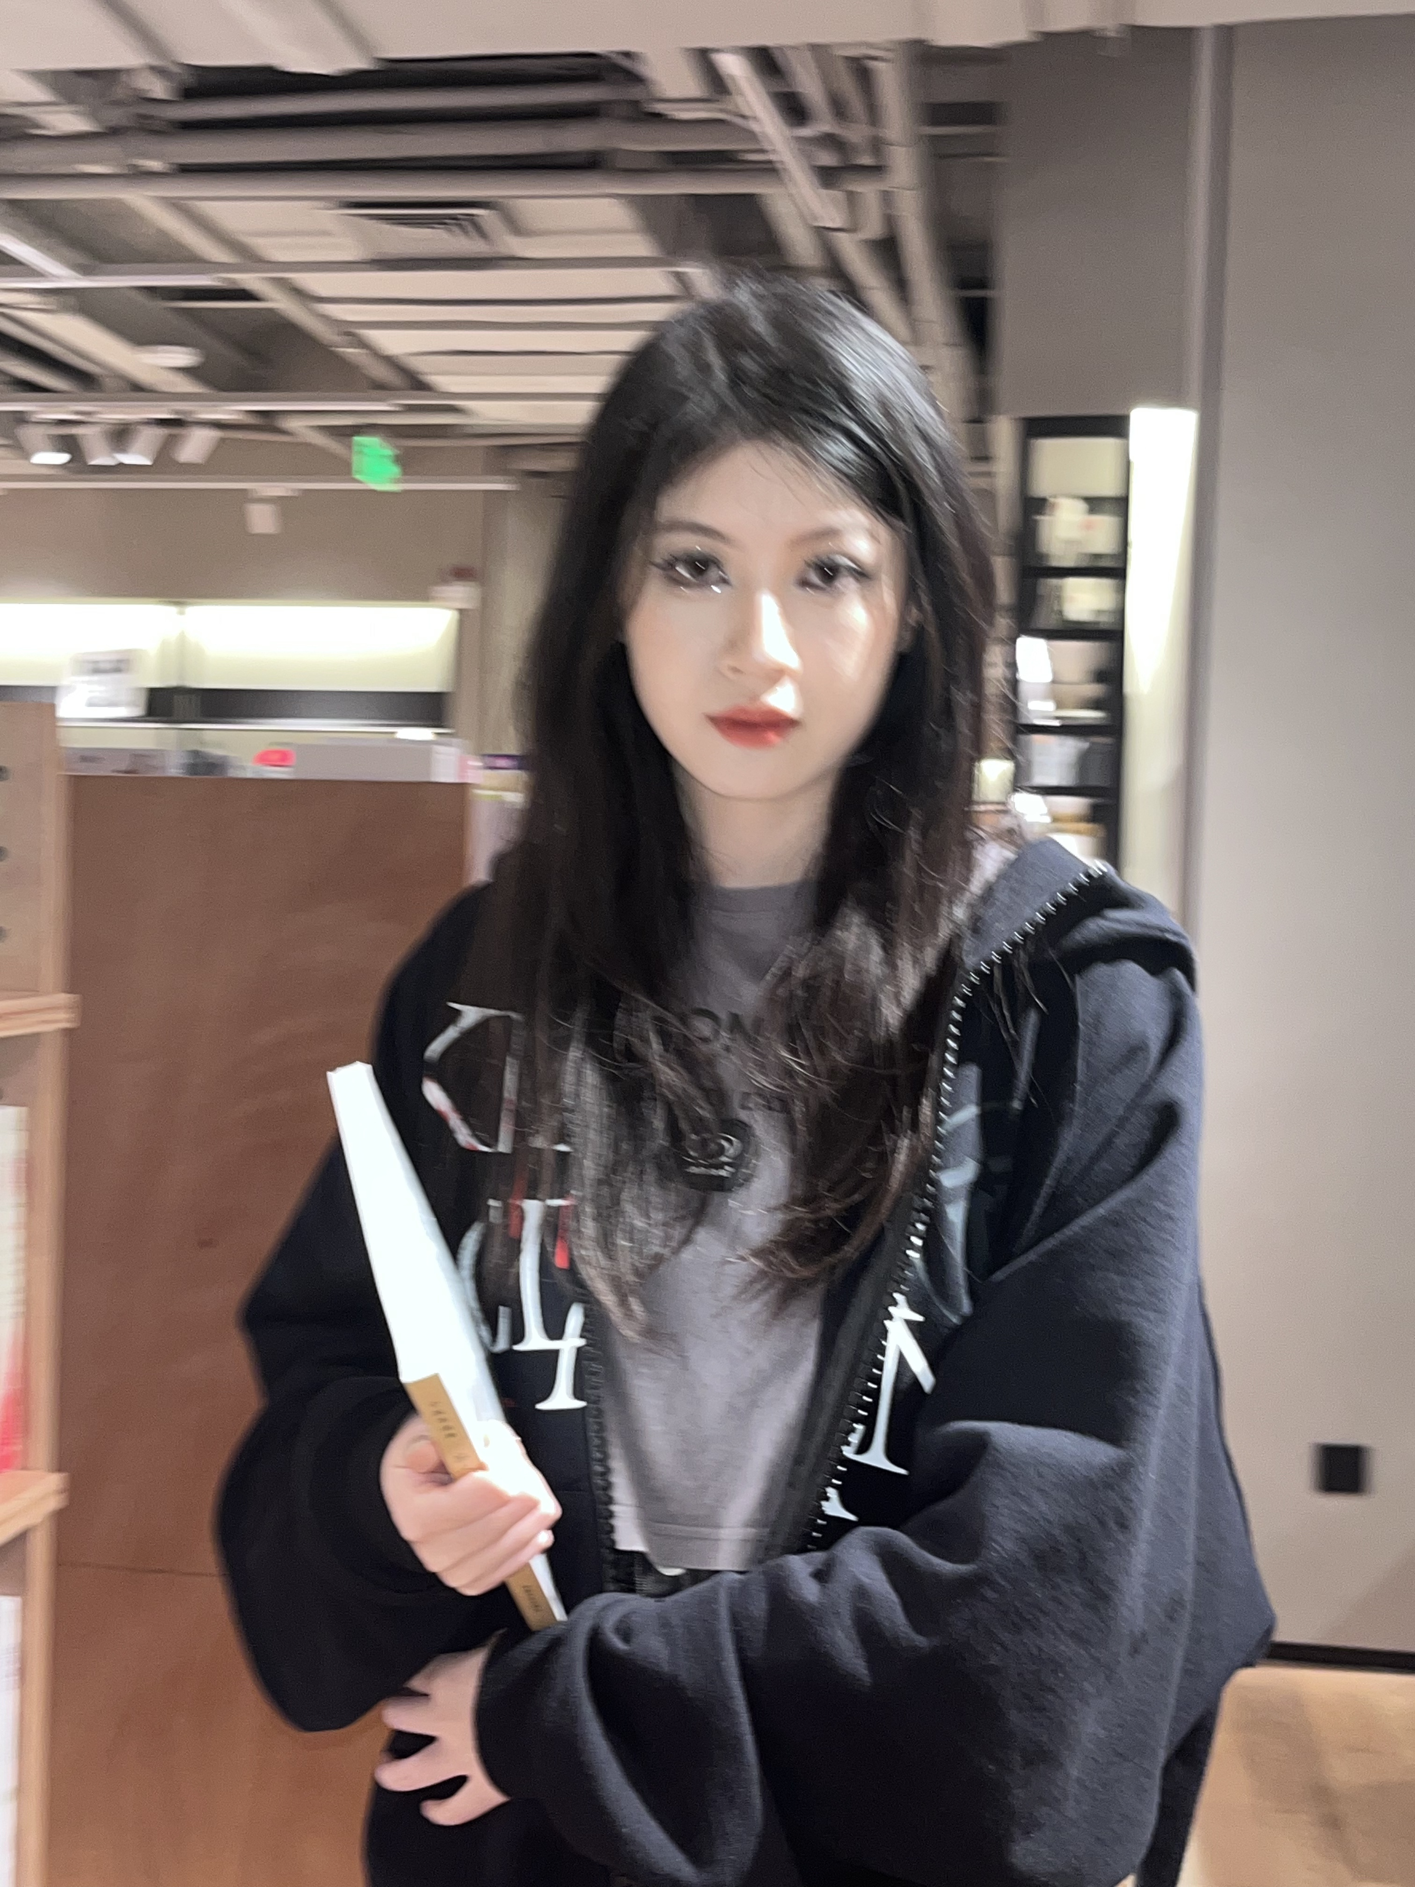
Fu Xinke ^, Zeng Xin v, Xie Ke v, Liu Li ^, Yang Lingyue v, Jiang Caiyun v, Cao Jialong ^, Hu Zetao ^, Kuang Jing v

Slide 4
Prepare for next time
Homework:
1. Please read the six texts for next time in the textbook.
2. Please add your final exam paper topic and your name in the respective section above.
3. Take the surveys (EU: https://wn8ae3qwafbc11zv.mikecrm.com/9gdWrQT
, 2024: https://wn8ae3qwafbc11zv.mikecrm.com/CTrdOjm).

Slide 5
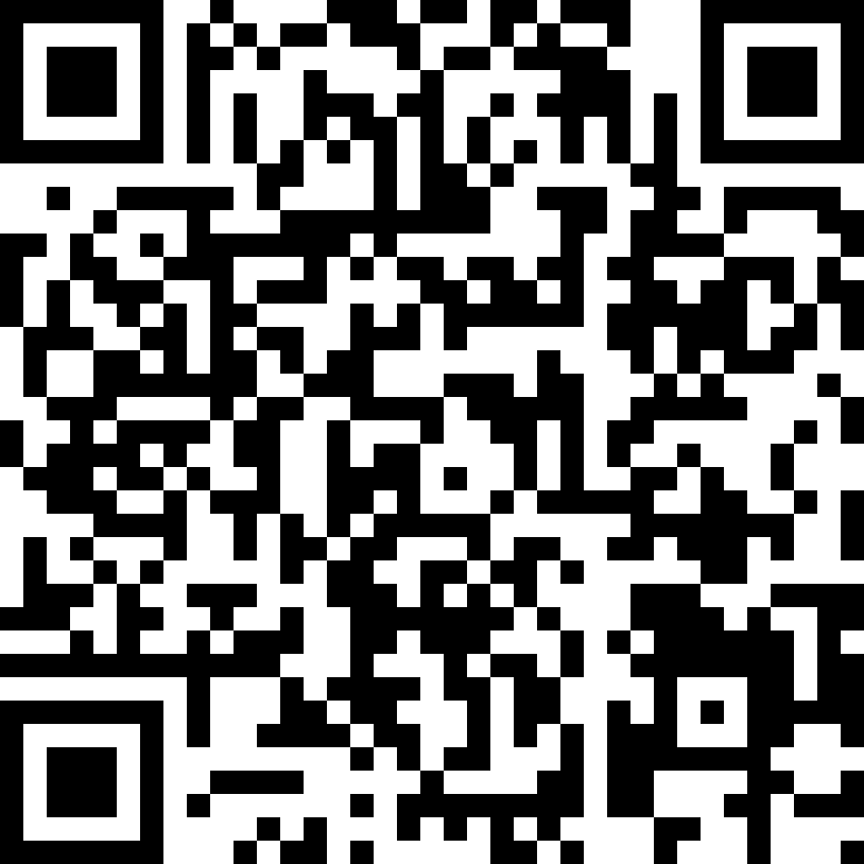
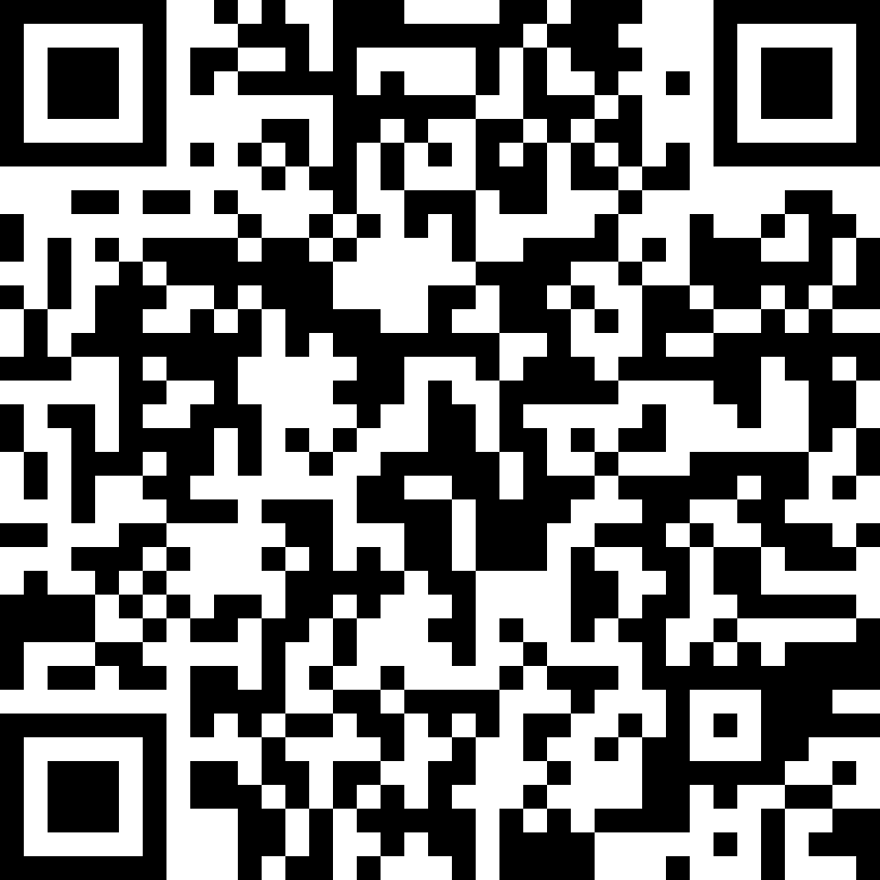
Questionnaires
EU
https://wn8ae3qwafbc11zv.mikecrm.com/9gdWrQT
2024 https://wn8ae3qwafbc11zv.mikecrm.com/CTrdOjm

